Slide 1



Mini Portofolio
Friska Ayu Listya Irawan
Exercise 1
Intensive Bootcamp Data Science
by @myskill.id

Slide 2




1
question number 1
From the ecommerce_event table, write a SQL query to output:
a. Total Unique user_session
b. Min, Max, and Average price
With criteria event_type is view, and brand except apple and samsung

Slide 3






query . . .
I use the aggregate function, COUNT with DISTINCT to count the number of unique user sessions, MIN to calculate the minimum price, MAX to calculate the maximum price, and AVG to calculate the average price. using NOT IN to exclude ‘samsung’ and ‘apple ’ brand from calculation
SELECT
COUNT(DISTINCT user_session) AS total_user_session,
MIN(price) AS minimum_price,
MAX(price) AS maximum_price,
AVG(price) AS average_price
FROM ecommerce_event
WHERE
event_type='view'
AND brand NOT IN ('samsung', 'apple');
query result . . .

Slide 4
2
question number 2
From the ecommerce_event table, write a SQL query to output Total Unique product_id . filter brand which start with ‘a’ or ‘k’ letter, and date after
‘2019-10-04’

Slide 5

query . . .
SELECT
COUNT(DISTINCT product_id) AS total_product
FROM ecommerce_event
WHERE
(brand LIKE 'a%' OR brand LIKE 'k%')
AND event_date > '2019-10-04'
I use the aggregate function,
COUNT with DISTINCT to count the total number of unique product. Using LIKE to filter brand which start with ‘a’ OR ‘k’ and using ‘>’ to filter date after ‘2019-10-04’
query result . . .

Slide 6
3
question number 3
From the ecommerce_event table, write a SQL query to output total unique product and total unique user, for every order date. Only show the date above 04 august 2019, and sort the result by the latest date

Slide 7

query . . .
SELECT
COUNT(DISTINCT product_id) as total_product,
COUNT(DISTINCT user_id) AS total_user, event_date
FROM ecommerce_event
WHERE
event_date > '2019-08-04'
GROUP by event_date
ORDER BY event_date DESC
LIMIT 10
I use the aggregate function,
COUNT with DISTINCT to count the total number of unique product and total unique user. Using ‘>’ to filter event date so it will show date after ‘2019-08-04’
The actual query result is 31 rows of data, but I limit it to only 10 rows of data that are shown. It can be seen on the next slide

Slide 8

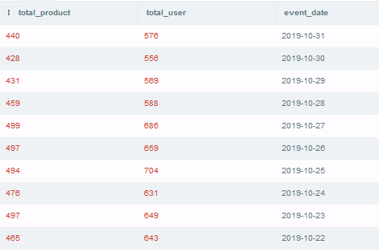

query result . . .

Slide 9
4
question number 4
From the question 3, filter only dates that have total_product more than 500

Slide 10
query . . .
SELECT
COUNT(DISTINCT product_id) as total_product,
COUNT(DISTINCT user_id) AS total_user, event_date
FROM ecommerce_event
WHERE event_date > '2019-08-04'
GROUP by event_date
HAVING total_product > 500
ORDER BY event_date DESC
I use the aggregate function,
COUNT with DISTINCT to count the total number of unique product and total unique user. Using ‘>’ to filter event date so it will show date after ‘2019-08-04’. To show the data with total product more than 500 i’m using HAVING.
Query result can be seen on the next slide

Slide 11
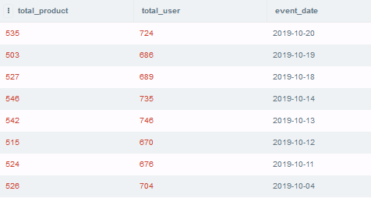
query result . . .

Slide 12
5
question number 5
From the event and user table, which gender has more sessions in october 2019?

Slide 13

query . . .
I use Nested query. First query to find total_session and gender in October 2019 by joining ecommerce_event table and user_profile table, then find MAX total_session from the first query result.
But, to make sure the result is correct, on the next slide will show the result of first query
SELECT MAX(total_session), gender FROM
( SELECT COUNT( DISTINCT e.user_session) as total_session, u.gender
FROM ecommerce_event e
LEFT JOIN user_profile u
ON e.user_id = u.user_id
WHERE e.event_date LIKE '2019-10-%'
GROUP BY u.gender)
query result . . .

Slide 14

query . . .
SELECT
COUNT( DISTINCT e.user_session) as total_session,
u.gender
FROM ecommerce_event e
LEFT JOIN user_profile u
ON e.user_id = u.user_id
WHERE e.event_date LIKE '2019-10-%'
GROUP BY u.gender
The result show that in October 2019 Female user has 9886 session and Male user has 10012 session. So, it’s true that Male user has more session in October 2019 than Female user.
query result . . .

Slide 15
6
question number 6
From the event and user table, is it true that iphone has more dominated by female and samsung dominated by male?

Slide 16
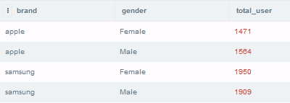
query . . .
I use the aggregate function, COUNT with DISTINCT to count the total unique user. Joining ecommerce_event table and user_profile table so i can figure out which gender dominate brand ‘samsung’ and ‘apple’.
By the result apple has more Male user and samsung has more Female user, So it FALSE.
SELECT e.brand, u.gender, COUNT(DISTINCT e.user_id) AS total_user
FROM ecommerce_event e
LEFT JOIN user_profile u ON e.user_id = u.user_id
WHERE e.brand = 'apple' OR e.brand = 'samsung'
GROUP BY e.brand, u.gender
query result . . .

Slide 17
7
question number 7
From the event and user table, show total user, product, and session, in every ages. Exclude age with total_user more than 320

Slide 18
query . . .
SELECT
u.age, COUNT(DISTINCT e.user_id) AS total_user, COUNT(DISTINCT e.product_id) as total_product,
COUNT(DISTINCT e.user_session) as total_session
FROM ecommerce_event e
LEFT JOIN user_profile u
ON e.user_id = u.user_id
GROUP BY u.age
HAVING total_user <= 320
I use the aggregate function, COUNT with DISTINCT to count the total unique user, total unique product, and total unique session. Joining ecommerce_event table and user_profile table so it can also show the age of user. To exclude age with total_user more than 320
i’m using HAVING and ‘<=’.
Query result can be seen on the next slide

Slide 19
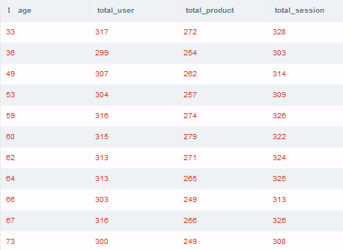
query result . . .

Slide 20
8
question number 8
Calculate the daily revenue and unique users for each date

Slide 21
query . . .
SELECT event_date, ROUND(SUM(price),2) AS revenue,
COUNT (DISTINCT user_id) AS total_user
FROM ecommerce_event
WHERE event_type = 'purchase'
GROUP BY event_date
ORDER BY event_date
LIMIT 10
I use agregate function SUM to calculate the daily revenue and COUNT with DISTINCT to count the total unique user.
The actual query result is 31 rows of data, but I limit it to only 10 rows of data that are shown.
It can be seen on the next slide

Slide 22
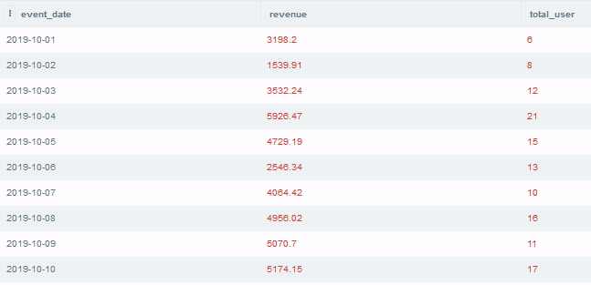
query result . . .

Slide 23
9
question number 9
Calculate the daily revenue and unique users for each date for male users

Slide 24
query . . .
SELECT e.event_date, ROUND(SUM(e.price),2) AS revenue,
COUNT (DISTINCT e.user_id) AS total_user
FROM ecommerce_event e
LEFT JOIN user_profile u ON e.user_id = u.user_id
WHERE e.event_type = 'purchase'
AND u.gender = 'Male'
GROUP BY e.event_date
ORDER BY e.event_date
LIMIT 10
I use agregate function SUM to calculate the daily revenue and COUNT with DISTINCT to count the total unique user. Joining ecommerce_event table and user_profile table so i can filter the result to only calculate the daily revenue of Male users.
The actual query result is 31 rows of data, but I limit it to only 10 rows of data that are shown.
It can be seen on the next slide

Slide 25
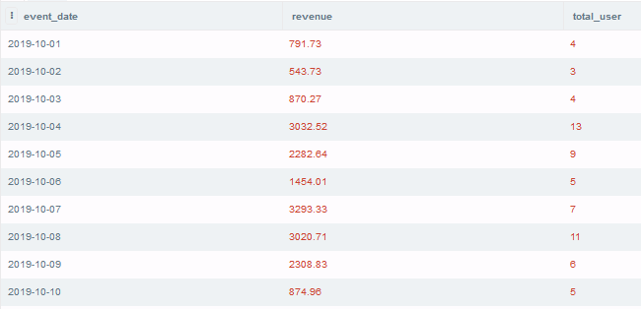
query result . . .

Slide 26
10
question number 10
Calculate the daily average revenue per user (Revenue/ # users) for date with revenue higher than 3000

Slide 27
query . . .
SELECT event_date, revenue, ROUND(revenue/total_user,2) AS ARPU
FROM
( SELECT e.event_date, ROUND(SUM(e.price),2) AS revenue,
COUNT (DISTINCT e.user_id) AS total_user
FROM ecommerce_event e
LEFT JOIN user_profile u
ON e.user_id = u.user_id
WHERE e.event_type = 'purchase'
GROUP BY e. event_date
HAVING revenue > 3000
ORDER BY e.event_date)
ORDER BY ARPU DESC
LIMIT 10
I use Nested query. First query to find daily revenue and total unique user by joining ecommerce_event table and user_profile table. Using HAVING so it can only show data with revenue higher than 3000. then find Average Revenue per User (ARPU) by calculate revenue/users.
The actual query result is 24 rows of data, but I limit it to only 10 rows of data that are shown. It can be seen on the next slide

Slide 28
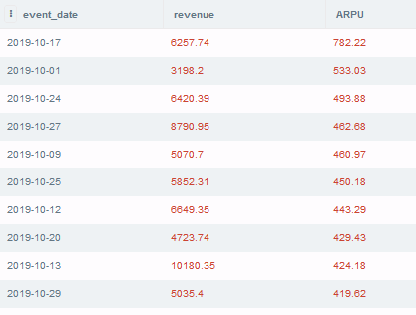
query result . . .

Slide 29







Thanks a bunch!
.
friska.listya@gmail.com
https://www.linkedin.com/in/friskaayu/

