Slide 1

Food price from 2005 to 2021
Analysis of food price variations in Haiti
Ayiti Analytics
Prepared by
Fritz Gerald Junior Valcin

Slide 2

Matters on the project
A brief look on the project
01
Objective
02
Hypothesis
03
Data source
04
Data cleaning
05
Data analysis
06
model
07
Reflexion

Slide 3
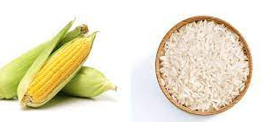
Search for the trend of the price evolution
Understand the factors that influence the price of food
Predicting the price of local rice in Port-au-Prince with ARDL model
Objective

Slide 4
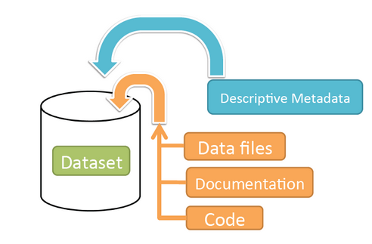
Data
Retrieval of data on:
The price of food in different municipalities in the country from 2005 to 2021.(site:https://data.humdata.org/dataset/wfp-food-prices-for-haiti, file:wfp_food_prices_hti (1))
The price of fuel during this period (file : https://docs.google.com/spreadsheets/d/1nbVAoaKjWFuFaci0ioH_rIirsOLD_89JowmkX0wB9HM/edit#gid=1457867413)
The exchange rate of the US dollar during this period (file:HTG=X)

Slide 5
Plan
-Product X product analysis
-Analysis local product price X imported product price
-Analysis category X category
-Price evolution by category
-Price variation of local marmite rice by department
We will use only the price in gourdes instead of the two prices (gourdes and US dollars) to avoid multicolinearity.

Slide 6
Imported
product
Beans -Maize Meal - Oil -pasta -Rice -Sorghum -Sugar
-Wheat flour
Local product
Maize Meal -Rice

Slide 7
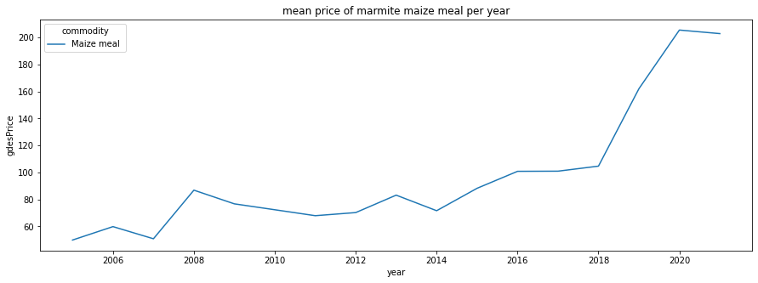
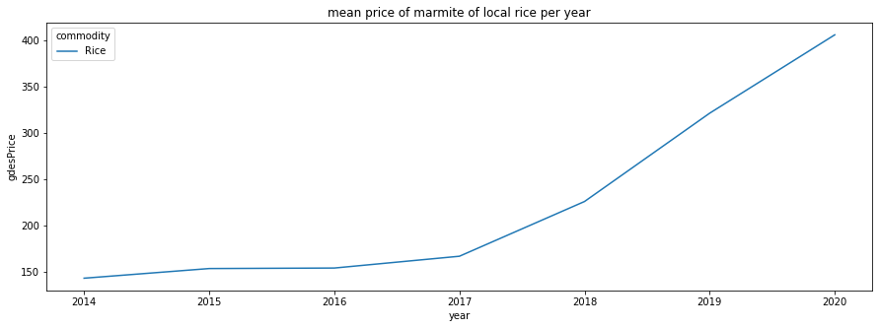
Local food analysis
The average price of a marmite local rise began to increase since the end of 2007 and reached its peak in 2008 with the phenomenon "Grangou Klorox", and since then, the price have attenuated to rise again since January 2014 after the people demanded the departure of President Michel Joseph Martelly.
We can note that the rise of the marmite local rice begins in 2017 after Hurricane Matthew devastated the department of Grand'Anse, including the city of Jeremie, the departments of South, Nippes and a good part of the West including Petit-Goâve

Slide 8
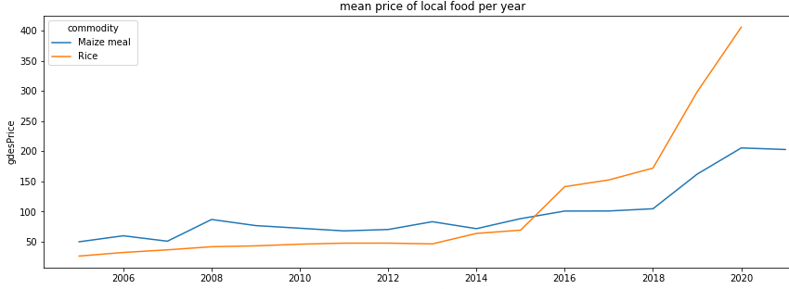
From 2005 to 2020 we notice that both prices increase, but under the Martelly Paul government the price of rice consumption exceeds the price of corn. But still remains the national dish

Slide 9
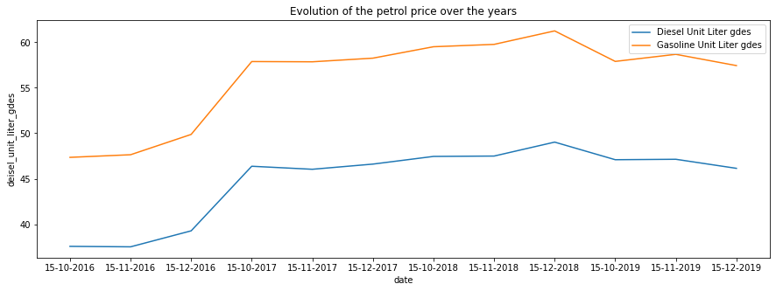

The trend of petrol prices is increasing despite their fluctuations of the descent

Slide 10
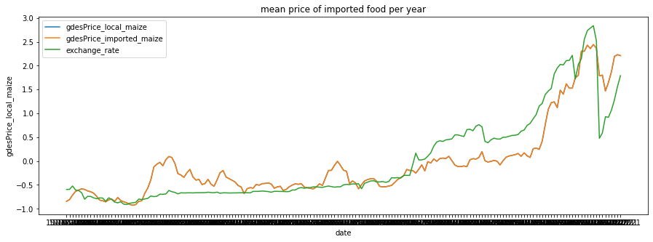
Imported and local food prices evolve in the same way, the gourdes price of local food and imported food increase in the same way, one appears on the other.

Slide 11
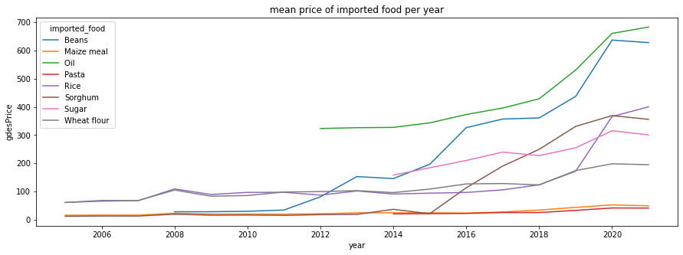
The evolution of price of every imported foods is increasing

Slide 12
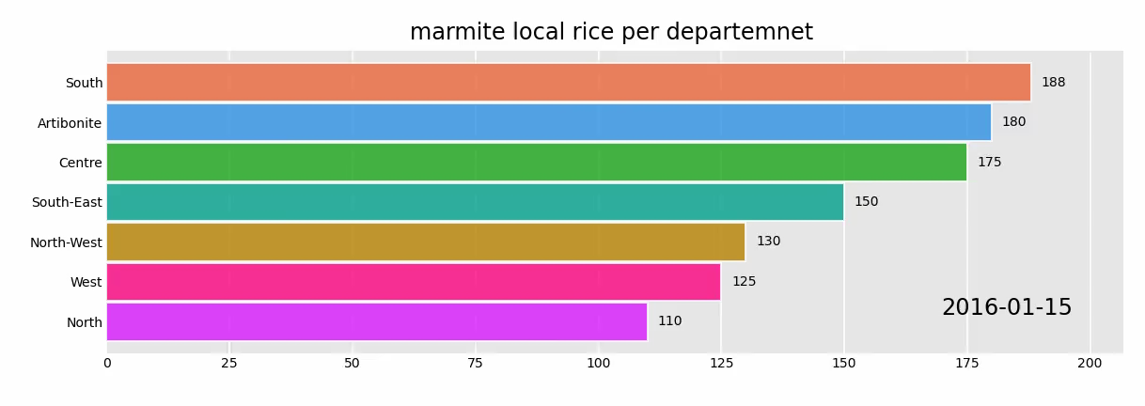
Evolution of local rice from 2016 to 2020

Slide 13
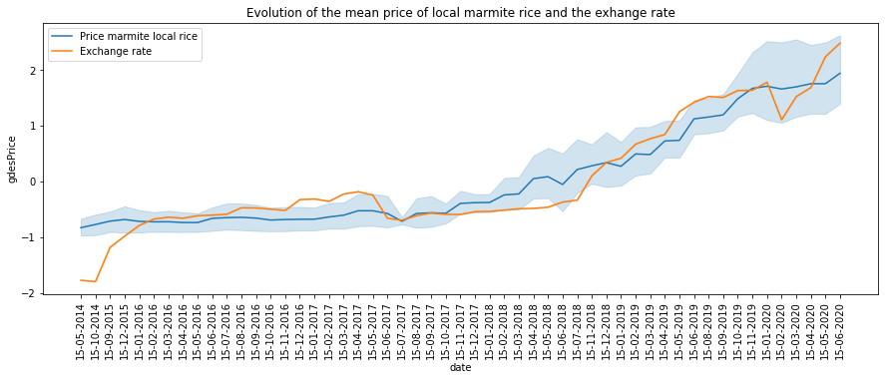
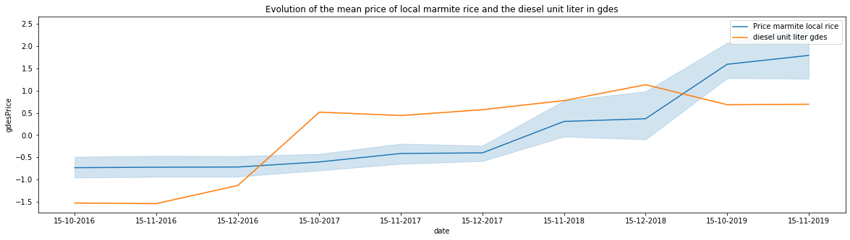
We can clearly see that the price of the marmite of local rice evolves in the same direction as the exchange rate, and after doing some statistical tests we could notice that the evolution of the exchange rate causes the evolution of the price of marmite local rice.
The price of diesel does not change in the same way as the price of a pot of local rice and statistical tests show that it has no influence on the price of local rice

Slide 14
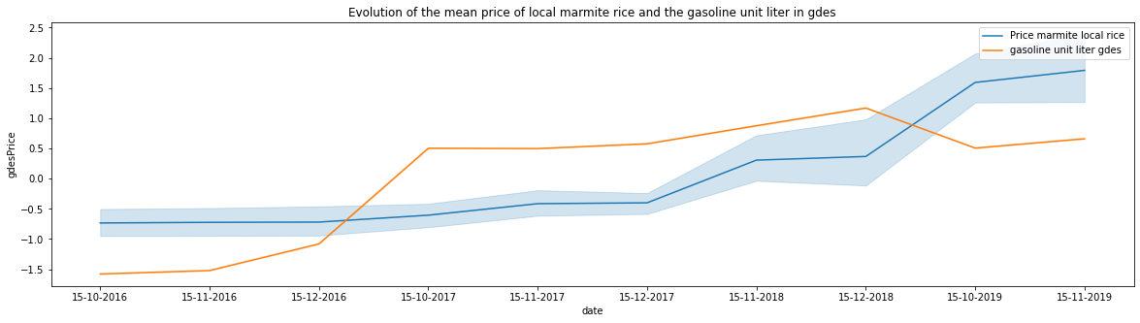
The price of gasoline does not evolve in the same way as the price of a pot of local rice, but it increases both as it goes along. And the evolution of the price of gasoline causes the evolution of the price of marmite rice.

Slide 15

We could notice that the evolution of the price of gasoline and the rise of the exchange rate cause the evolution of the price of the local marmite rice.
but the price of diesel has no impact on the price of local rice.

Slide 16
The problem with the Haitian economy in relation to rice is that first of all the national dish is rice. Almost the entire population eats rice, or consumes it on a regular basis.
After analyzing the data, we notice that the price of rice keeps increasing, and when analyzing other variables such as the price of petrol, or the exchange rate, they increase along with the price of food. This represents a serious problem because wages take longer to increase than inflation in the economy.

Slide 17
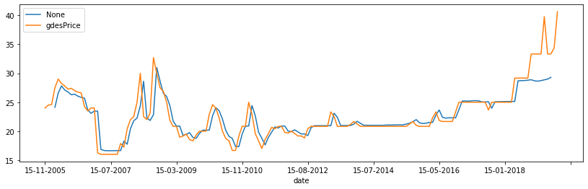
I chose an ardl model (1,0)
all the explicative variables are significant
Prediction of price of local rice at Port-au-Prince
I chose an ARDL model (1,0)all the explicative variables are significant

Slide 18
Recommendations
Make the forecast for the next 6 months...
In the short term: subsidize foreign rice, stimulate domestic rice production
- In the medium and long term: produce domestic rice, erect tariff barriers at the customs against foreign rice

Slide 19


Thank you
For your attention
Resource
Page
Github link:https://github.com/fritzgeraldvalcin/Creative-Capstone-Project.git

