Slide 1
Gonzaga Dental Clinic
Two branches, one patient record
Clinic management system · interface walkthrough
All screens shown use fabricated sample data. No real patient information is present.

Slide 2
What this replaces
• A paper front-desk register: a wall calendar for appointments and a card index for treatment history.
• The card index is where patient safety degrades — an allergy noted on one card is invisible on the next.
• With two branches, patients appear at either site, so a single shared record is the minimum requirement, not a nice-to-have.
• Appointments, clinical notes and consent are kept apart by role, so a secretary cannot silently alter a clinical record.
• Next.js app with PostgreSQL row-level security as the only authority on who sees what.
• Branch scoping is enforced in the database, so a hidden button is never the thing standing between two patients.
• Preview mode renders every screen against fabricated data with no database, so the interface can be reviewed before a backend is committed to.
• Designed around the three screens staff use all day: the day list, the patient record, and charting a tooth.
Gonzaga Dental Clinic · 02 / 27

Slide 3
Who sees what
Secretary
Own branch only
Patients, appointments, consent. Cannot record treatments or see staff, backups, audit or the branch comparison.
Dentist
Both branches
Adds treatment recording and the side-by-side branch view.
Admin
Both branches
Adds staff accounts, audit log and backups.
One deliberate exception: a secretary may open a patient registered at the other branch once that patient has an appointment at theirs. Without it, a visitor from the other site could never be checked in — the first cross-branch visit of the day is exactly when the desk needs the record. An unassigned secretary is granted no branch access, not all of it.
Gonzaga Dental Clinic · 03 / 27

Slide 4
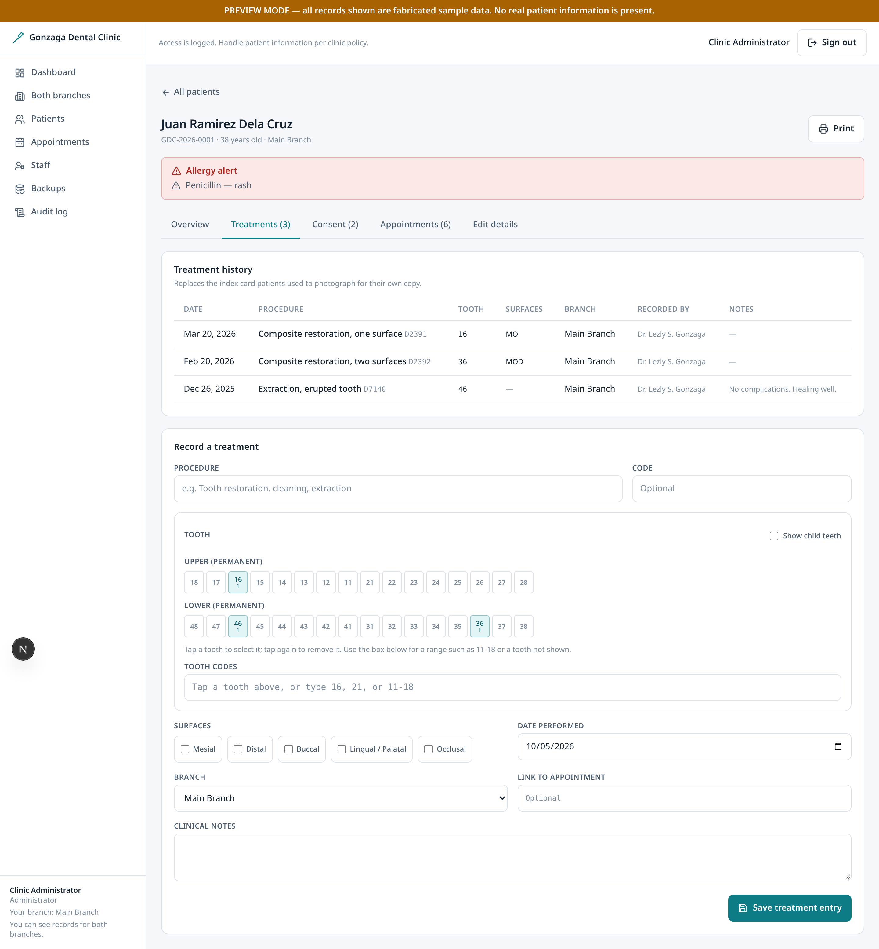
Charting: tap the tooth, don't code it
• Charting was a free-text field asking for an FDI code. A dentist identifies a tooth by where it sits, so a two-digit code is the slowest and most error-prone way to record one — and a wrong tooth is clinical data, not a typo.
• The chart is now interactive: tap to select, tap again to remove.
• Teeth already treated are shaded with their procedure count, so prior work is visible while charting rather than afterwards.
• The chart and the text box are two views of one value, so a tapped tooth and a typed range can never disagree about what is saved.
• Touch targets are 44x44 px, meeting the platform minimum rather than the 40 px that was being missed.
Tap targets cannot express a range like 11-18, so typing still works and stays in sync with the chart.
Gonzaga Dental Clinic · 04 / 27

Slide 5
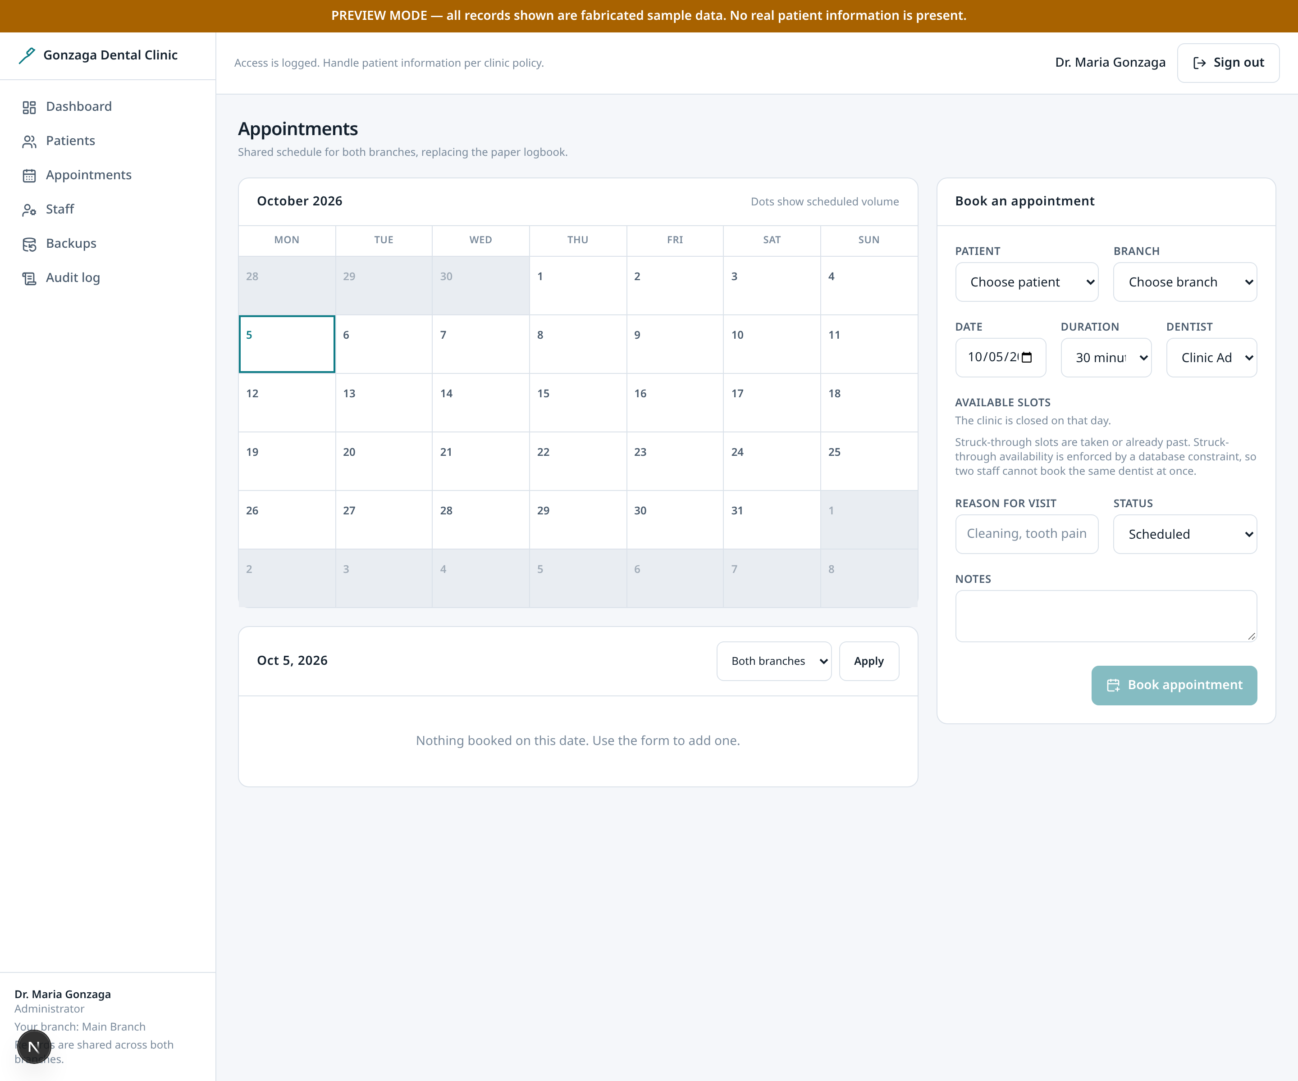
The waiting room: one tap, not a dropdown
• The day list opens with how many patients are still to be seen, so progress is readable without counting rows.
• Check in, then complete — the transition repeated all morning — is a single labelled button on each row. Anything else stays under 'More'.
• The buttons are labelled the way staff speak. The row says 'Check in', not 'confirmed'.
• Only the row being saved is disabled while it saves. A single global flag meant one slow request froze every row's controls.
• Status changes are announced to screen readers, so the outcome is not visual-only.
Gonzaga Dental Clinic · 05 / 27

Slide 6
Bugs found while making it usable
• Mobile overflow on every page. Responsive grids declared no base single column, so below the breakpoint the implicit column sized to its widest content and pushed the page into horizontal scroll. Fixed across 17 grids; verified at five widths.
• Treatment dates defaulted to the wrong day. The form used the server's UTC date, so between midnight and 8am Manila a treatment would default to yesterday.
• The 'secretary' preview persona never existed. The role fell through a conditional to 'dentist', so the entire secretary interface could not be reviewed despite being documented.
• Preview contradicted its own security model. The fabricated data ignored branch scoping, so a secretary persona saw every patient in the clinic while the sidebar insisted they saw one branch.
• A secondary button class used by several screens did not exist in the stylesheet.
Gonzaga Dental Clinic · 06 / 27

Slide 7
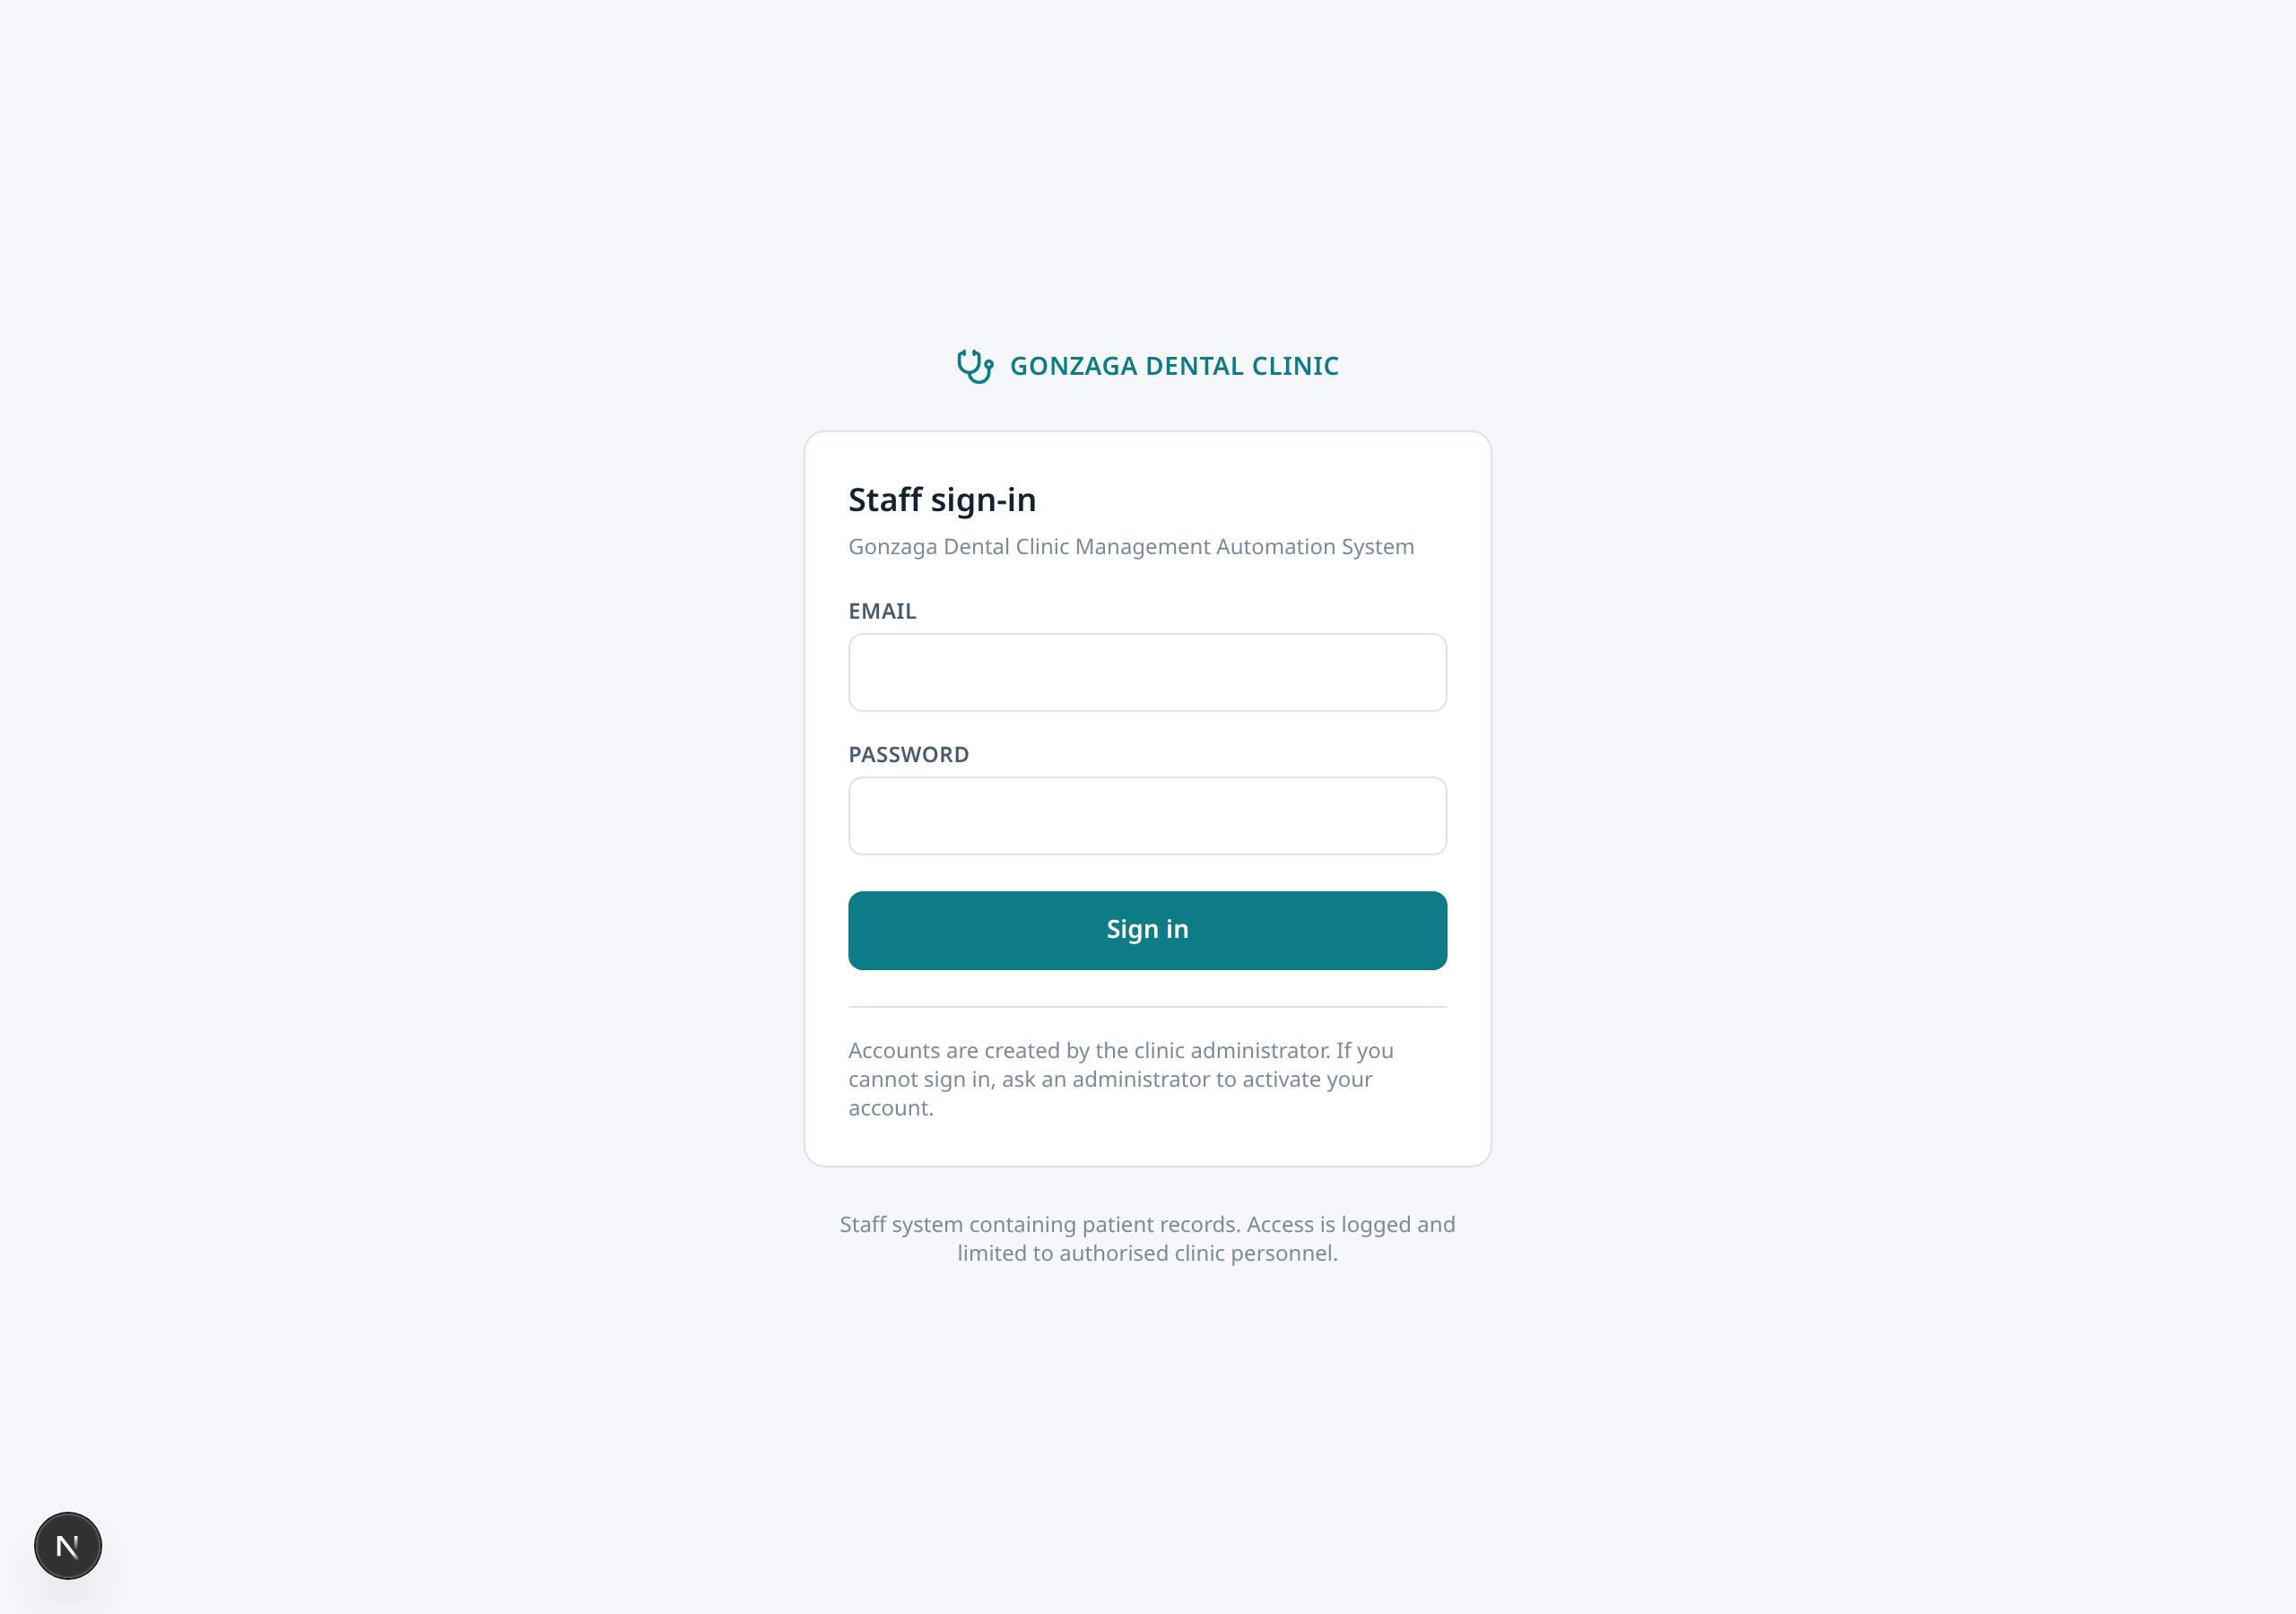
Sign in
PUBLIC
The only page reachable without a session.
• Email and password only. There is no patient login, because patients are records, not accounts.
• A valid password is not enough: the server layout re-checks that the staff row is still active, so a deactivated account cannot reach the app even with a valid password.
• The 'next' parameter is validated so it can only be a local path, closing off open-redirect abuse.
• Error text is deliberately vague. It never reveals whether an email has an account, which would leak staff existence to an attacker.
Gonzaga Dental Clinic · 07 / 27

Slide 8
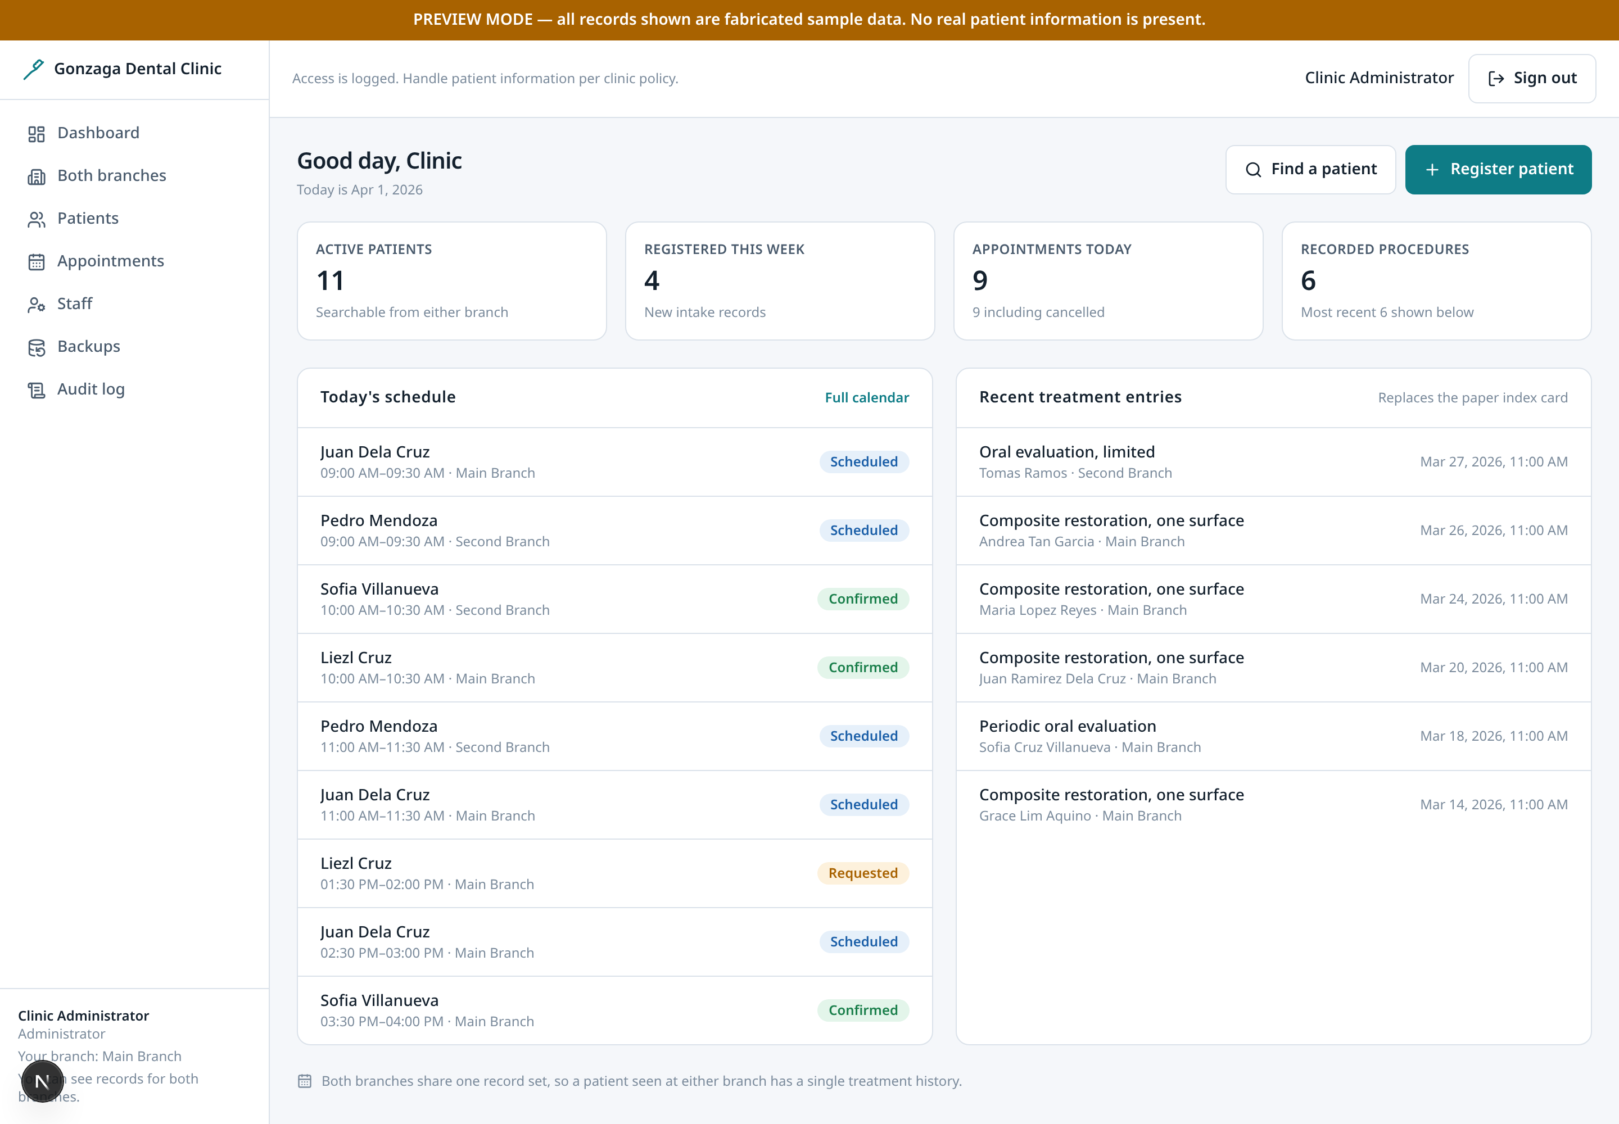
Dashboard
ALL STAFF
The landing page after sign-in: what needs attention today.
• Today's appointment list first, because that is the question the secretary asks on arrival.
• Counts for patients, appointments and treatments give orientation without needing to open each list.
• Recent treatment entries surface cross-branch clinical activity.
• Times render in clinic time (Asia/Manila) regardless of the server's timezone.
Gonzaga Dental Clinic · 08 / 27

Slide 9
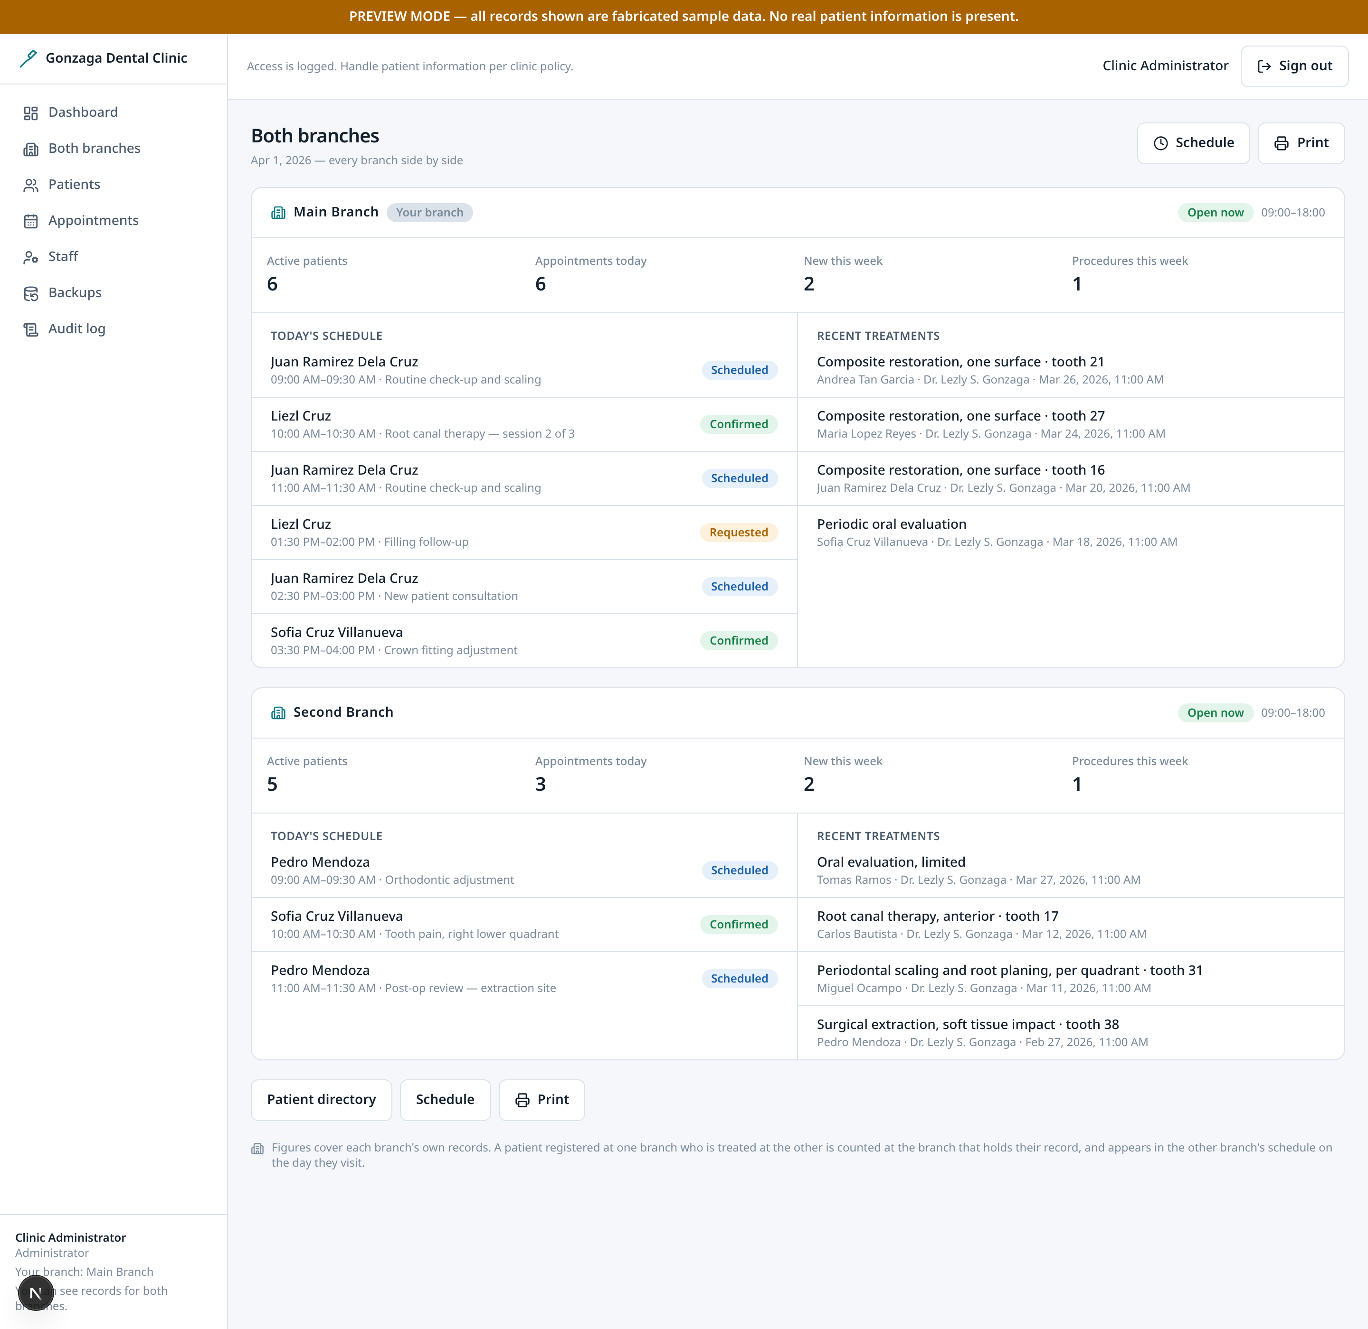
Both branches
DENTIST + ADMIN
The dentist's view of the clinic: two branches, side by side.
• Each branch gets its own block with its own figures. Merging them into one list would hide the thing that matters when you own two sites: whether one of them is behind.
• Per branch: active patients, appointments today, new registrations this week, and procedures recorded this week.
• Today's schedule is split by branch rather than interleaved, so the load at each site is visible at a glance.
• Open/closed status uses each branch's own hours, so a branch that has already closed reads differently from one still trading.
• Visible to dentists and admins. A secretary is scoped to a single branch by the database itself, so this comparison is not something they could reconstruct from the patient list.
• Reads on the phone as well, with the per-branch figures stacking into a single column.
Gonzaga Dental Clinic · 09 / 27

Slide 10
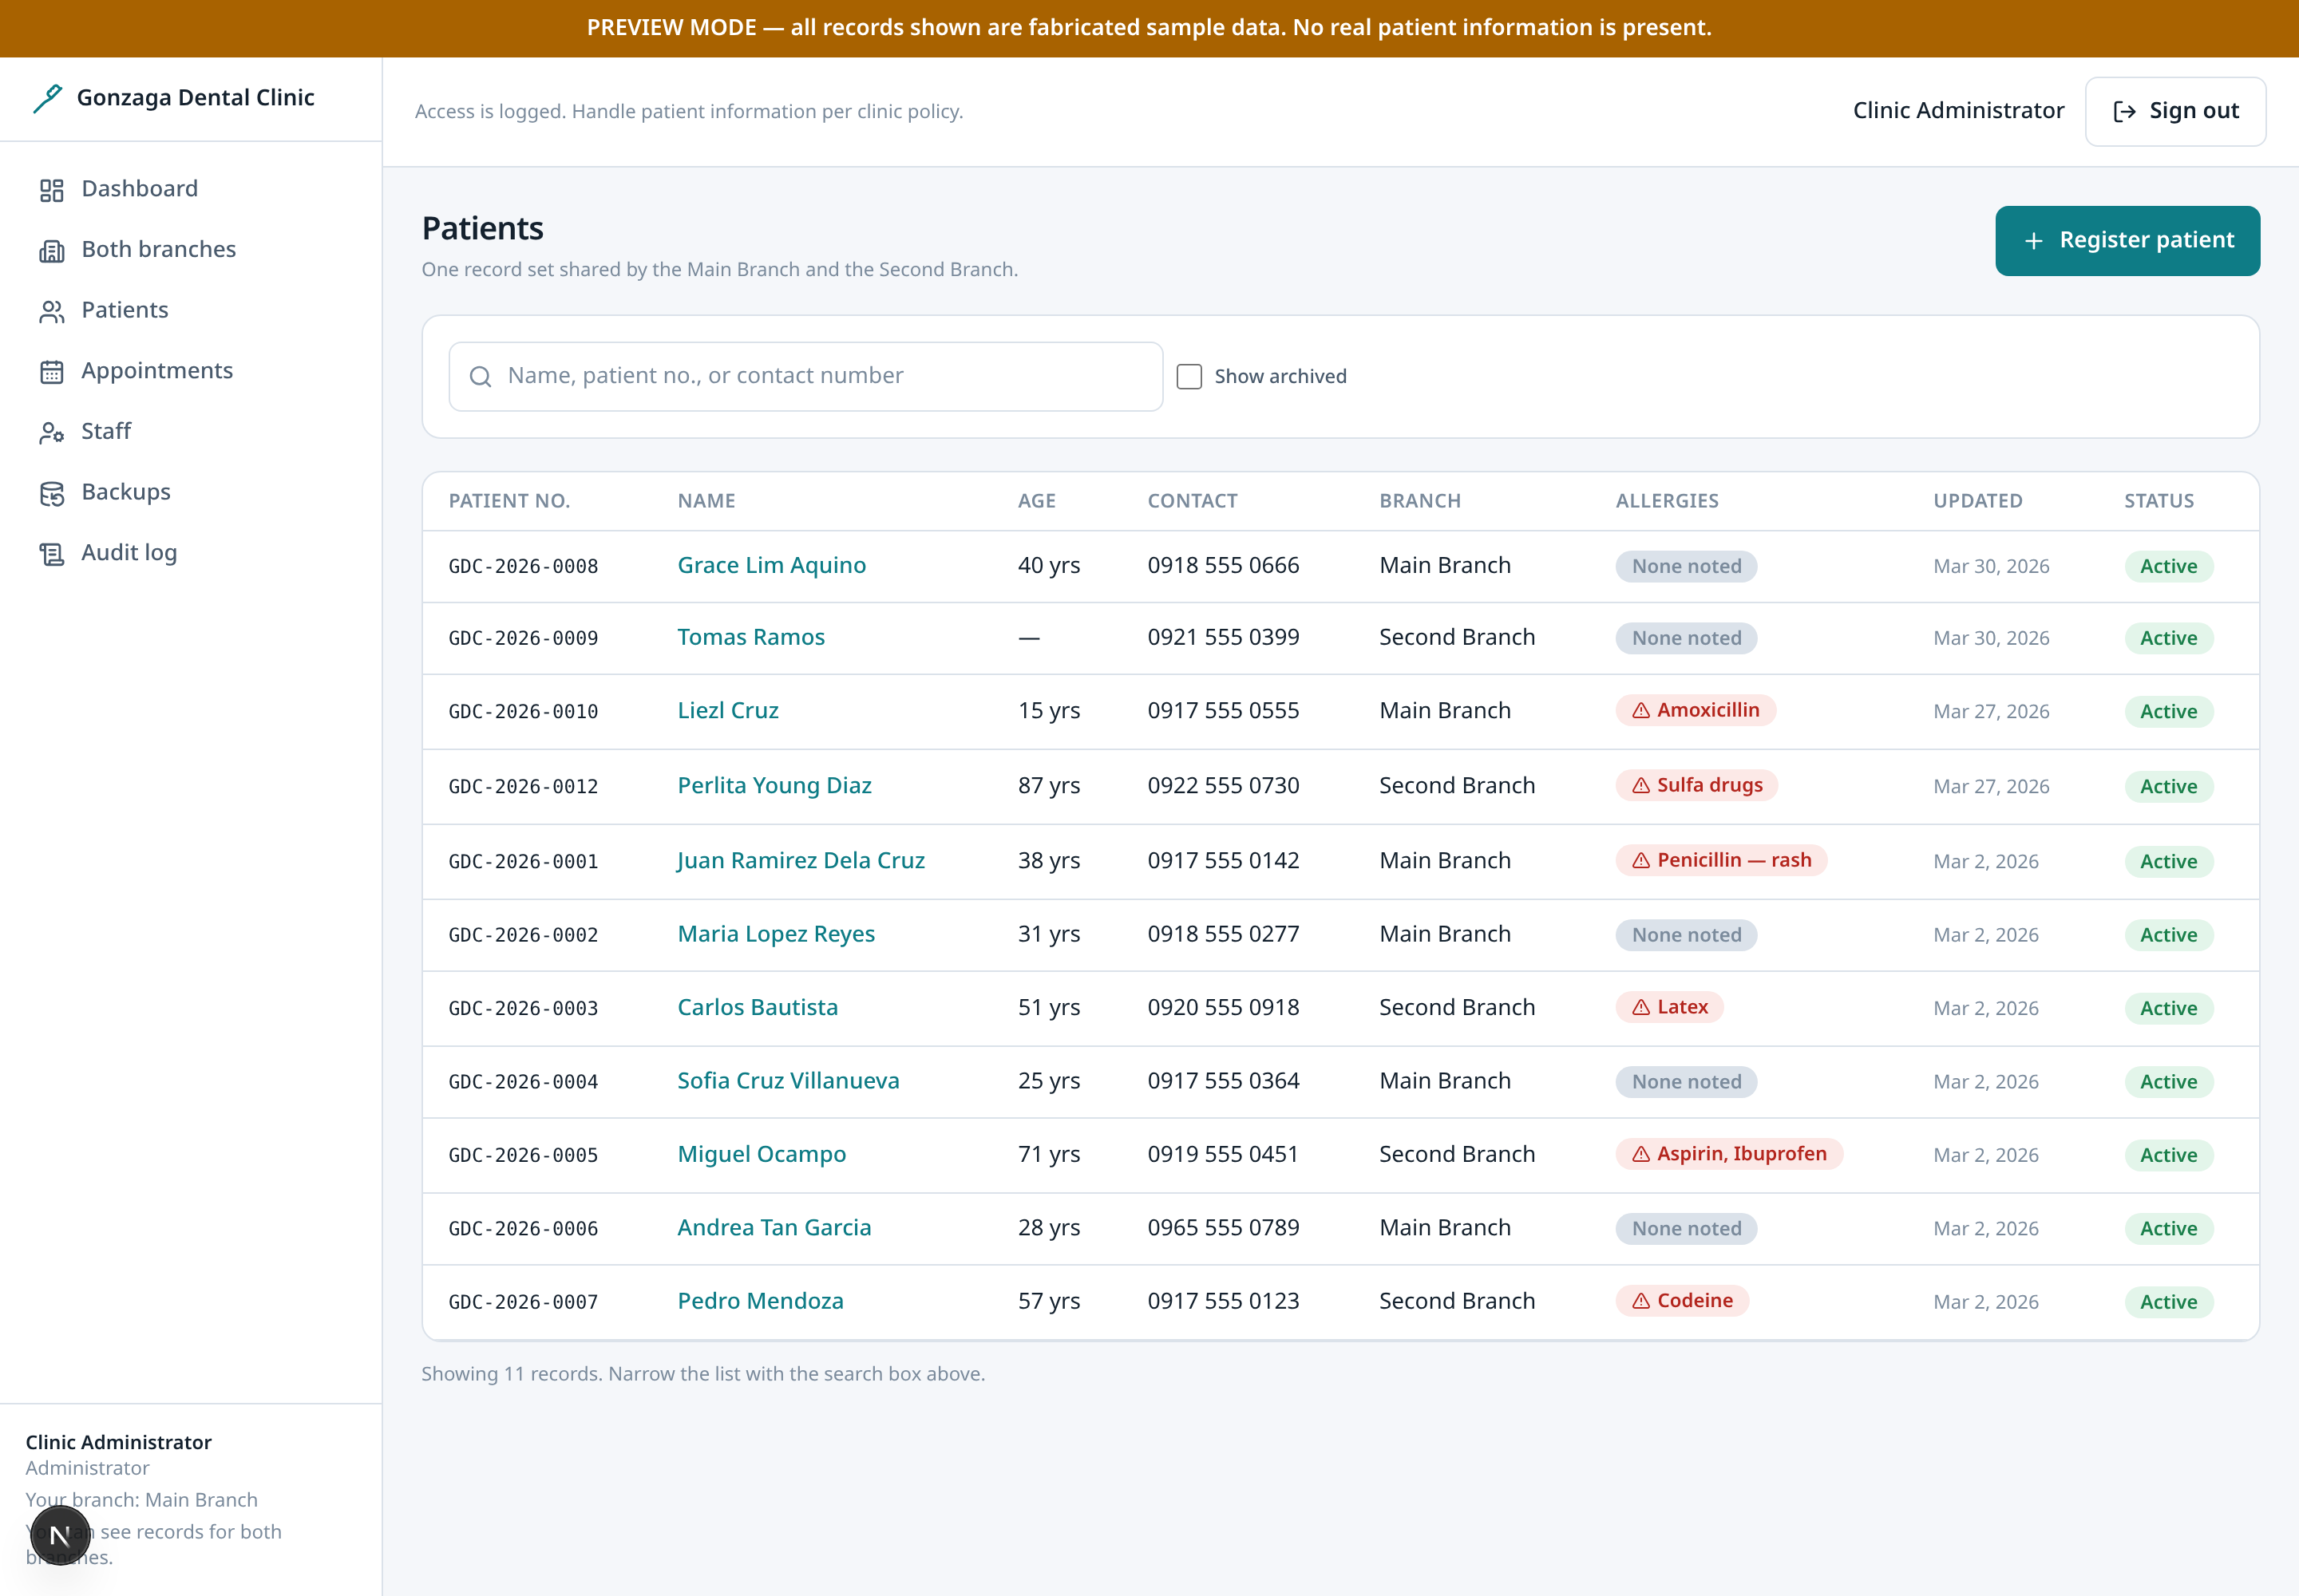
Patient directory
ALL STAFF
Every patient, searchable, with the duplicate warning built in.
• Search filters from the URL, so a filtered view can be bookmarked or shared with a colleague.
• Patient number, name, age and branch are shown together because staff identify people by any of them.
• New registrations are checked against likely duplicates by name and birthdate. Similarity is surfaced for a human to judge, never auto-merged, because merging patient records is unsafe to automate.
Gonzaga Dental Clinic · 10 / 27

Slide 11
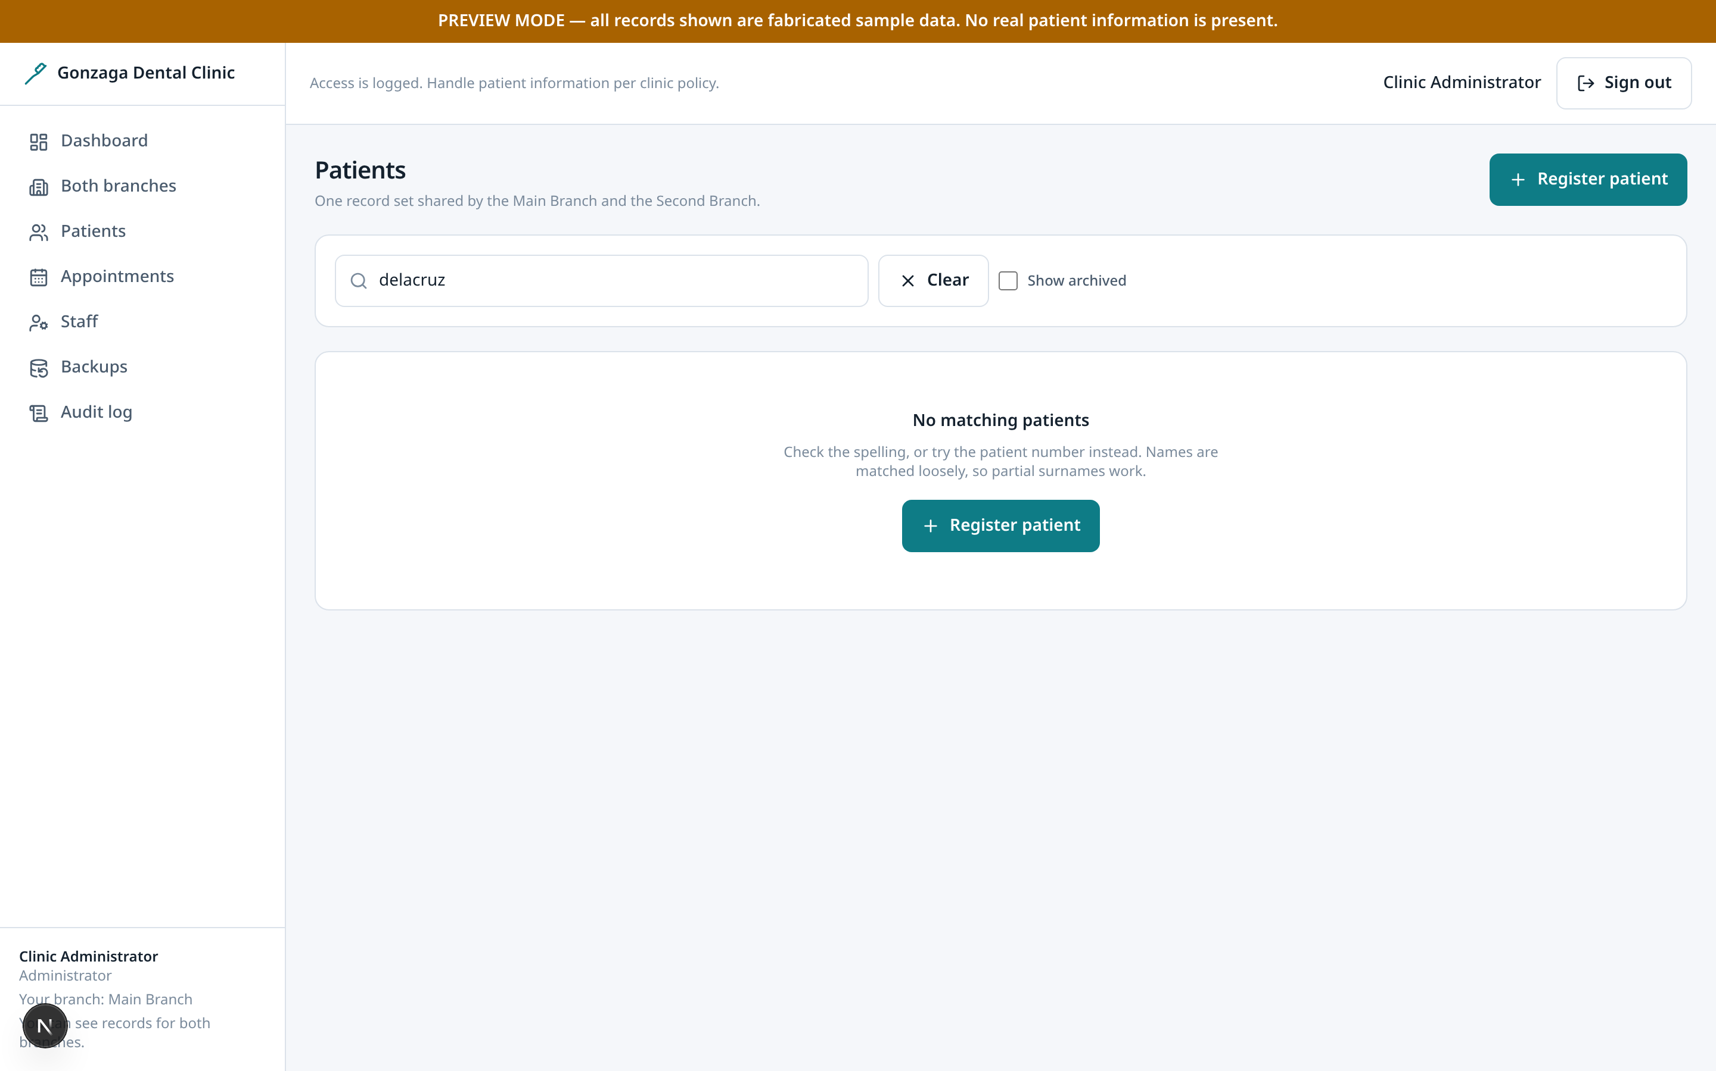
Search results
ALL STAFF
The same directory after a query, to show filtering end to end.
• Results update without a full page load and the query stays in the address bar.
• An archived patient is hidden by default; the toggle includes them for records that need correcting.
Gonzaga Dental Clinic · 11 / 27

Slide 12
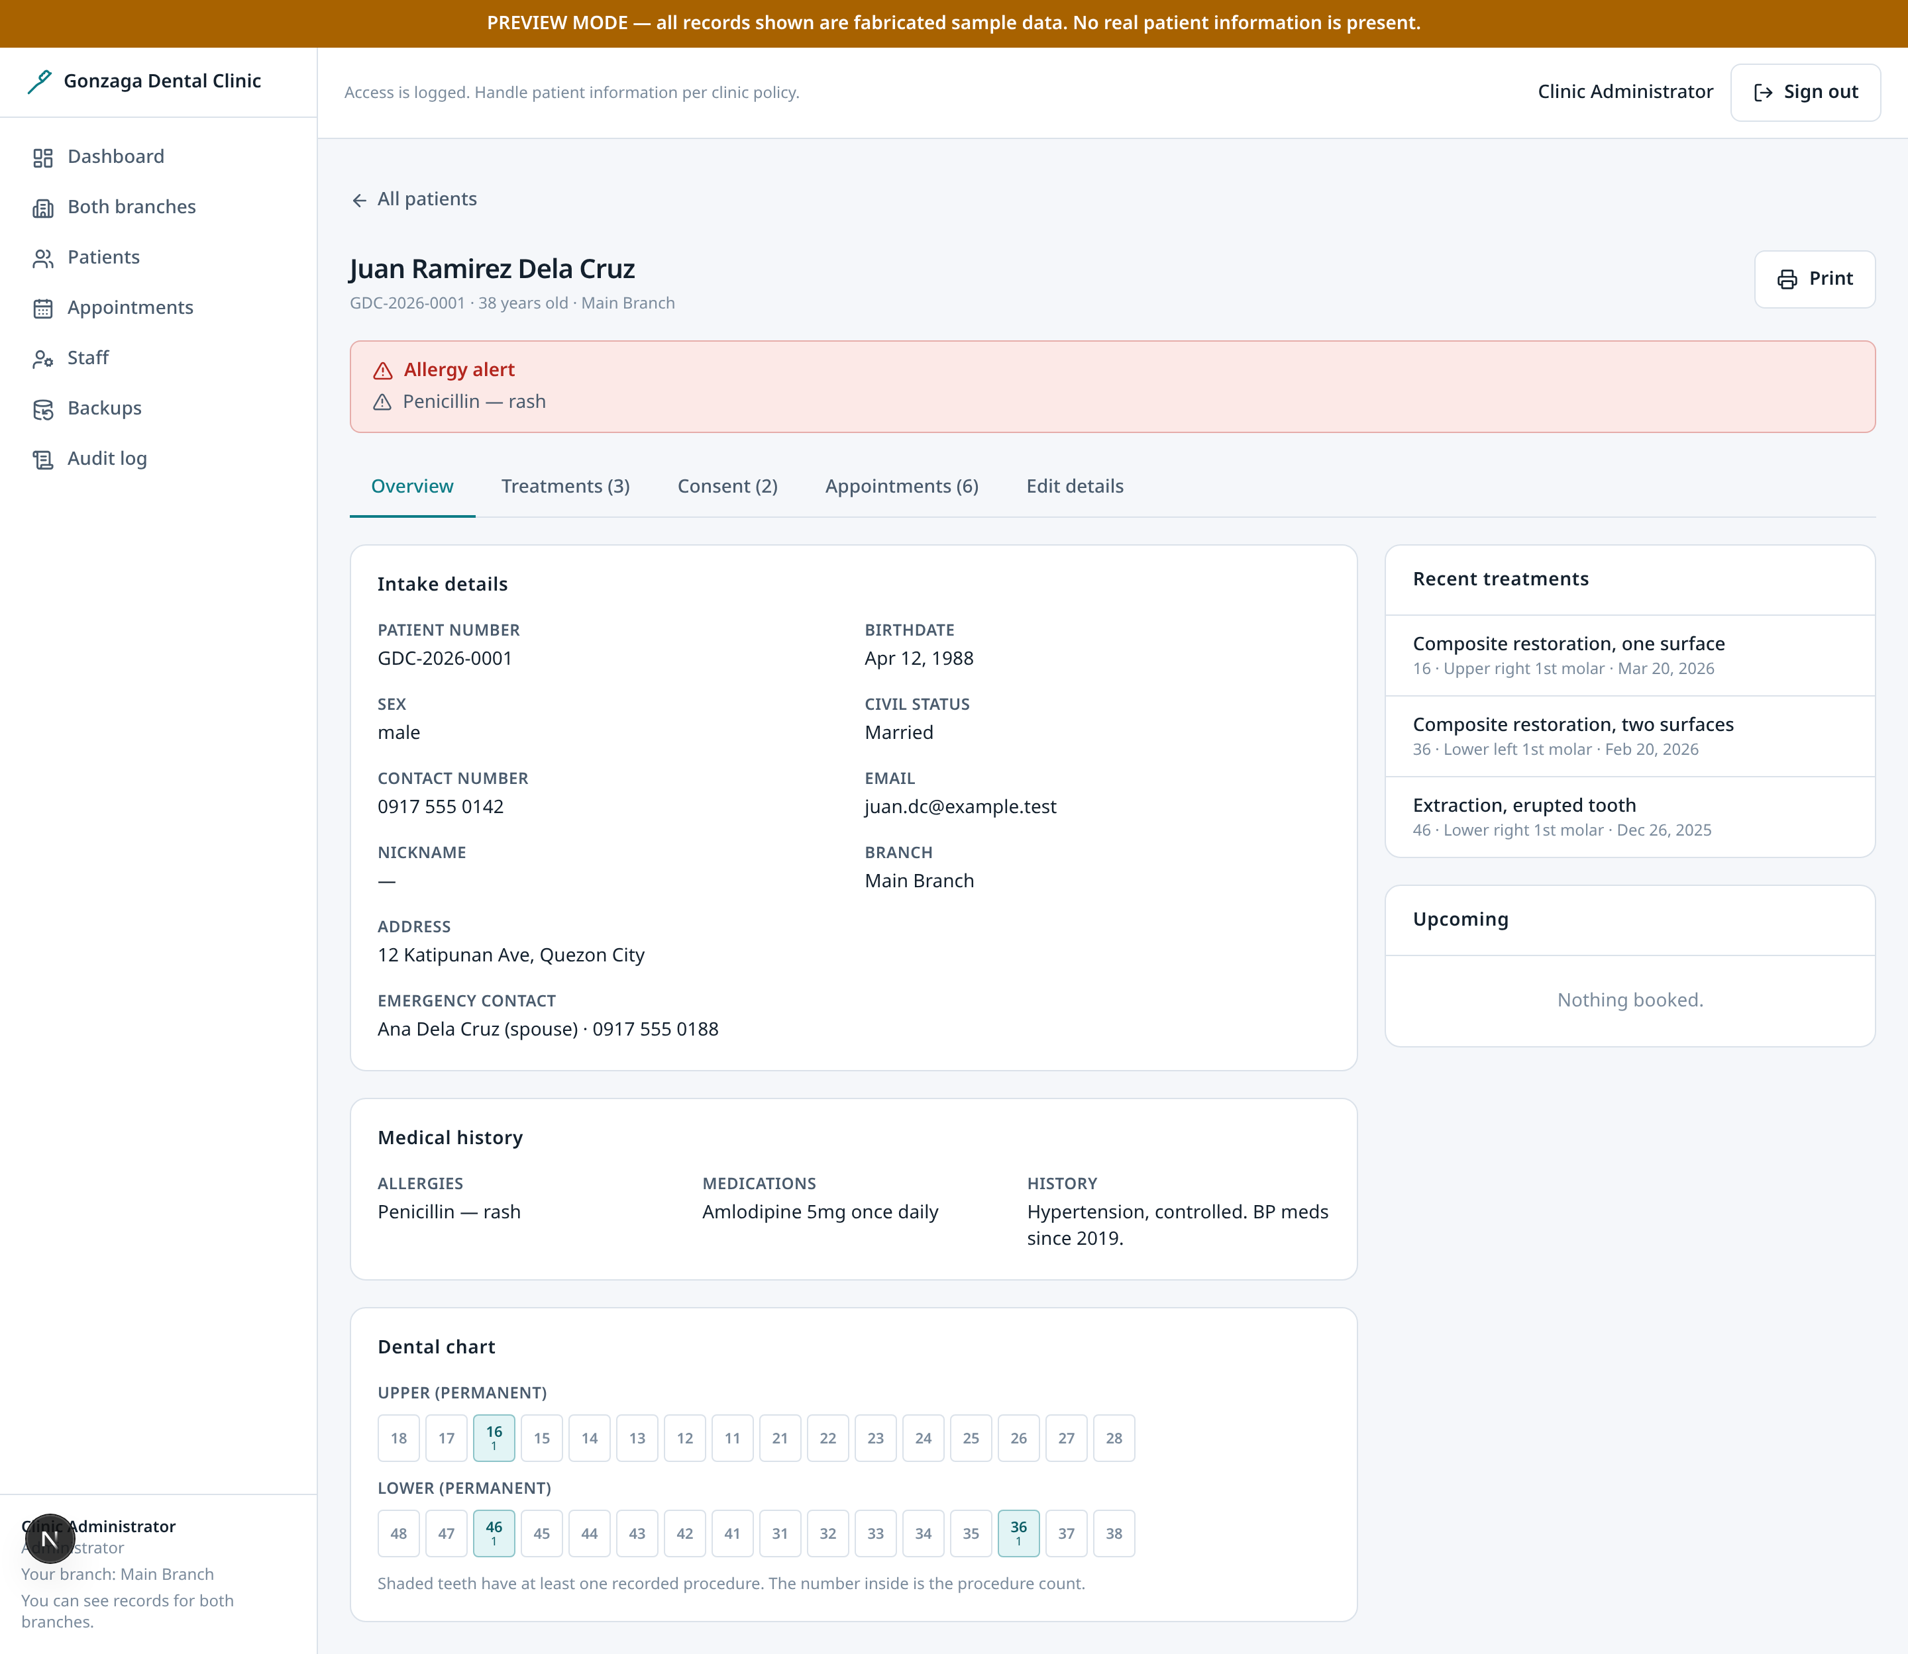
Patient record: overview
ALL STAFF
Demographics, medical context and upcoming visits for one patient.
• Allergies are placed at the top, not buried in a tab, because an unnoticed allergy is a clinical risk.
• Demographics are read-only here and edited through a separate, deliberate flow.
• The tab bar (overview, treatments, consent, appointments, edit) is the whole record; nothing important is more than one click away.
Gonzaga Dental Clinic · 12 / 27

Slide 13
Patient record: treatments
ALL STAFF
The clinical history that used to live on a paper index card.
• The tooth is chosen by tapping it on the chart rather than typing a two-digit code. A dentist identifies a tooth by where it sits; asking for a number is the slowest, most error-prone way to record it.
• Teeth already treated for this patient are shaded with their procedure count, so prior work on the tooth is visible while charting rather than after.
• The chart and the text box are two views of one value, so a tapped tooth and a typed range can never disagree about what gets saved. Child teeth are one checkbox away.
• Charting follows the FDI two-digit notation, so a tooth is named the same way the clinic already names it.
• Each entry records surfaces, procedure and who performed it, which is what an audit or a complaint review needs.
• Print produces a clean chart for the physical file, with navigation and controls hidden.
Gonzaga Dental Clinic · 13 / 27

Slide 14
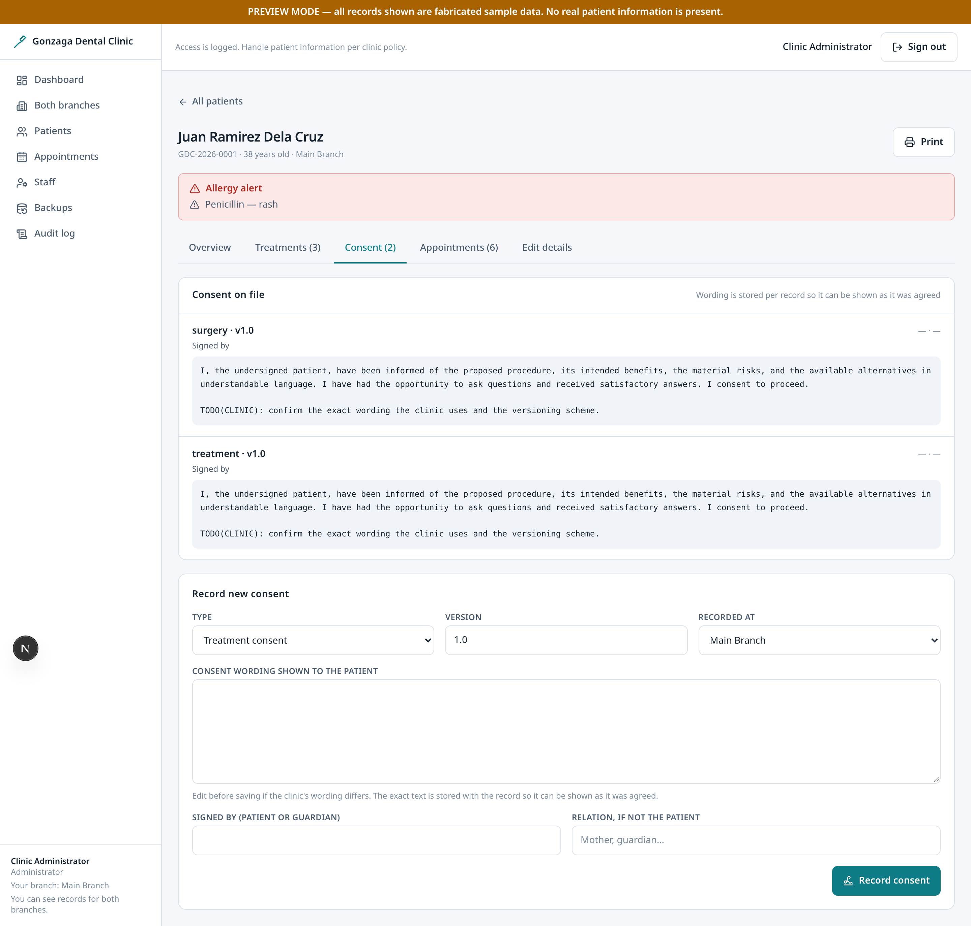
Patient record: consent
ALL STAFF
Consent captured per patient, versioned over time.
• A consent record stores the exact version the patient agreed to, not just a checkbox.
• History is retained so a later dispute can be answered with what was actually signed at the time.
• Consent wording is a clinic decision and is deliberately not invented here.
Gonzaga Dental Clinic · 14 / 27

Slide 15
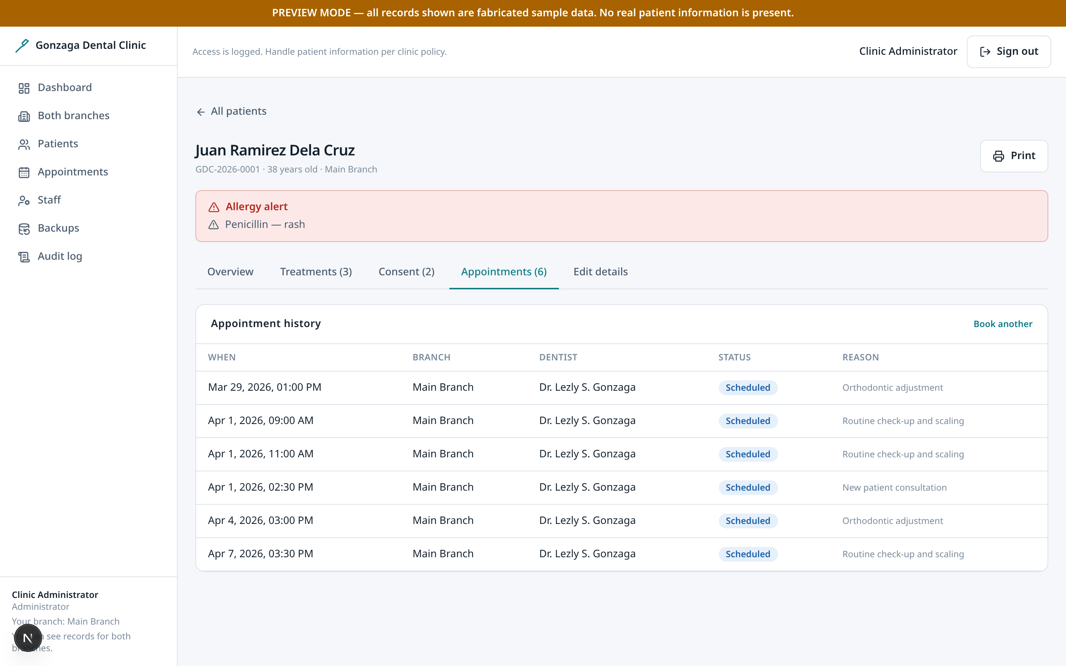
Patient record: appointments
ALL STAFF
This patient's appointment history.
• Past and upcoming are separated so the two are never confused.
• Overlapping appointments for the same patient are rejected by the database, not just by the form, so a race between two secretaries cannot double-book.
Gonzaga Dental Clinic · 15 / 27

Slide 16
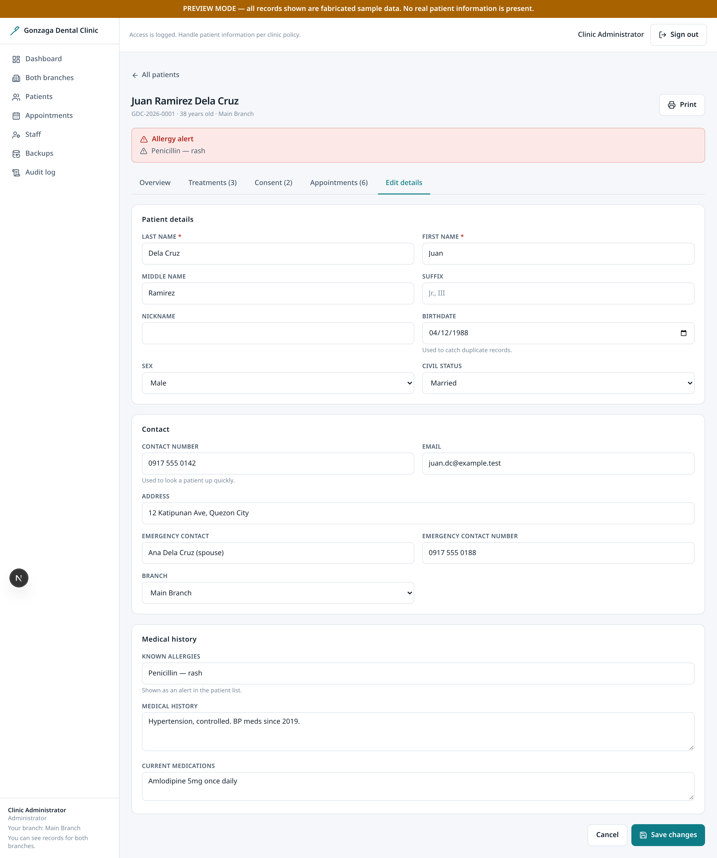
Patient record: edit
ALL STAFF
Editing an existing record rather than creating a new one.
• The form is pre-filled from the stored record, so an edit never silently blanks a field.
• Edits go through the same validation as registration, so a correction cannot create a record that registration would have refused.
Gonzaga Dental Clinic · 16 / 27

Slide 17
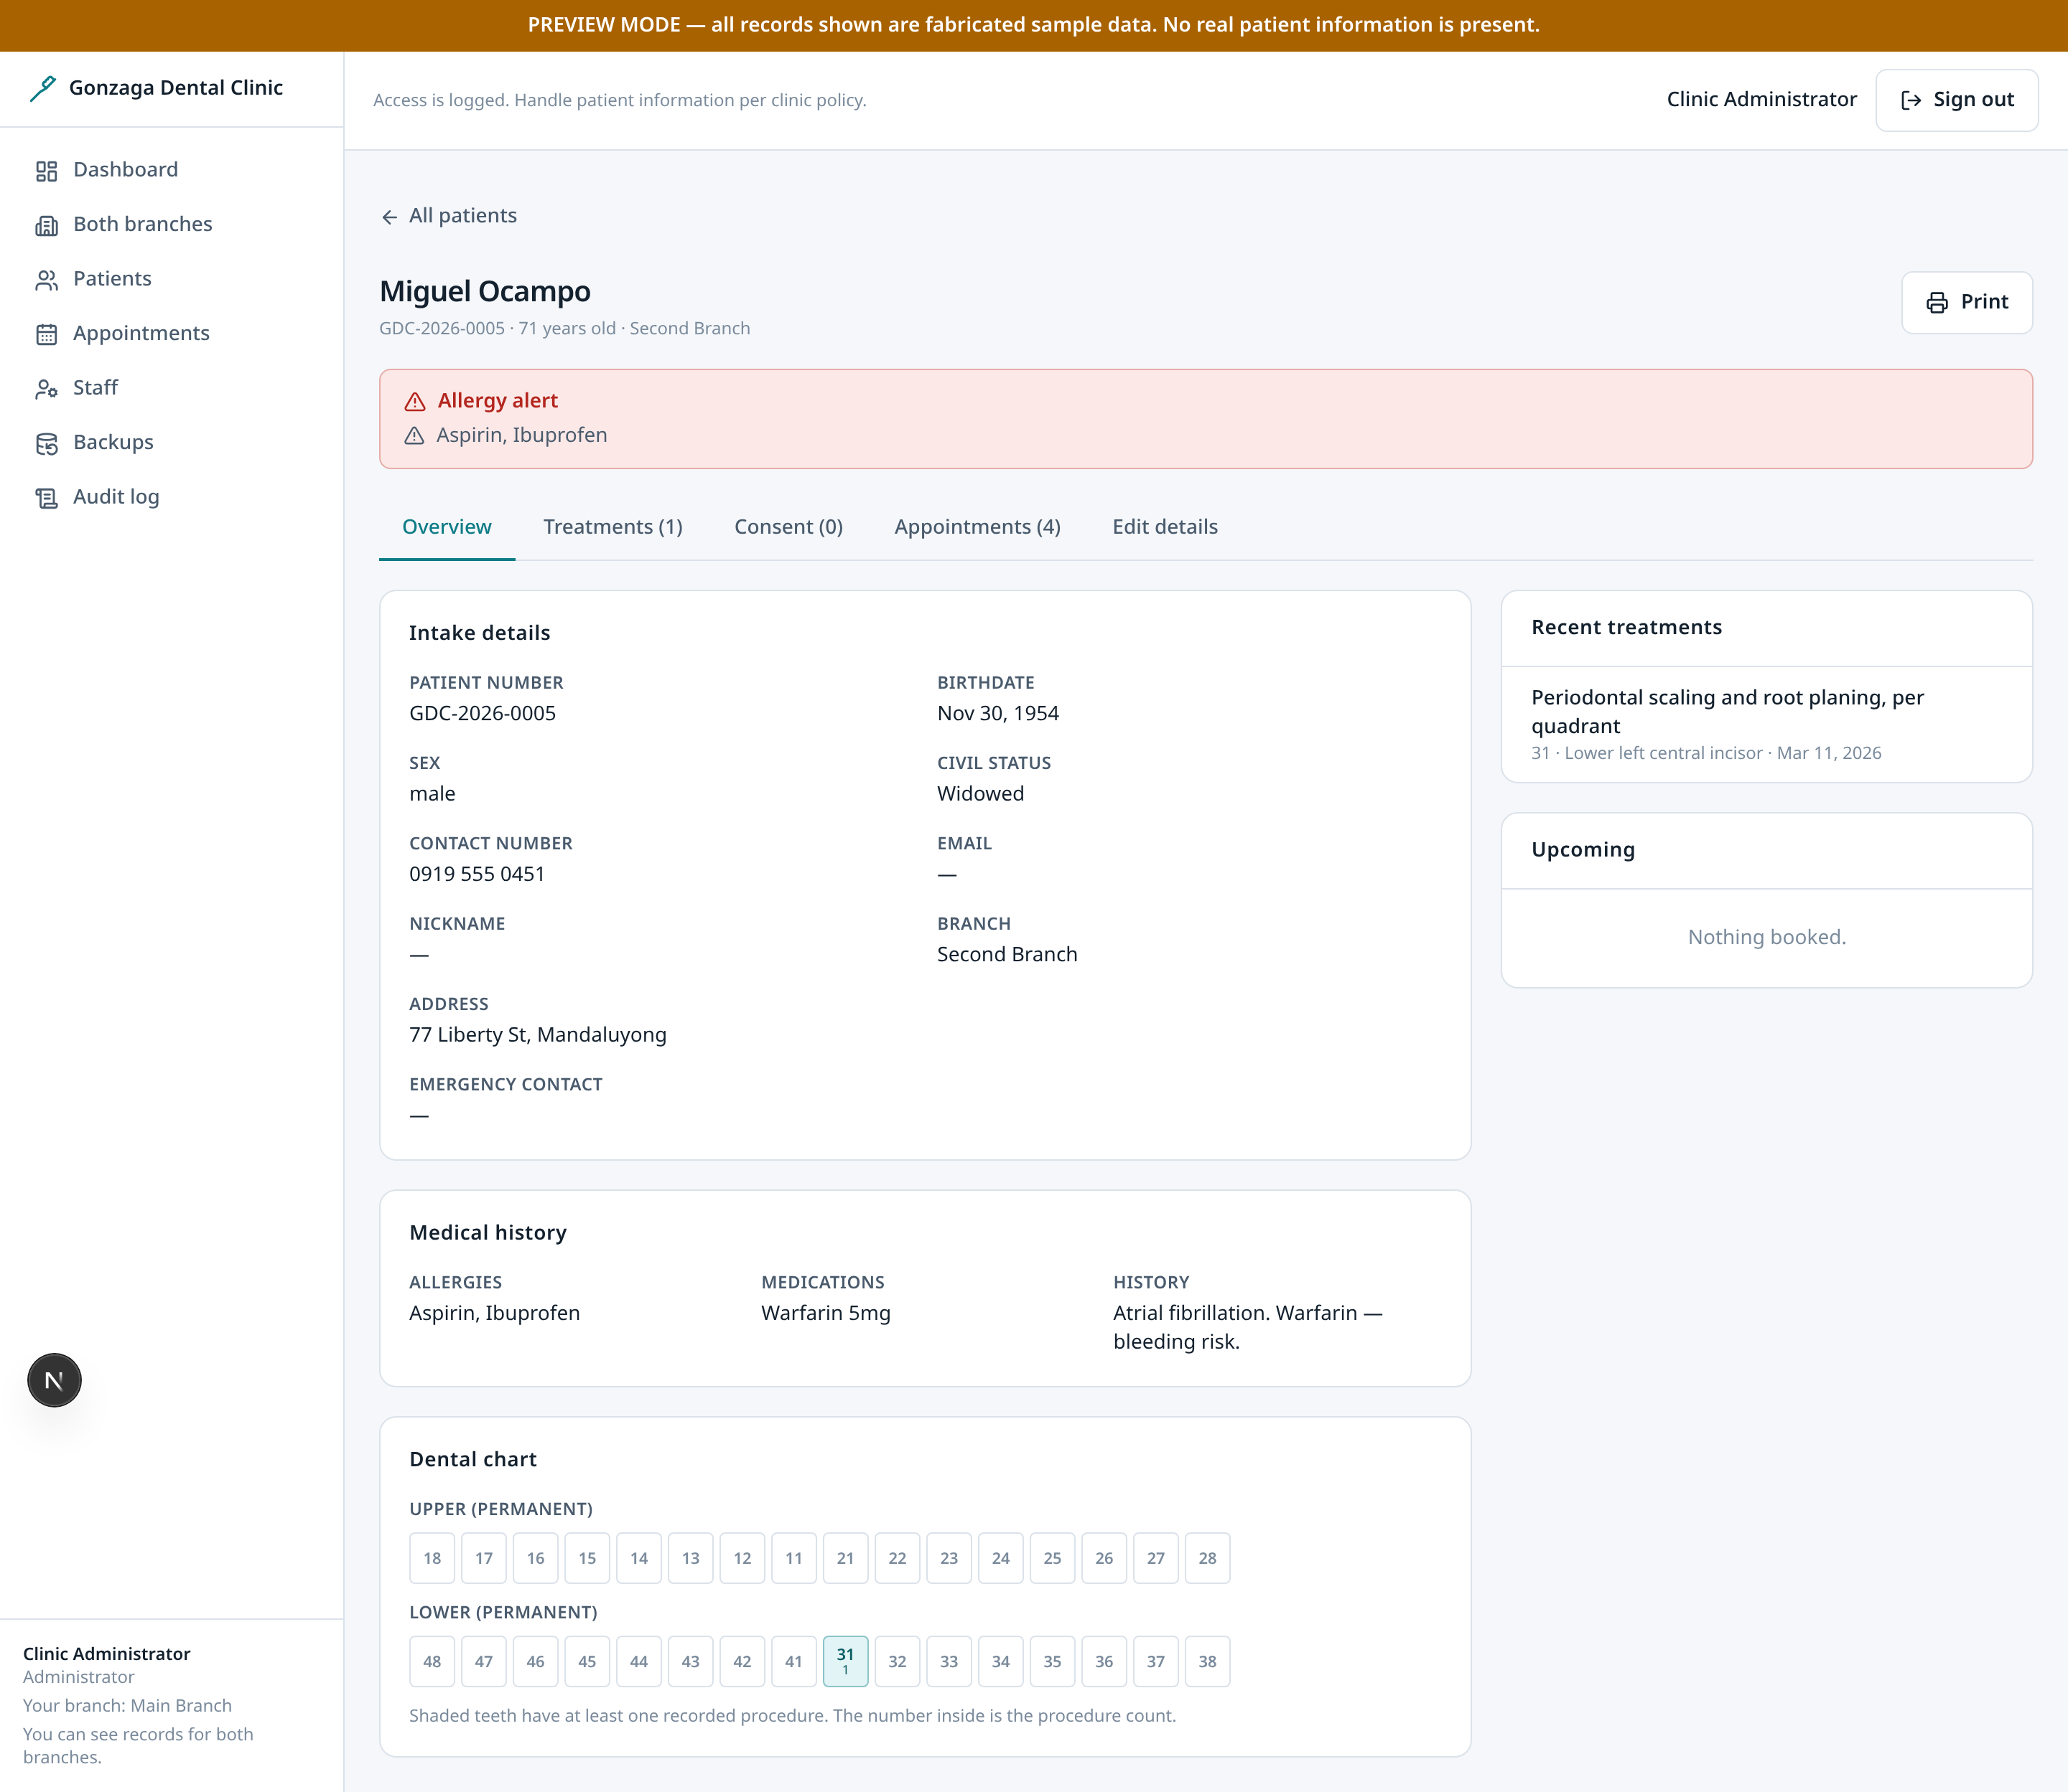
High-risk record: allergy alert
ALL STAFF
The same overview, chosen to show how risk is escalated.
• A patient with a recorded allergy is flagged prominently rather than left for the reader to notice.
• Escalation is visual and immediate because the cost of missing it is a medical incident.
Gonzaga Dental Clinic · 17 / 27

Slide 18
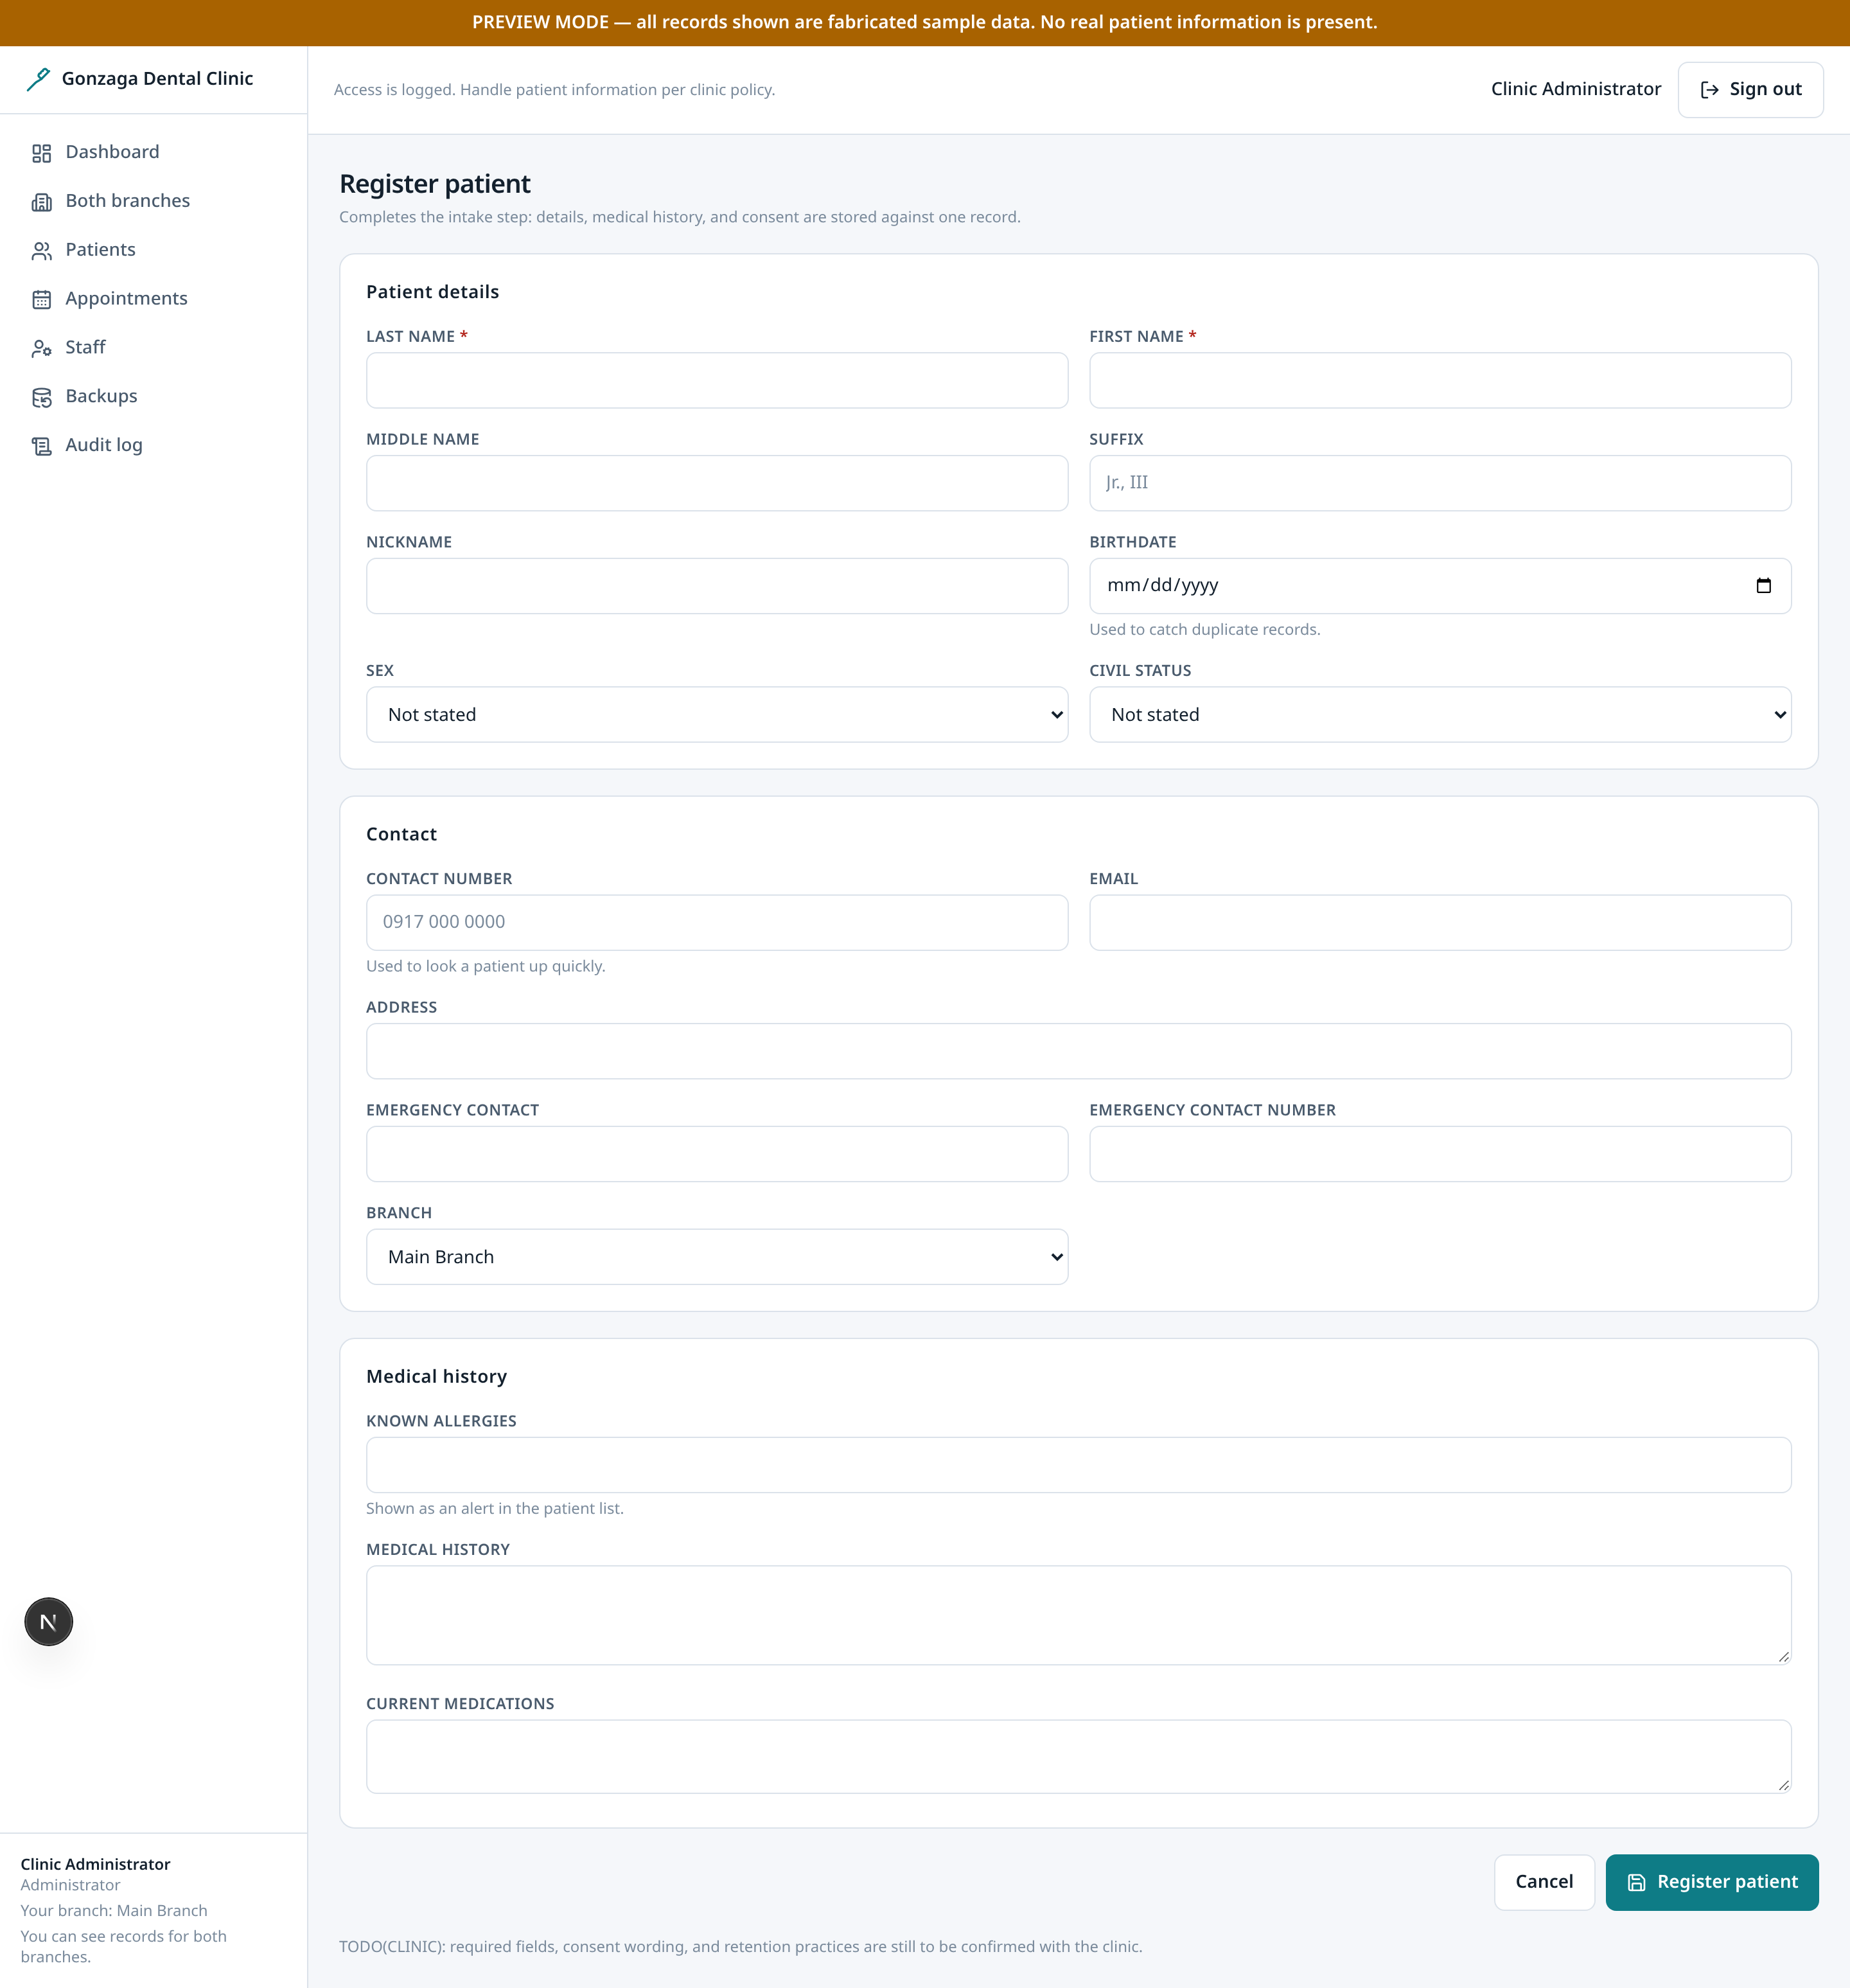
Register patient
ALL STAFF
Digital intake, replacing the paper front-desk form.
• Field-level validation messages appear next to the field that failed.
• A birthdate is optional. Blank means unknown, which is different from a wrong date, so it is never guessed.
• On a likely duplicate match the form pauses for explicit acknowledgement rather than creating a second record silently.
Gonzaga Dental Clinic · 18 / 27

Slide 19
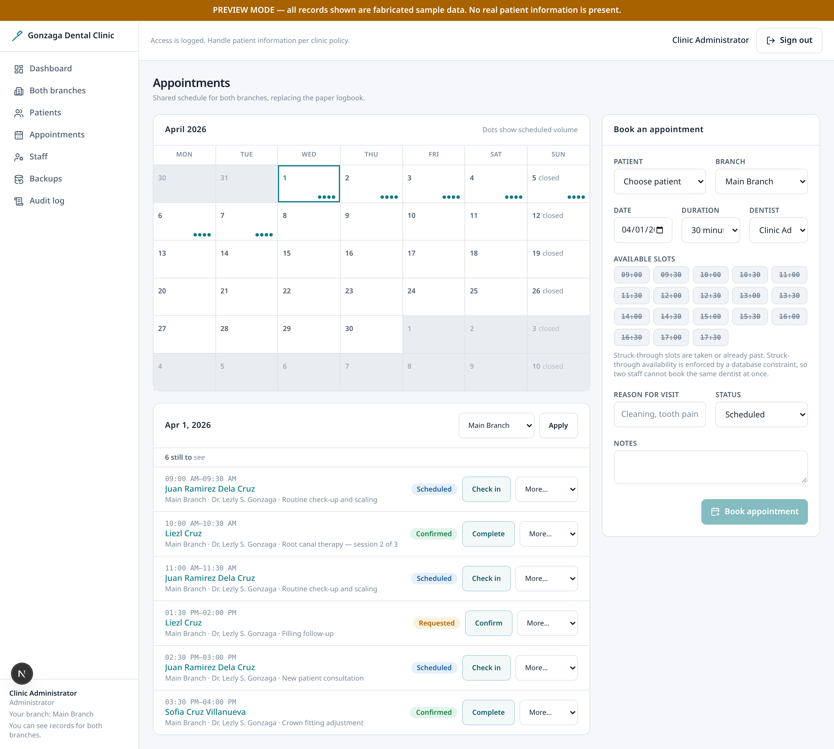
Appointments
ALL STAFF
The shared clinic schedule across branches.
• A month grid with per-day volume dots gives an overview before drilling into a day.
• The day view can be filtered by branch, and is labelled by branch to keep 'your branch' distinct from the clinic-wide record.
• The day list opens with a count of how many patients are still to be seen, so progress is readable without counting rows.
• The transition a secretary repeats all morning — check in, then complete — is a single labelled button on each row rather than an item in a dropdown. Anything else stays available under 'More'.
• Only the row being saved is disabled while it saves, so one slow request does not freeze the rest of the waiting room.
• The branch filter and its Apply control are both full-size touch targets for tablet use at the front desk.
Gonzaga Dental Clinic · 19 / 27

Slide 20
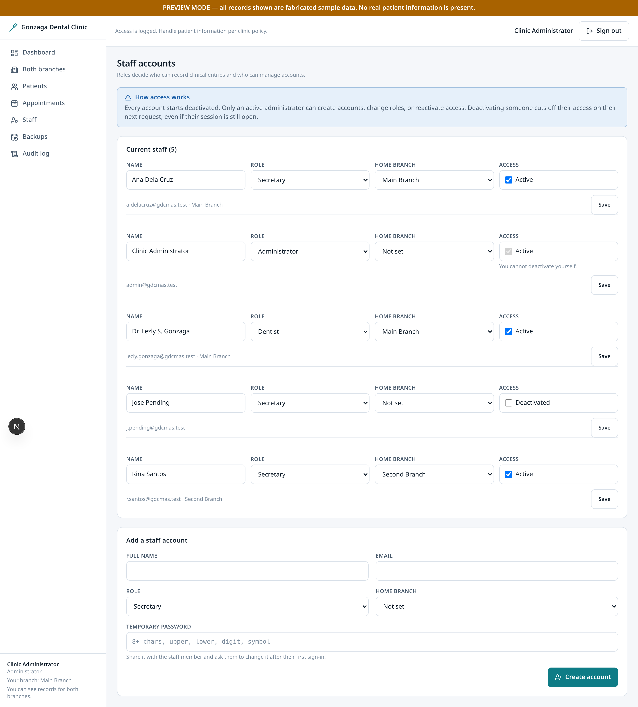
Staff
ADMIN ONLY
Staff accounts and roles. Admin only.
• Three roles: dentist, secretary, admin. Permissions are enforced by row-level security in the database, not by hiding buttons.
• The most recently created accounts are listed first so a new hire is easy to verify.
• An admin cannot deactivate their own account, which prevents locking the clinic out of its own system.
Gonzaga Dental Clinic · 20 / 27

Slide 21
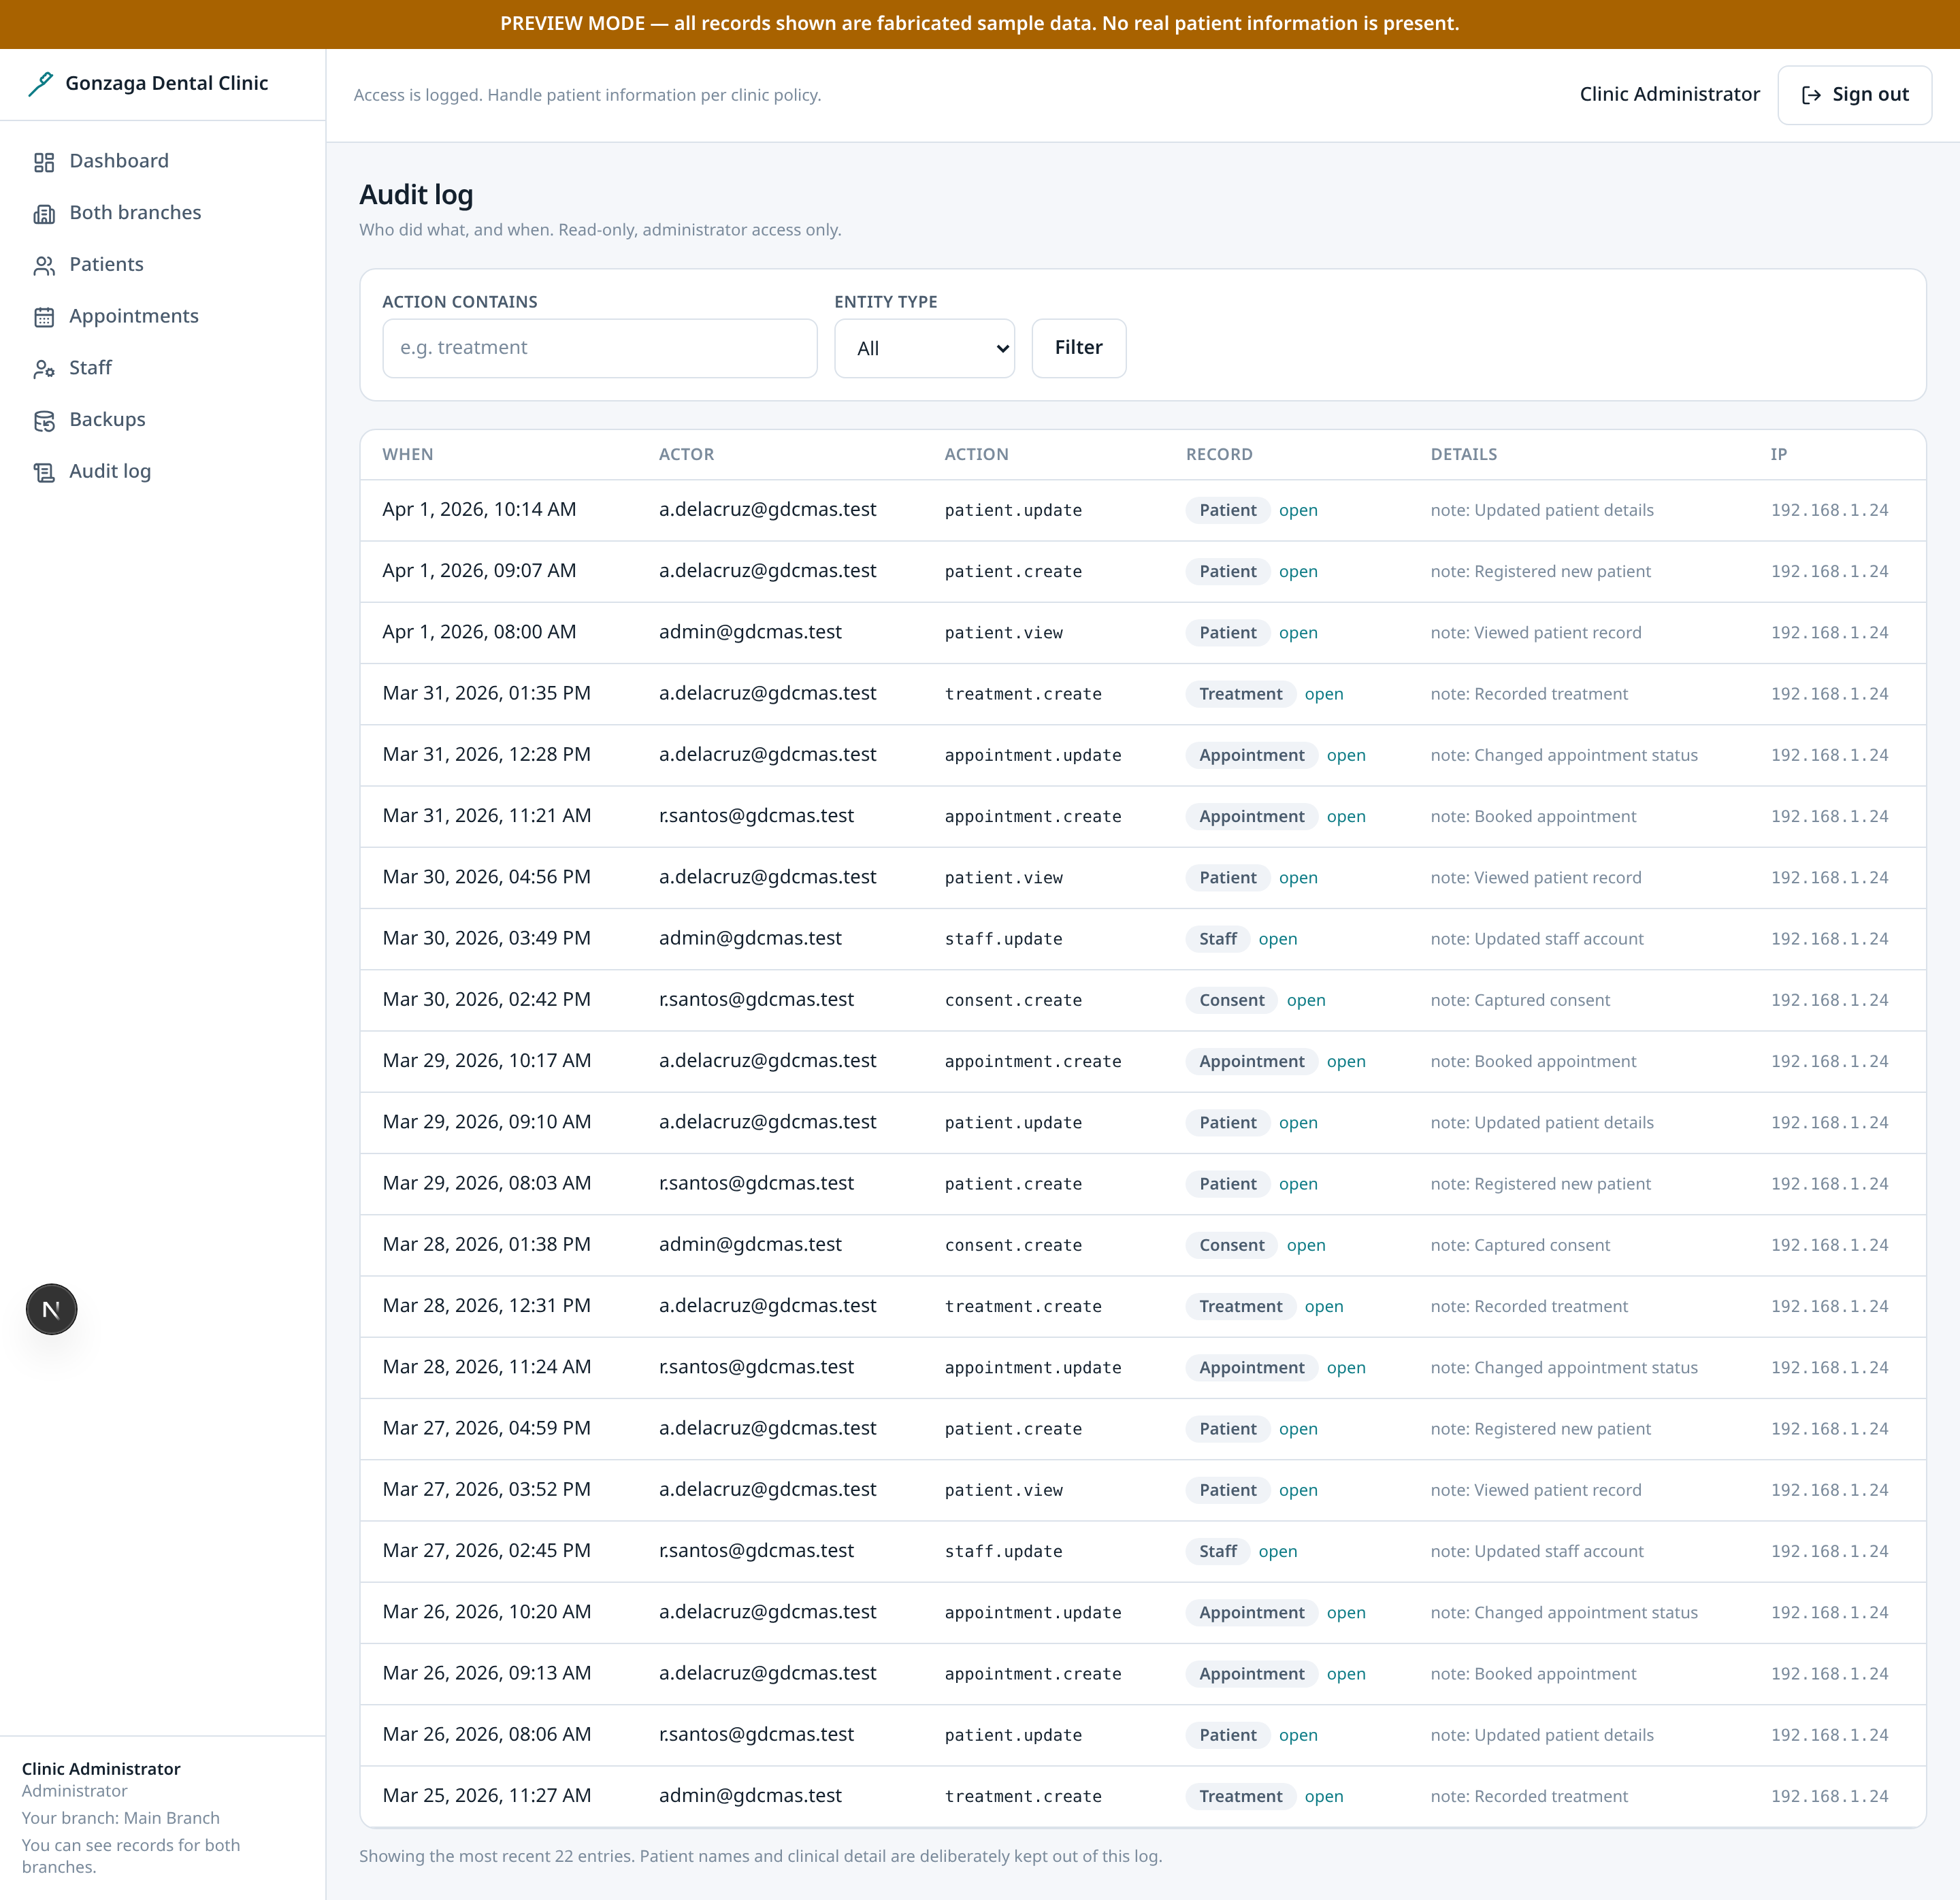
Audit log
ADMIN ONLY
Append-only record of access and changes. Admin only.
• Every read and write of patient data is recorded, because the system holds identifiable health information.
• Rows link to the record they describe, turning a log line into a starting point for investigation.
• The log is append-only: there is no edit or delete affordance anywhere in the interface.
Gonzaga Dental Clinic · 21 / 27

Slide 22
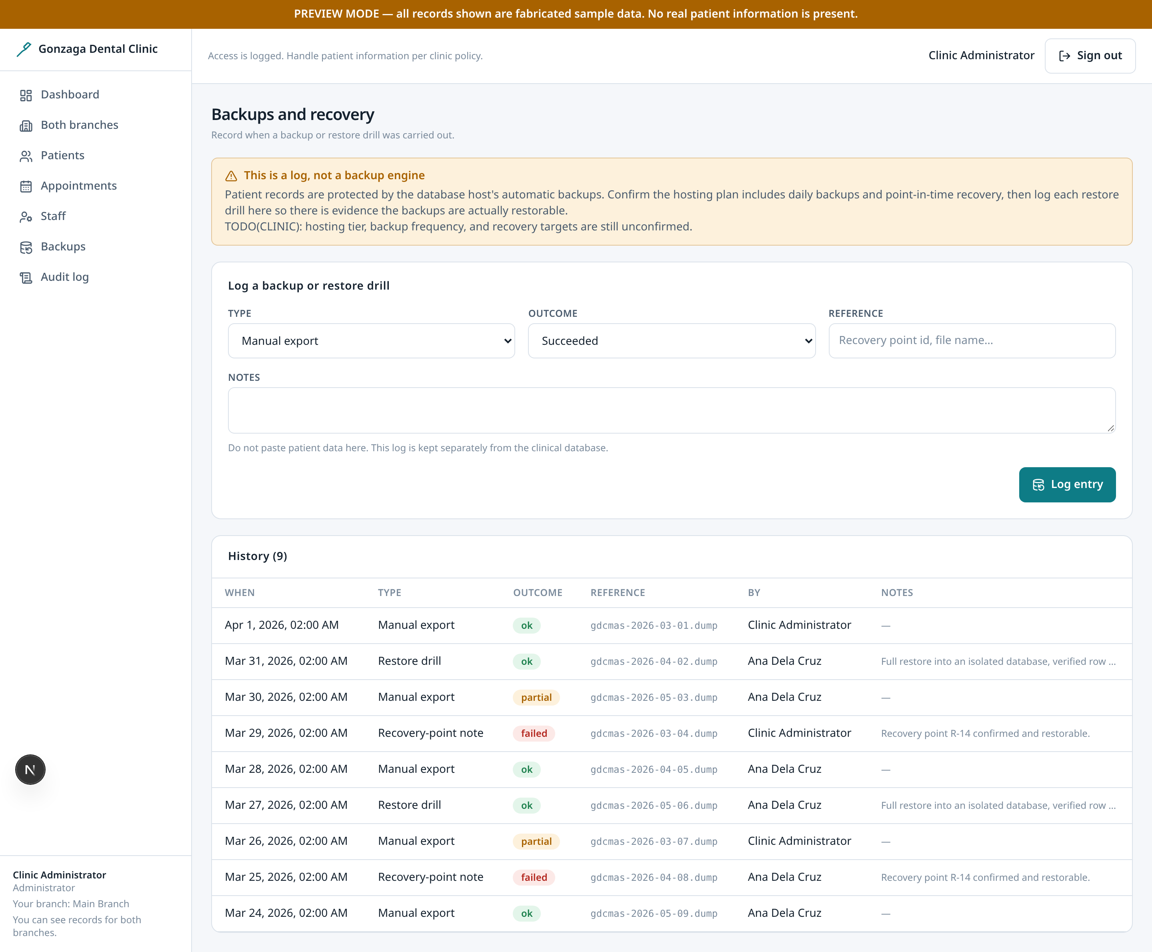
Backups
ADMIN ONLY
Backup and export activity. Admin only.
• A clinic holding patient records needs a recoverable copy and a way to take one deliberately.
• The log records what was exported, by whom and when, so leaving the building with a backup is itself traceable.
• Real scheduled backups are a deployment decision and are not automated by this application.
Gonzaga Dental Clinic · 22 / 27

Slide 23
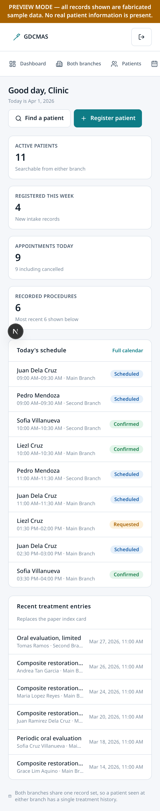
Mobile: dashboard
ALL STAFF
The dashboard at phone width.
• The sidebar collapses to a horizontal scrolling nav so navigation survives a narrow screen without hiding it behind a menu.
• Interactive controls are at least 44px tall, the minimum comfortable touch target, because front-desk staff work on phones.
Gonzaga Dental Clinic · 23 / 27

Slide 24
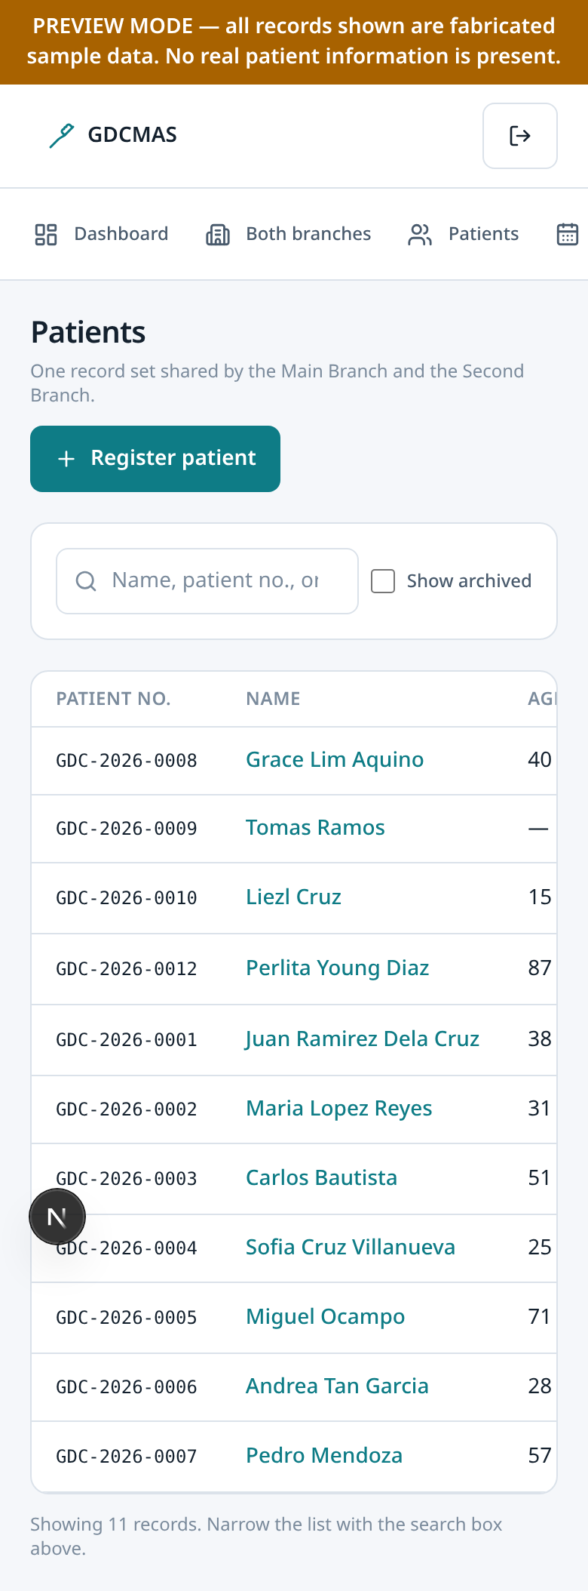
Mobile: patient directory
ALL STAFF
The patient list at phone width.
• The table remains readable by scrolling horizontally within the table, so columns are never silently dropped.
• Patient names are comfortably tappable rather than bare inline text.
Gonzaga Dental Clinic · 24 / 27

Slide 25
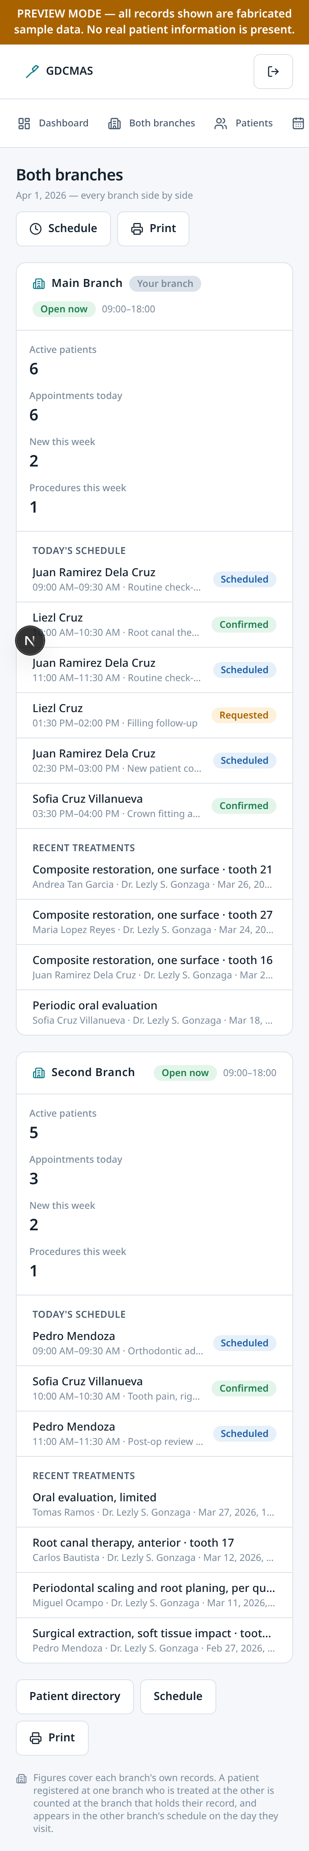
Both branches on a phone
DENTIST + ADMIN
The same cross-branch comparison, on the screen most staff actually carry.
• Each branch becomes its own stacked block, so the counts, schedule, and recent treatments are read by scrolling rather than side by side.
• The branch name and open/closed badge stay at the top of each block, which is the part that has to be legible at a glance before opening anything else.
Gonzaga Dental Clinic · 25 / 27

Slide 26
How it was verified
• Database smoke test against a throwaway PostgreSQL instance: 24 sections, including 7 attempts that must be denied by row-level security.
• The schema is applied twice per run to prove it is idempotent, and the seed runs twice.
• TypeScript, ESLint and a production build with preview disabled, confirming every authenticated route stays dynamic.
• 19 screenshots captured at desktop and mobile, with console errors and page errors treated as failures.
• A layout audit at five viewport widths checks for horizontal overflow and undersized touch targets.
• Not yet verified, and it matters: production authentication, the real REST layer, writes, and end-to-end row-level security all need live Supabase credentials.
• No automated browser tests are committed, so a regression in the interactive chart would only be caught by review.
• Branch opening hours are read per branch for display, but booking still uses one clinic-wide hours map.
• The first cross-branch visit of the day still needs a dentist or admin to create.
• No automated backups are running yet; the backups screen shows the manual procedure.
Gonzaga Dental Clinic · 26 / 27

Slide 27
Decisions needed from the clinic
• Real opening hours per branch. Today the branch pages display each branch's own hours, but appointment booking uses a single clinic-wide map, so a branch that is closed can still be booked.
• Consent wording and version, and whether consent is required before a procedure or only recorded afterwards.
• What intake must capture, and whether registration collects consent at the same time.
• The procedure code list, and whether codes must map to a national fee schedule.
• Record retention periods, backup schedule, and who may hold each role — particularly whether a receptionist ever needs the dentist and admin views.
• Whether a patient may be registered at one branch and treated routinely at the other, which changes how appointments are booked.
Gonzaga Dental Clinic · 27 / 27

