Slide 1
Results of NNMF and pLSA on real data

Slide 2
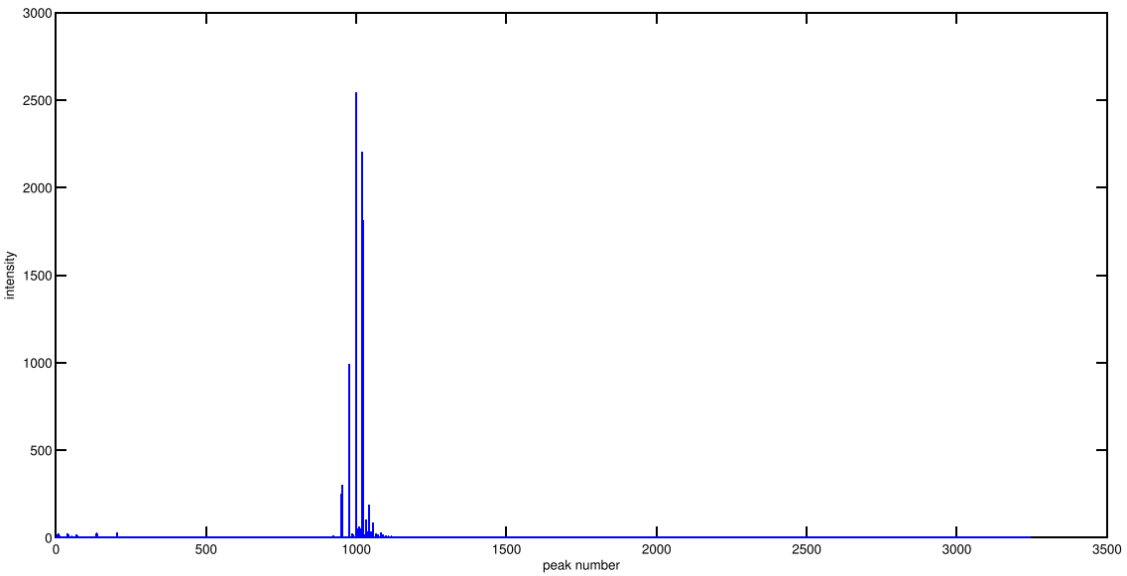
m/z values we concerned
m/z values mentioned in paper: 1007.7, 1021.8, 1035.8
m/z values that may come from noise, shown in our purified compound, with +/-14 m/z difference: 993.71, 1050.3
m/z: 1021.8
m/z: 1035.8
m/z: 1007.8
993.71 and 1050.3 are
really small signals in experiment data
m/z: 993.71
m/z: 1050.3

Slide 3
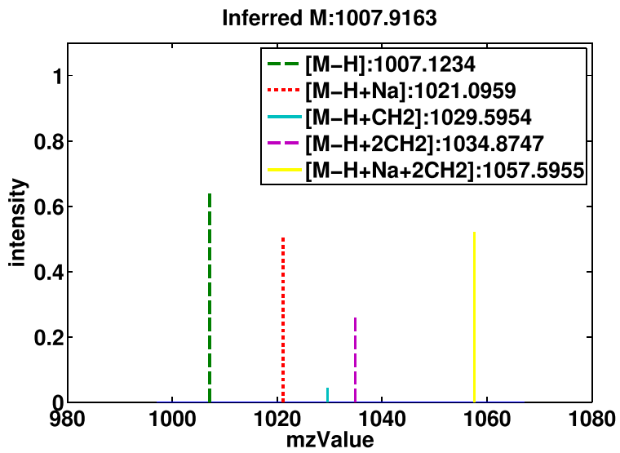
The suspected m/z
What we learned

Slide 4
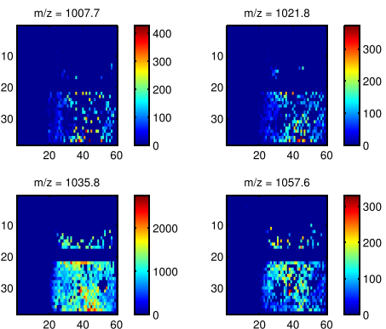
What these four peaks in data looks like
These peaks intensities are different from them in the purified compound

Slide 5
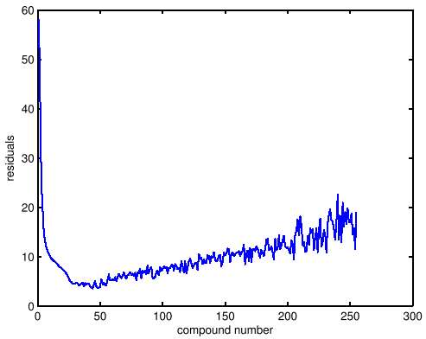
What NNMF performs
Run NNMF with 1000 times random initialization, alternative least square algorithm.
Run from dictionary element number from 1 to 250
Minimum residuals lies in number = 44

Slide 6
What NNMF performs
Find dictionary element in NNMF that best groups the three peaks we want, as well as not groups the fourth peak.
The best result comes from the experiment of not minimum residuals.
  Min residual : 3.58
  Best result’s residual: 7.2006
  Good results are not correlated with residuals.

Slide 7
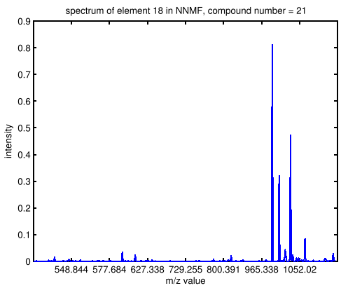
What NNMF performs
This element capture all three peaks we want.
This element also captures the fourth peak, but with small intensity
False positive
peaks

Slide 8
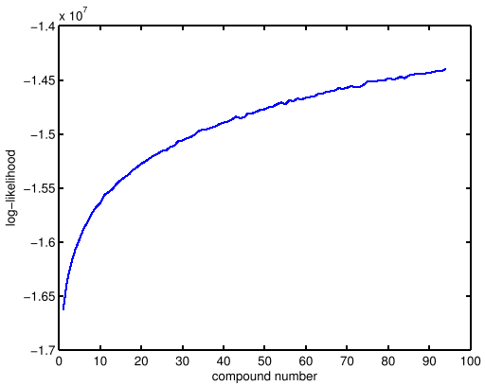
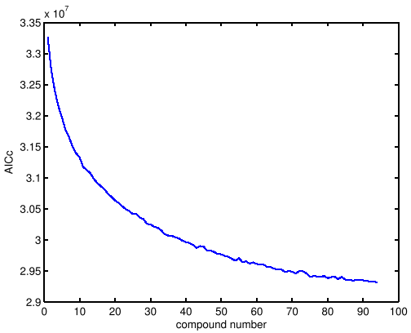
What pLSA performs
Run pLSA with 5000 iterations
Run from dictionary element number from 1 to 94
Dictionary element number (k) versus Log-likelihood and k versus AICc
AICc is closed to convergence at k = 94.

Slide 9
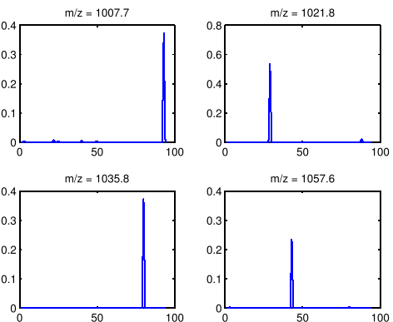
What pLSA performs
Find dictionary element in pLSA that best groups the three peaks we want, as well as not groups the fourth peak.
Don’t have a good result. pLSA put each peaks in a different dictionary element.
E.g. Check four m/z values we concerned in learned dictionary

