Slide 1
Machine Learning Based Solution
Improving Loan Portfolio Profitability
by
Furkan Gül
frkangul@gmail.com

Slide 2
Agenda
Case
Data Preprocessing
Loan, Customer, Financial, Delinquency Data Analysis
Heatmap Correlation Analysis
Model Evaluation
Model Training
Conclusion

Slide 3
Case | Data Prep | Loan | Customer | Finance | Delinquency | Heatmap | Eval | Training | Conclusion
Case Overview
Client: Personal Loans Lending Manager at a Bank.
Objective: Enhance the profitability of Bank’s personal loan portfolio.
Data Provided: Four comprehensive datasets encompassing loan details, customer demographics, financial backgrounds, and delinquency records.
Proposed Solution: Develop a machine learning model to predict and identify potential loan defaults.
Assumptions:
Definition: Loans are financial agreements where customers receive funds and agree to repay in monthly installments.
Profitability: Timely repayments by customers ensure loan profitability.
Default: A loan is marked as defaulted after three consecutive missed payments.
3

Slide 4
Case | Data Prep | Loan | Customer | Finance | Delinquency | Heatmap | Eval | Training | Conclusion
Data Preprocessing Overview
Data Cleaning: Addressed missing values, outliers, and data type discrepancies.
Missing Value Analysis: Evaluated and addressed missing data by calculating missing value percentages.
Missing Value Handling: For minor instances of missing values, rows were removed to maintain data integrity. Alternatively, a distinct category was created for missing values to allow the model to account for information absence.
Outlier Detection: Applied Interquartile Range (IQR) method to detect and handle outliers.

Slide 5
Case | Data Prep | Loan | Customer | Finance | Delinquency | Heatmap | Eval | Training | Conclusion
Loan Data Examination
Uniqueness Verification: Confirmed the uniqueness of customer and loan IDs.
Feature Engineering: Created new features such as `payback_amount`, `overall_interest_percentage`, and transformed numerical features into categories for enhanced analysis.
Note: The dataset contains 26 unique yearly interest rates, with extreme values such as 535%, 560%, and 590%. Due to limited domain expertise, a deep dive into these anomalies will not be conducted. Approximately 10,000 outliers in `overall_interest_percentage` were kept to avoid a significant data reduction of 25%.
Outlier Removal: Excluded outliers in `requested_amount`, `installment`, and `payback_amount` based on IQR criteria.

Slide 6
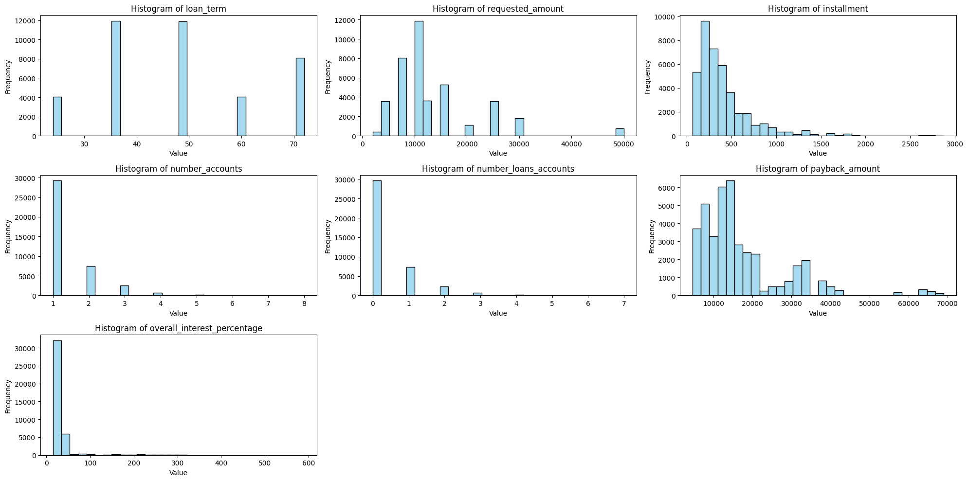
Case | Data Prep | Loan | Customer | Finance | Delinquency | Heatmap | Eval | Training | Conclusion
Loan Data Analysis: Histograms of Numerical Features
Distribution Analysis: The distributions of `requested_amount`, `installment`, and `payback_amount` are skewed. Skewness indicates an asymmetrical distribution of data values.
The histograms reveal that all numerical features, except for `installment`, `payback_amount`, and `overall_interest_percentage`, look alike categorical data due to their limited discrete values. These will be analyzed as categorical variables.

Slide 7
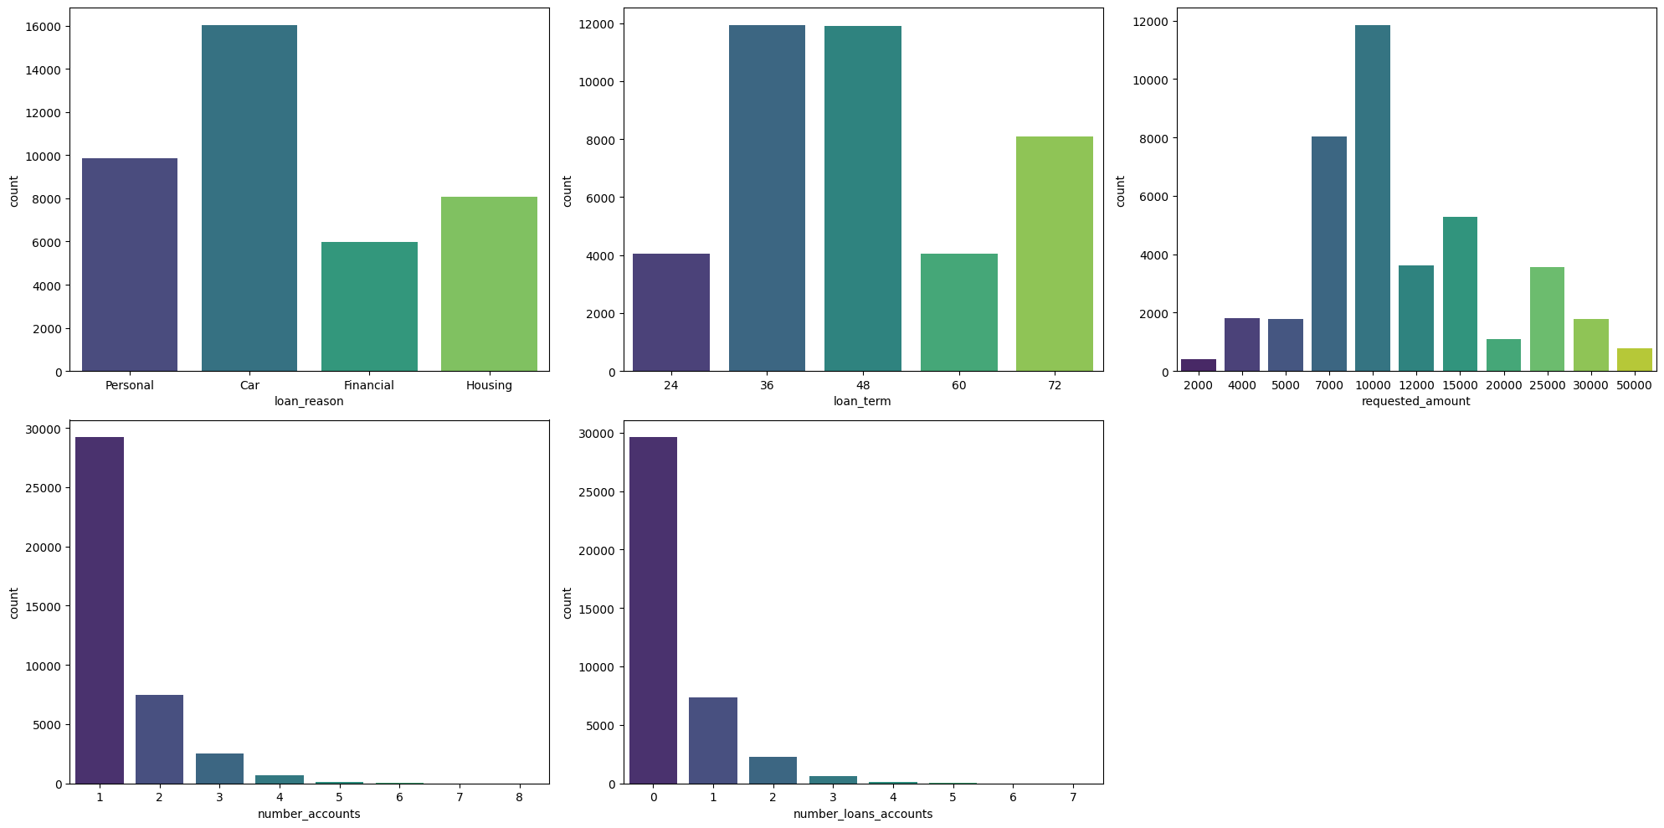
Case | Data Prep | Loan | Customer | Finance | Delinquency | Heatmap | Eval | Training | Conclusion
Loan Data Analysis: Categorical Feature Bar Plots
Categorical Transformation: Converted specific numerical features (e.g., `number_accounts`, `number_loans_accounts`) into categorical data to better represent customer behavior. Grouped rare categories within these features simplify the feature space.

Slide 8
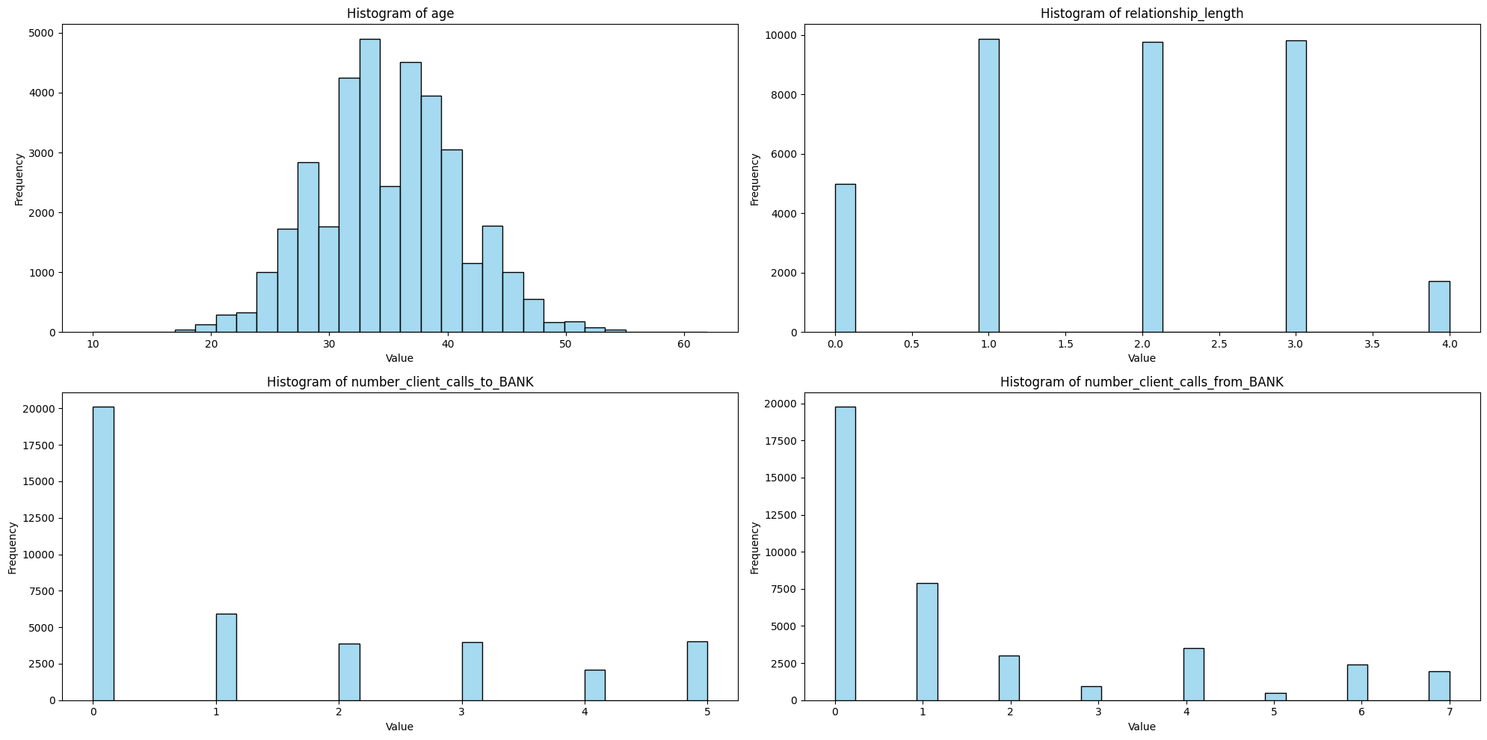
Case | Data Prep | Loan | Customer | Finance | Delinquency | Heatmap | Eval | Training | Conclusion
Customer Data Examination
Demographics: Calculated the age of customers and the length of their relationship with the Bank at the time of loan issuance.
The histogram analysis indicates that features like `number_client_calls_to_BANK` and `number_client_calls_from_BANK` exhibit categorical characteristics due to their limited discrete values. These will also be treated as categorical variables. Ages outside the range of 19 to 51 years are considered outliers based on IQR analysis.

Slide 9
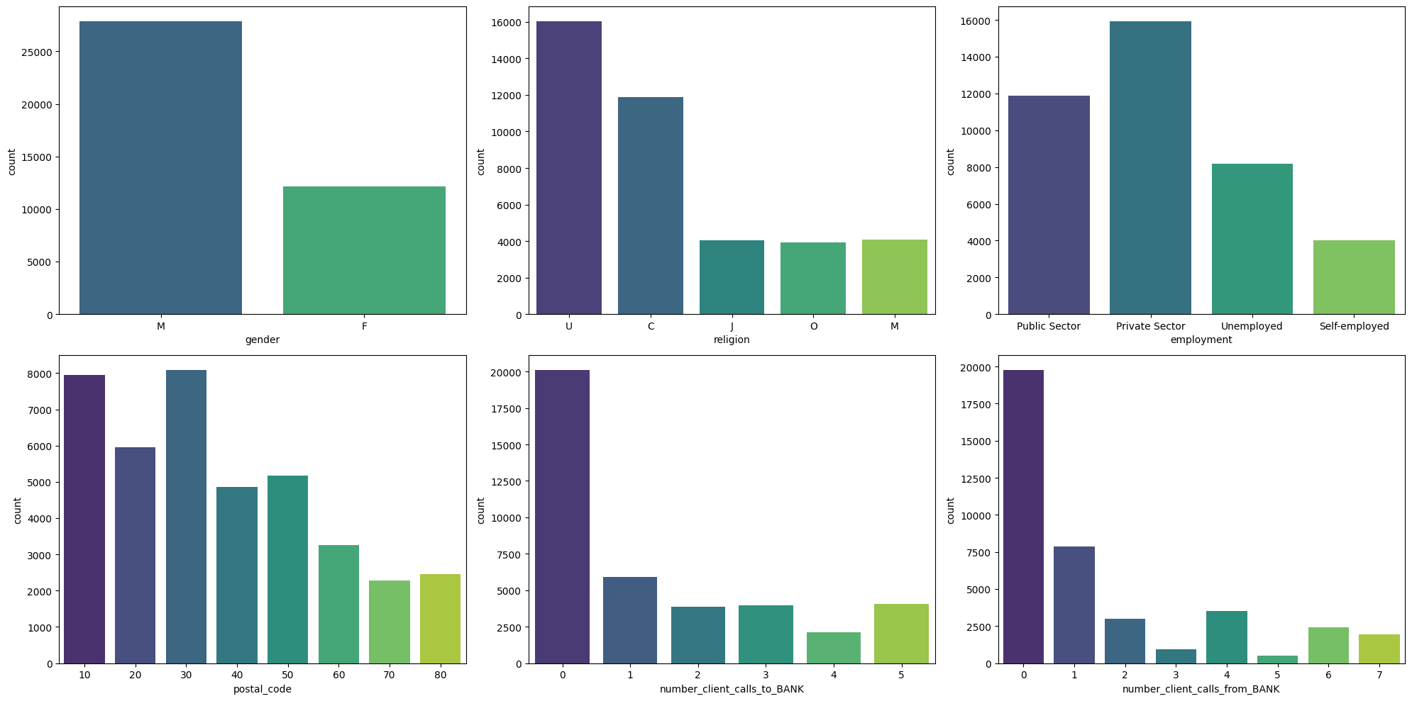
Case | Data Prep | Loan | Customer | Finance | Delinquency | Heatmap | Eval | Training | Conclusion
Customer Data Analysis: Categorical Feature Bar Plots
From IQR outlier analysis, values greater than 5 in ‘number_client_calls_from_BANK’ are outliers. The differentiation between the counts of 5, 6, and 7 calls is deemed insignificant for the analysis. Therefore, these values will be consolidated into a single categorical feature.

Slide 10
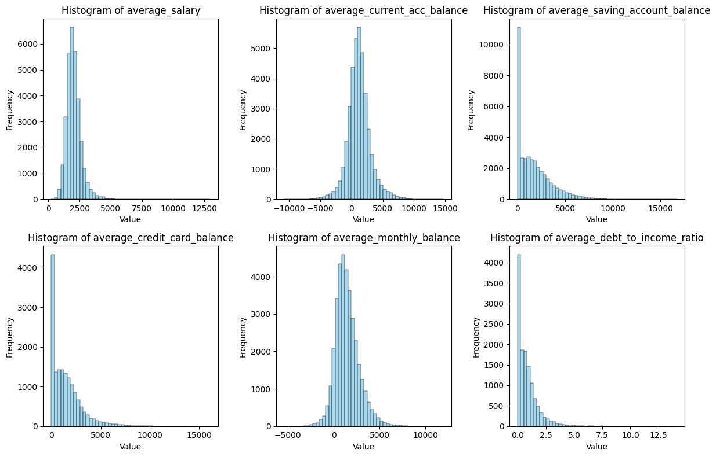
Case | Data Prep | Loan | Customer | Finance | Delinquency | Heatmap | Eval | Training | Conclusion
Financial Data Analysis: Histograms of Numerical Features
Data Leakage Prevention: Ensured that financial data utilized was from before the loan disbursement date.
Feature Engineering: Calculated average balances and debt-to-income ratios.
The distributions of `average_saving_account_balance`, `average_credit_card_balance`, and `average_debt_to_income_ratio` are highly skewed.
Outliers from all numerical features were dropped as they constituted a minor proportion (11.7%) of the dataset.

Slide 11
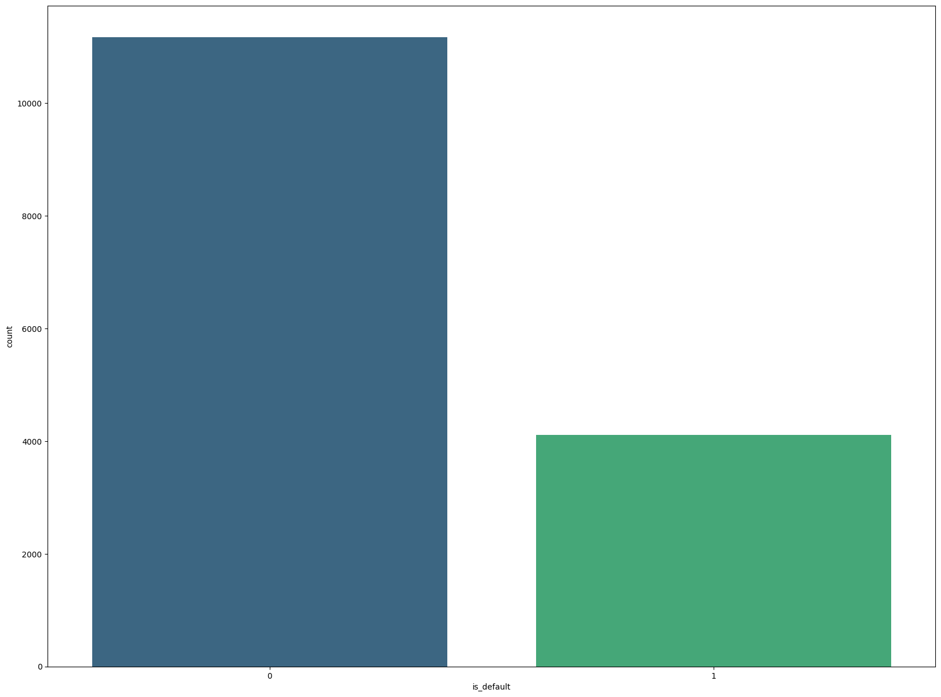
Case | Data Prep | Loan | Customer | Finance | Delinquency | Heatmap | Eval | Training | Conclusion
Delinquency Data Analysis
Delinquency Calculation: Calculated the number of months a loan payment was overdue.
Default Classification: Defined a loan as defaulted if delinquency exceeded 3 months.
11

Slide 12
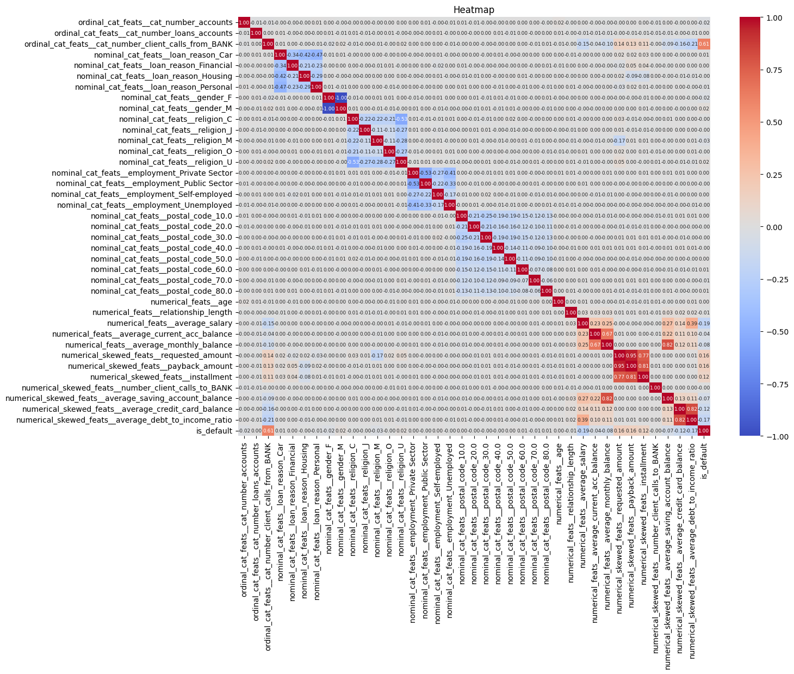
Case | Data Prep | Loan | Customer | Finance | Delinquency | Heatmap | Eval | Training | Conclusion
Heatmap Correlation Analysis
The feature `cat_number_client_calls_from_BANK` exhibits a strong positive correlation of 0.61 with the target variable, indicating a significant relationship.
Correlation values between 0.16 and 0.20 suggest a weak positive linear relationship with the target variable.
Most features demonstrate a weak relationship with the target variable, as indicated by correlation coefficients closer to 0 than to +1 or -1.
A correlation of 0.16 is considered low in terms of strength. While it indicates a positive relationship, the influence on the target variable is likely minimal. When training the baseline model using Logistic Regression, use the highly correlated feature: `cat_number_client_calls_from_BANK`. In the case of the XGBoost model, utilized 4 features with the highest correlation to enhance its predictive capabilities.
Notes:
A positive correlation implies that an increase in the feature may slightly increase the target variable.

Slide 13
Case | Data Prep | Loan | Customer | Finance | Delinquency | Heatmap | Eval | Training | Conclusion
Model Evaluation
Metrics: Presented a confusion matrix, precision-recall curve, and other relevant metrics to assess the model's performance.
Thanks to our assumptions, a positive case (false negative) results in the loss to the Bank than incorrectly diagnosing a default loan (false positive). false negatives are most crucial ones to detect for the case. Where our model states there is no default, but actually there is a default. According to my assumptions, this will cause a lot of loss to the bank. So, recall for default category in target is more important than precision and my main evaluation metric.
Under our assumptions, a false negative—where the model fails to identify a default—incurs a greater loss for the Bank than a false positive, where a non-defaulting loan is incorrectly flagged as a default. Therefore, detecting false negatives is critical for the Bank. Our focus is on maximizing recall for the default category, as it is more crucial than precision in this context.
It should be noted that if a customer is predicted to default but does not, it could potentially result in a loss for the bank. However, this scenario is not considered a direct loss for the Bank in our current framework. If it were, we would prioritize the AUC of the precision-recall curve as our main evaluation metric and also watch out for F-1 score.
13

Slide 14
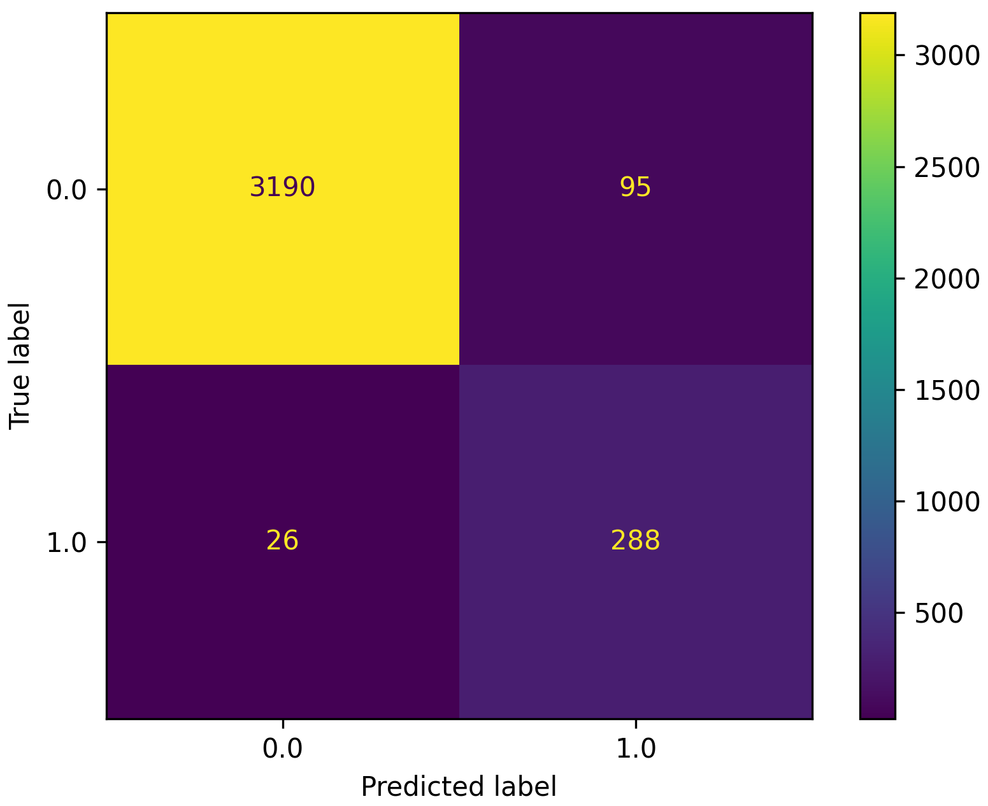
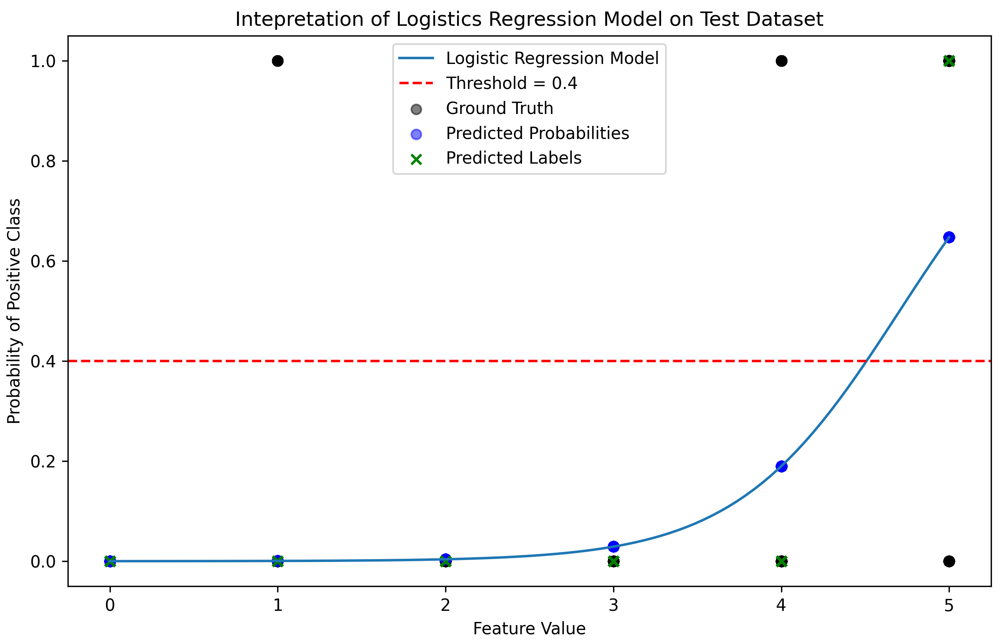
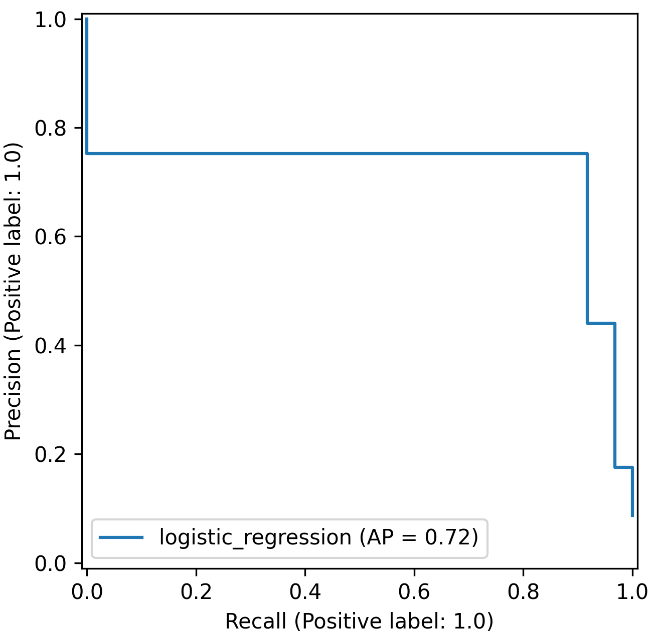
Case | Data Prep | Loan | Customer | Finance | Delinquency | Heatmap | Eval | Training | Conclusion
Model Training: Logistic Regression (Baseline)
90%-10% for train-test split. All features were considered, and Recursive Feature Elimination (RFE) was employed to identify the most significant feature: ‘cat_number_client_calls_from_BANK’. The results from the heatmap correlation analysis are in agreement with the RFE findings.
Evaluation metrics: Recall: 0.917, Precision: 0.752, AUC-PR: 0.718.

Slide 15
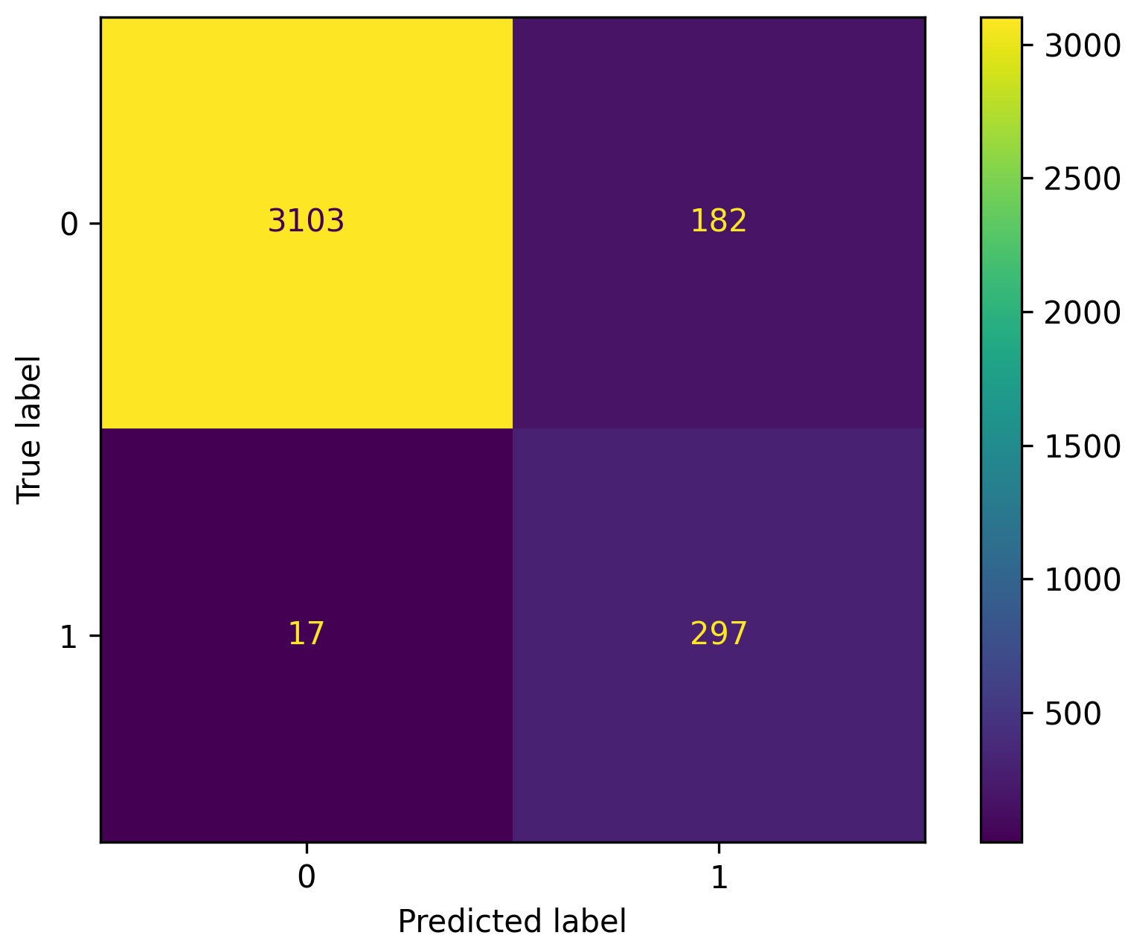
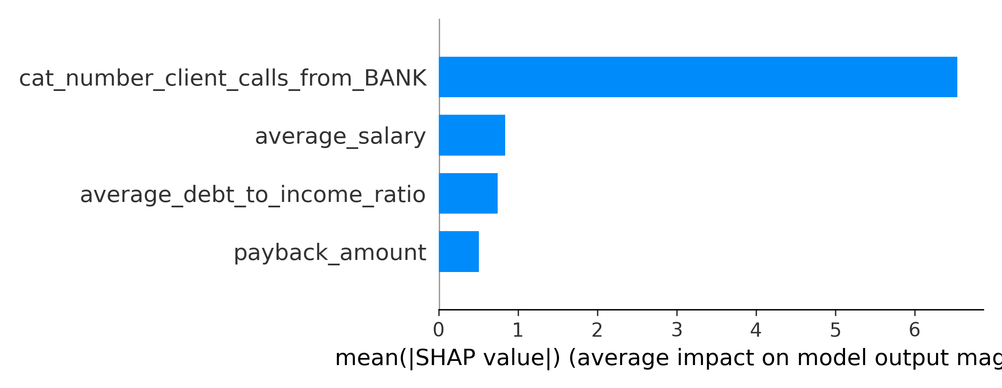
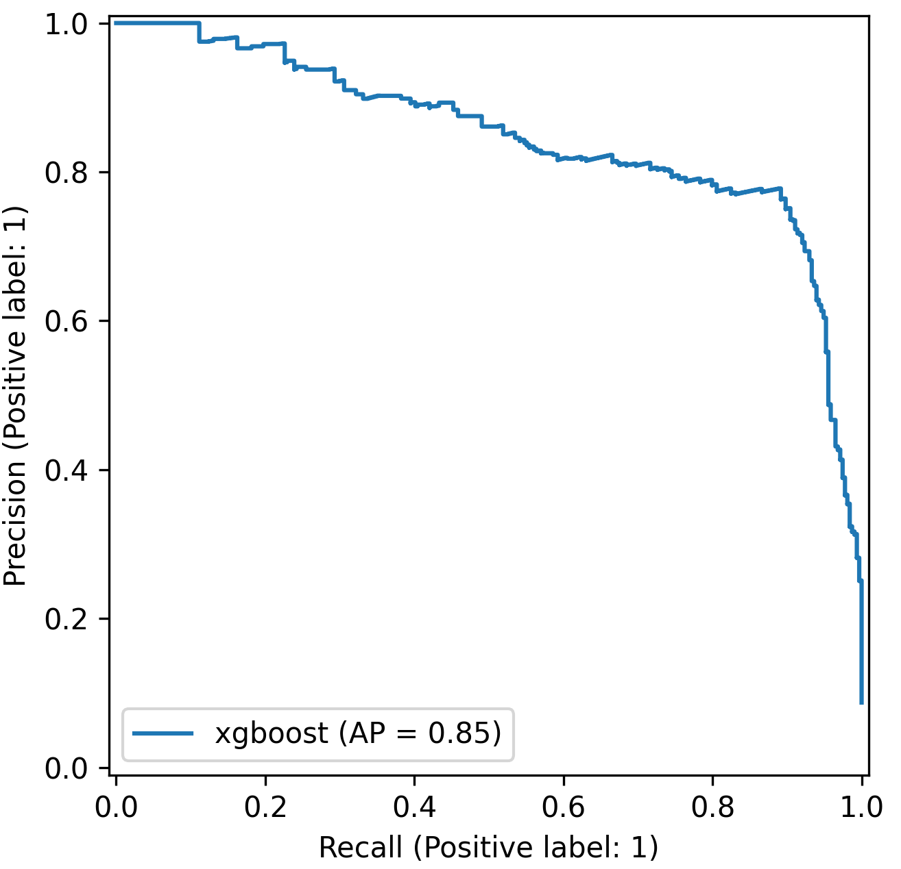
Case | Data Prep | Loan | Customer | Finance | Delinquency | Heatmap | Eval | Training | Conclusion
Model Training: XGBoost I
90%-10% for train-test split and selected the top 4 features with the highest correlation for training. The model was trained without Hyperparameter Optimization, using the following settings: objective as binary:logistic, eval_metric as aucpr, random_state set to 12345, n_estimators at 100, and all other parameters at XGBoost defaults.
Evaluation metrics: Recall: 0.946, Precision: 0.62, AUC-PR: 0.848.
15
Notes:
SHAP Analysis: Conducted SHAP analysis to understand the impact of features on model predictions.

Slide 16

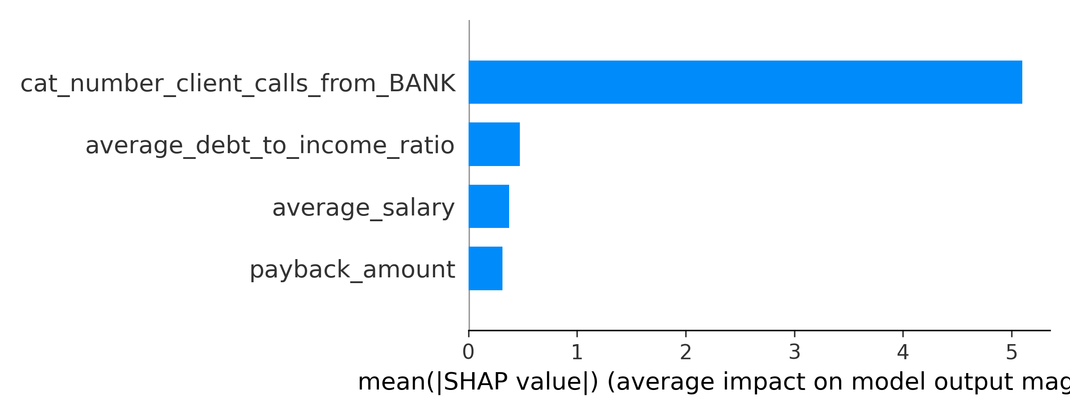
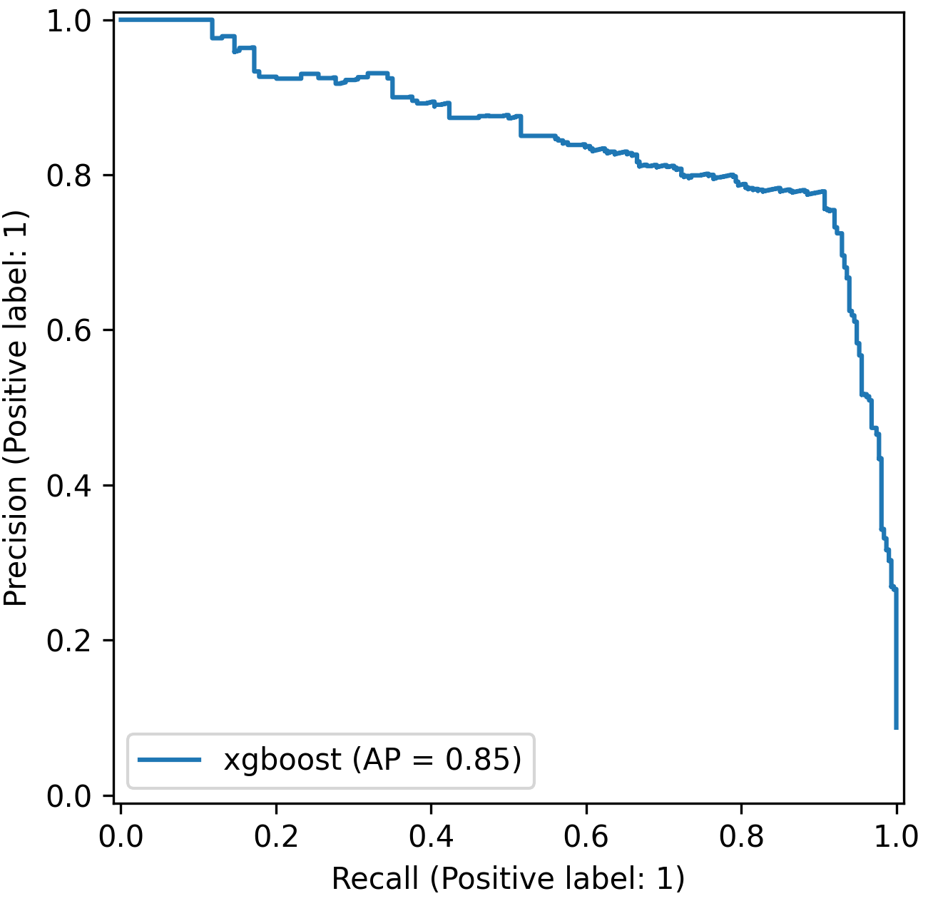
Case | Data Prep | Loan | Customer | Finance | Delinquency | Heatmap | Eval | Training | Conclusion
Model Training: XGBoost II
90%-10% for train-test split and the 4 most correlated features. Train with Hyperparameter Optimization. Constant parameters included objective as binary:logistic, eval_metric as aucpr, random_state as 12345, and num_boost_round in CV at 100. Key parameters were fine-tuned using Optuna with a 5-fold cross-validation technique.
Evaluation metrics: Recall: 0.952, Precision: 0.583, AUC-PR: 0.85.
16
Notes:
SHAP Analysis: Conducted SHAP analysis to understand the impact of features on model predictions.

Slide 17
Case | Data Prep | Loan | Customer | Finance | Delinquency | Heatmap | Eval | Training | Conclusion
Conclusion and Future Work
Model Performance: Summarized the model's proficiency in predicting loan defaults, which is instrumental in enhancing the profitability of the loan portfolio. We will select to deploy the tuned XGBoost model since it has the highest recall score.
Future Enhancements: Integrate additional data sources, such as credit scores and macroeconomic indicators. For missing categorical values that exhibit a predictable pattern, develop a classifier to impute these values based on other features. Explore the inference time comparison of models and conduct a cost-benefit analysis to fine-tune the threshold for classifying a loan as high risk.

Slide 18
Machine Learning Based Solution
Thank you!
Furkan Gül
Senior Data Scientist
frkangul@gmail.com

