Slide 1
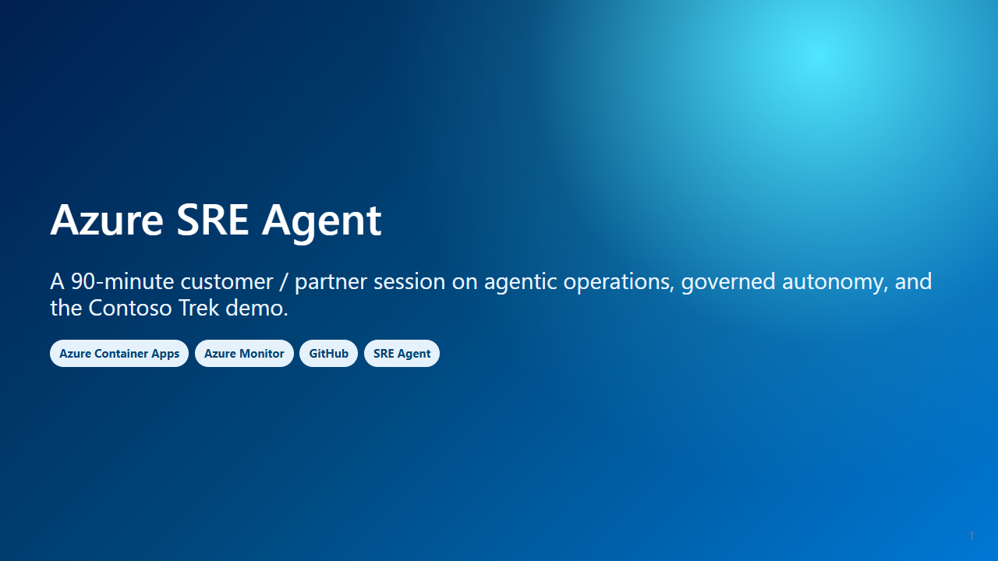
Notes:
Presenter notes: Open with outcomes: faster triage, less toil, and safer automation. Say numbers are cited or marked for verification.

Slide 2
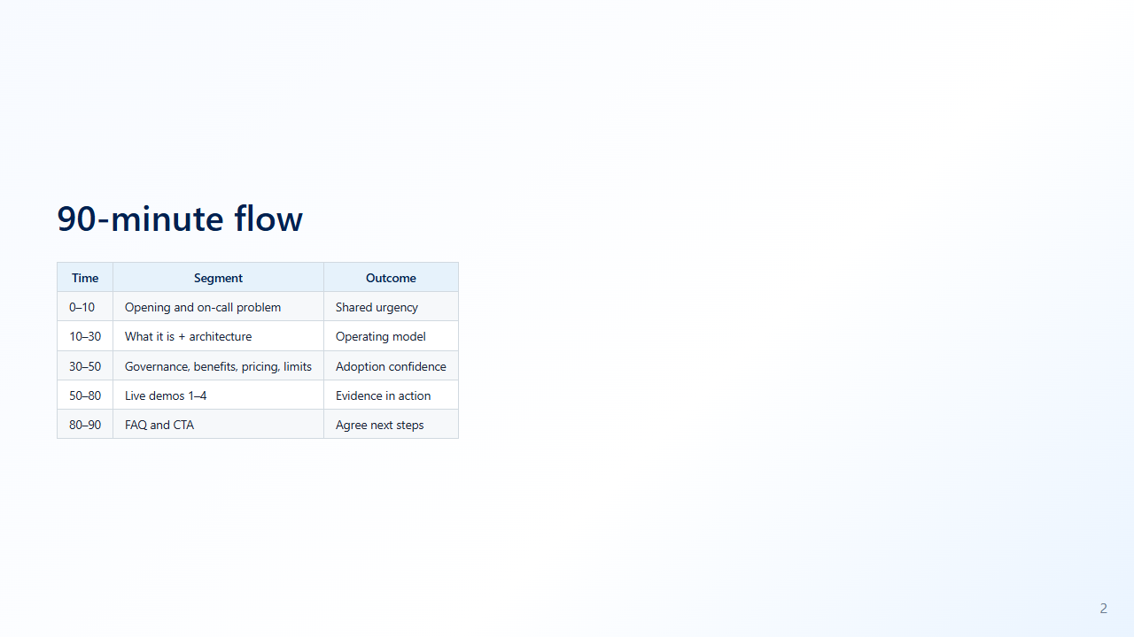
Notes:
Presenter notes: Keep the first half crisp so demos start on time.

Slide 3
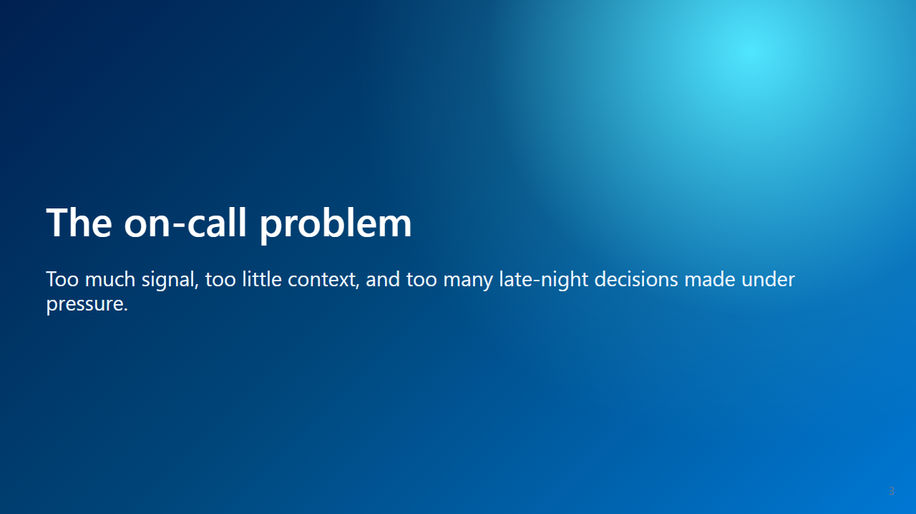
Notes:
Presenter notes: Transition from pain to need.

Slide 4
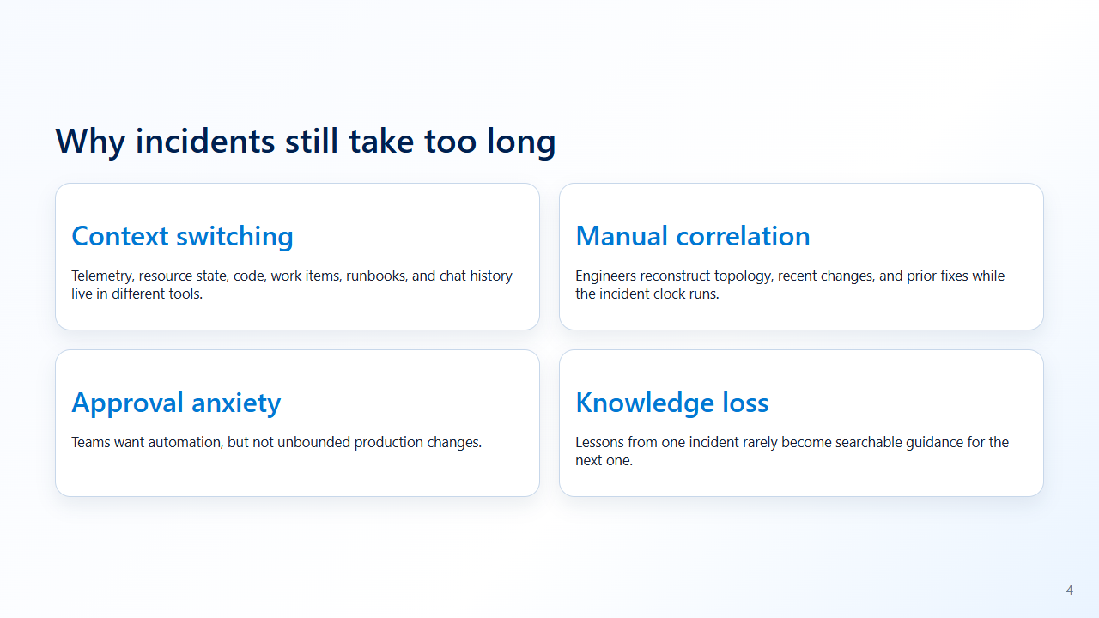
Notes:
Presenter notes: Ask which pain hurts most.

Slide 5
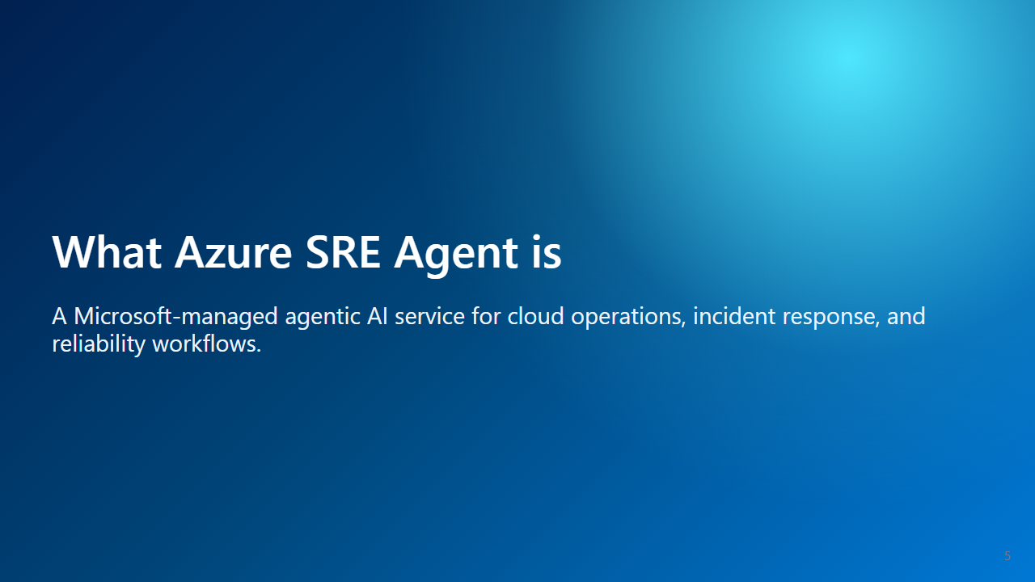
Notes:
Presenter notes: Definition slide.

Slide 6
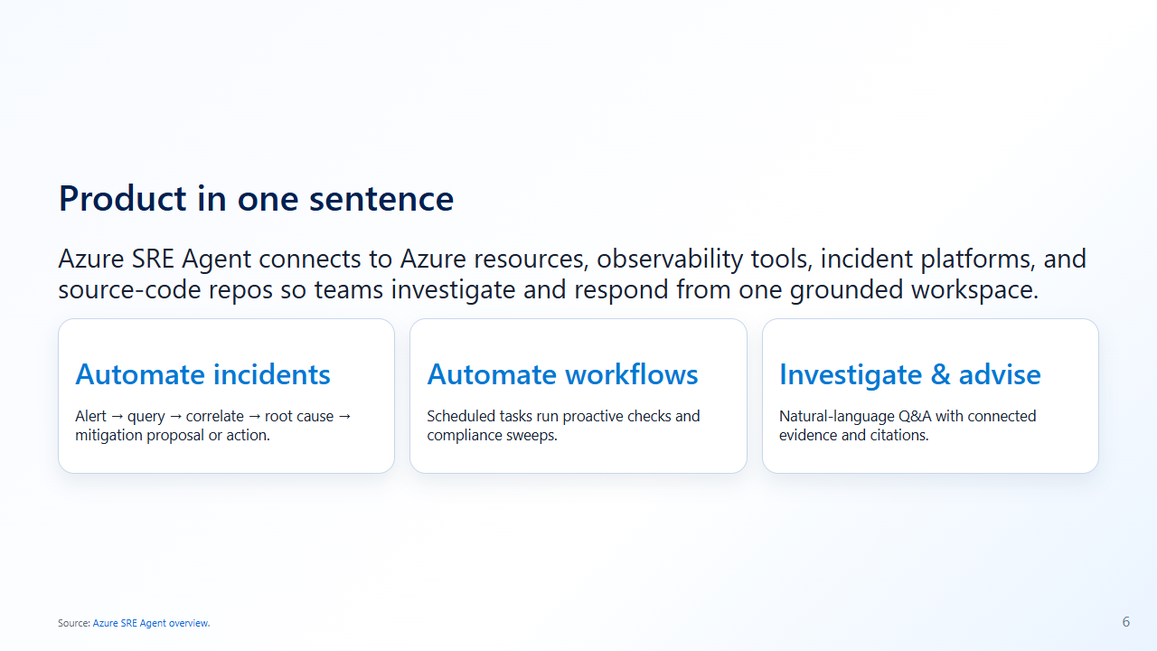
Notes:
Presenter notes: Use the three official usage patterns.

Slide 7
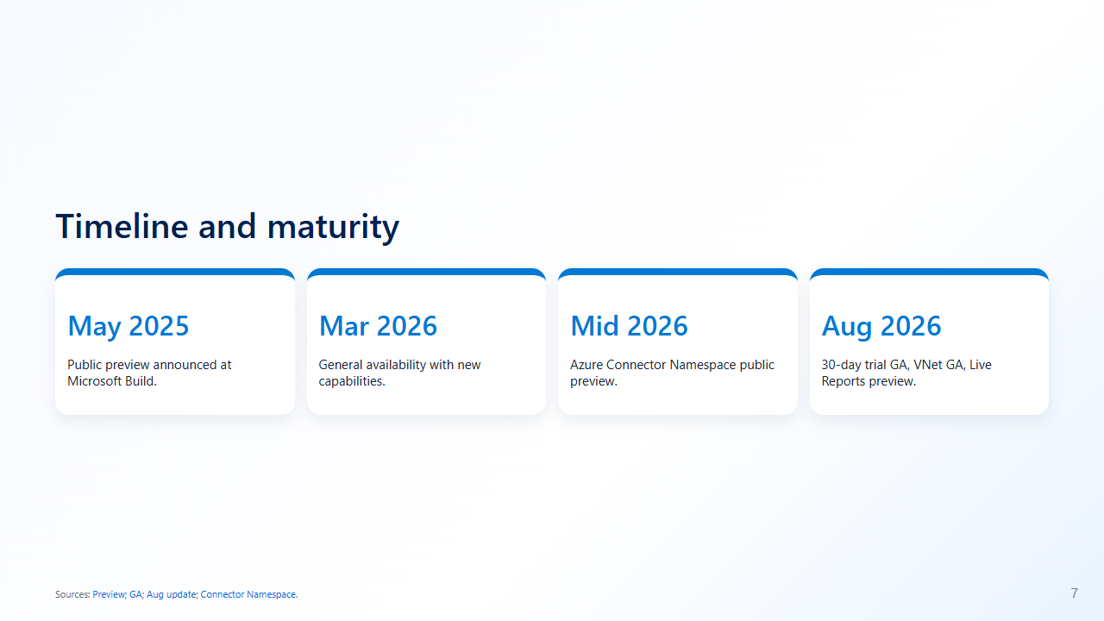
Notes:
Presenter notes: Avoid unverified Ignite date details.

Slide 8
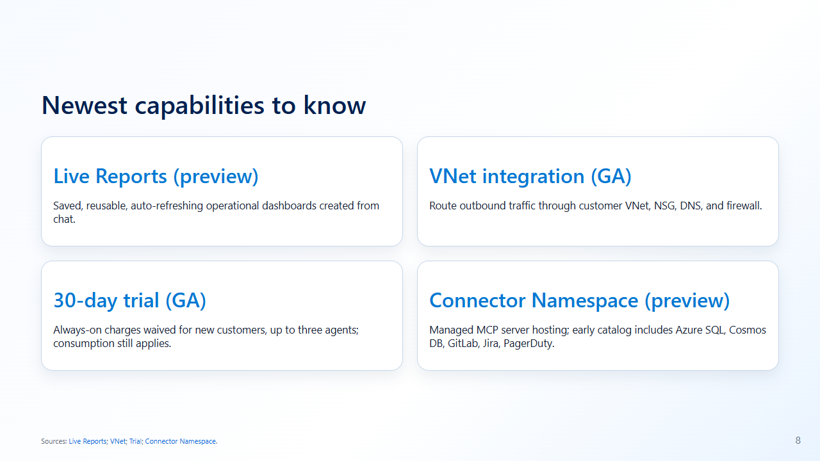
Notes:
Presenter notes: Customers may have seen older preview material.

Slide 9
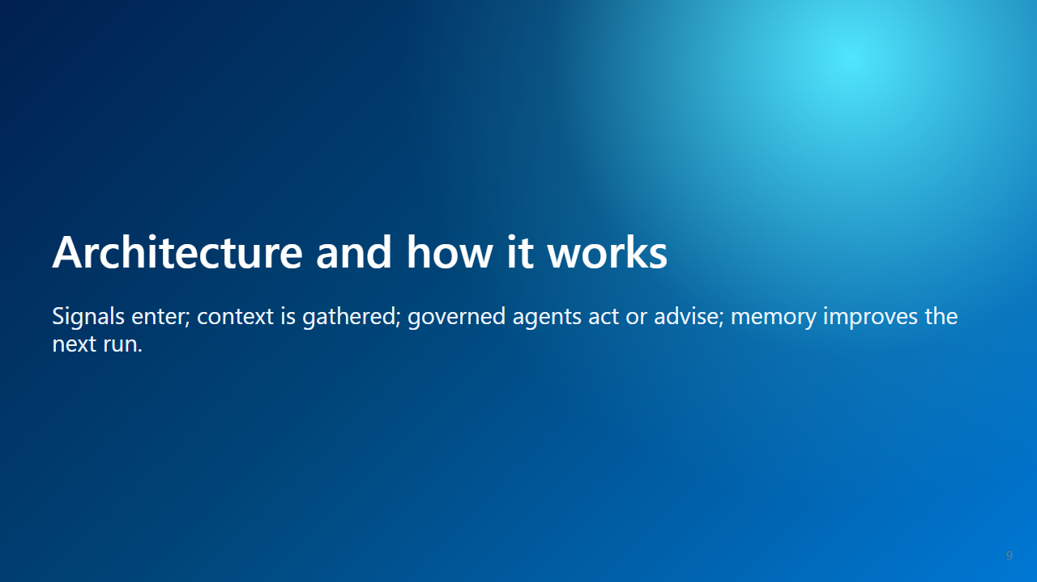
Notes:
Presenter notes: Set up the visual architecture.

Slide 10
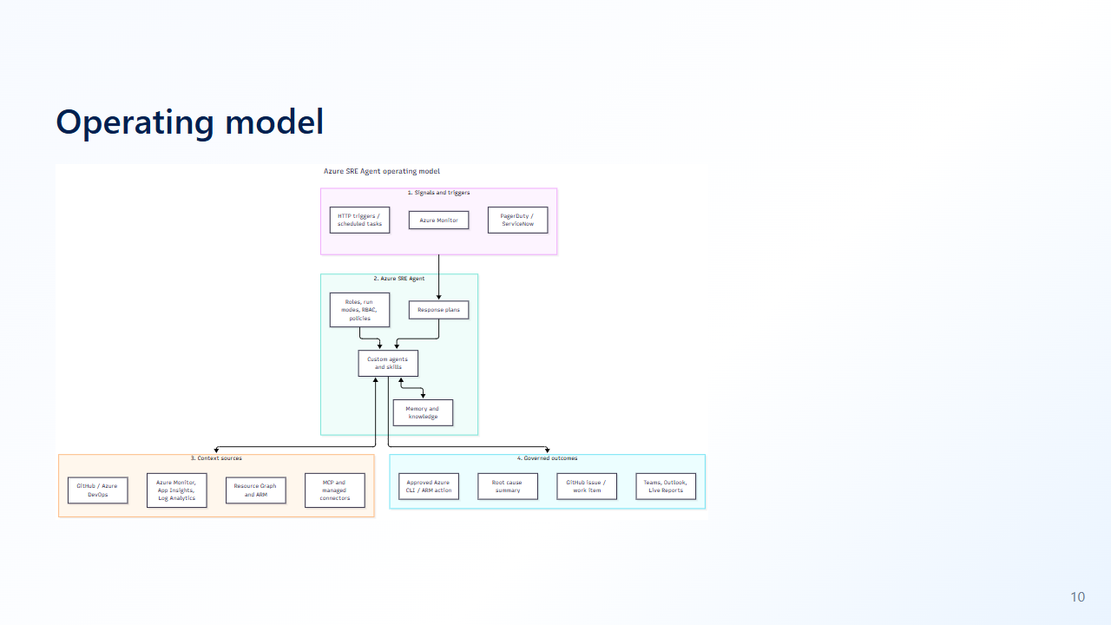
Notes:
Presenter notes: Walk left to right from signal to governed outcome.

Slide 11
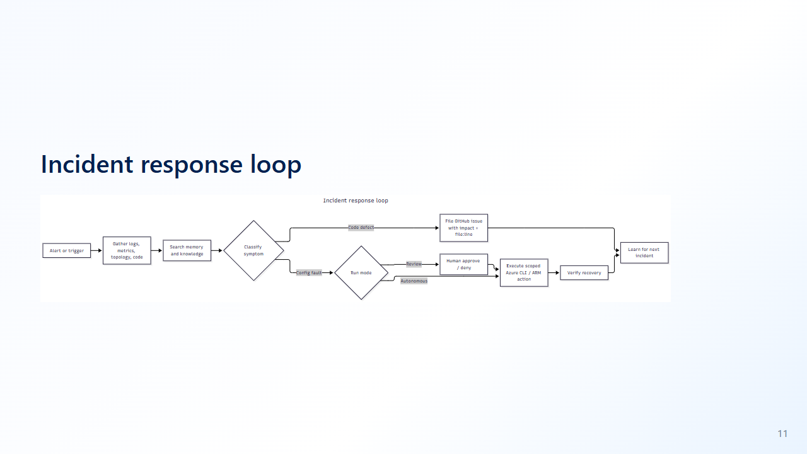
Notes:
Presenter notes: Use this to explain the two demos.

Slide 12
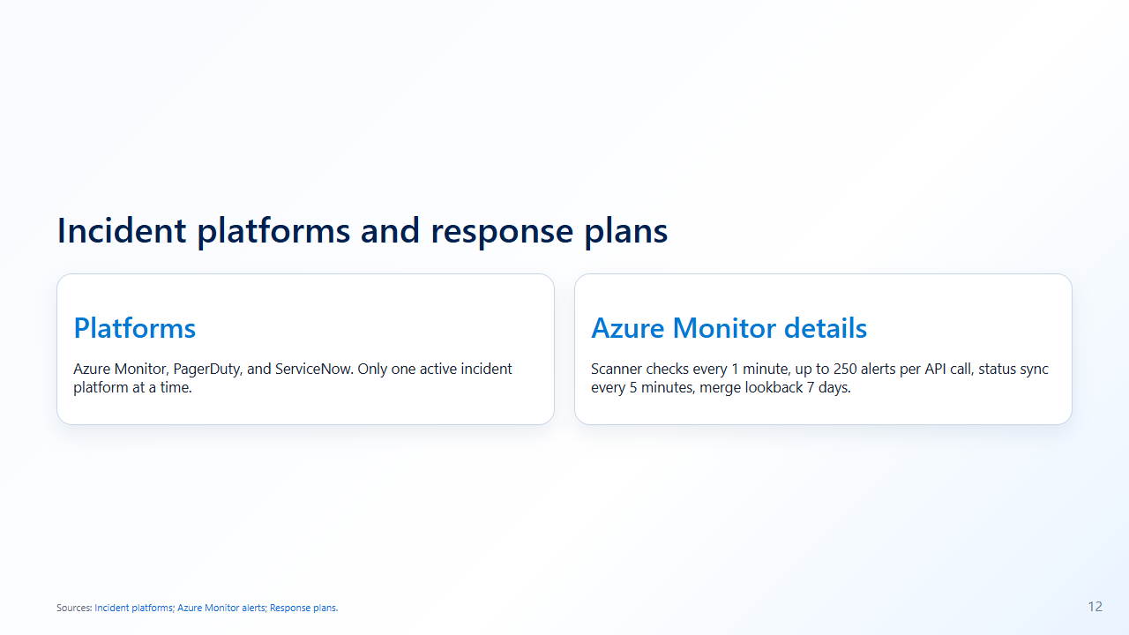
Notes:
Presenter notes: Response plans route by filters to custom agents and run modes.

Slide 13
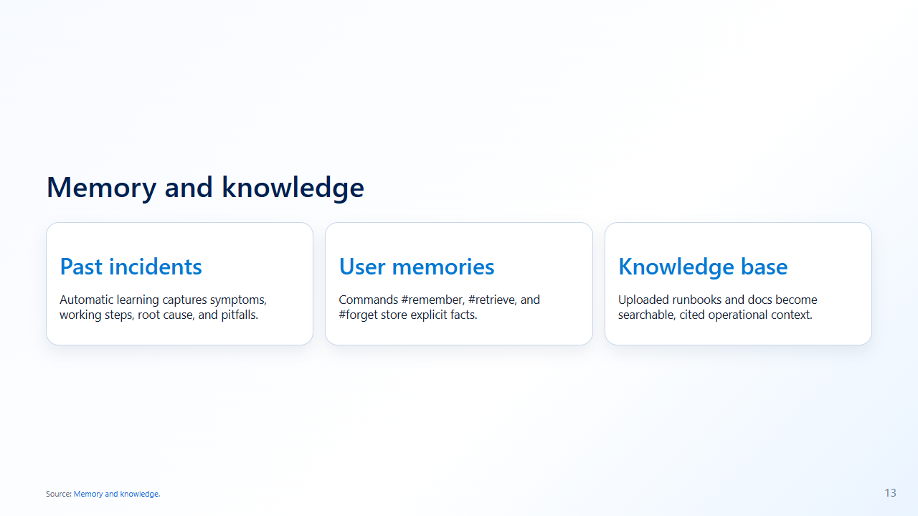
Notes:
Presenter notes: Tie this to uploaded runbooks.

Slide 14
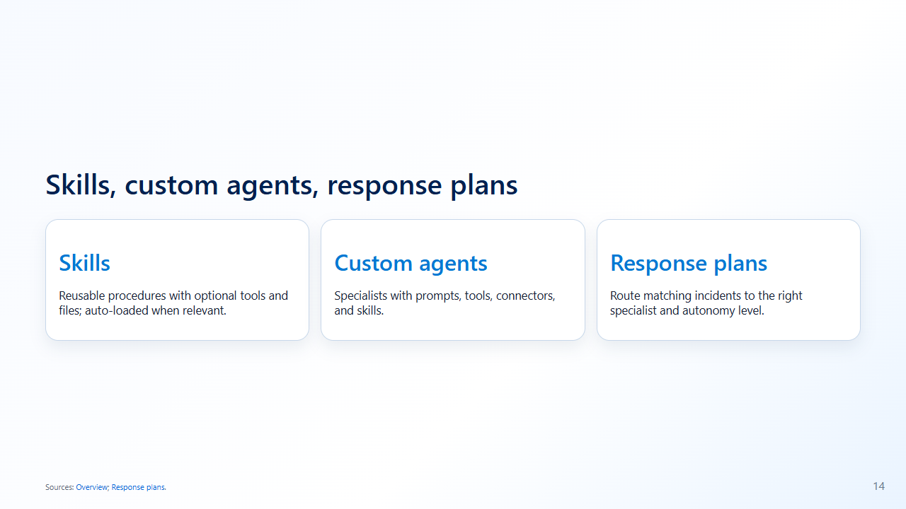
Notes:
Presenter notes: Introduce code-investigator and platform-operator.

Slide 15
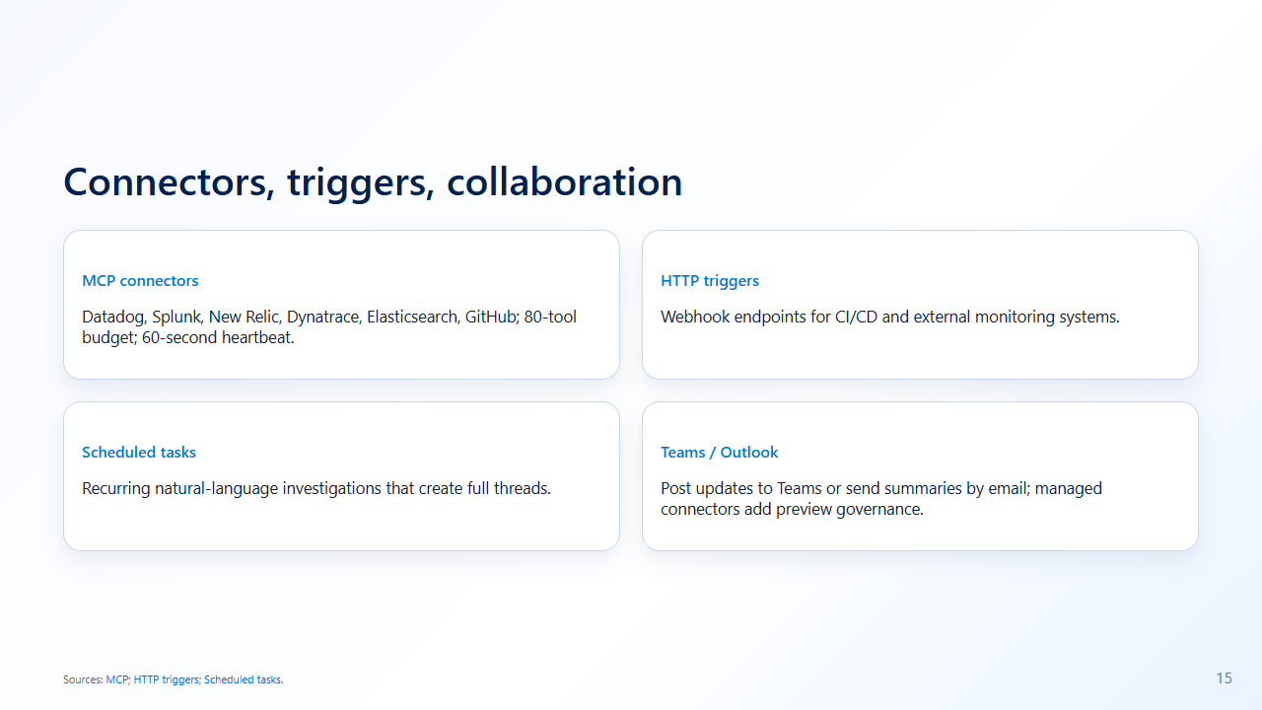
Notes:
Presenter notes: Azure is native; external systems are connector mediated.

Slide 16
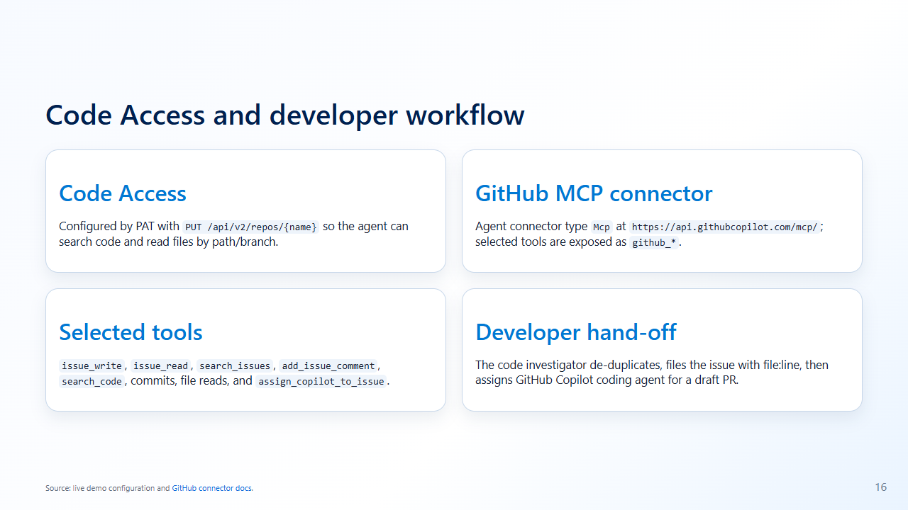
Notes:
Presenter notes: Update this from the live deployment: the demo uses Code Access plus GitHub MCP, not a generic GitHub connector-only story.

Slide 17
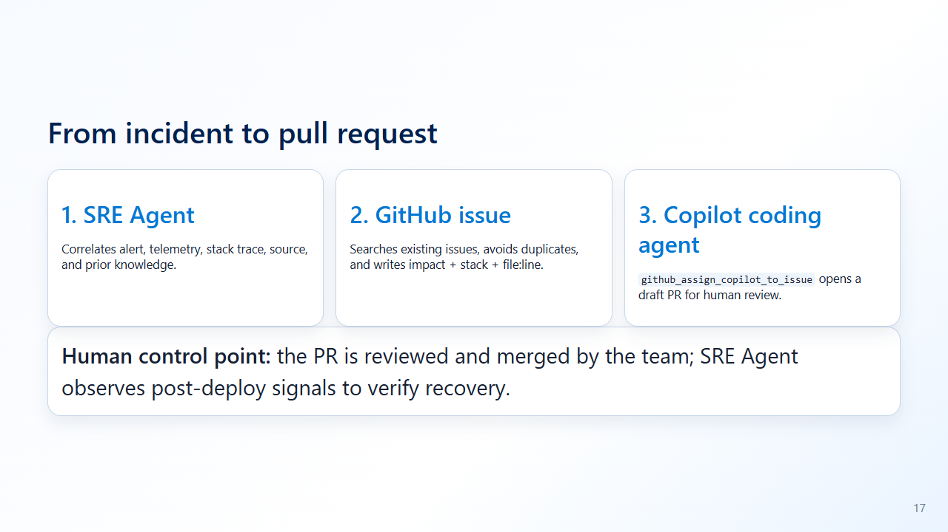
Notes:
Presenter notes: Make the hand-off concrete: incident response creates a developer-ready issue and Copilot coding agent drafts, but humans review the PR.

Slide 18
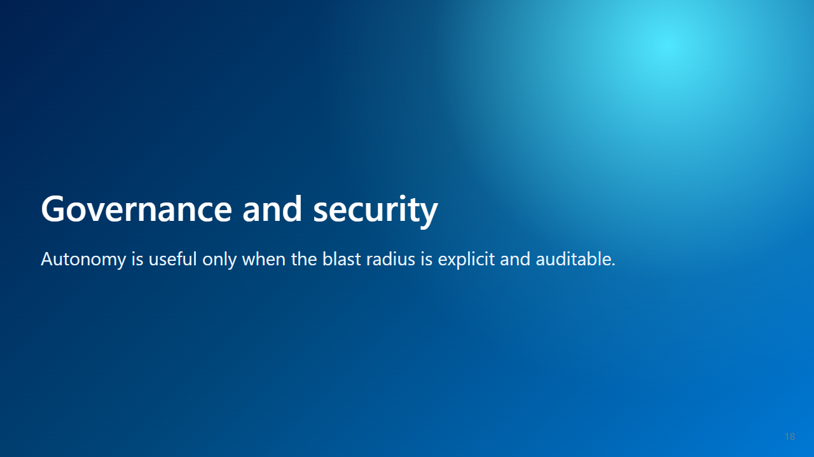
Notes:
Presenter notes: Confidence section.

Slide 19
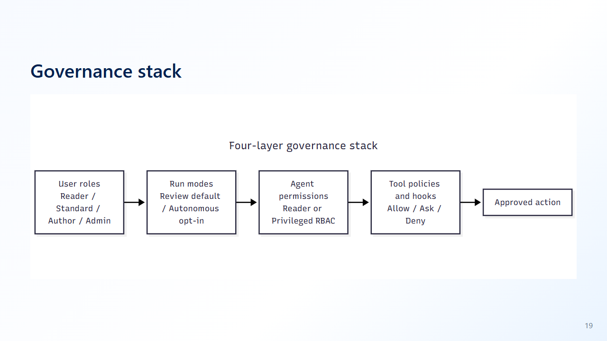
Notes:
Presenter notes: Four independent gates must align.

Slide 20
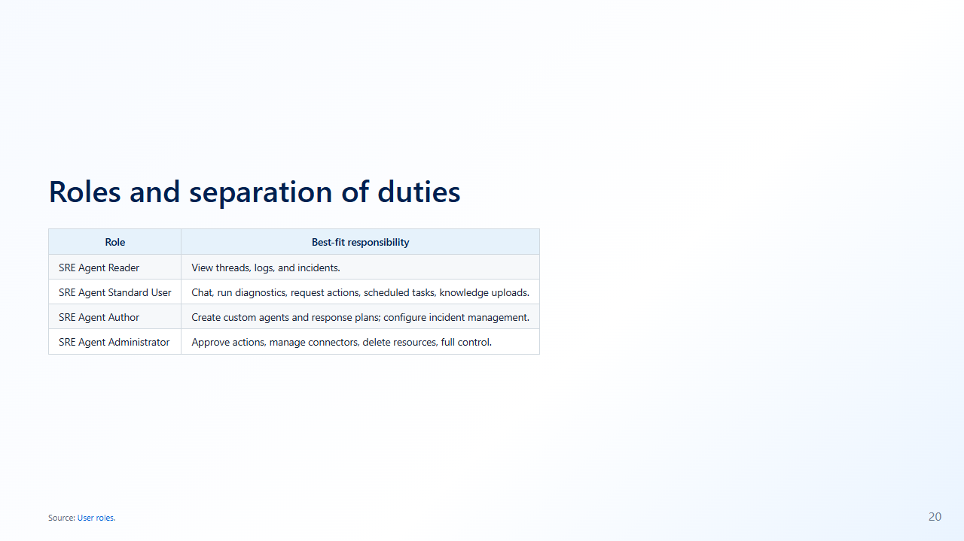
Notes:
Presenter notes: Map roles to personas.

Slide 21
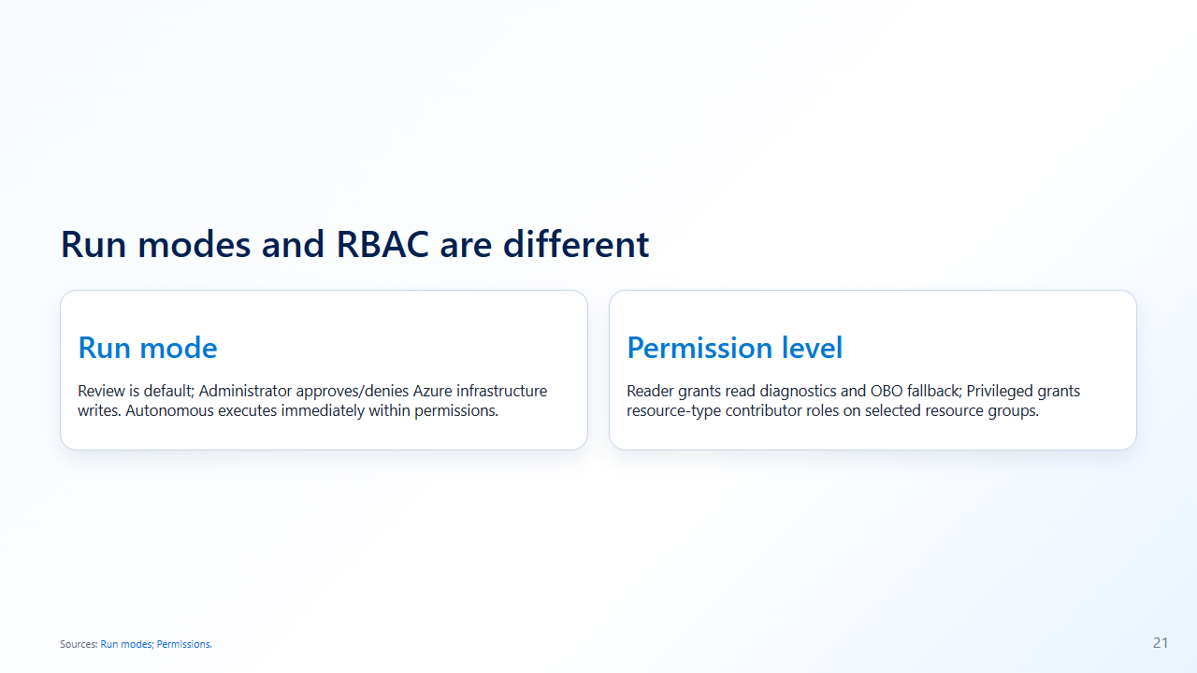
Notes:
Presenter notes: The agent needs both workflow and resource access.

Slide 22
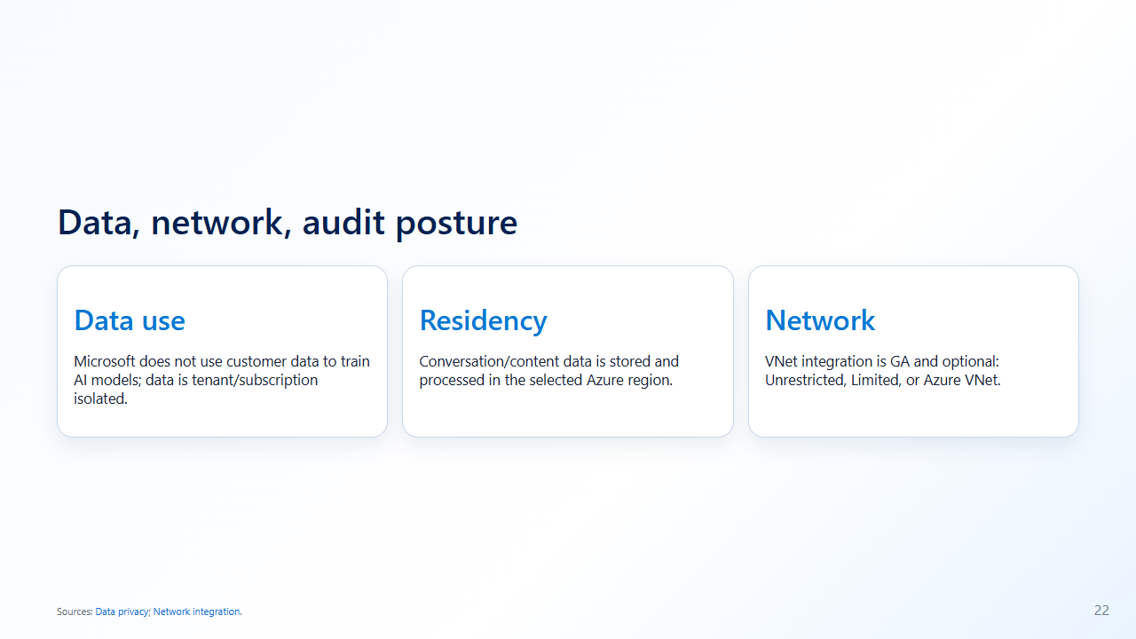
Notes:
Presenter notes: If EU comes up, explain provider choices.

Slide 23

Notes:
Presenter notes: Move to value.

Slide 24
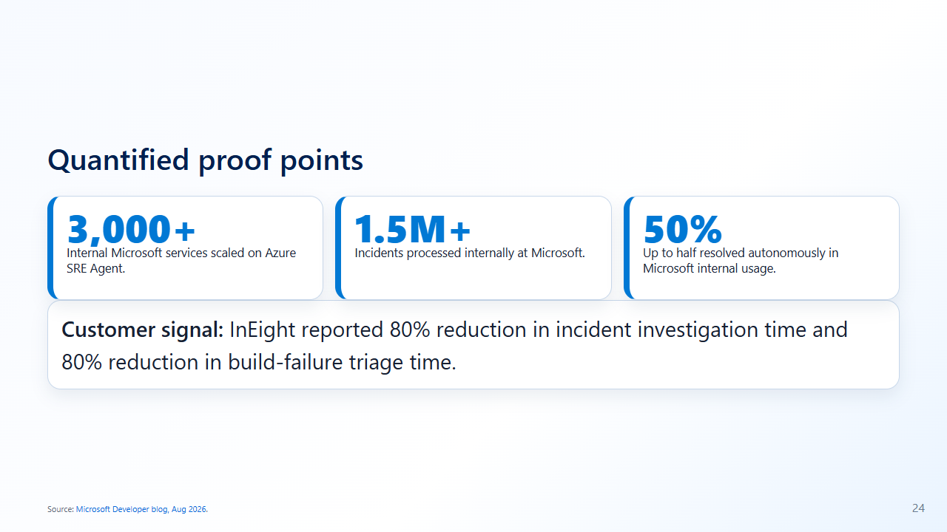
Notes:
Presenter notes: Use official stats only.

Slide 25
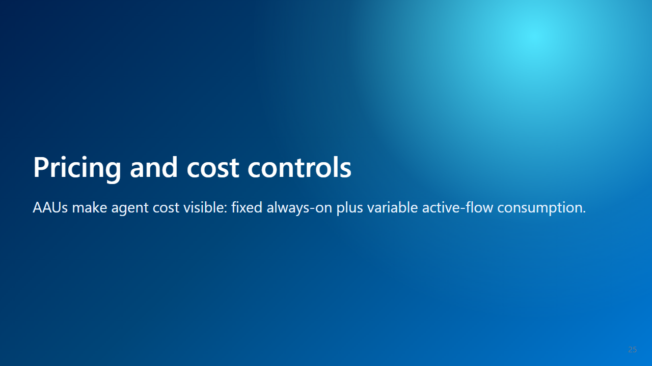
Notes:
Presenter notes: Signal that AAU unit prices are now verified and region-specific.

Slide 26
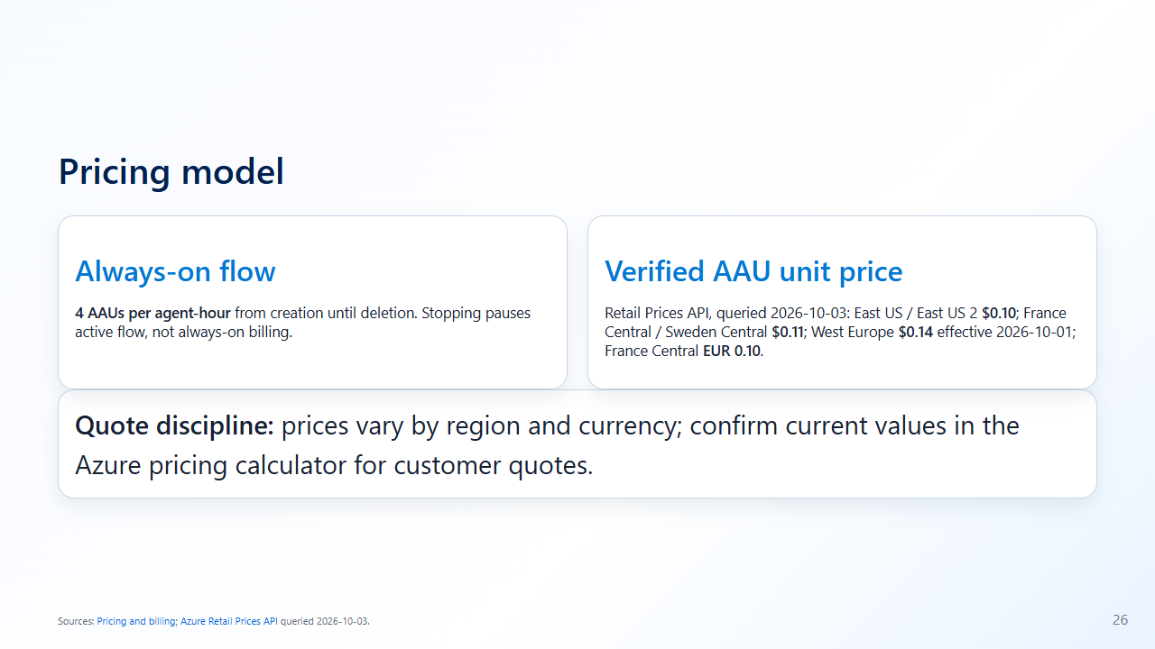
Notes:
Presenter notes: State the now-verified Retail Prices API values, but keep quote discipline because pricing can vary by region and currency.

Slide 27
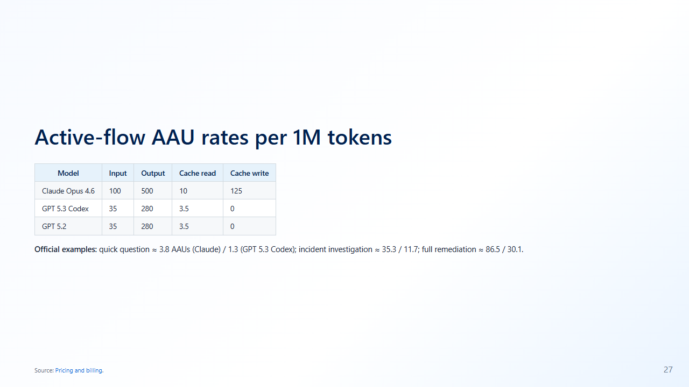
Notes:
Presenter notes: Explain cache reads are cheaper.

Slide 28
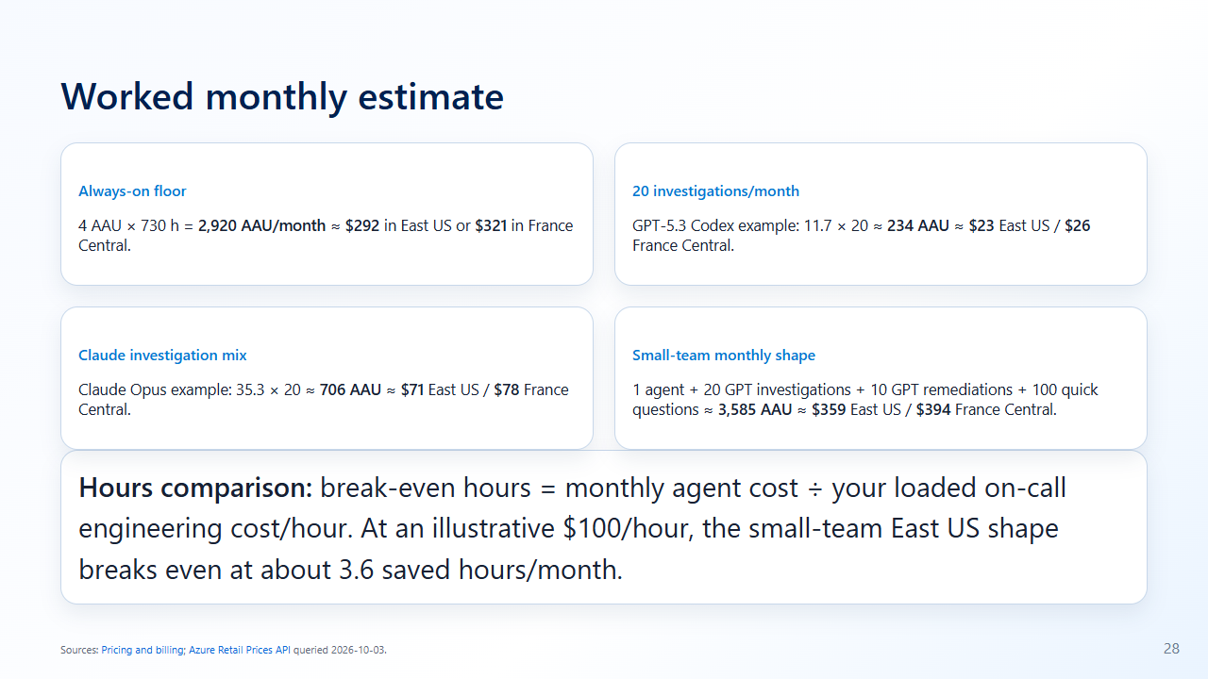
Notes:
Presenter notes: Show how AAUs translate into dollars and compare to on-call hours using the customer’s actual loaded labor rate.

Slide 29
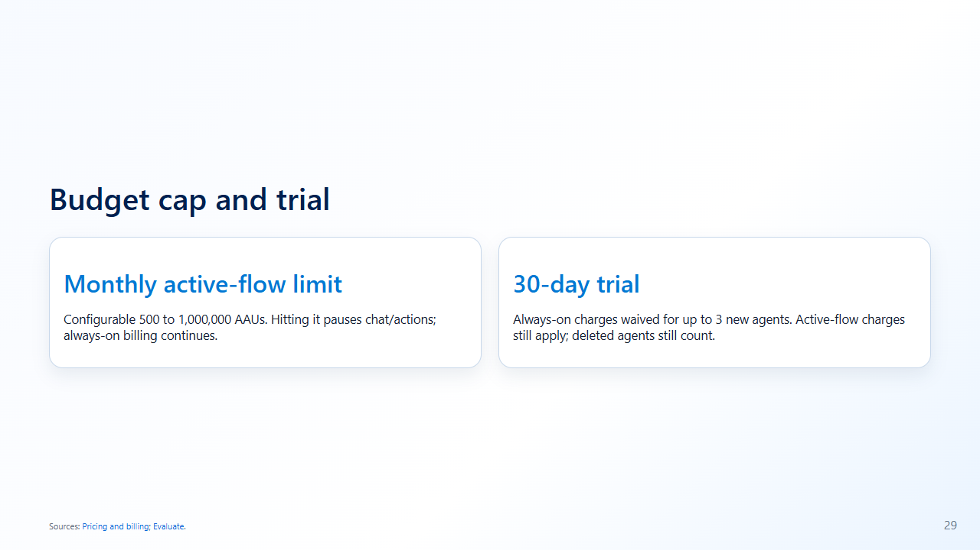
Notes:
Presenter notes: Deletion is the only full stop.

Slide 30

Notes:
Presenter notes: Limits are design inputs.

Slide 31
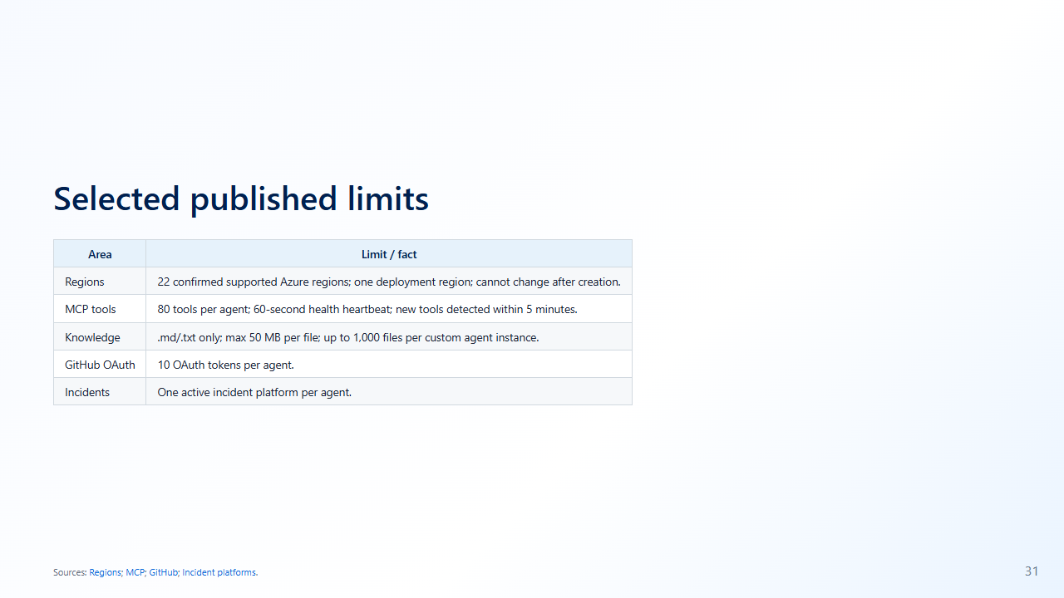
Notes:
Presenter notes: No public concurrent incident/chat cap found.

Slide 32
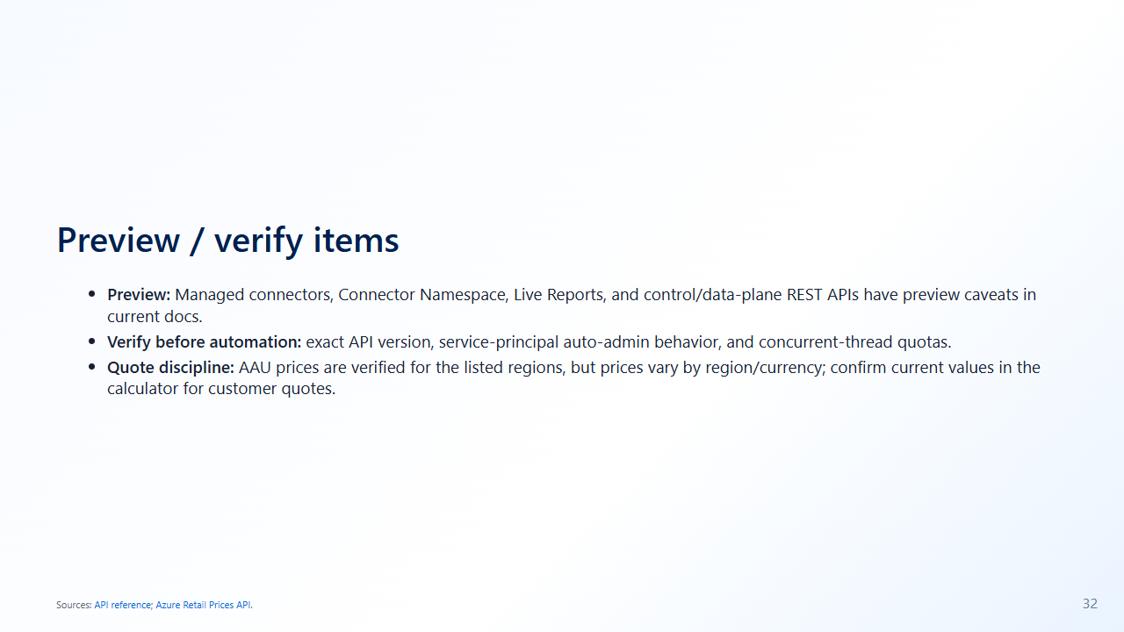
Notes:
Presenter notes: Remove the old unresolved price verification item and keep quote discipline plus remaining technical verify items.

Slide 33
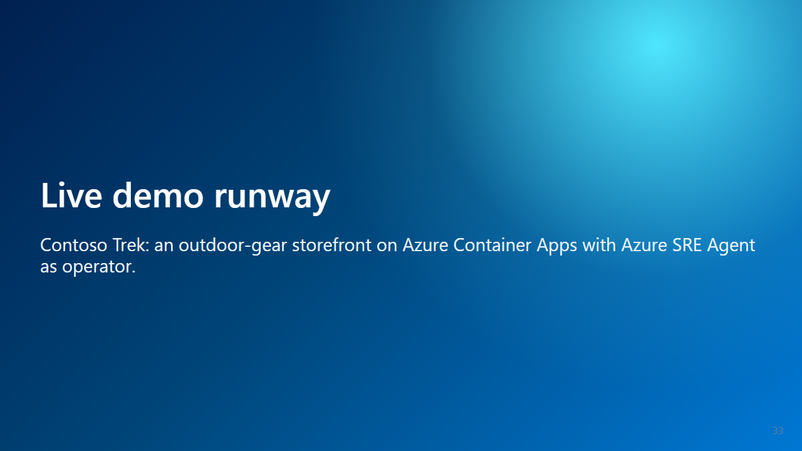
Notes:
Presenter notes: Switch to demo mode.

Slide 34
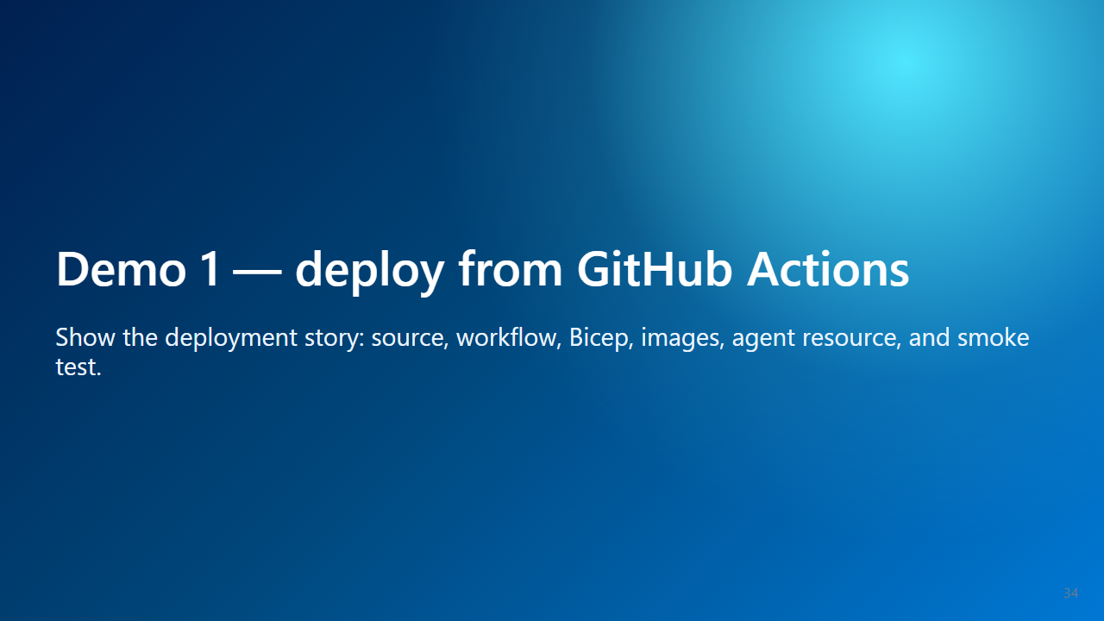
Notes:
Presenter notes: Open GitHub Actions and Azure portal.

Slide 35
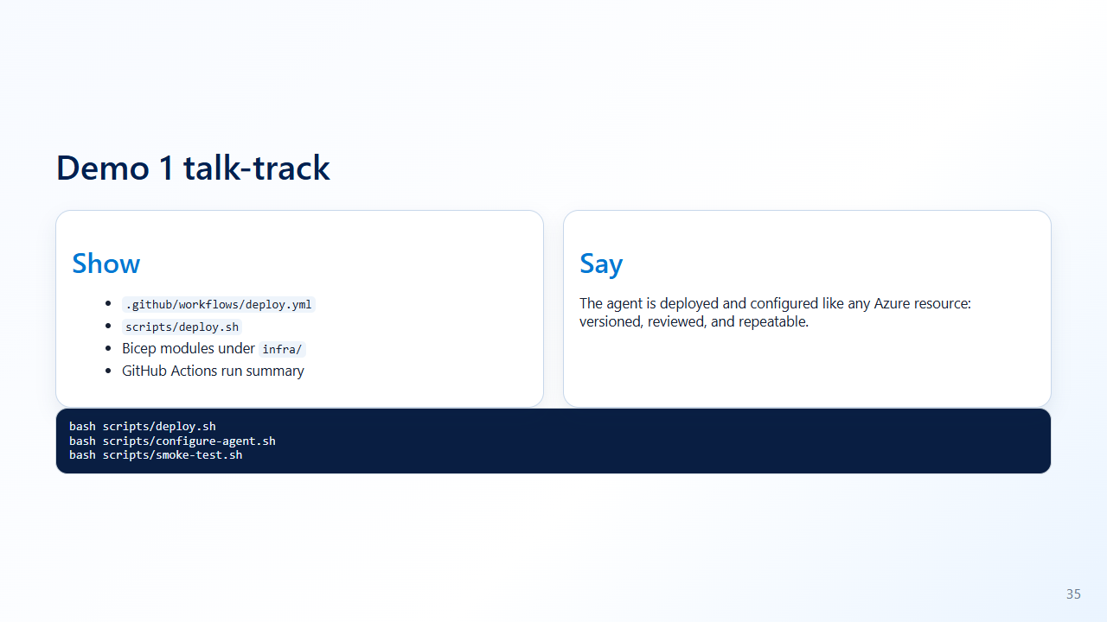
Notes:
Presenter notes: If deployed, show workflow summary instead of waiting.

Slide 36
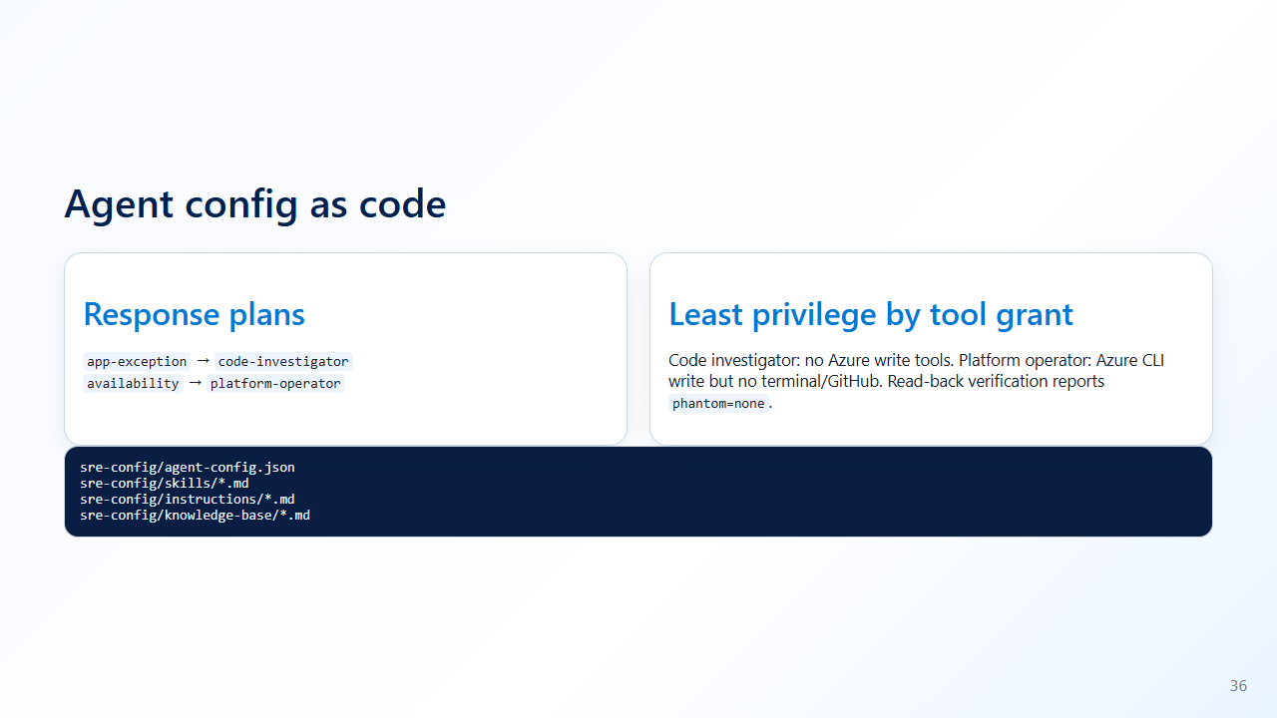
Notes:
Presenter notes: The guardrail is not just prompt text; it is verified tool grants per subagent with no phantom tools.

Slide 37

Notes:
Presenter notes: No Azure action can fix this class of problem.

Slide 38
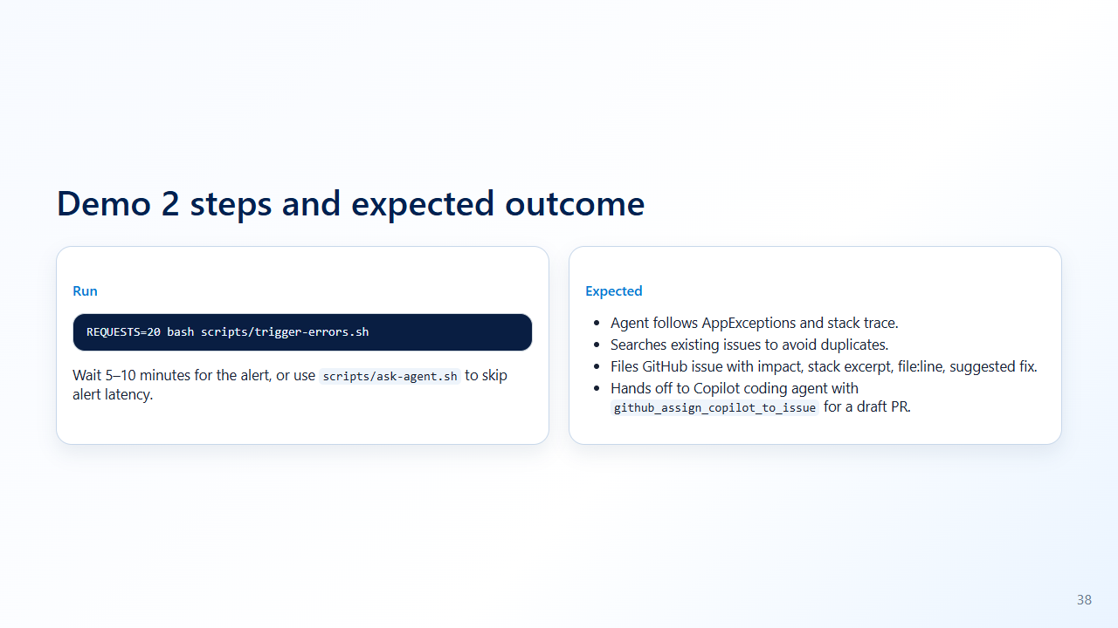
Notes:
Presenter notes: While waiting, show the GitHub MCP connector tools and explain that the PR remains human-reviewed.

Slide 39
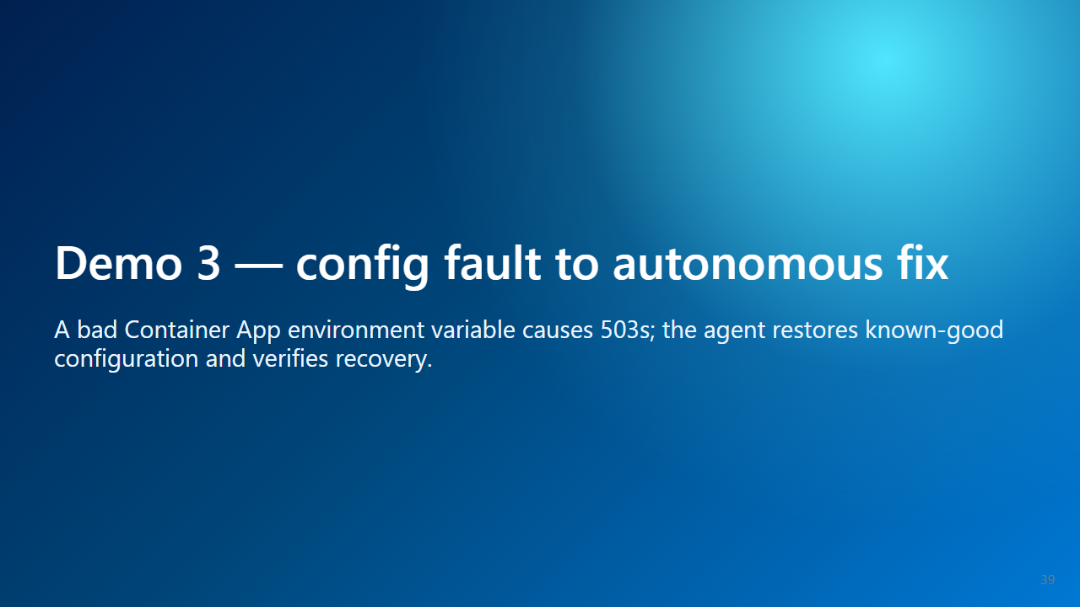
Notes:
Presenter notes: This is scoped autonomous repair.

Slide 40
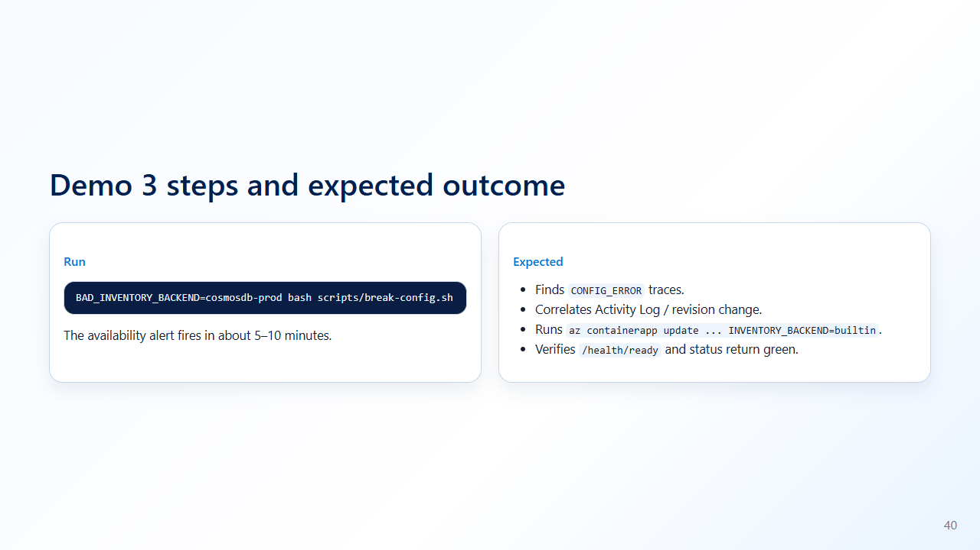
Notes:
Presenter notes: If delayed, run fix-config and narrate expected evidence.

Slide 41
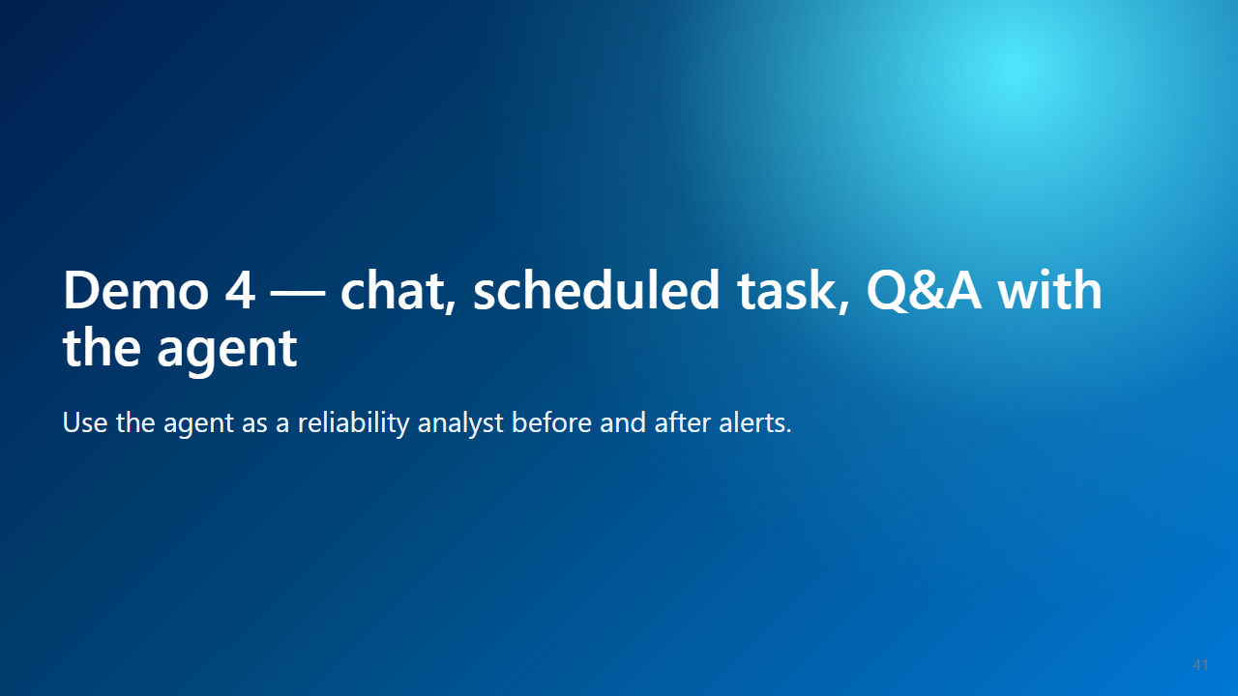
Notes:
Presenter notes: This can fill time during alert latency.

Slide 42
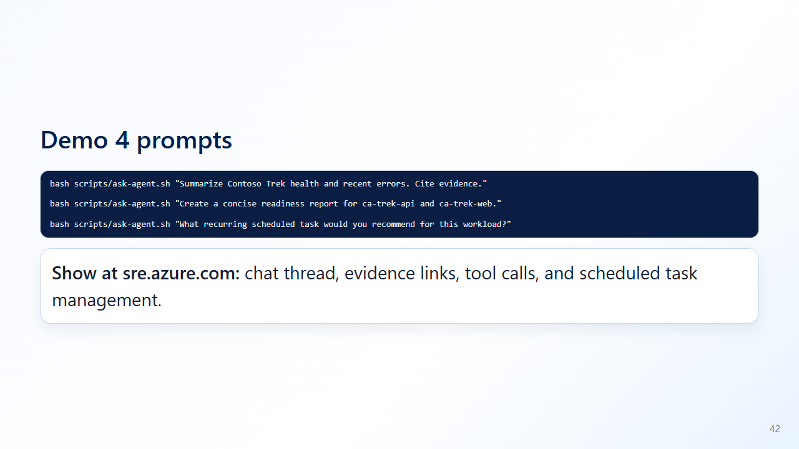
Notes:
Presenter notes: Ask one customer-supplied question.

Slide 43
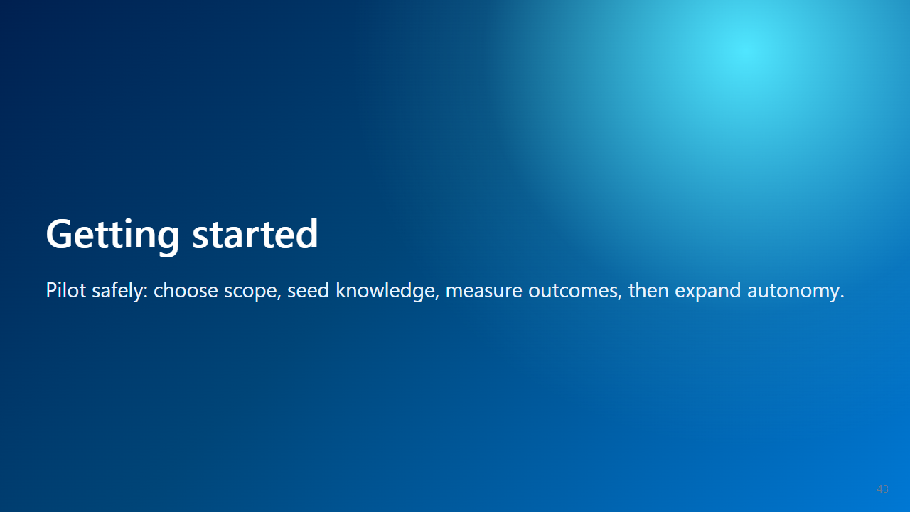
Notes:
Presenter notes: From demo to adoption.

Slide 44
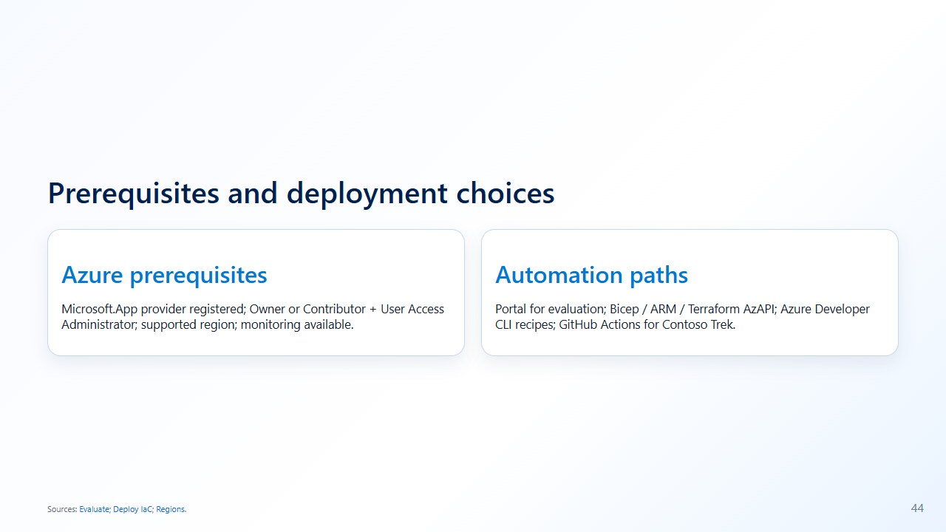
Notes:
Presenter notes: Partners can package repeatable deployment.

Slide 45
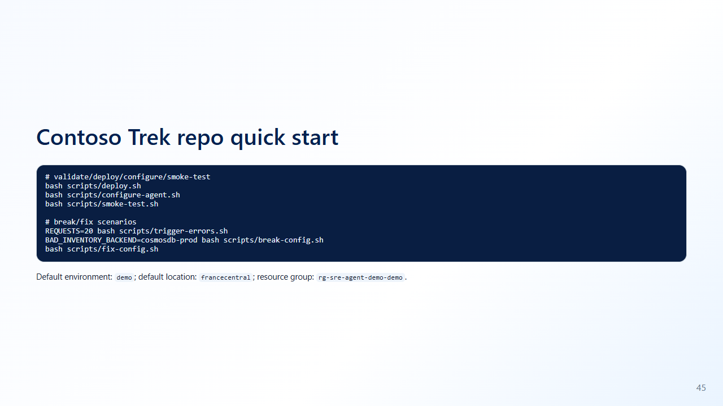
Notes:
Presenter notes: Commands come directly from the repo.

Slide 46
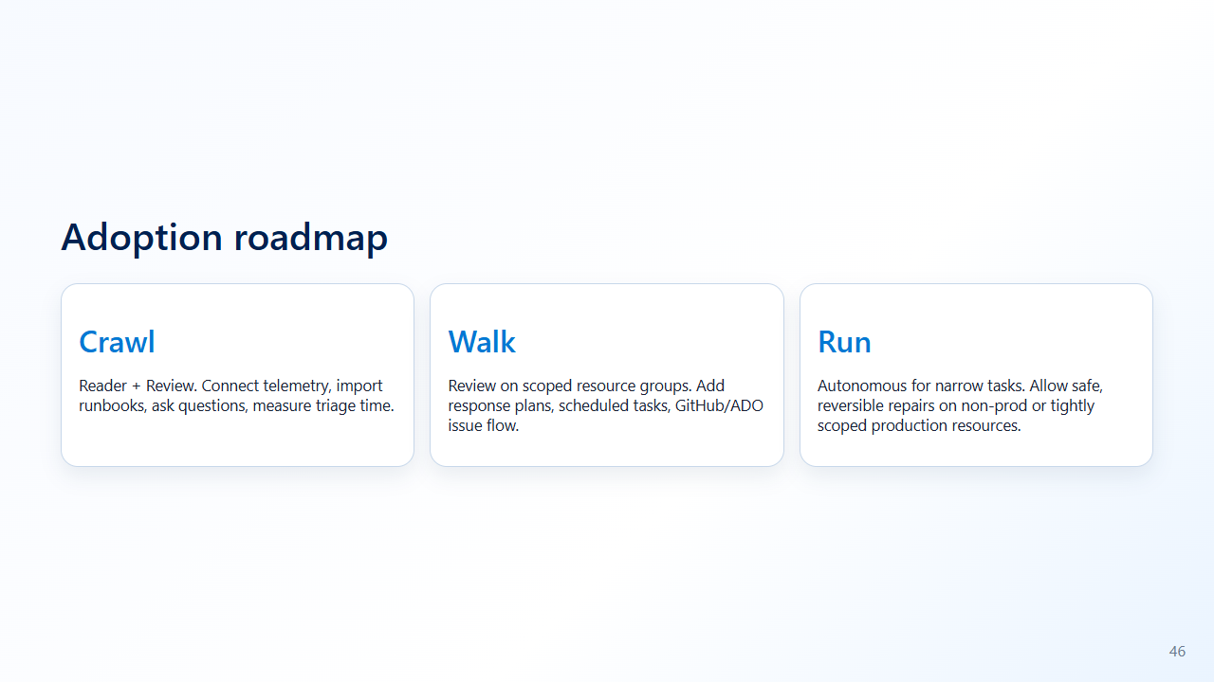
Notes:
Presenter notes: Choose one service, two alerts, one runbook, one metric.

Slide 47
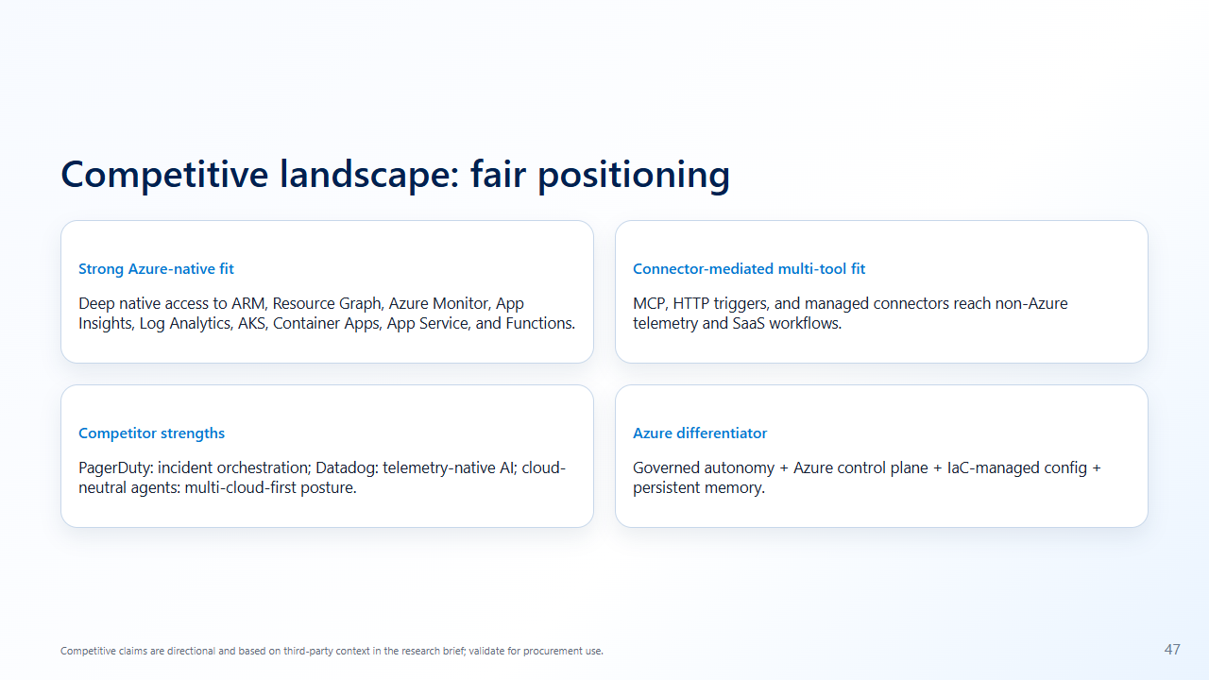
Notes:
Presenter notes: Be balanced and fair.

Slide 48
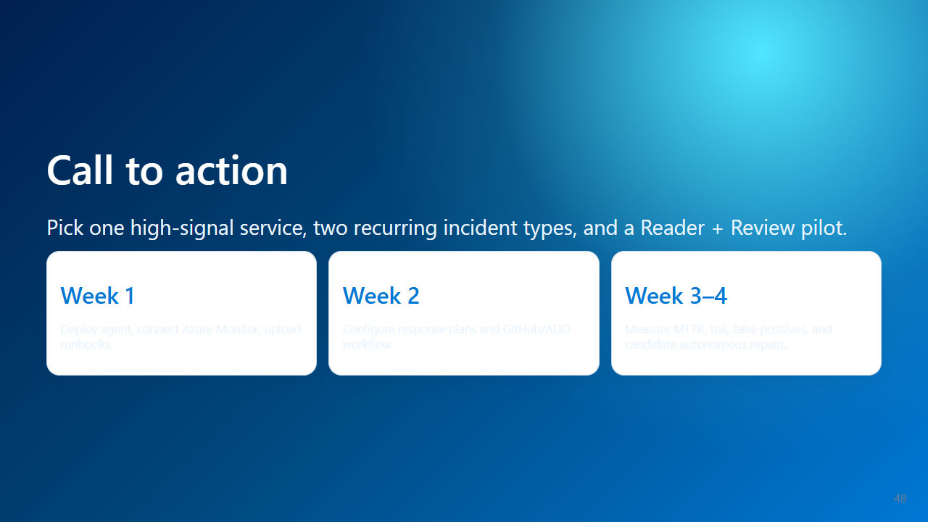
Notes:
Presenter notes: Ask for pilot workload, owner, approver, and success metrics.

Slide 49
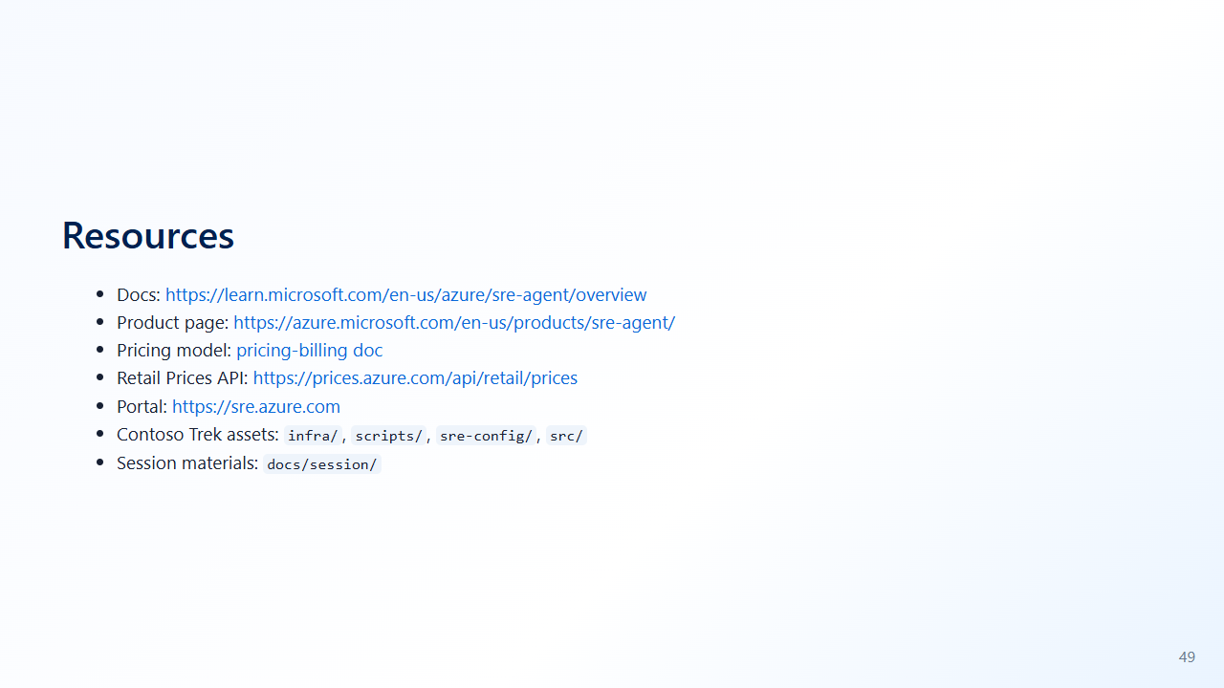
Notes:
Presenter notes: Pricing values are verified from the Retail Prices API; quotes should still confirm current calculator values.

Slide 50
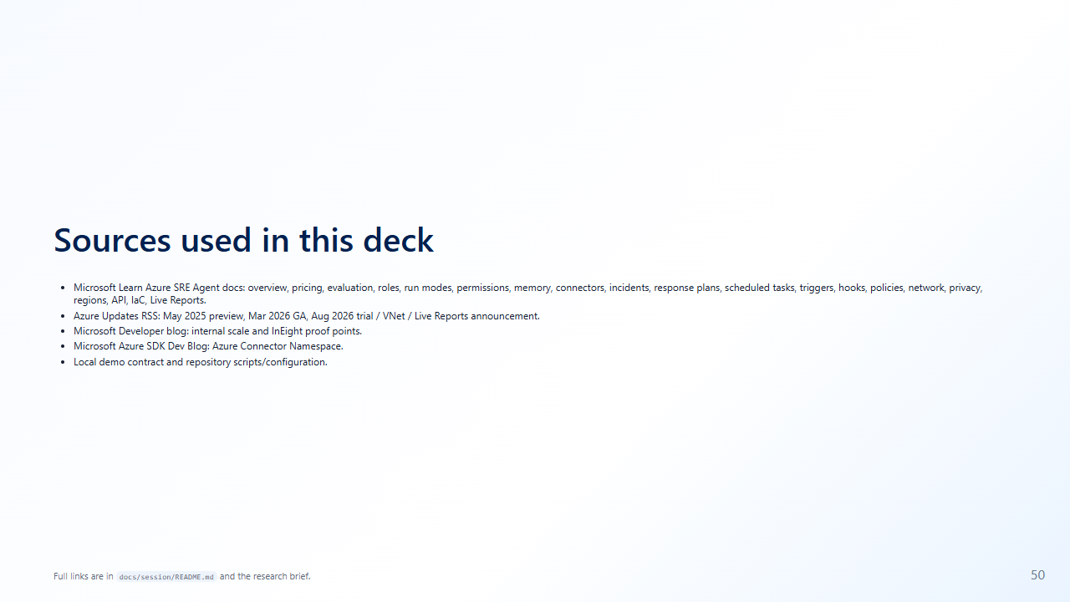
Notes:
Presenter notes: Traceability slide; do not linger unless asked.

