Slide 1
CSE 305 presentatIon
Team Members:
Fatih Keskin
Muhammet Ali Efe
Furkan Ünlütürk

Slide 2
Our Project: YumYum!
Yumyum is a Web App.
Serves as a restaurant finder.

Slide 3
Goal
The aim of the application is to help people to find restaurants and bring together the peoples reviews about their experience in that place.

Slide 4
Users and Their Needs
There are three main scenarios.

Slide 5
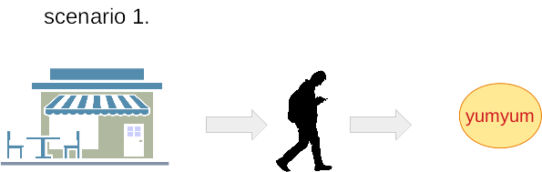
User leaves a restaurant, and then uses YumYum to share his thoughts about their service by adding review.

Slide 6
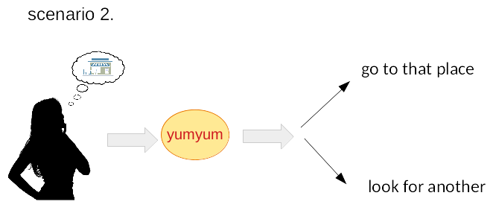
User is curious about a restaurant that s/he wants to go first time, and then uses YumYum to get information about that place.

Slide 7
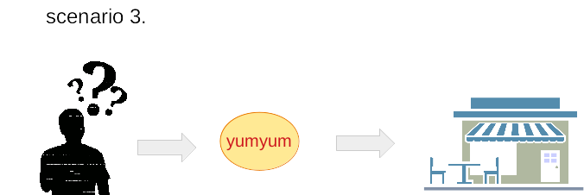
User doesn’t have a clue about where to eat, and then uses YumYum to find a good place.

Slide 8
FUNCTIONALITY
Restaurants are the main object in the application and they have reviews and stars as attributes.

Slide 9
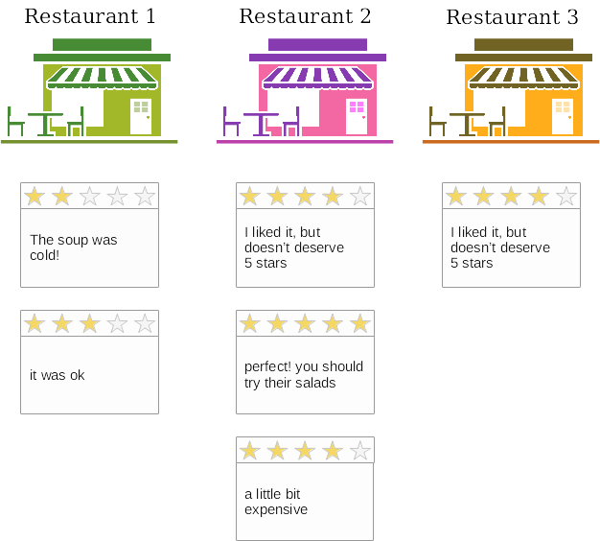

Slide 10
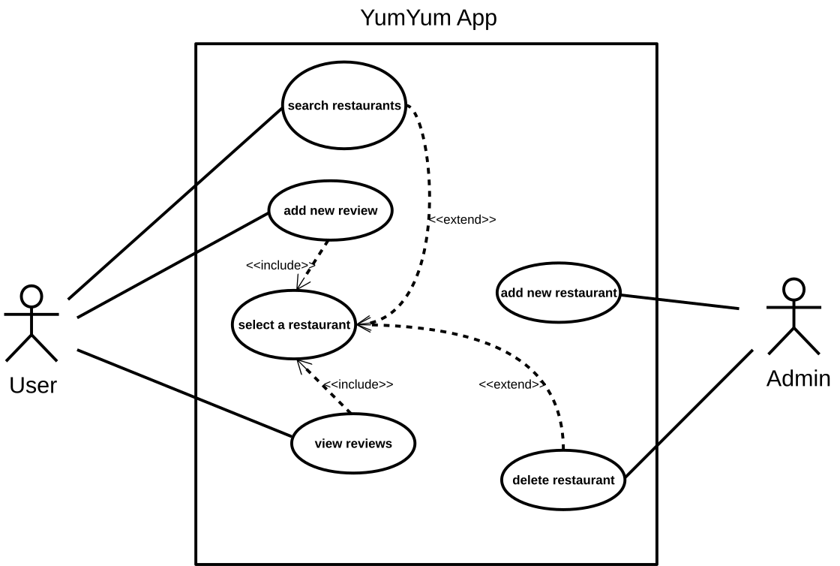

Slide 11
PHASES

Slide 12
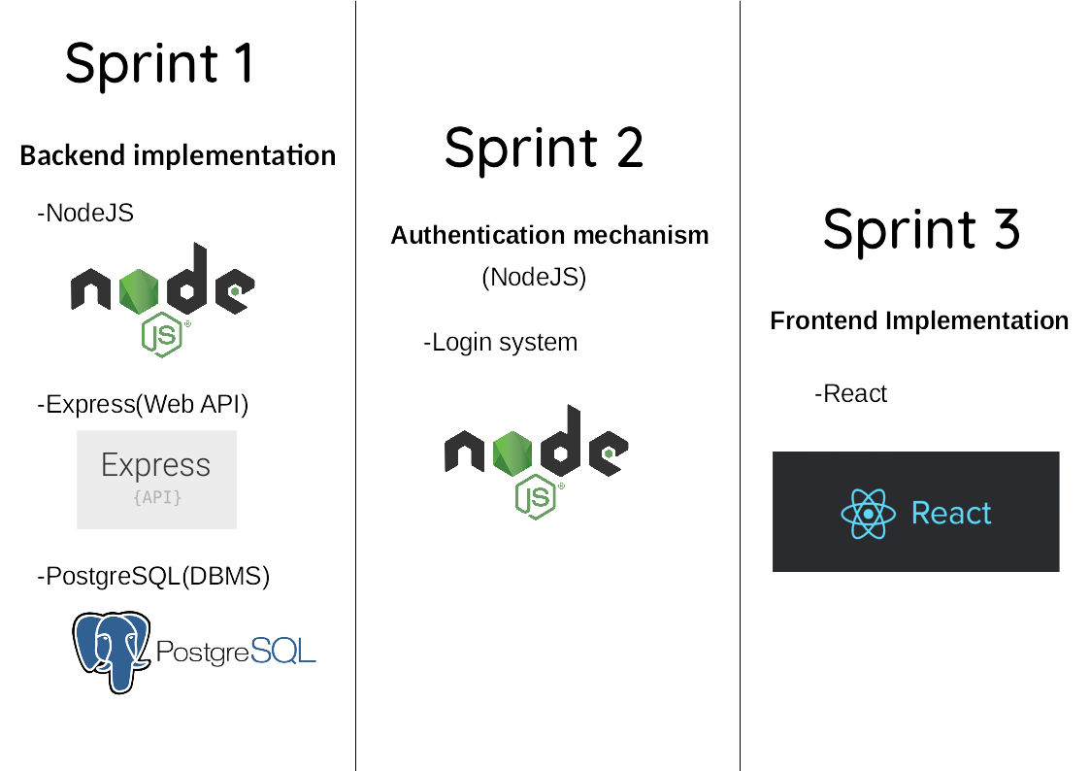

Slide 13
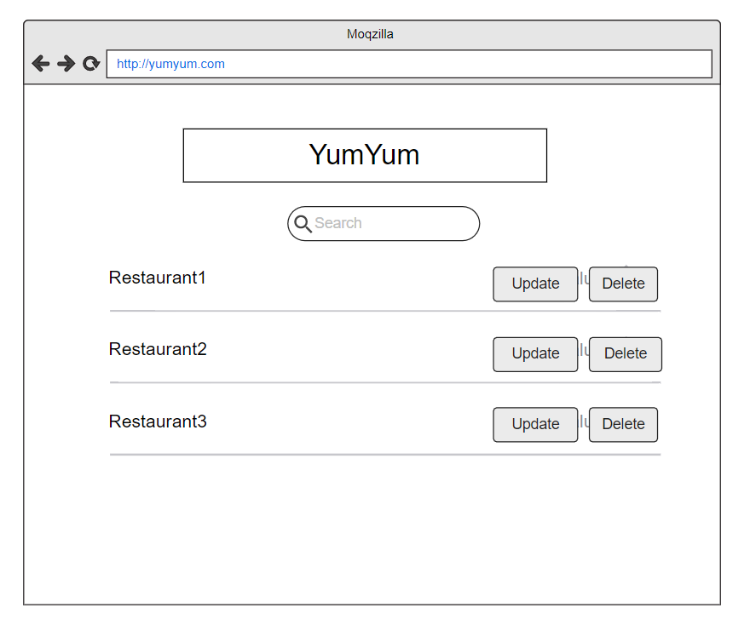

Slide 14
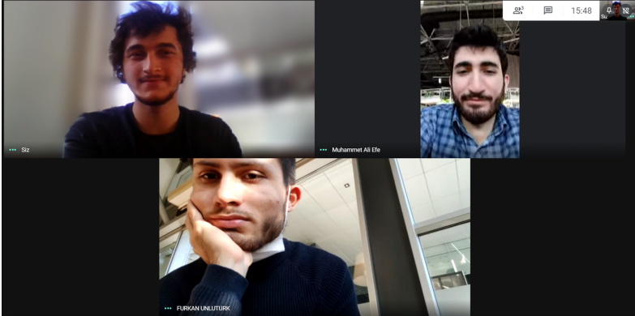
Teamwork

Slide 15
Thank You!

