Slide 1
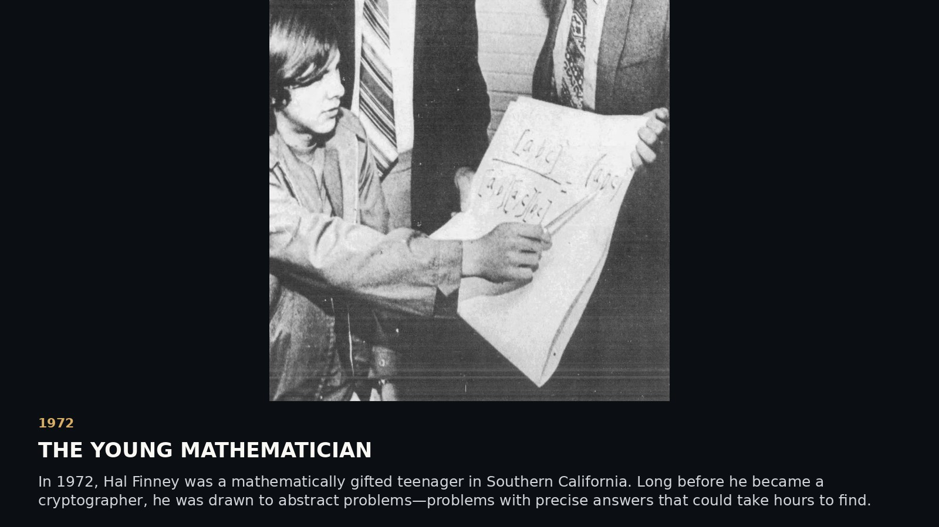
Notes:
SCENE 1 (original storyboard scene 1) — 1972 · AGE 16 · THE YOUNG MATHEMATICIAN
NARRATIVE
In 1972, Hal Finney was a mathematically gifted teenager in Southern California. Long before he became a cryptographer, he was drawn to abstract problems—problems with precise answers that could take hours to find.
SOURCE AND INTERPRETATION
Photo attribution and date to be documented from original newspaper archive.
The photograph/document is historical where explicitly described as such. Text-only editorial pages are not archival facsimiles. Hypotheses about Satoshi authorship are unproven.
PRESENTATION GUIDANCE: Allow the image or document to lead. Pause at the central question before advancing. Avoid presenting circumstantial similarity as authorship proof.

Slide 2
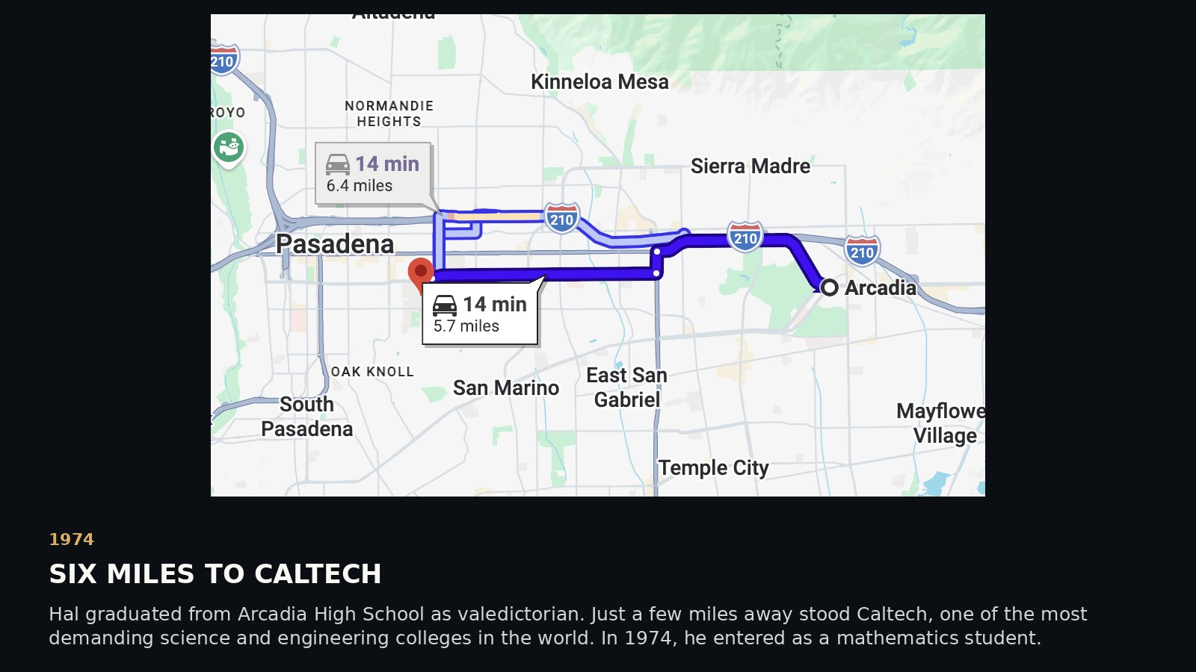
Notes:
SCENE 2 (original storyboard scene 2) — 1974 · AGE 18 · SIX MILES TO CALTECH
NARRATIVE
Hal graduated from Arcadia High School as valedictorian. Just a few miles away stood Caltech, one of the most demanding science and engineering colleges in the world. In 1974, he entered as a mathematics student.
SOURCE AND INTERPRETATION
Hal biographical profile, Alcor; map distances approximate.
The photograph/document is historical where explicitly described as such. Text-only editorial pages are not archival facsimiles. Hypotheses about Satoshi authorship are unproven.
PRESENTATION GUIDANCE: Allow the image or document to lead. Pause at the central question before advancing. Avoid presenting circumstantial similarity as authorship proof.

Slide 3
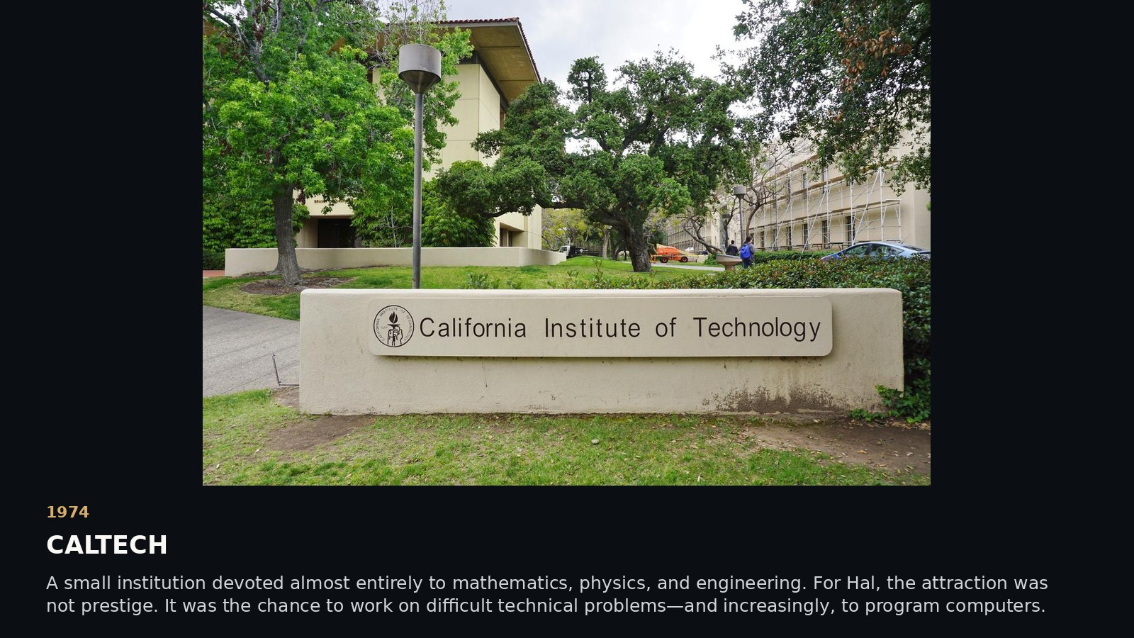
Notes:
SCENE 3 (original storyboard scene 3) — 1974 · AGE 18 · CALTECH
NARRATIVE
A small institution devoted almost entirely to mathematics, physics, and engineering. For Hal, the attraction was not prestige. It was the chance to work on difficult technical problems—and increasingly, to program computers.
SOURCE AND INTERPRETATION
Family biography and Hal's interviews.
The photograph/document is historical where explicitly described as such. Text-only editorial pages are not archival facsimiles. Hypotheses about Satoshi authorship are unproven.
PRESENTATION GUIDANCE: Allow the image or document to lead. Pause at the central question before advancing. Avoid presenting circumstantial similarity as authorship proof.

Slide 4
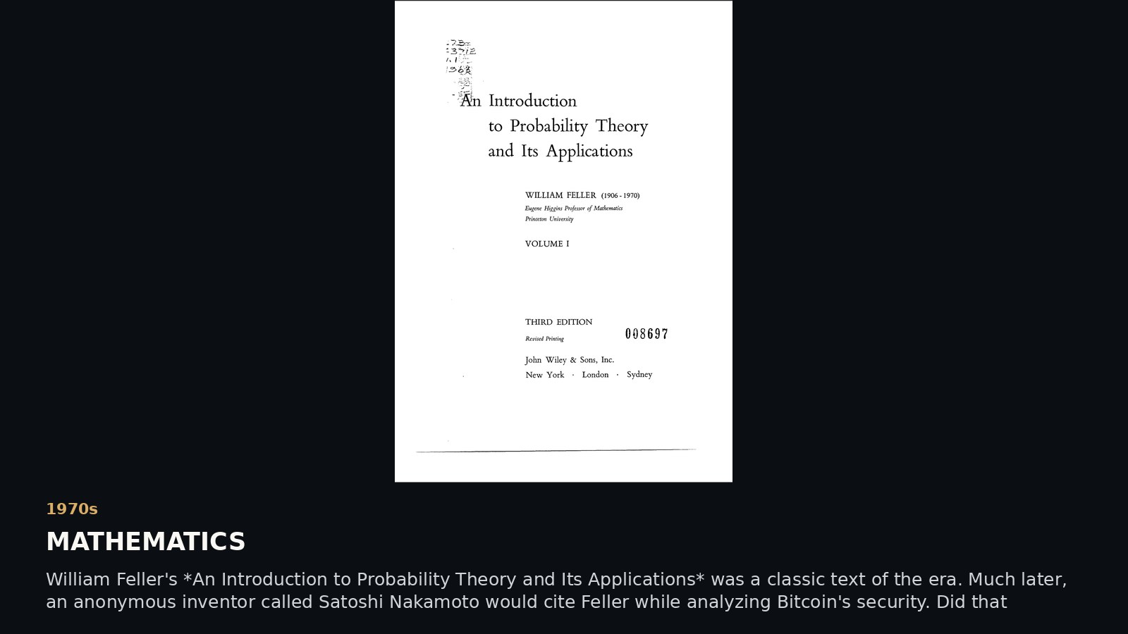
Notes:
SCENE 4 (original storyboard scene 4) — 1970s · AGE 18–23 · MATHEMATICS
NARRATIVE
William Feller's *An Introduction to Probability Theory and Its Applications* was a classic text of the era. Much later, an anonymous inventor called Satoshi Nakamoto would cite Feller while analyzing Bitcoin's security. Did that mathematical background matter?
SOURCE AND INTERPRETATION
Bitcoin whitepaper bibliography; no evidence Hal specifically studied Feller. Do not claim he did.
The photograph/document is historical where explicitly described as such. Text-only editorial pages are not archival facsimiles. Hypotheses about Satoshi authorship are unproven.
PRESENTATION GUIDANCE: Allow the image or document to lead. Pause at the central question before advancing. Avoid presenting circumstantial similarity as authorship proof.

Slide 5
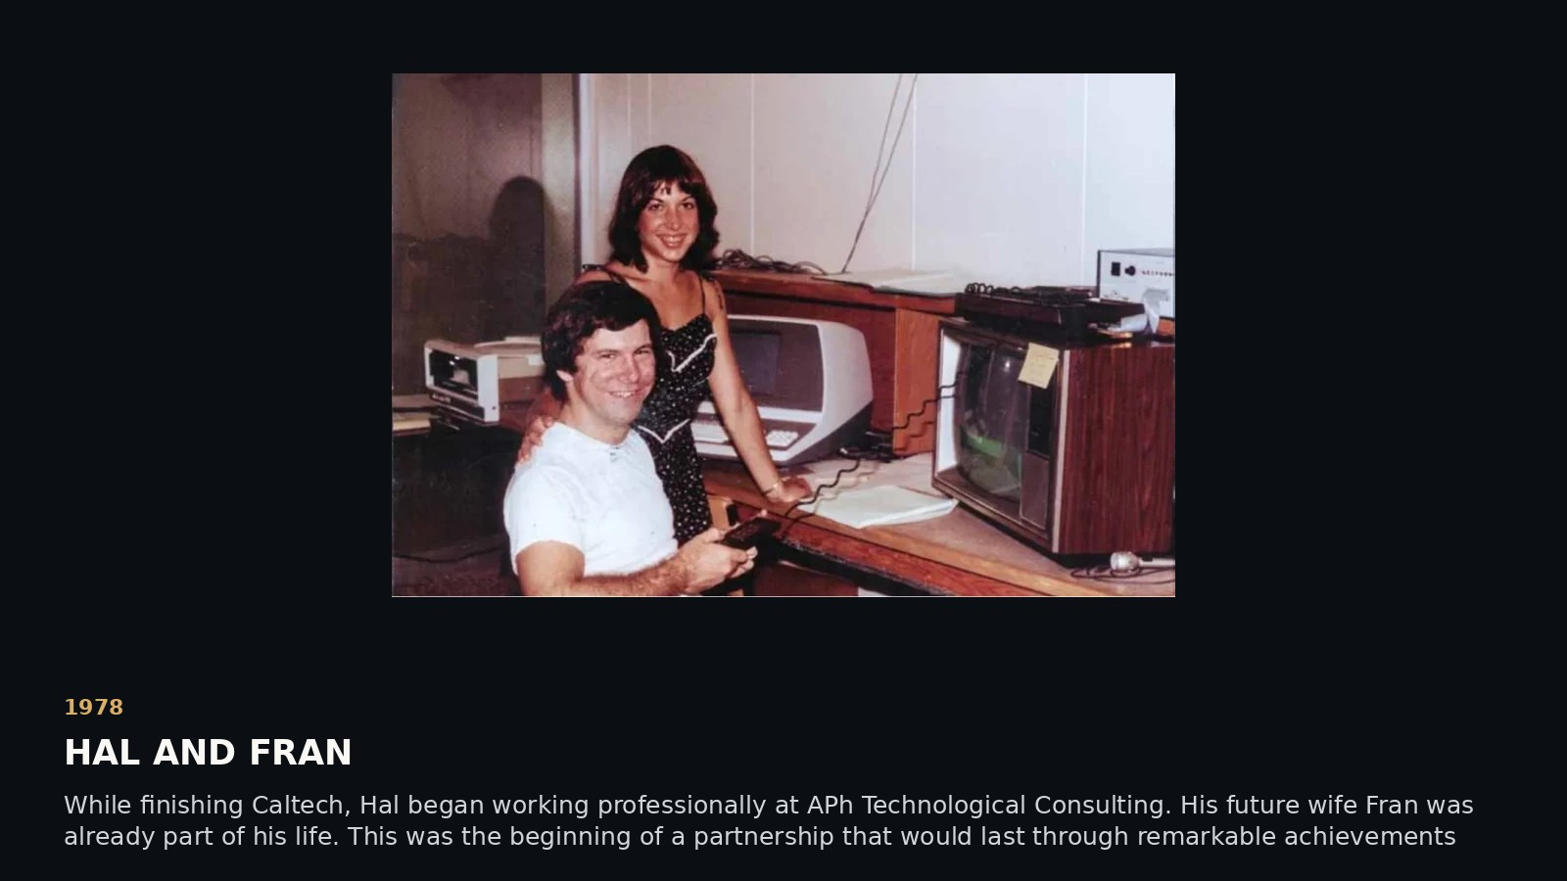
Notes:
SCENE 5 (original storyboard scene 5) — 1978 · AGE 22 · HAL AND FRAN
NARRATIVE
While finishing Caltech, Hal began working professionally at APh Technological Consulting. His future wife Fran was already part of his life. This was the beginning of a partnership that would last through remarkable achievements and extraordinary hardship.
SOURCE AND INTERPRETATION
Alcor family-supported profile; exact image credit to verify.
The photograph/document is historical where explicitly described as such. Text-only editorial pages are not archival facsimiles. Hypotheses about Satoshi authorship are unproven.
PRESENTATION GUIDANCE: Allow the image or document to lead. Pause at the central question before advancing. Avoid presenting circumstantial similarity as authorship proof.

Slide 6
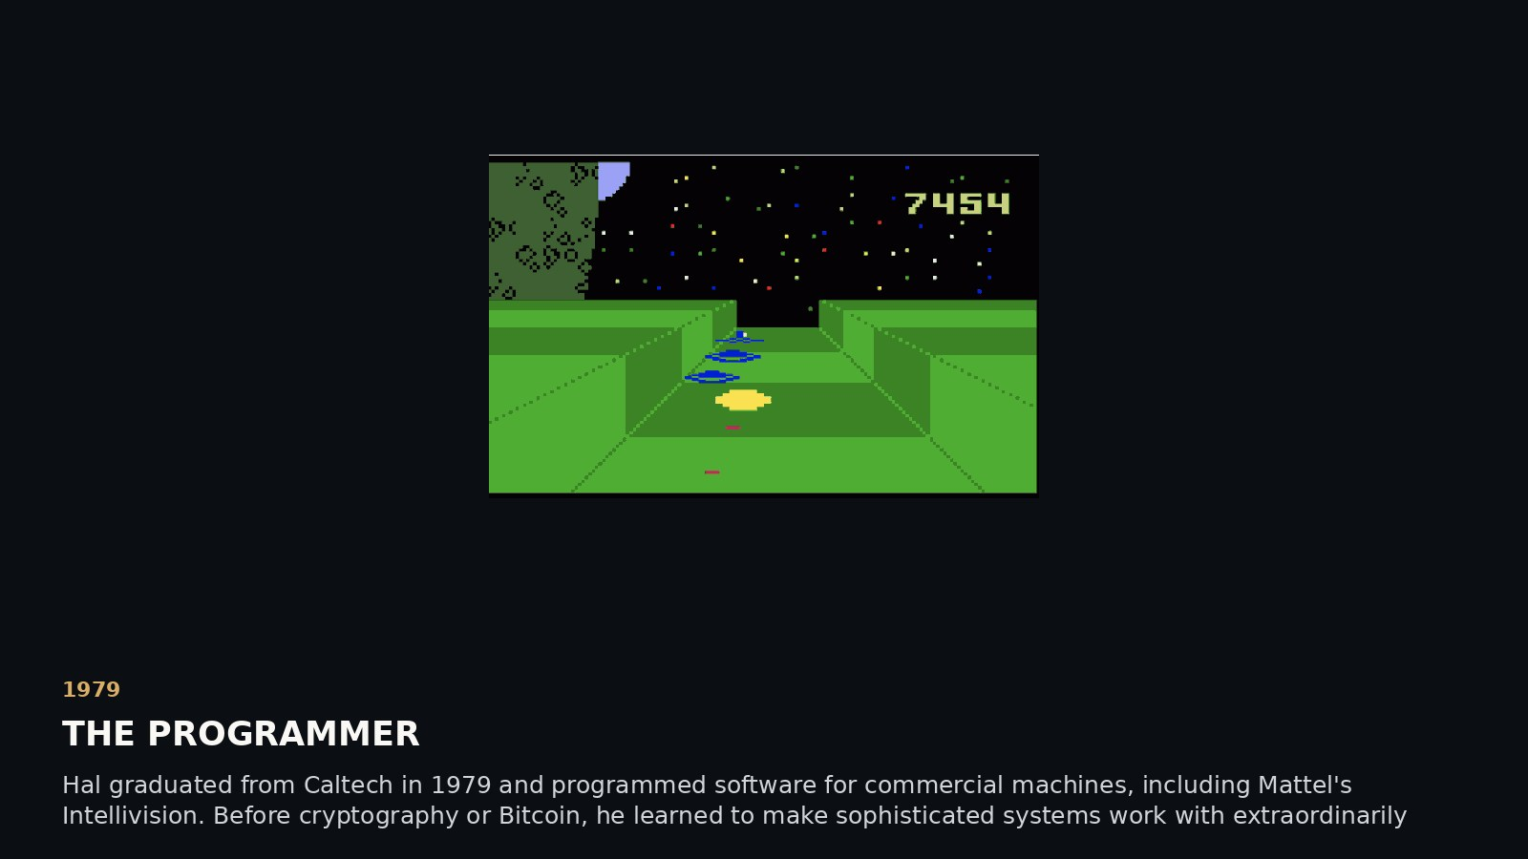
Notes:
SCENE 6 (original storyboard scene 6) — 1979 · AGE 23 · THE PROGRAMMER
NARRATIVE
Hal graduated from Caltech in 1979 and programmed software for commercial machines, including Mattel's Intellivision. Before cryptography or Bitcoin, he learned to make sophisticated systems work with extraordinarily limited memory and computing power.
SOURCE AND INTERPRETATION
Hal interview about APh and Intellivision work.
The photograph/document is historical where explicitly described as such. Text-only editorial pages are not archival facsimiles. Hypotheses about Satoshi authorship are unproven.
PRESENTATION GUIDANCE: Allow the image or document to lead. Pause at the central question before advancing. Avoid presenting circumstantial similarity as authorship proof.

Slide 7
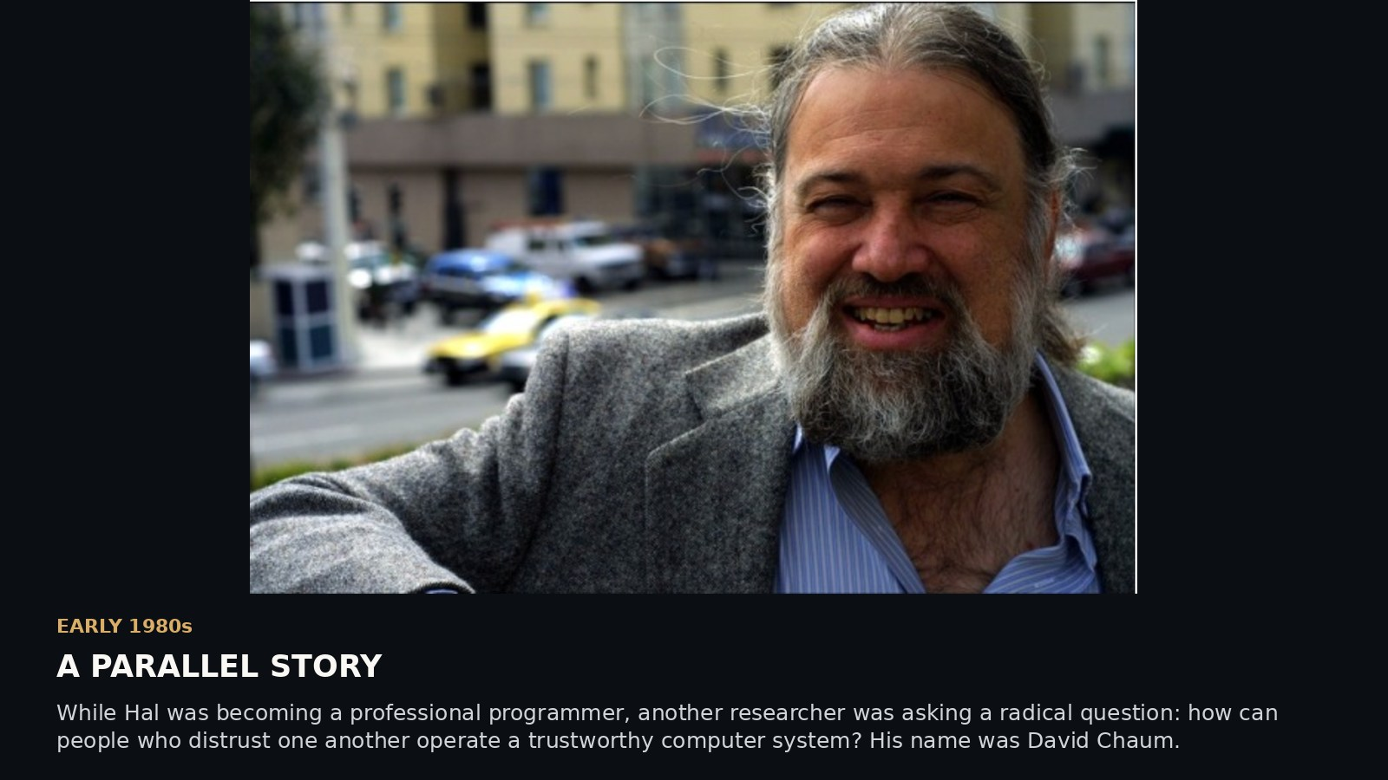
Notes:
SCENE 7 (original storyboard scene 7) — EARLY 1980s · AGE 26 · A PARALLEL STORY
NARRATIVE
While Hal was becoming a professional programmer, another researcher was asking a radical question: how can people who distrust one another operate a trustworthy computer system? His name was David Chaum.
SOURCE AND INTERPRETATION
Chaum publication record; photo date still needs verification.
The photograph/document is historical where explicitly described as such. Text-only editorial pages are not archival facsimiles. Hypotheses about Satoshi authorship are unproven.
PRESENTATION GUIDANCE: Allow the image or document to lead. Pause at the central question before advancing. Avoid presenting circumstantial similarity as authorship proof.

Slide 8
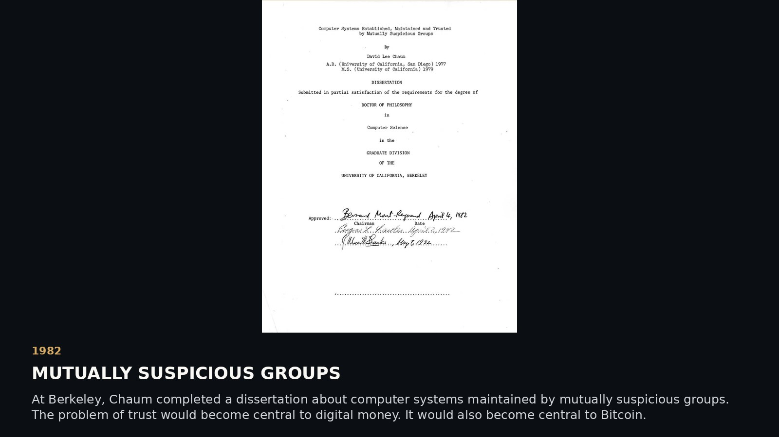
Notes:
SCENE 8 (original storyboard scene 8) — 1982 · AGE 26 · MUTUALLY SUSPICIOUS GROUPS
NARRATIVE
At Berkeley, Chaum completed a dissertation about computer systems maintained by mutually suspicious groups. The problem of trust would become central to digital money. It would also become central to Bitcoin.
SOURCE AND INTERPRETATION
UC Berkeley 1982 dissertation record.
The photograph/document is historical where explicitly described as such. Text-only editorial pages are not archival facsimiles. Hypotheses about Satoshi authorship are unproven.
PRESENTATION GUIDANCE: Allow the image or document to lead. Pause at the central question before advancing. Avoid presenting circumstantial similarity as authorship proof.

Slide 9
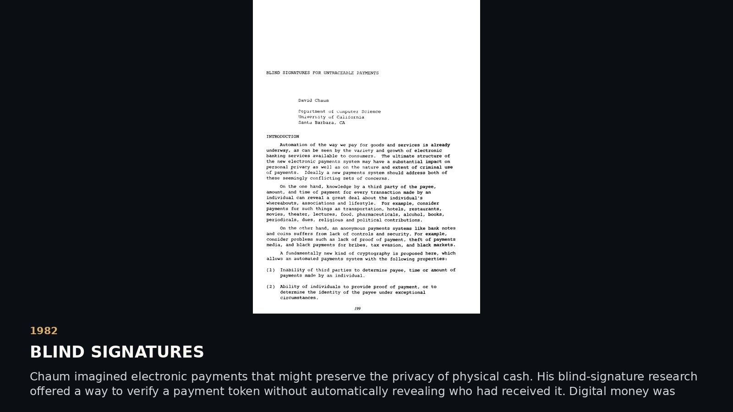
Notes:
SCENE 9 (original storyboard scene 9) — 1982 · AGE 26 · BLIND SIGNATURES
NARRATIVE
Chaum imagined electronic payments that might preserve the privacy of physical cash. His blind-signature research offered a way to verify a payment token without automatically revealing who had received it. Digital money was becoming a serious cryptographic project.
SOURCE AND INTERPRETATION
Chaum, CRYPTO '82 paper.
The photograph/document is historical where explicitly described as such. Text-only editorial pages are not archival facsimiles. Hypotheses about Satoshi authorship are unproven.
PRESENTATION GUIDANCE: Allow the image or document to lead. Pause at the central question before advancing. Avoid presenting circumstantial similarity as authorship proof.

Slide 10
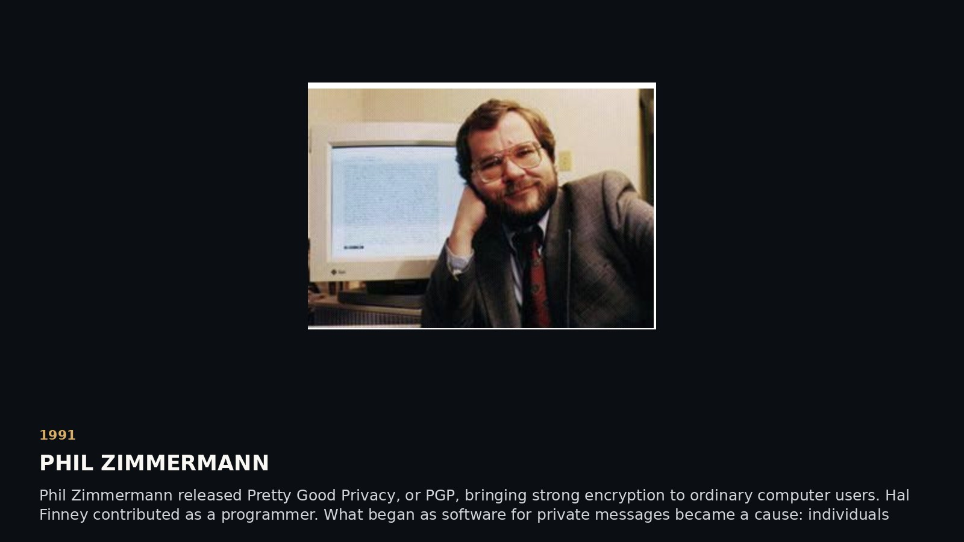
Notes:
SCENE 10 (original storyboard scene 11) — 1991 · AGE 35 · PHIL ZIMMERMANN
NARRATIVE
Phil Zimmermann released Pretty Good Privacy, or PGP, bringing strong encryption to ordinary computer users. Hal Finney contributed as a programmer. What began as software for private messages became a cause: individuals should be able to protect their communications.
SOURCE AND INTERPRETATION
PGP history; Hal family biography.
The photograph/document is historical where explicitly described as such. Text-only editorial pages are not archival facsimiles. Hypotheses about Satoshi authorship are unproven.
PRESENTATION GUIDANCE: Allow the image or document to lead. Pause at the central question before advancing. Avoid presenting circumstantial similarity as authorship proof.

Slide 11
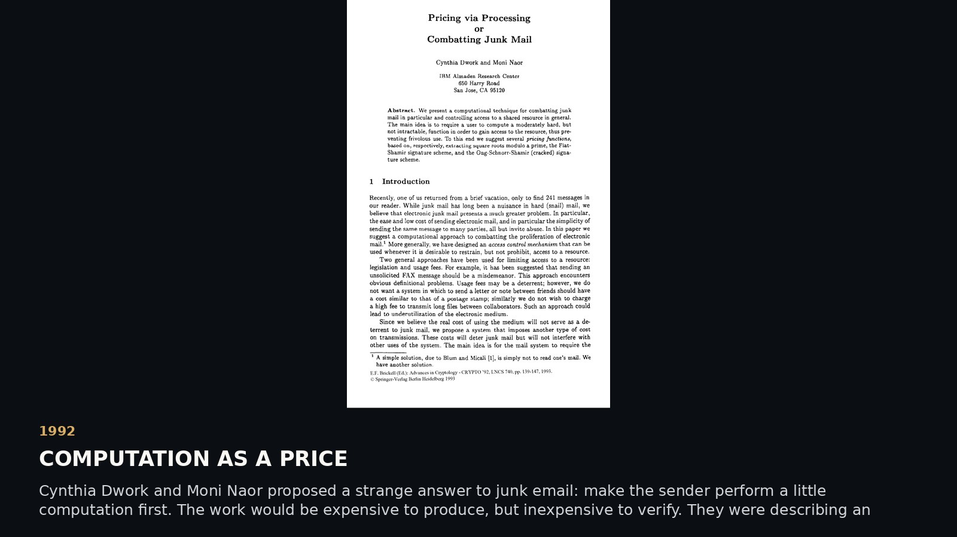
Notes:
SCENE 12 (original storyboard scene 13) — 1992 · AGE 36 · COMPUTATION AS A PRICE
NARRATIVE
Cynthia Dwork and Moni Naor proposed a strange answer to junk email: make the sender perform a little computation first. The work would be expensive to produce, but inexpensive to verify. They were describing an ancestor of proof of work.
SOURCE AND INTERPRETATION
CRYPTO '92 paper, published 1993. Presenter may add personal recollections of discussing proof of work with Cynthia Dwork; these are firsthand recollections, not independently verified quotations.
The photograph/document is historical where explicitly described as such. Text-only editorial pages are not archival facsimiles. Hypotheses about Satoshi authorship are unproven.
PRESENTATION GUIDANCE: Allow the image or document to lead. Pause at the central question before advancing. Avoid presenting circumstantial similarity as authorship proof.

Slide 12
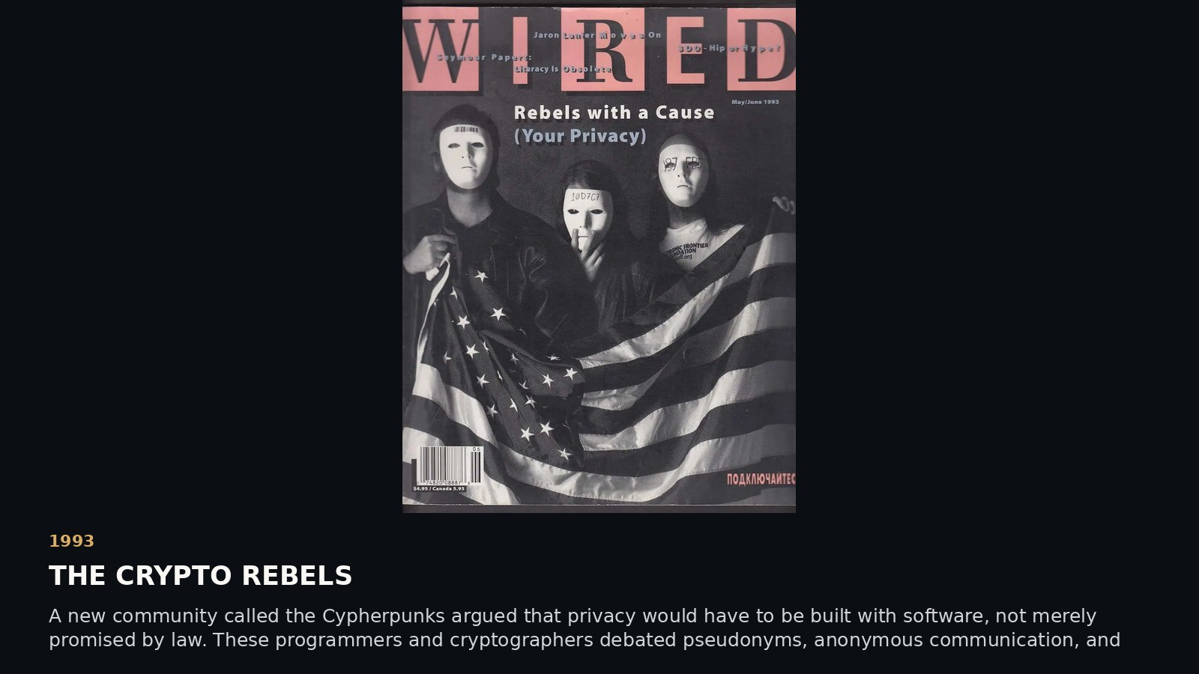
Notes:
SCENE 11 (original storyboard scene 12) — 1993 · AGE 37 · THE CRYPTO REBELS
NARRATIVE
A new community called the Cypherpunks argued that privacy would have to be built with software, not merely promised by law. These programmers and cryptographers debated pseudonyms, anonymous communication, and money that could move without permission.
SOURCE AND INTERPRETATION
WIRED 1993 feature; original Cypherpunk mailing-list records.
The photograph/document is historical where explicitly described as such. Text-only editorial pages are not archival facsimiles. Hypotheses about Satoshi authorship are unproven.
PRESENTATION GUIDANCE: Allow the image or document to lead. Pause at the central question before advancing. Avoid presenting circumstantial similarity as authorship proof.

Slide 13
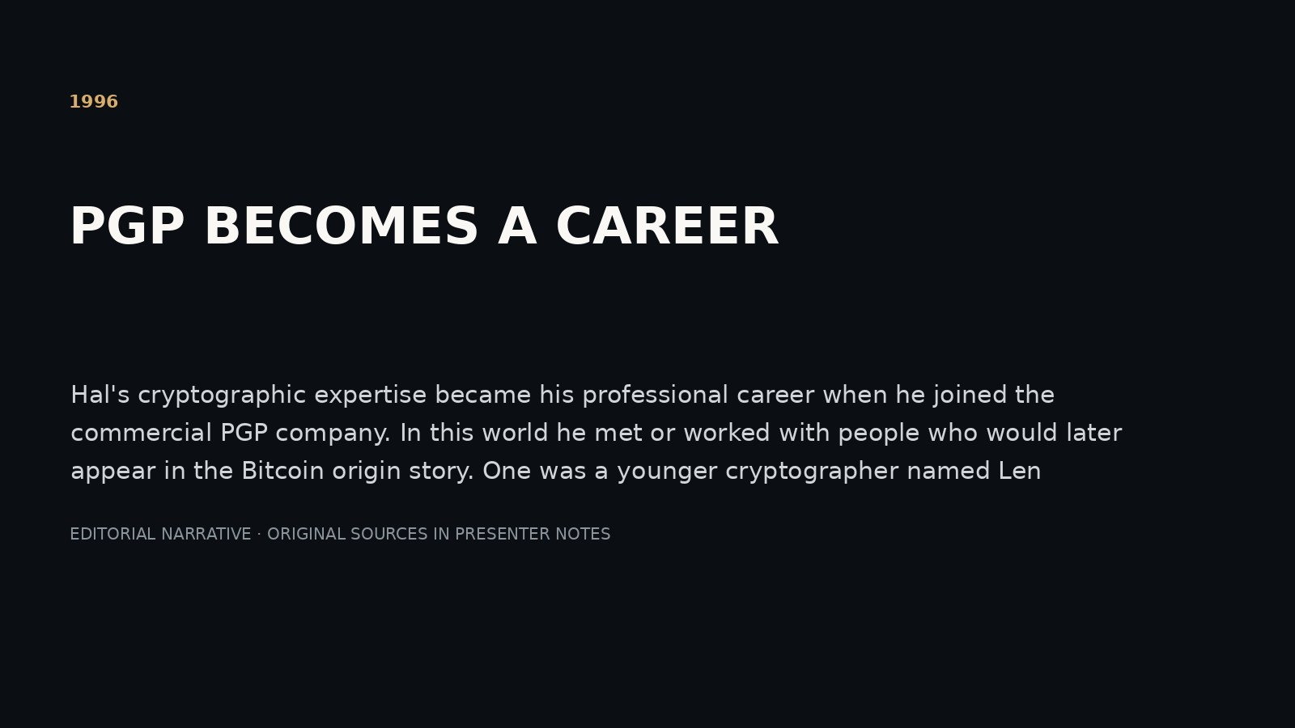
Notes:
SCENE 13 (original storyboard scene 14) — 1996 · AGE 40 · PGP BECOMES A CAREER
NARRATIVE
Hal's cryptographic expertise became his professional career when he joined the commercial PGP company. In this world he met or worked with people who would later appear in the Bitcoin origin story. One was a younger cryptographer named Len Sassaman.
SOURCE AND INTERPRETATION
Family biography, PGP company chronology. Precise Hal–Len employment overlap to verify.
The photograph/document is historical where explicitly described as such. Text-only editorial pages are not archival facsimiles. Hypotheses about Satoshi authorship are unproven.
PRESENTATION GUIDANCE: Allow the image or document to lead. Pause at the central question before advancing. Avoid presenting circumstantial similarity as authorship proof.

Slide 14
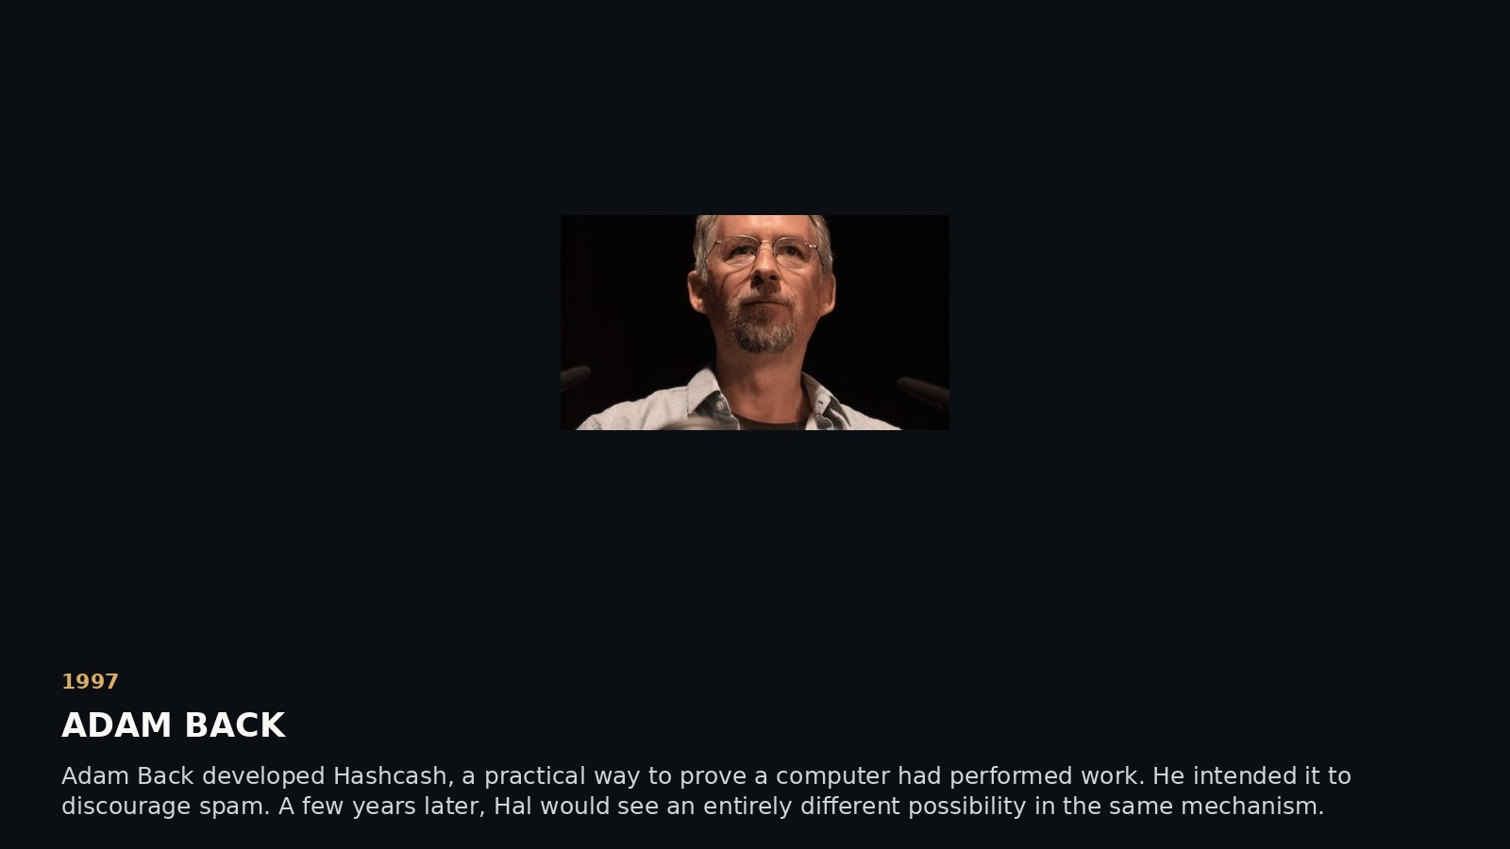
Notes:
SCENE 14 (original storyboard scene 15) — 1997 · AGE 41 · ADAM BACK
NARRATIVE
Adam Back developed Hashcash, a practical way to prove a computer had performed work. He intended it to discourage spam. A few years later, Hal would see an entirely different possibility in the same mechanism.
SOURCE AND INTERPRETATION
Adam Back's Hashcash documentation and 1997 announcement.
The photograph/document is historical where explicitly described as such. Text-only editorial pages are not archival facsimiles. Hypotheses about Satoshi authorship are unproven.
PRESENTATION GUIDANCE: Allow the image or document to lead. Pause at the central question before advancing. Avoid presenting circumstantial similarity as authorship proof.

Slide 15
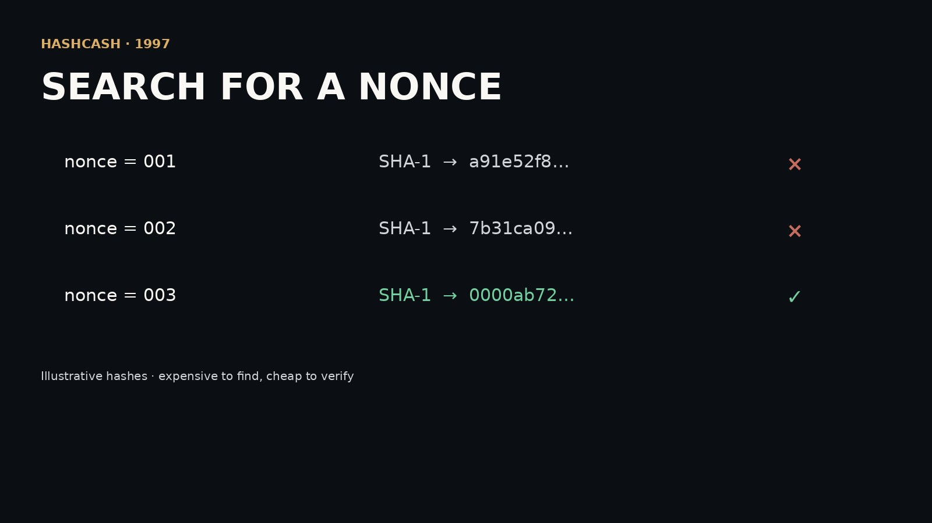
Notes:
SCENE 15 (original storyboard scene 16) — 1997 · THE NONCE
NARRATIVE
Try a nonce. Hash the message. Wrong result? Change the nonce and try again. Eventually, one hash meets a difficulty target. Finding it may take millions of attempts. Verifying it takes one. This asymmetry would become central to Bitcoin mining.
SOURCE AND INTERPRETATION
Hashcash technical specification. Original Hashcash used SHA-1; Bitcoin later used double SHA-256.
The photograph/document is historical where explicitly described as such. Text-only editorial pages are not archival facsimiles. Hypotheses about Satoshi authorship are unproven.
PRESENTATION GUIDANCE: Allow the image or document to lead. Pause at the central question before advancing. Avoid presenting circumstantial similarity as authorship proof.

Slide 16
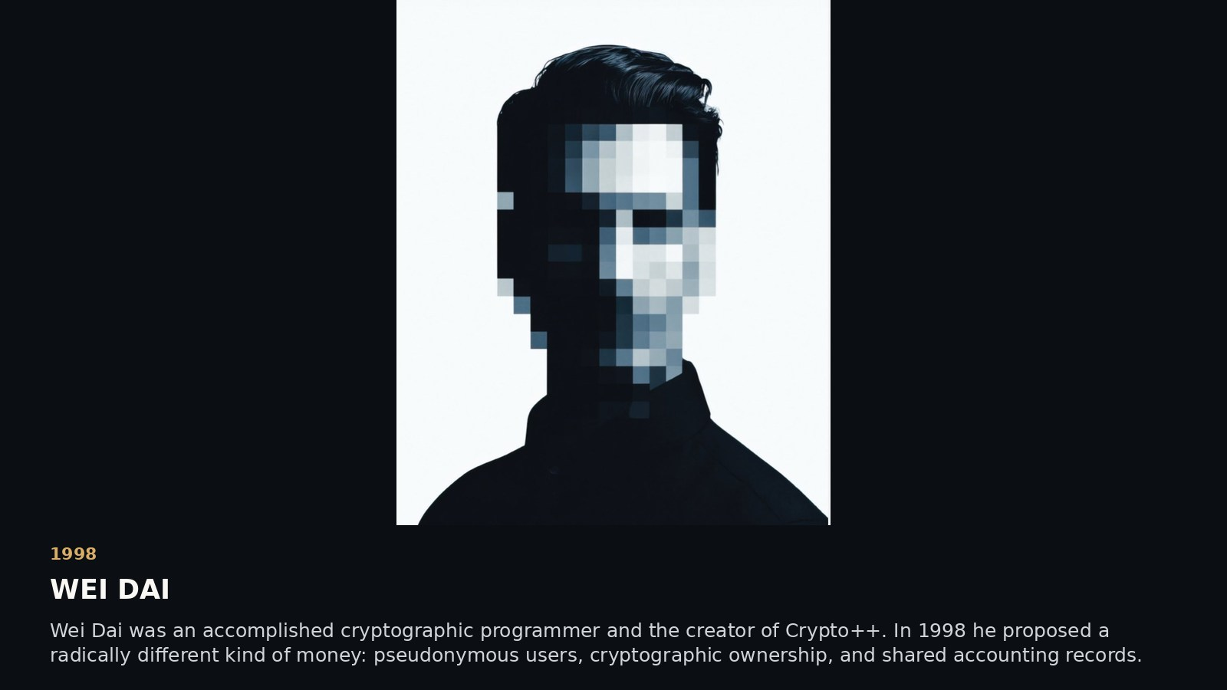
Notes:
SCENE 16 (original storyboard scene 17) — 1998 · AGE 42 · WEI DAI
NARRATIVE
Wei Dai was an accomplished cryptographic programmer and the creator of Crypto++. In 1998 he proposed a radically different kind of money: pseudonymous users, cryptographic ownership, and shared accounting records. Unlike most of the people in this story, he has no verified public portrait.
SOURCE AND INTERPRETATION
Wei Dai's site and b-money proposal; image is illustrative, not photographic identification.
The photograph/document is historical where explicitly described as such. Text-only editorial pages are not archival facsimiles. Hypotheses about Satoshi authorship are unproven.
PRESENTATION GUIDANCE: Allow the image or document to lead. Pause at the central question before advancing. Avoid presenting circumstantial similarity as authorship proof.

Slide 17
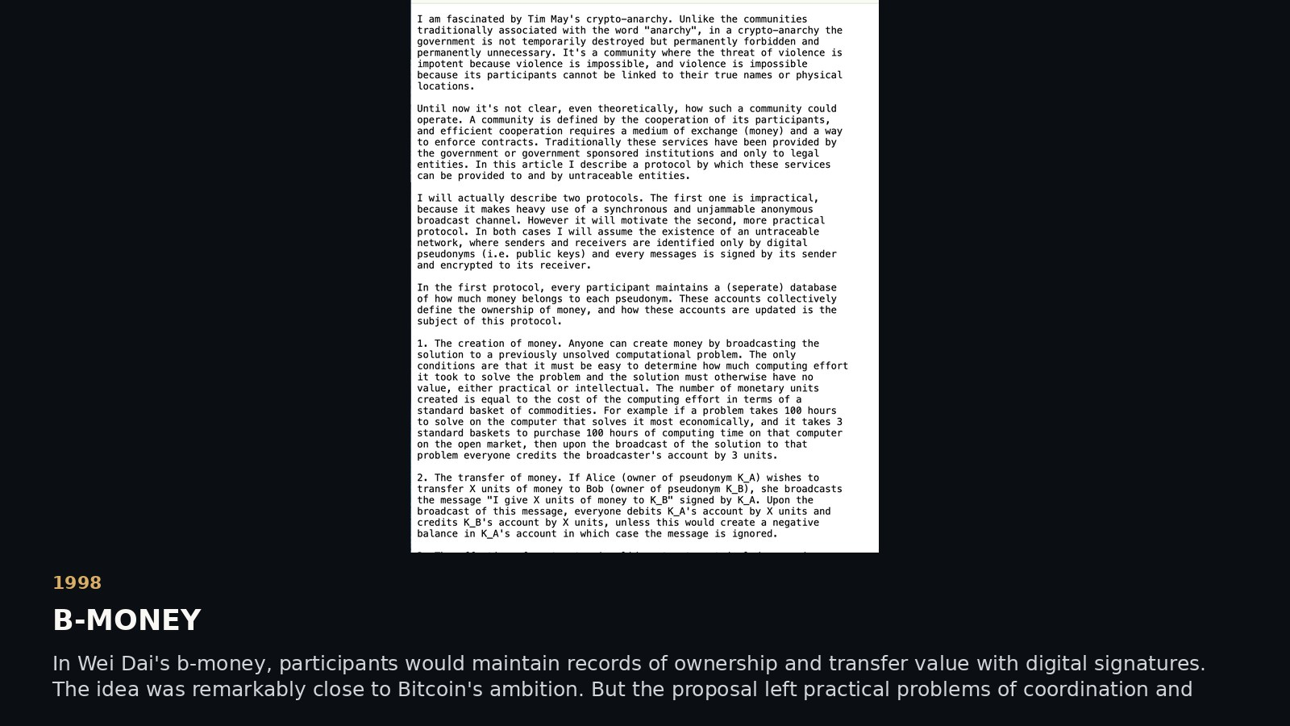
Notes:
SCENE 17 (original storyboard scene 18) — 1998 · B-MONEY
NARRATIVE
In Wei Dai's b-money, participants would maintain records of ownership and transfer value with digital signatures. The idea was remarkably close to Bitcoin's ambition. But the proposal left practical problems of coordination and reliable agreement unresolved.
SOURCE AND INTERPRETATION
Wei Dai, *b-money* (1998).
The photograph/document is historical where explicitly described as such. Text-only editorial pages are not archival facsimiles. Hypotheses about Satoshi authorship are unproven.
PRESENTATION GUIDANCE: Allow the image or document to lead. Pause at the central question before advancing. Avoid presenting circumstantial similarity as authorship proof.

Slide 18
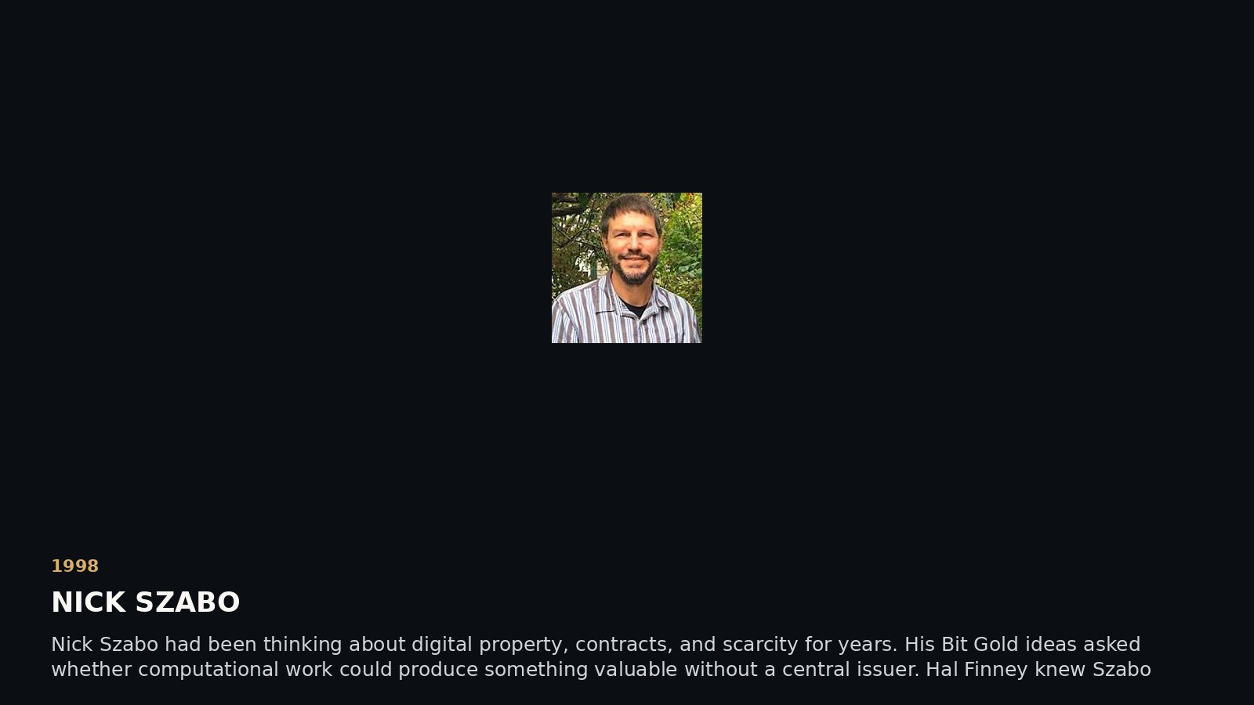
Notes:
SCENE 18 (original storyboard scene 19) — 1998 · NICK SZABO
NARRATIVE
Nick Szabo had been thinking about digital property, contracts, and scarcity for years. His Bit Gold ideas asked whether computational work could produce something valuable without a central issuer. Hal Finney knew Szabo personally and corresponded with him extensively.
SOURCE AND INTERPRETATION
Szabo's writings and Hal's *Bitcoin and Me* (2013).
The photograph/document is historical where explicitly described as such. Text-only editorial pages are not archival facsimiles. Hypotheses about Satoshi authorship are unproven.
PRESENTATION GUIDANCE: Allow the image or document to lead. Pause at the central question before advancing. Avoid presenting circumstantial similarity as authorship proof.

Slide 19
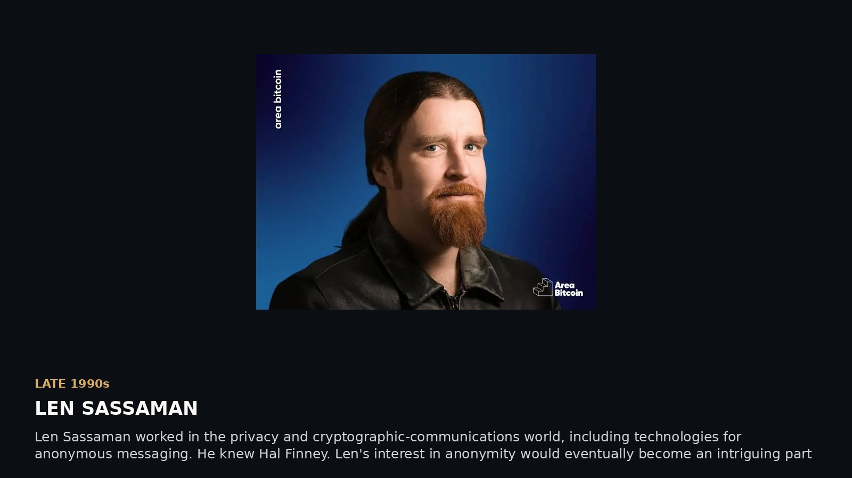
Notes:
SCENE 19 (original storyboard scene 21) — LATE 1990s · LEN SASSAMAN
NARRATIVE
Len Sassaman worked in the privacy and cryptographic-communications world, including technologies for anonymous messaging. He knew Hal Finney. Len's interest in anonymity would eventually become an intriguing part of the Satoshi mystery.
SOURCE AND INTERPRETATION
Len biographies and *Finding Satoshi* interviews; precise employment details should be sourced.
The photograph/document is historical where explicitly described as such. Text-only editorial pages are not archival facsimiles. Hypotheses about Satoshi authorship are unproven.
PRESENTATION GUIDANCE: Allow the image or document to lead. Pause at the central question before advancing. Avoid presenting circumstantial similarity as authorship proof.

Slide 20
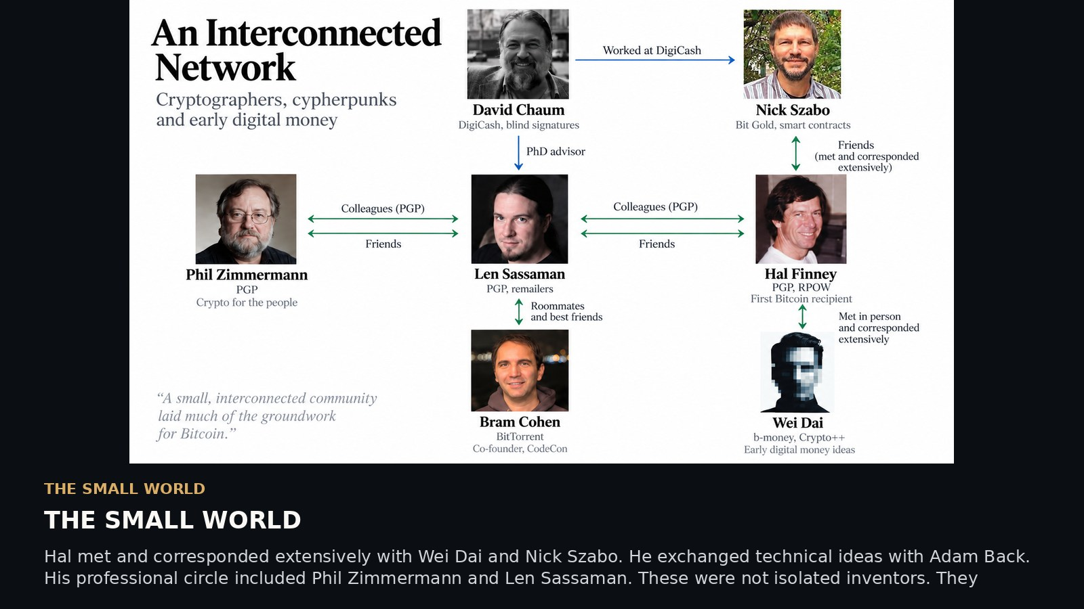
Notes:
SCENE 20 (original storyboard scene 22) — THE SMALL WORLD
NARRATIVE
Hal met and corresponded extensively with Wei Dai and Nick Szabo. He exchanged technical ideas with Adam Back. His professional circle included Phil Zimmermann and Len Sassaman. These were not isolated inventors. They worked in an overlapping world of ideas and personal relationships.
SOURCE AND INTERPRETATION
Hal's *Bitcoin and Me*; PGP history; RPOW correspondence; *Finding Satoshi* recollections.
The photograph/document is historical where explicitly described as such. Text-only editorial pages are not archival facsimiles. Hypotheses about Satoshi authorship are unproven.
PRESENTATION GUIDANCE: Allow the image or document to lead. Pause at the central question before advancing. Avoid presenting circumstantial similarity as authorship proof.

Slide 21
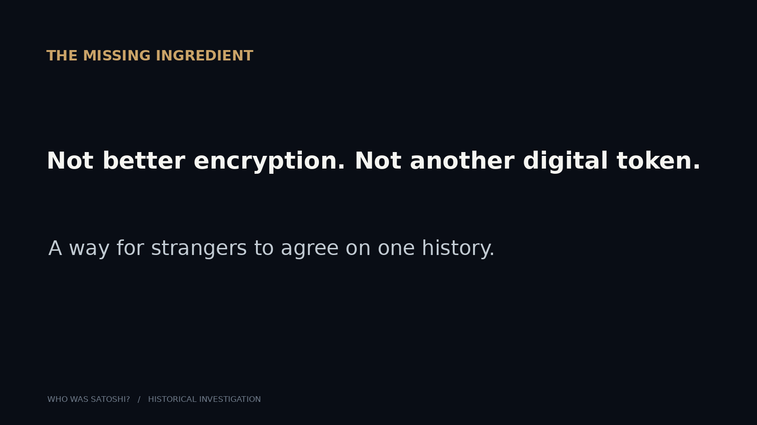
Notes:
SCENE 21 (original storyboard scene 23) — THE MISSING INGREDIENT
NARRATIVE
By the early 2000s, the ingredients were scattered among a small community. Digital cash. Proof of work. Cryptographic ownership. Distributed records. But a practical currency without a trusted issuer had still not appeared. Who would put the pieces together?
SOURCE AND INTERPRETATION
Synthesis; not a claim of a secret development team.
The photograph/document is historical where explicitly described as such. Text-only editorial pages are not archival facsimiles. Hypotheses about Satoshi authorship are unproven.
PRESENTATION GUIDANCE: Allow the image or document to lead. Pause at the central question before advancing. Avoid presenting circumstantial similarity as authorship proof.

Slide 22
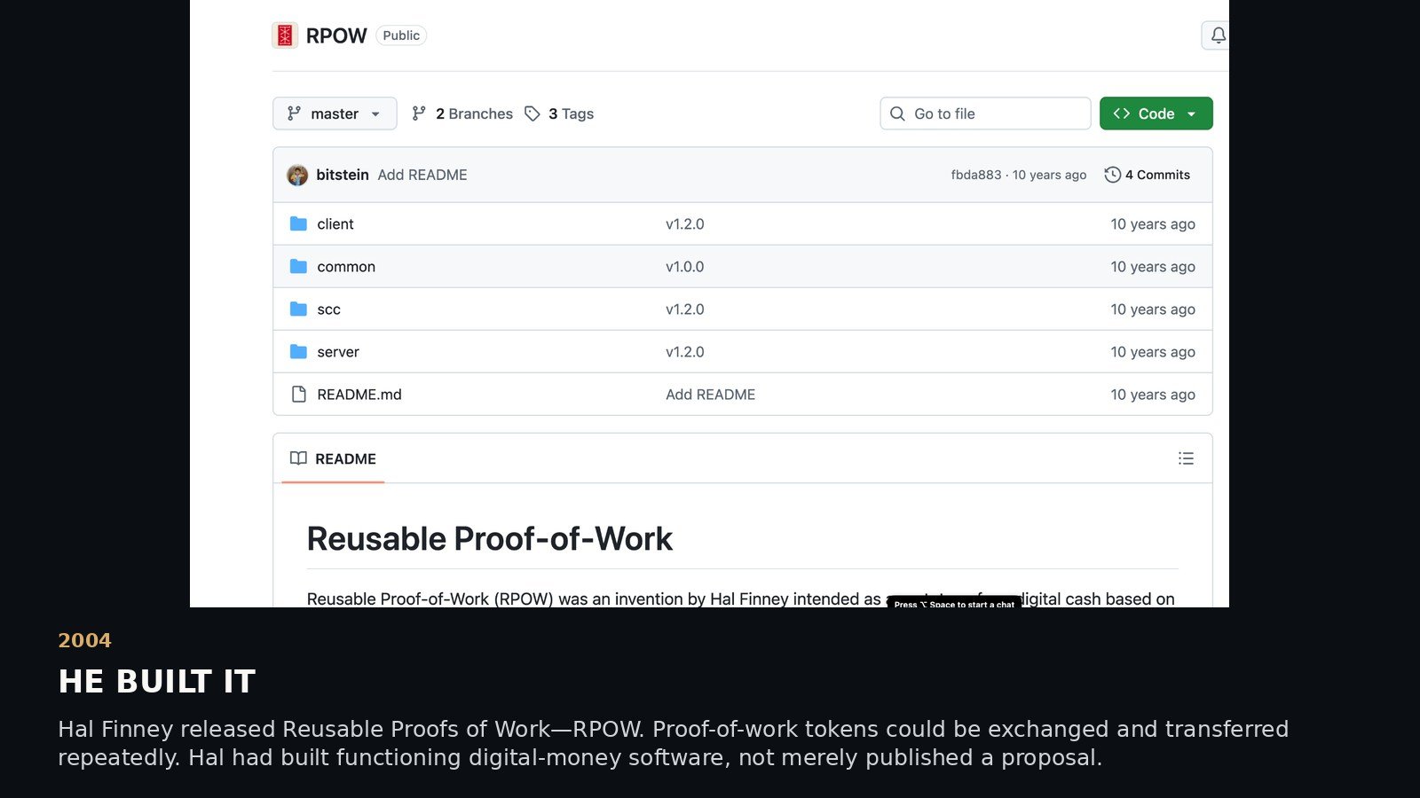
Notes:
SCENE 22 (original storyboard scene 24) — 2004 · AGE 48 · HE BUILT IT
NARRATIVE
Hal Finney released Reusable Proofs of Work—RPOW. Proof-of-work tokens could be exchanged and transferred repeatedly. Hal had built functioning digital-money software, not merely published a proposal.
SOURCE AND INTERPRETATION
Hal's August 2004 RPOW announcement. GitHub upload dates are later archival dates.
The photograph/document is historical where explicitly described as such. Text-only editorial pages are not archival facsimiles. Hypotheses about Satoshi authorship are unproven.
PRESENTATION GUIDANCE: Allow the image or document to lead. Pause at the central question before advancing. Avoid presenting circumstantial similarity as authorship proof.

Slide 23
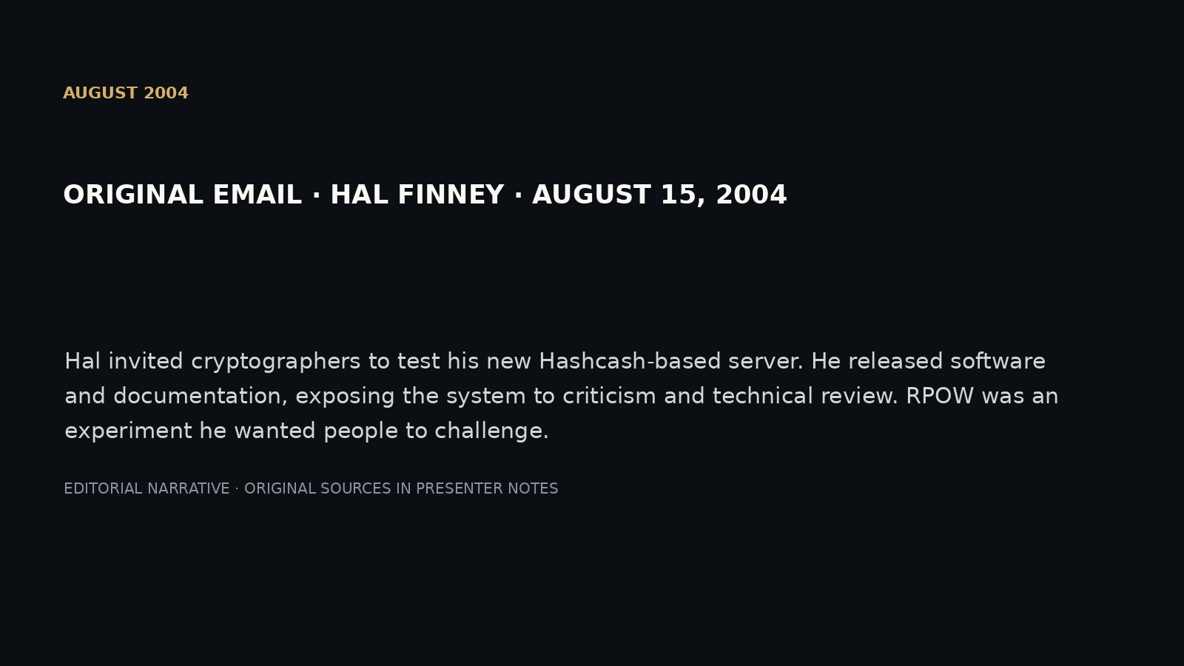
Notes:
SCENE 23 (original storyboard scene 25) — AUGUST 2004 · THE ANNOUNCEMENT
NARRATIVE
Hal invited cryptographers to test his new Hashcash-based server. He released software and documentation, exposing the system to criticism and technical review. RPOW was an experiment he wanted people to challenge.
SOURCE AND INTERPRETATION
MetzDowd Cryptography mailing-list archive, August 2004.
The photograph/document is historical where explicitly described as such. Text-only editorial pages are not archival facsimiles. Hypotheses about Satoshi authorship are unproven.
PRESENTATION GUIDANCE: Allow the image or document to lead. Pause at the central question before advancing. Avoid presenting circumstantial similarity as authorship proof.

Slide 24
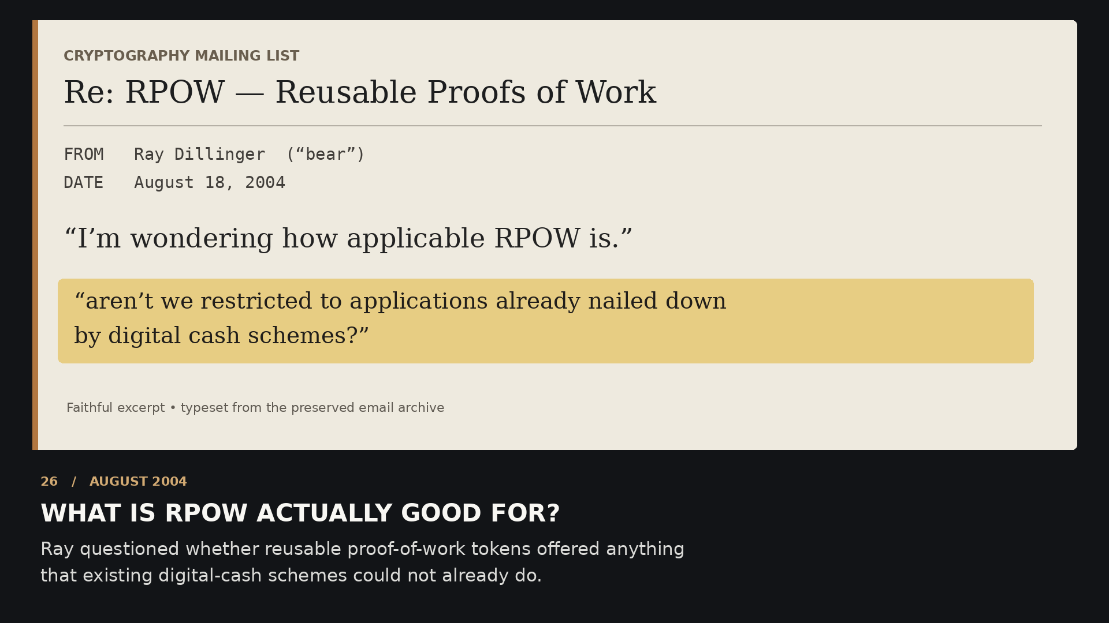
Notes:
SCENE 24 (original storyboard scene 26) — AUGUST 2004 · THE CRITIC
NARRATIVE
Ray Dillinger questioned what transferable proof-of-work tokens were actually good for. If work could be transferred and reused, what gave the tokens practical value? It was a difficult question for anyone attempting to invent new money.
SOURCE AND INTERPRETATION
Original mailing-list correspondence.
The photograph/document is historical where explicitly described as such. Text-only editorial pages are not archival facsimiles. Hypotheses about Satoshi authorship are unproven.
PRESENTATION GUIDANCE: Allow the image or document to lead. Pause at the central question before advancing. Avoid presenting circumstantial similarity as authorship proof.

Slide 25
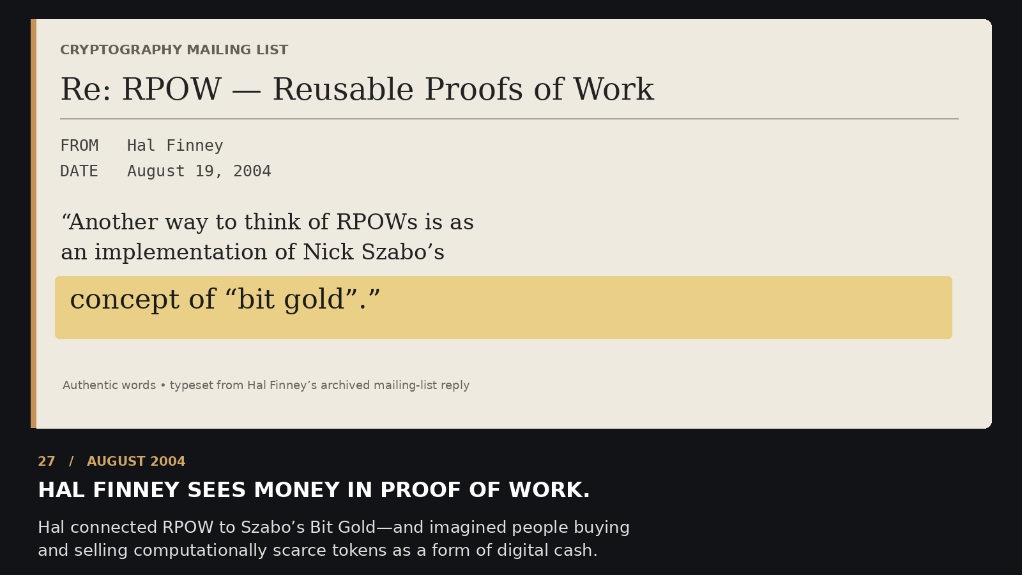
Notes:
SCENE 25 (original storyboard scene 27) — AUGUST 2004 · HAL ANSWERS
NARRATIVE
Hal connected RPOW directly to Nick Szabo's Bit Gold. He imagined computationally scarce tokens being bought and sold, if people found a compelling use for them. Four years before Bitcoin, he was wrestling with the economics of digital scarcity.
SOURCE AND INTERPRETATION
Original mailing-list response by Hal.
The photograph/document is historical where explicitly described as such. Text-only editorial pages are not archival facsimiles. Hypotheses about Satoshi authorship are unproven.
PRESENTATION GUIDANCE: Allow the image or document to lead. Pause at the central question before advancing. Avoid presenting circumstantial similarity as authorship proof.

Slide 26
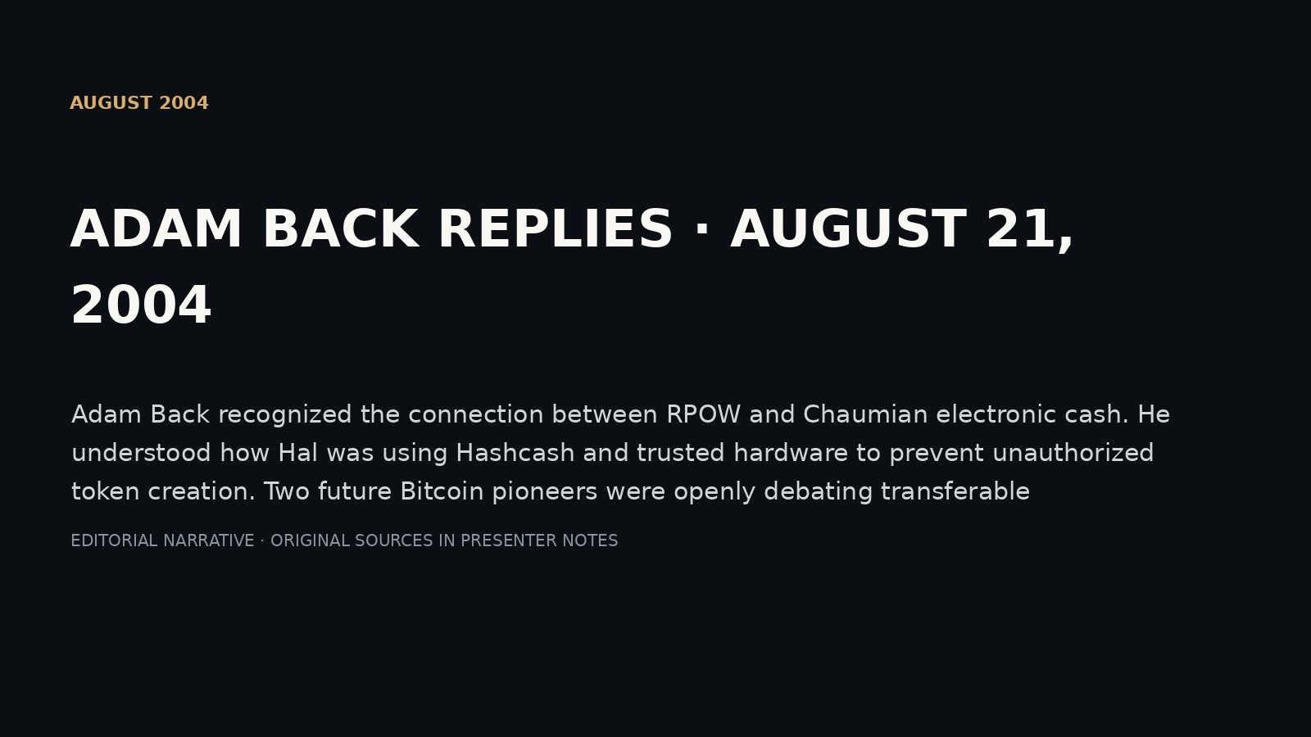
Notes:
SCENE 26 (original storyboard scene 28) — AUGUST 2004 · ADAM BACK REPLIES
NARRATIVE
Adam Back recognized the connection between RPOW and Chaumian electronic cash. He understood how Hal was using Hashcash and trusted hardware to prevent unauthorized token creation. Two future Bitcoin pioneers were openly debating transferable proof-of-work money.
SOURCE AND INTERPRETATION
MetzDowd August 2004 thread.
The photograph/document is historical where explicitly described as such. Text-only editorial pages are not archival facsimiles. Hypotheses about Satoshi authorship are unproven.
PRESENTATION GUIDANCE: Allow the image or document to lead. Pause at the central question before advancing. Avoid presenting circumstantial similarity as authorship proof.

Slide 27
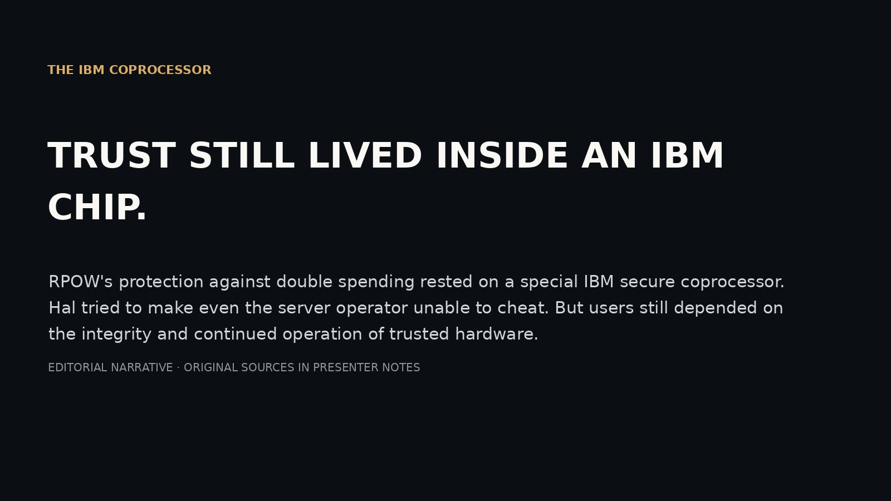
Notes:
SCENE 27 (original storyboard scene 29) — THE IBM COPROCESSOR
NARRATIVE
RPOW's protection against double spending rested on a special IBM secure coprocessor. Hal tried to make even the server operator unable to cheat. But users still depended on the integrity and continued operation of trusted hardware.
SOURCE AND INTERPRETATION
RPOW technical documentation.
The photograph/document is historical where explicitly described as such. Text-only editorial pages are not archival facsimiles. Hypotheses about Satoshi authorship are unproven.
PRESENTATION GUIDANCE: Allow the image or document to lead. Pause at the central question before advancing. Avoid presenting circumstantial similarity as authorship proof.

Slide 28
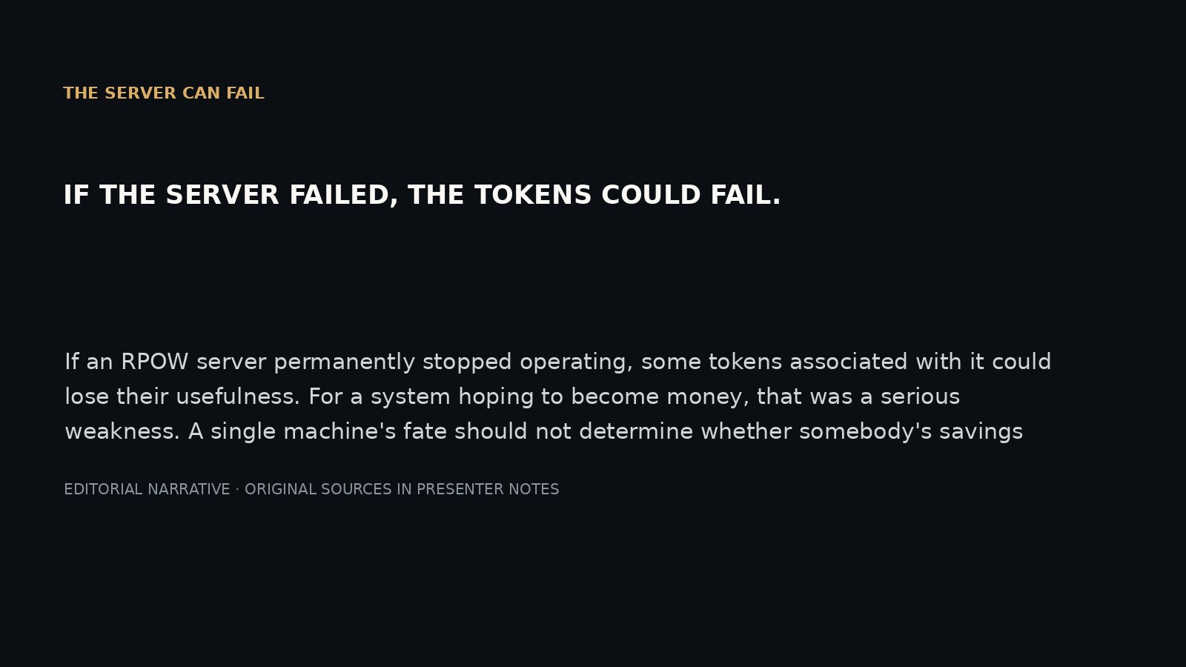
Notes:
SCENE 28 (original storyboard scene 30) — THE SERVER CAN FAIL
NARRATIVE
If an RPOW server permanently stopped operating, some tokens associated with it could lose their usefulness. For a system hoping to become money, that was a serious weakness. A single machine's fate should not determine whether somebody's savings survive.
SOURCE AND INTERPRETATION
Hal, *World of RPOW*.
The photograph/document is historical where explicitly described as such. Text-only editorial pages are not archival facsimiles. Hypotheses about Satoshi authorship are unproven.
PRESENTATION GUIDANCE: Allow the image or document to lead. Pause at the central question before advancing. Avoid presenting circumstantial similarity as authorship proof.

Slide 29
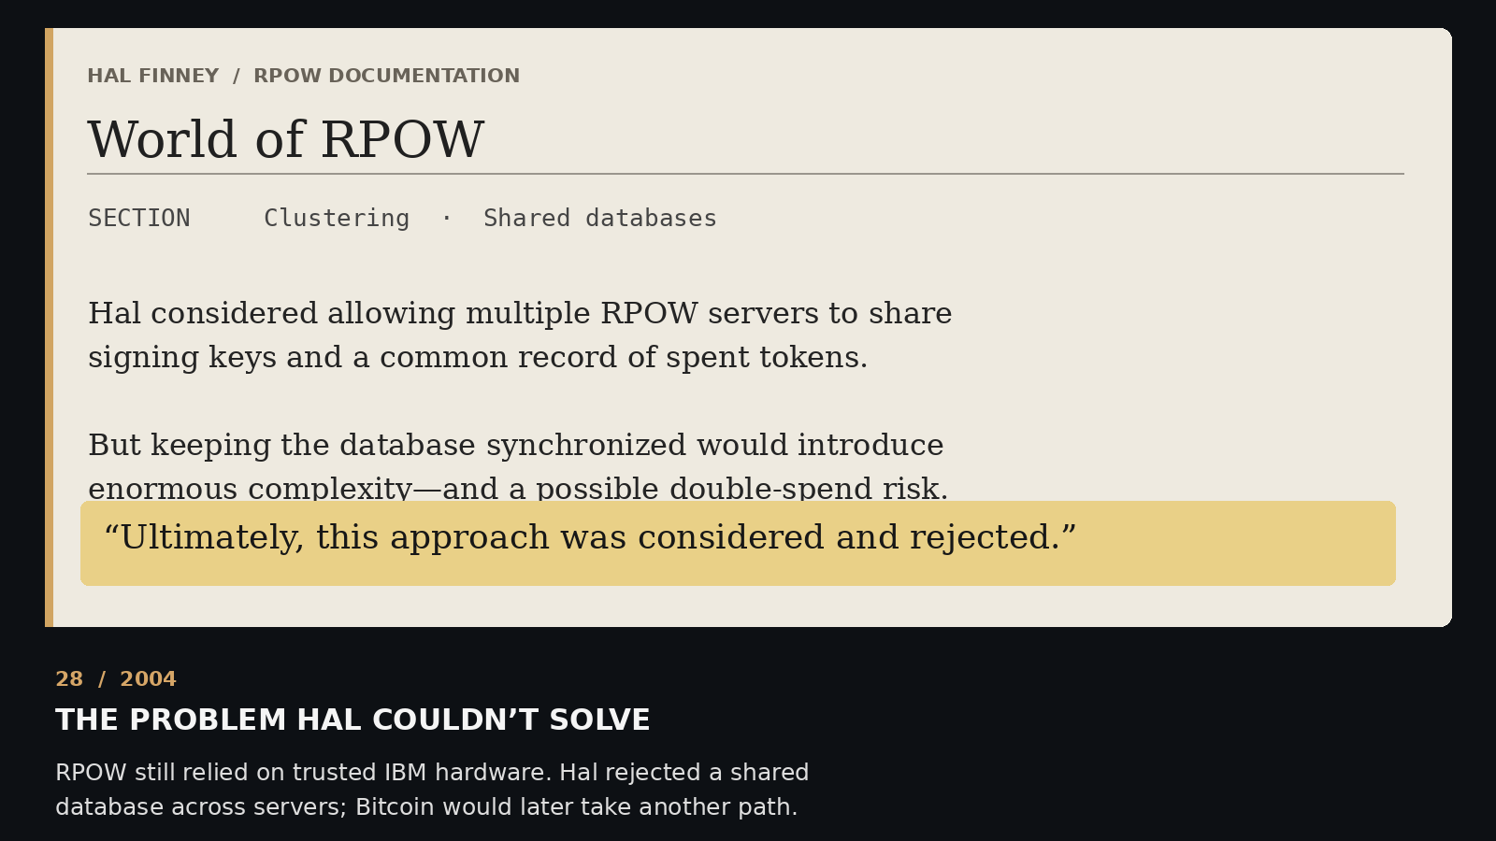
Notes:
SCENE 29 (original storyboard scene 31) — A SHARED DATABASE?
NARRATIVE
Hal considered having multiple RPOW servers maintain a shared record of spent tokens. That required keeping their histories consistent while preventing double spending. He judged the proposed design too complex for RPOW and rejected it.
SOURCE AND INTERPRETATION
Hal, *World of RPOW*. The rejected architecture was not Bitcoin's later consensus system.
The photograph/document is historical where explicitly described as such. Text-only editorial pages are not archival facsimiles. Hypotheses about Satoshi authorship are unproven.
PRESENTATION GUIDANCE: Allow the image or document to lead. Pause at the central question before advancing. Avoid presenting circumstantial similarity as authorship proof.

Slide 30
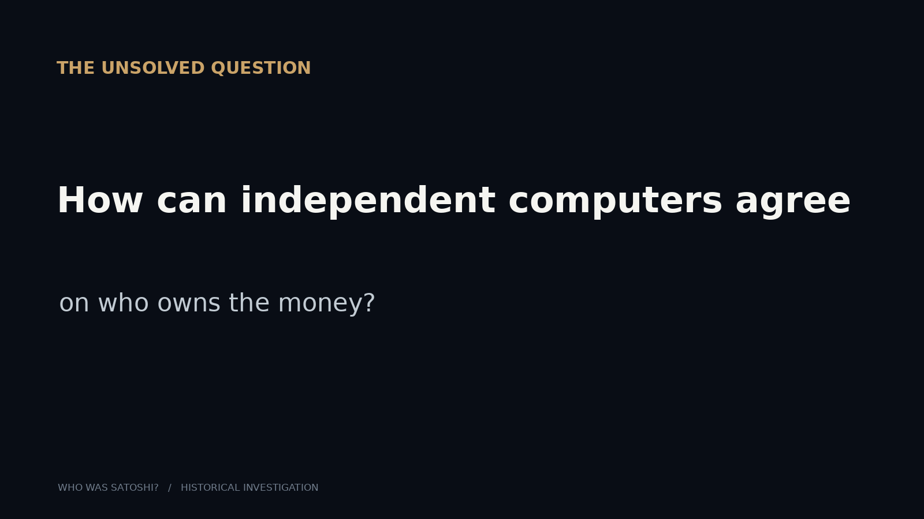
Notes:
SCENE 30 (original storyboard scene 32) — THE PROBLEM
NARRATIVE
How can computers that don't trust one another agree about who owns the money? Hal had confronted the problem. He had not published a permissionless consensus solution. This was the missing step between working digital tokens and decentralized money.
SOURCE AND INTERPRETATION
Historical synthesis; avoid asserting Hal personally solved this later.
The photograph/document is historical where explicitly described as such. Text-only editorial pages are not archival facsimiles. Hypotheses about Satoshi authorship are unproven.
PRESENTATION GUIDANCE: Allow the image or document to lead. Pause at the central question before advancing. Avoid presenting circumstantial similarity as authorship proof.

Slide 31
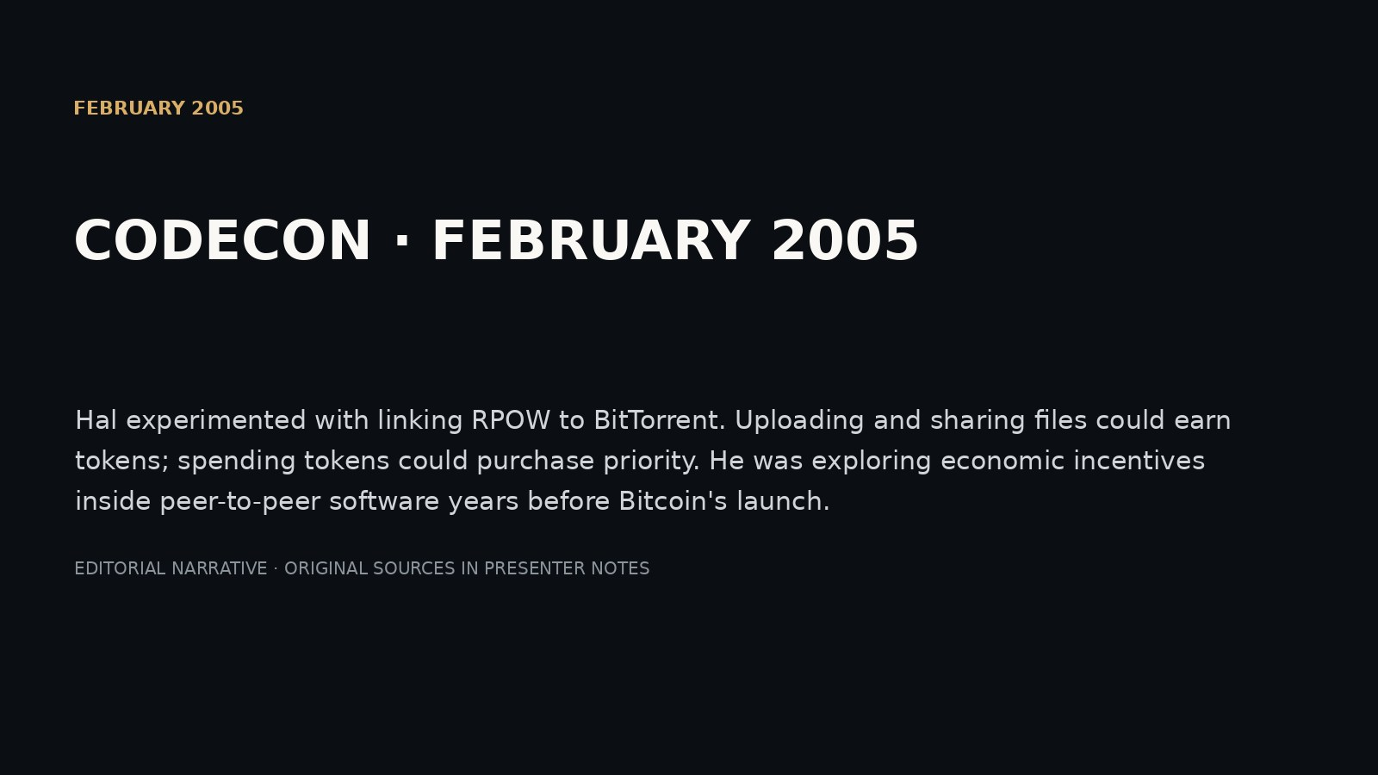
Notes:
SCENE 31 (original storyboard scene 33) — FEBRUARY 2005 · PEER-TO-PEER MONEY
NARRATIVE
Hal experimented with linking RPOW to BitTorrent. Uploading and sharing files could earn tokens; spending tokens could purchase priority. He was exploring economic incentives inside peer-to-peer software years before Bitcoin's launch.
SOURCE AND INTERPRETATION
Hal's February 2005 announcement.
The photograph/document is historical where explicitly described as such. Text-only editorial pages are not archival facsimiles. Hypotheses about Satoshi authorship are unproven.
PRESENTATION GUIDANCE: Allow the image or document to lead. Pause at the central question before advancing. Avoid presenting circumstantial similarity as authorship proof.

Slide 32
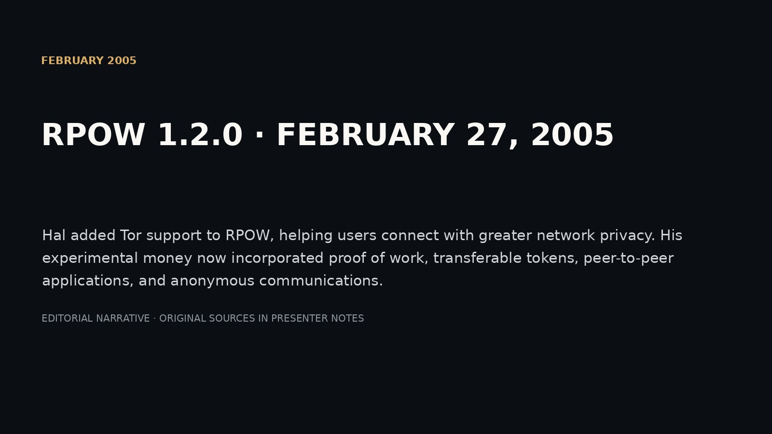
Notes:
SCENE 32 (original storyboard scene 34) — FEBRUARY 2005 · TOR
NARRATIVE
Hal added Tor support to RPOW, helping users connect with greater network privacy. His experimental money now incorporated proof of work, transferable tokens, peer-to-peer applications, and anonymous communications.
SOURCE AND INTERPRETATION
RPOW release log February 27, 2005.
The photograph/document is historical where explicitly described as such. Text-only editorial pages are not archival facsimiles. Hypotheses about Satoshi authorship are unproven.
PRESENTATION GUIDANCE: Allow the image or document to lead. Pause at the central question before advancing. Avoid presenting circumstantial similarity as authorship proof.

Slide 33
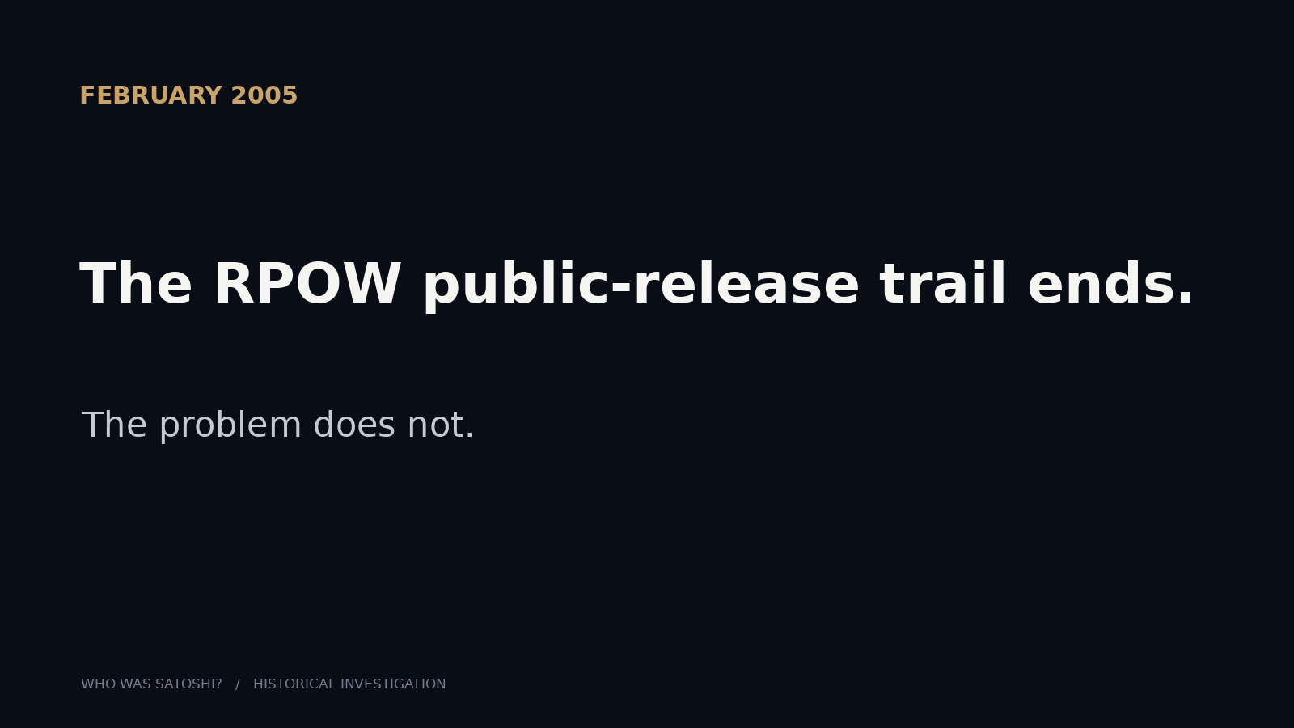
Notes:
SCENE 33 (original storyboard scene 35) — FEBRUARY 2005 · THE PUBLIC TRAIL ENDS
NARRATIVE
The last verified public RPOW release appeared in February 2005. Hal did not disappear: he continued cryptographic work. But the surviving public RPOW record no longer tells us whether he was pursuing the deeper monetary problem.
SOURCE AND INTERPRETATION
RPOW news archive; gaps in public records are not proof of private Bitcoin development.
The photograph/document is historical where explicitly described as such. Text-only editorial pages are not archival facsimiles. Hypotheses about Satoshi authorship are unproven.
PRESENTATION GUIDANCE: Allow the image or document to lead. Pause at the central question before advancing. Avoid presenting circumstantial similarity as authorship proof.

Slide 34
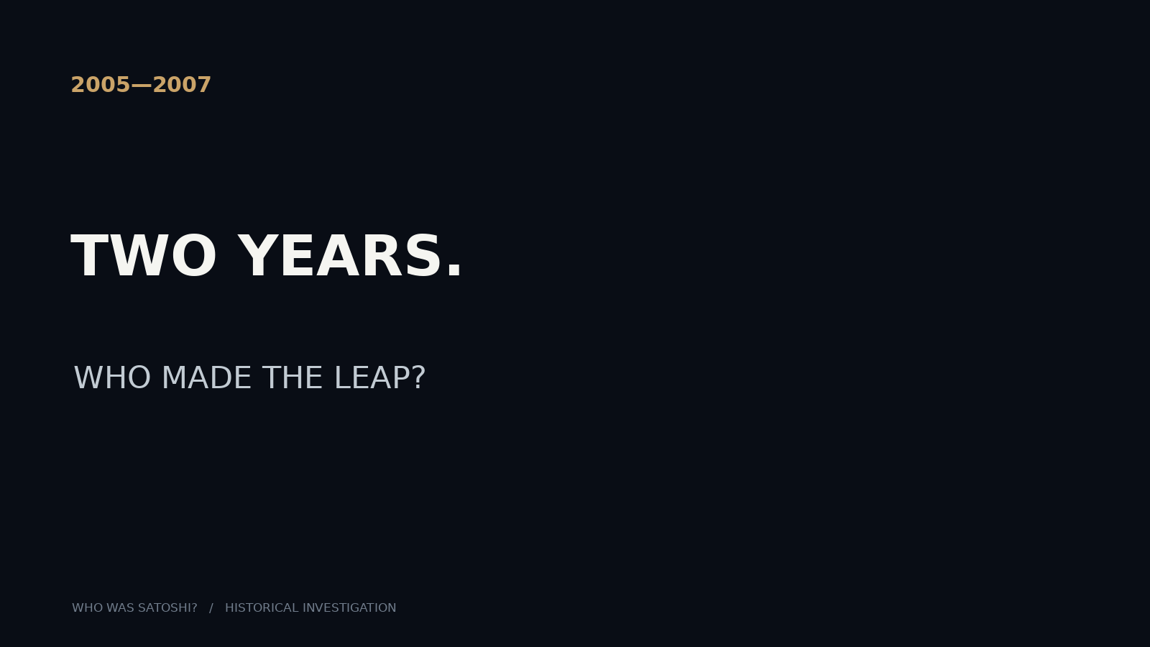
Notes:
SCENE 34 (original storyboard scene 36) — 2005–2007 · TWO YEARS
NARRATIVE
Wei Dai continued Crypto++ development. Nick Szabo described Bit Gold in detail. Hal Finney worked on cryptographic engineering and trusted computing. We can document much of their public work—but not the invention of Bitcoin's consensus rule.
SOURCE AND INTERPRETATION
Crypto++ release history; Szabo 2005 essay; OpenPGP records.
The photograph/document is historical where explicitly described as such. Text-only editorial pages are not archival facsimiles. Hypotheses about Satoshi authorship are unproven.
PRESENTATION GUIDANCE: Allow the image or document to lead. Pause at the central question before advancing. Avoid presenting circumstantial similarity as authorship proof.
Missing public RPOW releases do NOT mean that Hal stopped working: RFC 4880 and trusted-computing correspondence document other work.

Slide 35
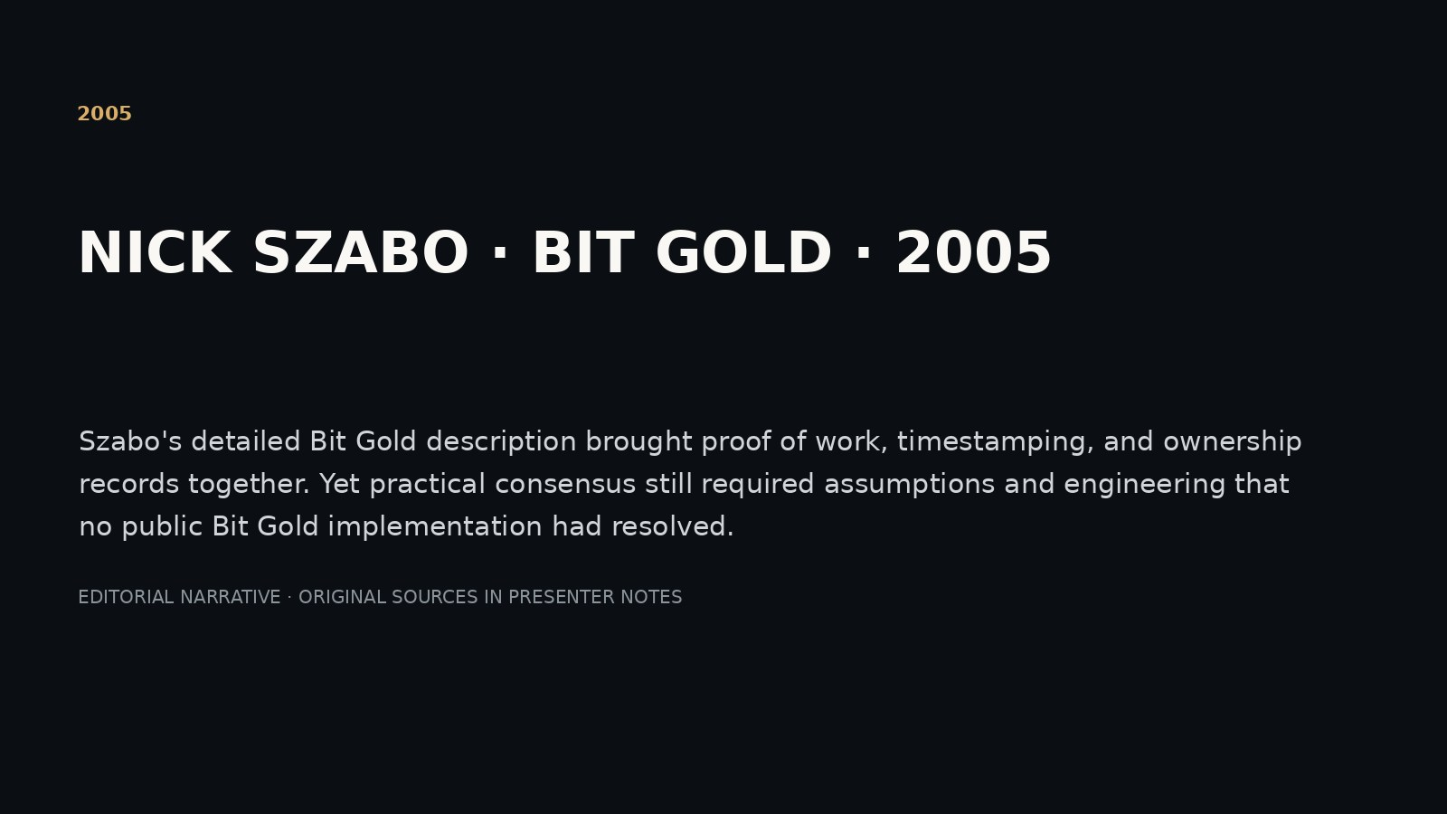
Notes:
SCENE 35 (original storyboard scene 37) — 2005 · BIT GOLD IN PRINT
NARRATIVE
Szabo's detailed Bit Gold description brought proof of work, timestamping, and ownership records together. Yet practical consensus still required assumptions and engineering that no public Bit Gold implementation had resolved.
SOURCE AND INTERPRETATION
Szabo, *Bit Gold*, December 2005.
The photograph/document is historical where explicitly described as such. Text-only editorial pages are not archival facsimiles. Hypotheses about Satoshi authorship are unproven.
PRESENTATION GUIDANCE: Allow the image or document to lead. Pause at the central question before advancing. Avoid presenting circumstantial similarity as authorship proof.

Slide 36
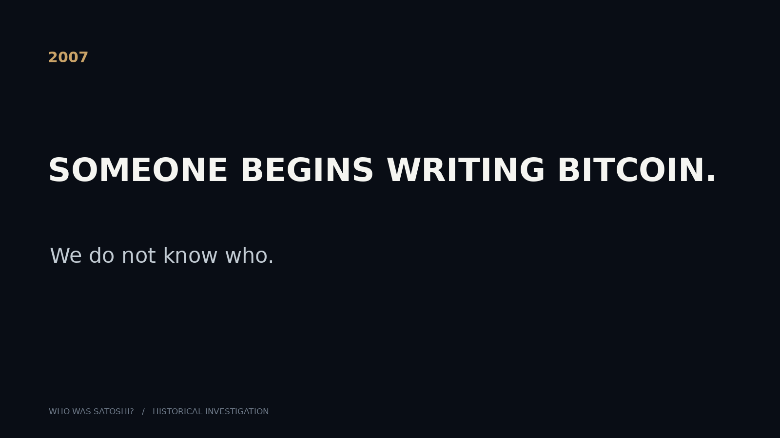
Notes:
SCENE 36 (original storyboard scene 38) — 2007 · SOMEBODY BEGINS CODING
NARRATIVE
Satoshi would later say he had spent roughly a year and a half coding Bitcoin by November 2008. That places the project around the first half of 2007. The code began long before the world saw the whitepaper.
SOURCE AND INTERPRETATION
Satoshi correspondence, November 2008. Approximate start date, not a precise timestamp.
The photograph/document is historical where explicitly described as such. Text-only editorial pages are not archival facsimiles. Hypotheses about Satoshi authorship are unproven.
PRESENTATION GUIDANCE: Allow the image or document to lead. Pause at the central question before advancing. Avoid presenting circumstantial similarity as authorship proof.

Slide 37
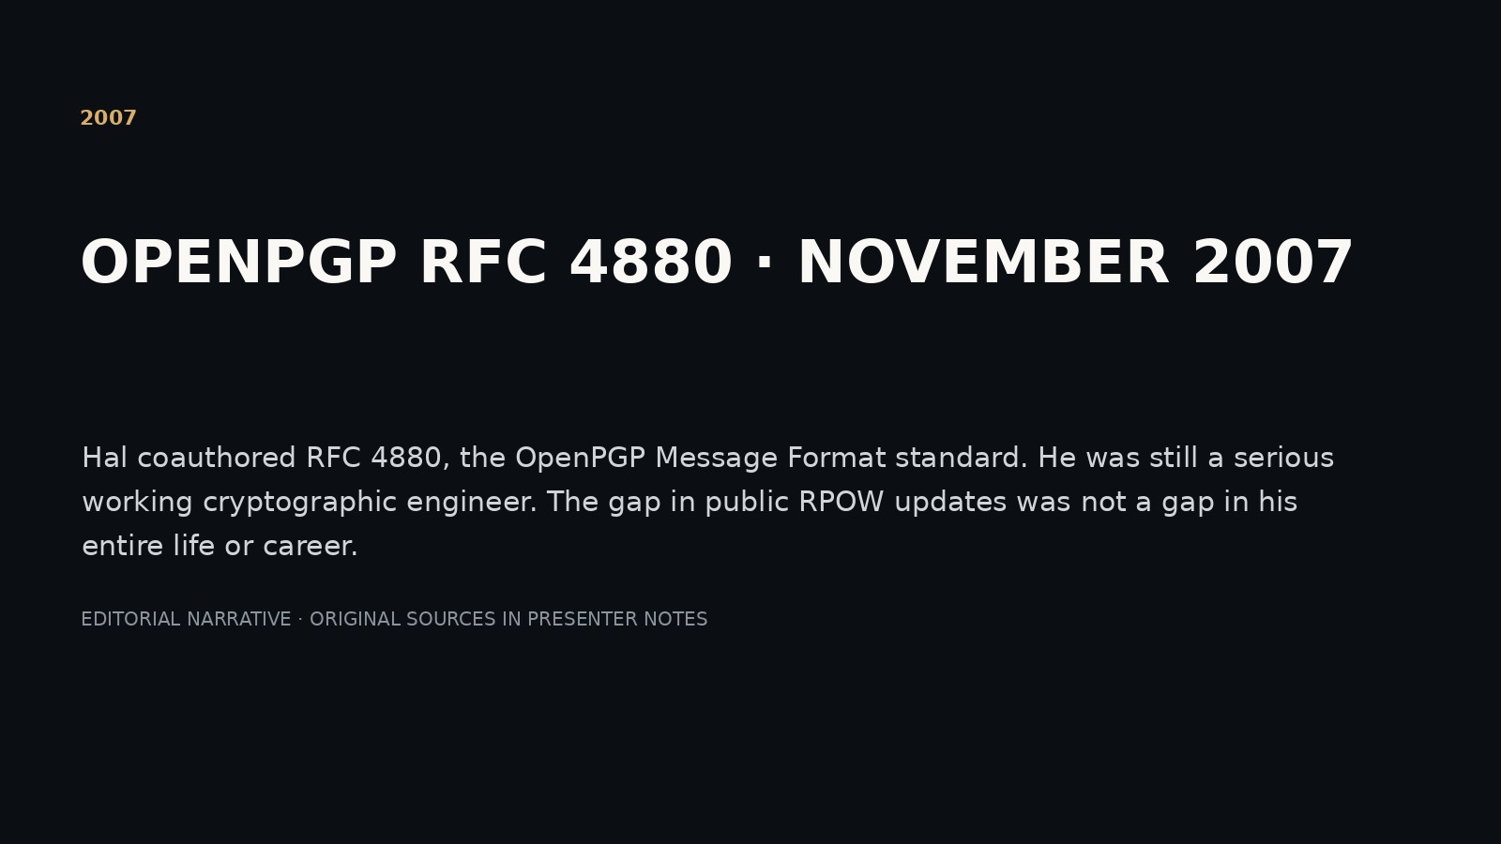
Notes:
SCENE 37 (original storyboard scene 39) — 2007 · HAL IS STILL ACTIVE
NARRATIVE
Hal coauthored RFC 4880, the OpenPGP Message Format standard. He was still a serious working cryptographic engineer. The gap in public RPOW updates was not a gap in his entire life or career.
SOURCE AND INTERPRETATION
RFC Editor, November 2007.
The photograph/document is historical where explicitly described as such. Text-only editorial pages are not archival facsimiles. Hypotheses about Satoshi authorship are unproven.
PRESENTATION GUIDANCE: Allow the image or document to lead. Pause at the central question before advancing. Avoid presenting circumstantial similarity as authorship proof.

Slide 38
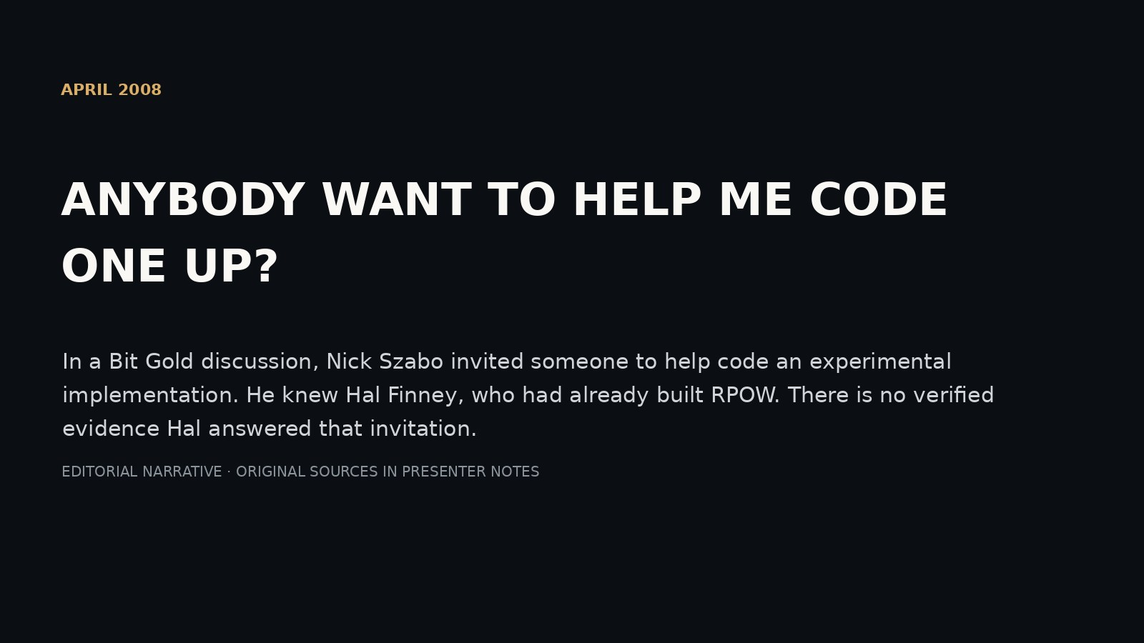
Notes:
SCENE 38 (original storyboard scene 40) — APRIL 2008 · SZABO ASKS FOR HELP
NARRATIVE
In a Bit Gold discussion, Nick Szabo invited someone to help code an experimental implementation. He knew Hal Finney, who had already built RPOW. There is no verified evidence Hal answered that invitation.
SOURCE AND INTERPRETATION
Szabo blog comment, date reconstruction requires careful verification.
The photograph/document is historical where explicitly described as such. Text-only editorial pages are not archival facsimiles. Hypotheses about Satoshi authorship are unproven.
PRESENTATION GUIDANCE: Allow the image or document to lead. Pause at the central question before advancing. Avoid presenting circumstantial similarity as authorship proof.

Slide 39
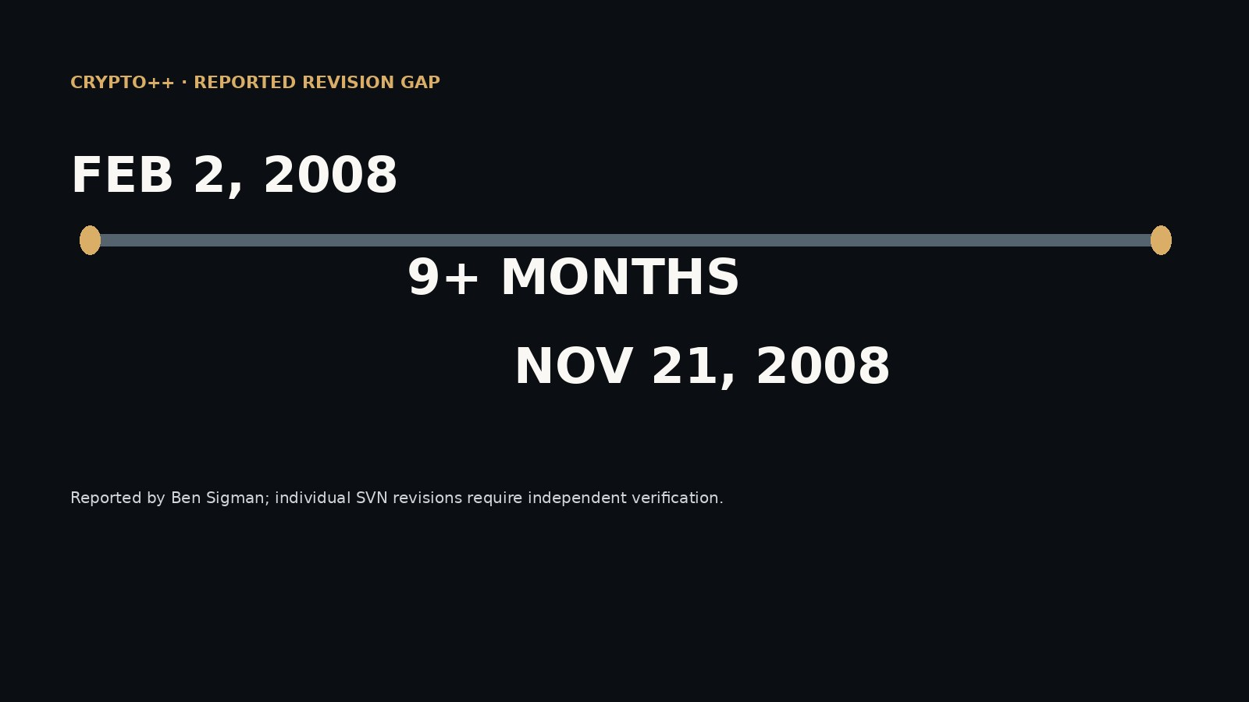
Notes:
SCENE 39 (original storyboard scene 41) — FEBRUARY–NOVEMBER 2008 · WEI'S COMMIT GAP
NARRATIVE
Ben Sigman identified a reported gap in recorded Crypto++ commits from February 2 to November 21, 2008. It overlaps Bitcoin development. But a version-control gap does not tell us what Wei Dai was doing—and the historical log needs independent audit.
SOURCE AND INTERPRETATION
Ben Sigman's 2026 thread; avoid equating release gaps with commits.
The photograph/document is historical where explicitly described as such. Text-only editorial pages are not archival facsimiles. Hypotheses about Satoshi authorship are unproven.
PRESENTATION GUIDANCE: Allow the image or document to lead. Pause at the central question before advancing. Avoid presenting circumstantial similarity as authorship proof.
The reported February–November Crypto++ commit gap is attributed to Ben Sigman and has not been independently reconstructed from original version-control metadata.

Slide 40
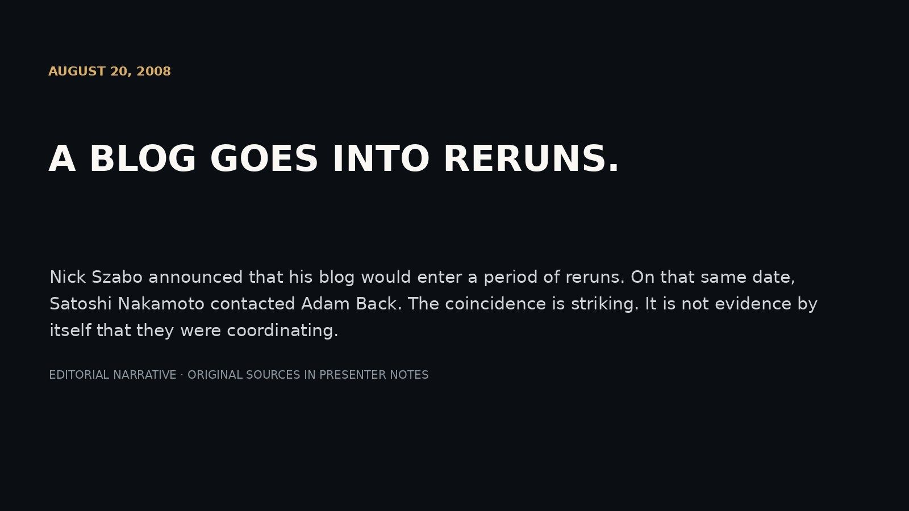
Notes:
SCENE 40 (original storyboard scene 42) — AUGUST 20, 2008 · RERUNS
NARRATIVE
Nick Szabo announced that his blog would enter a period of reruns. On that same date, Satoshi Nakamoto contacted Adam Back. The coincidence is striking. It is not evidence by itself that they were coordinating.
SOURCE AND INTERPRETATION
Unenumerated archive; Szabo continued posting afterward.
The photograph/document is historical where explicitly described as such. Text-only editorial pages are not archival facsimiles. Hypotheses about Satoshi authorship are unproven.
PRESENTATION GUIDANCE: Allow the image or document to lead. Pause at the central question before advancing. Avoid presenting circumstantial similarity as authorship proof.

Slide 41
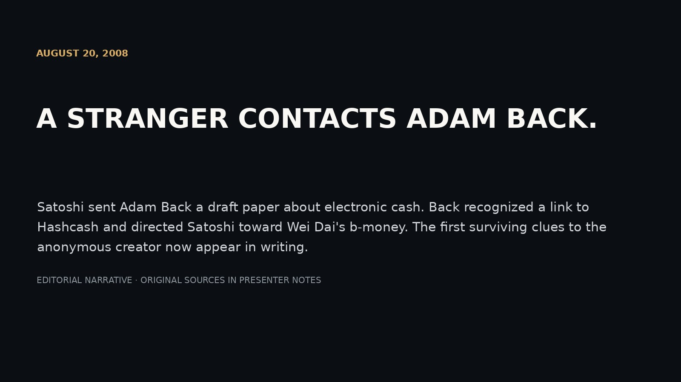
Notes:
SCENE 41 (original storyboard scene 43) — AUGUST 20, 2008 · A STRANGER WRITES
NARRATIVE
Satoshi sent Adam Back a draft paper about electronic cash. Back recognized a link to Hashcash and directed Satoshi toward Wei Dai's b-money. The first surviving clues to the anonymous creator now appear in writing.
SOURCE AND INTERPRETATION
Preserved 2008 correspondence.
The photograph/document is historical where explicitly described as such. Text-only editorial pages are not archival facsimiles. Hypotheses about Satoshi authorship are unproven.
PRESENTATION GUIDANCE: Allow the image or document to lead. Pause at the central question before advancing. Avoid presenting circumstantial similarity as authorship proof.

Slide 42
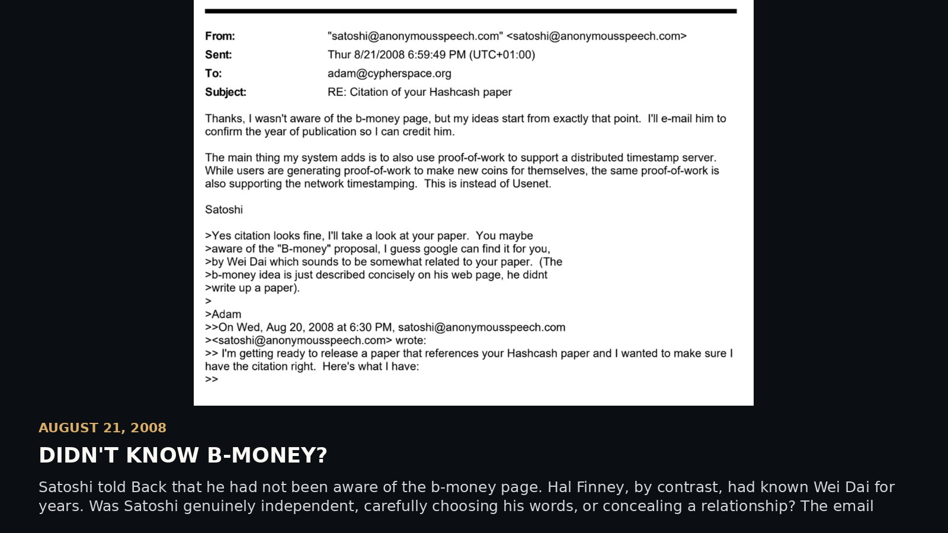
Notes:
SCENE 42 (original storyboard scene 44) — AUGUST 21, 2008 · DIDN'T KNOW B-MONEY?
NARRATIVE
Satoshi told Back that he had not been aware of the b-money page. Hal Finney, by contrast, had known Wei Dai for years. Was Satoshi genuinely independent, carefully choosing his words, or concealing a relationship? The email alone cannot tell us.
SOURCE AND INTERPRETATION
Original Satoshi–Back correspondence.
The photograph/document is historical where explicitly described as such. Text-only editorial pages are not archival facsimiles. Hypotheses about Satoshi authorship are unproven.
PRESENTATION GUIDANCE: Allow the image or document to lead. Pause at the central question before advancing. Avoid presenting circumstantial similarity as authorship proof.

Slide 43
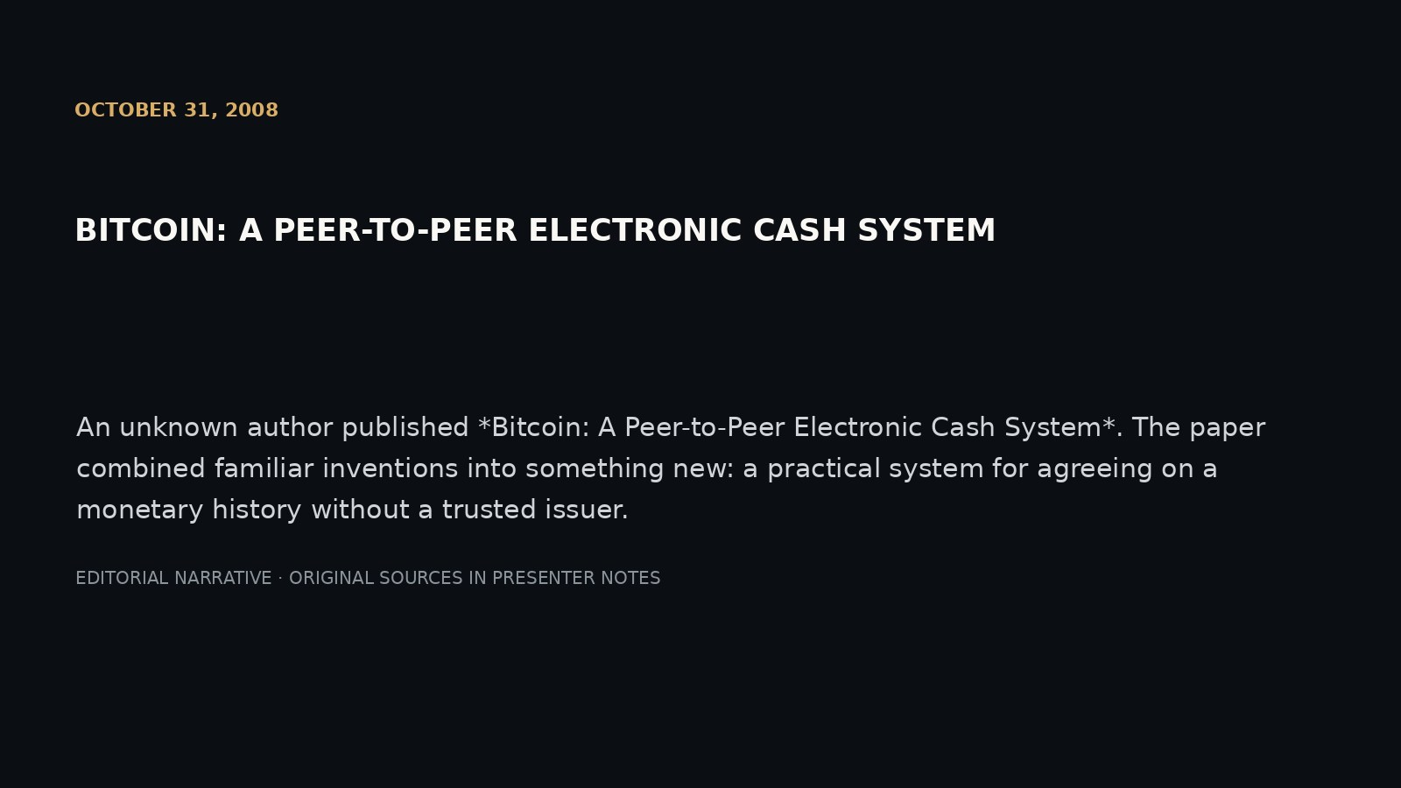
Notes:
SCENE 43 (original storyboard scene 45) — OCTOBER 31, 2008 · THE WHITEPAPER
NARRATIVE
An unknown author published *Bitcoin: A Peer-to-Peer Electronic Cash System*. The paper combined familiar inventions into something new: a practical system for agreeing on a monetary history without a trusted issuer.
SOURCE AND INTERPRETATION
Satoshi Nakamoto (2008).
The photograph/document is historical where explicitly described as such. Text-only editorial pages are not archival facsimiles. Hypotheses about Satoshi authorship are unproven.
PRESENTATION GUIDANCE: Allow the image or document to lead. Pause at the central question before advancing. Avoid presenting circumstantial similarity as authorship proof.

Slide 44
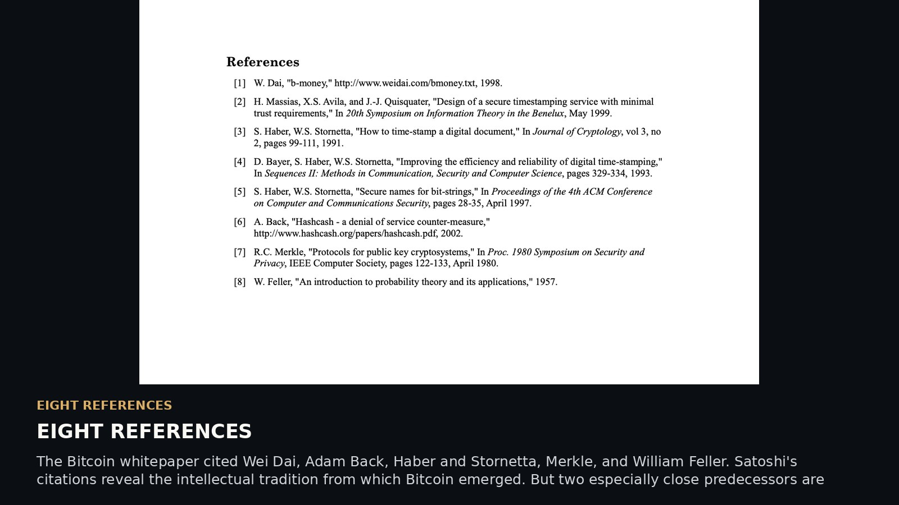
Notes:
SCENE 44 (original storyboard scene 46) — EIGHT REFERENCES
NARRATIVE
The Bitcoin whitepaper cited Wei Dai, Adam Back, Haber and Stornetta, Merkle, and William Feller. Satoshi's citations reveal the intellectual tradition from which Bitcoin emerged. But two especially close predecessors are absent from the bibliography.
SOURCE AND INTERPRETATION
Bitcoin whitepaper bibliography.
The photograph/document is historical where explicitly described as such. Text-only editorial pages are not archival facsimiles. Hypotheses about Satoshi authorship are unproven.
PRESENTATION GUIDANCE: Allow the image or document to lead. Pause at the central question before advancing. Avoid presenting circumstantial similarity as authorship proof.

Slide 45
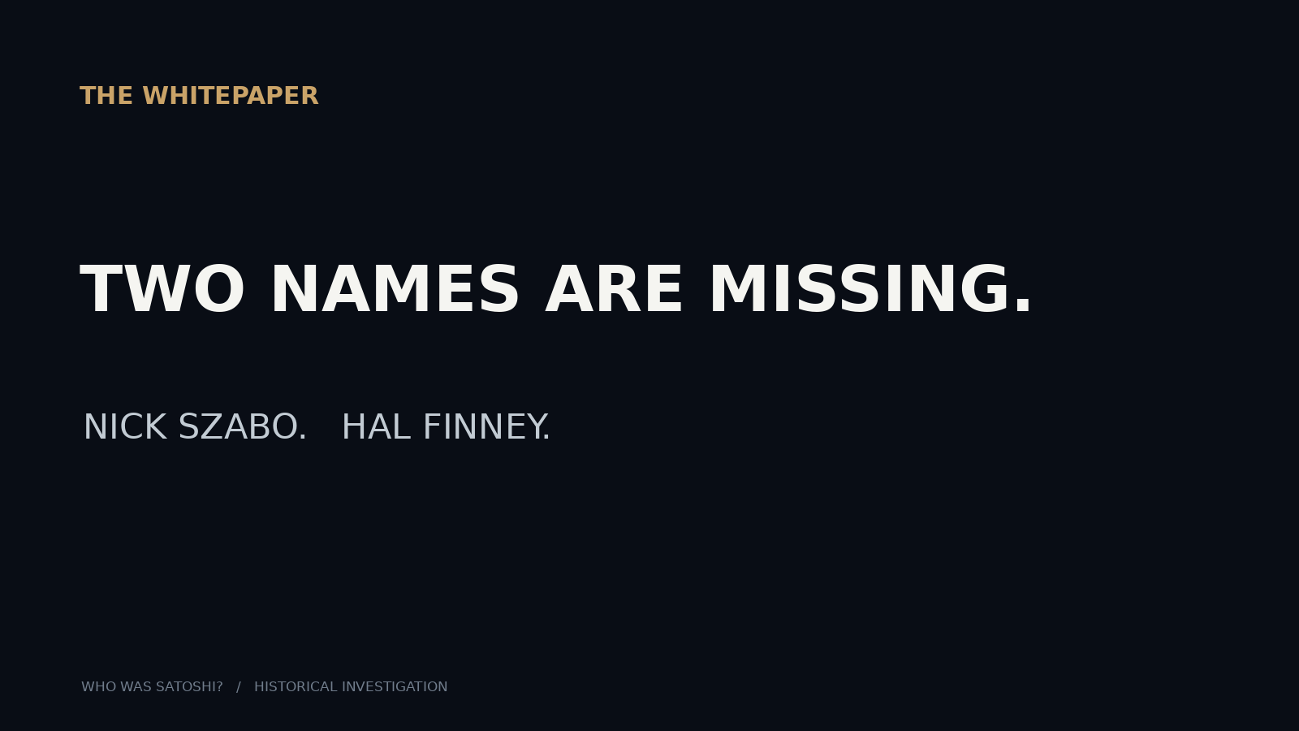
Notes:
SCENE 45 (original storyboard scene 47) — TWO NAMES ARE MISSING
NARRATIVE
NICK SZABO. HAL FINNEY. Bit Gold and RPOW were important precursors to Bitcoin, but neither was cited in the whitepaper. Was the omission editorial judgment, an oversight, or deliberate distancing? We have no evidence establishing the motive.
SOURCE AND INTERPRETATION
Whitepaper references; do not claim suppression as fact.
The photograph/document is historical where explicitly described as such. Text-only editorial pages are not archival facsimiles. Hypotheses about Satoshi authorship are unproven.
PRESENTATION GUIDANCE: Allow the image or document to lead. Pause at the central question before advancing. Avoid presenting circumstantial similarity as authorship proof.
Absence of Szabo and Finney from the bibliography does not establish deliberate concealment.

Slide 46
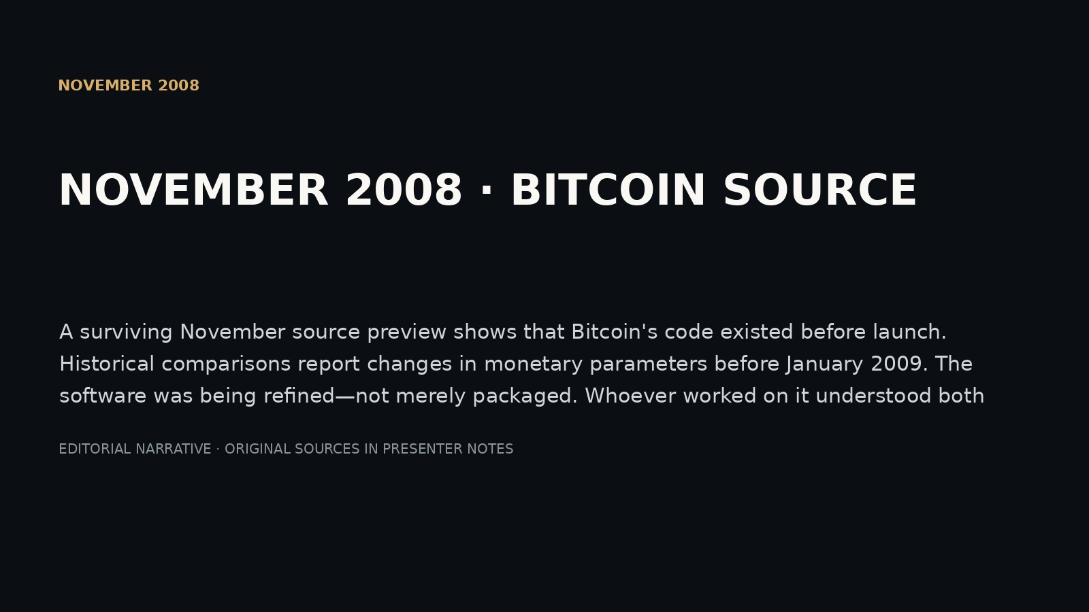
Notes:
SCENE 46 (original storyboard scene 48) — NOVEMBER 2008 · BITCOIN WAS STILL CHANGING
NARRATIVE
A surviving November source preview shows that Bitcoin's code existed before launch. Historical comparisons report changes in monetary parameters before January 2009. The software was being refined—not merely packaged. Whoever worked on it understood both systems engineering and monetary design.
SOURCE AND INTERPRETATION
Original November source snapshot; exact parameter comparisons must be validated from preserved files.
The photograph/document is historical where explicitly described as such. Text-only editorial pages are not archival facsimiles. Hypotheses about Satoshi authorship are unproven.
PRESENTATION GUIDANCE: Allow the image or document to lead. Pause at the central question before advancing. Avoid presenting circumstantial similarity as authorship proof.

Slide 47
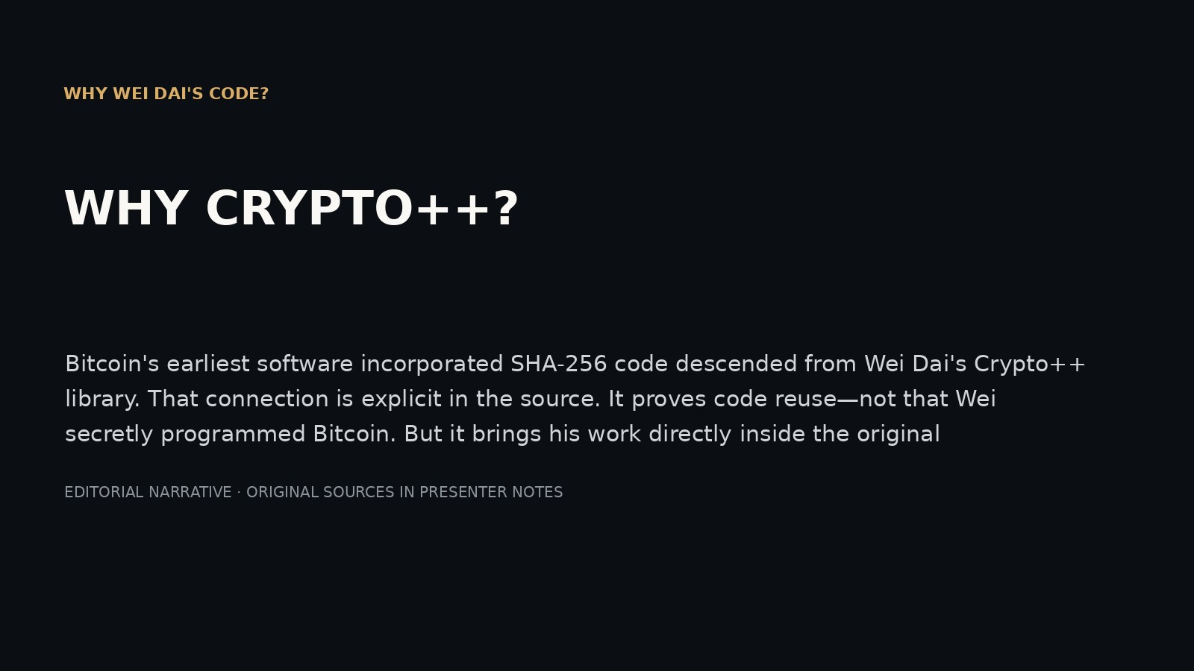
Notes:
SCENE 47 (original storyboard scene 49) — WHY WEI DAI'S CODE?
NARRATIVE
Bitcoin's earliest software incorporated SHA-256 code descended from Wei Dai's Crypto++ library. That connection is explicit in the source. It proves code reuse—not that Wei secretly programmed Bitcoin. But it brings his work directly inside the original implementation.
SOURCE AND INTERPRETATION
Crypto++ 5.5.2 and Bitcoin v0.1 historical source.
The photograph/document is historical where explicitly described as such. Text-only editorial pages are not archival facsimiles. Hypotheses about Satoshi authorship are unproven.
PRESENTATION GUIDANCE: Allow the image or document to lead. Pause at the central question before advancing. Avoid presenting circumstantial similarity as authorship proof.

Slide 48
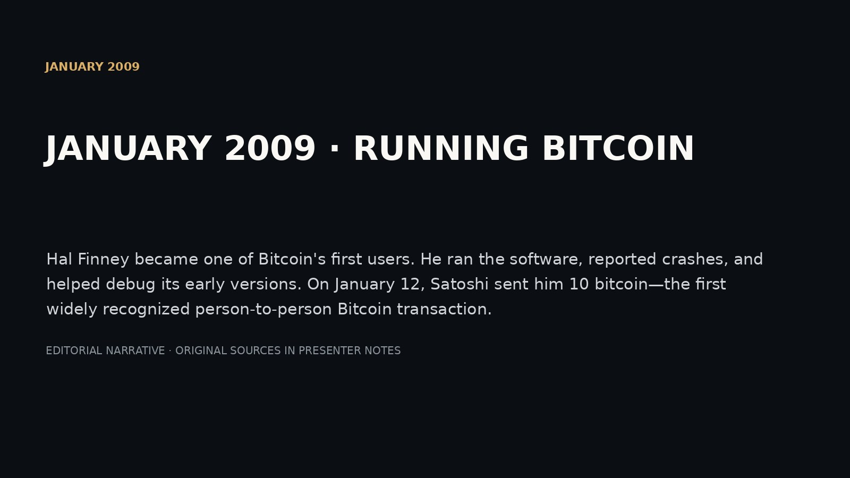
Notes:
SCENE 48 (original storyboard scene 50) — JANUARY 2009 · RUNNING BITCOIN
NARRATIVE
Hal Finney became one of Bitcoin's first users. He ran the software, reported crashes, and helped debug its early versions. On January 12, Satoshi sent him 10 bitcoin—the first widely recognized person-to-person Bitcoin transaction.
SOURCE AND INTERPRETATION
Hal's contemporaneous post and Bitcoin transaction record.
The photograph/document is historical where explicitly described as such. Text-only editorial pages are not archival facsimiles. Hypotheses about Satoshi authorship are unproven.
PRESENTATION GUIDANCE: Allow the image or document to lead. Pause at the central question before advancing. Avoid presenting circumstantial similarity as authorship proof.

Slide 49
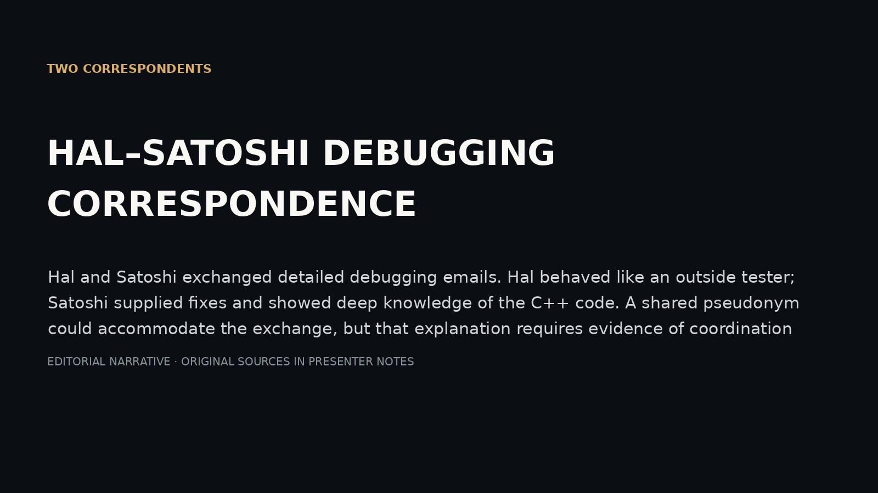
Notes:
SCENE 49 (original storyboard scene 51) — TWO CORRESPONDENTS
NARRATIVE
Hal and Satoshi exchanged detailed debugging emails. Hal behaved like an outside tester; Satoshi supplied fixes and showed deep knowledge of the C++ code. A shared pseudonym could accommodate the exchange, but that explanation requires evidence of coordination that has not been found.
SOURCE AND INTERPRETATION
Hal–Satoshi email archive.
The photograph/document is historical where explicitly described as such. Text-only editorial pages are not archival facsimiles. Hypotheses about Satoshi authorship are unproven.
PRESENTATION GUIDANCE: Allow the image or document to lead. Pause at the central question before advancing. Avoid presenting circumstantial similarity as authorship proof.

Slide 50
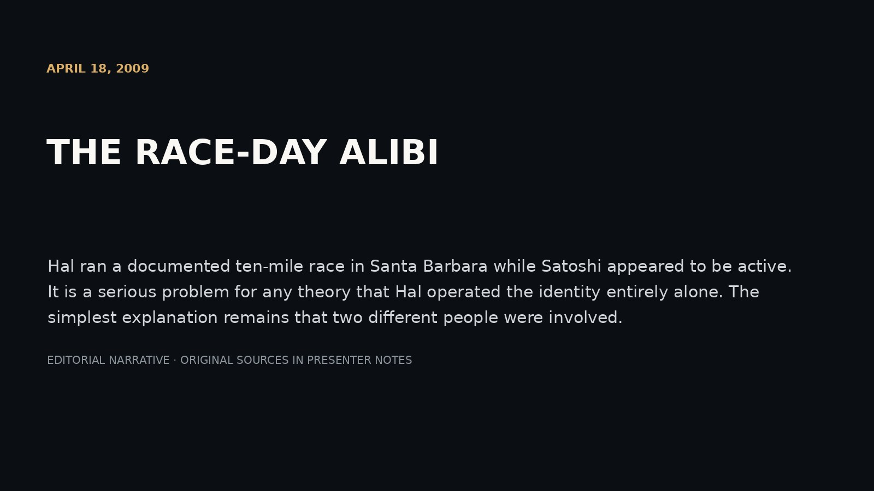
Notes:
SCENE 50 (original storyboard scene 52) — APRIL 18, 2009 · THE RACE
NARRATIVE
Hal ran a documented ten-mile race in Santa Barbara while Satoshi appeared to be active. It is a serious problem for any theory that Hal operated the identity entirely alone. The simplest explanation remains that two different people were involved.
SOURCE AND INTERPRETATION
Race records and Jameson Lopp's analysis; distinguish transaction broadcast timing from confirmation timing.
The photograph/document is historical where explicitly described as such. Text-only editorial pages are not archival facsimiles. Hypotheses about Satoshi authorship are unproven.
PRESENTATION GUIDANCE: Allow the image or document to lead. Pause at the central question before advancing. Avoid presenting circumstantial similarity as authorship proof.

Slide 51

Notes:
SCENE 51 (original storyboard scene 53) — WHAT IF SATOSHI WASN'T ONE PERSON?
NARRATIVE
What if 'Satoshi Nakamoto' named a project, not a person? One engineer might have designed software, while another handled correspondence and releases. It is an intriguing explanation for apparent contradictions—but possibility alone does not demonstrate that such a partnership existed.
SOURCE AND INTERPRETATION
Hypothesis, not established fact.
The photograph/document is historical where explicitly described as such. Text-only editorial pages are not archival facsimiles. Hypotheses about Satoshi authorship are unproven.
PRESENTATION GUIDANCE: Allow the image or document to lead. Pause at the central question before advancing. Avoid presenting circumstantial similarity as authorship proof.

Slide 52

Notes:
SCENE 52 (original storyboard scene 54) — LEN RETURNS
NARRATIVE
Len Sassaman knew Hal and understood the world of pseudonymous cryptography. Bram Cohen remembered Len encouraging software authors to use pseudonyms. *Finding Satoshi* proposes that Len may have assisted Hal. Neither friendship nor anonymity expertise proves that he did.
SOURCE AND INTERPRETATION
Bram's attributed documentary recollections and Meredith Patterson interview.
The photograph/document is historical where explicitly described as such. Text-only editorial pages are not archival facsimiles. Hypotheses about Satoshi authorship are unproven.
PRESENTATION GUIDANCE: Allow the image or document to lead. Pause at the central question before advancing. Avoid presenting circumstantial similarity as authorship proof.

Slide 53

Notes:
SCENE 53 (original storyboard scene 55) — THE THEORY MEETS ITS LIMITS
NARRATIVE
Hal denied being Satoshi. His emails read like correspondence with another developer. Len reportedly criticized Bitcoin. Wei's commit gap has innocent explanations. The multi-person theory is possible, but it must compete with a simpler possibility: Satoshi was someone else.
SOURCE AND INTERPRETATION
Hal's 2013 account and early emails; documentary and independent criticism.
The photograph/document is historical where explicitly described as such. Text-only editorial pages are not archival facsimiles. Hypotheses about Satoshi authorship are unproven.
PRESENTATION GUIDANCE: Allow the image or document to lead. Pause at the central question before advancing. Avoid presenting circumstantial similarity as authorship proof.

Slide 54

Notes:
SCENE 54 (original storyboard scene 56) — 2009 · AGE 52 · THE RUNNER
NARRATIVE
Hal was not only an accomplished engineer. He was an enthusiastic distance runner, with a demanding athletic routine and ambitions that reached beyond the computer screen. In 2009, as Bitcoin began, he was in excellent physical condition.
SOURCE AND INTERPRETATION
Fran's recollections and Hal's *Bitcoin and Me*.
The photograph/document is historical where explicitly described as such. Text-only editorial pages are not archival facsimiles. Hypotheses about Satoshi authorship are unproven.
PRESENTATION GUIDANCE: Allow the image or document to lead. Pause at the central question before advancing. Avoid presenting circumstantial similarity as authorship proof.

Slide 55

Notes:
SCENE 55 (original storyboard scene 57) — AUGUST 2009 · AGE 53 · ALS
NARRATIVE
Seven months after Bitcoin's launch, Hal was diagnosed with ALS. The disease would progressively take away his ability to move and speak. It did not end his interest in building and understanding software.
SOURCE AND INTERPRETATION
Hal's *Bitcoin and Me* and family reporting.
The photograph/document is historical where explicitly described as such. Text-only editorial pages are not archival facsimiles. Hypotheses about Satoshi authorship are unproven.
PRESENTATION GUIDANCE: Allow the image or document to lead. Pause at the central question before advancing. Avoid presenting circumstantial similarity as authorship proof.

Slide 56

Notes:
SCENE 56 (original storyboard scene 58) — DECEMBER 2009 · THE FINISH LINE
NARRATIVE
Fran helped turn a marathon into a fundraising effort for ALS research. Hal could no longer run the full distance, but he joined the final portion and crossed the finish line. The endurance that shaped his running would shape the final years of his life.
SOURCE AND INTERPRETATION
Contemporary Noozhawk reporting and family account.
The photograph/document is historical where explicitly described as such. Text-only editorial pages are not archival facsimiles. Hypotheses about Satoshi authorship are unproven.
PRESENTATION GUIDANCE: Allow the image or document to lead. Pause at the central question before advancing. Avoid presenting circumstantial similarity as authorship proof.

Slide 57

Notes:
SCENE 57 (original storyboard scene 59) — 2013 · AGE 56 · BITCOIN AND ME
NARRATIVE
As ALS progressed, Hal continued working with assistive technology. In 2013, he published *Bitcoin and Me*: an extraordinarily personal account of Bitcoin's first days. He wrote about Satoshi as someone else. His story deserves to be heard on its own terms.
SOURCE AND INTERPRETATION
Hal's original essay.
The photograph/document is historical where explicitly described as such. Text-only editorial pages are not archival facsimiles. Hypotheses about Satoshi authorship are unproven.
PRESENTATION GUIDANCE: Allow the image or document to lead. Pause at the central question before advancing. Avoid presenting circumstantial similarity as authorship proof.

Slide 58

Notes:
SCENE 58 (original storyboard scene 60) — 2014 · AGE 58 · THE LEGACY
NARRATIVE
Hal Finney died on August 28, 2014. He helped make encryption available to ordinary people, built a remarkable digital-cash experiment, and became one of Bitcoin's first advocates. Whether he secretly helped invent Bitcoin remains unresolved. His documented achievements need no mystery to matter.
SOURCE AND INTERPRETATION
Family and obituary records; final sentence deliberately distinguishes evidence from conjecture.
The photograph/document is historical where explicitly described as such. Text-only editorial pages are not archival facsimiles. Hypotheses about Satoshi authorship are unproven.
PRESENTATION GUIDANCE: Allow the image or document to lead. Pause at the central question before advancing. Avoid presenting circumstantial similarity as authorship proof.

