Slide 1
A HISTORICAL INVESTIGATION
Who was
Satoshi?
The road to Bitcoin, 1972–2014
1972
2014
Notes:
Notes that apply to the whole deck (from the original presenter notes):
The photograph/document is historical where explicitly described as such. Text-only editorial pages are not archival facsimiles. Hypotheses about Satoshi authorship are unproven.
Presentation guidance: Allow the image or document to lead. Pause at the central question before advancing. Avoid presenting circumstantial similarity as authorship proof.

Slide 2
CHAPTER I
The
Mathematician
1972 – 1979
1972
2014

Slide 3
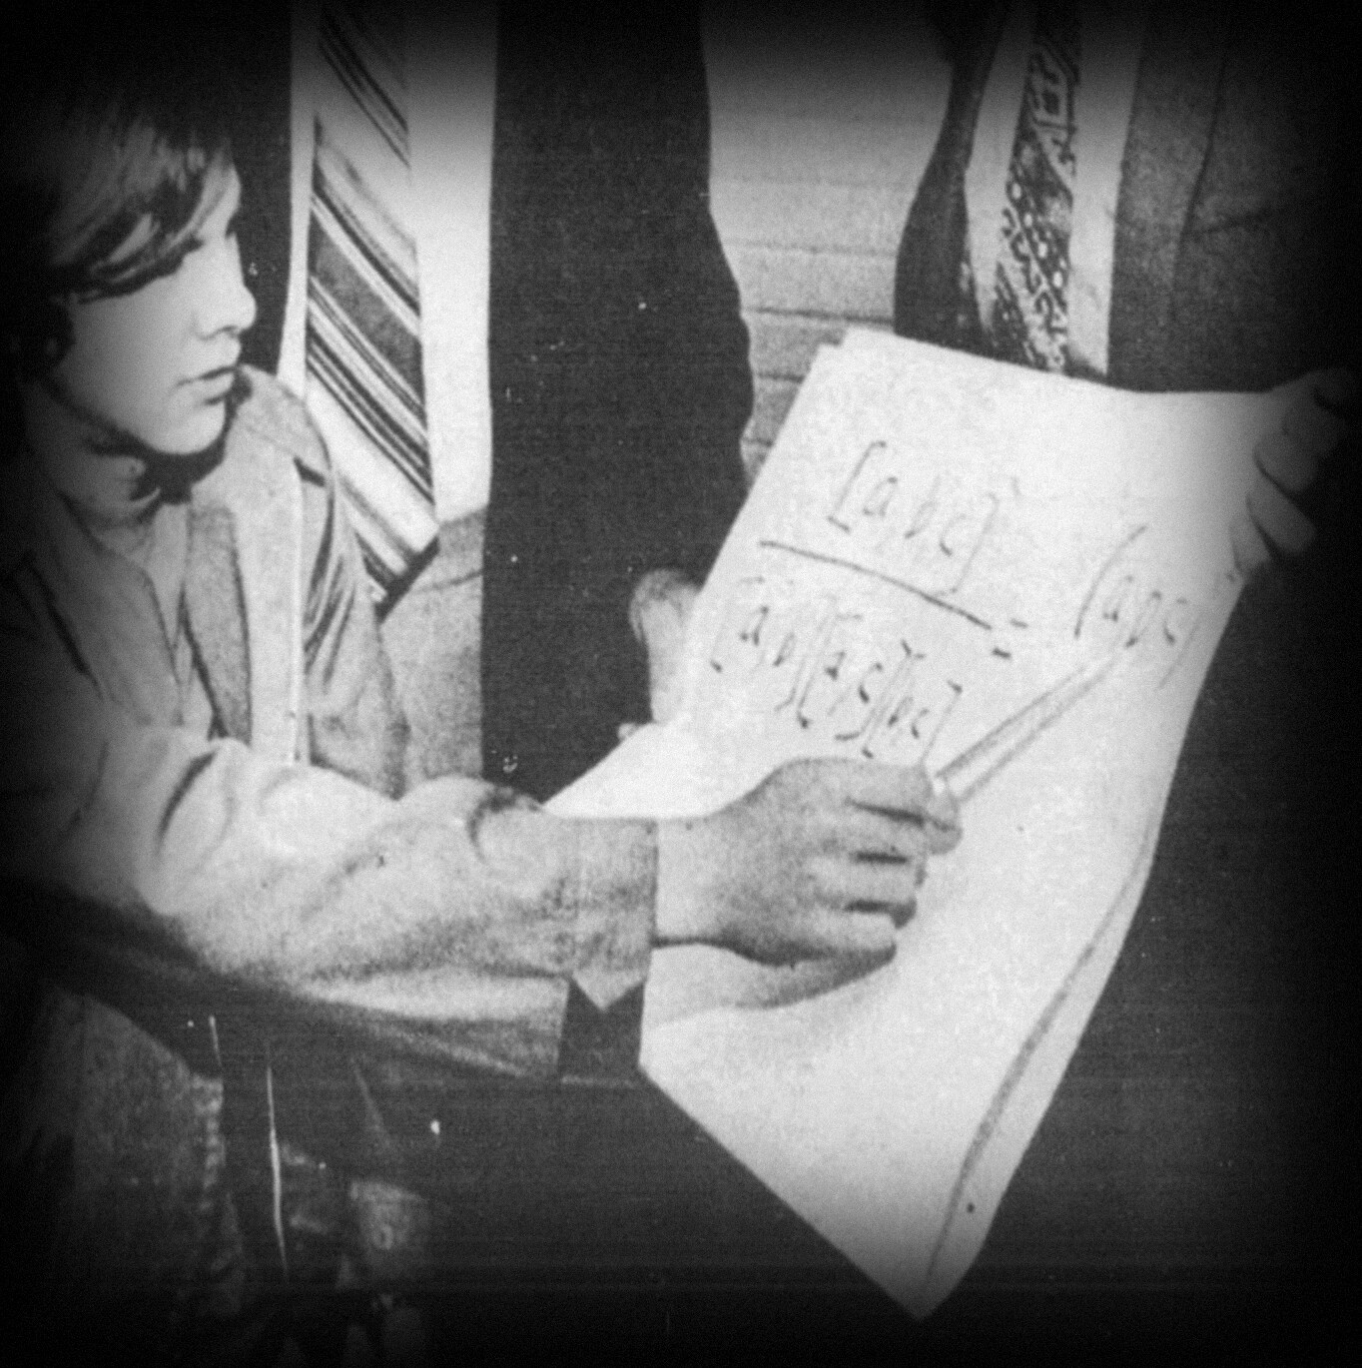
1972 · AGE 16
The young
mathematician
Drawn to problems with
precise answers — answers
that could take hours to find.
1972
2014
Notes:
In 1972, Hal Finney was a mathematically gifted teenager in Southern California. Long before he became a cryptographer, he was drawn to abstract problems—problems with precise answers that could take hours to find.
Source: Photo attribution and date to be documented from original newspaper archive.
(Original scene 1)

Slide 4
1974 · AGE 18
Six miles
From Arcadia High School, valedictorian, to Caltech.
1972
2014
Notes:
Hal graduated from Arcadia High School as valedictorian. Just a few miles away stood Caltech, one of the most demanding science and engineering colleges in the world. In 1974, he entered as a mathematics student.
Source: Hal biographical profile, Alcor; map distances approximate.
(Original scene 2)

Slide 5
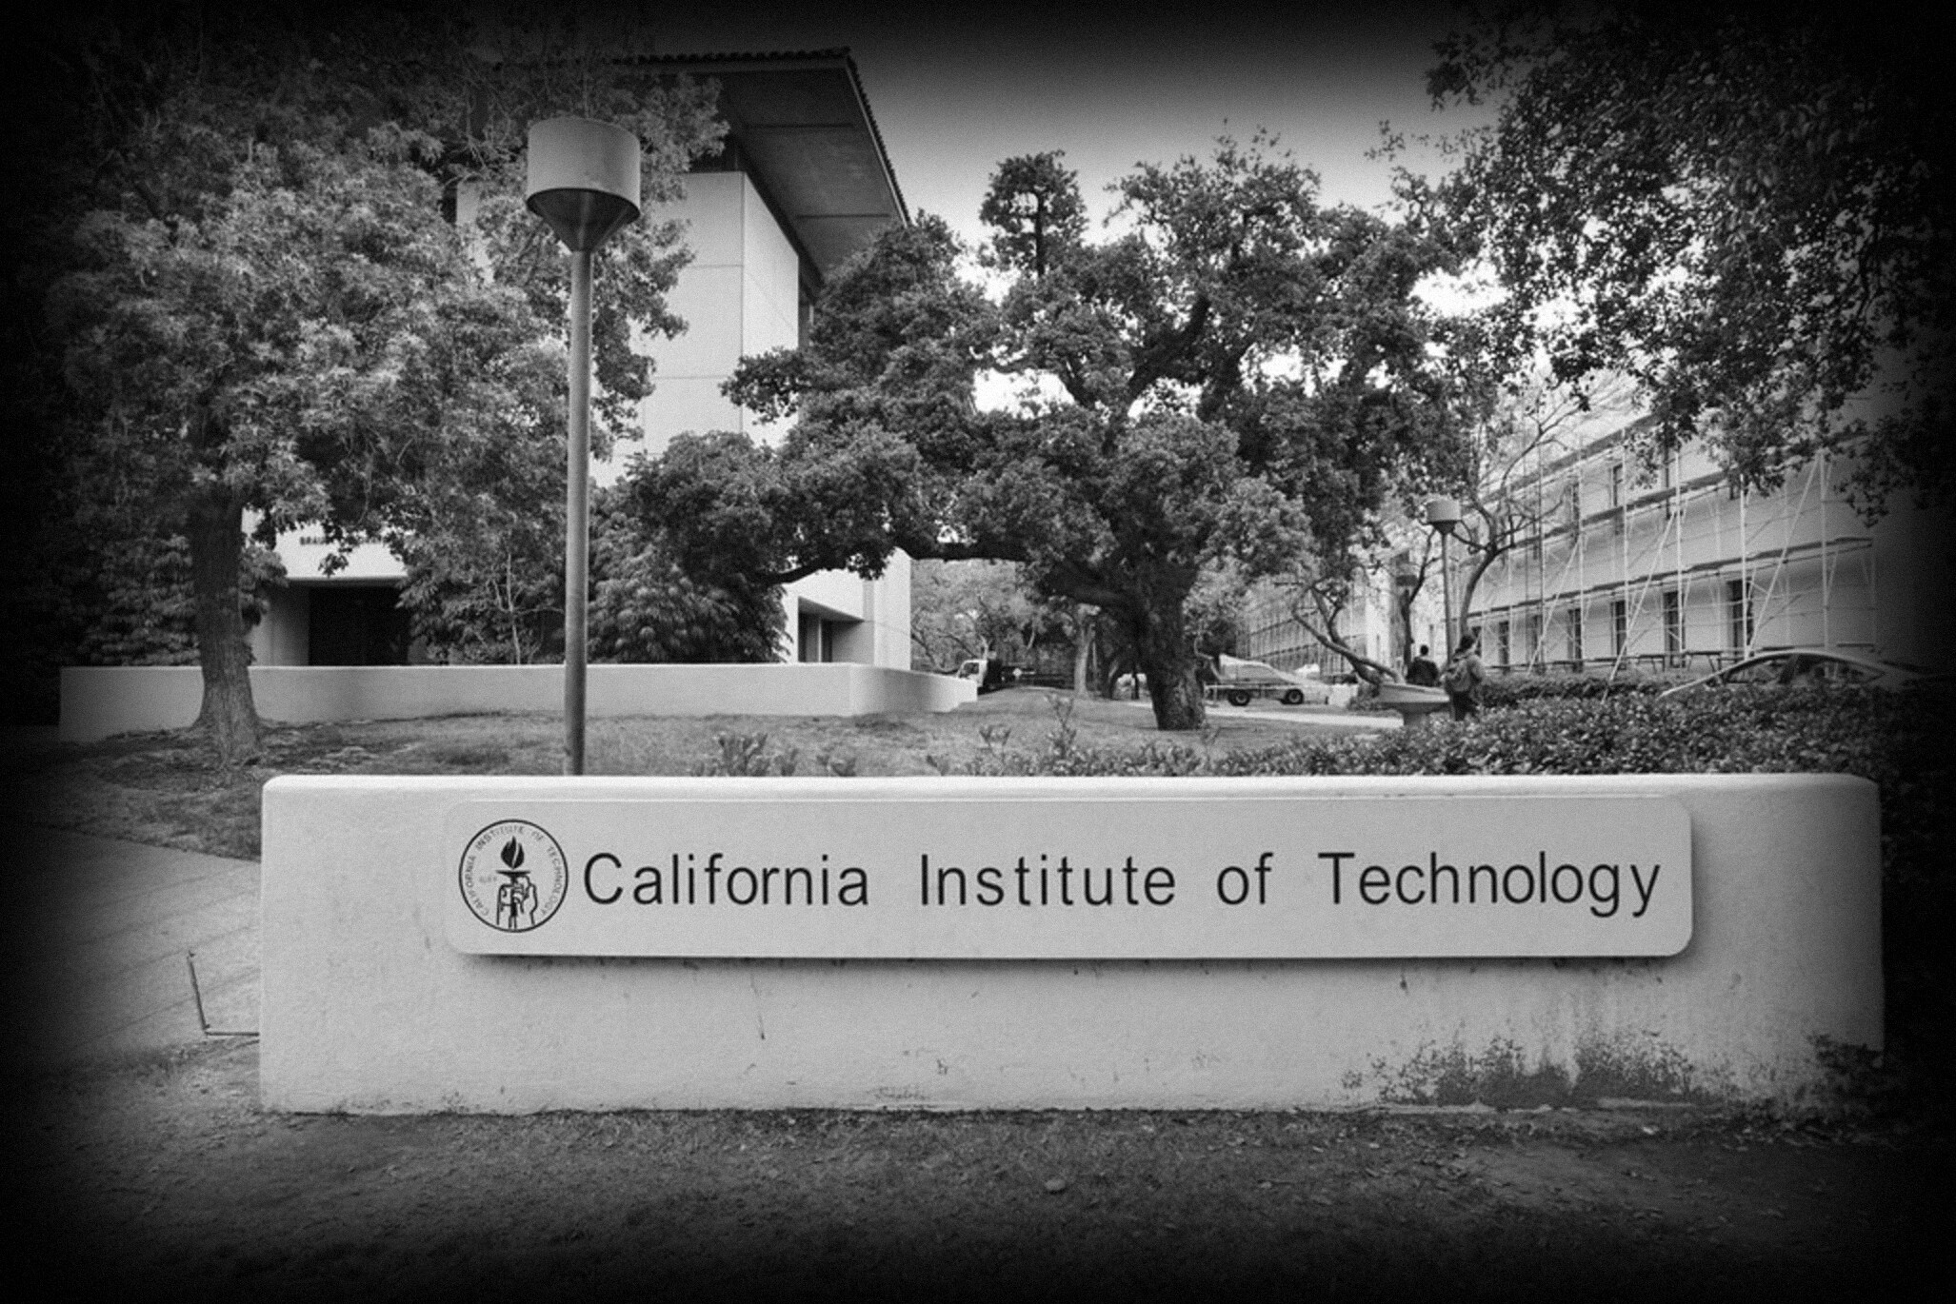
1974 · AGE 18
Caltech
Mathematics, physics, engineering
— and, increasingly, computers.
1972
2014
Notes:
A small institution devoted almost entirely to mathematics, physics, and engineering. For Hal, the attraction was not prestige. It was the chance to work on difficult technical problems—and increasingly, to program computers.
Source: Family biography and Hal's interviews.
(Original scene 3)

Slide 6
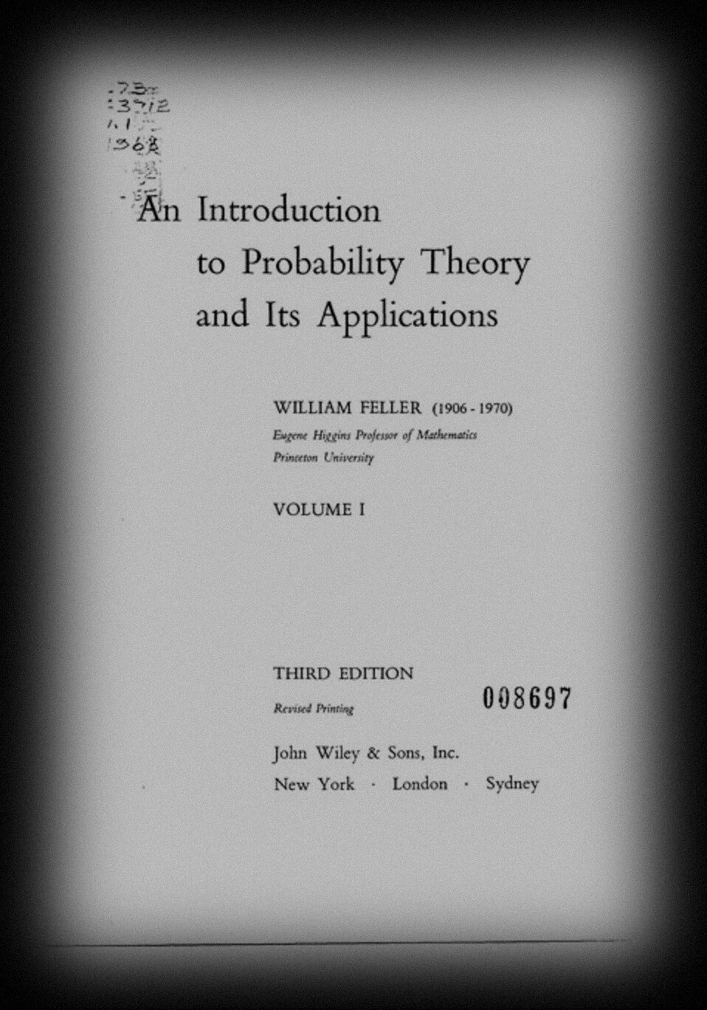
1970S · MATHEMATICS
A classic text
William Feller’s probability
theory. Decades later, Satoshi
would cite it in the whitepaper.
1972
2014
Notes:
William Feller's *An Introduction to Probability Theory and Its Applications* was a classic text of the era. Much later, an anonymous inventor called Satoshi Nakamoto would cite Feller while analyzing Bitcoin's security. Did that mathematical background matter?
Source: Bitcoin whitepaper bibliography; no evidence Hal specifically studied Feller. Do not claim he did.
(Original scene 4)

Slide 7
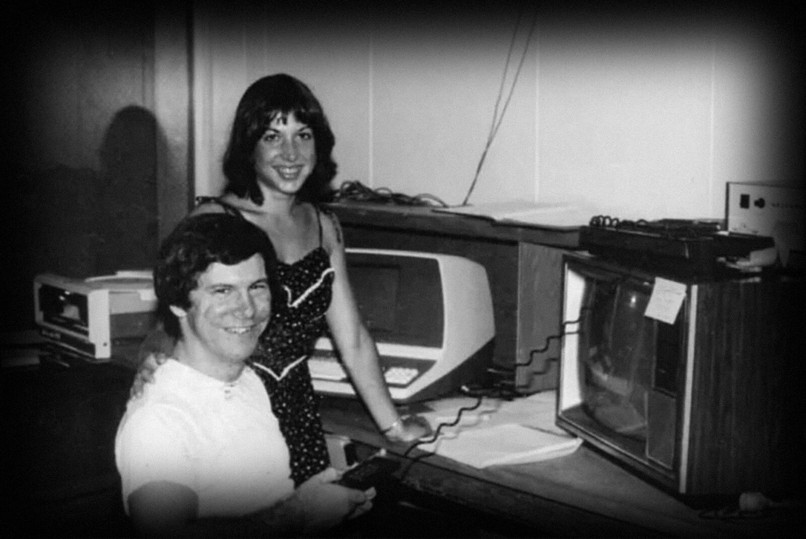
1978 · AGE 22
Hal and Fran
A partnership through
remarkable achievements —
and extraordinary hardship.
1972
2014
Notes:
While finishing Caltech, Hal began working professionally at APh Technological Consulting. His future wife Fran was already part of his life. This was the beginning of a partnership that would last through remarkable achievements and extraordinary hardship.
Source: Alcor family-supported profile; exact image credit to verify.
(Original scene 5)

Slide 8
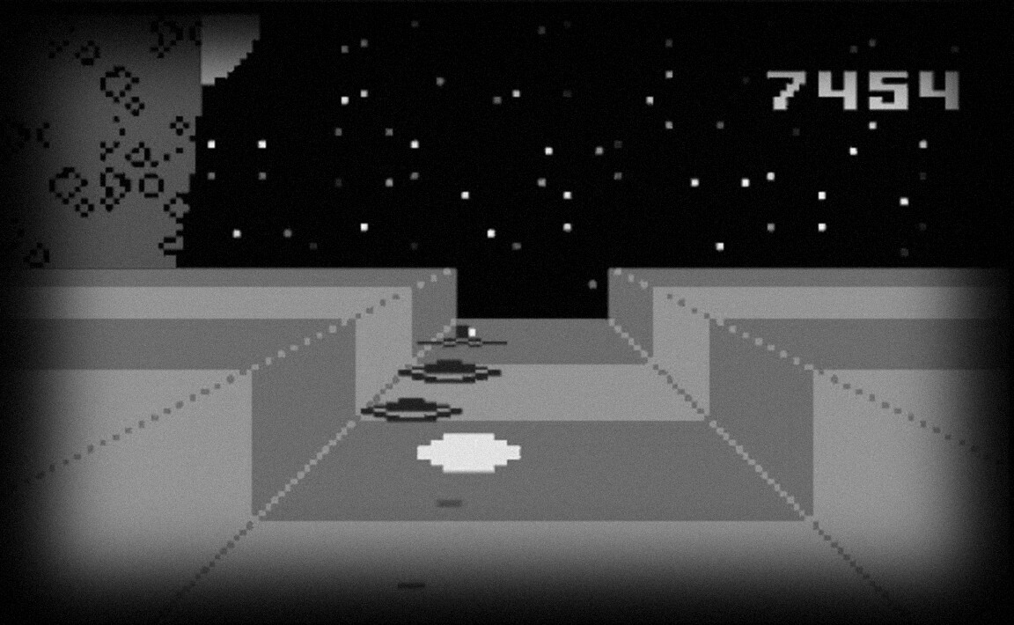
1979 · AGE 23
The programmer
Mattel’s Intellivision:
sophisticated systems in
extraordinarily little memory.
1972
2014
Notes:
Hal graduated from Caltech in 1979 and programmed software for commercial machines, including Mattel's Intellivision. Before cryptography or Bitcoin, he learned to make sophisticated systems work with extraordinarily limited memory and computing power.
Source: Hal interview about APh and Intellivision work.
(Original scene 6)

Slide 9
CHAPTER II
Trust and
Privacy
1981 – 1993
1972
2014

Slide 10
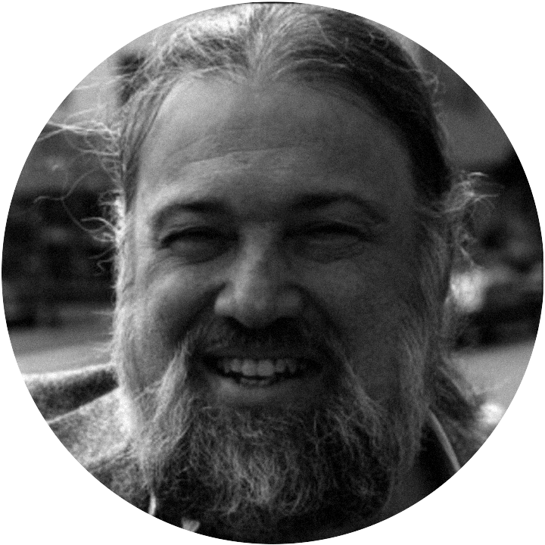
EARLY 1980S · A PARALLEL STORY
David Chaum
How can people who distrust
one another run a trustworthy
computer system?
1972
2014
Notes:
While Hal was becoming a professional programmer, another researcher was asking a radical question: how can people who distrust one another operate a trustworthy computer system? His name was David Chaum.
Source: Chaum publication record; photo date still needs verification.
(Original scene 7)

Slide 11
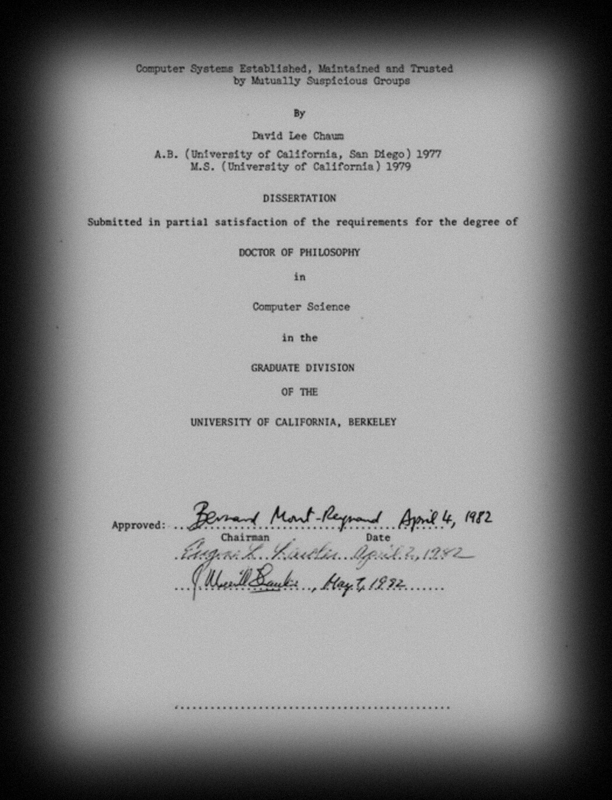
1982 · UC BERKELEY
Mutually
suspicious groups
The problem of trust — central to
digital money, and one day to Bitcoin.
1972
2014
Notes:
At Berkeley, Chaum completed a dissertation about computer systems maintained by mutually suspicious groups. The problem of trust would become central to digital money. It would also become central to Bitcoin.
Source: UC Berkeley 1982 dissertation record.
(Original scene 8)

Slide 12
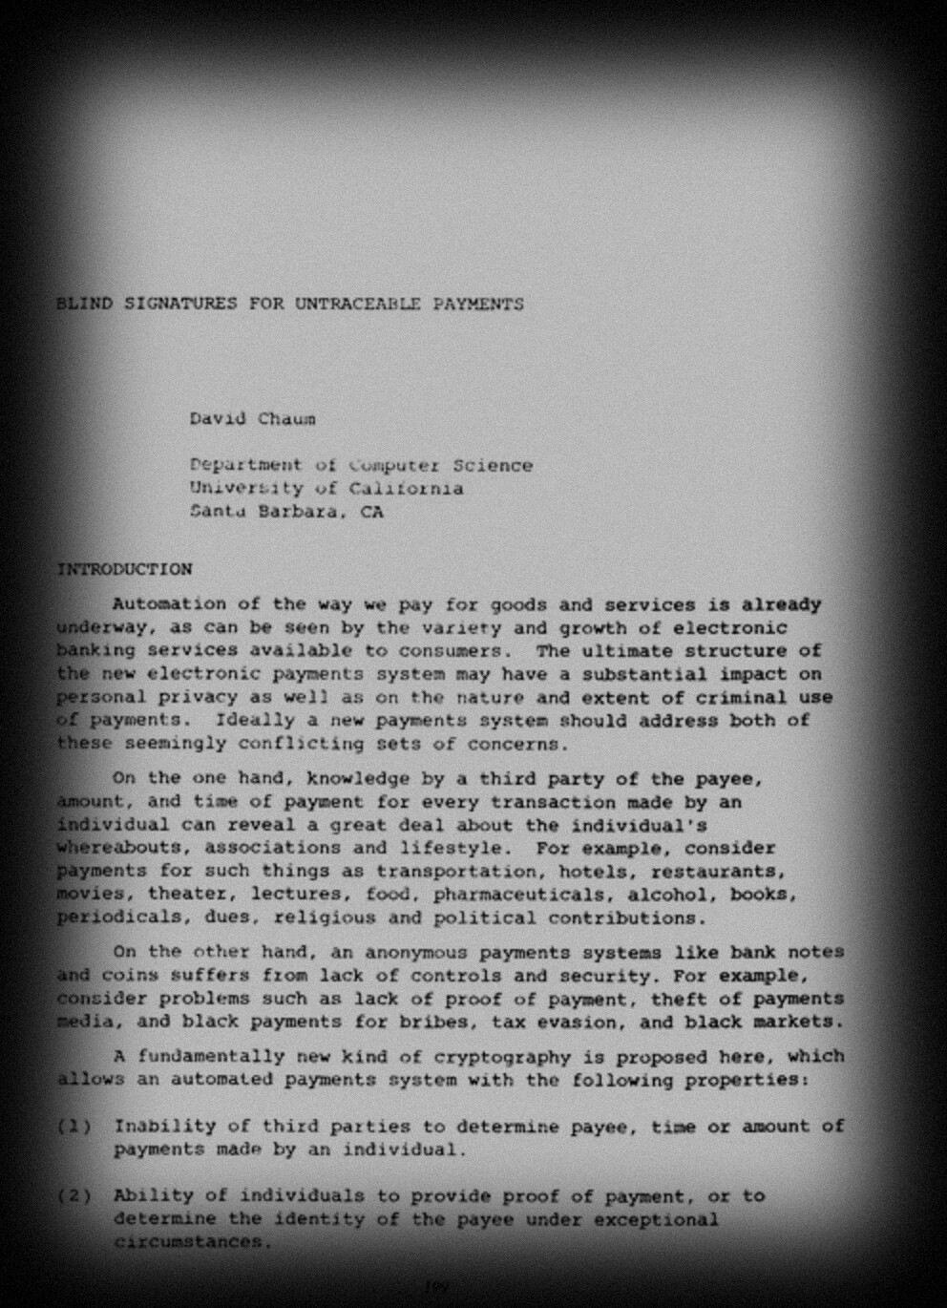
1982 · CRYPTO ’82
Blind signatures
Electronic payments with
the privacy of physical cash.
1972
2014
Notes:
Chaum imagined electronic payments that might preserve the privacy of physical cash. His blind-signature research offered a way to verify a payment token without automatically revealing who had received it. Digital money was becoming a serious cryptographic project.
Source: Chaum, CRYPTO '82 paper.
(Original scene 9)

Slide 13
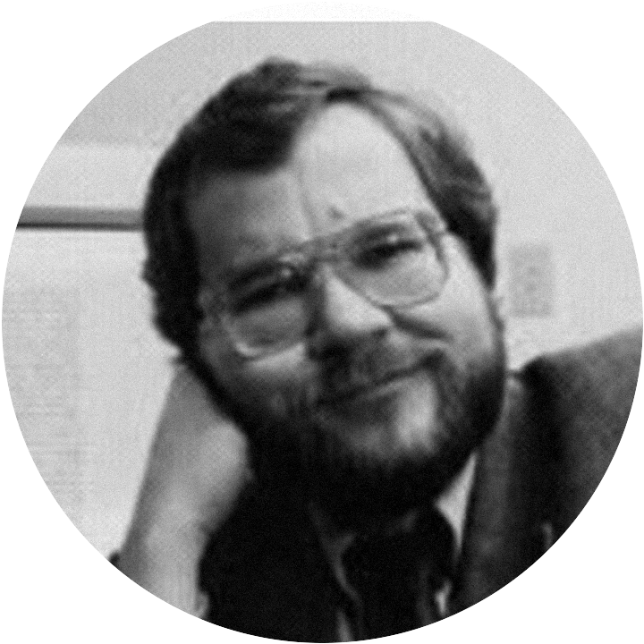
1991
Phil Zimmermann
PGP: strong encryption for
ordinary users. Hal Finney
contributed as a programmer.
1972
2014
Notes:
Phil Zimmermann released Pretty Good Privacy, or PGP, bringing strong encryption to ordinary computer users. Hal Finney contributed as a programmer. What began as software for private messages became a cause: individuals should be able to protect their communications.
Source: PGP history; Hal family biography.
(Original scene 10)

Slide 14
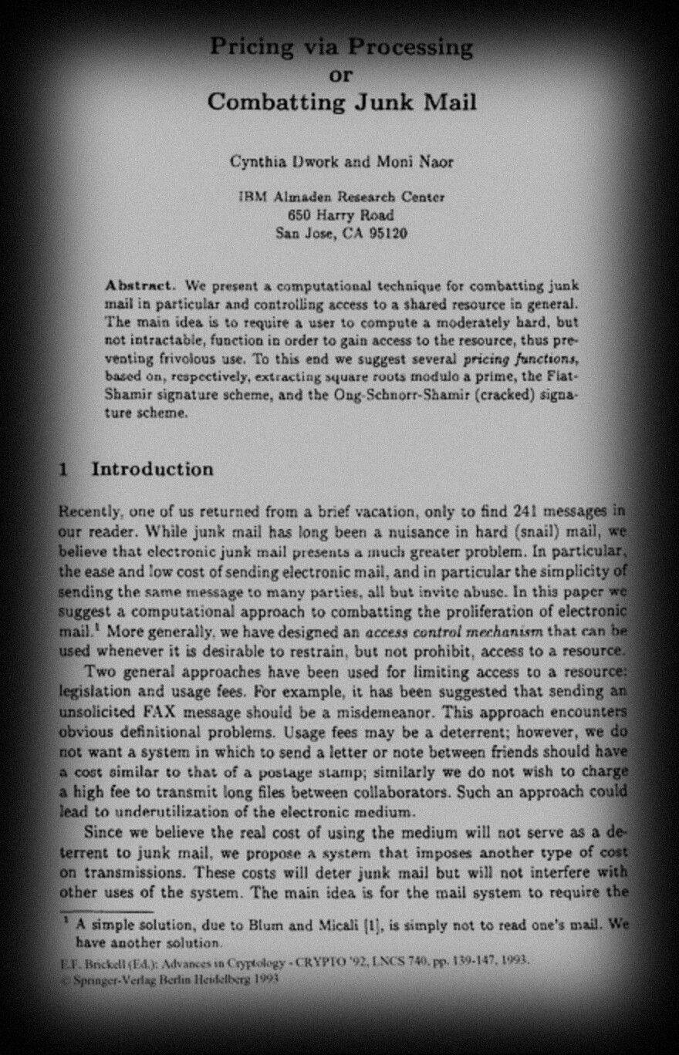
1992 · CRYPTO ’92
Computation
as a price
Cynthia Dwork and Moni Naor: make the
sender of junk email do a little work first.
1972
2014
Notes:
Cynthia Dwork and Moni Naor proposed a strange answer to junk email: make the sender perform a little computation first.
Source: CRYPTO '92 paper, published 1993. Presenter may add personal recollections of discussing proof of work with Cynthia Dwork; these are firsthand recollections, not independently verified quotations.
(Original scene 11)

Slide 15
1992
Expensive to produce.
Cheap to verify.
An ancestor of proof of work.
1972
2014
Notes:
The work would be expensive to produce, but inexpensive to verify. They were describing an ancestor of proof of work.
Source: CRYPTO '92 paper, published 1993. Presenter may add personal recollections of discussing proof of work with Cynthia Dwork; these are firsthand recollections, not independently verified quotations.
(Original scene 11)

Slide 16
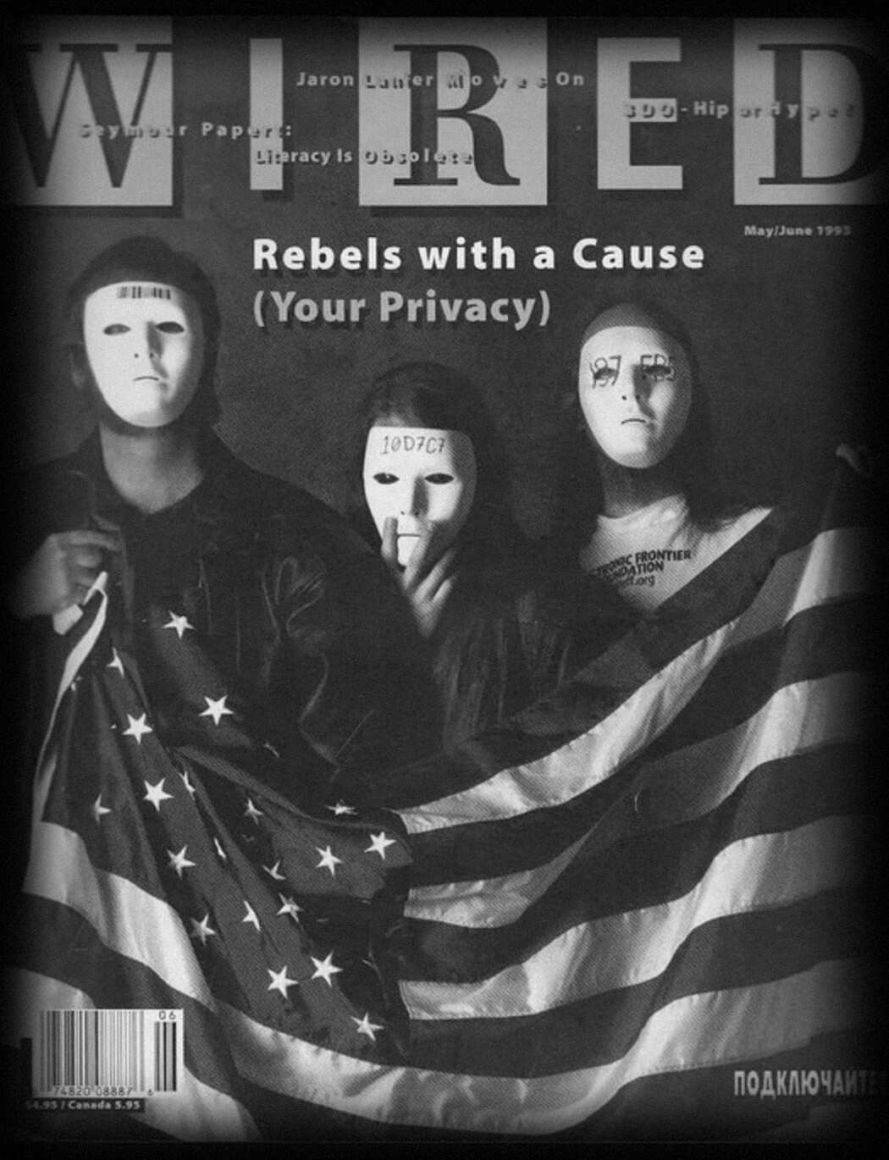
1993 · WIRED
The crypto rebels
The Cypherpunks: privacy built with
software, not merely promised by law.
1972
2014
Notes:
A new community called the Cypherpunks argued that privacy would have to be built with software, not merely promised by law. These programmers and cryptographers debated pseudonyms, anonymous communication, and money that could move without permission.
Source: WIRED 1993 feature; original Cypherpunk mailing-list records.
(Original scene 12)

Slide 17
CHAPTER III
The Small
World
1996 – 2002
1972
2014

Slide 18
1996 · AGE 40
PGP becomes
a career.
In this world: a younger
cryptographer named Len Sassaman.
1972
2014
Notes:
Hal's cryptographic expertise became his professional career when he joined the commercial PGP company. In this world he met or worked with people who would later appear in the Bitcoin origin story. One was a younger cryptographer named Len Sassaman.
Source: Family biography, PGP company chronology. Precise Hal–Len employment overlap to verify.
(Original scene 13)

Slide 19
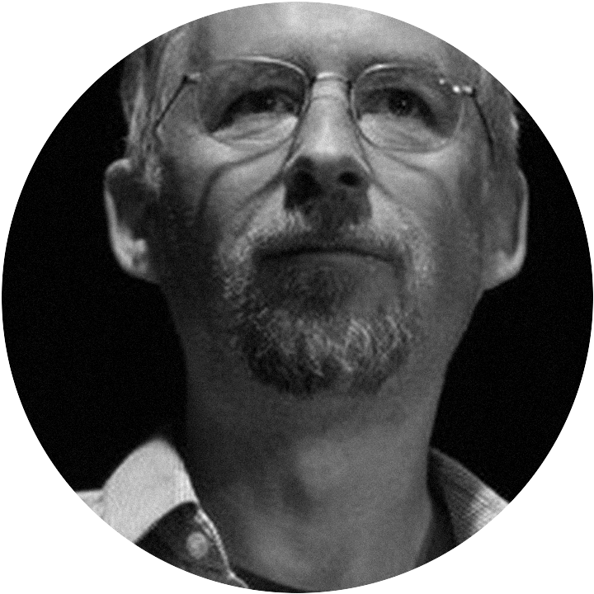
1997
Adam Back
Hashcash: proof that a computer
has done work. Built to fight spam.
1972
2014
Notes:
Adam Back developed Hashcash, a practical way to prove a computer had performed work. He intended it to discourage spam. A few years later, Hal would see an entirely different possibility in the same mechanism.
Source: Adam Back's Hashcash documentation and 1997 announcement.
(Original scene 14)

Slide 20
HASHCASH · 1997
Search for a nonce
nonce 001
SHA-1 →
a91e52f8…
×
1972
2014
Notes:
Try a nonce. Hash the message. Wrong result?
Source: Hashcash technical specification. Original Hashcash used SHA-1; Bitcoin later used double SHA-256.
(Original scene 15)

Slide 21
HASHCASH · 1997
Search for a nonce
nonce 001
SHA-1 →
a91e52f8…
×
nonce 002
SHA-1 →
7b31ca09…
×
1972
2014
Notes:
Change the nonce and try again.
Source: Hashcash technical specification. Original Hashcash used SHA-1; Bitcoin later used double SHA-256.
(Original scene 15)

Slide 22
HASHCASH · 1997
Search for a nonce
nonce 001
SHA-1 →
a91e52f8…
×
nonce 002
SHA-1 →
7b31ca09…
×
nonce 003
SHA-1 →
0000ab72…
✓
Millions of attempts to find. One to verify.
1972
2014
Notes:
Eventually, one hash meets a difficulty target. Finding it may take millions of attempts. Verifying it takes one. This asymmetry would become central to Bitcoin mining.
Source: Hashcash technical specification. Original Hashcash used SHA-1; Bitcoin later used double SHA-256.
(Original scene 15)

Slide 23
No verified
public photograph
1998
Wei Dai
Creator of Crypto++.
Proposed b-money.
1972
2014
Notes:
Wei Dai was an accomplished cryptographic programmer and the creator of Crypto++. In 1998 he proposed a radically different kind of money: pseudonymous users, cryptographic ownership, and shared accounting records. Unlike most of the people in this story, he has no verified public portrait.
Source: Wei Dai's site and b-money proposal; image is illustrative, not photographic identification.
(Original scene 16)

Slide 24
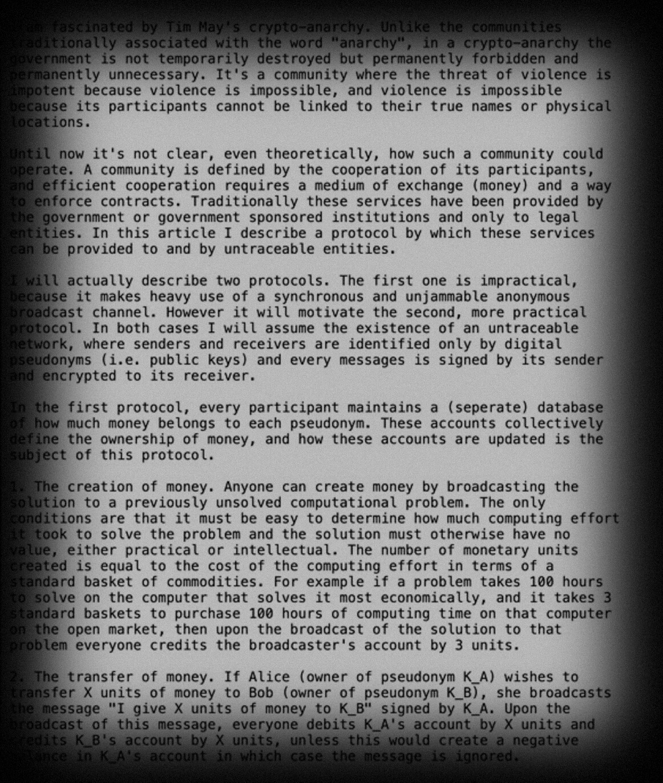
1998
b-money
Pseudonymous users. Signed transfers.
Shared records of who owns what.
1972
2014
Notes:
In Wei Dai's b-money, participants would maintain records of ownership and transfer value with digital signatures. The idea was remarkably close to Bitcoin's ambition.
Source: Wei Dai, *b-money* (1998).
(Original scene 17)

Slide 25
B-MONEY
But how would
everyone agree?
Coordination and reliable
agreement were left unresolved.
1972
2014
Notes:
But the proposal left practical problems of coordination and reliable agreement unresolved.
Source: Wei Dai, *b-money* (1998).
(Original scene 17)

Slide 26
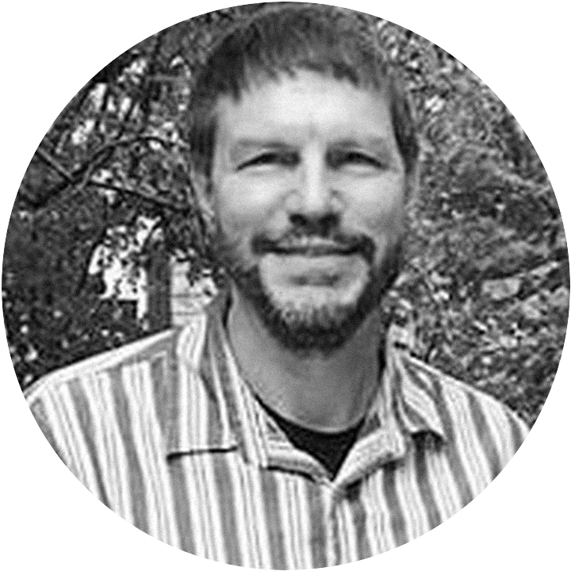
1998
Nick Szabo
Digital property, contracts, scarcity —
and Bit Gold.
1972
2014
Notes:
Nick Szabo had been thinking about digital property, contracts, and scarcity for years. His Bit Gold ideas asked whether computational work could produce something valuable without a central issuer. Hal Finney knew Szabo personally and corresponded with him extensively.
Source: Szabo's writings and Hal's *Bitcoin and Me* (2013).
(Original scene 18)

Slide 27
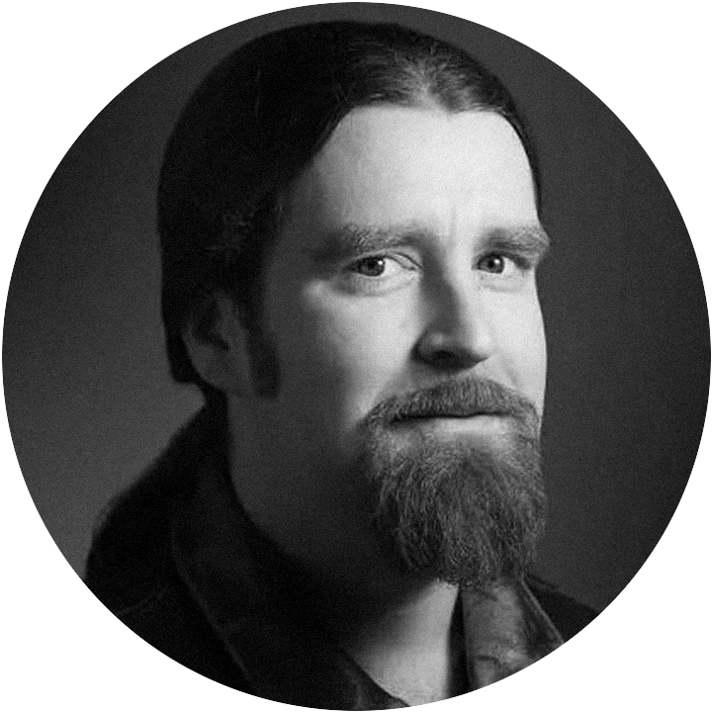
LATE 1990S
Len Sassaman
Privacy and anonymous messaging.
He knew Hal Finney.
1972
2014
Notes:
Len Sassaman worked in the privacy and cryptographic-communications world, including technologies for anonymous messaging. He knew Hal Finney. Len's interest in anonymity would eventually become an intriguing part of the Satoshi mystery.
Source: Len biographies and *Finding Satoshi* interviews; precise employment details should be sourced.
(Original scene 19)

Slide 28
THE SMALL WORLD
Hal Finney
1972
2014
Notes:
Hal met and corresponded extensively with Wei Dai and Nick Szabo. He exchanged technical ideas with Adam Back. His professional circle included Phil Zimmermann and Len Sassaman.
Source: Hal's *Bitcoin and Me*; PGP history; RPOW correspondence; *Finding Satoshi* recollections.
(Original scene 20)

Slide 29
THE SMALL WORLD
Wei Dai
met and corresponded
Phil Zimmermann
Nick Szabo
professional circle
Hal Finney
met and corresponded
Len Sassaman
Adam Back
professional circle
exchanged ideas
1972
2014
Notes:
These were not isolated inventors. They worked in an overlapping world of ideas and personal relationships.
Source: Hal's *Bitcoin and Me*; PGP history; RPOW correspondence; *Finding Satoshi* recollections.
(Original scene 20)

Slide 30
THE MISSING INGREDIENT
Not better encryption.
Not another digital token.
1972
2014
Notes:
By the early 2000s, the ingredients were scattered among a small community. Digital cash. Proof of work. Cryptographic ownership. Distributed records. But a practical currency without a trusted issuer had still not appeared.
Source: Synthesis; not a claim of a secret development team.
(Original scene 21)

Slide 31
THE MISSING INGREDIENT
A way for strangers
to agree on one history.
1972
2014
Notes:
Who would put the pieces together?
Source: Synthesis; not a claim of a secret development team.
(Original scene 21)

Slide 32
CHAPTER IV
RPOW
Reusable Proofs of Work · 2004 – 2005
1972
2014

Slide 33
2004 · AGE 48 · HE BUILT IT
RPOW
Working digital-money software — not merely a proposal.
1972
2014
Notes:
Hal Finney released Reusable Proofs of Work—RPOW. Proof-of-work tokens could be exchanged and transferred repeatedly. Hal had built functioning digital-money software, not merely published a proposal.
Source: Hal's August 2004 RPOW announcement. GitHub upload dates are later archival dates.
(Original scene 22)

Slide 34
AUGUST 15, 2004 · CRYPTOGRAPHY MAILING LIST
An open
invitation.
Hal asked cryptographers to test his
Hashcash-based server — and to criticize it.
1972
2014
Notes:
Hal invited cryptographers to test his new Hashcash-based server. He released software and documentation, exposing the system to criticism and technical review. RPOW was an experiment he wanted people to challenge.
Source: MetzDowd Cryptography mailing-list archive, August 2004.
(Original scene 23)

Slide 35
AUGUST 18, 2004 · THE CRITIC
“I’m wondering how applicable
RPOW is.”
“…aren’t we restricted to
applications already nailed
down by digital cash schemes?”
Ray Dillinger (“bear”), Cryptography mailing list
1972
2014
Notes:
Ray Dillinger questioned what transferable proof-of-work tokens were actually good for. If work could be transferred and reused, what gave the tokens practical value? It was a difficult question for anyone attempting to invent new money.
Source: Original mailing-list correspondence.
(Original scene 24)

Slide 36
AUGUST 19, 2004 · HAL ANSWERS
“Another way to think of RPOWs
is as an implementation of Nick
Szabo’s concept of ‘bit gold’.”
Hal Finney, Cryptography mailing list
1972
2014
Notes:
Hal connected RPOW directly to Nick Szabo's Bit Gold. He imagined computationally scarce tokens being bought and sold, if people found a compelling use for them. Four years before Bitcoin, he was wrestling with the economics of digital scarcity.
Source: Original mailing-list response by Hal.
(Original scene 25)

Slide 37
AUGUST 21, 2004 · ADAM BACK REPLIES
Two future Bitcoin
pioneers, debating.
Back saw RPOW as Chaumian e-cash,
built from Hashcash and trusted hardware.
1972
2014
Notes:
Adam Back recognized the connection between RPOW and Chaumian electronic cash. He understood how Hal was using Hashcash and trusted hardware to prevent unauthorized token creation. Two future Bitcoin pioneers were openly debating transferable proof-of-work money.
Source: MetzDowd August 2004 thread.
(Original scene 26)

Slide 38
THE IBM COPROCESSOR
Trust still lived
inside an IBM chip.
Even the operator couldn’t cheat — but
everyone depended on trusted hardware.
1972
2014
Notes:
RPOW's protection against double spending rested on a special IBM secure coprocessor. Hal tried to make even the server operator unable to cheat. But users still depended on the integrity and continued operation of trusted hardware.
Source: RPOW technical documentation.
(Original scene 27)

Slide 39
THE WEAKNESS
If the server failed,
the tokens could fail.
One machine’s fate should not decide
whether someone’s savings survive.
1972
2014
Notes:
If an RPOW server permanently stopped operating, some tokens associated with it could lose their usefulness. For a system hoping to become money, that was a serious weakness. A single machine's fate should not determine whether somebody's savings survive.
Source: Hal, *World of RPOW*.
(Original scene 28)

Slide 40
WORLD OF RPOW
A shared
database?
Several RPOW servers keeping one
common record of spent tokens.
1972
2014
Notes:
Hal considered having multiple RPOW servers maintain a shared record of spent tokens. That required keeping their histories consistent while preventing double spending.
Source: Hal, *World of RPOW*. The rejected architecture was not Bitcoin's later consensus system.
(Original scene 29)

Slide 41
HAL FINNEY · WORLD OF RPOW
“Ultimately, this approach was
considered and rejected.”
Hal Finney, RPOW documentation: clustering and shared databases
1972
2014
Notes:
He judged the proposed design too complex for RPOW and rejected it.
Source: Hal, *World of RPOW*. The rejected architecture was not Bitcoin's later consensus system.
(Original scene 29)

Slide 42
THE UNSOLVED QUESTION
How can computers
that don’t trust
one another agree on
who owns the money?
1972
2014
Notes:
How can computers that don't trust one another agree about who owns the money? Hal had confronted the problem. He had not published a permissionless consensus solution. This was the missing step between working digital tokens and decentralized money.
Source: Historical synthesis; avoid asserting Hal personally solved this later.
(Original scene 30)

Slide 43
FEBRUARY 2005 · CODECON
Peer-to-peer
money.
RPOW meets BitTorrent: share files to
earn tokens, spend tokens to buy priority.
1972
2014
Notes:
Hal experimented with linking RPOW to BitTorrent. Uploading and sharing files could earn tokens; spending tokens could purchase priority. He was exploring economic incentives inside peer-to-peer software years before Bitcoin's launch.
Source: Hal's February 2005 announcement.
(Original scene 31)

Slide 44
FEBRUARY 27, 2005 · RPOW 1.2.0
Add Tor.
Proof of work, transferable tokens, peer-to-peer
apps — and anonymous communication.
1972
2014
Notes:
Hal added Tor support to RPOW, helping users connect with greater network privacy. His experimental money now incorporated proof of work, transferable tokens, peer-to-peer applications, and anonymous communications.
Source: RPOW release log February 27, 2005.
(Original scene 32)

Slide 45
FEBRUARY 2005
The public RPOW
trail ends.
The problem does not.
1972
2014
Notes:
The last verified public RPOW release appeared in February 2005. Hal did not disappear: he continued cryptographic work. But the surviving public RPOW record no longer tells us whether he was pursuing the deeper monetary problem.
Source: RPOW news archive; gaps in public records are not proof of private Bitcoin development.
(Original scene 33)

Slide 46
CHAPTER V
The Silence
2005 – 2008
1972
2014

Slide 47
2005 – 2007
Two years.
Who made the leap?
1972
2014
Notes:
Wei Dai continued Crypto++ development. Nick Szabo described Bit Gold in detail. Hal Finney worked on cryptographic engineering and trusted computing. We can document much of their public work—but not the invention of Bitcoin's consensus rule.
Source: Crypto++ release history; Szabo 2005 essay; OpenPGP records. Missing public RPOW releases do NOT mean that Hal stopped working: RFC 4880 and trusted-computing correspondence document other work.
(Original scene 34)

Slide 48
DECEMBER 2005 · NICK SZABO
Bit Gold,
in print.
Proof of work, timestamping, ownership
records — and still no public implementation.
1972
2014
Notes:
Szabo's detailed Bit Gold description brought proof of work, timestamping, and ownership records together. Yet practical consensus still required assumptions and engineering that no public Bit Gold implementation had resolved.
Source: Szabo, *Bit Gold*, December 2005.
(Original scene 35)

Slide 49
2007
Someone begins
writing Bitcoin.
We do not know who.
1972
2014
Notes:
Satoshi would later say he had spent roughly a year and a half coding Bitcoin by November 2008. That places the project around the first half of 2007. The code began long before the world saw the whitepaper.
Source: Satoshi correspondence, November 2008. Approximate start date, not a precise timestamp.
(Original scene 36)

Slide 50
NOVEMBER 2007
RFC 4880
Hal co-authors the OpenPGP standard
— still a working cryptographic engineer.
1972
2014
Notes:
Hal coauthored RFC 4880, the OpenPGP Message Format standard. He was still a serious working cryptographic engineer. The gap in public RPOW updates was not a gap in his entire life or career.
Source: RFC Editor, November 2007.
(Original scene 37)

Slide 51
APRIL 2008 · NICK SZABO, ON BIT GOLD
“Anybody want to help
me code one up?”
Nick Szabo, blog comment
1972
2014
Notes:
In a Bit Gold discussion, Nick Szabo invited someone to help code an experimental implementation.
Source: Szabo blog comment, date reconstruction requires careful verification.
(Original scene 38)

Slide 52
APRIL 2008
Hal had already
built RPOW.
There is no verified evidence he answered.
1972
2014
Notes:
He knew Hal Finney, who had already built RPOW. There is no verified evidence Hal answered that invitation.
Source: Szabo blog comment, date reconstruction requires careful verification.
(Original scene 38)

Slide 53
CRYPTO++ · REPORTED COMMIT GAP
Feb 2, 2008
last recorded commit
Reported by Ben Sigman. Individual SVN revisions require independent verification.
1972
2014
Notes:
Ben Sigman identified a reported gap in recorded Crypto++ commits, beginning February 2, 2008.
Source: Ben Sigman's 2026 thread; avoid equating release gaps with commits. The reported February–November Crypto++ commit gap is attributed to Ben Sigman and has not been independently reconstructed from original version-control metadata.
(Original scene 39)

Slide 54
CRYPTO++ · REPORTED COMMIT GAP
Feb 2, 2008
9+ months
Nov 21, 2008
last recorded commit
commits resume
Reported by Ben Sigman. Individual SVN revisions require independent verification.
1972
2014
Notes:
The reported gap runs to November 21, 2008 — more than nine months.
Source: Ben Sigman's 2026 thread; avoid equating release gaps with commits. The reported February–November Crypto++ commit gap is attributed to Ben Sigman and has not been independently reconstructed from original version-control metadata.
(Original scene 39)

Slide 55
CRYPTO++ · REPORTED COMMIT GAP
Oct 31 · The whitepaper
Aug 20 · Satoshi writes to Adam Back
Feb 2, 2008
9+ months
Nov 21, 2008
last recorded commit
commits resume
Reported by Ben Sigman. Individual SVN revisions require independent verification.
1972
2014
Notes:
It overlaps Bitcoin development. But a version-control gap does not tell us what Wei Dai was doing—and the historical log needs independent audit.
Source: Ben Sigman's 2026 thread; avoid equating release gaps with commits. The reported February–November Crypto++ commit gap is attributed to Ben Sigman and has not been independently reconstructed from original version-control metadata.
(Original scene 39)

Slide 56
AUGUST 20, 2008
A blog goes
into reruns.
Nick Szabo’s. The same day, Satoshi writes
to Adam Back. Striking — but not evidence.
1972
2014
Notes:
Nick Szabo announced that his blog would enter a period of reruns. On that same date, Satoshi Nakamoto contacted Adam Back. The coincidence is striking. It is not evidence by itself that they were coordinating.
Source: Unenumerated archive; Szabo continued posting afterward.
(Original scene 40)

Slide 57
CHAPTER VI
Bitcoin
2008 – 2009
1972
2014

Slide 58
AUGUST 20, 2008 · A STRANGER WRITES
“I’m getting ready to release a
paper that references your
Hashcash paper and I wanted to
make sure I have the citation right.”
Satoshi Nakamoto, first email to Adam Back
1972
2014
Notes:
Satoshi sent Adam Back a draft paper about electronic cash.
Source: Preserved 2008 correspondence.
(Original scene 41)

Slide 59
ADAM BACK REPLIES
“You maybe aware of the ‘B-money’
proposal … by Wei Dai which sounds
to be somewhat related to your paper.”
Adam Back, reply to Satoshi
1972
2014
Notes:
Back recognized a link to Hashcash and directed Satoshi toward Wei Dai's b-money. The first surviving clues to the anonymous creator now appear in writing.
Source: Preserved 2008 correspondence.
(Original scene 41)

Slide 60
AUGUST 21, 2008 · SATOSHI TO ADAM BACK
“Thanks, I wasn’t aware of the
b-money page, but my ideas
start from exactly that point.”
Satoshi Nakamoto, email to Adam Back
1972
2014
Notes:
Satoshi told Back that he had not been aware of the b-money page.
Source: Original Satoshi–Back correspondence.
(Original scene 42)

Slide 61
AUGUST 21, 2008
Hal Finney had known
Wei Dai for years.
Independent? Careful wording? Concealment?
The email alone cannot tell us.
1972
2014
Notes:
Hal Finney, by contrast, had known Wei Dai for years. Was Satoshi genuinely independent, carefully choosing his words, or concealing a relationship? The email alone cannot tell us.
Source: Original Satoshi–Back correspondence.
(Original scene 42)

Slide 62
OCTOBER 31, 2008
Bitcoin: A Peer-to-Peer
Electronic Cash System
An unknown author. Familiar inventions —
combined into agreement without a trusted issuer.
1972
2014
Notes:
An unknown author published *Bitcoin: A Peer-to-Peer Electronic Cash System*. The paper combined familiar inventions into something new: a practical system for agreeing on a monetary history without a trusted issuer.
Source: Satoshi Nakamoto (2008).
(Original scene 43)

Slide 63
THE WHITEPAPER
Eight references
[1]
W. Dai
b-money
1998
[2]
H. Massias et al.
Secure timestamping with minimal trust
1999
[3]
S. Haber, W.S. Stornetta
How to time-stamp a digital document
1991
[4]
D. Bayer et al.
Efficiency of digital time-stamping
1993
[5]
S. Haber, W.S. Stornetta
Secure names for bit-strings
1997
[6]
A. Back
Hashcash — a denial of service counter-measure
2002
[7]
R.C. Merkle
Protocols for public key cryptosystems
1980
[8]
W. Feller
An introduction to probability theory
1957
1972
2014
Notes:
The Bitcoin whitepaper cited Wei Dai, Adam Back, Haber and Stornetta, Merkle, and William Feller. Satoshi's citations reveal the intellectual tradition from which Bitcoin emerged. But two especially close predecessors are absent from the bibliography.
Source: Bitcoin whitepaper bibliography.
(Original scene 44)

Slide 64
THE WHITEPAPER
Two names
are missing.
1972
2014
Notes:
Two especially close predecessors are absent from the bibliography.
Source: Whitepaper references; do not claim suppression as fact. Absence of Szabo and Finney from the bibliography does not establish deliberate concealment.
(Original scene 45)

Slide 65
NOT CITED
Nick Szabo.
Hal Finney.
Oversight, editorial judgment, or deliberate
distancing? The motive is unknown.
1972
2014
Notes:
NICK SZABO. HAL FINNEY. Bit Gold and RPOW were important precursors to Bitcoin, but neither was cited in the whitepaper. Was the omission editorial judgment, an oversight, or deliberate distancing? We have no evidence establishing the motive.
Source: Whitepaper references; do not claim suppression as fact. Absence of Szabo and Finney from the bibliography does not establish deliberate concealment.
(Original scene 45)

Slide 66
NOVEMBER 2008 · BITCOIN SOURCE
Bitcoin was still
changing.
The code existed before launch — and its
monetary parameters were still being refined.
1972
2014
Notes:
A surviving November source preview shows that Bitcoin's code existed before launch. Historical comparisons report changes in monetary parameters before January 2009. The software was being refined—not merely packaged. Whoever worked on it understood both systems engineering and monetary design.
Source: Original November source snapshot; exact parameter comparisons must be validated from preserved files.
(Original scene 46)

Slide 67
BITCOIN V0.1 · SHA-256
Inside Bitcoin:
Wei Dai’s code.
SHA-256 code descended from Crypto++.
Proof of reuse — not of authorship.
1972
2014
Notes:
Bitcoin's earliest software incorporated SHA-256 code descended from Wei Dai's Crypto++ library. That connection is explicit in the source. It proves code reuse—not that Wei secretly programmed Bitcoin. But it brings his work directly inside the original implementation.
Source: Crypto++ 5.5.2 and Bitcoin v0.1 historical source.
(Original scene 47)

Slide 68
JANUARY 2009
“Running bitcoin”
Hal Finney, on Twitter
1972
2014
Notes:
Hal Finney became one of Bitcoin's first users. He ran the software, reported crashes, and helped debug its early versions.
Source: Hal's contemporaneous post and Bitcoin transaction record.
(Original scene 48)

Slide 69
JANUARY 12, 2009
10 bitcoin
Satoshi → Hal: the first widely recognized
person-to-person Bitcoin transaction.
1972
2014
Notes:
On January 12, Satoshi sent him 10 bitcoin—the first widely recognized person-to-person Bitcoin transaction.
Source: Hal's contemporaneous post and Bitcoin transaction record.
(Original scene 48)

Slide 70
JANUARY 2009 · HAL–SATOSHI EMAILS
Tester and
developer.
Hal reported bugs. Satoshi replied with
fixes and deep knowledge of the C++ code.
1972
2014
Notes:
Hal and Satoshi exchanged detailed debugging emails. Hal behaved like an outside tester; Satoshi supplied fixes and showed deep knowledge of the C++ code. A shared pseudonym could accommodate the exchange, but that explanation requires evidence of coordination that has not been found.
Source: Hal–Satoshi email archive.
(Original scene 49)

Slide 71
APRIL 18, 2009 · SANTA BARBARA
10 miles
Hal runs a documented ten-mile race.
1972
2014
Notes:
Hal ran a documented ten-mile race in Santa Barbara.
Source: Race records and Jameson Lopp's analysis; distinguish transaction broadcast timing from confirmation timing.
(Original scene 50)

Slide 72
APRIL 18, 2009
Satoshi appears
to be active.
A serious problem for any theory
that Hal ran the identity alone.
1972
2014
Notes:
Meanwhile, Satoshi appeared to be active. It is a serious problem for any theory that Hal operated the identity entirely alone. The simplest explanation remains that two different people were involved.
Source: Race records and Jameson Lopp's analysis; distinguish transaction broadcast timing from confirmation timing.
(Original scene 50)

Slide 73
CHAPTER VII
The Theory
One name. More than one person?
1972
2014

Slide 74
THE ALIBI CHANGES THE QUESTION
What if Satoshi
wasn’t one person?
1972
2014
Notes:
What if 'Satoshi Nakamoto' named a project, not a person?
Source: Hypothesis, not established fact.
(Original scene 51)

Slide 75
A HYPOTHESIS
A project,
not a person?
One engineer designing the software. Another
handling correspondence and releases.
1972
2014
Notes:
One engineer might have designed software, while another handled correspondence and releases. It is an intriguing explanation for apparent contradictions—but possibility alone does not demonstrate that such a partnership existed.
Source: Hypothesis, not established fact.
(Original scene 51)

Slide 76
LEN RETURNS
Len Sassaman
Knew Hal. Understood pseudonymous
cryptography. Encouraged authors to
use pseudonyms.
1972
2014
Notes:
Len Sassaman knew Hal and understood the world of pseudonymous cryptography. Bram Cohen remembered Len encouraging software authors to use pseudonyms.
Source: Bram's attributed documentary recollections and Meredith Patterson interview.
(Original scene 52)

Slide 77
FINDING SATOSHI
Did Len
help Hal?
The documentary proposes it.
Friendship and expertise do not prove it.
1972
2014
Notes:
Finding Satoshi proposes that Len may have assisted Hal. Neither friendship nor anonymity expertise proves that he did.
Source: Bram's attributed documentary recollections and Meredith Patterson interview.
(Original scene 52)

Slide 78
THE HYPOTHESIS
Hal Finney
+
ONE OR MORE OF
Len Sassaman
Nick Szabo
Wei Dai
Possible. Not proven.
1972
2014
Notes:
The hypothesis this presentation explores: Hal Finney, working with one or more of Len Sassaman, Nick Szabo and Wei Dai.
Hypothesis, not established fact. Each connection rests on documented relationships and circumstantial timing, not on evidence of coordination.

Slide 79
THE THEORY MEETS ITS LIMITS
Hal denied being Satoshi.
His emails read like correspondence
with another developer.
Len reportedly criticized Bitcoin.
Wei’s commit gap has innocent explanations.
1972
2014
Notes:
Hal denied being Satoshi. His emails read like correspondence with another developer. Len reportedly criticized Bitcoin. Wei's commit gap has innocent explanations.
Source: Hal's 2013 account and early emails; documentary and independent criticism.
(Original scene 53)

Slide 80
THE CASE IS NOT CLOSED
A compelling hypothesis
is not proof.
It competes with a simpler possibility:
Satoshi was someone else.
1972
2014
Notes:
The multi-person theory is possible, but it must compete with a simpler possibility: Satoshi was someone else.
Source: Hal's 2013 account and early emails; documentary and independent criticism.
(Original scene 53)

Slide 81
CHAPTER VIII
Hal
2009 – 2014
1972
2014

Slide 82
2009 · AGE 52
The runner.
As Bitcoin began, Hal was in
excellent physical condition.
1972
2014
Notes:
Hal was not only an accomplished engineer. He was an enthusiastic distance runner, with a demanding athletic routine and ambitions that reached beyond the computer screen. In 2009, as Bitcoin began, he was in excellent physical condition.
Source: Fran's recollections and Hal's *Bitcoin and Me*.
(Original scene 54)

Slide 83
AUGUST 2009 · AGE 53
ALS
Seven months after Bitcoin’s launch.
1972
2014
Notes:
Seven months after Bitcoin's launch, Hal was diagnosed with ALS. The disease would progressively take away his ability to move and speak. It did not end his interest in building and understanding software.
Source: Hal's *Bitcoin and Me* and family reporting.
(Original scene 55)

Slide 84
DECEMBER 2009
The finish line.
Fran turned a marathon into an ALS fundraiser.
Hal joined the final stretch — and crossed the line.
1972
2014
Notes:
Fran helped turn a marathon into a fundraising effort for ALS research. Hal could no longer run the full distance, but he joined the final portion and crossed the finish line. The endurance that shaped his running would shape the final years of his life.
Source: Contemporary Noozhawk reporting and family account.
(Original scene 56)

Slide 85
2013 · AGE 56
Bitcoin and Me
Written with assistive technology. He
wrote about Satoshi as someone else.
1972
2014
Notes:
As ALS progressed, Hal continued working with assistive technology. In 2013, he published *Bitcoin and Me*: an extraordinarily personal account of Bitcoin's first days. He wrote about Satoshi as someone else. His story deserves to be heard on its own terms.
Source: Hal's original essay.
(Original scene 57)

Slide 86
AUGUST 28, 2014
Hal Finney
1956 – 2014
Encryption for ordinary people. A
working digital-cash experiment.
One of Bitcoin’s first advocates.
1972
2014
Notes:
Hal Finney died on August 28, 2014. He helped make encryption available to ordinary people, built a remarkable digital-cash experiment, and became one of Bitcoin's first advocates.
Source: Family and obituary records; final sentence deliberately distinguishes evidence from conjecture.
(Original scene 58)

Slide 87
WHO WAS SATOSHI? · STILL UNRESOLVED
His documented
achievements need
no mystery to matter.
1972
2014
Notes:
Whether he secretly helped invent Bitcoin remains unresolved. His documented achievements need no mystery to matter.
Source: Family and obituary records; final sentence deliberately distinguishes evidence from conjecture.
(Original scene 58)

