Slide 1
Leading Content Management Systems (CMS)
Fred McClurg
Comparing the top CMS
http://cecert.kirkwood.edu/~fmcclurg/courses/cms/topCms.pptx

Slide 2
What is a Content Management System?
A Content Management System usually provides two capabilities:
Content Delivery Application (CDA)
Displays database-driven content.
Content Management Application (CMA)
Allows content authors to create and modify content via a user interface.
Provides the administrator a mechanism for adding content authors, users, and additional administrators.

Slide 3
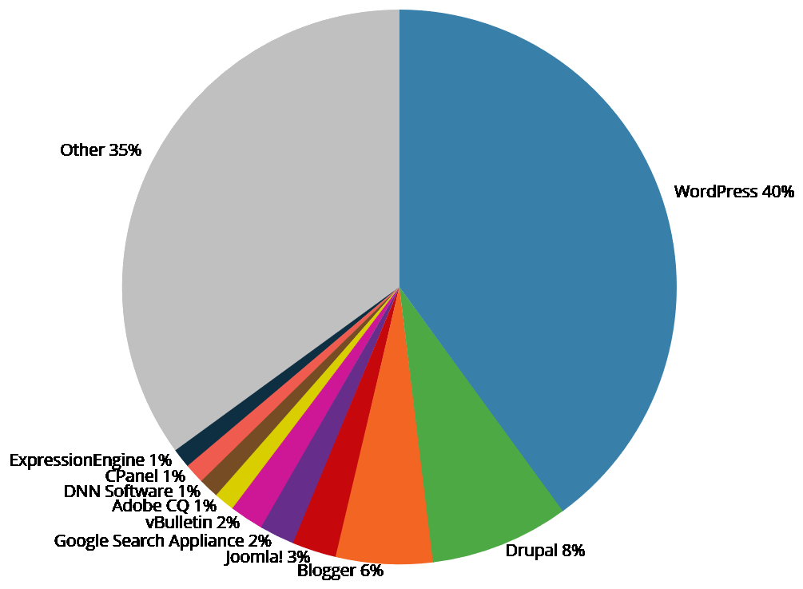
What are the top CMS?
Statistics:
http://trends.builtwith.com/cms
Top 100K CMS
May 16th 2016
Ranking:
Wordpress 40%
Drupal 8%
Blogger 6%
Joomla! 3%

Slide 4
Making MySQL More Secure
Inside of the MySQL directory is a Perl script that makes your database installation much more secure including changing the root password:
C:\> cd "C:\xampp\mysql\bin"
C:\> c:\xampp\bin\perl.exe mysql_secure_installation.pl

Slide 5
Changing root password in phpMyAdmin
Once the root password is changed, phpMyAdmin also needs to be modified. Inside the directory C:\xampp\phpMyAdmin the following line from the file “config.inc.php” needs to be modified:
$cfg['Servers'][$i]['password'] = 'secret';

Slide 6
Creating a database user
A CMS user (other than root) should be created that has database rights. Note the following procedure:
After logging in via phpmyadmin or the operating system shell:
cd C:\xampp\mysql\bin
mysql -u username -p
Issue the following SQL command:
GRANT ALL PRIVILEGES ON drupal.* TO drupaluser@localhost IDENTIFIED BY 'password';

Slide 7
WordPress Installation
The process for installing the WordPress base product. See also http://codex.wordpress.org/Installing_WordPress/
Download WordPress *.zip file from https://wordpress.org/download/
Unzip the download and move the extracted files to the server’s document root (example “/opt/lamp/htdocs” or “c:\xampp\htdocs”).
Create a new MySQL or MariaDB database for WordPress on the web server. Note the database user and database password defined earlier.
Rename the file “wp-config-sample.php” to “wp-config.php”.
Edit the file “wp-config.php” so it contains the newly created database name, the username and password.
Execute the installation script by accessing the URL of the WordPress installation in the web browser.
Enter the CMS administrator username login and password.

Slide 8
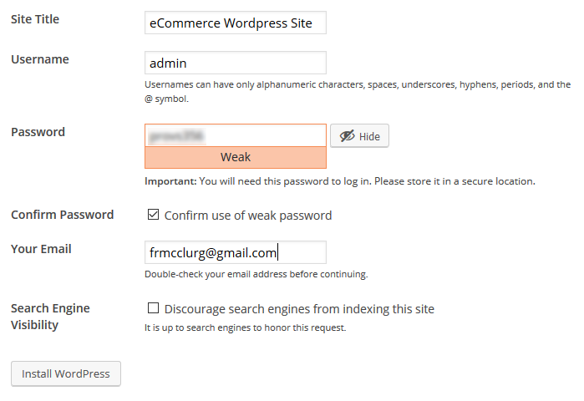
WordPress Setup

Slide 9
WordPress New Theme
In general, customizing WordPress is pretty straightforward. In order to change the theme (skin) of the website:
Click on the menu:
eCommerce WordPress Site -> Dashboard -> Plugins
Press button “Add New”.
Select the new theme.
If you get a prompt for FTP password, make sure the web server can read the /wp-content director and add the following line to your “wp-config.php” file:
define( 'FS_METHOD', 'direct' );
Click on “Activate”.
Some of the themes have dependencies upon other plugins.

Slide 10
WordPress New Plugin
In addition, installing a new WordPress is also pretty easy:
Click on the menu: “Customize”
Press vertical menu “Plugins -> Add New”.
Enter the name of the plugin (e.g. WooCommerce).
Press the button “Install Now”.
Click on link “Activate Plugin”.
Installing WooCommerce starts a wizard that sets many of the defaults.

Slide 11
Adding Products to WooCommerce
Adding Products to WordPress WooCommerce is also easy:
From the menubar, click on the menu: “New -> Product”
From this page you can add product name, description, regular price, sales price, product categories, tags (taxonomies), product image, related images.

Slide 12
WooCommerce Training
WooCommerce training is available at the following:
https://support.woothemes.com/hc/en-us/articles/203252645-WooCommerce-101-Video-Tutorials-Build-your-store-from-start-to-sale- (Excellent video training)
https://www.lynda.com/WordPress-tutorials/WordPress-Ecommerce-WooCommerce/122464-2.html (Monthly Fee)

Slide 13
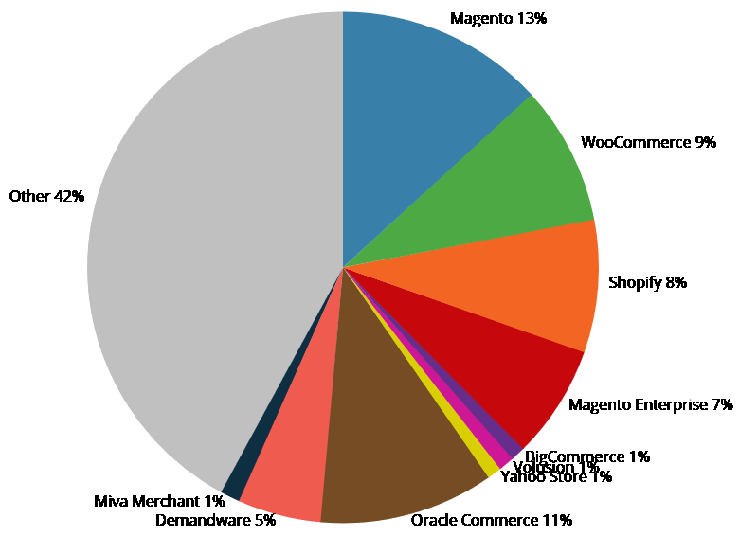
What are the top Ecommerce?
Statistics:
trends.builtwith.com/shop
Top 10K CMS
June 6th 2016
Ranking:
Magento 13%
Oracle Commerce 11%
WooCommerce 9%
Shopify 8%
Magento Enterprise 7%

Slide 14
Magento Installation
The process for installing Magento. See also http://devdocs.magento.com/guides/m1x/install/installing_install.html
Download Magento *.zip file with or without data from https://www.magentocommerce.com/download
Unzip the download. Note may need to install and use 7-zip to from http://www.7-zip.org/ to extract zip file due to long pathnames.
Create a new MySQL or MariaDB database for WordPress on the web server. Note the database user and database password defined earlier.
Several lines of the “php.ini” file may need to be uncommented in order for the configuration file to use several extra required PHP extensions (DLL libraries). In addition, the webserver will need to be restarted.
In the windows installation, a number of the icons were missing. This was resolved by following the instructions via the webpage: http://magento.stackexchange.com/questions/113945/admin-backend-icon-fonts-missing and issuing the this command: c:\xampp\php\php.exe bin\magento setup:static-content:deploy

Slide 15
Magento Development
In order to login to a Magento installation, use the following URL:
http://localhost/admin
The cache helps speed up the display of your site. However, during development, when things are changing frequently, it is highly recommended to turn the cache off:
Select All -> Disable -> Submit
When the site is in production, don’t forget to turn the cache back on.

Slide 16
Magento HowTos
To create general use coupons:
Marketing -> Cart Price Rules -> Add New Rule
To create customers:
Customers -> All Customers -> Add New Customer
To create customer groups:
Stores -> Customer Groups -> Add New Customer Group
To create an order for customer:
Sales -> Orders -> Create New Order
To create single use coupons:
Marketing -> Cart Price Rules -> Add New Rule

Slide 17
Magento Training
Magento training is available at the following:
http://code.tutsplus.com/courses/magento-fundamentals (Two are free)
Eyemagine Part 1: http://www.eyemaginetech.com/blog/magento/magento-training-videos-part1
Eyemagine Part 2: http://www.eyemaginetech.com/blog/magento/magento-training-videos-part2

Slide 18
Magento Documentation
Magento documentation is available at the following:
HTML Users Guide: http://docs.magento.com/m2/ce/user_guide/getting-started.html?_ga=1.216394390.1222503417.1464120335
PDF Users Guide: http://docs.magento.com/m2/ce/user_guide/Resources/pdf/Magento_Community_Edition_2.0_User_Guide.pdf

Slide 19
Drupal Commerce Kickstart
The easiest way to get install Drupal with Commerce is to install Kickstart. This distribution comes bundled with Drupal core, Drupal Commerce and other modules that are needed. See also https://www.drupal.org/project/commerce_kickstart
Download WordPress *.zip or *.tar.gz file from https://wordpress.org/download/
Unzip or untar the download. You may have to use 7-zip to extract due to long file names.
Move the extracted directory to your document root.
Create a new MySQL or MariaDB database for Drupal on the web server. Note the database user and database password defined earlier.
Execute the installation script by accessing the URL of the Drupal installation in the web browser.
You may need to increase the installation time in the “C:\xampp\php\php.ini” file to the following: max_execution_time = 600 max_input_time = 600 memory_limit = 512M post_max_size = 64M upload_max_filesize = 64M mysql.connect_timeout = 600
If this still does not work, you may need to edit “sites/default/settings.php” file to the following: ini_set('max_execution_time', 0); After the initial installation, you will want to comment or delete this line when completed.
You may also need to change the following line in the “C:\xampp\mysql\bin\my.ini”: max_allowed_packet=64M
Enter the CMS administrator username login and password.

Slide 20
Installing Modules
In order to install additional modules, try the following:
Site Settings -> Modules
Press “Install new module” button
If you are prompted for an FTP username and password, you may have to change the ownership of the /sites/default directory (linux) so that it is owned by the same user that runs the apache process:
cd /opt/lampp/htdocs/pdm/sites
ls -ld default
ps -aux | grep httpd
sudo chown daemon default
ls -ld default

Slide 21
Selecting Modules
In order to select a module, use google or drupal.org to navigate to the module project page. For example: webform or webform token
From Firefox, right click on the recommended release version that matches the version of Drupal core (e.g. version 7.x or 8.x) and select the menu “Copy Link Location”.
On the Modules page within Drupal, paste the URL and press the “Install” button.

Slide 22
Enabling Modules
After installing the module, you must enable it to make it active. Click on the link “Enable newly added modules”.
Next click the toggle to “On” next to the module you wish to enable.
Finally, press the “Save configuration” button.

Slide 23
Configuring Modules
After installing and enabling a module, sometimes the module needs to be configured:
Site settings -> Configuration
or
Site settings -> Modules
Configure (links dropdown list)
Set the appropriate configuration settings.
Finally, press the “Save configuration” button.

Slide 24
Drupal Training
Acquia (commercial arm of Drupal) recently started offering free training:
https://training.acquia.com/free-training
Lynda.com also offers some excellent Drupal courses via a monthly fee:
https://www.lynda.com/Drupal-training-tutorials/186-0.html
Drupalize.me also offers excellent Drupal courses via a monthly fee:
https://drupalize.me/tutorials
I have personal experience using buildamodule.com and highly recommend them. They offer first class, in-depth online Drupal training and much more:
https://buildamodule.com/

Slide 25
More Drupal Training
OSTraining released 200 Drupal 8 videos for free on youtube:
The Drupal 8 Beginner Class (62 videos)
Drupal 8 Site Building (11 videos)
Installing Drupal 8 (5 videos)
Backing up Drupal 8 Sites (5 videos)
Updating Drupal 8 Sites, Modules (5 videos)
Yet another Drupal (and more) training site for a fee. A number of the videos are free:
https://modulesunraveled.com

Slide 26
Drupal Documentation
Drupal documentation is available here:
https://www.drupal.org/documentation
You can search for Drupal modules and themes via the following page:
https://www.drupal.org/documentation

Slide 27
Which eCommerce is better?
To answer the question, which eCommerce is better really depends upon your requirements. Here are my observations:
Wordpress WooCommerce:
Easiest to use
Most “out-of-the-box” ready
Plugins costly
Magento:
Currently has the market share
Does not handle non-eCommerce well
Plugins costly
Drupal:
Difficult setup
Great general purpose CMS
Flexible feature set
Free
Drupal vs. Magento review:
https://commerceguys.com/blog/comparing-drupal-commerce-magento

Slide 28
Questions?

