Slide 1
Linux Operating System
Practical Guide to Linux Commands, Editors, and Shell Programming, A (3rd Edition) by Mark Sobell
Unit 1: An Introduction to Linux
Chapter 1: Welcome to Linux
Copyright © 2013, Fred McClurg, All Rights Reserved

Slide 2
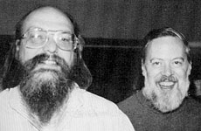
Birth of Unix
It’s a Unix system http://www.youtube.com/watch?v=dFUlAQZB9Ng
Unix originated by Ken Thompson and Dennis Ritchie at AT&T Bell Labs: http://www.youtube.com/v/7FjX7r5icV8
Thompson and Ritchie in the early days of Unix

Slide 3
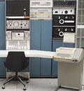
Origins of Unix
August 1969, First version written in assembly language on Digital Equipment Corp. (DEC) PDP-7 minicomputer
Ken Thompson spent one week on each of the following:
Operating System, Shell, Editor, Assembler
In an age when most computers ran single jobs in batch mode via punch cards
Multi-user Operating System
Users communicated to computer via terminal
February 1971, ported to DEC PDP-11
PDP-7 minicomputer

Slide 4
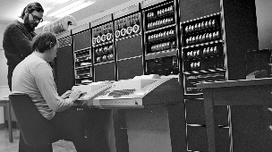
Relationship with C
1972 Richie develops C programming language (based on Thompson’s B language)
Originally named Unics (Uniplexed Information and Computing Service)
Unix rewritten in C by Thompson to make it more portable
“hacker” referred to someone who used creativity, intelligence and midnight oil to solve problems

Slide 5
Unix Goes Public
1973, The “pipe” mechanism allowed output of one program to be used by another
July 1974, Richie and Thompson published article The Unix Time-Sharing System in Communications of the Association for Computing Machinery (CACM):
“A general-purpose, multi-user, interactive operating system.”
“A powerful operating system for interactive use need not be expensive either in equipment or in human effort,”
“[We hope that] users of Unix will find that the most important characteristics of the system are its simplicity, elegance, and ease of use.”
1975, Bell Labs offered Unix to Universities at minimal cost

Slide 6
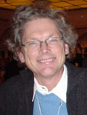
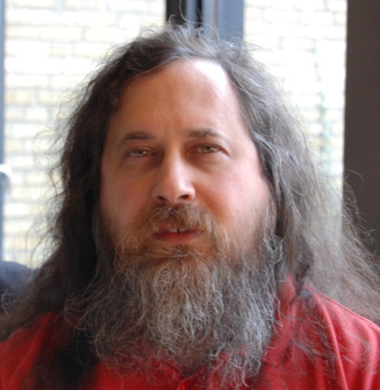
Early Unix Hackers
1976, Bill Joy, University of California, developed ex, vi, NFS, csh
1983, Turing Award honored Thompson and Ritchie's Unix:
"The model of the Unix system has led a generation of software designers to new ways of thinking about programming.“
"The genius of the Unix system is its framework, which enables programmers to stand on the work of others."
September 1983, Richard Stallman launched GNU project.
GNU Compiler (gcc)
GNU Debugger (gdb)
Emacs
October 1985, Richard Stallman founded Free Software Foundation
Pioneered concept of “copyleft”
Free software advocate
Opponent of software patents
http://www.youtube.com/watch?v=uJi2rkHiNqg
Bill Joy
Richard Stallman

Slide 7

Popular Unix Shells
sh: Bourne Shell was developed by Stephen Bourne, of AT&T Bell Laboratories, and was released in 1977 in the Version 7 Unix
csh: C Shell was developed by Bill Joy, at University of Berkeley, and was released in 1978 in the BSD system.
bash: Released in 1989 as a replacement for the Bourne Again Shell. It is the default shell in Linux.

Slide 8

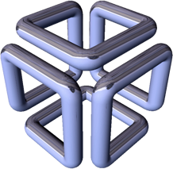



The Unix Wars
March 1978: Bill Joy’s modifications resulted in Berkeley Software Distribution (BSD) priced at $50
1979: Lawyers prohibited AT&T Version 7 prohibited universities from studying Unix source code in courses
1982: Bill Joy, Scott McNealy, Vinod Khosla, and Andy Bechtolsheim founded Sun Microsystems (birthplace of Java) developed Sun workstation running SunOS (BSD derivative)

Slide 9
The Unix Wars
1983: Two branches of Unix:
Berkeley Software Distribution or BSD (Sun)
AT&T Unix System V (SGI IRIX, IBM AIX, HP-UX)
1997: AT&T/Sun Alliance released System V Release (SVR4)
1998: Open Software Foundation or OSF (IBM, HP, DEC) developed Motif

Slide 10
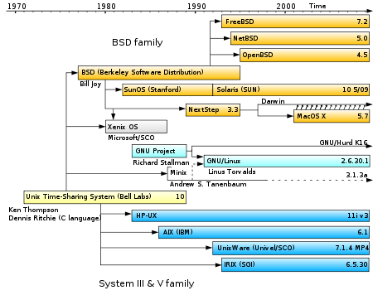
Unix Genealogy Tree

Slide 11
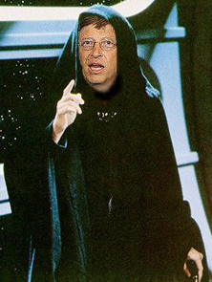
Dark Side Emerges
July 1993, Microsoft released Windows NT, enterprise-class 32-bit multiprocessing OS
March 1993, Common Open Software Environment (COSE) goal of open unified operating system (OS)
The Unix Wars ended
Common Desktop Environment (CDE) Motif based
1996, Open Group formed by merging X/Open (European) and OSF
Certification of Unix trademark
Official definition of Unix

Slide 12
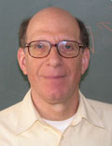
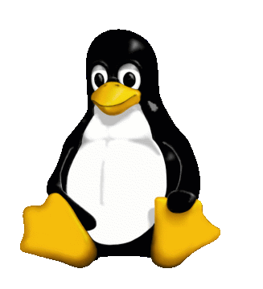
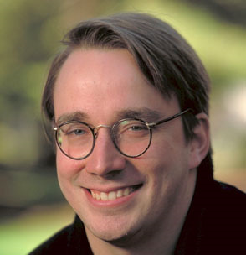
Birth of Linux
1987, Andrew Tanenbaum, professor in Amsterdam wrote a Unix clone called Minix for his classrooms which ran on the 80286 microprocessor
Andrew Tanenbaum
September 1991, Linux Torvalds, Finnish undergraduate student used Minix as starting point for the Linux kernel.
Linus Torvalds

Slide 13
Linux runs every where
Linux now runs on a variety of architectures including i386, PPC, x86_64

Slide 14
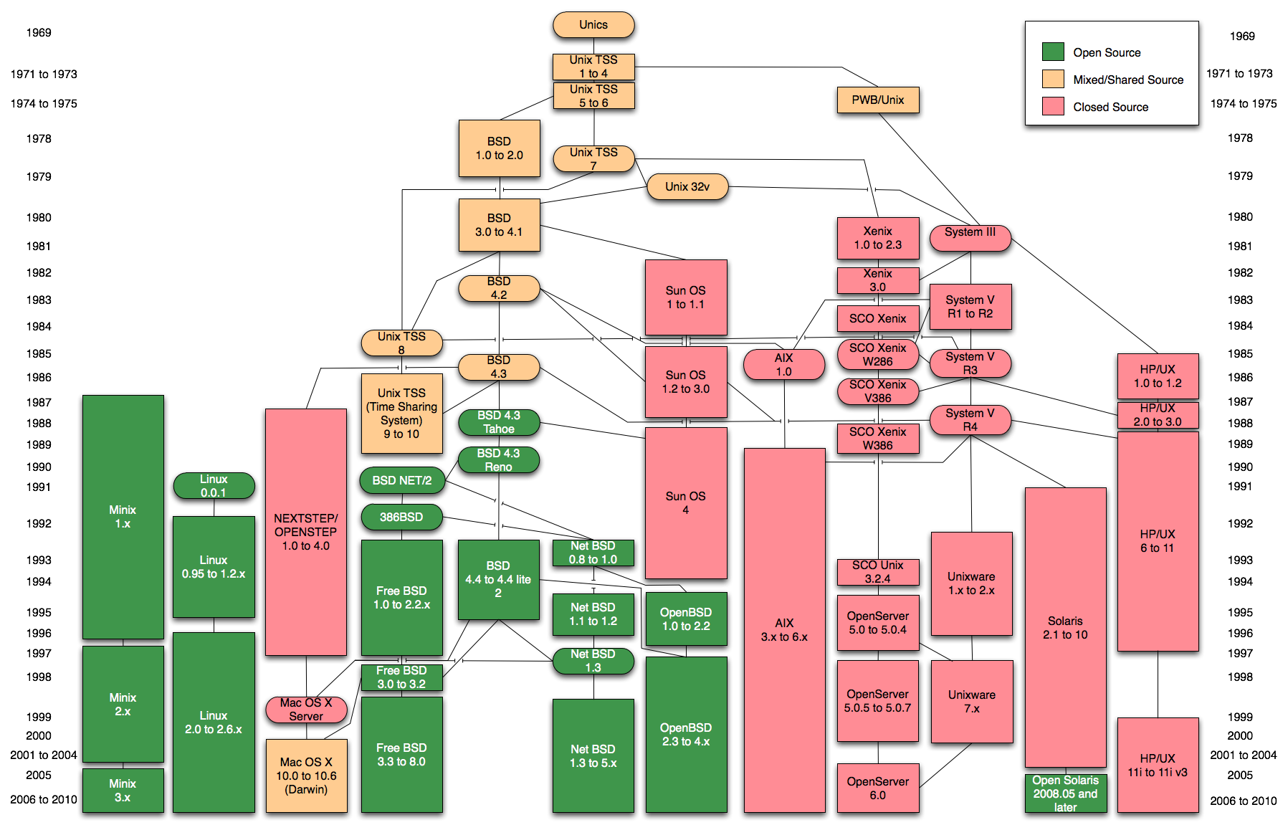
Unix Family Tree

