Slide 1
Linux Operating System
A Practical Guide to Fedora and Red Hat Enterprise Linux
Unit 2: The Linux Desktop
Chapter 4: Introduction to Fedora and Red Hat Enterprise Linux
By Fred R. McClurg
© Copyright 2013, All Rights Reserved

Slide 2
The Linux Desktop
GNOME:
Three menus: Applications, Places, System
Changes take effect upon choosing
Focus on simplicity adds to ease of use
KDE:
KMenu: Favorites, Applications, Computer, Recently Used, Leave
More similar to windows
More popup dialogs
Changes after click “Apply” or “Save”
Focus on features adds complexity

Slide 3
How do you pronounce GNOME?
On Jan. 4, 2000, Miguel di Icaza, the creator of the GNOME desktop environment, answered your GNOME questions and discussed GNOME development.
Miguel di Icaza: “I guess guhnome, nome, ge-nome are all good pronunciations. Just use the one that you feel comfortable with. We are flexible.”

Slide 4
How do you pronounce GNU?
Richard Stallman, founder of the GNU Project, Speech at New York University, May 29, 2001:
But, when it's the name of our system, the correct pronunciation is "guh-NEW" -- pronounce the hard "G". If you talk about the "new" operating system, you'll get people very confused, because we've been working on it for 17 years now, so it is not new any more.
http://www.gnu.org/audio/gnu-pronunciation.ogg

Slide 5
Running Applications
Run in terminal
Main Menus
Double Click from Nautilus
Alt+F2 Run Applications

Slide 6
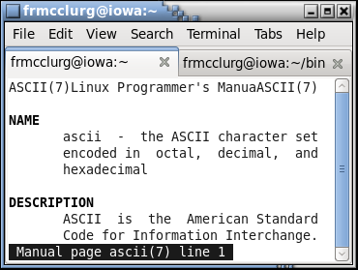
Running Applications
Terminal Execution
Applications=>System Tools=>Terminal

Slide 7
Main Menu
Applications
Games
Graphics
Internet
Office
Places
Opens file browser window at location
System
Allows configuration of system (may require root privileges)

Slide 8
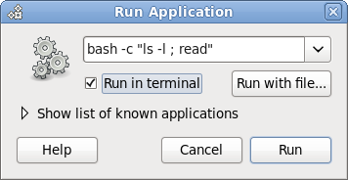
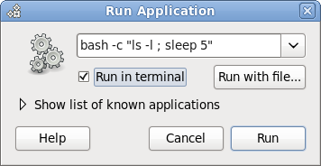
Alt+F2 Run Applications Dialog

Slide 9
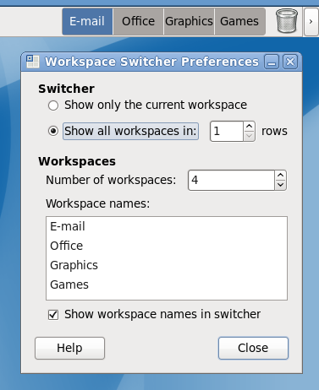
Switching Workspaces

Slide 10
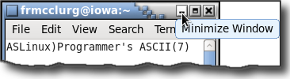
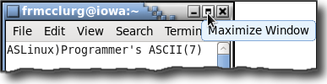

Working with Windows
Minimize (Iconify)
Maximize/Restore
Close

Slide 11

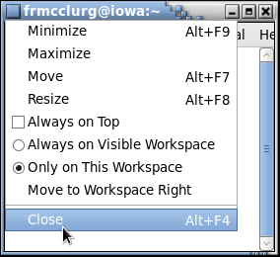
Working with Windows
Window Menu
Window Menu Options

Slide 12
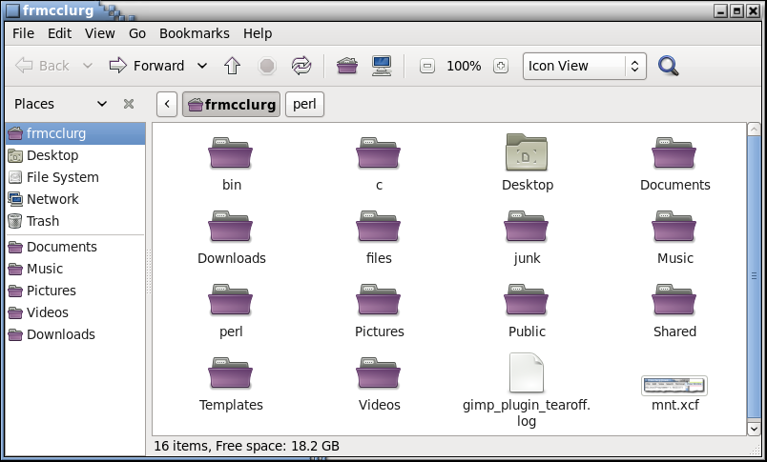
Nautilus: Gnome File Manager

Slide 13
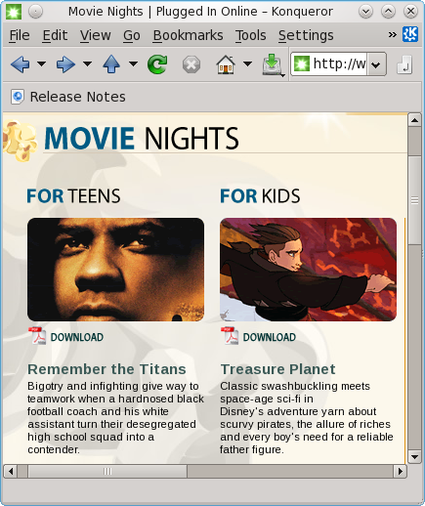
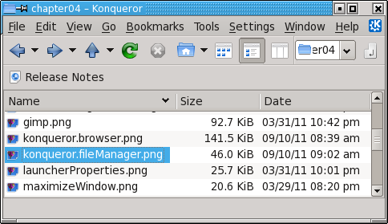
Konqueror: KDE File Manager & Browser

Slide 14
Creating Documents
Gnome Text Editor
gedit
Applications=>System Tools=>Terminal
Word Processor
OpenOffice Writer
Applications=>Office=>OpenOffice=>Writer

Slide 15
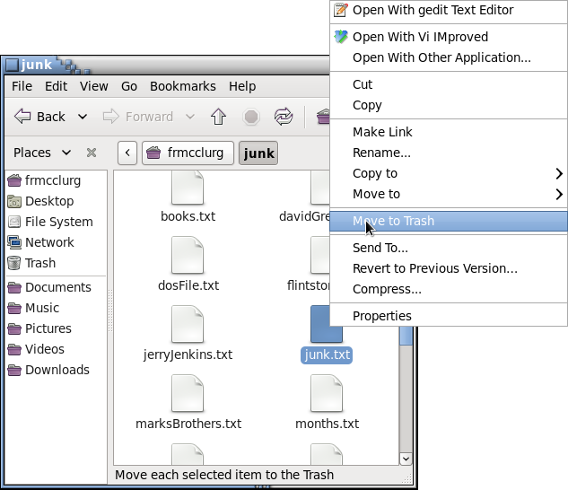
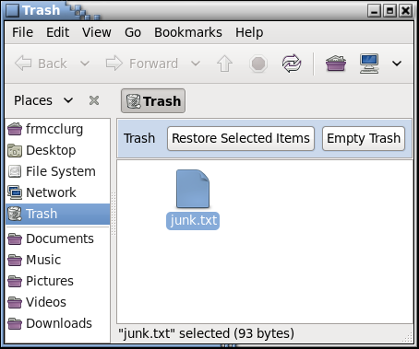
Trash Can
Move to trash
Empty trash

Slide 16

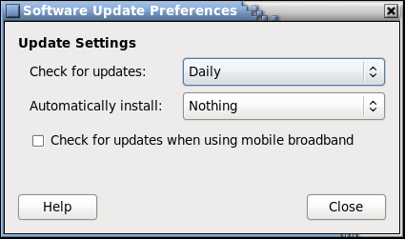
Updating Software
Update Applet
System=>Preferences=>Software Updates

Slide 17
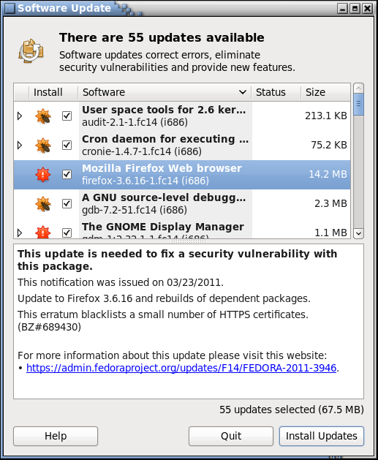
Updating Software
System=> Administration=> Software Update

Slide 18
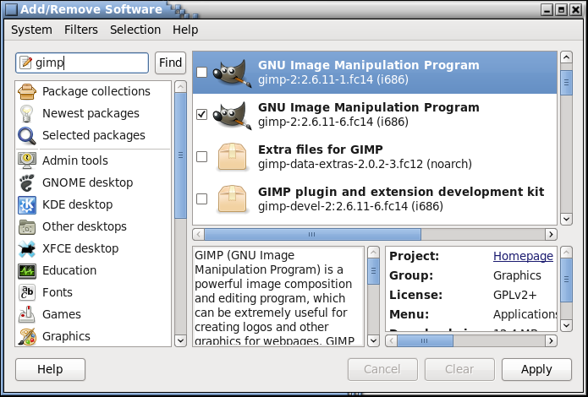
Installing Software via GUI
System=>Administration=>Add/Remove Software

Slide 19
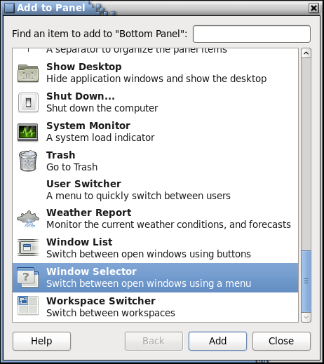
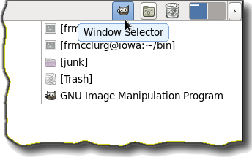
Adding Applets to Panel
Window Selector Applet
Right+Click=>Add to Panel

Slide 20
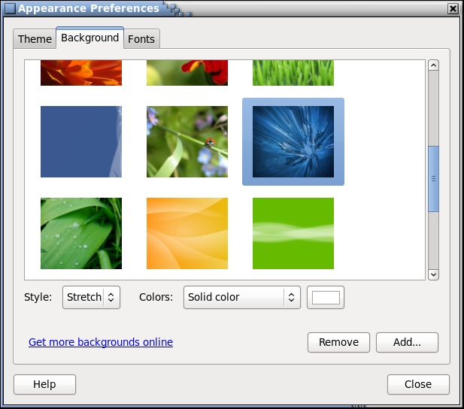
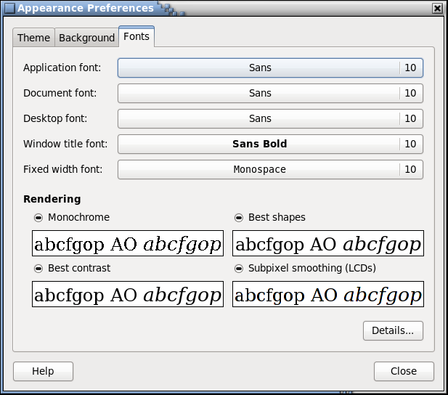
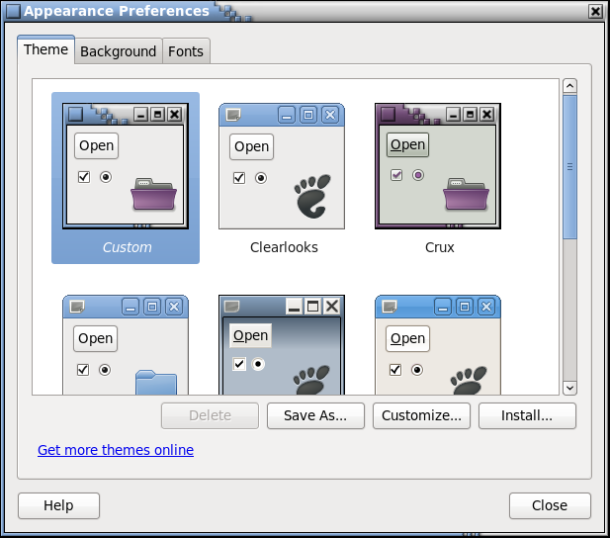
Changing Appearance
Right+Click on Root=>Change Desktop Background
Fonts Tab
Theme Tab

Slide 21
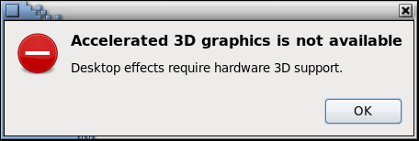
Desktop Effects
System=>Preferences=>Special Effects

Slide 22
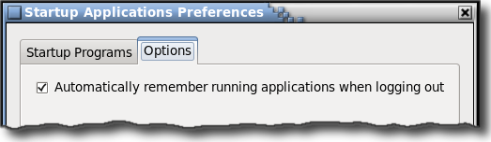
Session Management
System=>Preferences=>Startup Applications

Slide 23
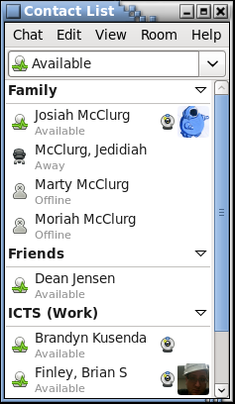
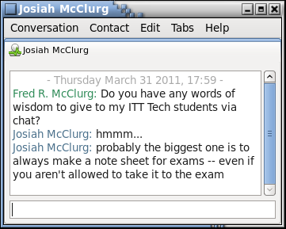
Other Applications
Applications=>Internet=>Empathy Applications

Slide 24
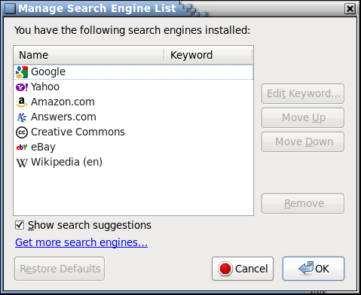
Manage Search Engine List
Select menu: Manage Search Engines...
Click on: Get more search engines...

Slide 25
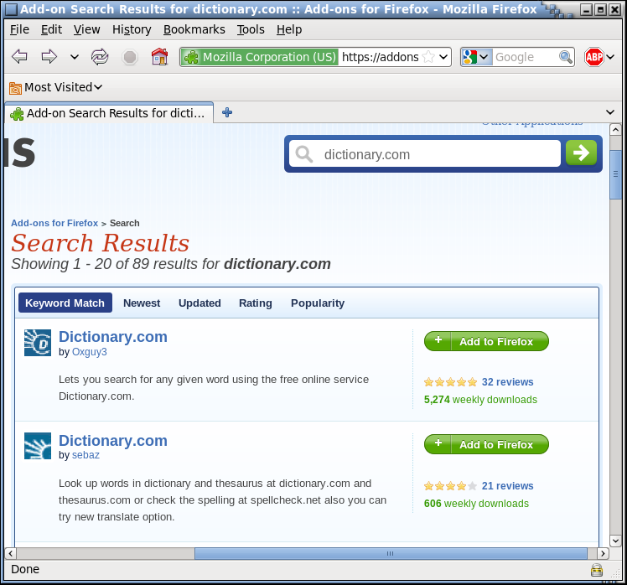
Install Search Engine Plugins
Type:
dictionary.com
Press:
Add to Firefox

Slide 26
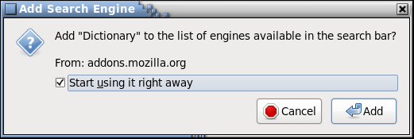
Add Search Engine Dialog
Check: Start using it right away
Press: Add

Slide 27
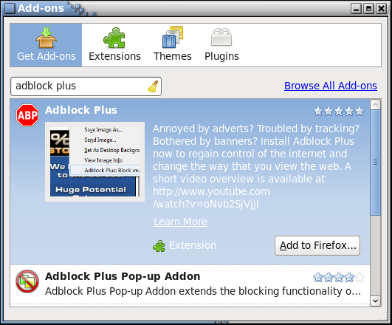
Firefox: Adding Plugins
Tools=>Add Ons
Get Add Ons
adblock plus
Add to Firefox...

Slide 28
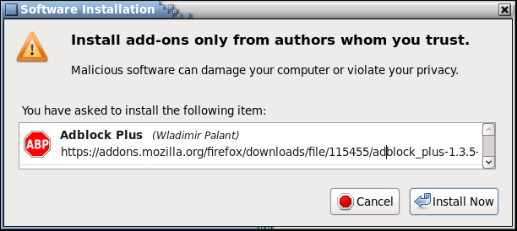
Firefox: Adding Plugins
Install Now
Restart Firefox

Slide 29
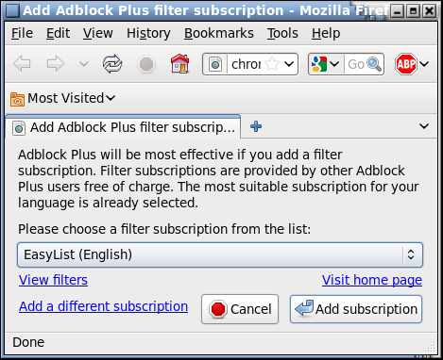
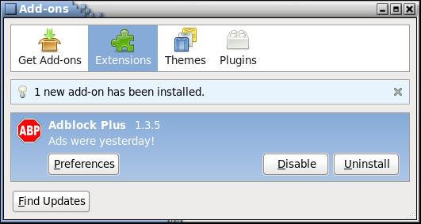
Firefox: Adding Plugins
Add subscription: EasyList (English)

Slide 30
Terminology
Applet
Small program that runs on the panel (examples: Clock, System Monitor, Workspace Switcher)
Workspaces
Expands the desktop size by using the switcher to traverse and view a portion of the desktop area

Slide 31
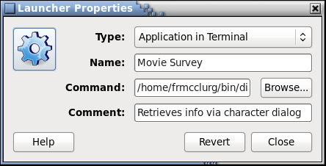
Terminology
Launcher
Starts an application from the panel

Slide 32
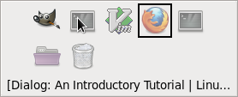
Window Management
Window Cycling (changing input focus)
Alt+Tab: Cycle forward through windows on desktop
Alt+Shift+Tab: Cycle backward through windows

Slide 33
Cutting and Pasting
Copy Buffer
Ctrl+X: Cut
Ctrl+C: Copy
Ctrl+V: Paste
Selection Buffer
Highlight: Copy
Middle Mouse: Paste

Slide 34
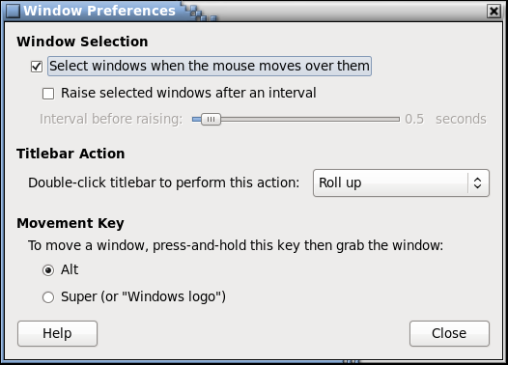
Window Focus
Click to focus (explicit focus)
Focus follows mouse
System=> Preferences=> Window

Slide 35
Linux Documentation
Help Browser:
System=>Help
Man Pages:
man [-S x] command
--help command line argument
cat --help | less
Search man page names and descriptions
apropos keyword | grep –i string

Slide 36
Changing Passwords
Via the GUI:
System=>Preferences=>About Me
Via the Command Line:
passwd

Slide 37
Password Rules
Rules:
At least six characters (7 or 8)
Should not be in dictionary
Not the name of person, place or pet
Contains at least one digit (integer)
Contains at least one upper case
Contains at least one alpha character
Contains at least one punctuation
Not username
Not reverse

