Slide 1
Linux Operating System
A Practical Guide to Fedora and Red Hat Enterprise Linux
Unit 2: The Linux Desktop
Chapter 8: Linux GUIs: X and Gnome
By Fred R. McClurg
© Copyright 2013, All Rights Reserved

Slide 2
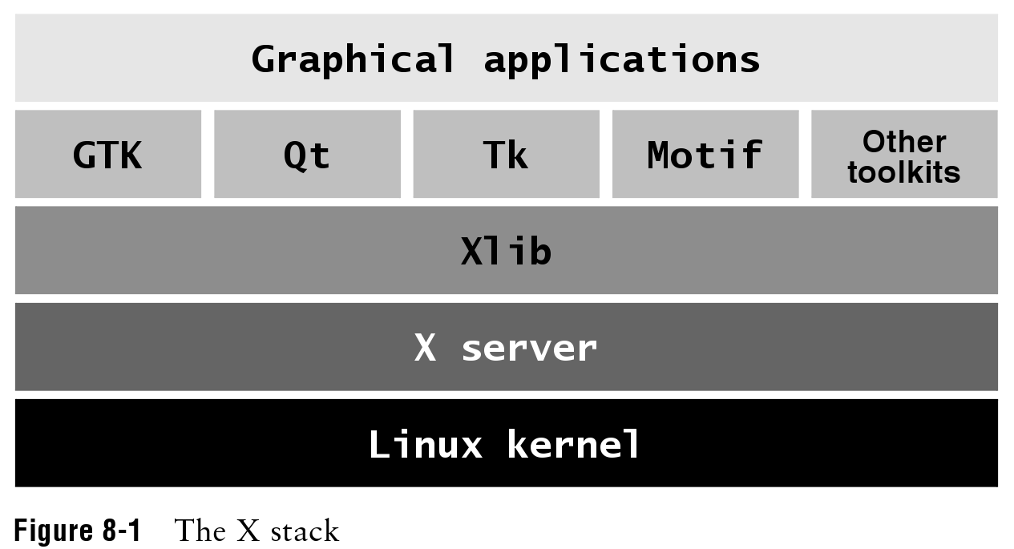
X Application Layer

Slide 3
Starting X Windows
The command for starting X Windows:
startx

