Slide 1
Linux Operating System
Introduction to Web Programming
A Practical Guide to Fedora and Red Hat Enterprise Linux
Unit 4: More Command Line Interface (CLI)
Chapter 5: The vim Editor
By Fred R. McClurg
© Copyright 2016, All Rights Reserved

Slide 2
Install for this class …
vi, vim, gvim:
yum install vim-X11 ascii man page:
yum install man-pages

Slide 3
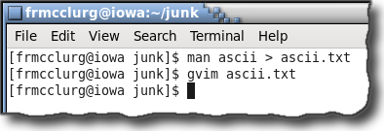
vi, vim, gvim: Visual Editor
Syntax:
gvim filename

Slide 4
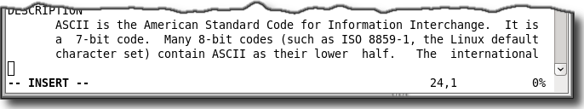
vim: Modes of Operation
Command Mode: Accepts vim commands
Input Mode: Accepts any text
Escape Key: Toggles between Command and Input Modes
cursor
mode
indicator
line
number
column
number
percent
content

Slide 5
vim: Command Modes
Vi Command Mode:
Short (usually one or two) character commands
Ex Command Mode:
Always begins with colon

Slide 6
Vi Commands

Slide 7
vi: Cursor Movement Commands
goto first line of file
 |  |  | 1G
 |  |  | H
 |  |  | k
^ | 0 | h | M | l | $
 |  |  | j
 |  |  | L
 |  |  | G
home (top of screen)
line up
begin line
end of line
middle screen
right
begin text
left
line down
lower (btm of screen)
goto last line of file

Slide 8
vi: Insert/Append Commands
open above
append line
 |  | O
I | i | □ | a | A
 |  | o
cursor position
insert line
insert left
append
right
open below

Slide 9
vi: Change/Substitute Commands
cursor position
□
substitute line
S | s | C
change
line end
substitute character
vim: Replace (Overwrite) Commands
cursor position
r | R
replace character
replace line end

Slide 10
vi: Page Scroll Commands
up full screen
Ctrl+U
Ctrl+B
□
Ctrl+D
Ctrl+F
back half screen
cursor position
down half screen
forward full screen

Slide 11
vi: Screen Scroll Commands
top screen
zt
zz
zb
middle screen
bottom screen

Slide 12
vi: Move by word, sentence, paragraph
paragraph up
 |  | {
 |  | (
B | b | □ | w | e | W | E
 |  | )
 |  | }
end word
sentence up
cursor
end big word
back big word
back word
word big
word
sentence down
paragraph down

Slide 13
vi: Delete Commands
cursor position
□
delete previous
X | x | D
delete to
line end
delete character

Slide 14
vi: Misc one character commands
Char | Description
u | Undo last operation
U | Undo last line change
Ctrl+R | Redo the undo command
. | Repeat previous command
J | Join current line with next
% | Match brace or parenthesis
* | Find next occurrence of word
~ | Change case of character

Slide 15
vi: Delete and Change
Cmd | Description
cw | Change word
cc | Change line
dw | Delete word
dd | Delete line
"add | Delete line into buffer named “a”

Slide 16
vi: Yank and Put Commands
Cmd | Description
Y | Yank (copy) line
yy | Yank (copy) line
P | Put (paste) yanked line above
p | Put (paste) yanked line below
"ayy | Yank line into buffer named “a”
"ap | Put line from named buffer “a”

Slide 17
vi: Marker commands
Cmd | Description
mx | Mark position with letter “x”
'x | Go to marked line “x”
`x | Go to marked char position “x”

Slide 18
vi: Shift (indentation) commands
Cmd | Description
>> | Shift (indent) current line
>} | Shift (indent) next paragraph
<< | Unshift (unindent) current line
<} | Unshift (unindent) paragraph

Slide 19
vi: Find character commands
Cmd | Description
fx | Find character “x”
Fx | Find previous “x”
tx | Find character before “x”
Tx | Find character after previous “x”
; | Repeat prior f, F, t, or T command

Slide 20
vi: Find string commands
Cmd | Description
/str | Define and find string “str”
?str | Define & find previous “str”
n | Find next string occurrence
N | Find previous occurrence

Slide 21
Ex Commands

Slide 22
ex: Substitute Addresses
Syntax:
:[address]s/search/replace/options
Address Examples:
none Current line
% Entire buffer
1,$ Lines one through the last line
.,$ Current line through the last line
'm,'n From marker “m” through marker “n”
Address | Description
. | Current line
% | Entire buffer
1,$ | Lines one through last line
.,$ | Current line through last line
'm,'n | Line range from mark “m” to “n”

Slide 23
ex: Search Regular Expressions
Syntax:
:[address]s/search/replace/options
Chars | Description
^ | Beginning of line anchor
$ | End of line anchor
. | Any one character
* | Zero or more of the previous character
\= | Zero or one of the previous character
\+ | One or more of the previous character
[] | Any character in set (ex: [0-9], [a-z], [aeiou])
[^] | Character not in set (ex: [^ -~] and [^aeiou])

Slide 24
ex: Search Regular Expressions
Syntax:
:[address]s/search/replace/options
Regular Expression Search Examples:
^ Beginning of line anchor
$ End of line anchor
. Any one character
* Zero or more of the previous character
\= Zero or one of the previous character
\+ One or more of the previous character
[] Any character in set (ex: [0-9], [a-z], [aeiou])
[^] Any character not in set (ex: [^ -~], [^aeiou])
\< Beginning of word
\> End of word
\( \) Grouping
Char | Description
\< | Beginning of word anchor
\> | End of word anchor
\( \) | Numbered grouping
\| | Alternative (OR) expressions
\{n,m} | Matches n to m of the previous character
\{n} | Matches exactly n times of previous character
\{,m} | Matches maximum of m (0 to m) of previous
\{n,} | Matches a minimum of n of previous character

Slide 25
ex: Search Regular Expressions
Syntax:
:[address]s/search/replace/options
 | Matching | Equivalent
\s | Any white space character
\S | Non white space character
\a | Alphabetic character | [a-zA-Z]
\A | Non alphabetic character | [^a-zA-Z]
\d | Digit character | [0-9]
\D | Non digit character | [^0-9]
\l | Lowercase character | [a-z]
\u | Uppercase character | [A-Z]

Slide 26
ex: Regular Expression Replacements
Syntax:
:[address]s/search/replace/options
Replace Examples:
& Replace with string that was matched
\1 End of line anchor
\< Beginning of word
\> End of word
* Zero or more of the previous character
. Any one character
[] Any character in set (ex: [0-9], [a-z], [aeiou])
[^] Any character not in set (ex: [^ -~], [^aeiou])
\( \) Grouping
Replace | Description
& | Replace with matched string
\1 … \9 | Matched groups
\L | Following characters lowercase
\U | Following characters uppercase
\l | Next character lowercase
\u | Next character uppercase

Slide 27
ex: Search Modifiers
Syntax:
:[address]s/search/replace/options
Options | Description
c | Confirm substitutions
g | All occurrences in line
i | Ignore case

Slide 28
ex: Global Commands
Syntax:
:[address]g[!]/search/cmds
:[address]v/search/cmds
Cmd | Description
g | Delete lines matching. Ex: :g/Microsoft/d
g | Search and replace match. Ex: :g/^search/s/$/append/i
v | Delete lines not matching. Ex: :v/Linux/d

Slide 29
ex: Copy and Move Commands
Syntax:
:[address]co[address]
:[address]m[address]
Cmd | Description
co | Copy lines 5 to last line after current line: :5,$co.
m | Move lines marked “a” to “b” after line marked “z”: :’a,’bm’z

Slide 30
ex: Editing Files
Syntax:
:e file Edit file “filename”
:e! Revert file to last save
:w file Write file “filename”
:q Quit the editor
:q! Quit without saving
:wq Write file and quit editor
:n Next file
ZZ Write file (if modified) and exit

Slide 31
ex: Editor Settings
Keep same indentation as previous line (Ctrl+T for next indent, Ctrl+D previous indent)
:set autoindent :set ai
Writes file before using “:n” to edit next file
:set autowrite :set aw
Number of columns in editor
:set columns=80 :set co=80
Insert spaces instead of tabs
:set expandtab :set et
Highlight search string
:set hlsearch :set hls
Case insensitive search
:set ignorecase :set ic

Slide 32
ex: More Editor Settings
Number of lines displayed
:set lines=30
Search for pattern as it is typed
:set incsearch :set is
Display line numbers
:set nonumber :set nu
Wrap buffer when searching for a string
:set wrapscan :set ws
Define number of spaces in a tab
:set tabstop=3 :set ts=3
Threshold for reporting number of lines changed.
set report=1

Slide 33
ex: Still More Editor Settings
Number of spaces for shift (indent). Works with “>>” and “<<”.
:set shiftwidth=3 :set sw=3
Show matching braces {}, parenthesis (), or brackets []
:set showmatch :set sm
Number of characters from right margin where wrapping begins
:set wrapmargin=2 :set wm=2
Flash screen instead of beeping
:set visualbell :set vb

Slide 34
vim: Ex Editor Alias Commands
Alias an Insert Mode abbreviation
Syntax:
:abbreviate alias expanded
Example:
:ab ittti ITT Technical Institute

Slide 35
ex: Editor Key Map Commands
Map an unused key to a command
:map K :%s/[ \t][ \t]*$//^M
Unused vim key commands:
Ctrl+A Ctrl+Q Ctrl+Z
g Ctrl+S
K v
Ctrl+K V
Ctrl+O Ctrl+V
q Ctrl+X

Slide 36
ex: Execute Shell Commands
Syntax
:!!cmd Use current line as input to cmd and replace with output from cmd
:!}cmd Use paragraph as input to cmd and replace with output from cmd
Examples:
:!!which perl Inputs the location of Perl
:!}sort Sort the next paragraph
:!}fmt Format next paragraph by wrapping long lines and joining short lines
:1,$!expand –t 3 Replace tabs with 3 spaces

Slide 37
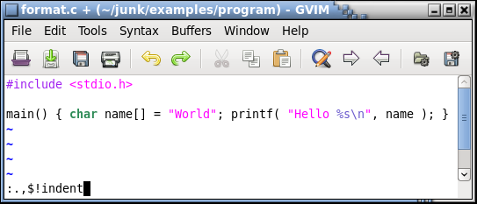
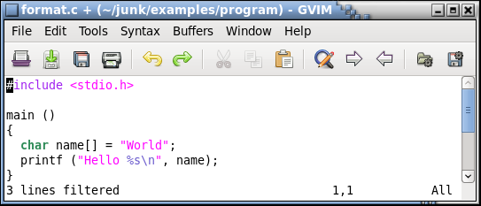
ex: Indent Shell Command
Syntax
:1,$!indent

Slide 38
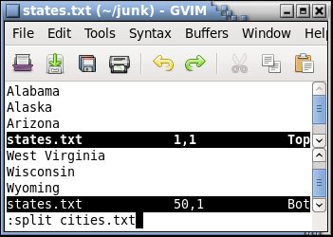
ex: Split Command
Syntax
:split [filename]

Slide 39
vim: Location of vimrc
Location:
Unix:
$HOME/.vimrc
~/.vimrc
Windows:
:version
:echo $HOME
:echo $VIM

