Slide 1
Linux Operating System
A Practical Guide to Fedora and Red Hat Enterprise Linux
Unit 4: More Command Line Interface (CLI)
Chapter 6: The Linux File System
By Fred R. McClurg
© Copyright 2015, All Rights Reserved

Slide 2
Working With Directories
Print Working Directory
  pwd
Tilde in Pathnames
  vim ~/foo
  vim /home/frmcclurg/foo
  cat ~baw/.bashrc
  cat /home/baw/.bashrc

Slide 3
Absolute Pathnames
Absolute pathnames start with slash “/”.
Example:
  cd /home/frmcclurg/bin

Slide 4
Relative Pathnames
Relative pathnames start from working directory (pwd).
Examples:
  cd . Current directory
  cd .. Parent directory
  cd bin Down directory (child)
  cd ../src Parallel directory src
  cd ../.. Up two directores

Slide 5
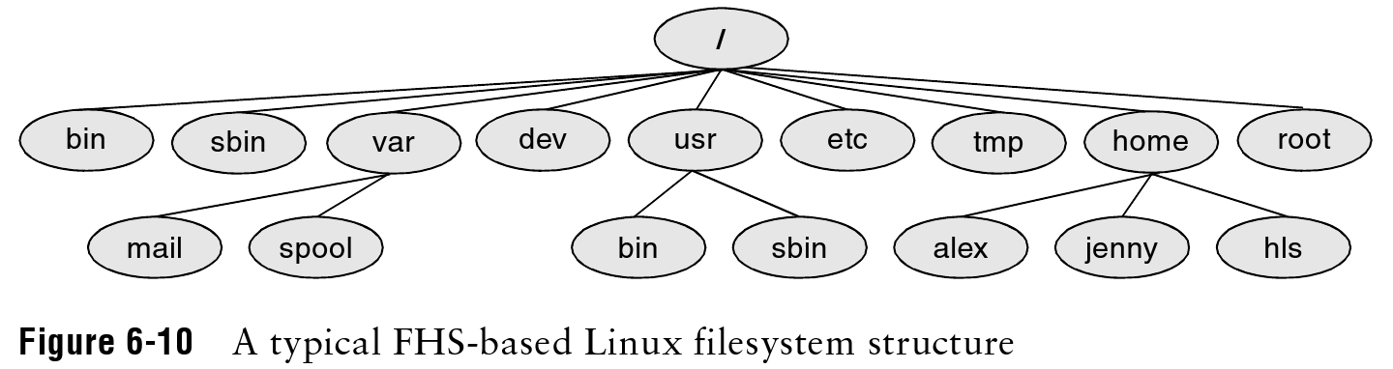
Important Directories
Linux Filesystem Hierarchy Standard (FHS), Feburary 14, 1994

Slide 6
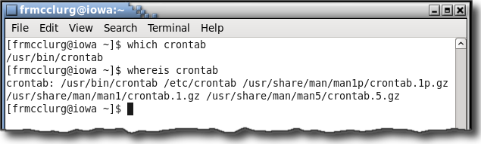
which and whereis: Path of executable
Syntax:
  which executable
  whereis executable
  whereis manpage

Slide 7
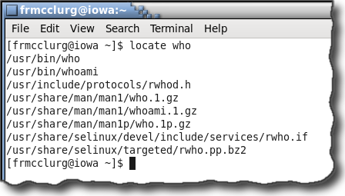
locate: File path keyword search
Syntax:
  locate keyword

Slide 8
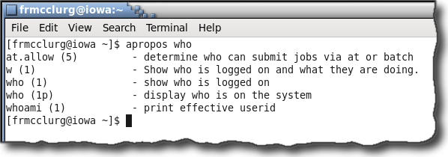
apropos: Man page keyword search
Syntax:
  apropos keyword

Slide 9
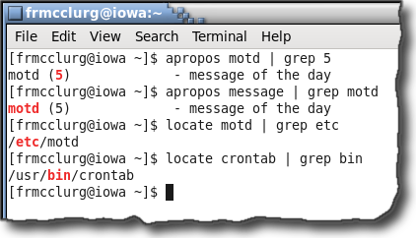
apropos, locate, & grep: Narrow search
Syntax:
  apropos keyword | grep string
  locate keyword | grep string

Slide 10
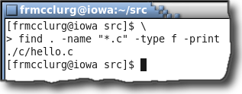
find: Swiss army knife search cmd
Syntax:
  find [dir] [–name file]
  [–type f|d|l] [–print]
  [–exec cmd {} \;]

Slide 11
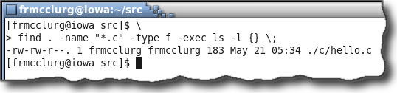
find: Search and execute cmd
find . -name "*.c" -type f \
  -print -exec ls -l {} \;

Slide 12
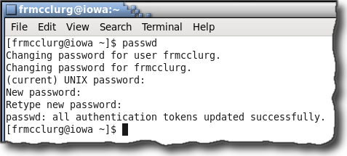
passwd: Change account password
Syntax:
  passwd

Slide 13
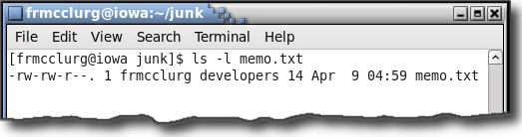
File Permissions
Gives a fine grained access to files and directories
Links
ACL Flag
Size
Filename
File Permissions
Group
File Type
Owner
Last Modified Date

Slide 14
chmod: Changing Permissions
Syntax:
  chmod [options]
  [u][g][o][+-][r][w][x] fileOrDirectory
Permissions:
  - rwx rwx r-x
Others (World) Access
Group Access
User (Owner) Access

Slide 15
chmod: by Mode
Examples:
  chmod ugo+x script.bsh
  chmod go-rw secret.txt
  chmod ugo+rw readWriteMe
  chmod ugo-w readOnly.txt

Slide 16
chmod: By Numbers
Syntax:
  chmod [options] [number] fileOrDir
Example:
  chmod 754 script.pl
Binary Perspective
- | rwx | r-x | r--
 | 111 | 101 | 100
 | 7 | 5 | 4
Integer Perspective
- | rwx | r-x | r--
 | 421 | 401 | 400
 | 7 | 5 | 4

Slide 17




Command Line Editing
Recall Command History
  Arrow Up: Previous Command
  Arrow Down: Next Command
Editing History
  Arrow Left: Move Cursor Left
  Arrow Right: Move Cursor Right
  Ctrl+W: Word Delete Left
  Ctrl+U: Undo (Delete) Line Left

Slide 18
Unix Links
Hard Link
Symbolic Link

Slide 19
Hard Link
Defined:
File with multiple filenames
Syntax:
  ln existing newLink

Slide 20

Hard Link
Analogy:
One man many aliases
David Webb
Charles Briggs
Delta One
Jean-Pierre
Kane
Gilberto de Piento
Jason Charles Bourne
Foma Kiniaev
Paul Kay
Mr. Cruet
John Michael Kane
Cain
George P. Washburn

Slide 21
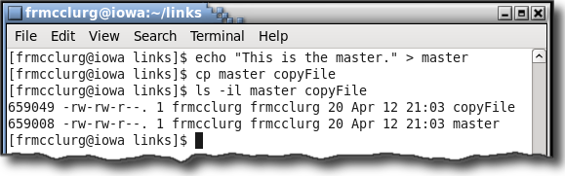
Hard Link vs Copy
inode: File Control Structure (unique identifier)
Listing inodes:
  ls -i file

Slide 22
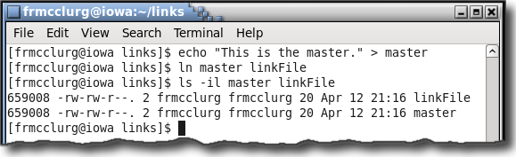
Creating a Hard Link
inode: Can be thought of as the address of a file

Slide 23
Hard Link Disadvantages
No hard links to directories
No hard links between file systems

Slide 24
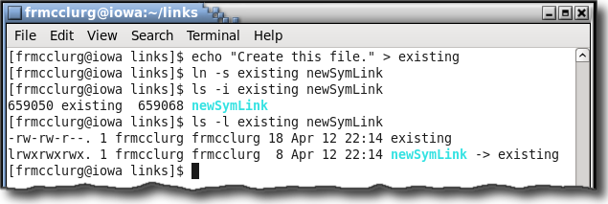
Symbolic Link
Description:
  Pointer to a file
Syntax:
  ln -s existing newSymLink

