Slide 1
Linux Operating System
A Practical Guide to Fedora and Red Hat Enterprise Linux
Unit 4: More Command Line Interface (CLI)
Chapter 7: The Linux Shell
By Fred R. McClurg
© Copyright 2013, All Rights Reserved

Slide 2
Command Line Interface (CLI)
Advantages
More options
Wildcards
Stack multiple commands together
Scriptable
GUI not always available (server, telnet, single user mode)
No clickity-clackity-click!

Slide 3
Editing the Command Line
set –o vi
Escape begins edit of history list
Slash “/” searches most current cmd
Ex commands can’t be used
Can start upon login via ~/.bashrc
Carriage Return (Enter) terminates edit and executes command

Slide 4
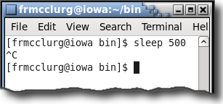
Abort Command Execution
Abort Command
Ctrl+C: Aborts current execution

Slide 5
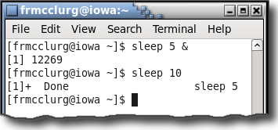
Launching Background Commands
Background Execution
command &

Slide 6
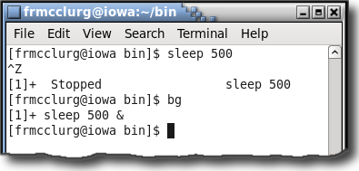
Suspended Jobs & Background
Interactive Background Execution
Ctrl+Z: Suspends current execution
bg: Move suspended job to background

Slide 7
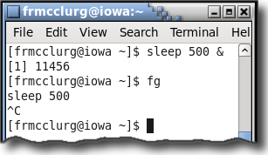
Suspended Jobs & Foreground
Interactive Foreground Execution
fg: Move background job to foreground

Slide 8
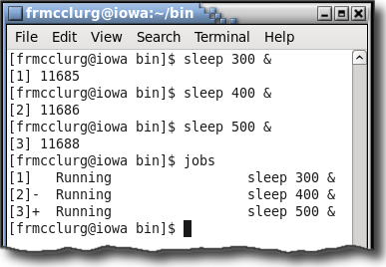
Listing Background Jobs
List jobs running in background
Every job has a unique job number
jobs

Slide 9
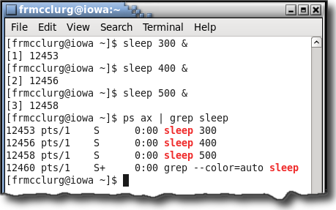
Listing Background Jobs
Every job has a unique process id

Slide 10
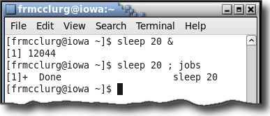
Finished Background Jobs
Jobs with “Done” status

Slide 11
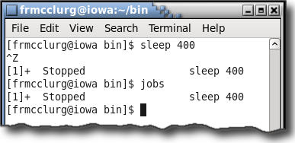
Finished Background Jobs
Jobs with “Stopped” status

Slide 12
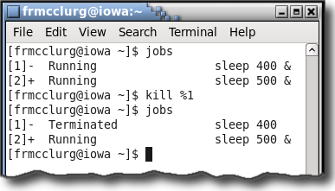
Terminating Background Jobs
Killing a background job:
kill %x

Slide 13
Standard Input, Output & Error
Three Streams in Linux OS
Standard Output
(STDOUT)
Standard Input
(STDIN)
command
Standard Error
(STDERR)

Slide 14
Output Redirection
Syntax:
command [args] > filename
Example:
cat > file.txt text from keyboard second line of text Ctrl+D
Caution: Redirecting output can destroy a file!

Slide 15
Input Redirection
Syntax:
command [args] < filename
Example:
sort < file.txt

Slide 16
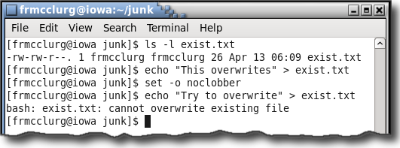
noclobber: Prevent Overwrites
Turn on:
set -o noclobber
Caution: noclobber does not prevent overwrites from cp or mv

Slide 17
Overriding noclobber
Clobber regardless of noclobber:
set -o noclobber echo "contents" > file.txt echo "no can do" > file.txt echo "clobber me" >| file.txt
Turn off:
set +o noclobber echo "clobber it" > file.txt

Slide 18
/dev/null: The Bit Bucket
Data Sink:
echo "gone!" > /dev/null
Unix Universe Black Hole:
mv trash.txt /dev/null

Slide 19
Appending a File
Syntax:
command [args] >> filename
Example:
date >> timestamps.txt

Slide 20
Pipes
Description:
Connects standard output of one command to the standard input of another command.
Syntax:
command [args] | command [args]
Example:
cat grades | sort -n

Slide 21
Eliminating Temporary Files
Description: A pipe can negate the need for temporary or intermediary files.
Example:
sort -n grades > sorted
tail -1 < sorted
rm sorted
Syntax:
sort -n grades | tail -1

Slide 22
Filters
Description:
Command that uses standard input stream to produce a standard output stream.
Syntax:
cmd [args] | filter [args] | cmd [args]
Example:
cat dates | sort | grep J

Slide 23
tee: Output in Two Directions
Description:
tee utility copies standard input to a file and sends output to standard output.
Syntax:
cmd [args] | tee file | cmd [args]
Example:
ls | tee output.out | grep txt

Slide 24
What is Shell Expansion
One or more characters used to match a set of filenames
Also known as “glob” or “globbing”
The characters are called “wildcards”

Slide 25
Wildcard: *
Star “*” (aka asterisk, splat) Character:
Wildcard matches zero or more characters in a filename
Example:
ls bad*
Matches:
bad badland
Does not match:
obadiah

Slide 26
Wildcard: ?
The “?” Character:
Wildcard matches any single character in a filename
Example:
ls verb?
Matches:
verbs verb1
Does not match:
verb proverb

Slide 27
Wildcards: []
The “[x]” Character Set:
Wildcard matches a single character contained in the set.
Example:
echo *[aeiou]*
Matches:
ape dog gnu platypus aardvark
Does not match:
fly

Slide 28
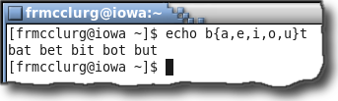
Brace Expansion: {}
Generates strings at the command line by specifying a comma separated list inside curly braces “{}”.

Slide 29
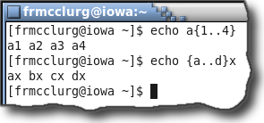
Brace Expansion: {}
A sequence consists of a starting and ending value separated by two periods “..”.

Slide 30
Globbing Hidden Files
Hidden File Matching:
Wildcards do not match the dot in hidden files
Example:
echo ?ark
echo *ark
Matches:
mark park dark
stark
Does not match:
.ark

Slide 31
Globbing Hidden Files
Example:
echo .*
Matches:
. .. .ark
Note:
Use caution using “.*” as a wildcard because it matches the current and parent directory!

Slide 32

Yanking the Rug From Under You
Unexpected action may result from specifying “.*” as a wildcard pattern
Note:
Someday, you will regret specifying “.*” as a wildcard pattern for hidden files. You have been warned!
Also Note:
If you are not big enough to use a Red Ryder BB gun, perhaps you should not be using Linux!
Trivia Question:
How many times was Ralphie warned by his mother, “You’ll shoot your eye out!”? [Answer: Several times]

Slide 33
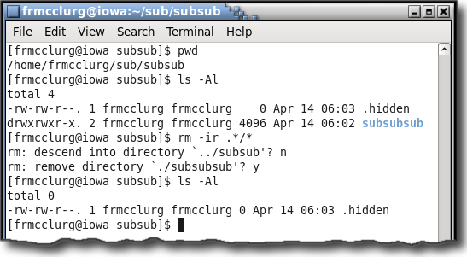
Shooting Your Eye Out in Linux
Example:
rm -r .*/*
Also Note:
If you are not big enough to use a Red Ryder BB gun, perhaps you should not be using Linux!
Trivia Question:
How many times was Ralphie warned by his mother, “You’ll shoot your eye out!”?

