Slide 1
Linux Operating System
A Practical Guide to Fedora and Red Hat Enterprise Linux
Unit 5: Command Line Interface (CLI)
Chapter 9: The Bourne Again Shell
By Fred R. McClurg
© Copyright 2013, All Rights Reserved

Slide 2
Bash Shell Start Up Files
/etc/profile (system)
~/.bash_profile (user)
~/.bash_login (
~/.profile
Filename | When Started | Owner
/etc/profile | Interactive login | System
~/.bash_profile | Interactive login | User
~/.bash_login | Executes only if no ~/.bash_profile | User
~/.profile | Executes only if no ~/.bash_login or ~/.bash_profile | User
~/.bashrc | Interactive non-login (new shell) | User

Slide 3
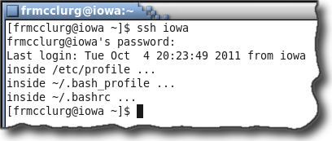
Startup Files Upon Login

Slide 4
Startup File: ~/.bash_profile
~/.bash_profile:
# Get aliases and functions
if [ -f ~/.bashrc ] ; then
. ~/.bashrc
fi
PATH=$PATH:$HOME/bin:.
export PATH

Slide 5
Startup File: ~/.bash_profile
~/.bash_profile (continued):
# User functions
function chmodx()
{
chmod ugo+x $*
}

Slide 6

Startup Files Upon New Shell

Slide 7
Startup File: ~/.bashrc
~/.bashrc:
# Source global definitions
if [ -f /etc/bashrc ] ; then
. /etc/bashrc
fi
# User aliases and functions
set -o noclobber
set -o vi

Slide 8
Startup File: ~/.bashrc
~/.bashrc (continued 2):
# User aliases
alias list='ls -lF | less'
alias last='ls -ltF | less'
alias h='history | less'
alias chx='chmod ugo+x'

Slide 9
Startup File: ~/.bashrc
~/.bashrc (continued 3):
# User functions
function switch()
{
local tmp="switch.$$"
mv "$1" $tmp
mv "$2" "$1"
mv $tmp "$2"
}

Slide 10
Standard Input, Output & Error
Three Streams
Standard Ouput
(STDOUT)
Standard Input
(STDIN)
command
Standard Error
(STDERR)

Slide 11
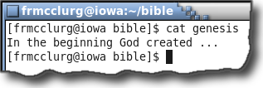
Standard Out

Slide 12
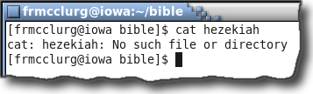
Standard Error

Slide 13
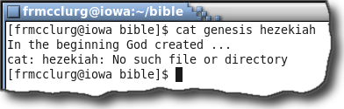
Both Standard Out & Error
Questions:
If stdout and stderr look the same, how can you tell the difference?
If the two go to the same place, how do you separate them?

Slide 14
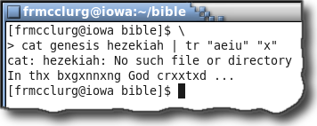
Stderr and pipes don’t mix
Note:
Standard error does not normally go through pipes

Slide 15
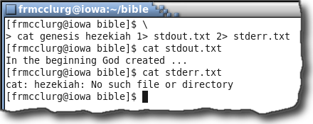
Separating stdout & stderr
cat genesis hezekiah \
1> stdout.txt \
2> stderr.txt

Slide 16
Copying stderr to stdout
cat genesis hezekiah \
1> stdOutErr 2>&1
Question:
What is the contents of file “stdOutErr”?

Slide 17
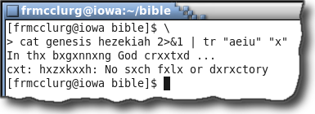
Copy stderr to stdout prior to pipe
Note:
Now standard error can go through a pipe

Slide 18
Copying stdout to stderr
echo "I'm sorry Dave \
I can not do that" 1>&2
Note:
Sends a message to standard error
Used for error reporting in scripts

Slide 19
Shell Script Writing Procedure
Specify the shell type on first line. Example: #!/bin/bash
Create script body with shell commands
Save the file
Make file executable using “chmod”
Execute the script by specifying:
./scriptName (relative pathname)
/full/path/scriptName (absolute path)
Or make sure script pathname is in the $PATH

Slide 20
Writing Your First Script
#!/bin/bash
# Print friendly message
echo "Hello World"

Slide 21
ROT13 Encryption Filter
#!/bin/bash
# Created: Fred McClurg
# Creation: April 14, 2010
# Purpose: ROT13 Encryption
echo "Processing ..." 1>&2
tr "a-zA-Z" "n-za-mN-ZA-M"
date 1>&2

Slide 22
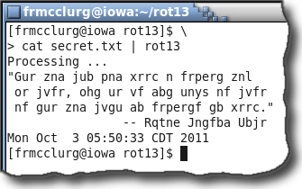
ROT13 encryption via a pipe

Slide 23
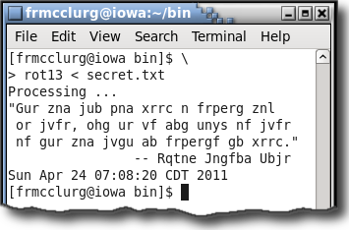
ROT13 encryption via stdin

Slide 24
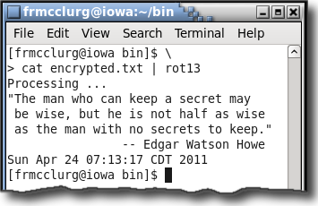
ROT13 decryption via pipe

Slide 25
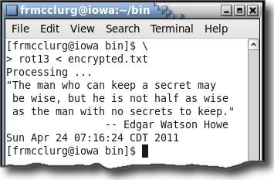
ROT13 decryption via stdin

Slide 26
Filename Completion
Description:
Automatic completion of a filename upon specifying an unique prefix and entering the tab key. See page 1082

Slide 27
Filename Completion
Better Description:
Automatic completion of a filename after specifying an unique prefix and typing the tab character.
Example:
ls fra <tab>

Slide 28
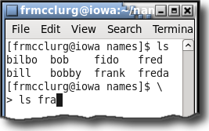
Tab for File Completion
Example:
ls fra<tab>
<tab>

Slide 29
Filename Completion
Description Continued:
... If the prefix is not unique, a single tab will not perform an automatic filename completion. A double tab can be used to list all the filenames matched by the current prefix.
Example:
ls fr <tab> <tab>

Slide 30
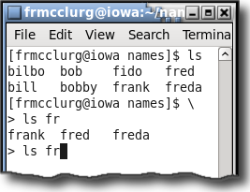
Tab Tab for File Matches
Example:
ls fra<tab><tab>
<tab>
<tab>

Slide 31
Command History
Description:
The shell maintains a list of recently issued commands (aka events). These events can be re-executed.
Example:
history | tail

Slide 32
History Expansion Event Designators
Designator | Description
!str | Execute cmd starting with “str”
!n | Execute cmd n from history
!-n | Execute n^{th} preceding cmd
!! | Execute previous command
^old^new | Substitute old for new on previous command
!$ | Use last arg of previous cmd
!* | Use all args of previous cmd

Slide 33
Editing Command History
fc: Fix Command
Command | Description
fc -l | List cmd history
fc first last | Edit previous cmd
fc -s old=new | Cmd substitution

Slide 34
Editing Command History
set -o vi
Escape key begins history edit
Carriage return executes

