Slide 1
Linux Operating System
A Practical Guide to Fedora and Red Hat Enterprise Linux
Unit 9: Basic Linux Administration
Chapter 11: System Administration: Core Concepts
Chapter 16: Administration Tasks
By Fred R. McClurg
© Copyright 2013, All Rights Reserved

Slide 2
System Administration Duties
Tune the operating system so it runs fast enough to meet user’s needs
Provide enough storage to accommodate user’s needs
Set up user accounts
Install and upgrade software

Slide 3
System Administration Duties
Make sure the operating system is functioning securely
Back up the system regularly
Keep management appraised of system status and make recommendations for improvement.
Install hardware as needed

Slide 4
Superuser Privileges
Description: User “root” has additional privileges beyond an ordinary user account. The following are things only the root user can do:
Add new users
Partition hard drives
Change system configuration

Slide 5
Superuser Characteristics
Shell displays a command prompt with “#” as a indicator
Read, write, and execute privileges do not apply
Some command restrictions do not apply to root. Example: Root can change user passwords without knowing old password

Slide 6
Logging in as root
Bringing up the system in single-user mode
Log in as root in multi-user mode
Use sudo to grant superuser privileges on a per-command basis
Issue su (substitue user) command

Slide 7
su: Substitute User
Description: Opens a shell or executes a program as another user. Allows you to assume another user’s identity with all privileges of that user.

Slide 8
su: Substitute User
Examples:
Log in as user “frmcclurg”:
su - frmcclurg
Execute as user “frmcclurg”:
su -c whoami frmcclurg
Log in as root (super user):
su -

Slide 9
System Run Levels
Number | Name | Login | Network | File Systems
0 | Halt
1 | Single user | Textual | Down | Mounted
2 | Multiuser without NFS | Textual | Up (partially) | Mounted
3 | Multiuser | Textual | Up | Mounted
4 | User defined
5 | Multiuser with X | Graphical | Up | Mounted
6 | Reboot

Slide 10
runlevel: Display Run Level
Description:
Determines previous (if possible) and current runlevels

Slide 11
Bringing the System Down
Description: Brings the system down safely. Notifies current users. Prevents new logins.
Syntax:
shutdown [option] TIME [message]
Examples:
shutdown -h +5 Log off now
shutdown -h 09:30 Repairs
shutdown -h now Computer fire!

Slide 12
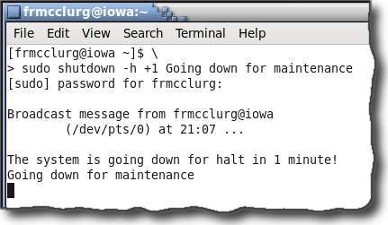
Shutdown Message

Slide 13
wall: Warn All Users
Description: Out of courtesy to others, if possible give users advance notice regarding down time.
Example:
wall Hit by lightning, going down!

Slide 14
Rebooting the System
Description: On rare occasions, a Linux machine may need to be rebooted.
Example:
shutdown -r +5 Save files
reboot

Slide 15
Single User Mode
Warn users (wall)
Disable the network (exportfs -ua)
Confirm no critical processing running
Bring system to single user mode (telinit 1)
Unmount all devices not being used (umount -a)

Slide 16
Turning off the power
telinit 0
poweroff
shutdown -P
halt

Slide 17
fsck: File System Check
Description: Utility that checks and optionally repairs a file system.
Note: Do not use “fsck” on a virtual file machine! A virtual file system may appear to as though it needs repair.

