Slide 1
Linux Operating System
A Practical Guide to Fedora and Red Hat Enterprise Linux
Unit 9: Linux Network Services
Chapter 16: Administration Tasks
By Fred R. McClurg
© Copyright 2013, All Rights Reserved

Slide 2
groupadd: Creating Groups
Syntax:
groupadd [options] group
Example:
groupadd developers
grep developers /etc/group

Slide 3
useradd: Creating Accounts
Syntax:
useradd [options] username
Example:
useradd -g developers \ -c "Fred McClurg" \ frm

Slide 4
userdel: Removing Accounts
Syntax:
userdel [options] username
-r Remove user’s home dir
Example:
userdel -r frm

Slide 5
groupdel: Removing Groups
Syntax:
groupdel group
Example:
groupdel developers

Slide 6
usermod: Modifying Users
Syntax:
usermod [options] user
-g Primary group membership
-G Supplementary group membership
Example:
usermod -g developers \ -G sysadmin frm
groups frm

Slide 7
at: Scheduling execution
Syntax:
at timespec
Examples:
at now + 5 minutes < script
at 04:30am reboot Ctrl+D
at -l
atrm 7

Slide 8
crontab: Scheduling Tasks
Syntax:
crontab [-u user] [-l | -r | -e]
Examples:
crontab -l # list
crontab -e # edit
crontab -r # remove

Slide 9
crontab: Crontab Format
day of week (0-7)
Syntax:
* * * * * command
month (1-12)
day of month (1-31)
hour (0-23)
minute (0-59)

Slide 10
crontab: Examples
# run five minutes after midnight, every day
5 0 * * * $HOME/bin/daily >> /tmp/out 2>&1
#
# run at 2:15pm on the first of every month
15 14 1 * * $HOME/bin/monthly
#
# send e-mail at 9am on weekdays
0 9 * * 1-5 mailx -s "Coffee break!" frm
#
# at 23 min after midnight & every 2 hours
23 0-23/2 * * * date >> $HOME/logs
#
# run 10am every sunday, send e-mail reminder
0 10 * * sun echo "Church time" | mailx frm

Slide 11
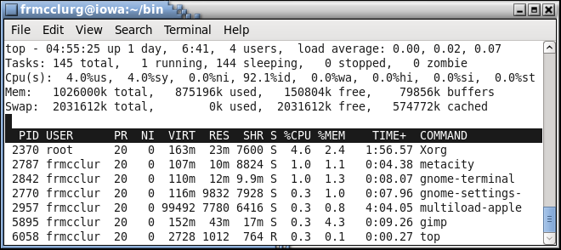
top: Display sorted processes
Description: Lists CPU intensive processes

Slide 12
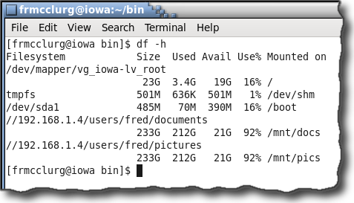
df: Disk space on file system
Description: Displays amount of disk space available on the file systems

Slide 13
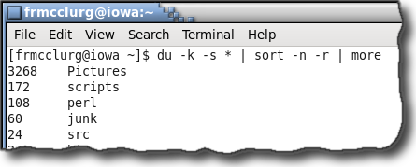
du: Disk space usage
Description: Summarize disk usage for directories

Slide 14
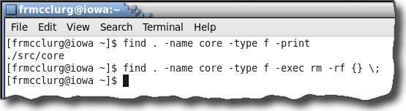
find: Locate files
Description: Search a directory hierarchy for files

Slide 15
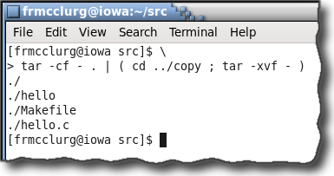
tar: Copying Directories
Description: tar can be used in a pipeline to copy files

Slide 16
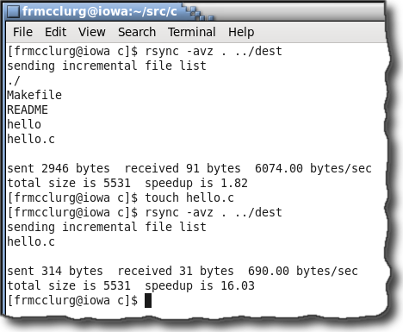
rsync: Synchronize Directories
Description: Make two directories synchronized

Slide 17
logrotate: Manage log files
See page 579
cat /etc/logrotate.conf weekly rotate 4 create dateext ...

Slide 18
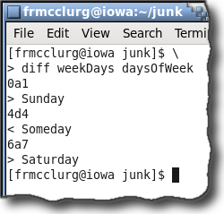
diff: Compare two files
Description: Performs a difference between two files line by line.
weekDays
Monday
Tuesday
Wednesday
Someday
Thursday
Friday
daysOfWeek
Sunday
Monday
Tuesday
Wednesday
Thursday
Friday
Saturday

