Slide 1
Linux Operating System
A Practical Guide to Fedora and Red Hat Enterprise Linux
Unit 10: Basic Apache Configuration and Management
Chapter 26: Apache (httpd): Setting Up a Web Server
By Fred R. McClurg
© Copyright 2013, All Rights Reserved

Slide 2
What is a web server?
Defined: Server software that responds to requests for content (web pages, audio, etc) from clients like web browsers (Firefox, IE, etc). The web server then returns content which is then rendered by the browser.

Slide 3
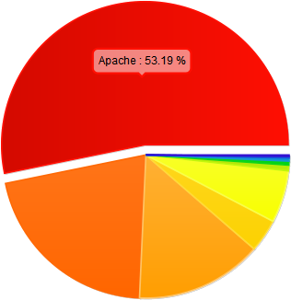
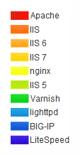
Apache: Web Server
http://trends.builtwith.com/Web%20Server
Worlds most popular web server

Slide 4
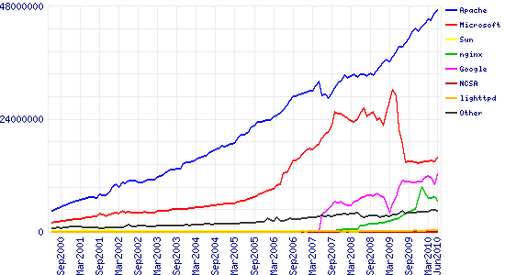
Web Server Trends
http://news.netcraft.com/archives/2010/06/16/june-2010-web-server-survey.html
June 2010: 47,215,212 (47 million)

Slide 5
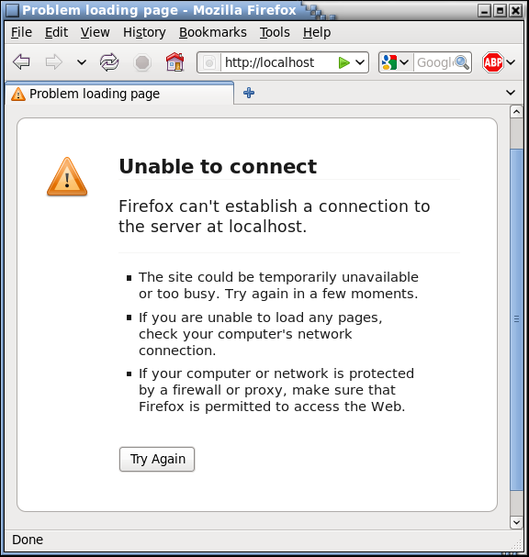
Apache: Before Installation

Slide 6
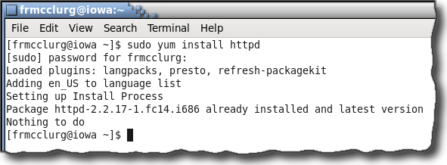
Apache: Minimal Installation
Install httpd (HTTP Daemon):
yum install httpd

Slide 7
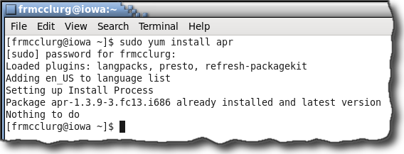
Apache: Minimal Installation
Install apr (Apache Portable Runtime):
yum install apr

Slide 8
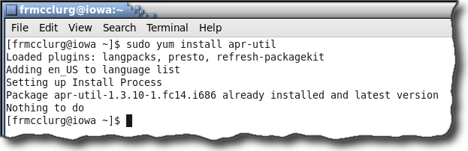
Apache: Minimal Installation
Install apr-util (APR utilities):
yum install apr-util

Slide 9
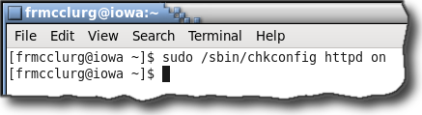
Apache: Startup
Run chkconfig to start httpd upon multi-user mode (boot):
/sbin/chkconfig httpd on

Slide 10
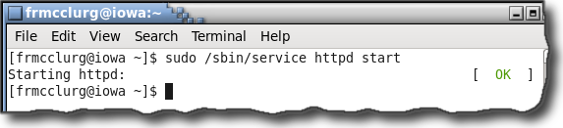
Apache: Start httpd now
Start apache daemon now:
/sbin/service httpd start

Slide 11
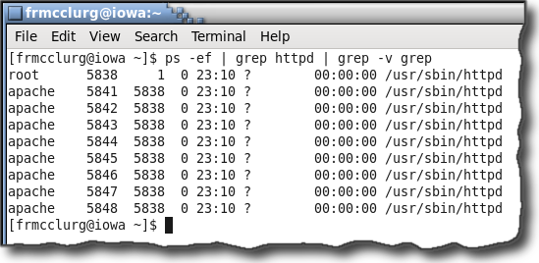
Runs as background process
Look at Apache processes:
ps -ef | grep httpd

Slide 12
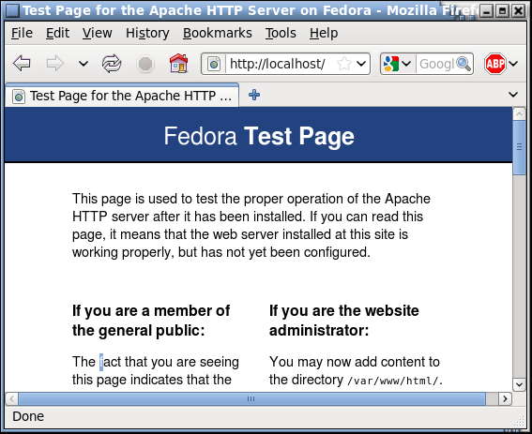
Running on local server
http://localhost
http://127.0.0.1
http://iowa

Slide 13
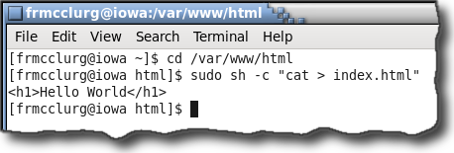
Creating a web page
DocumentRoot location:
/var/www/html

Slide 14
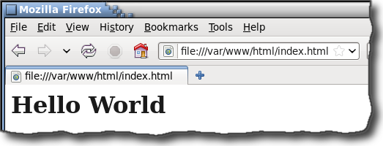
Browser Rendering Web Pages
File protocol:
file:///var/www/html/index.html

Slide 15
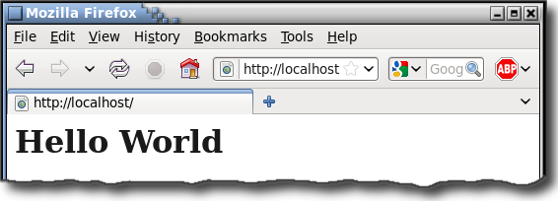
Apache Serving Web Pages
Main “home” page:
/var/www/html/index.html

Slide 16
HTML Template
<html>
<head>
<title>
Website's Home Page
</title>
</head>
<body>
<h1>
Website's Home Page
</h1>
<p>
Location: /var/www/html
</p>
</body>
</html>

Slide 17
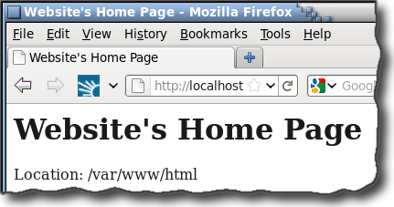
Template in Web Browser

Slide 18
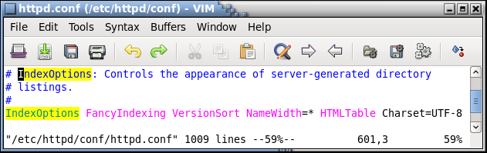
httpd.conf Configuration File
Apache Directive to control directory listings:
IndexOptions

Slide 19
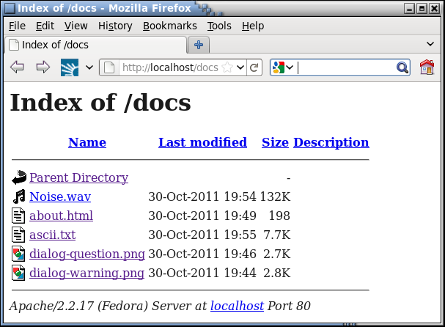
Result of IndexOptions

Slide 20
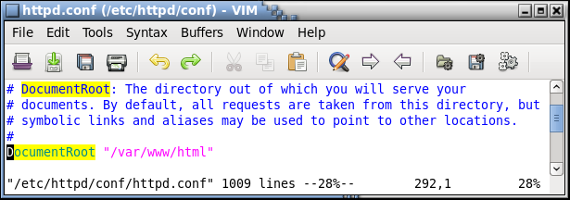
httpd.conf Configuration File
Apache Directive granting access to directory:
DocumentRoot

Slide 21
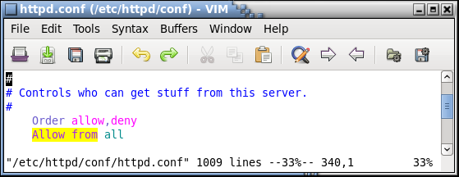
httpd.conf Configuration File
Apache Directive grants access to a directory:
Allow from

Slide 22
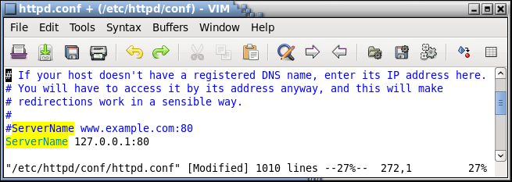
httpd.conf Configuration File
Apache Directive setting the server name:
ServerName

Slide 23
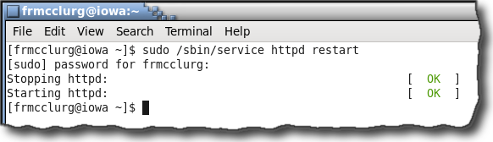
Restart Apache Process
Restarting apache after httpd.conf modification:
/sbin/service httpd restart

Slide 24
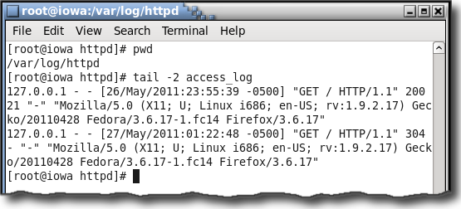
Apache access log
Records requests made to the server:
/var/log/httpd/access_log

Slide 25
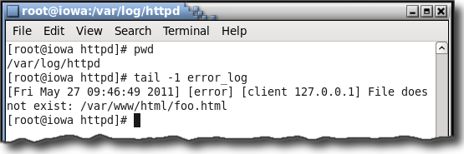
Apache error log
Records runtime server errors:
/var/log/httpd/error_log

Slide 26
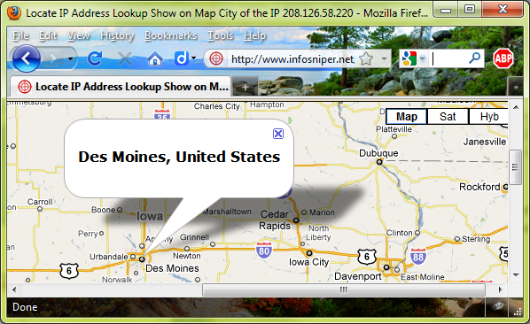
IP Address Geolocation
The approximate location of your IP address can be obtained

