Slide 1
Introduction to
PHP and MySQL
Kirkwood Center for Continuing Education
By Fred McClurg, frmcclurg@gmail.com
© Copyright 2016, Fred McClurg, All Rights Reserved

Slide 2
Chapter One
Why LAMP Technologies?
http://cecert.kirkwood.edu/~fmcclurg/courses/php/slides/chapter01.overview.ppt

Slide 3
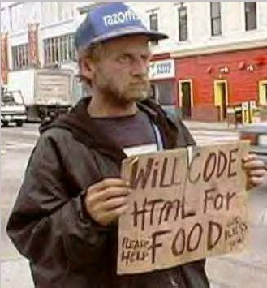
How important are web technologies?
Desperate times require desperate measures

Slide 4
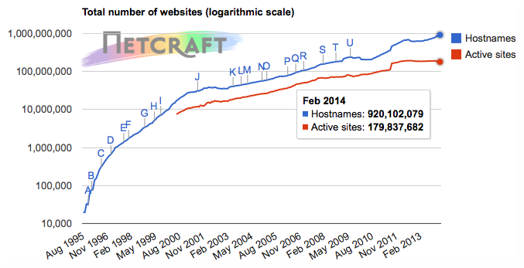
Web Site Count Continues to Climb
Total Sites: http://news.netcraft.com
Total Sites Across All Domains
August 1995 – February 2015

Slide 5
What is LAMP?
LAMP is more than a piece of furniture. It is an acronym:
  Linux
  Apache
  MySQL
  PHP (and Perl)

Slide 6
Why Linux? LAMP Component “L”
  Lean Operating System
  Fast
  Reliable
  Secure
  Hackable
  Bundled with Mature Tools
  Free

Slide 7
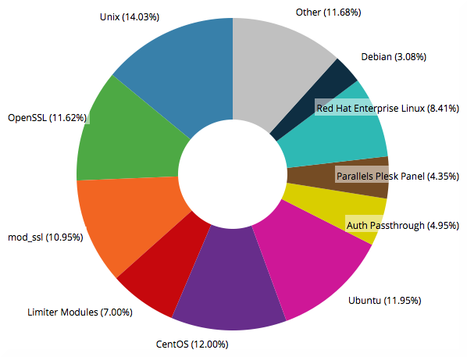
Web Server Distribution in 10k Sites
Source: http://trends.builtwith.com/Server
Date: February 2015

Slide 8
LAMP Application Component: Apache
Popular Web Servers
  MS Internet Information Services (IIS) Strengths
    Easier integration with Active Directory
    Supports Microsoft Languages (ASP)
    Free with Windows
  Apache Strengths
    2.0 supports multi-threading
    Fast
    Very secure
    Multiple platform support (Win, Mac, Linux)
    Multi Language Support (PHP, etc.)
    Free Full Version

Slide 9
Why Apache? LAMP Component “A”
Very Secure
Fast (supports multi-threading)
Extensible (PHP, JSP, LDAP, etc.)
Portable (Windows, Mac, Unix)
Reliable
Popular (#1 web server on planet)
Free Full Version

Slide 10
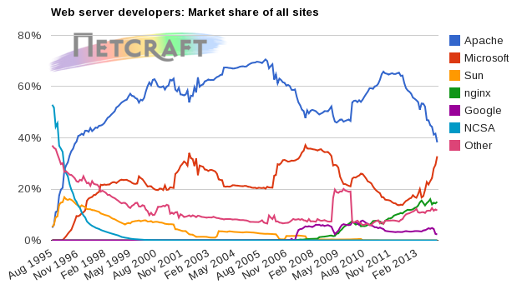
The most widely used web server
Survey: http://news.netcraft.com
Market Share of All Sites
August 1995 – February 2015

Slide 11
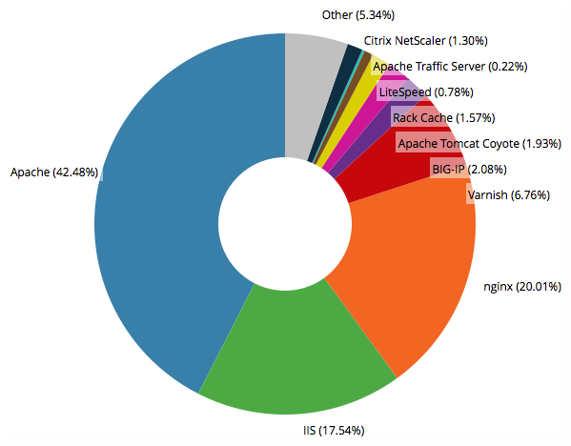
Web Server Distribution in 10k Sites
Source: http://trends.builtwith.com/Web-Server
Date: February 2015

Slide 12
Why MySQL? LAMP Component “M”
Fast
Easy to use
Multiple database engines available
Full featured
Large user base
Application Programming Interface (API) available for most languages
Multiple platform support
Free*†
* Unless selling modified version of MySQL
† Unless embedding MySQL within non-free app

Slide 13
Why not Perl? Alternate LAMP “P”
Perl and PHP languages are cousins.
Shared philosophy:
  “There's more than one way to do it.”
  “Easy things should be easy, and hard things should be possible.”

Slide 14
Why PHP? LAMP Component “P”
  Embedded with HTML
  Easy to learn
  Advanced capabilities (XML, XSL, DOM, Soap)
  Large user community
  Interpreted language
  Strong text handling
  Integrates well with MySQL
  Many built-in functions
  Free

Slide 15
Chapter One
PHP Overview

Slide 16
Advantages of PHP over Perl
PHP relies upon fewer “side effects”
PHP has a function for everything
PHP is not quite as cryptic
Specifically designed for the web

Slide 17
PHP History
  Known originally as “Personal Home Page”
  Conceived in 1994 by Rasmus Lerdorf to display and track traffic to his resume
  Started as a collection of Perl scripts
  First released as an open-source project in June 1995 and became version 2
  In 1997 Zeev Suraski and Andi Gutmans rewrote the parser and became PHP3
    Name changed to the recursive acronym: PHP: Hypertext Preprocessor
  In June 1998 Zeev Suraski and Andi Gutmans rewrote the core of PHP4 and dubbed it “Zend engine” based on their first names
  PHP 5 was release in July 2004

Slide 18
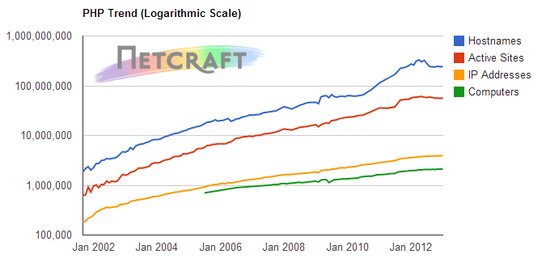
PHP Applications Continue to Grow
PHP Usage: http://www.php.net/usage.php
January 2002 – January 2013

Slide 19
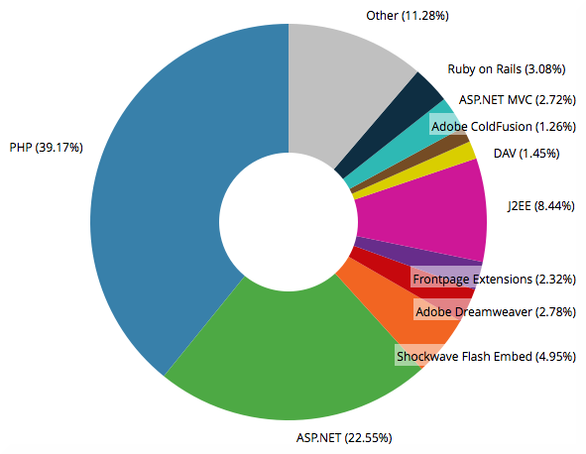
Top Framework Technologies
Source: http://trends.builtwith.com/framework
Date: February 2015

Slide 20
The Popularity of PHP
TIOBE Programming Community Index:
http://www.tiobe.com/index.php/content/paperinfo/tpci
Position Feb 2015 | Position Feb 2013 | Change | Programming Language | Ratings Aug 2013 | Delta Aug 2012
1 | 2 |  | C | 18.334% | +1.25%
2 | 1 |  | Java | 17.316% | -1.07%
3 | 3 |  | Objective-C | 11.341% | +1.54%
4 | 4 |  | C++ | 6.892% | -1.87%
5 | 5 |  | C# | 6.450% | -0.23%
6 | 6 |  | PHP | 4.219% | -0.85%
7 | 8 |  | (Visual) Basic | 2.759% | -1.89%
8 | 7 |  | Python | 2.157% | -2.79%
9 | 11 |  | JavaScript | 1.929% | +0.51%
10 | 12 |  | Visual Basic .NET | 1.798% | +0.79%
11 | 16 |  | Transact-SQL | 1.667% | +0.89%

Slide 21
Chapter One
How does it work?

Slide 22
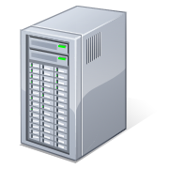

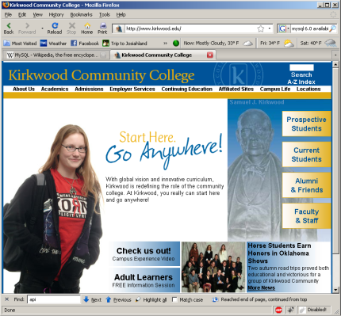
Life on the Web without PHP/MySQL
Internet
Web Server
2
Your Computer
Request
3
1
Response
5
http://google
4
Disk Storage
6

Slide 23
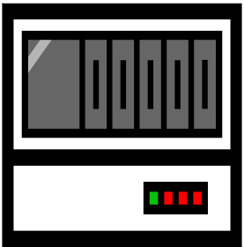
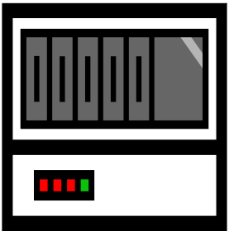
Life on the Web with PHP/MySQL
3
4
Web
Server
Disk Storage
2
Your Computer
Request
6
5
PHP Interpreter
9
10
Write
1
Response
Read
7
http://cecert
MySQL
Database
11
Internet
8
Web Host

Slide 24
Installing PHP and other components
Description: The easiest way to set up Apache, MySQL and PHP (AMP) is to install them as a bundle from one of the following:
Windows:
http://www.apachefriends.org/en/xampp.html
http://www.wampserver.com/en/download.php
Mac:
http://www.apachefriends.org/en/xampp.html
http://www.mamp.info/en/download.html
Linux:
http://www.apachefriends.org/en/xampp.html
WAMP, MAMP, XAMPP, LAMP:
http://bitnami.com/stacks
Note: No other tools may communicate on ports 80 and 3306 while Apache and MySQL is running.

Slide 25
to be continued ...
http://cecert.kirkwood.edu/~fmcclurg/courses/php/slides/chapter03.fundamentals.ppt

