Slide 1
Introduction to
PHP and MySQL
Kirkwood Center for Continuing Education
By Fred McClurg, frmcclurg@gmail.com
© Copyright 2016, Fred McClurg, All Rights Reserved

Slide 2
Chapter Four
Gonna go ‘round in circles
Spinning wheel got to go round Ride a painted pony let the spinning wheel spin
I'm so dizzy, my head is spinnin'
Like a whirlpool, it never ends
http://cecert.kirkwood.edu/~fmcclurg/courses/php/slides/chapter04b.looping.ppt

Slide 3
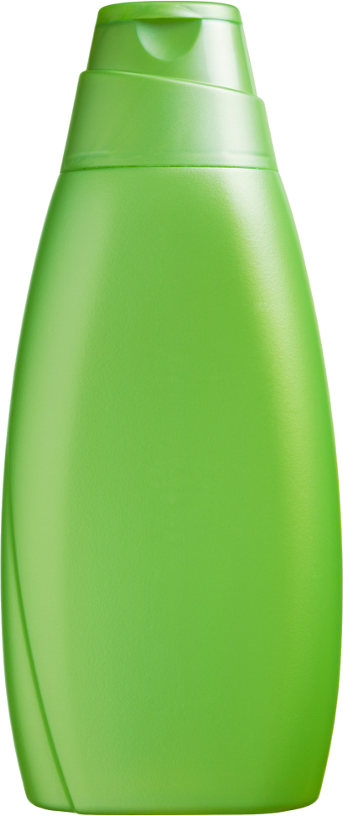

Looping in the Wild
Definition:
  Set of instructions that are performed repeatedly and whose end condition is clearly defined.
Why is this poor code?
What is missing?
  Conditioner
  Counter
Instructions:
Lather
Rinse
Repeat

Slide 4




PHP Loop Family
Dad While Loop
Mom Do While Loop
Bubba For Loop
Sissy Foreach Loop

Slide 5
The “while” Flow Chart
Preferred Usage:
When a condition must be met first before statement execution.
Preferred Usage:
When the number of loop iterations is not known in advance.
Code Execution
while condition
FALSE
Exit Loop
Repeat
Loop
TRUE
Continue Execution
block of code

Slide 6
The “while” Loop
Description: A looping construct which defines that while a condition is true, execute a block of code.
Characteristics:
  The condition is at the top of the loop.
  The body executes zero or more times.
  Often used to “protect” code from execution.
Disadvantages:
  Variables must be initialized prior to condition.
  Condition must be updated within body of loop.
  Caution must be used to avoid an infinite loop.

Slide 7
The “while” Syntax
Syntax:
while ( condition ) // is true
{
statement;
...
}
Defines when loop exits
Changes the condition

Slide 8
“Pick a number between ...” via while
  <?php
  $min = 0;
  $max = 100;
  $magicNumber = rand( $min, $max );
  // initialization before condition
  $guessCurrent = rand( $min, $max );
  while ( $guessCurrent != $magicNumber )
  {
  $guessWrong++; // count wrong guesses
  // prep for next iteration or exit
  $guessCurrent = rand( $min, $max );
  }
  printf( "Mystery Number: %d<br>
  Random Guesses: %d",
  $magicNumber, $guessWrong );
  ?>

Slide 9
Student Exercise: Count up via “while”
Problem:
Print out the numbers 1 to 10 in ascending order.
Requirements:
  Use a “while” loop to handle the iterations.
  Use the “++” or “+=” operator to increment the count.
Output:
Each number should be on a separate line.

Slide 10
Student Solution: Count up via “while”
<?php
$count = 1;
$max = 10;
while ( $count <= $max )
{
printf( "%d<br>", $count );
$count++;
}
?>
Variable initialization
Condition
Display output
Variable increment

Slide 11
Student Exercise (High/Low Game)
Problem: Perform a computer simulation of the high/low guessing game.
Requirements:
  Use a “while” loop to handle the iterations.
  Use “rand()” function to initialize target number and simulate guesses.
  Use an “if/else” statement to narrow the range.
  Count the number of wrong guesses.
Input: A variable initialized to a random “mystery” number.
Outputs:
  The mystery number.
  The number of guesses attempted.

Slide 12
Student Solution (High/Low Game)
  <?php
  $min = 0; $max = 100;
  $wrong = 0; // init for ++
  $mystery = rand( $min, $max ); // pick a "secret" number
  $guess = rand( $min, $max ); // try to guess secret number
  while ( $guess != $mystery )
  {
  $wrong++;
  if ( $guess < $mystery ) // guess is too small
  $min = $guess + 1; // raise bottom range
  else // if ( $guess >= $mystery ) // guess is too large
  $max = $guess; // lower top range
  $guess = rand( $min, $max ); // narrow range & prep condition
  }
  printf( "Mystery Number: %d<br> High/Low Guesses: %d",
  $mystery, $wrong );
  ?>

Slide 13
The “do … while” flow chart
Preferred Usage:
When not knowing the number of loop iterations.
Begin Execution
Preferred Usage:
When required to execute the loop at least once.
code block
Repeat
Loop
FALSE
do while condition
Exit Loop
TRUE
Continue Execution

Slide 14
The “do … while” Loop
Description: A looping construct that executes a block of code while a condition is true. Also known as “repeat until” because loop continues until condition is false.
Characteristics:
  The condition is located at the bottom of the loop.
  The body executes at least one or more times.
Advantage:
  The variable that changes the expression used in the conditional statement of the loop, can be initialized and updated in a single location inside the body of the loop.
Disadvantages:
  Condition must be updated within body of loop.
  Caution must be used to avoid an infinite loop.

Slide 15
The “do … while” Syntax
Syntax:
  do
  {
  statement;
  ...
  }
  while ( condition ); // is true
Note: The semi-colon at the end of the “do … while” statement is required.
Pitfall: Omission of the semi-colon at the end of a statement is a common error.
Changes the condition
Repeat until ... condition is false

Slide 16
Yahtzee Simulation via “do … while”
  <?php
  $yahtzee = 5; // count of matching dice
  $diceMin = 1; // smallest number on dice
  $diceMax = 6; // largest number on dice
  $correct = 0; // correct guesses matched
  $failed = 0; // count of wrong guesses
  // select initial value to match other rolls
  $choice = rand( $diceMin, $diceMax );
  $correct++; // first roll
  do // while()
  {
  $current = rand( $diceMin, $diceMax ); // roll the dice
  if ( $current == $choice ) // dice matches first roll
  $correct++;
  else // dice doesn’t match
  $failed++;
  } while ( $correct < $yahtzee ); // do...while requires semi-colon!
  printf( "Yahtzee required %d rolls.", $failed + $correct );
  ?>

Slide 17
Student Exercise: Count via “do…while”
Problem: Print out the numbers 10 to 1 in descending order.
Requirements:
  Use a “do...while” loop to handle the iterations.
  Use the “--” or “-=” operator to increment the count.
Output:
  Each number should be on a separate line.

Slide 18
Student Solution: Count via “do...while”
  <?php
  $count = 10;
  $min = 1;
  do // while
  {
  printf( "%d<br>",
  $count );
  $count--;
  } while ( $count >= $min );
  ?>

Slide 19

The “for” Loop
Description: General purpose looping construct that uses a counter.
Preferred Usage:
  When the number of
  iterations is known.
  When an index value
  (counter) is needed.

Slide 20
The “for” Syntax
Syntax:
for ( initialization;
condition;
expression )
{
statement;
...
}

Slide 21
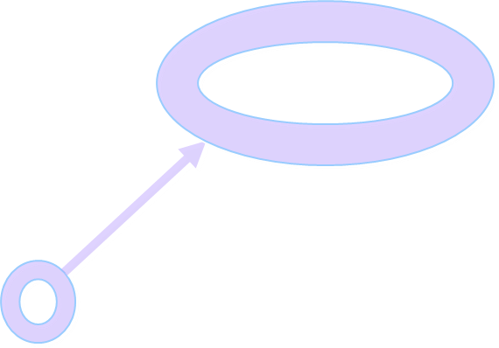
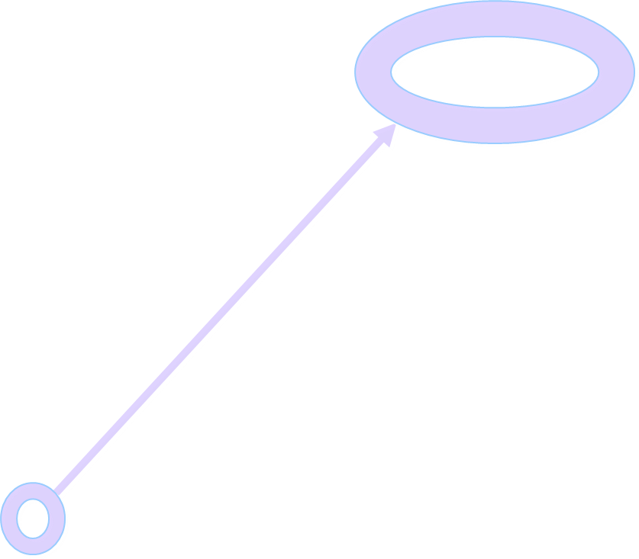
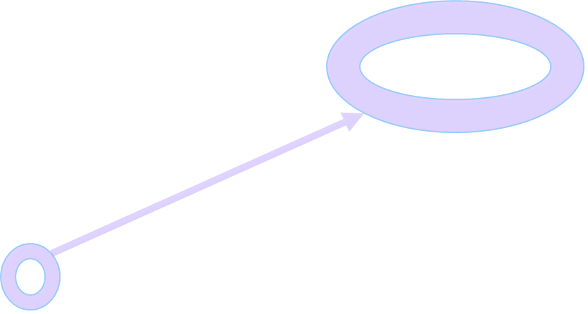
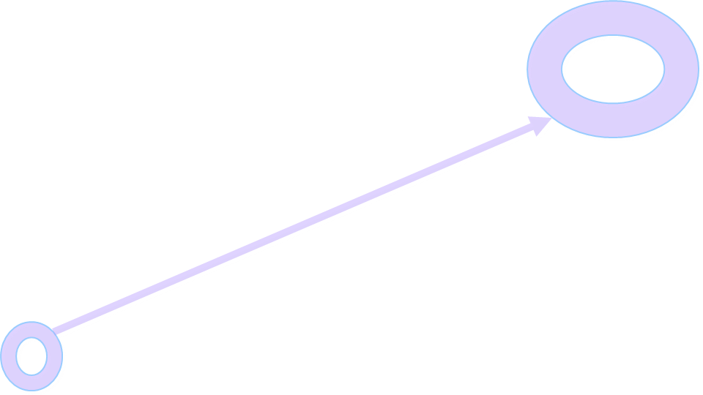
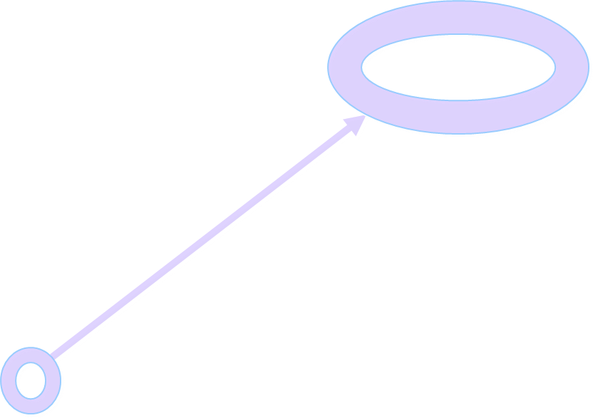
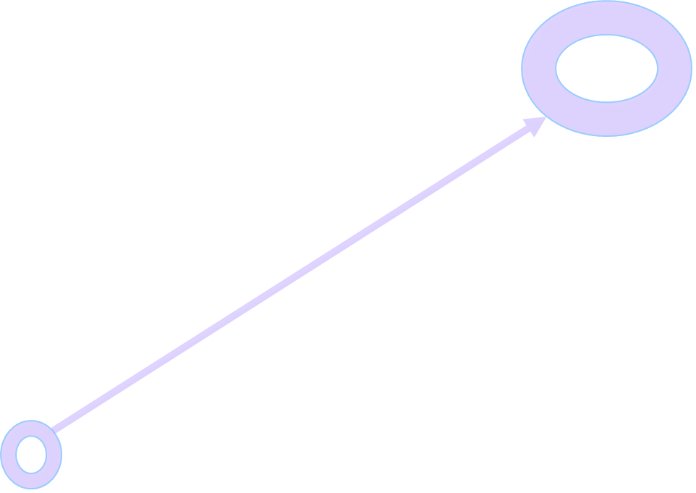


A “for” Example
Pretend you are a computer. What steps would you take?
<?php
$init = 0;
$max = 2;
for ( $i = $init; $i < $max; $i++ )
printf( "%d<br>", $i );
?>
Code Trace (sequential steps):
$i = 0; // initialization happens once
0 < 2; // condition is true
printf( 0 ); // loop body executes
$i = 0 + 1; // increment
1 < 2; // condition is true
printf( 1 ); // loop body executes
$i = 1 + 1; // increment
2 < 2; // condition is false
// loop exits
Condition
Initialization
Increment/ Decrement
Body

Slide 22
Student Exercise: Count via “for”
Problem: Count from 0 to 50 in multiples of 5. Print out the numbers ascending order.
Requirements:
  Use a “for” loop to handle the iterations.
  Use the “++” or “+=” operator to increment the count.
Output:
Each number should be on a separate line.

Slide 23
Student Solution: “for” with an “if”
  <?php
  $min = 0;
  $max = 50;
  $multiple = 5;
  for ( $count = $min;
  $count <= $max;
  $count++ )
  {
  if ( ( $count % 5 ) == 0 )
  printf( "%d<br>",
  $count );
  }
  ?>

Slide 24
Student Solution: “for” with an index
  <?php
  $min = 0;
  $max = 50;
  $multiple = 5;
  for ( $count = $min;
  $count <= $max;
  $count += $multiple )
  {
  printf( "%d<br>",
  $count );
  }
  ?>

Slide 25
A “for” with multiple indexes
<?php
for ( $i = 0, $j = 9; // multi init
$i < 10; // condition
$i++, $j-- ) // multi inc/dec
{
printf( "\$i: %d", $i );
echo str_repeat( "&nbsp;", 5 );
printf( "\$j: %d", $j );
printf( "<br>\n" );
}
?>
What would be printed?
Notes:
Question: What would be printed?
Answer: $i: 0...9 $j: 9...0

Slide 26
Using “break” in a loop
Description: A “break” statement terminates execution of a loop.
Example:
  <?php
  for ( $cnt = 0; $cnt < 10; $cnt++ )
  {
  if ( $cnt == 4 )
  break; // bail out of loop
  printf( "Count: %d <br>",
  $cnt );
  }
  ?>
What would be printed?
Notes:
Question: What would be printed?
Answer: 0, 1, 2, 3, 4

Slide 27
Using “break” in multiple loops
Description: A “break” statement terminates the nearest enclosing loop.
  <?php
  for ( $x = -2; $x < 3; $x++ ) // outer loop
  {
  for ( $y = -2; $y < 3; $y++ ) // inner loop
  {
  if ( $y == 0 )
  {
  // can't divide by zero
  break; // escape inner loop
  }
  $result = $x / $y;
  printf( "%d / %d = %f<br>",
  $x, $y, $result );
  } // inner loop
  } // outer loop
  ?>
Notes:
Question: What is the value of $x and $y at the print statement?
Answer: See next slide.

Slide 28
Tracing variables in loops containing “break”
Description: A “break” statement terminates the nearest enclosing loop.
  <pre>
  <?php
  for ( $x = -2; $x < 3; $x++ ) // outer loop
  {
  printf( "\$x=%d\t", $x );
  for ( $y = -2; $y < 3; $y++ )
  {
  if ( $y == 0 )
  break; // escape inner
  printf( "\$y=%d\t", $y );
  } // inner loop
  printf( "<br>" );
  } // outer loop
  ?>
  </pre>
Inner Loop
$x | $y | $y
-2
-2
-1
Outer Loop
-1
-2
-1
0
-2
-1
1
-2
-1
2
-2
-1
Notes:
Question: What is the value of $x and $y at the print statement? Description: A “break” statement terminates the nearest enclosing loop.
<pre>
<?php
for ( $x = -2; $x < 3; $x++ ) // outer loop
{
printf( "\$x=%d\t", $x );
for ( $y = -2; $y < 3; $y++ )
{
if ( $y == 0 )
break; // escape inner
printf( "\$y=%d\t", $y );
} // inner loop
printf( "<br>" );
} // outer loop
?>
</pre>
Answer: See next slide.

Slide 29
Using “continue” in a loop
Description: The “continue” statement stops processing the current loop iteration and jumps to the next iteration of the loop.
Example:
<?php
for ( $cnt = 0; $cnt < 10; $cnt++ )
{
if ( $cnt == 4 )
continue; // skip iteration
printf( "Count: %d<br>",
$cnt );
}
?>
What would be printed?
Notes:
Question: What would be printed?
Answer: 0, 1, 2, 3, 5, 6, 7, 8, 9

Slide 30
Using “continue” in multiple loops
Description: The “continue” statement skips processing the current iteration of the nearest enclosing loop and jumps to the next iteration of the loop.
  <?php
  for ( $x = -2; $x < 2; $x++ ) // outer loop
  {
  for ( $y = -2; $y < 2; $y++ ) // inner loop
  {
  if ( $y == 0 ) // can't divide by zero
  continue; // next inner
  $result = $x / $y;
  printf( "%d / %d = %f<br>",
  $x, $y, $result );
  } // inner loop
  } // outer loop
  ?>

Slide 31
Tracing variables in loops containing “continue”
Description: The “continue” statement stops processing the current loop iteration.
  <pre>
  <?php
  for ( $x = -2; $x < 3; $x++ ) // outer loop
  {
  printf( "\$x=%d\t", $x );
  for ( $y = -2; $y < 3; $y++ ) // inner loop
  {
  if ( $y == 0 )
  continue; // skip one
  printf( "\$y=%d\t", $y );
  } // inner loop
  printf( "<br>" );
  } // outer loop
  ?>
  </pre>
Inner Loop
$x | $y | $y | $y | $y
-2
-2
-1
1
2
Outer Loop
-1
-2
-1
1
2
0
-2
-1
1
2
1
-2
-1
1
2
2
-2
-1
1
2
Notes:
Question: What is the value of $x and $y at the print statements?
Answer: See next slide.

Slide 32
to be continued ...
http://cecert.kirkwood.edu/~fmcclurg/courses/php/slides/chapter05a.functions.ppt

