Slide 1
Introduction to
PHP and MySQL
Kirkwood Center for Continuing Education
By Fred McClurg, frmcclurg@gmail.com
Copyright © 2015, Fred McClurg, All Rights Reserved.

Slide 2
Chapter Eight
MySQL Fundamentals
http://cecert.kirkwood.edu/~fmcclurg/courses/php/slides/chapter08a.fundamentals.ppt

Slide 3
MySQL History
Released internally May 23, 1995
Version 3.23 (January 2001) supported multiple DB engines:
  MyISAM: For large amounts of data
  InnoDB: For transaction safe processing
  InnoDB: For foreign key support
Version 4.0 (March 2003):
  Unions: Merging results of two queries into one result
Version 4.1 (October 2004):
  Subqueries: Query within a query
  Prepared Statements: Precompiled statement

Slide 4
MySQL History (continued)
  Version 5.0 (October 2005):
    Cursors: Retrieving multi-row data
    Stored Procedures: SQL functions stored in the database
    Triggers: Events executed upon tables and columns and defined in the database
    Views: Predefined select statement
    Transactions: Guarantee the order and success of operations

Slide 5
MySQL History (continued)
  Sun Microsystems acquires MySQL February 26, 2008
  Current Generally Available Release: 5.1.53
    Event scheduler: Execute event at a specified time
    Row-base replication: Copy data from one table to another at the row level
    Partitioning: Divide the data into independent parts

Slide 6
MySQL History Summary
  Sun Microsystems acquires MySQL on February 26, 2008
  Oracle buys Sun on April 20, 2009
  Generally Available Release: 5.6.13
  MySQL Editions:
    Community Server (free)
    Enterprise Edition (commercial)
    Cluster Carrier Grade Edition (commercial)

Slide 7
MySQL References
MySQL Home Page:
http://www.mysql.com
MySQL MySQL Reference Manual:
http://dev.mysql.com/doc/refman/5.6/en/
SQL Tutorial:
http://www.w3schools.com/sql/

Slide 8
MySQL Books
Web Database Applications with PHP & MySQL:
http://docstore.mik.ua/orelly/webprog/webdb/
Managing and Using MySQL:
http://docstore.mik.ua/orelly/weblinux2/mysql/

Slide 9
MySQL Applications
MySQL Documentation Search (plugin for firefox):
https://addons.mozilla.org/en-US/firefox/addon/mysql-documentation-search/?src=search
MySQL Workbench:
http://www.mysql.com/products/workbench/

Slide 10
What is MySQL?
MySQL uses Structured Query Language (SQL)
SQL is language for retrieving, updating, deleting, information from a database
Relational databases use a model that define data according to relationships
Other databases: Oracle, Informix, DB2 (IBM) Access (Microsoft), SQL Server, PostgreSQL

Slide 11
Database Definition of Terms
Table: A named set of data that is organized into data types (or columns) and data values (or rows). A table has a specific number of columns, but can have any number of rows.
Column: A named collection of data elements of the same data type. A database column is analogous to an array variable in a programming language.
Row: A row consists of a field that corresponds to each column in a table. A row is also known as a database record.

Slide 12
Database Definition of Terms (cont.)
Database: A database is a named collection of tables that have a similar purpose.
Field: A single database element that contains a data value. It is the intersection of a column and a row.
Schema: Refers to the database structure of how data is organized.

Slide 13
Chapter Eight
MySQL Commands

Slide 14
Login/Logout Syntax
MySQL can be a accessed via command line (and the API from within PHP).
To login to MySQL:
  mysql -h hostname -u user -p
Note: On new MySQL installations the user is “root” and the password is blank (e.g. "").
Exit the command line shell:
  quit | exit

Slide 15
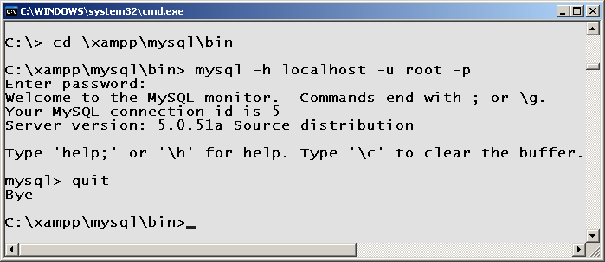
Login/Logout Example
Example command line login:

Slide 16
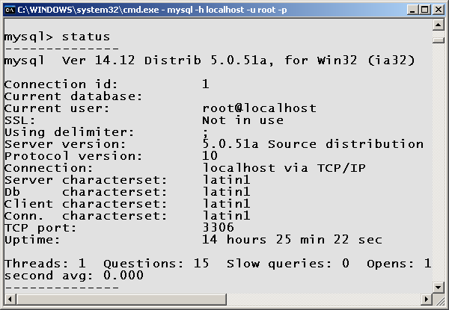
MySQL Status
Display the database version and misc information.
Example: status;

Slide 17
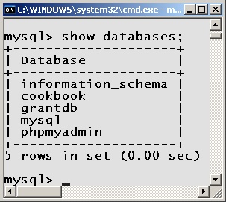
Show Databases
Display all databases available.
Example: show databases;
Note: The databases “information_schema”, “mysql”, “phpmyadmin”, contain meta data (e.g. data about data) concerning tables. They are used for administrative purposes. DO NOT DELETE THEM!
The databases “test” and “cdcol” are for user testing.

Slide 18
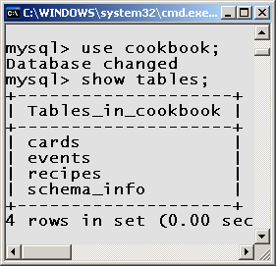
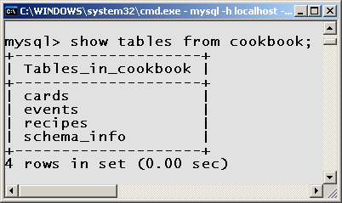
Show Tables
show tables; Display all the tables in a database.

Slide 19
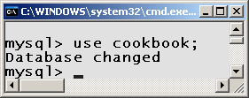
Database Connection
Sets a connection to a specific database.
Syntax:
use dbName;

Slide 20
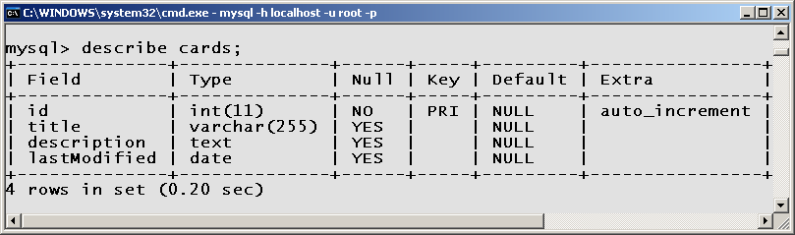
Describe Table
Display the column names and types in a table.
Syntax:
describe tableName;

Slide 21
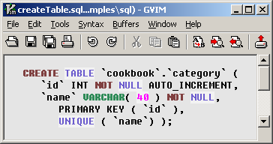
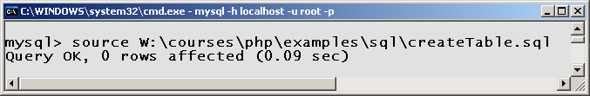
MySQL Source File
source fileName; Execute SQL commands contained in a file as a script:

Slide 22
MySQL Comments
MySQL permits syntax for three different comments.
Example:
/*
* Multi-line comment
* and /* nested comments
* are legal */
*/
# Shell-like comment
-- Standard SQL comment

Slide 23
Chapter Eight
Schema Design Commands

Slide 24
Creating a Database
Syntax:
CREATE DATABASE dbName;
Example:
CREATE DATABASE carddb;
USE carddb;

Slide 25
Table Creation Syntax
Syntax:
CREATE TABLE tblName (
colName1 dataType1
[colAttr1 ...]
[, colName2 dataType2]
[, colAttr2 ...]
[, tblAttr1, ...] );

Slide 26
Table Creation Anatomy
CREATE TABLE notecard (
# id INT NOT NULL AUTO_INCREMENT,
id /* column name */
INT /* column data type */
NOT NULL /* data can’t be null */
AUTO_INCREMENT, /* next integer */
name VARCHAR(50), /* 50 chr max */
content TEXT, /* unlimited char */
creation TIMESTAMP DEFAULT NOW(),
category_id INT, /* foreign key */
PRIMARY KEY(id) ); /* index */

Slide 27
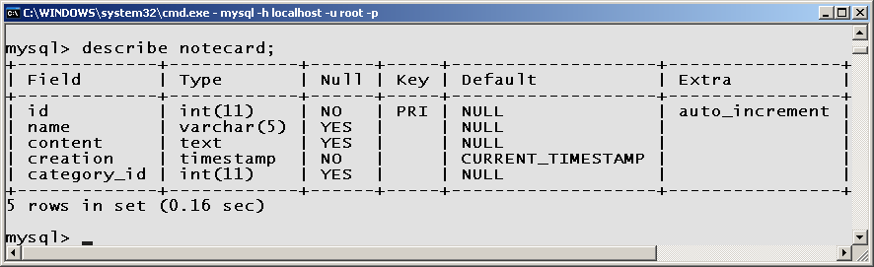
Tables Described
Description: The describe command displays the column name, column type, and other attributes regarding a table.
Syntax:
DESCRIBE tableName;

Slide 28
Renaming a Table
Syntax:
  ALTER TABLE oldTable
  RENAME newTable;
Example:
  ALTER TABLE notecard
  RENAME recipe;

Slide 29
Renaming a Column
Syntax:
  ALTER TABLE tableName
  CHANGE oldColNam
  newColNam newColType;
Example:
  ALTER TABLE author
  CHANGE penname
  pseudonym varchar(25);

Slide 30
Modifying a Column Data Type
Syntax:
  ALTER TABLE tableName
  MODIFY colName colType;
Example:
  ALTER TABLE book
  MODIFY author
  varchar(25);
Warning: Changing the data type of a column in a table that contains values could cause a loss of data!

Slide 31
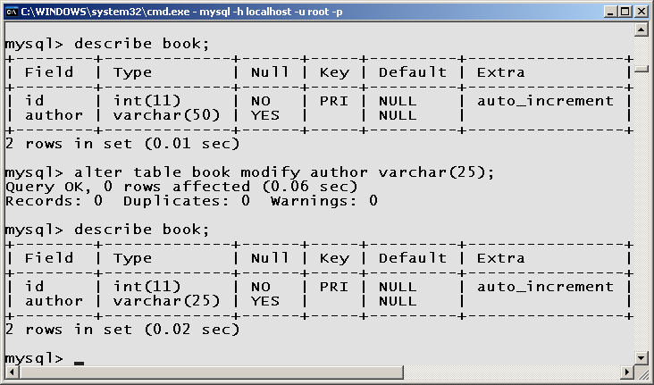
Modifying a Column Data Type (cont.)

Slide 32
Adding a Column
Syntax:
  ALTER TABLE tblName
  ADD colName1 colType1
  FIRST|AFTER colName2;
Example:
  ALTER TABLE book
  ADD pseudonym
  varchar(25)
  AFTER id;

Slide 33
Changing the Column Order
Syntax:
  ALTER TABLE tblName
  MODIFY colNam1 colType
  FIRST|AFTER colNam2;
Example:
  ALTER TABLE book
  MODIFY pseudonym
  varchar(25)
  AFTER author;

Slide 34
Removing a Column
Syntax:
  ALTER TABLE tableName
  DROP columnName;
Example:
  ALTER TABLE book
  DROP pseudonym;
Pitfall: Dropping a column also removes the data stored in the column!
Note: There is no “undo” on dropped columns.

Slide 35
Removing a Table
Syntax:
  DROP TABLE tableName;
Example:
  DROP TABLE book;
Pitfall: Dropping a table also removes the data stored in the table!
Note: There is no “undo” on dropped tables.

Slide 36
to be continued ...
http://cecert.kirkwood.edu/~fmcclurg/courses/php/slides/chapter08b.crud.ppt

