Slide 1
Introduction to
PHP and MySQL
Kirkwood Center for Continuing Education
By Fred McClurg, frmcclurg@gmail.com
Copyright © 2016, Fred McClurg, All Rights Reserved.

Slide 2
Chapter Eight
Learning Database CRUD
http://cecert.kirkwood.edu/~fmcclurg/courses/php/slides/chapter08b.crud.ppt

Slide 3
Chapter Eight
Getting started with phpMyAdmin

Slide 4
Web interface to MySQL
phpMyAdmin: A popular web interface to MySQL that comes bundled with XAMPP and WAMP
The default URL:
http://localhost/phpmyadmin
Note: On new MySQL installations the single user account defined is “root” and the password is blank or “”.

Slide 5
Database CRUD
Explanation: The acronym CRUD represents the most common SQL operations performed on a database.
Letter | Operation | MySQL Statement
C | Create | INSERT
R | Retrieve | SELECT
U | Update | UPDATE
D | Destroy | DELETE

Slide 6
Chapter Eight
The “R” in CRUD
Retrieving Database Data

Slide 7
SQL Data Manipulation (Select)
Description: The following are the most often used SQL data commands.
SELECT: Querying data in a database.
INSERT: Adding data to tables.
UPDATE: Modifying existing table data.
DELETE: Removing rows from tables.

Slide 8
Querying Table Data
SELECT: Used for extracting data contained in a table.
Syntax:
SELECT column1 [, ...]
FROM table1 [, ...]
[WHERE clause]
# no [SANTA clause]
[ ORDER BY clause [ASC|DESC] ]
[LIMIT n];

Slide 9
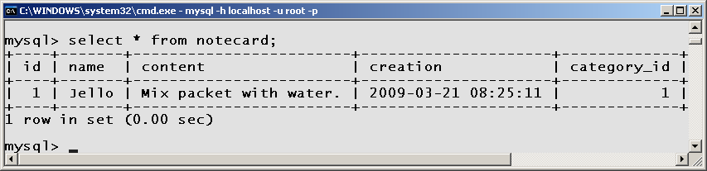
Examining Table Values
Description: The asterisk (*) can be used as a wildcard to specify all the columns in a query.
Example:
SELECT * FROM recipe LIMIT 1;

Slide 10
Select Examples
/* display all columns and all rows */
SELECT * FROM recipe;
/* column names specified */
SELECT name, content
FROM recipe;
/* specify matching row(s) */
SELECT * FROM recipe
WHERE name = "Jello";
/* sort according to name */
SELECT * FROM recipe ORDER BY name;
/* obtain most recent recipe */
SELECT id FROM recipe ORDER BY creation
DESC LIMIT 1;

Slide 11
Joining Tables Theory
recipe
id | name | category_id
1 | Jello | 2
2 | Pudding | 2
3 | Koolaid | 1
category
id | name
1 | Beverage
2 | Dessert
Often multiple tables are combined to obtain the information required. The tables are “joined” via the where clause.

Slide 12
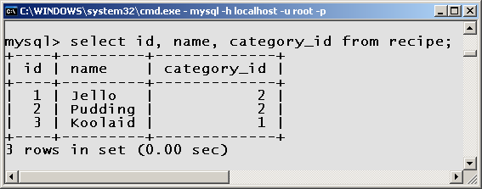
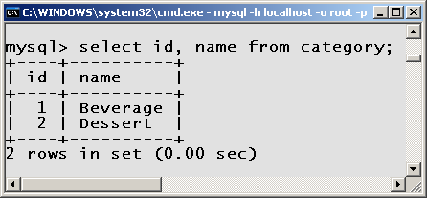
Joining Tables Example
SELECT recipe.name,
category.name
FROM recipe, category
WHERE category_id =
category.id;

Slide 13
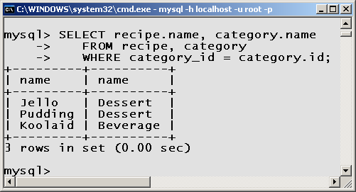
Joining Tables Results
Foreign Key
Primary Key
Note: The column “id” in the category table is called a primary key. The column “category_id” in the “recipe” table is called a “foreign key”. The two tables are joined together by linking the primary and foreign keys.

Slide 14
Selecting Unique Values
Description: A select statement may result in duplicate row values. Unique rows can be obtained by using the DISTINCT key word.
Syntax:
SELECT DISTINCT col1 [, ...]
FROM tbl1 [, ...]
[WHERE condition]
[ORDER BY col1 [, ...]
[LIMIT n];

Slide 15
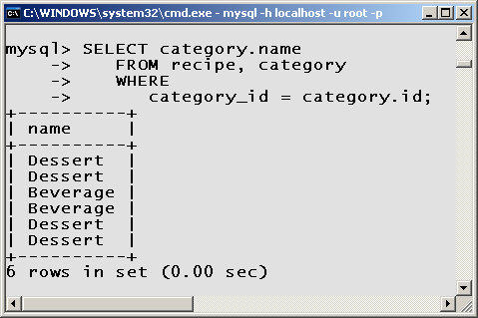
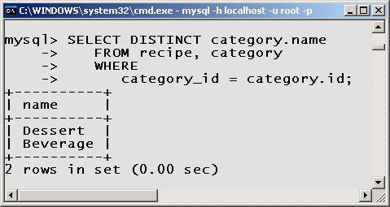
Select Distinct Example

Slide 16
Table Aliases
A table alias is an alternative name (often abbreviated) which references a table.
Table Alias Example:
SELECT *
FROM recipe AS r,
category AS c
WHERE r.category_id = c.id
Note: “r” alias for table “recipe”
“c” alias for table “category”

Slide 17
Column Aliases
A column alias is an alternative abbreviated name of which to reference a column.
Column Alias Example:
SELECT r.name AS 'Title',
c.name AS 'Type'
FROM recipe AS r,
category AS c
WHERE r.category_id = c.id
ORDER BY 'Title';
Note: “Title” alias for column “recipe.name”
“Type” alias for column “category.name”

Slide 18
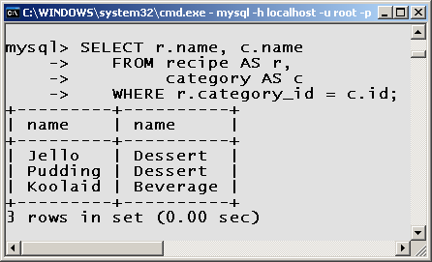
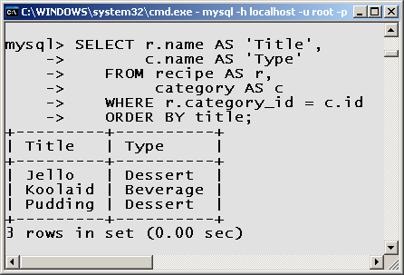
Column Aliases Example

Slide 19
Chapter Eight
The “C” in CRUD
Creating Database Data

Slide 20
SQL Data Manipulation (Insert)
Description: The following are the most often used data modification commands.
SELECT: Querying data in a database.
INSERT: Adding data to tables.
UPDATE: Modifying existing table data.
DELETE: Removing rows from tables.

Slide 21
Adding New Data
INSERT: Used for creating a new row of data in a table.
Syntax:
INSERT INTO table
[(column1, ... )]
VALUES (value1, ...);

Slide 22
Insert Rules
If columns are not specified, values must be in the same order in which they were defined (via CREATE command).
Numeric values should not be quoted.
String values must be quoted.
Date and time values should be quoted.

Slide 23
Insert Rules (cont.)
SQL functions should not be quoted.
NULL should never be quoted.
If a value is not specified, the value inserted is NULL, unless a default column value has been defined or column attribute is AUTO_INCREMENT.
Quoting a column name is optional.

Slide 24
Inserting Without Columns Specified
Example:
INSERT INTO recipe
VALUES (
NULL, # id
"Jello", # name
"Add water", # content
NULL, # creation
2 ); # category_id
Note: Values must be specified in the order which the columns were created. No columns can be skipped. Every column must have a value or NULL.

Slide 25
Inserting With Columns Specified
Example:
INSERT INTO notecard
# COLUMNS
( name,
content,
category_id )
VALUES
( "Pudding", # name
"Add milk.", # content
2 ); # category_id
Note: The order of the column names must match the order of the values.

Slide 26
Obtaining the ID of the last record
Worst Solution:
SELECT COUNT(id) FROM RECIPE;
Poor Solution:
SELECT MAX(id) FROM RECIPE;
Good Solution:
SELECT id FROM recipe ORDER BY
creation DESC LIMIT 1;
Best Solution:
SELECT LAST_INSERT_ID();

Slide 27
Chapter Eight
The “U” in CRUD
Updating Database Data

Slide 28
SQL Data Manipulation (Update)
Description: The following are the most often used data modification commands.
SELECT: Querying data in a database.
INSERT: Adding data to tables.
UPDATE: Modifying existing table data.
DELETE: Removing rows from tables.

Slide 29
Modifying Data
UPDATE: Used for modifying existing table data.
Syntax:
UPDATE tableName
SET colName = newValue
[WHERE colName = const]
[LIMIT n];
Pitfall: Failing to specify the WHERE or LIMIT clause modifies all the records in the table!
Note: There is no “undo” on inadvertently modified data.

Slide 30
Update Examples
Examples:
/* modify column 'content' on all rows */
UPDATE recipe
SET content = "Mix ingredients";
/* replace "Drink" with "Beverage" (1st match) */
UPDATE category
SET name = "Beverage"
WHERE name = "Drink"
LIMIT 1;
/* modify via unique id (most common) */
UPDATE recipe
SET content = "Stir ingredients";
WHERE id = 1;

Slide 31
Chapter Eight
The “D” in CRUD
Deleting Database Data

Slide 32
SQL Data Manipulation (Delete)
Description: The following are the most often used data modification commands.
SELECT: Querying data in a database.
INSERT: Adding data to tables.
UPDATE: Modifying existing table data.
DELETE: Removing rows from tables.

Slide 33
Deleting Data
Delete: Used for removing row(s) in a table.
Syntax:
DELETE FROM tableName
[WHERE colName = const]
[LIMIT n];
Pitfall: Failing to specify the WHERE or LIMIT clause deletes all records in table!
Note: There is no “undo” on deleted data.

Slide 34
Delete Examples
Examples:
/* delete all rows (you sure?) */
DELETE FROM book;
/* delete the first match */
DELETE FROM book
WHERE lastName = "Wesley"
LIMIT 1;
/* delete via id (most common) */
DELETE FROM book
WHERE id = 1;

Slide 35
to be continued ...
http://cecert.kirkwood.edu/~fmcclurg/courses/php/slides/chapter08c.wildcards.ppt

