Slide 1
Introduction to
PHP and MySQL
Kirkwood Center for Continuing Education
By Fred McClurg, frmcclurg@gmail.com
Copyright © 2016, Fred McClurg, All Rights Reserved.

Slide 2
Chapter Eight
MySQL Wildcards
http://cecert.kirkwood.edu/~fmcclurg/courses/php/slides/chapter08c.wildcards.ppt

Slide 3
Search Function with “%” Wildcard
Description: Searching records in a database often involves matching part of string in a field.
Percent Character (%): Wildcard that matches zero or more characters and is used with keyword “LIKE”.
Example:
  SELECT *
  FROM recipe WHERE
  (content LIKE "%rubarb%" AND
  content LIKE "%strawberr%");

Slide 4
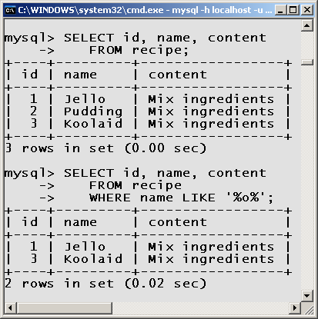
Search Function Example Using “%”

Slide 5
Logical Operators
Description: The keywords AND, OR and NOT can be used in the WHERE clause to combine multiple statements.
Examples:
  SELECT r.name AS 'Title',
  c.name AS 'Type'
  FROM recipe AS r,
  category AS c
  WHERE (
  r.name LIKE '%chocolate%' OR
  r.name LIKE '%cocoa%' ) AND
  c.name = "Dessert" AND
  r.category_id = c.id;

Slide 6
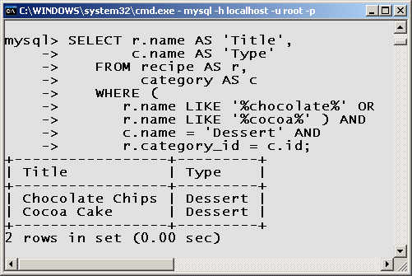
Logical Operator Example

Slide 7
Search Function with “_” Wildcard
Description: Searching records in a database often involves matching part of string in a field.
Underscore Character (_): Wildcard that matches exactly one character and is used with keyword “LIKE”.
Example:
  SELECT id, name
  FROM recipe WHERE
  name LIKE '_______'; # 7

Slide 8
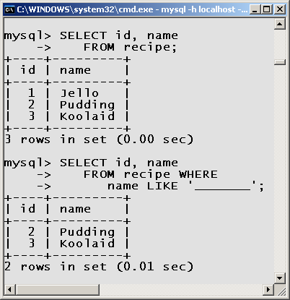
Search Function Example Using “_”

Slide 9
to be continued ...
http://cecert.kirkwood.edu/~fmcclurg/courses/php/slides/chapter08d.functions.ppt

