Slide 1
Introduction to
PHP and MySQL
Kirkwood Center for Continuing Education
By Fred McClurg, frmcclurg@gmail.com
Copyright © 2016, Fred McClurg, All Rights Reserved.

Slide 2
Chapter Eight
MySQL Time/Date Functions
http://cecert.kirkwood.edu/~fmcclurg/courses/php/slides/chapter08d.functions.ppt

Slide 3
Date and Time Functions
Functions return the current time and date.
NOW()
SYSDATE()
CURRENT_TIMESTAMP()
Example:
SELECT NOW();
SELECT SYSDATE();
SELECT CURRENT_TIMESTAMP();

Slide 4
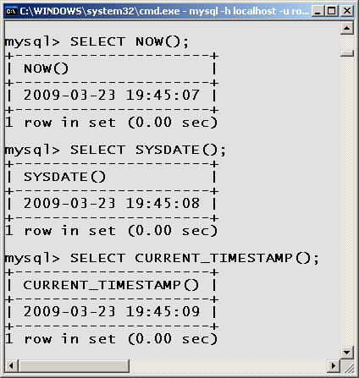
Date and Time Functions (cont.)

Slide 5
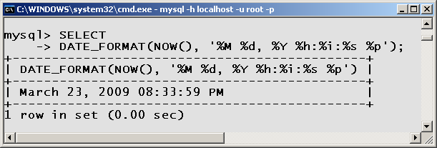
Date Format Function
DATE_FORMAT()
Displays the date in the format specified.
Example:
SELECT
DATE_FORMAT(
NOW(), '%M %d, %Y %h:%i:%s %p');

Slide 6
Date Format Specifier Characters (1)
Specifier | Description
%a | Abbreviated weekday name (Sun..Sat)
%b | Abbreviated month name (Jan..Dec)
%c | Month, numeric (0..12)
%D | Day of the month with English suffix (1st, 2nd, 3rd, …)
%d | Day of the month, numeric (00..31)
%e | Day of the month, numeric (0..31)
%f | Microseconds (000000..999999)
%H | Hour (00..23)
%h | Hour (01..12)
%I | Hour (01..12)

Slide 7
Date Format Specifier Characters (2)
Specifier | Description
%i | Minutes, numeric (00..59)
%j | Day of year (001..366)
%k | Hour (0..23)
%l | Hour (1..12)
%M | Month name (January..December)
%m | Month, numeric (00..12)
%p | AM or PM
%r | Time, 12-hour (hh:mm:ss with AM or PM)
%S | Seconds (00..59)
%s | Seconds (00..59)

Slide 8
Date Format Specifier Characters (3)
Specifier | Description
%T | Time, 24-hour (hh:mm:ss)
%U | Week (00..53), where Sunday is the first day of the week
%V | Week (01..53), where Sunday is the first day of the week; used with %X
%W | Weekday name (Sunday..Saturday)
%w | Day of the week (0=Sunday..6=Saturday)
%X | Year for week where Sunday is first day of week, numeric, four digits; used with %V
%Y | Year, numeric, four digits
%y | Year, numeric (two digits)
%% | A literal “%” character

Slide 9
Chapter Eight
Other Common MySQL Functions

Slide 10
SQL Functions: MIN and MAX
MIN(): Finds the minimum value for a column.
MAX(): Finds the maximum value for a column.
Example:
  SELECT MIN(salary) AS Poor,
  MAX(salary) AS Rich
  FROM paystub;
Note: “Poor” and “Rich” are aliases for “MIN(salary)” and “MAX(salary)”.

Slide 11
SQL Function: COUNT
COUNT(): Finds the number of data rows.
Example:
  SELECT COUNT(id) AS tally
  FROM recipe;
Note: “tally” is an alias for “COUNT(id)”.

Slide 12
Other SQL Function: SUM
SUM(): Finds the total value of a column.
Example:
  SELECT SUM(salary)
  AS Total
  FROM paystub;
Note: “Total” is an alias for
“SUM(salary)”.

Slide 13
Other SQL Function: AVG
AVG(): Finds the average value for a column.
Example:
  SELECT AVG(salary)
  AS Average
  FROM paystub;
Note: “Average” is an alias for “AVG(salary)”.

Slide 14
to be continued ...
http://cecert.kirkwood.edu/~fmcclurg/courses/php/slides/chapter09a.dataTypes.ppt

