Slide 1
Introduction to
PHP and MySQL
Kirkwood Center for Continuing Education
By Fred McClurg, frmcclurg@gmail.com
Copyright © 2016 All Rights Reserved.

Slide 2
Supplemental
Eclipse
http://cecert.kirkwood.edu/~fmcclurg/courses/php/slides/eclipse.ppt

Slide 3
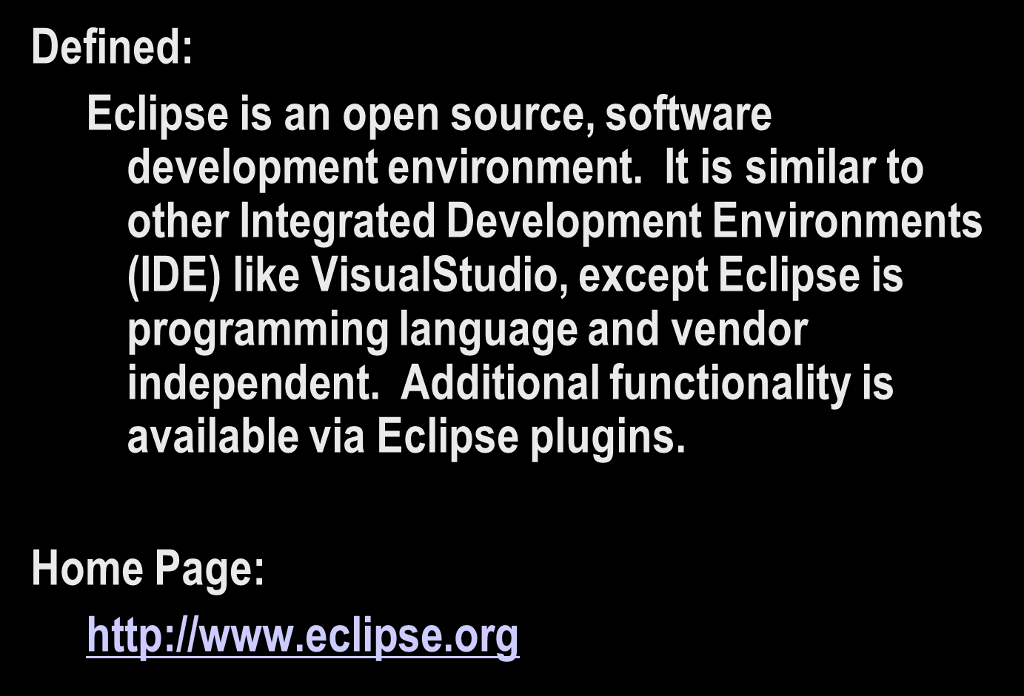
What is Eclipse?

Slide 4
Using Eclipse for PHP Development
Eclipse bundles a number of plugins that are specifically designed for software development using PHP (and other languages):
Eclipse Downloads:
http://www.eclipse.org/downloads/

Slide 5
to be continued ...
http://cecert.kirkwood.edu/~fmcclurg/courses/php/slides/frameworks.ppt

