Slide 1
Introduction to
PHP and MySQL
Kirkwood Center for Continuing Education
By Fred McClurg, frmcclurg@gmail.com
Copyright © 2016 All Rights Reserved.

Slide 2
Supplemental
HTML 5
http://cecert.kirkwood.edu/~fmcclurg/courses/php/slides/html5.ppt

Slide 3
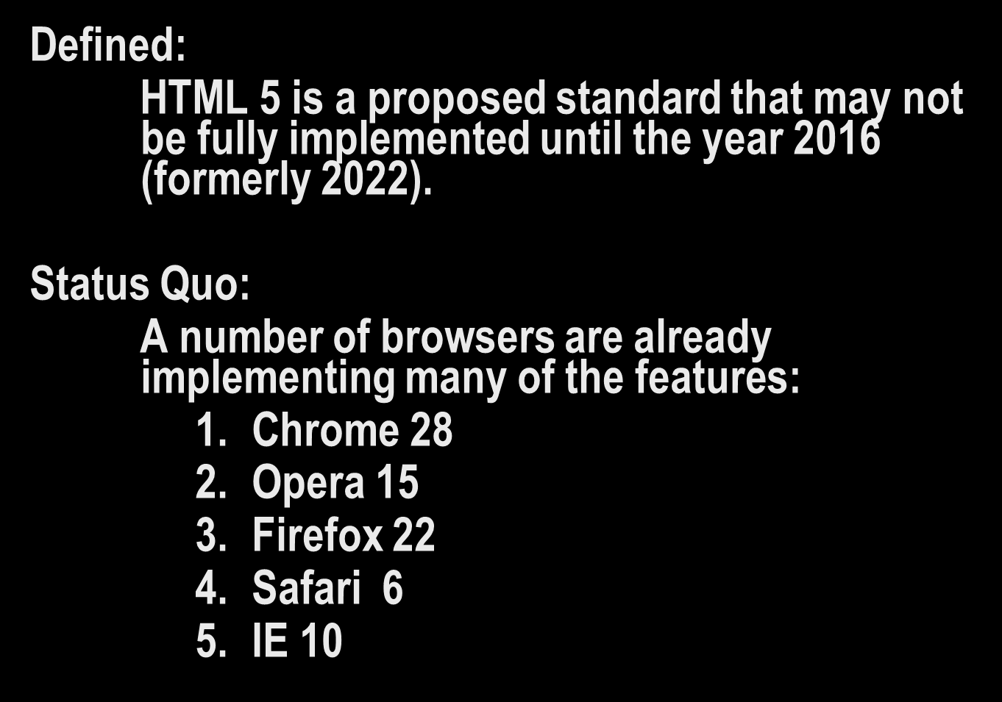
What is HTML 5?

Slide 4
Which browsers support HTML 5 best?
The following websites check your browser to see which HTML5 features are supported:
http://fmbip.com/
http://html5test.com/
The following websites have a score sheet concerning the HTML 5 compatibility of the most popular browsers:
http://findmebyip.com/litmus

Slide 5
Are there HTML 5 demos?
The following is a very excellent HTML 5 demo that actually uses HTML5! The following presentation was meant to run in Google Chrome:
http://slides.html5rocks.com

Slide 6
Where can I go for more information?
The following is my collection of HTML 5 bookmarks:
http://diveintohtml5.org
http://html5doctor.com
http://caniuse.com
http://html5demos.com

Slide 7
to be continued ...
http://cecert.kirkwood.edu/~fmcclurg/courses/php/slides/doxygen.ppt

