Slide 1
Introduction to
PHP and MySQL
Kirkwood Center for Continuing Education
By Fred McClurg, frmcclurg@gmail.com
© Copyright 2016 All Rights Reserved.

Slide 2
Class Project
Recipe DB Application
Part One: Search & Delete
http://cecert.kirkwood.edu/~fmcclurg/courses/php/slides/recipe01.ppt

Slide 3
Requirements Definition
Description: The first step of any project is to define the requirements.
Provide a web interface to the “cookbookdb” database.
Make sure that user can perform CRUD operations on data.
Function is usually more important than esthetics. For this project, we pick “fast” and “cheap”.
Good
Fast
Cheap

Slide 4
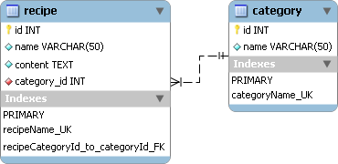
Database Requirements
Review: An understanding of the database schema is important.
To rapidly create database and test data, import “cookbookdb.sql” or create the following database from scratch.

Slide 5
Interface Design of Class Project One
Description: It is pretty hard to beat pencil and paper for rapidly laying out ideas. The original sketch can be refined using “visio”, “dia”, “xfig”, or “OpenOffice/Libre Office”.
The form controls can also be captured as images to be pasted and arranged in any graphics application. (see “webParts.html”)

Slide 6
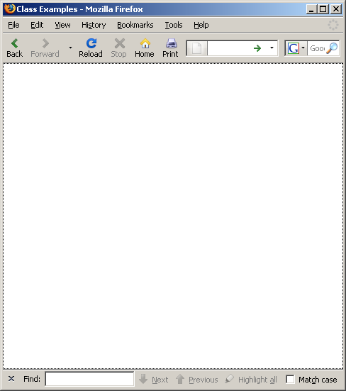

Interface Design: Project One v1
Sketch of interface that handles the “R” and “D” of CRUD:
Search
Title | Recipe | Category | Delete?
Jello | Mix ... | Dessert
Pudding | Mix ... | Dessert
Koolaid | Mix ... | Beverage
... | ... | ...
Delete
Selected

Slide 7
Interface Design: Project One v2
Alternate sketch of GUI interface that handles the “R” and “D” of CRUD:
Search
Title | Recipe | Category | Delete
Jello | Mix ... | Dessert
Pudding | Mix ... | Dessert
Koolaid | Mix ... | Beverage
... | ... | ...
Delete
Delete
Delete
Delete

Slide 8

Interface Design: Project Two
Sketch of GUI interface that handles the “C” and “U” of CRUD:
Hot Cocoa
Beverage
Mix Cocoa packet with water. Heat. Stir.
Create
Modify

Slide 9
General Tasks
Discussion: The following procedure represents the tasks we will follow to complete the “search.php” application.
0. Convert from HTML to PHP.
Perform the following tasks:
  Initialize variables (Step 0)
  Connect to database (Step 1)
  Use a database (Step 2)
  Close the database connection (Steps 6).

Slide 10
General Tasks
Perform the following tasks:
        Build the SQL “SELECT” statement (Step 3).
        Execute the SQL statement (Step 4).
Build a SQL debug statement. (optional)
Build a HTML table with database data:
        Get results from “SELECT” statement (Step 5)
        Display data in dynamic HTML table.

Slide 11
General Tasks (cont. 2)
Remove the static HTML table.
Make form changes:
  Make form self-referential (action flexibility).
  Make text field “sticky” (remember previous state).
Populate drop-down list with DB values.

Slide 12
General Tasks (cont. 3)
Add search capabilities for title.
Add search for category (optional).
Add search for content (optional).
Make checkboxes “sticky” (optional).
Separate CSS into a separate file.
Separate JavaScript into separate file.

Slide 13
General Tasks (cont. 4)
Discussion: The items below are the tasks and the procedure we will follow to complete the “delete.php” application.
Perform the following tasks:
  Connect and use the database (Steps 1 & 2).
  Build the SQL “DELETE” statement (Step 3).
  Execute the SQL statement (Step 4).
  Obtain results from “DELETE” statement (Step 5).

Slide 14
to be continued ...
http://cecert.kirkwood.edu/~fmcclurg/courses/php/slides/recipe02.ppt

