Slide 1
Introduction to
PHP and MySQL
Kirkwood Center for Continuing Education
By Fred McClurg, frmcclurg@gmail.com
© Copyright 2016 All Rights Reserved.

Slide 2
Class Project
Recipe DB Application
Part Two: Insert & Update
http://cecert.kirkwood.edu/~fmcclurg/courses/php/slides/recipe02.ppt

Slide 3
Top Level Design
Description: Top level design is a methodology that addresses the large picture first and then the details. For today’s in class project, will apply that methodology.

Slide 4
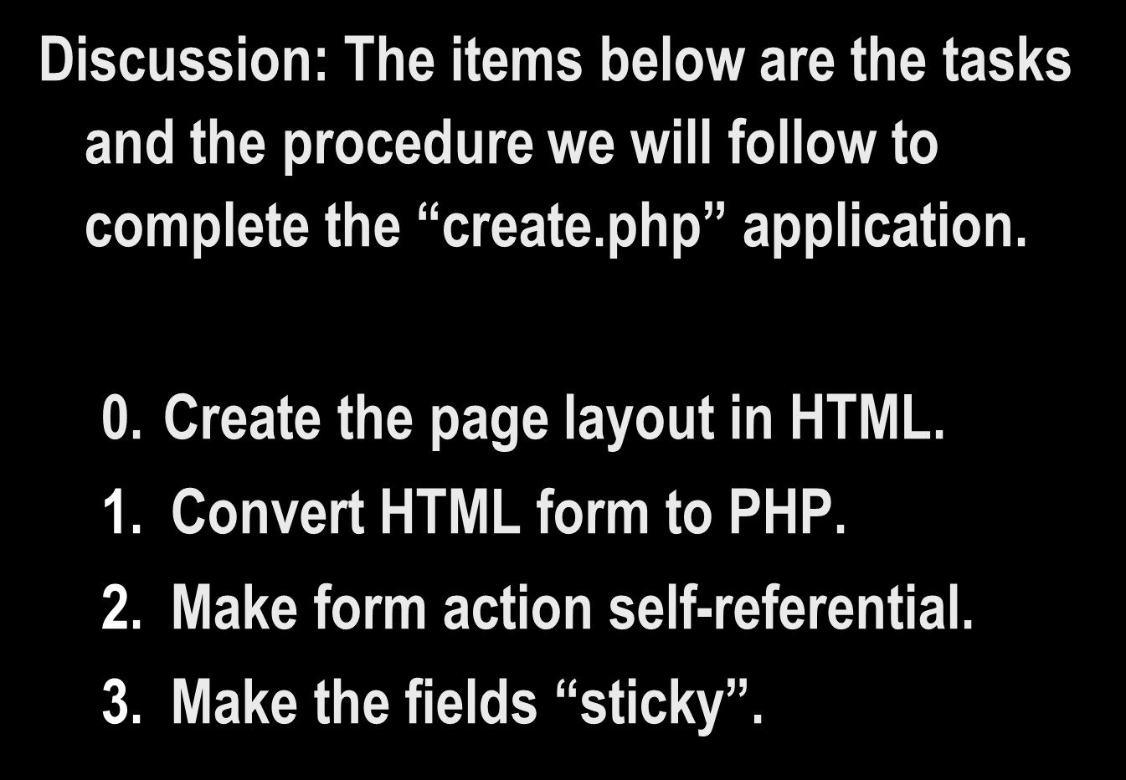
General Tasks

Slide 5
General Tasks (continued 2)
Connect, use and close the database (Steps 0, 1, 2 and 6).
Create function that populates drop down list with database values.
Determine if a submit button was pressed and which one.
Build the SQL statements for “SELECT”, “INSERT” and “UPDATE” (Step 3).

Slide 6
General Tasks (continued 3)
Output SQL debug statements.
Execute SQL statements (Step 4).
Obtain results from INSERT.
Obtain results from UPDATE.
Obtain results from SELECT.

Slide 7
General Tasks (continued 4)
Protect SQL from “bad” SQL values.
Status message INSERT & UPDATE.
Pop-up error dialog messages.

Slide 8
to be continued ...
http://cecert.kirkwood.edu/~fmcclurg/courses/php/slides/html5.ppt

