Slide 1
Design Considerations
© Copyright 2016, Fred McClurg All Rights Reserved

Slide 2
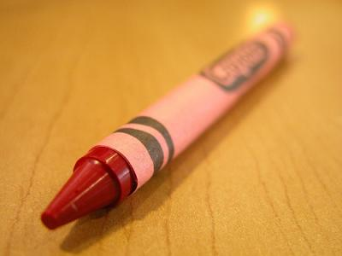
This is a Red Crayon
Q: What is it?
A: A red crayon.
Q: What does it do?
A: It colors things red.
Q: Do you use it on real art projects?
A: Yes, when you need to color something red.

Slide 3
Is a Red Crayon Useful?
Q: I mean, did the art masters (Rembrandt, etc.) use this?
A: Well, no ...
Q: Do you use it on every art project?
A: No, only projects that need to be red.
Q: How often do you personally use it?
A: Truthfully, I don’t usually use crayons very often.
Q: I don’t get it, why would you use it? Can you give me an example?
A: Coloring a red heart.

Slide 4
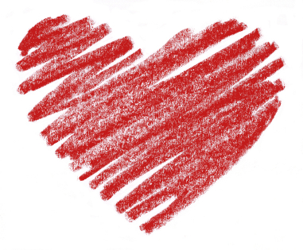
This is a Red Heart
Logical Conclusion:
Crayons are not very useful.
Crayons are not for serious artists.
Red crayons can only draw red hearts.
Red hearts can only be drawn with crayons.

Slide 5
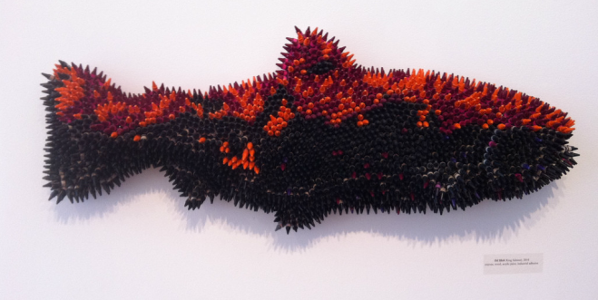
This is also a Red Crayon
Artist Herb Williams creates original sculptures out of individual crayons that may require as many as hundreds of thousands. He is one of the only independent buyers in the world who maintains an account with Crayola. Herb explains, “To most adults, the sight and smell of crayons produce specific memories of childhood. The twist in the road to nostalgia is the creation of a new object, from a medium in which it was not intended.” http://www.herbwilliamsart.com

