Slide 1
Variables
Introduction to JavaScript
© Copyright 2016, Fred McClurg All Rights Reserved

Slide 2
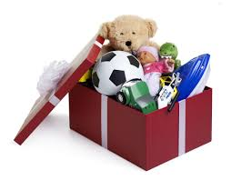
What is a Variable?
Named location (or container) for storing a value in memory
Similar to a shoe box with label
The box only holds one thing
Anything can be stored in the box

Slide 3
Variable Name Requirements
Contains only letters (a-zA-Z), numbers (0-9), “_”, or “$”
Can not start with a number.
Variables cannot contain a space.
Must be declared before used.
Can’t use reserved words as variables.
https://developer.mozilla.org/en-US/docs/Web/JavaScript/Reference/Reserved_Words

Slide 4
Variable Recommendations
Best Practices:
First character should be lowercase letter.
Use “camelCase” instead of “under_scores” to separate multiple words.
Give variables a descriptive name.

Slide 5
Variable Examples
variables.html
Examples:
var e-mail; // error!
var email; // okay
var today'sDate; // error!
var todaysDate; // okay
var 10000years; // error!
var years10000; // okay
var day, month, year; // okay

Slide 6
Declaring and Initializing Variables
Examples:
// declare and initialize
var x = 4;
console.log( x );
// string assignment
var city = "Cedar Rapids";
console.log( city );
declare.html

Slide 7
Initializing Multiple Variables
Examples:
// initialize multiple strings
var bud = "Abbott",
lou = "Costello",
stan = "Laurel",
oliver = "Hardy";
console.log( bud );
console.log( lou );
console.log( stan );
console.log( oliver );
multiInit.html

