Slide 1
Eclipse
Overview
Introduction to Web Programming
Kirkwood Continuing Education
Fred McClurg
© Copyright 2016, Fred McClurg, All Rights Reserved
Notes:
Introduction to Web Programming
Eclipse

Slide 2
What is Eclipse?
Integrated Development Environment (IDE)
Open Source
Platform Neutral
Multiple Language Support
Plugin Based
Notes:
Introduction to Web Programming
Eclipse

Slide 3
Installing Eclipse
Download:
Eclipse Classic, version 4.3 (recommended installation):
    http://www.eclipse.org/downloads/
Eclipse & PHP Development Tools (PDT) alternative installation:
    http://www.eclipse.org/pdt/downloads/_x000b_
Extract Untar/Unzip Archive
Move the file hierarchy to a writable application directory:
    C:/eclipse or
    C:/Users/Fred/Applications/Eclipse
Make a shortcut to launch eclipse
Notes:
Introduction to Web Programming
Eclipse

Slide 4
Running Eclipse Successfully
The System OS, Java, and Eclipse must all be 32 or 64-bit
Java must be on the system path
Eclipse should be installed in location with write access

Slide 5
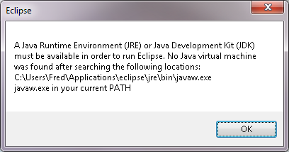
Telling Eclipse Java’s location
Add this line to eclipse.ini file:
-vm "C:\Program Files\Java\jre7\bin\javaw.exe"

Slide 6
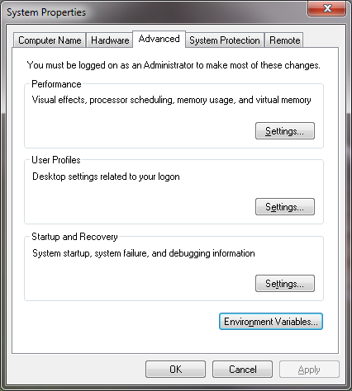
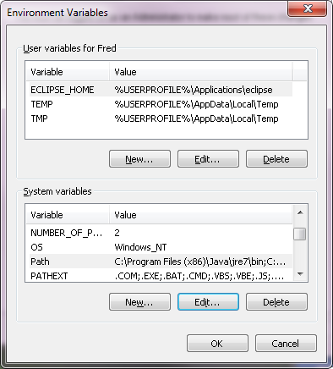
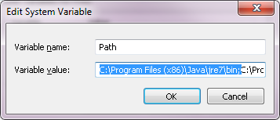
Telling OS Java’s location
Control Panel ‒> System ‒> Advanced system settings
Advanced Tab
Environment Button
Select “Path” system variable
Edit Button
Prefix “Path” system variable value with:
C:\Program Files (x86)\Java\jre7\bin;

Slide 7
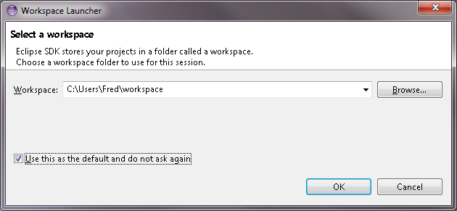
Eclipse Workspace Launcher
The eclipse workspace is the location containing the configuration of your projects. Many only use a single workspace.

Slide 8
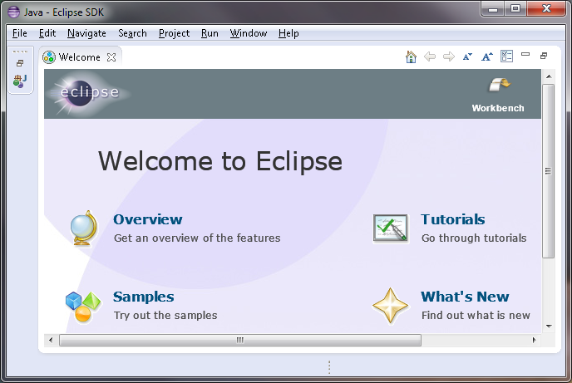
Eclipse Welcome Screen
When eclipse is launched the first time, a welcome screen is displayed.
Click on “Workbench” to open the IDE.
Notes:
Introduction to Web Programming
Eclipse

Slide 9
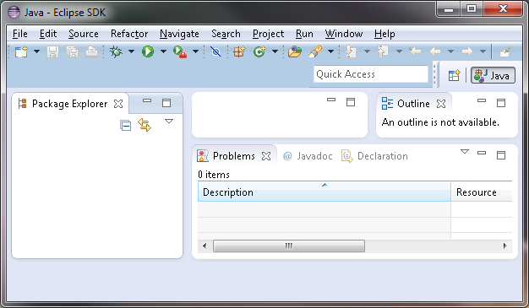
Eclipse Workspace
Eclipse organizes the IDE into a number of tabbed panes.
The Java Perspective is displayed by default.
Notes:
Introduction to Web Programming
Eclipse

Slide 10
Installing eclipse.org Plugins
Several Eclipse plugins are available via the software site from eclipse.org
  Help ‒> Install New Software ...
  Work with: Mars (or your current version)
    http://download.eclipse.org/releases/mars
Notes:
Introduction to Web Programming
Eclipse

Slide 11
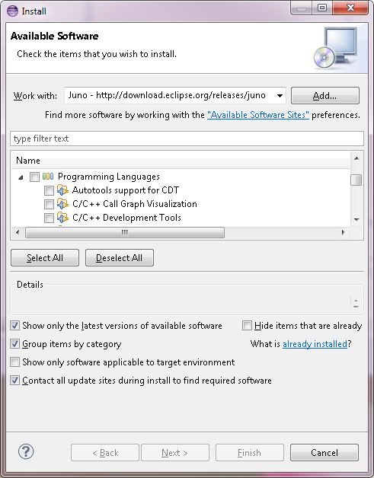
Available Software
Part of the challenge of Eclipse is not the lack of available software but selecting the plugin which is the best for getting the task done.
Notes:
Introduction to Web Programming
Eclipse

Slide 12
Available Software
Programming Languages:
JavaScript Developer Tools
PHP Development Tools (PDT)
Web, XML, Java EE and OSGi Enterprise Development:
Eclipse Web Developer Tools
Notes:
Introduction to Web Programming
Eclipse

Slide 13
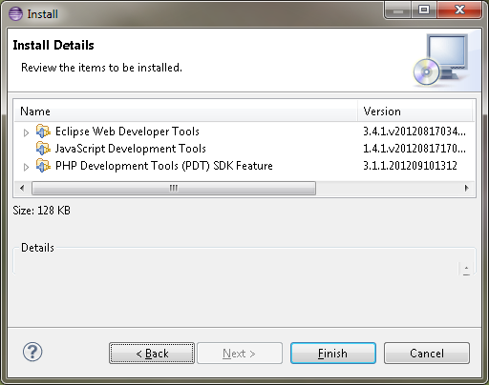
Install Details
Review items to be installed
Notes:
Introduction to Web Programming
Eclipse

Slide 14
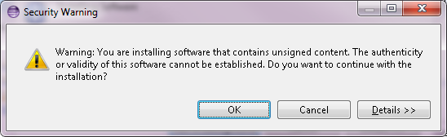
Security Warning
Click “OK”.
Notes:
Introduction to Web Programming
Eclipse

Slide 15
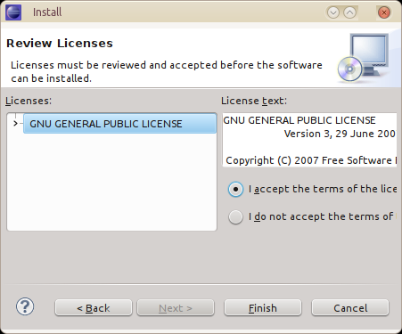
Review License Agreement
Accept the terms of the license agreement
Notes:
Introduction to Web Programming
Eclipse

Slide 16
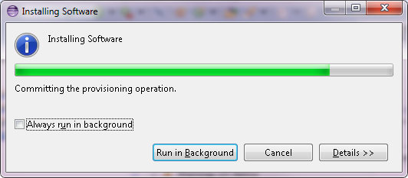
Installing Software
Eclipse downloads and installs the plugins into the application.
Notes:
Introduction to Web Programming
Eclipse

Slide 17
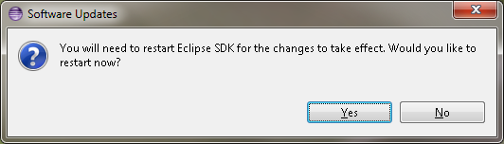
Software Updates
Restart eclipse for the changes to take effect.
Notes:
Introduction to Web Programming
Eclipse

Slide 18
Installing via Update Site
Description: Another common way to install software is via an Update Site.
Help ‒> Install New Software …
Press “Add ...” push button
Name: Eclox (doxygen plugin)
Location: http://download.gna.org/eclox/update
Notes:
Introduction to Web Programming
Eclipse

Slide 19
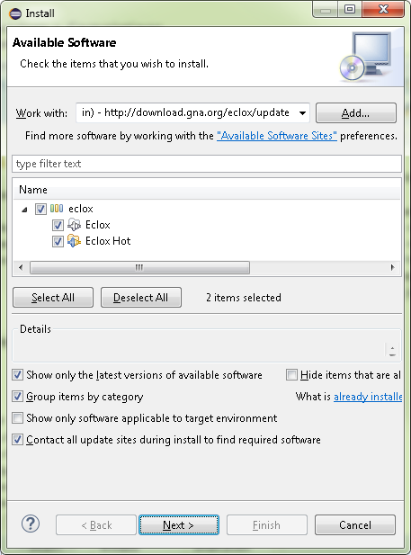
Available Software
Check plugins you wish to install and press the “Next >” push button.
Notes:
Introduction to Web Programming
Eclipse

Slide 20
Installing via Eclipse Marketplace
Description: Recently introduced, Eclipse Marketplace provides a streamlined interface for installations.
Help ‒> Eclipse Marketplace …
Find: vim
Press Vrapper (Vim) “Update” button
Notes:
Introduction to Web Programming
Eclipse

Slide 21
Installing via Eclipse Marketplace
Description: Recently introduced, Eclipse Marketplace provides a streamlined interface for installations.
Help ‒> Eclipse Marketplace …
Find: jquery
Press JSDT jQuery “Update” button
Notes:
Introduction to Web Programming
Eclipse

Slide 22
Installing via Archive File
Description: If no update site is available, the plugin can be installed via an update site zip archive file:
Download the plugin zip file:
  http://eclipsetidy.sourceforge.net/
Click “Download”
Download most recent zip file: (e.g. net.sf.eclipsetidy_1.2.2_local_site.zip)
Move the zip file to a permanent location:
  C:\eclipse\archive
Help -> Install New Software ...
Press “Add ...” button
Specify a name (e.g. Eclipse Tidy Archive)
Press “Archive …” and select the zip file downloaded to the local hard drive.
Check “net.sf.eclipsetidy.feature”item.
Notes:
Introduction to Web Programming
Eclipse

Slide 23
Eclipse Perspectives
Description: A collection of panes that function together to accomplish a task. To change perspective:
Window ‒> Open Perspective ‒> Other …
Notes:
Introduction to Web Programming
Eclipse

Slide 24
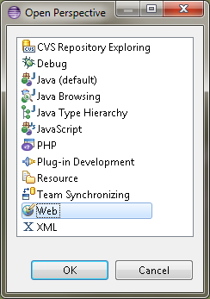
Open Perspectives
Description: Perspectives are grouped by programming languages or a common set of tasks.
Notes:
Introduction to Web Programming
Eclipse

Slide 25
Creating a Project
Description: A project is a collection of files that comprise a common website, application, or set of applications.
File ‒> New ‒> Project ...
Notes:
Introduction to Web Programming
Eclipse

Slide 26
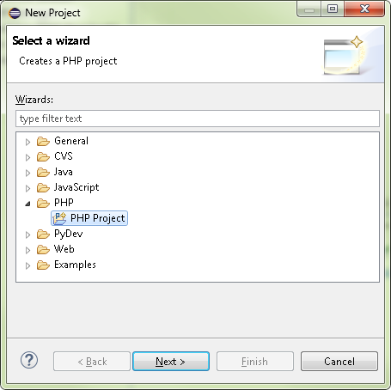
New Project
File ‒>
New -> Project ... ->
PHP Project
Notes:
Introduction to Web Programming
Eclipse

Slide 27
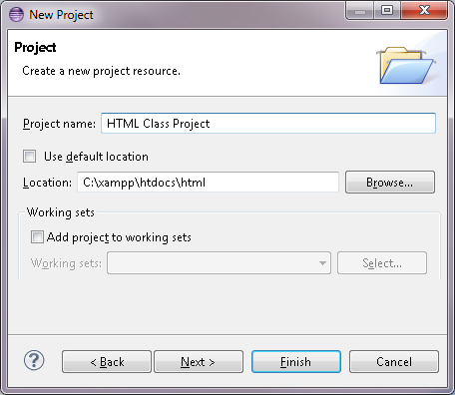
Specifying Project Name
Enter project name
Uncheck “Use default location”
Specify “html” sub directory in the document root
Press “Finish”
Notes:
Introduction to Web Programming
Eclipse

Slide 28
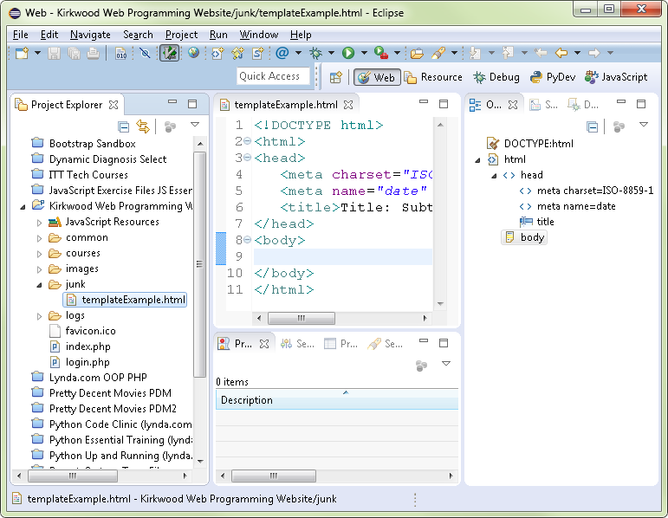
Creating a Project
The new project is displayed in the “Project Explorer” pane on the left.
Notes:
Introduction to Web Programming
Eclipse

Slide 29
Eclipse Layout
The Project Explorer pane provides an interface to the operating system.
The central pane provides an editor.
The Outline pane provides a hierarchy of the document.
Notes:
Introduction to Web Programming
Eclipse

Slide 30
Eclipse Editing
Creating Directories:
Right click on Project Name
File -> New -> Folder
Select Project Name (location of parent folder
Creating Files:
Right click on Directory Name
File -> New -> Other ...
Select file type from the list:
    Web -> HTML
Notes:
Introduction to Web Programming
Eclipse

Slide 31
Creating a Project
The new file is displayed in the center pane.
Notes:
Introduction to Web Programming
Eclipse

Slide 32
Creating a Project
The “Outline Pane” on the right displays a hierarchy view showing the page structure.
Notes:
Introduction to Web Programming
Eclipse

Slide 33
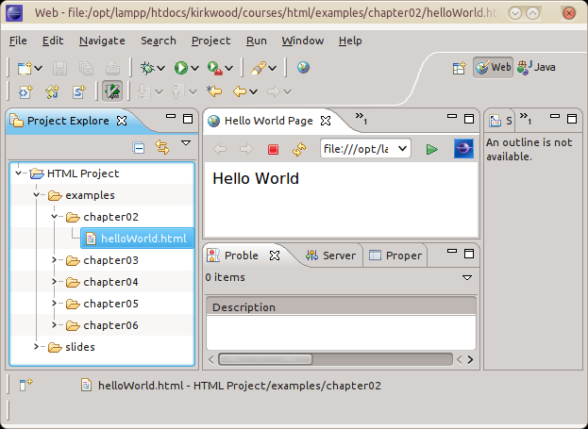
HTML Browser in Eclipse
Right click ‒> Open With ‒> Web Browser
Notes:
Introduction to Web Programming
Eclipse

Slide 34
Eclipse Preferences
Description: Eclipse can be customized to meet your preferences.
Window ‒> Preferences
  Type “space” in filter window
  Change the indentation to spaces
  Change the indentation size to 3
Notes:
Introduction to Web Programming
Eclipse

Slide 35
Eclipse Formatting
Eclipse Formatting:
  Source ‒> Format
Notes:
Introduction to Web Programming
Eclipse

Slide 36
Eclipse File Templates
New file via template:
  File ‒> New ‒> HTML
Modify existing template:
  Window ‒> Preferences
Type Filter Text:
  Templates
Click on template to modify:
  HTML Files ‒> Editor ‒> Templates
Press “Edit ...”
  Templates
Notes:
Introduction to Web Programming
Eclipse

Slide 37
Formatting File Template
Insert the following after the <head> tag:
  <meta name="date"
  content="${date}">
Replace the <title> tag with the following:
  <title>Title: Subtitle</title>
Notes:
Introduction to Web Programming
Eclipse

Slide 38
Viewing HTML Page via Eclipse
Built-in Internal Web Browser
  Right click on HTML file:
  Open with ... -> Web Browser
External Web Browser
  Right click on HTML file:
  Open with ... -> Other ...
  Select “External programs” radio button
  Select “Firefox HTML Document” from list
Notes:
Introduction to Web Programming
Eclipse

Slide 39
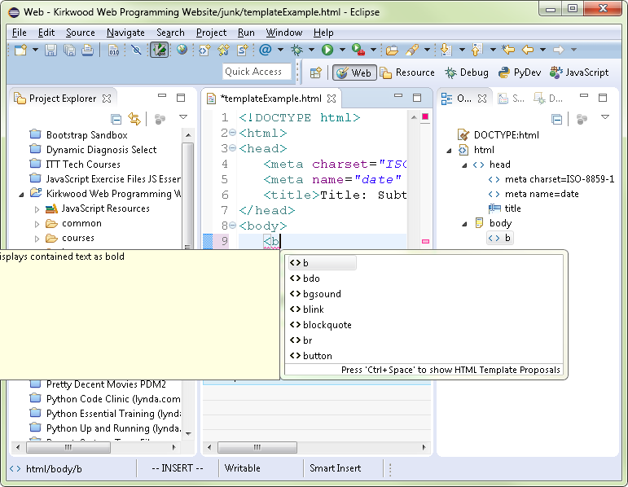
Eclipse Code Assist
Code Recommender (also or content assist):
    Shift+Space
Code completion (closing tags)
Notes:
Introduction to Web Programming
Eclipse

