Slide 1
FileZilla
Introduction to Web Programming
Kirkwood Community College
Fred McClurg
© Copyright 2016, Fred McClurg, All Rights Reserved
Notes:
8/16/12 09:23:56 AM
© 2007 Microsoft Corporation. All rights reserved. Microsoft, Windows, Windows Vista and other product names are or may be registered trademarks and/or trademarks in the U.S. and/or other countries.
The information herein is for informational purposes only and represents the current view of Microsoft Corporation as of the date of this presentation. Because Microsoft must respond to changing market conditions, it should not be interpreted to be a commitment on the part of Microsoft, and Microsoft cannot guarantee the accuracy of any information provided after the date of this presentation. MICROSOFT MAKES NO WARRANTIES, EXPRESS, IMPLIED OR STATUTORY, AS TO THE INFORMATION IN THIS PRESENTATION.
1

Slide 2
About FileZilla
FileZilla is a tool for transferring files over a secure protocol from a client to a server via a Graphical User Interface (GUI).
Download:
https://filezilla-project.org/download.php?type=client
Notes:
8/16/12 09:23:56 AM
© 2007 Microsoft Corporation. All rights reserved. Microsoft, Windows, Windows Vista and other product names are or may be registered trademarks and/or trademarks in the U.S. and/or other countries.
The information herein is for informational purposes only and represents the current view of Microsoft Corporation as of the date of this presentation. Because Microsoft must respond to changing market conditions, it should not be interpreted to be a commitment on the part of Microsoft, and Microsoft cannot guarantee the accuracy of any information provided after the date of this presentation. MICROSOFT MAKES NO WARRANTIES, EXPRESS, IMPLIED OR STATUTORY, AS TO THE INFORMATION IN THIS PRESENTATION.
2

Slide 3
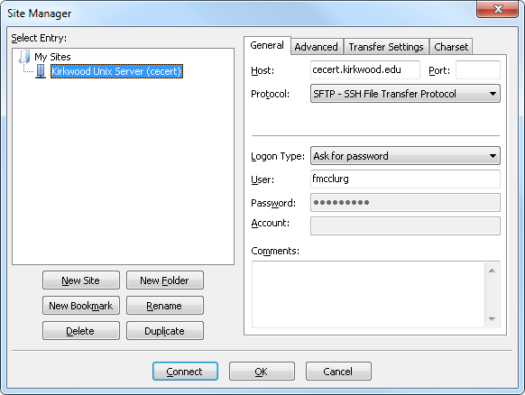
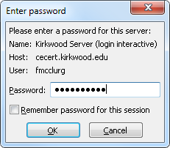
FileZilla Setup
My Sites:
Kirkwood Unix Server (cecert)
Host: cecert.kirkwood.edu
Protocol:
SFTP - SSH File Transfer
Logon Type:
Ask for Password
User: flast
Password:
See Notes
Notes:
8/16/12 09:23:56 AM
© 2007 Microsoft Corporation. All rights reserved. Microsoft, Windows, Windows Vista and other product names are or may be registered trademarks and/or trademarks in the U.S. and/or other countries.
The information herein is for informational purposes only and represents the current view of Microsoft Corporation as of the date of this presentation. Because Microsoft must respond to changing market conditions, it should not be interpreted to be a commitment on the part of Microsoft, and Microsoft cannot guarantee the accuracy of any information provided after the date of this presentation. MICROSOFT MAKES NO WARRANTIES, EXPRESS, IMPLIED OR STATUTORY, AS TO THE INFORMATION IN THIS PRESENTATION.
3

