Slide 1

GIMP
GNU Image Manipulation
Program
Introduction to Web Programming
Kirkwood Continuing Education
© Copyright 2016, Fred McClurg All Rights Reserved
Powerpoint Templates

Slide 2
What is GIMP?
GNU Image Manipulation Program (GIMP)
Open Source Software
Available for many Operating Systems
GNU/Linux (i386, PPC)
Microsoft Windows (XP, Vista)
Mac OS X
Sun OpenSolaris
FreeBSD

Slide 3
GIMP General Capabilities
Digital Retouching
Image Composition
Supports many file formats
Image format conversion

Slide 4
GIMP Specific Features
Painting
Painting Tools (brush, pencil, airbrush, clone, etc.)
Gradient editor and blend tool
Advanced Manipulation
Full alpha channel (transparency) support
Multiple Layers
Multiple Undo/Redo
Transformation tools (rotate, scale, shear and flip)
Selection tools (rectangle, ellipse, free, fuzzy)
Extensible
Over 100 plug-ins already available
Animation
Load and save animations in a convenient frame-as-layer format
File Handling
Many file formats (bmp, gif, jpeg, mng, pcx, pdf, png, ps, psd, svg, tiff, tga, xpm, etc.)
Load, display, convert, save to multiple file formats
SVG path import/export
Much, much more!

Slide 5
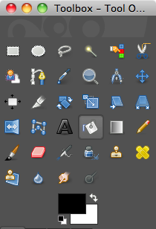
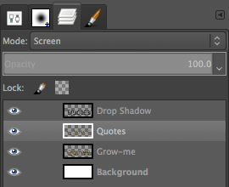
GIMP Snapshots
Layers
Toolbox

Slide 6
Installing GIMP
Download GIMP at the following:
http://www.gimp.org/downloads/

