Slide 1
Linux Operating System
A Practical Guide to Fedora and Red Hat Enterprise Linux
Chapter 5: The Command Line Interface (CLI)
By Fred R. McClurg
© Copyright 2016, All Rights Reserved

Slide 2
Command Line Interface (CLI)
Advantages
More options
Wildcards
Stack multiple commands together
Scriptable
GUI not always available (server, telnet, single user mode)
No clickity-clackity-click!

Slide 3
Special Shell Characters
Some characters have meaning to the shell. Avoid using the following characters in filenames:
& ; | * ? ' "
‘ [ ] ( ) $ < >
{ } # / \ ! ~ space

Slide 4
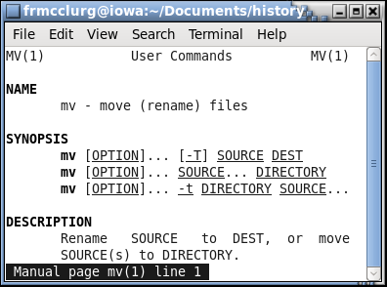
man: Display reference manual
Syntax:
man [-S n] [page ...]

Slide 5
man: Display reference manual
Examples:
Display the first manual page:
man cp
Display the manual page section 5:
man –S 5 crontab
Interactive Paging Commands:
space Next page
/pattern Search for pattern
n Next pattern
b Backward a page
v Start editor at current line
q Exit

Slide 6
man: Display reference manual
Man Page Sections:
Section | Description
1 | General commands
2 | System calls
3 | C library functions
4 | Special files (usually devices, those found in /dev) and drivers
5 | File formats and conventions
6 | Games and screensavers
7 | Miscellanea
8 | System administration commands and daemons

Slide 7
man: Display reference manual
On-Line Man Pages:
Linux and Solaris 10 Man Pages
LinuxManPages.com with user comments
Linux man pages at die.net
Linux/FreeBSD Man Pages with user comments
Man-Wiki: Linux / Solaris / UNIX / BSD
On-line UNIX manual pages
The UNIX and Linux Forums Man Page Repository with multiple OS search (favorite)
Ubuntu Manpage Repository

Slide 8
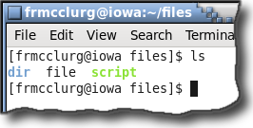
ls: List files and directories
Syntax:
ls [opts] [file1 dir1 ...]

Slide 9
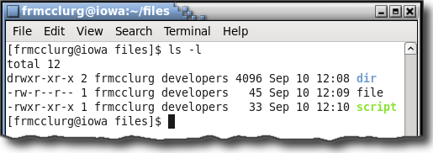
ls -l: Long file listing
Syntax:
ls -l [file1 dir1 ...]

Slide 10
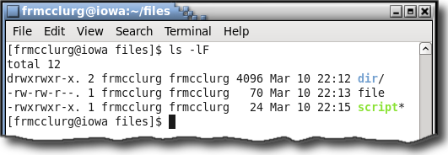
ls -lF: Long listing and file type
Syntax:
ls -lF [file1 dir1 ...]

Slide 11
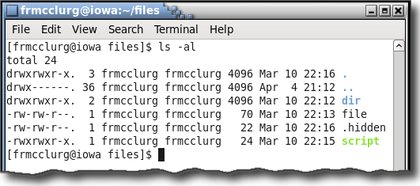
ls -al: Long listing and all hidden files
Syntax:
ls -al [file1 dir1 ...]

Slide 12
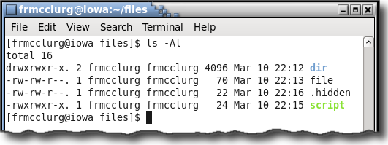
ls -Al: Long listing and most hidden
Syntax:
ls -Al [file1 dir1 ...]

Slide 13
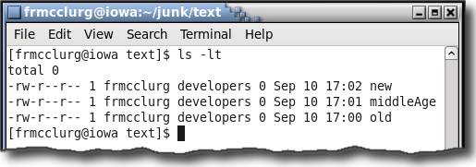
ls -lt: Sort files most recent first
Syntax:
ls -lt [file1 dir1 ...]

Slide 14
ls -R: Recursive file listing
Syntax:
ls -R [file1 dir1 ...]

Slide 15
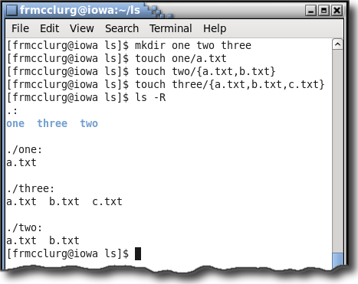
ls -R: Recursive file listing

Slide 16
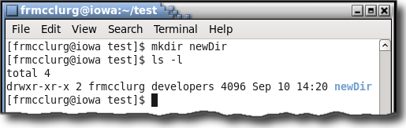
mkdir: Make directories
Syntax:
mkdir [dir1 ...]

Slide 17
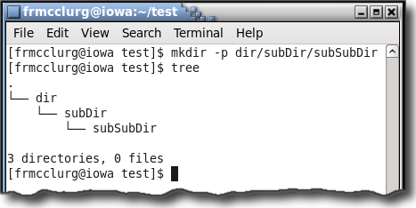
mkdir -p: Make directory hierarchy
Syntax:
mkdir -p [dir1 ...]

Slide 18
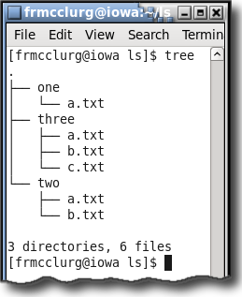
tree: Recursive tree listing
Syntax:
tree \ [dir1 ...]

Slide 19
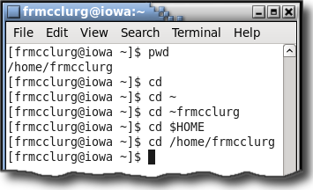
cd: Change Directory
Syntax:
cd [dir1]

Slide 20
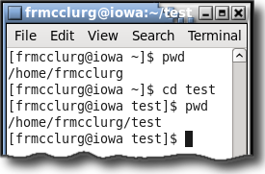
pwd: Present working directory
Syntax:
pwd

Slide 21
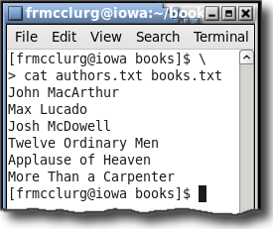
cat: Display text file contents
Syntax:
cat [file ...]

Slide 22
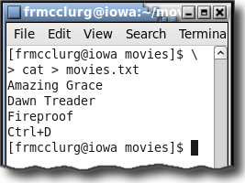
cat: Create a text file
Syntax:
cat > file

Slide 23
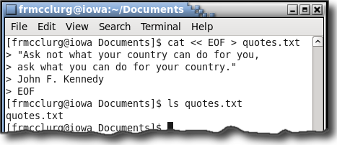
cat: Text via “Here” document
Syntax:
cat << EOF > file

Slide 24
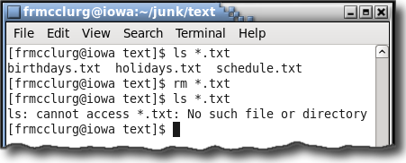
rm: Remove files
Syntax:
rm [options] file [...]

Slide 25
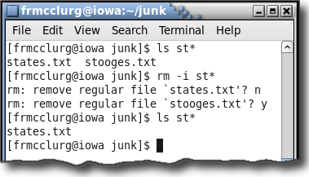
rm -i: Interactively remove files
Syntax:
rm -i [file ...]

Slide 26
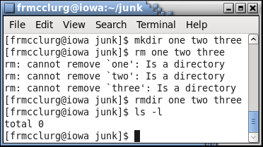
rmdir: Remove directories
Syntax:
rmdir [dir1 ...]

Slide 27
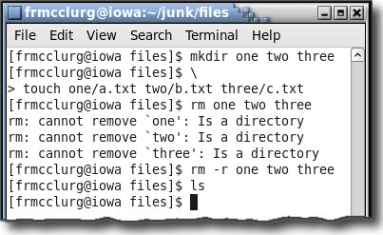
rm -r: Remove directory hierarchy
Syntax:
rm -r [dir1 ...]

Slide 28
rm -ri: Interactive hierarchy removal
Syntax:
rm -ri [dir1 ...]

Slide 29
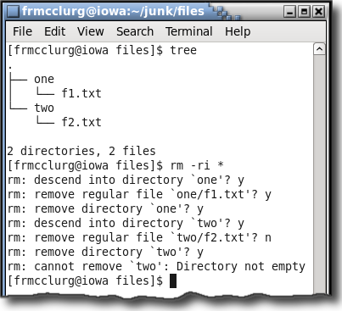

Slide 30
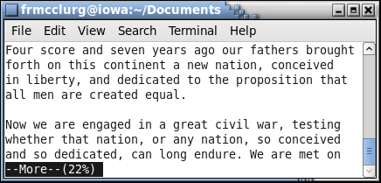
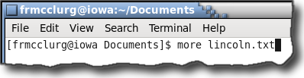
more: Display screen page
Syntax:
more [file ...]

Slide 31
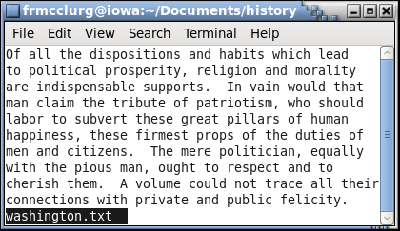
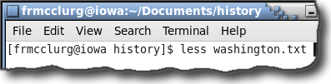
less: Display screen page
Syntax:
less [file ...]

Slide 32
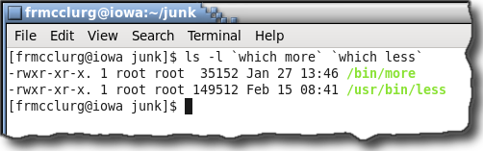

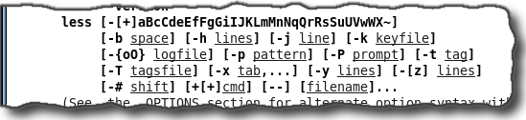
less is more: Display screen page

Slide 33
uname: Display system information
uname [options]
Option | Description | Example
-s | Kernel name | Linux
-n | Network node hostname | iowa
-r | Kernel release | 2.6.35.11-83.fc14.i686
-v | Kernel version | #1 SMP Mon Feb 7 07:04:18 UTC 2011
-m | Machine hardware name | i686
-p | Processor type | i686
-i | Hardware platform | i386
-o | Operating system | GNU/Linux
-a | All previous information | Linux iowa 2.6.35.11-83.fc14.i686 #1 SMP Mon Feb 7 07:04:18 UTC 2011 i686 i686 i386 GNU/Linux

Slide 34
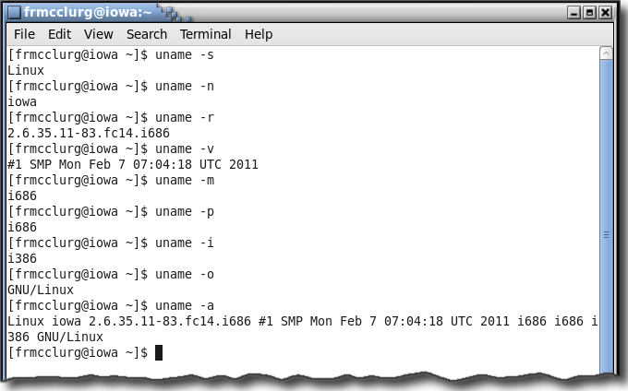
uname: Display system information

Slide 35
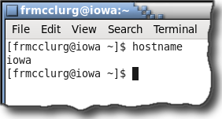
hostname: Display system host name

Slide 36
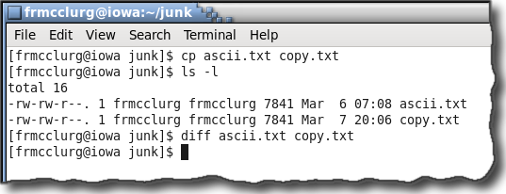
cp: Copy a file
Syntax:
cp sourceFile destinationFile
Caution: The “cp” command will overwrite an existing destination file without warning!

Slide 37
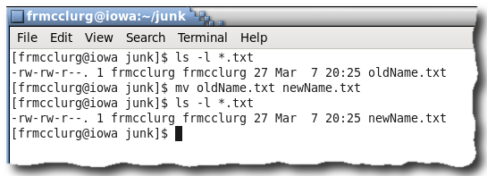
mv: Rename a file
Syntax:
mv sourceFile destinationFile
Caution: The “mv” command will overwrite an existing destination file without warning!

Slide 38
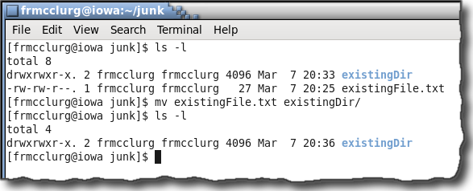
mv: Move a file
Syntax:
mv sourceFile destinationDir
Note: To force the “mv” command to moveinstead of renamea file, specify “/” after the directory.

Slide 39
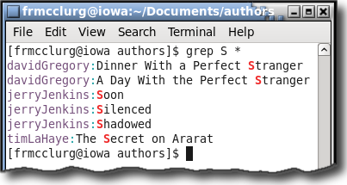
grep: Find matches in a file
Syntax:
grep str file

Slide 40
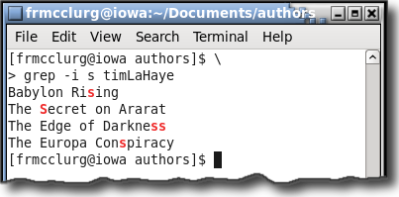
grep -i : Find matches ignore case
Syntax:
grep -i str file

Slide 41
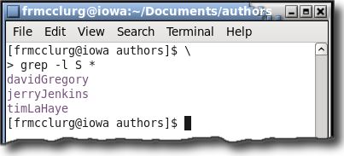
grep -l: Find matches, display file
Syntax:
grep -l str file

Slide 42
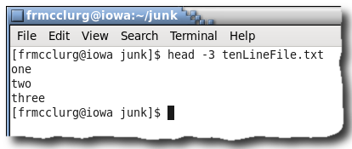
head: Display top of file
Syntax:
head [-n] file

Slide 43
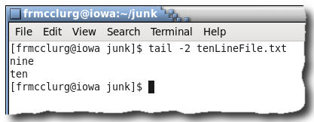
tail: Display bottom of file
Syntax:
tail [-n] file

Slide 44
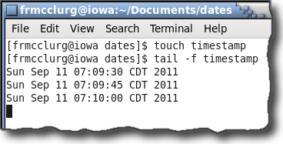
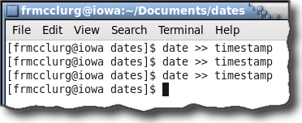
tail: Follow bottom of file
Syntax:
tail [-f] file

Slide 45
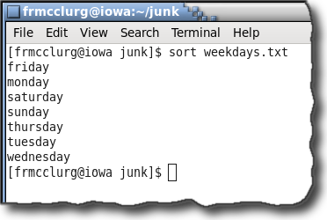
sort: Displays in sorted order
Syntax:
sort [file]

Slide 46
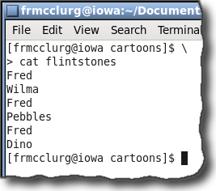
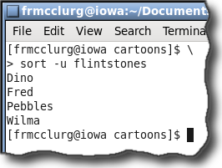
sort: Displays unique sorted lines
Syntax:
sort -u file

Slide 47
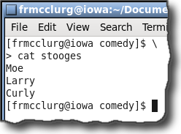
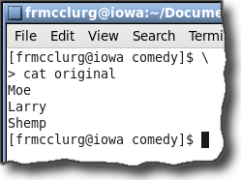
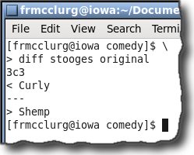
diff: Difference between two files
Syntax:
diff file1 file2

Slide 48
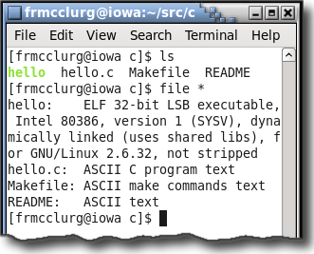
file: Determine file type (content)
Syntax:
file file1 ...

Slide 49
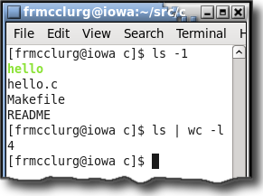
|: Pipe output of one command to input of another command
Syntax:
command | command

Slide 50
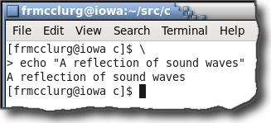
echo: Displays a string to stdout
Syntax:
echo "string"

Slide 51
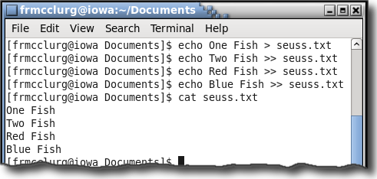
>>: Appending Text
Syntax:
echo string >> file

Slide 52
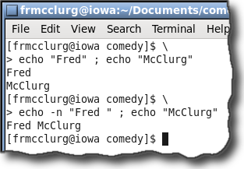
echo -n: Displays text without return
Syntax:
echo -n "string"

Slide 53

date: Displays system date and time
Syntax:
date [options] [+format]

Slide 54

od: Dump files in octal & other formats
Syntax:
od [-c ...] [file ...]

Slide 55

unix2dos: Installation

Slide 56

unix2dos and dos2unix

Slide 57
Compressing files
Compression: Rewrites the file and stores the contents in a more compact format

Slide 58

bzip2: Compress a file
Syntax:
bzip2 [-v options] [file ...]

Slide 59

bzcat: Catenate a decompressed file
Syntax:
bzcat [options] [file.bz2 ...]

Slide 60

bunzip2: Decompress a file
Syntax:
bunzip2 [options] [file.bz2 ...]

Slide 61

gzip: Compress a file
Syntax:
gzip [-v options] [file ...]

Slide 62

zcat: Catentate a compressed file
Syntax:
zcat [options] [file ...]

Slide 63

gunzip: Decompress a file
Syntax:
gunzip [options] [file.gz ...]

Slide 64
Archiving files
Archival: Storing a collection of files inside a single file (similar to a zip file)

Slide 65

tar: Creating an archive file
Syntax:
tar –cvf file.tar dir [dir|file ...]

Slide 66

tar: Table of contents list of archive
Syntax:
tar –tvf tarfile.tar

Slide 67

tar: Extracting an archive file
Syntax:
tar –xvf tarfile.tar

Slide 68

tar: Extracting compressed tar via zcat
Syntax:
zcat tarfile.tar.gz | tar –xvf -

Slide 69

tar: Extracting compressed tar via gunzip
Syntax:
gunzip –c tarfile.tar.gz | tar –xvf -

Slide 70

tar: Extracting compressed tar via tar
Syntax:
tar –xvzf tarfile.tar.gz [*.tgz]

Slide 71

tar: Extracting bz2 compressed tar via tar
Syntax:
tar –xvjf tarfile.tar.bz2 [*.tbz]

Slide 72

who: List users on the system
Syntax:
who

Slide 73

whoami: List username of current user
Syntax:
whoami

Slide 74

who am i: User associated with STDIN
Syntax:
who am i

Slide 75

paste: Join files into columns
Syntax:
paste [file1 ...]

Slide 76

cut: Cut file by columns
Syntax:
cut options [file1 ...]

Slide 77

sudo: Execute command as a user
Syntax:
sudo command

Slide 78


visudo: Edit sudoers File

Slide 79
rpm: Software installation
Red Hat Package Manager
Distinctive:
Downloads files
Uses rpm format
Installs packages

Slide 80
yum: Software installation
Yellow Dog Update Manager
Distinctive:
Downloads files
Uses rpm format
Determines dependencies
Installs packages

Slide 81
yum: Software installation
List the entire repository:
yum list | grep str
Search repository for a specific package:
yum search package
Install a package from the repository:
yum install package
Update a package to the latest version:
yum update package

Slide 82


yum: Software installation

Slide 83
Firefox: Installing from remi repository
sudo rpm -Uvh http://download1.rpmfusion.org/free/fedora/rpmfusion-free-release-stable.noarch.rpm
sudo rpm -Uvh http://download1.rpmfusion.org/nonfree/fedora/rpmfusion-nonfree-release-stable.noarch.rpm
sudo rpm -Uvh http://rpms.famillecollet.com/remi-release-14.rpm
sudo yum --enablerepo=remi install firefox

