Slide 1
puTTY
ssh client
Introduction to Web Programming
Kirkwood Continuing Education
by Fred McClurg
© Copyright 2016, All Rights Reserved
Notes:
8/16/12 09:29:19 AM
© 2007 Microsoft Corporation. All rights reserved. Microsoft, Windows, Windows Vista and other product names are or may be registered trademarks and/or trademarks in the U.S. and/or other countries.
The information herein is for informational purposes only and represents the current view of Microsoft Corporation as of the date of this presentation. Because Microsoft must respond to changing market conditions, it should not be interpreted to be a commitment on the part of Microsoft, and Microsoft cannot guarantee the accuracy of any information provided after the date of this presentation. MICROSOFT MAKES NO WARRANTIES, EXPRESS, IMPLIED OR STATUTORY, AS TO THE INFORMATION IN THIS PRESENTATION.
1

Slide 2
PuTTY
PuTTY is a SSH and telnet client for windows.
Used for securely logging into Unix servers.
No installation script.
Notes:
8/16/12 09:29:19 AM
© 2007 Microsoft Corporation. All rights reserved. Microsoft, Windows, Windows Vista and other product names are or may be registered trademarks and/or trademarks in the U.S. and/or other countries.
The information herein is for informational purposes only and represents the current view of Microsoft Corporation as of the date of this presentation. Because Microsoft must respond to changing market conditions, it should not be interpreted to be a commitment on the part of Microsoft, and Microsoft cannot guarantee the accuracy of any information provided after the date of this presentation. MICROSOFT MAKES NO WARRANTIES, EXPRESS, IMPLIED OR STATUTORY, AS TO THE INFORMATION IN THIS PRESENTATION.
2

Slide 3
PuTTY Installation
Download the putty.exe binary: http://www.putty.org
Create new folder “PuTTY” at the following: C:\Program Files (x86)\PuTTY
Move the downloaded binary into that folder
Notes:
8/16/12 09:29:19 AM
© 2007 Microsoft Corporation. All rights reserved. Microsoft, Windows, Windows Vista and other product names are or may be registered trademarks and/or trademarks in the U.S. and/or other countries.
The information herein is for informational purposes only and represents the current view of Microsoft Corporation as of the date of this presentation. Because Microsoft must respond to changing market conditions, it should not be interpreted to be a commitment on the part of Microsoft, and Microsoft cannot guarantee the accuracy of any information provided after the date of this presentation. MICROSOFT MAKES NO WARRANTIES, EXPRESS, IMPLIED OR STATUTORY, AS TO THE INFORMATION IN THIS PRESENTATION.
3

Slide 4
PuTTY Installation (continued 2)
Click “Start” windows circle icon at lower left
Right click “All Programs”
Select menu “Open All Users”
Create new folder “PuTTY” at the following: C:\ProgramData\Microsoft\Windows\Start Menu\Programs\PuTTY
Notes:
8/16/12 09:29:19 AM
© 2007 Microsoft Corporation. All rights reserved. Microsoft, Windows, Windows Vista and other product names are or may be registered trademarks and/or trademarks in the U.S. and/or other countries.
The information herein is for informational purposes only and represents the current view of Microsoft Corporation as of the date of this presentation. Because Microsoft must respond to changing market conditions, it should not be interpreted to be a commitment on the part of Microsoft, and Microsoft cannot guarantee the accuracy of any information provided after the date of this presentation. MICROSOFT MAKES NO WARRANTIES, EXPRESS, IMPLIED OR STATUTORY, AS TO THE INFORMATION IN THIS PRESENTATION.
4

Slide 5
PuTTY Installation (continued 3)
Right click and “putty.exe” paste shortcut into folder: C:\ProgramData\Microsoft\Windows\Start Menu\Programs\PuTTY
Right click on created shortcut and rename to “putty”.
At this point “putty” can be selected from the menu: Start -> All Programs -> PuTTY -> putty
Notes:
8/16/12 09:29:19 AM
© 2007 Microsoft Corporation. All rights reserved. Microsoft, Windows, Windows Vista and other product names are or may be registered trademarks and/or trademarks in the U.S. and/or other countries.
The information herein is for informational purposes only and represents the current view of Microsoft Corporation as of the date of this presentation. Because Microsoft must respond to changing market conditions, it should not be interpreted to be a commitment on the part of Microsoft, and Microsoft cannot guarantee the accuracy of any information provided after the date of this presentation. MICROSOFT MAKES NO WARRANTIES, EXPRESS, IMPLIED OR STATUTORY, AS TO THE INFORMATION IN THIS PRESENTATION.
5

Slide 6
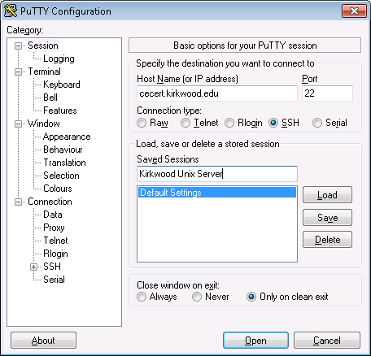
PuTTY Configuration
Host Name:
cecert.kirkwood.edu
Port:
22
Connection Type:
SSH
Saved Sessions:
Kirkwood Unix Server
Press “Save” button
Press “Open” button
Notes:
8/16/12 09:29:19 AM
© 2007 Microsoft Corporation. All rights reserved. Microsoft, Windows, Windows Vista and other product names are or may be registered trademarks and/or trademarks in the U.S. and/or other countries.
The information herein is for informational purposes only and represents the current view of Microsoft Corporation as of the date of this presentation. Because Microsoft must respond to changing market conditions, it should not be interpreted to be a commitment on the part of Microsoft, and Microsoft cannot guarantee the accuracy of any information provided after the date of this presentation. MICROSOFT MAKES NO WARRANTIES, EXPRESS, IMPLIED OR STATUTORY, AS TO THE INFORMATION IN THIS PRESENTATION.
6

Slide 7
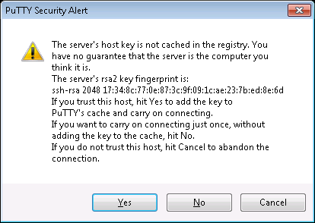
PuTTY Login Server Authentication
Press the “Yes” button
Notes:
8/16/12 09:29:19 AM
© 2007 Microsoft Corporation. All rights reserved. Microsoft, Windows, Windows Vista and other product names are or may be registered trademarks and/or trademarks in the U.S. and/or other countries.
The information herein is for informational purposes only and represents the current view of Microsoft Corporation as of the date of this presentation. Because Microsoft must respond to changing market conditions, it should not be interpreted to be a commitment on the part of Microsoft, and Microsoft cannot guarantee the accuracy of any information provided after the date of this presentation. MICROSOFT MAKES NO WARRANTIES, EXPRESS, IMPLIED OR STATUTORY, AS TO THE INFORMATION IN THIS PRESENTATION.
7

Slide 8
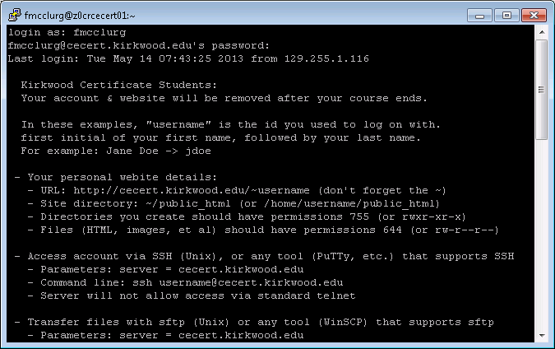
PuTTY Server Login
Enter username at the “login as” prompt.
Enter password at “password” prompt.
Notes:
8/16/12 09:29:19 AM
© 2007 Microsoft Corporation. All rights reserved. Microsoft, Windows, Windows Vista and other product names are or may be registered trademarks and/or trademarks in the U.S. and/or other countries.
The information herein is for informational purposes only and represents the current view of Microsoft Corporation as of the date of this presentation. Because Microsoft must respond to changing market conditions, it should not be interpreted to be a commitment on the part of Microsoft, and Microsoft cannot guarantee the accuracy of any information provided after the date of this presentation. MICROSOFT MAKES NO WARRANTIES, EXPRESS, IMPLIED OR STATUTORY, AS TO THE INFORMATION IN THIS PRESENTATION.
8

