Slide 1
XAMPP
Web Server Software Distribution
Introduction to Web Programming
Kirkwood Community College
Fred McClurg
© Copyright 2016, Fred McClurg, All Rights Reserved
Notes:
8/16/12 09:27:48 AM
© 2007 Microsoft Corporation. All rights reserved. Microsoft, Windows, Windows Vista and other product names are or may be registered trademarks and/or trademarks in the U.S. and/or other countries.
The information herein is for informational purposes only and represents the current view of Microsoft Corporation as of the date of this presentation. Because Microsoft must respond to changing market conditions, it should not be interpreted to be a commitment on the part of Microsoft, and Microsoft cannot guarantee the accuracy of any information provided after the date of this presentation. MICROSOFT MAKES NO WARRANTIES, EXPRESS, IMPLIED OR STATUTORY, AS TO THE INFORMATION IN THIS PRESENTATION.
1

Slide 2
About XAMPP
Xampp is a distribution bundle of the following software:
Apache
MySQL
PHP
Perl (optionally)
There is currently a distribution for Linux, Windows, Mac OSX, and Solaris.
Notes:
8/16/12 09:27:48 AM
© 2007 Microsoft Corporation. All rights reserved. Microsoft, Windows, Windows Vista and other product names are or may be registered trademarks and/or trademarks in the U.S. and/or other countries.
The information herein is for informational purposes only and represents the current view of Microsoft Corporation as of the date of this presentation. Because Microsoft must respond to changing market conditions, it should not be interpreted to be a commitment on the part of Microsoft, and Microsoft cannot guarantee the accuracy of any information provided after the date of this presentation. MICROSOFT MAKES NO WARRANTIES, EXPRESS, IMPLIED OR STATUTORY, AS TO THE INFORMATION IN THIS PRESENTATION.
2

Slide 3
Downloading XAMPP
The download for XAMPP is available at the following location:
https://www.apachefriends.org/download.html
Notes:
8/16/12 09:27:48 AM
© 2007 Microsoft Corporation. All rights reserved. Microsoft, Windows, Windows Vista and other product names are or may be registered trademarks and/or trademarks in the U.S. and/or other countries.
The information herein is for informational purposes only and represents the current view of Microsoft Corporation as of the date of this presentation. Because Microsoft must respond to changing market conditions, it should not be interpreted to be a commitment on the part of Microsoft, and Microsoft cannot guarantee the accuracy of any information provided after the date of this presentation. MICROSOFT MAKES NO WARRANTIES, EXPRESS, IMPLIED OR STATUTORY, AS TO THE INFORMATION IN THIS PRESENTATION.
3

Slide 4
Installing XAMPP
The FAQs for windows is available at the following location:
https://www.apachefriends.org/faq_windows.html
Notes:
8/16/12 09:27:48 AM
© 2007 Microsoft Corporation. All rights reserved. Microsoft, Windows, Windows Vista and other product names are or may be registered trademarks and/or trademarks in the U.S. and/or other countries.
The information herein is for informational purposes only and represents the current view of Microsoft Corporation as of the date of this presentation. Because Microsoft must respond to changing market conditions, it should not be interpreted to be a commitment on the part of Microsoft, and Microsoft cannot guarantee the accuracy of any information provided after the date of this presentation. MICROSOFT MAKES NO WARRANTIES, EXPRESS, IMPLIED OR STATUTORY, AS TO THE INFORMATION IN THIS PRESENTATION.
4

Slide 5
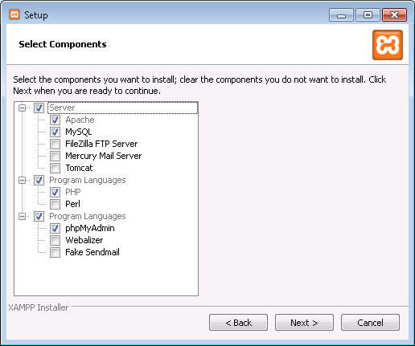
XAMPP Installation Components
Check the checkboxes:
Apache
MySQL
PHP
phpMyAdmin
Perl (optional)
Tomcat (optional)

Slide 6
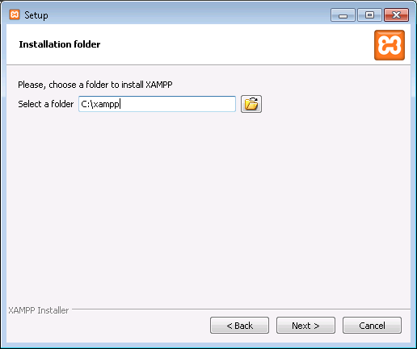
XAMPP Installation Location
Specify installation folder:
C:\xampp

Slide 7
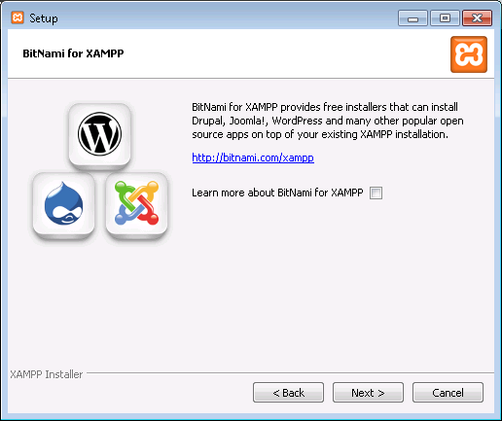
XAMPP Setup
Uncheck “Learn more about BitNami for XAMPP”

Slide 8
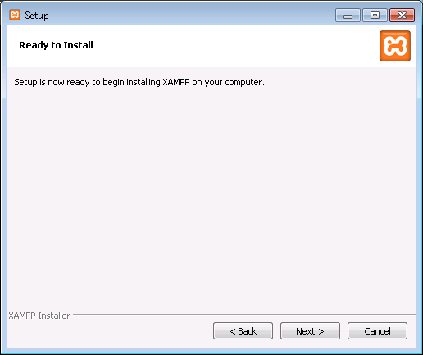
XAMPP Setup
Press “Next” button.

Slide 9
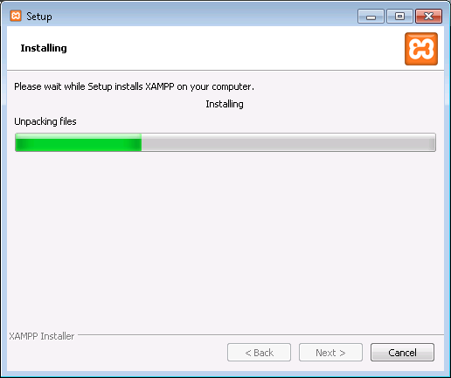
XAMPP Setup
Press “Next” button.

Slide 10
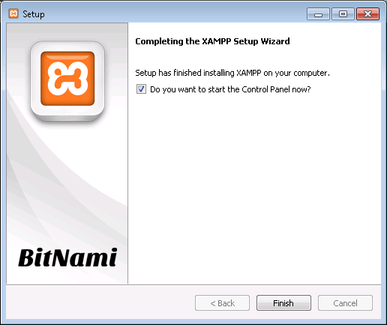
XAMPP Setup
Press “Finish” button.

Slide 11
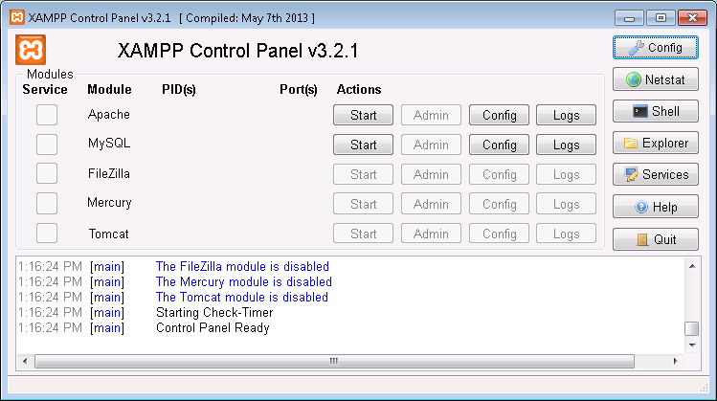
XAMPP Setup
Press “Start” buttons on Control Panel:
Apache
MySQL

Slide 12
XAMPP Setup
The “document root” directory for XAMPP on windows is:
C:\xampp\htdocs The browser URL alias of your local web server:
http://localhost

