Slide 1




How to Integrate Selenium Grid with Docker?

Slide 2

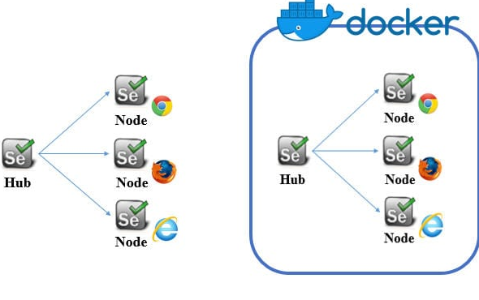
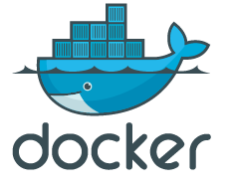
Introduction Selenium Grid with Docker
Selenium grid helps to master hub to disturbed test cases among the slave machine.
A hub is a machine on which best tests are executed, but they run on different nodes. Docker is an also container which is using store libraries and dependencies. So if you want your selenium grid server to be up to running at that time representation will enable you to understand the process quick & easily too.

Slide 3

Prerequisites for Docker Setup in your machine
If your device consists of JDK 1.7 or later version
In configuring Testng.xml file to run test cases as parallel tests would be possible
Selenium web driver and TestNG based test case
Chrome & Firefox browser installed on your system

Slide 4


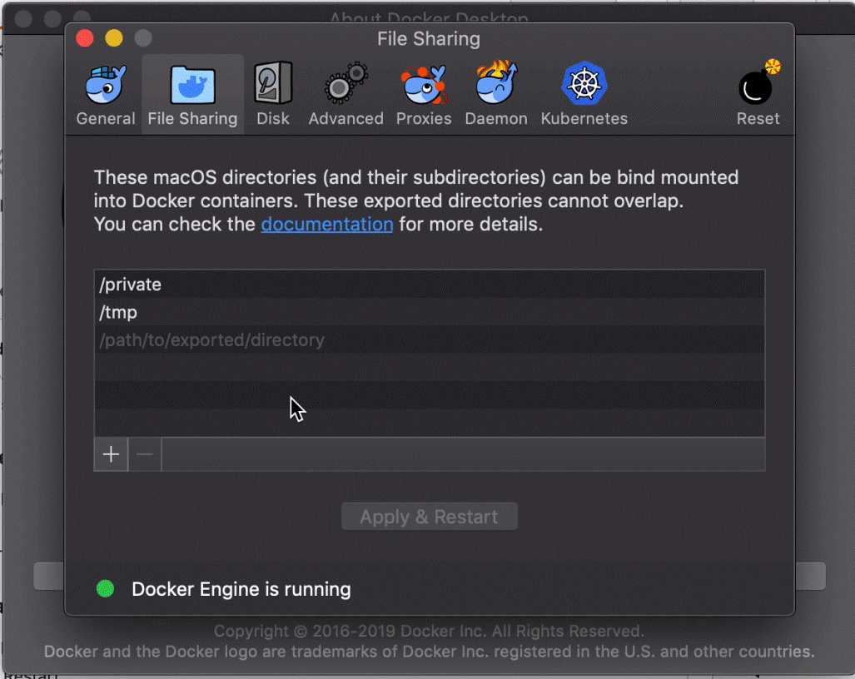

Visit the official website: https://www.docker.com/products/docker-toolbox and download Docker toolbox.
For successful installation, click on all the checkboxes and you will get follow the procedure.
After successful installation, you will notice below icons on your desktop.

Slide 5
Download Docker Images
Download images by search from https://hub.docker.com/ here you will get a list of images so click on them which have maximum numbers of pulls.
Selenium hub image
Selenium node-chrome image
Selenium node-chrome-debug image
Selenium node -Firefox image
Selenium node -Firefox -debug image

Slide 6

When you click on the image, you will see a Docker Command. It is a command to install images to Docker container.
Copy this command and paste into Docker container one by one. You can write next command after the previous image download.
Image | Command
Selenium hub | docker pull selenium/hub
Selenium firefox node | docker pull selenium/node-firefox
Selenium chrome node | docker pull selenium/node-chrome
Selenium firefox debug | docker pull selenium/node-firefox-debug
Selenium chrome debug | docker pull selenium/node-chrome-debug

Slide 7
Start Selenium Hub
First step is to start selenium hub, so write below command in Docker container.
docker run -d -p 4444:4444 –name selenium-hub selenium/hub
Selenium Hub will be opened by this command, now check that it is started or not using below URL:
http://Your.IP.Address /grid/console
Note: Here Replace Your.IP.Address with real your IP Address.

Slide 8


Start Selenium Node
Let's start Chrome node and Firefox node one by one. You can run nodes as you require. Here I have used two nodes only. Run browsers by below commands:
docker run -d –link selenium-hub:hub selenium/node-chrome
docker run -d –link selenium-hub:hub selenium/node-firefox
After that run the Chrome debug node and Firefox debug node by following commands:

Slide 9
docker run -d –P –link selenium-hub:hub selenium/node-chrome-debug
docker run -d –P –link selenium-hub:hub selenium/node-firefox-debug
Now, we have to find the port numbers on which node – Chrome and Firefox is running. We can simply find out by firing below command in the Quickstart terminal.
docker ps -a
Soon, we know the port numbers of chrome and firefox debug nodes that are running so we can start both the browsers working VNC viewer.

Slide 10
Start browsers using VNC viewer
Download VNC viewer from their official site: Download VNC
Once it is download, Run it
You have to then type the HUB URL after the port number of your chrome node
When you click on connect it will ask for a password, default password is “Secret” so add it
Do the same thing for Firefox browser and you can see them in the VNC viewer

Slide 11
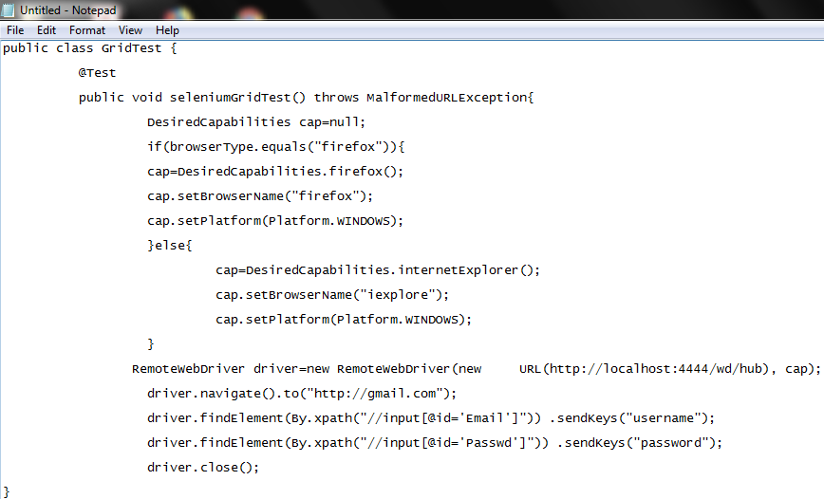
Let’s see a sample test script:
Also, here we have to set parallel flag in a testng.xml file by writing parallel=” tests” tag in suite name. By running this test, we will see that it is executing on both the browsers.

Slide 12

So here we learn how to integrate Selenium with Docker step by step.
When we have a huge number of test cases, you can apply a selenium grid for making test case executions fast.
Using selenium grid, we can test our test cases under different Browser and Different Operating system.
References:
https://datafloq.com/read/how-integrate-selenium-grid-with-docker/6264
https://www.softwaretestinghelp.com/docker-selenium-tutorial/

Slide 13










www.nexsoftsys.com
hs@nexsoftsys.com
Royal Square, 1st Floor,
Off No. 110, Nr. Shilp Tower, Tagore Road,
Rajkot – 360001 Gujarat, India.

