Slide 1
YELLEVATE
DISPUTE ANALYSIS
PROJECT ASSIGNMENT # 1
BATCH 7
GROUP 19
Carlo Velez
Dexter Aterrado
Renato Calma
Francis Domingo
Elve Tobias
Marrielle Magbutong
FEBRUARY 16, 2023

Slide 2



UNSATISFIED CLIENTS
DISPUTE LOST
REVENUE LOST

Slide 3
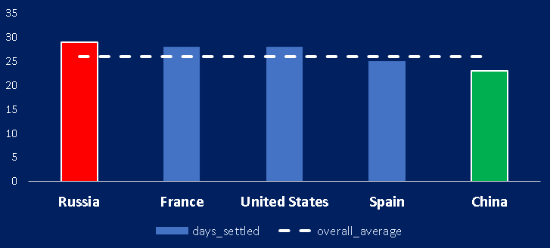
FINDINGS
Average Invoice Processing Time per Country (AIPT)(Days)
CHINA HAD THE SHORTEST AIPT WHICH IS
3 DAYS LESS THAN THE AVERAGE
RUSSIA HAD THE LONGEST AIPT WHICH IS 3 DAYS MORE THAN THE AVERAGE
26

Slide 4
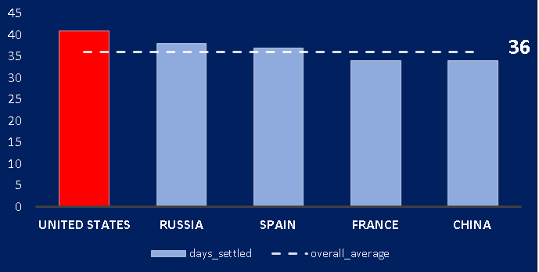
FINDINGS
Average Dispute Settlement per Country ( Days)
UNITED STATES
LEAD THE LONGEST TIME TO SETTLE DISPUTES WHICH IS 4 DAYS MORE THAN THE AVERAGE

Slide 5
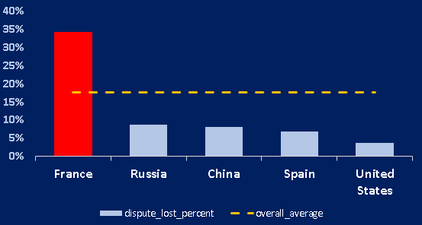
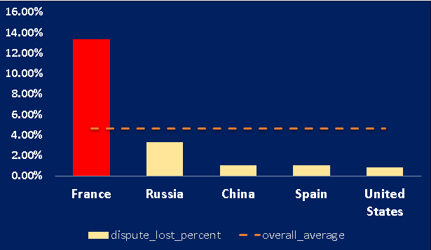
FINDINGS
FRANCE IS DOMINATING IN TERMS OF DISPUTE LOSSES PER COUNTRY
Lost Disputes per Country (Percentage)
Total Losses From Disputes Per Country (%)
18%
5%

Slide 6
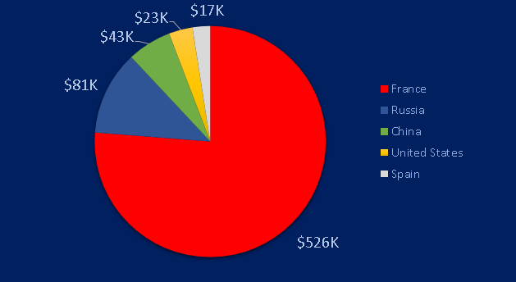
FINDINGS
Total Losses From Disputes Per Country (USD)
$700,000
Approximate
TOTAL LOSS
IN REVENUE
FRANCE IS THE PROPONENT OF THE LOSSES THAT TAKES UP 76% OF THE TOTAL REVENUE

Slide 7
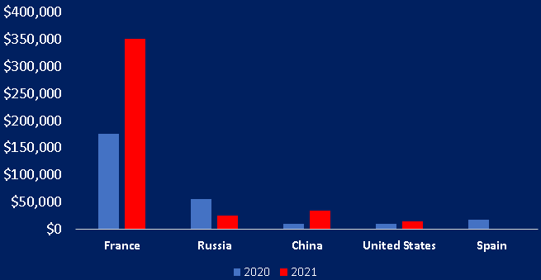
FINDINGS
Yearly Revenue Losses per Country
100%
INCREASE IN REVENUE LOSSES ATTRIBUTED TO FRANCE IN YEAR 2021 COMPARED YEAR 2020

Slide 8
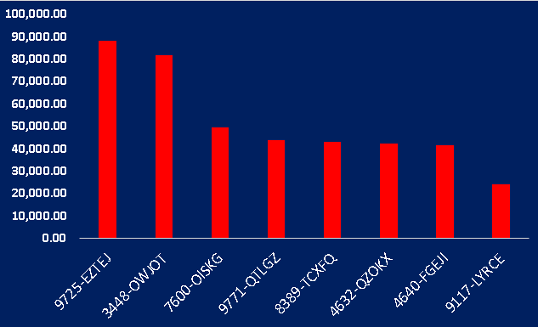
CONCLUSION
8
Customers with Top Revenue Losses
from Disputes in France
FRANCE CUSTOMERS CONTRIBUTE 60% OF THE COMPANY'S LOSSES FROM DISPUTES
TOTAL: 414k LOSSES

Slide 9


RECOMMENDATIONS
INVESTIGATE THE IDENTIFIED 8
CUSTOMERS IN FRANCE THAT CONTRIBUTE TO THE SIGNIFICANT NUMBER OF LOSSES
CONFIRM THE BASES ON WHY THESE CUSTOMERS HAVE DISPUTED
CONFIRM THE REASONS WHY THE COMPANY LOST TO THESE DISPUTES
PROVIDE UPDATED FILE INDICATING DISPUTES DRIVERS FOR FURTHER ANALYSIS

Slide 10
END
THANK YOU

