Slide 1
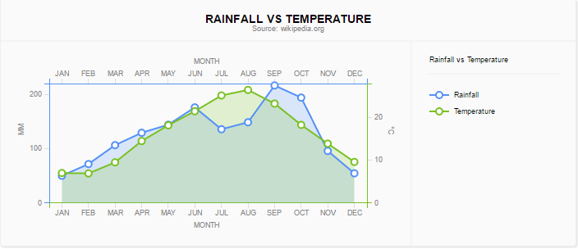
Title
Padding
Plot Area
Legend

