Slide 1

Ice cream Parlor
Because its just that damn good.

Slide 2
THE PROBLEM
We need to create an ice cream dessert!

Slide 3
THE workflow

Slide 4
THE workflow (in json)
{ "StartAt": " CreateDessert ", ”Tasks": { ” CreateDessert ": { ”Task": ”CreateDessert function", "Next": ”AddIceCream" }, "AddIceCream": { " Task": ”AddIceCream function", "Next": "AddToppings" }, "AddToppings": { " Task": ”AddToppings function", "Next": "ServeDessert" }, "ServeDessert": {
" Task": ”ServeCustomer function",
} }

Slide 5
hiring
Order Taker: takes the order and creates an empty dessert order.
Container Artist: selects container(s) from the supply cooler and adds these to the order.
Ice cream Artist: selects ice cream flavors from the cooler and adds these to the order.
Topping Artist: selects toppings from the cooler and adds these to the order.
Server: presents the final dessert to the customer.

Slide 6
Stock the shelves
Container Artist:
Create flat text file listing types of ice cream containers.
One entry per line
Ice Cream Artist:
Create flat text file listing ice cream flavors.
One entry per line
Toppings Artist:
Create flat text file listing types of toppings.
One entry per line
Parlor Host:
Create flat text file listing all students first names.
One entry per line
Parlor Server:
Create the S3 bucket to hold these files.
Finally (ALL): Upload your files to the newly created s3 bucket.
Notes:
Consider talking about:
Ostwald ripening

Slide 7
create the dessert
Clone the GitHub repo at:
Open the project in your favorite IDE.
Compile and package the project.
Create AWS lambda and upload the jar file.
Define environment variables for:
INPUT_FILE
BUCKET_NAME
NUMBER_OF_ITEMS_TO_ADD
Copy and set aside:
Java package name
Java class name
Java method handler name

Slide 8
Putting it together

Slide 9
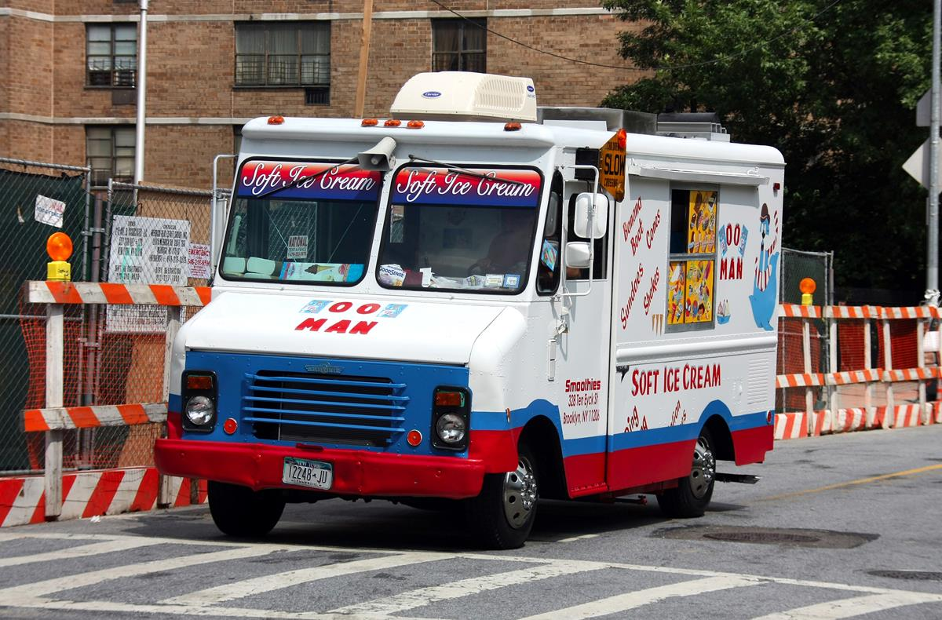
Congratulations
Notes:
Consider talking about:
Specialty job

