Slide 1
Sakai

Slide 2
List of Menu Before Registeration
Welcome
About
Features
Site Browser
Training
Acknowledgement
New Account
Reset Password
Help

Slide 3
About
A set of software tools designed to help instructors, researchers, and students create websites for collaboration.
Common users of Sakai:
A researcher can create a website for collaboration on a project with colleagues.
An instructor can create a website that serves as an online discussion board for students to collaborate on an assignment.
A student can create a site for a study group or for extra curricular activities (depending on institutional policy).

Slide 4
Site Browser
Can search for sites by site name (e.g. ECON 101) or project name.
Can be filtered by type of site (project or any).

Slide 5
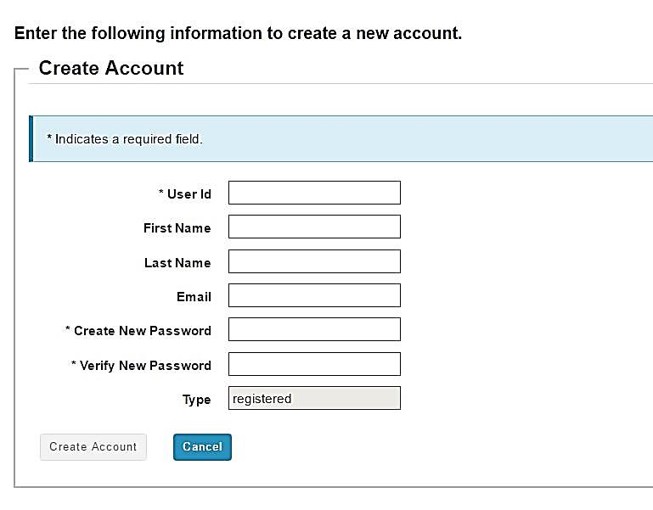
Create New Account

Slide 6
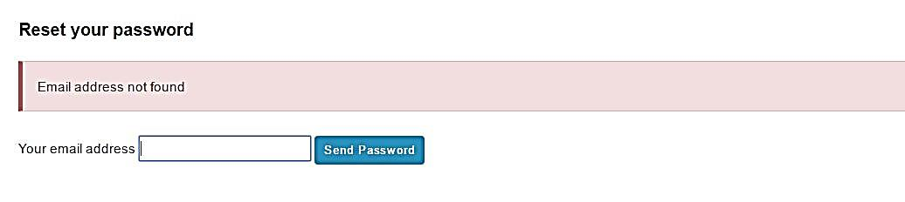
Reset Password
* Real email address can be used to reset password.
If you have not created account yet, error message will be displayed.

