Slide 1
SAKAI

Slide 2
Types of Non-Administrative User
Non-administrative: Account type in the non-administrative sense essentially defines the ability to create worksites; there are three default non-administrative account types:
Registered: This account type can create new sites. An account created with the "New Account widget" is given the "registered" type. Administrative note: The ability to create a site derives from the site.add permission granted in the !user.template.registered realm. Complicating this, however, is the fact that a user account type has associated with it both .auth (authorized) and .anon (anonymous, i.e., not logged in) roles. Strictly speaking, it is the site.add permission in the .auth role of !user.template.registered that grants the permission.
Maintain: The "maintain" account type exists for legacy reasons; its functionality is the same as "registered".Note: Do not confuse the account type "maintain" with the role of "maintain" that may be given to a user in a particular site and/or for a particular tool. Account type and role in a worksite serve different purposes.
Guest: By default, "guest" user types cannot create worksites.

Slide 3
List of Menu after Registration
Overview
Profile
Membership
Calendar
Resources
Announcements
Worksite Setup
Preferences
Account
Wiki
Help

Slide 4
(1)Overview
Overview is also the Home page including 5 categories 1) MESSAGE OF THE DAY 2)CALENDAR 3)HOME INFORMATION DISPLAY 4)RECENT ANNOUNCEMENTS 5)MESSAGE CENTER NOTIFICATIONS 6)COURSE SITE INFORMATION
In (1), displays “MESSAGE OF THE DAY” and can edit message’s display with “OPTIONS” button.
In (2), displays the calendar and includes “OPTION” button to edit the calendar’s display and “PUBLISH(private)” button to publish a link of user’s calendar.
In (3), displays Welcome message.
In (4), displays announcements.
In (5), displays recent activities.
In (6), displays course site information.

Slide 5
(2)Profile
Profile includes 7 categories.
MY PROFILE
PICTURES
CONNECTIONS
MESSAGES
SEARCH
PRIVACY
PREFERENCES

Slide 6
MY PROFILE
Can upload profile picture, can upload and save pictures to the folder “My pictures” and can upload status.
In Profile tab, user’s information such as email, staff info, student info, social networking, personal info can be described.
In Wall tab, displays the previous activities like wall posts, changing profile pictures, uploading pictures, and can give comments to these all.

Slide 7
PICTURES
There are two folders “My pictures” and “Add picture”.
“My pictures” includes the previous uploaded photos.
“Add picture” includes “Choose File” button for uploading new pictures.

Slide 8
CONNECTIONS
Includes two functions “Create worksite” and “Search for connections”.
Create worksite is for creating new worksites.
Search for connections is for searching new connection that is another person by name, e-mail or worksite. This is redirected to the “SEARCH” category.

Slide 9
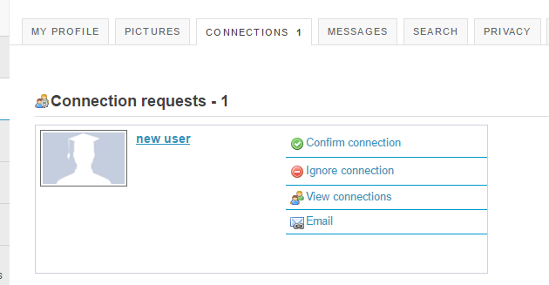
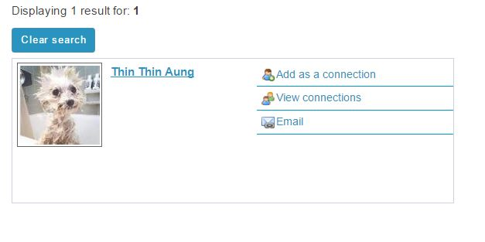
CONNECTIONS

Slide 10
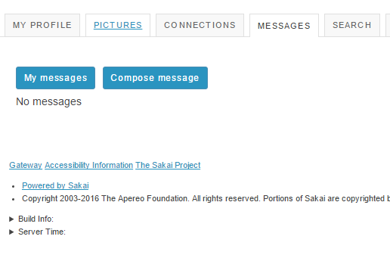
MESSAGES
Includes “My messages” and “Compose message”.
My messages displays as the message inbox.
Compose message is for sending message to other connections.

Slide 11
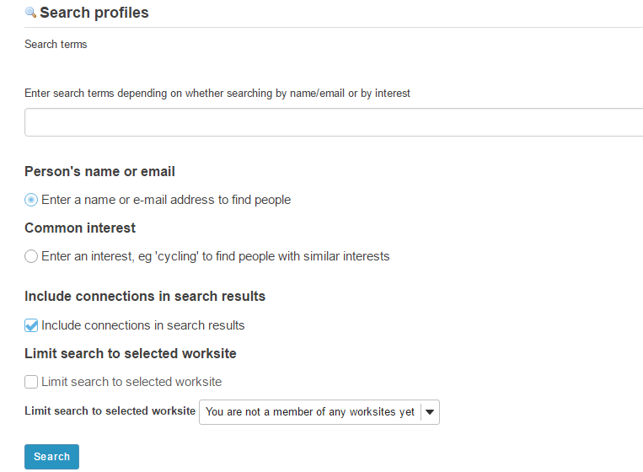
SEARCH
SEARCH is redirected by the “SEARCH CONNECTION” of CONNECTIONS tab.

Slide 12
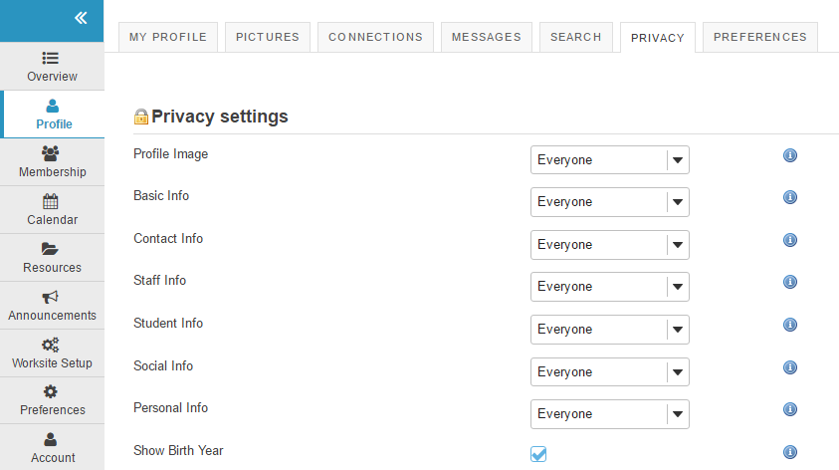
PRIVACY
The privacy of the user profile’s information can be changed.

Slide 13
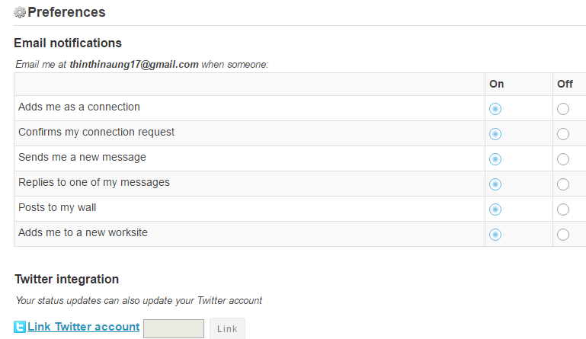
PREFERENES
Controls email notifications setting, profile image setting, and widget setting, and subscribes the twitter account for updating status updates to Twitter.

Slide 14
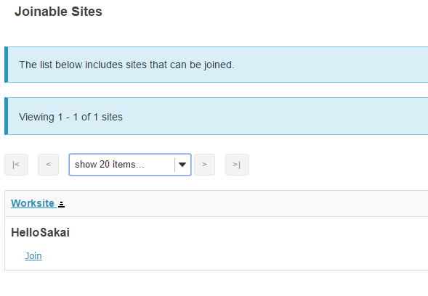
(3)Membership
Includes “My Current Sites” and “Joinable Sites”.
My current sites shows the worksite that the user is in as a member.
Joinable Sites shows the list of sites that can be joined.

Slide 15
(4)Calendar
Shows the calendar and can print the calendar.
Includes 7 tabs
ADD EVENT
IMPORT EVENTS
MERGE INTERNAL CALENDARS
MERGE EXTERNAL CALENDARS
PUBLISH (PUBLIC)
PUBLISH (PRIVATE)
FIELDS

Slide 16
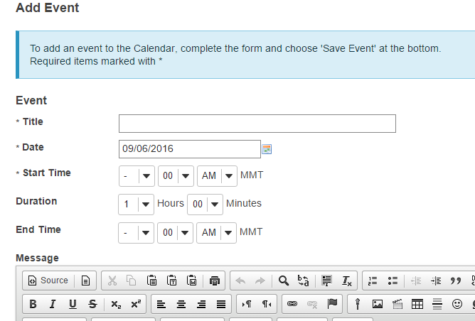
Add Event
Add the new event and can add attachments to event.
Events shows in Calendar.

Slide 17
Import Events
For importing calendar
4 types of calendar can be imported
Microsoft Outlook
Meeting Marker
iCalendar
Generic calendar import (comma-separate values)

Slide 18
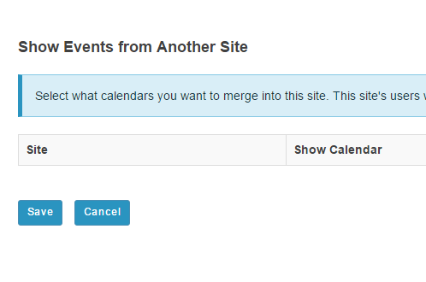
Merge Internal Calendar
Merges calendars of the other sites.
The site’s users need to have permission to see these events in the source site.

Slide 19
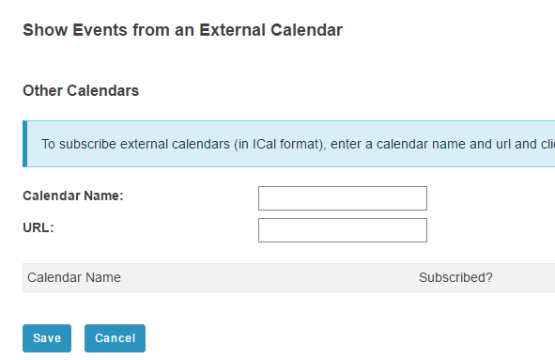
Merge External Calendar
Adds the calendar of the searched URL.

Slide 20
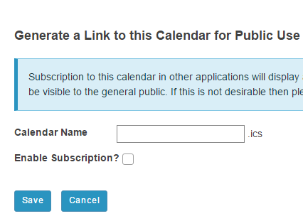
Publish (Public)
Generating a link of the site’s calendar for public use
Authentication is not required and all events will potentially be visible to the general public.

Slide 21
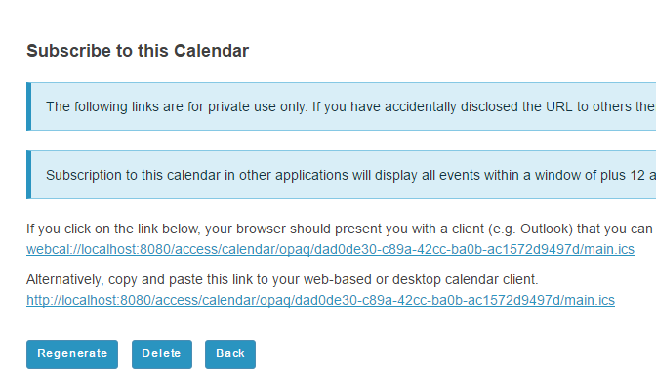
Publish (Private)
Generating a link of the site’s calendar for private use only

Slide 22
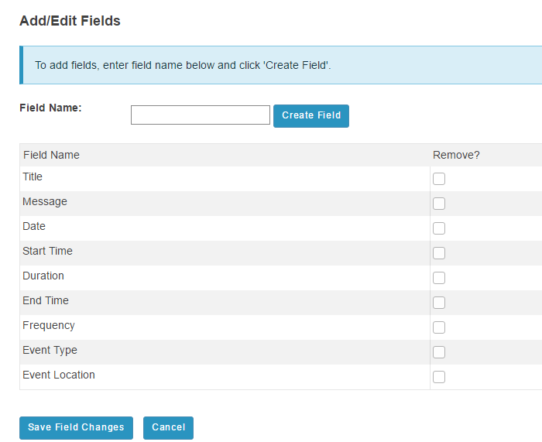
Fields
Add or Edit fields including in creating events in the calendar.

Slide 23
(5)Resources
Includes 5 categories
SITE RESOURCES
TRASH
TRANSFER FILES
OPTIONS
CHECK QUOTA

Slide 24
SITE RESOURCES
Workspace is displayed and actions that can be performed about workspace are Upload File, Create Folders, Add Web Links (URLs), Create Text Document, Create HTML Page, Create Citation List, Copy, Edit Details, Compress to ZIP Archive, Move, Move to Trash, Edit Folder Permissions.

Slide 25
Trash
Trash is where deleted files from the workspace are stored.

Slide 26
Transfer File
The instructions on this page show you how to create a folder on your desktop machine that will allow you to drag and drop files and folders between your computer and this site’s Resources tool.
This involves using a protocol called WebDAV.
If you simply want to upload files to the Resources tool one by one, click “Site Resources” at the top of the page, then click Add>Upload Files to the right of a folder.

Slide 27
OPTIONS
Setting options for resources of user’s worksite.

Slide 28
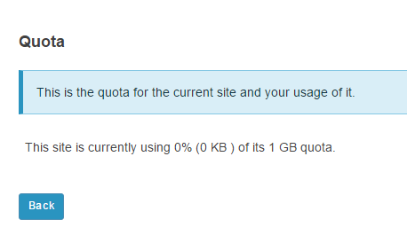
SET QUOTA
This is the quota for the current site and your usage of it.

Slide 29
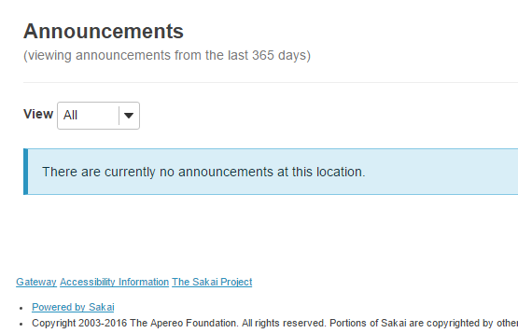
(6)Announcements
Displays the announcements from the last 365 days

Slide 30
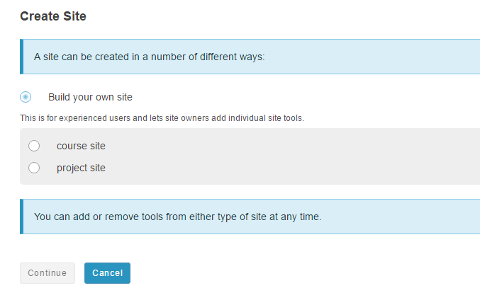
(7) Worksite Setup
This is where worksites are created and edited.
Two types of site are course site and project site.
Course site can only be created with a maintainer role in the course sections.

Slide 31
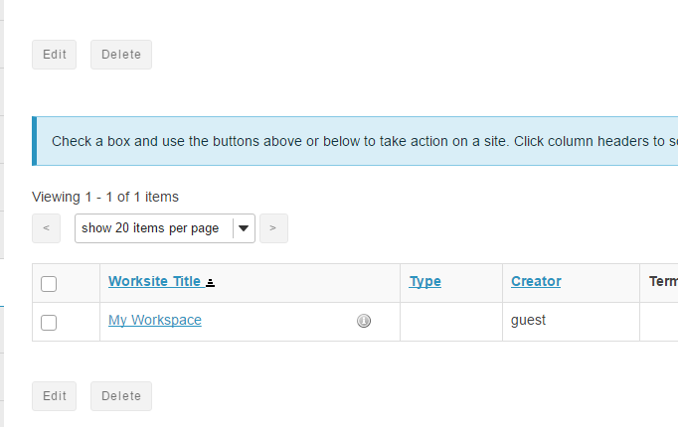
Worksite Setup
This is where worksites are edited and deleted.
Guest Account can’t create worksite.

Slide 32
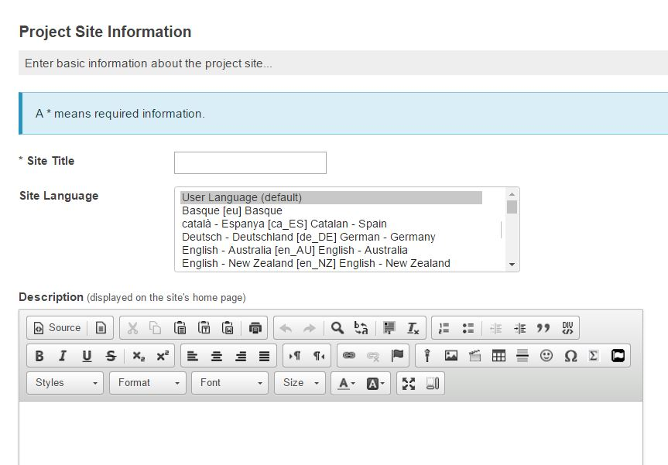
Creating WorkSite
First, enter the information about the created site such as site title, site language, short description, icon URL, site contact’s name and email.

Slide 33
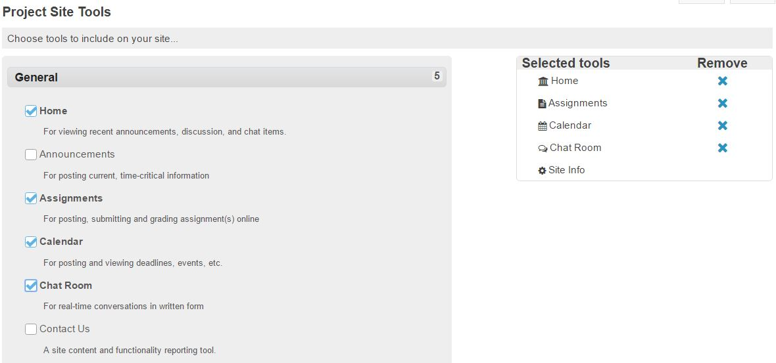
Creating WorkSite
Choose tools to include on the site

Slide 34
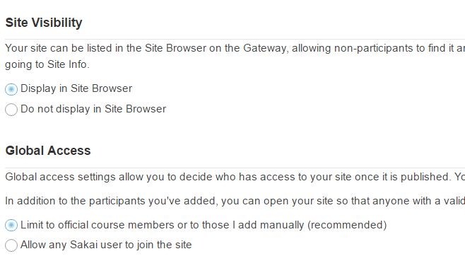
Creating Worksite
Set access options for the site
In Global access, there are two options 1) limit to official course members or to those site owner add manually 2) Allow any Sakai users to join the site

Slide 35

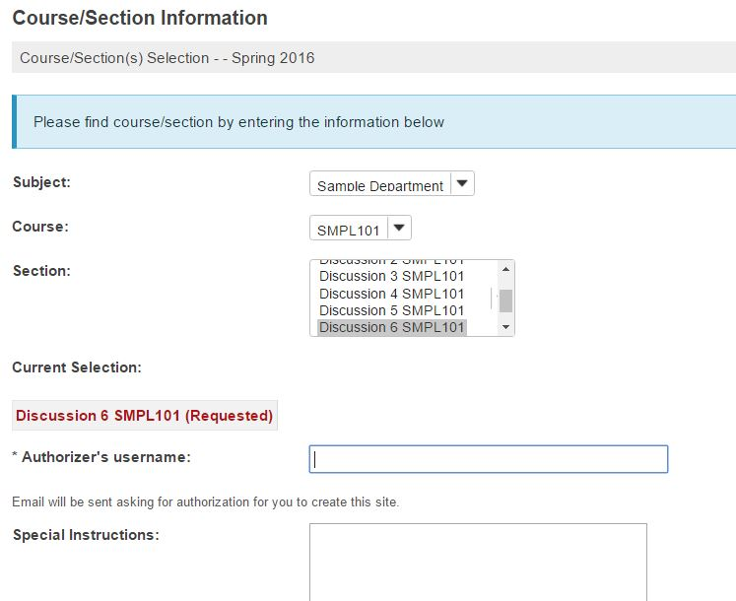
Course Site
There are some differences between course site and project site.

Slide 36
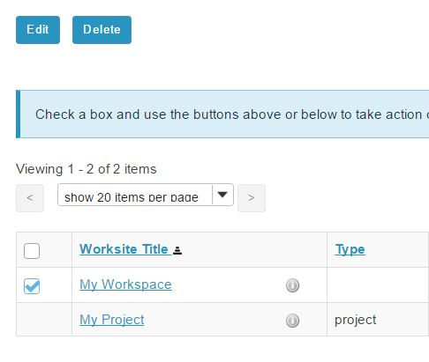
Editing WorkSpace
Can edit user’s workspace.

Slide 37
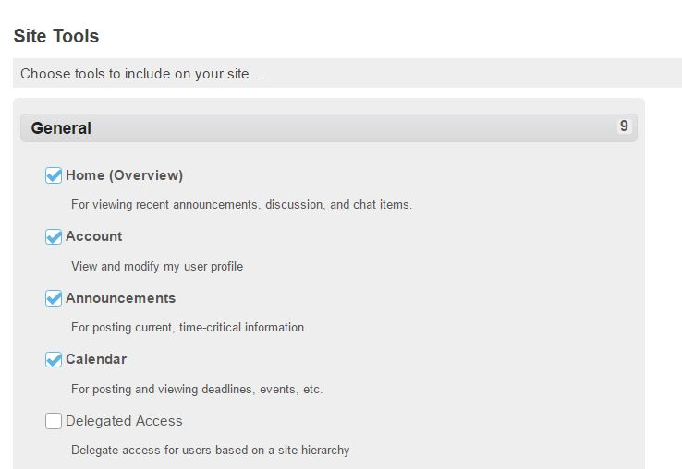
Editing WorkSpace
Can add more tools such as Delegated Access, News, Search, Trusted Applications, Web Content.

Slide 38
(8) Preferences
Includes 4 categories
NOTIFICATIONS
TIME ZONE
LANGUAGE
SITES

Slide 39
Notifications
Change notification setting of the Announcements, Resources and Drop Box, Email Archive, Syllabus, Tests & Quizzes.

Slide 40
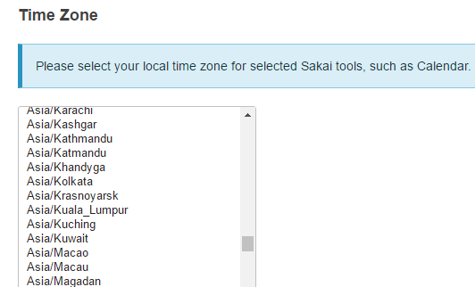
Time Zone
Selects the local time zone

Slide 41
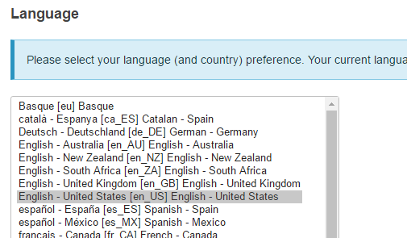
Language
Selects the language(country)

Slide 42
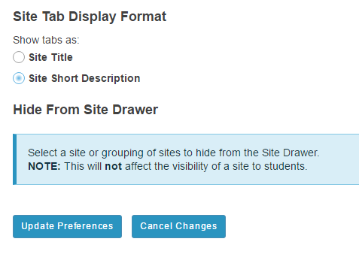
Sites
Select as site or grouping of sites to hide from the Site Drawer. This will not affect the visibility of a site to students.

Slide 43
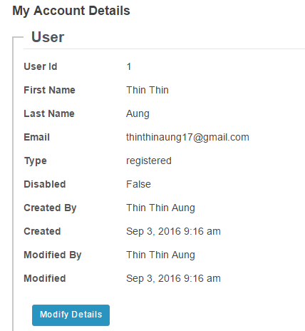
(9) Account
Shows detail information about the logged in account and can edit the account’s information.

Slide 44
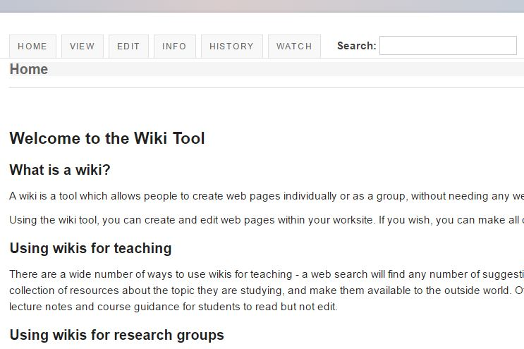
(10) Wiki
A wiki is a tool which allows people to create web pages individually or as a group, without needing any web skills.

Slide 45
(11) Help
Displays About Sakai Help in new window

Slide 46
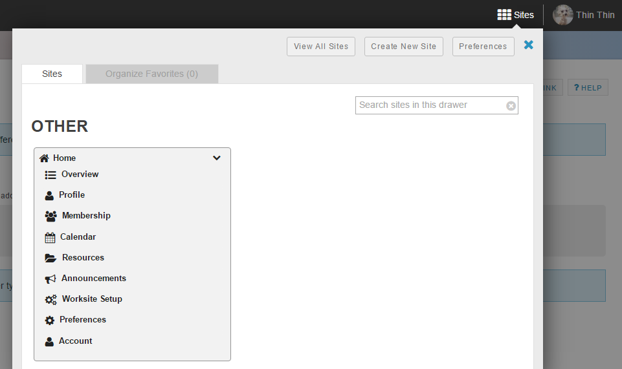
Sites on home menu bar
Create, view and search sites.

Slide 47
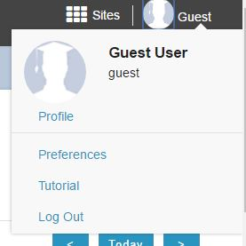
Profile on home menu bar

