Slide 1
Work Site

Slide 2
User Access
Site owner and Admin can have access to edit , add, delete worksite.
Other joined users can only view the worksite, and take the test.

Slide 3
List of Menu
Lessons
Resources
Forums
Assignments
Tests & Quizzes
Drop Box
Grade Book
Podcasts
Polls
SCORM Player

Slide 4
Getting Started with Lesson
Put your content on this page by using the "Add Content" pulldown menu. The most common options are
Add Text - type text into a rich-text editor
Add Content Link - upload a document or add a URL for a web site. This results in a link.
Embed Content on Page - add an item that will show on the page, e.g. a Flash presentation or video.
Add Content Link and Embed Content on Page can both be used to upload a file or link to an external web page. The difference is that Add Content Link will result in a link to the item, while Embed Content on Page will put the item itself on the page. In the case of video, Embed Content will use an appropriate video player.
Once you've added content, you'll find Edit buttons next to each item where you can adjust the size of multimedia objects, change titles, add descriptive text, etc. You can also use Edit to release activities and information sequentially.

Slide 5
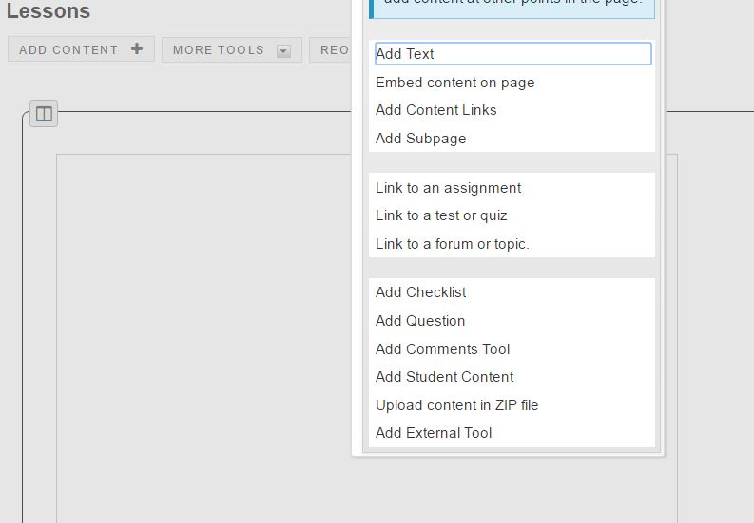
(1) Lessons
In lessons, user can add content as follows.

Slide 6
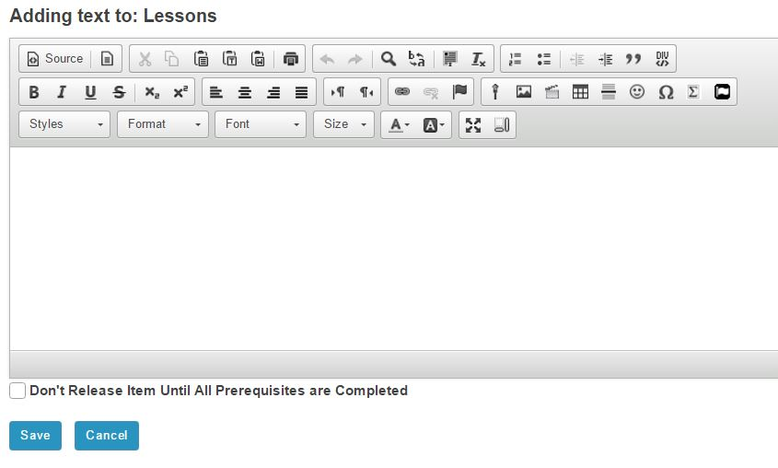
Adding Text to Lessons
User can add video(mp4 recommended and swf), picture and other attached contents.

Slide 7
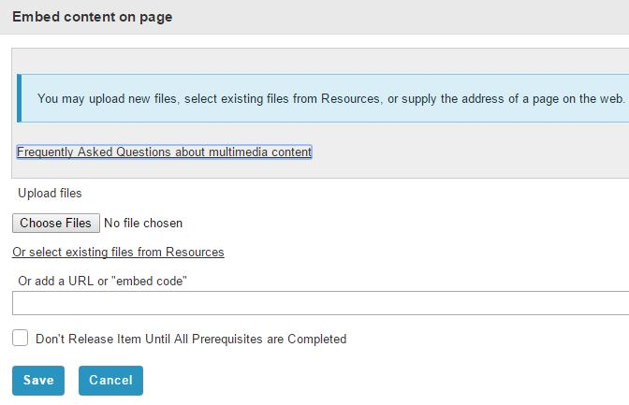
Adding Embed Content to Lessons
User can add multimedia content by adding URL or embed code, or select existing files from resources.

Slide 8
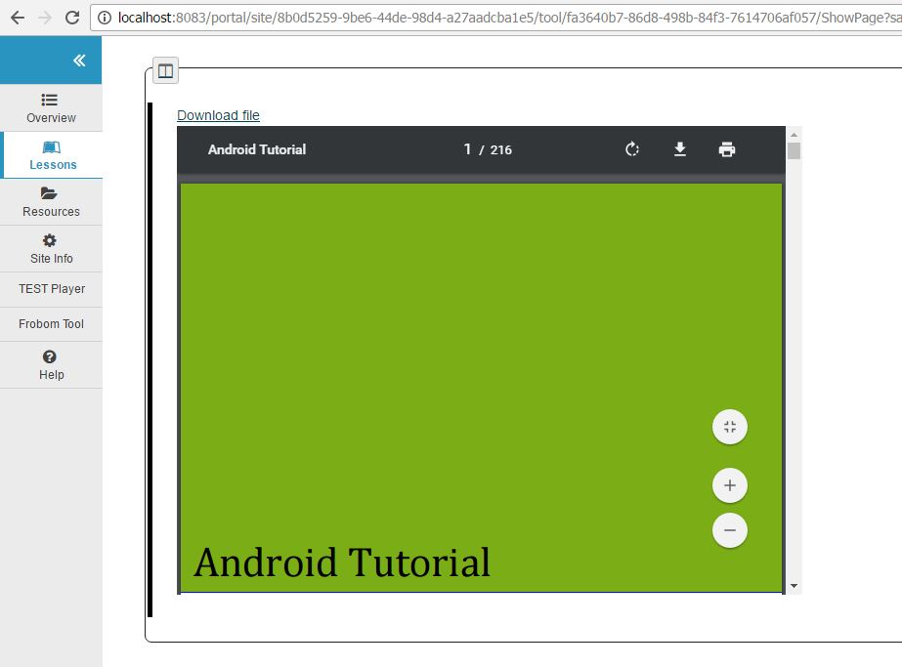
Uploading PDF

Slide 9
Uploading PPT
To upload PowerPoint as embedded content, we converted PowerPoint file to PDF file.

Slide 10
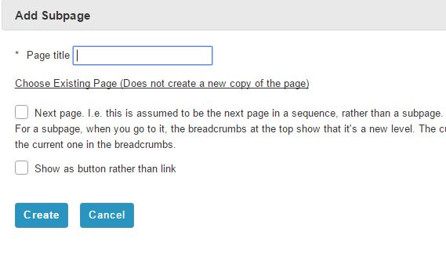
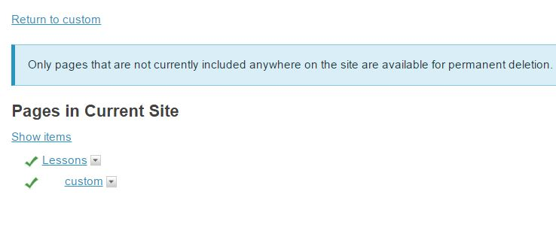
Adding Subpages to Lessons

Slide 11
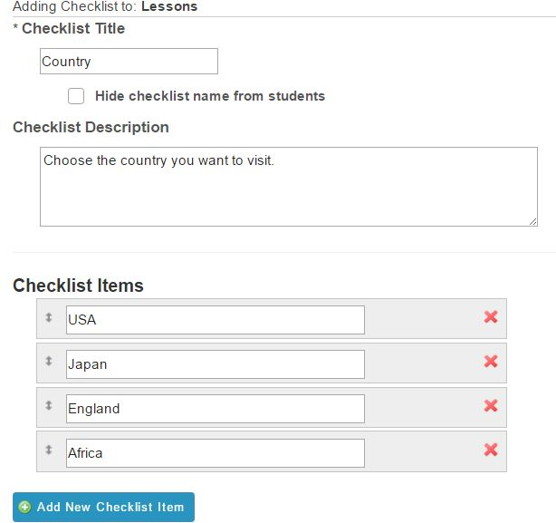
Adding Checklist to Lessons
User create checklist question and can view the checklist progress when other users take the question.

Slide 12
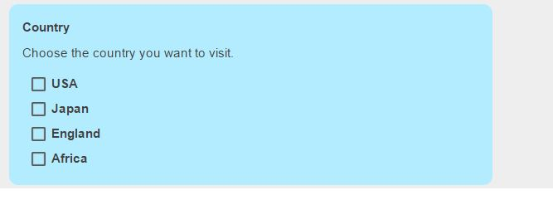
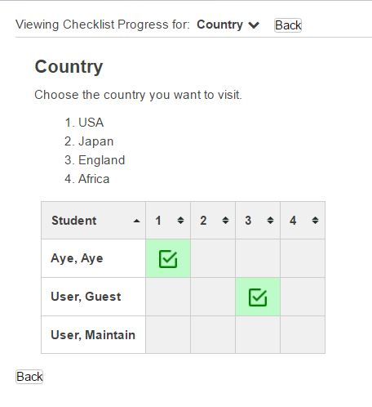
Adding Checklist to Lessons

Slide 13
Adding Questions to Lesson
Two types of Questions: Multiple Choice, and Short Answer.
For multiple choice, site owner can define the correct answer.
For short answer, site owner can define the possible answer.

Slide 14
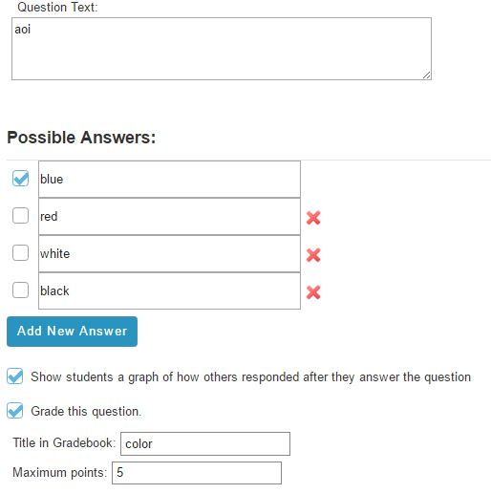
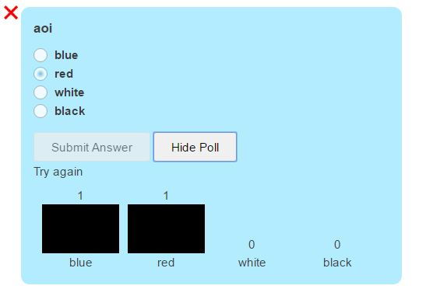
Adding Questions to Lesson
Multiple Choice Question

Slide 15
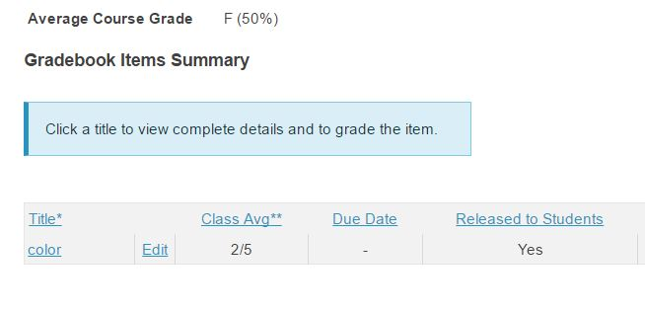
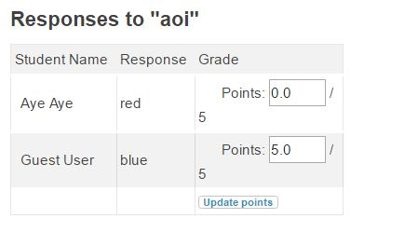
Adding Questions to Lesson
Result of Questions is displayed by Grade

Slide 16
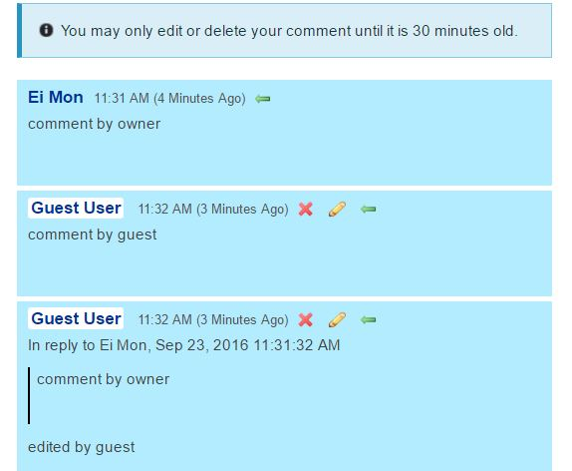
Adding Comment Tool to Lesson
Site owner adds the comment tool and write the comment, guest can reply to site owner’s comment, and site owner can edit, or delete guest’s comment.

Slide 17
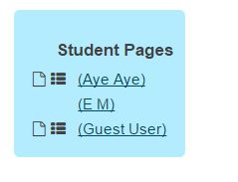
Adding Student Content to Lesson
In student content, each user can create own page.

Slide 18
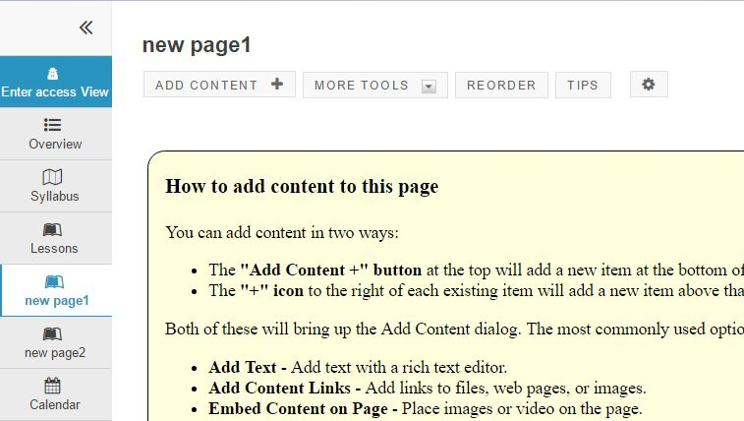
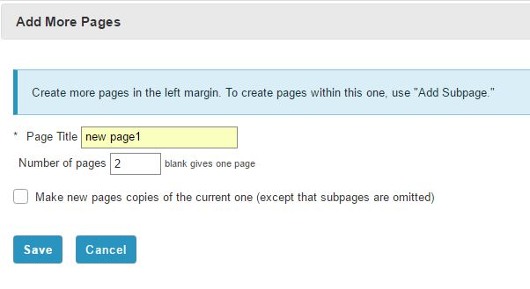
Adding more pages to Lesson
Can create new more lesson pages.

Slide 19
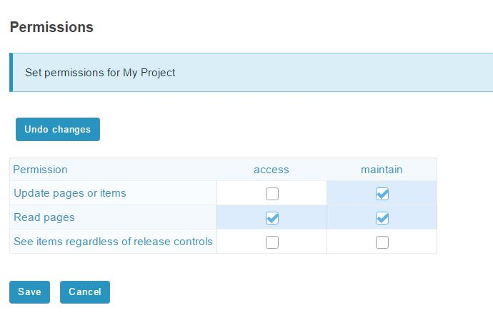
Permission for Project
Set the permission for the project according to the role(access,maintain).

Slide 20
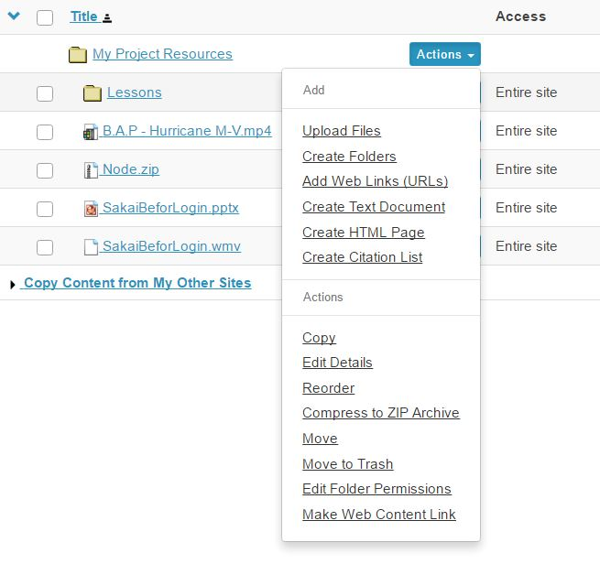
(2) Resources
Resources is where user can upload various files.
Files available to upload are as follows.

Slide 21
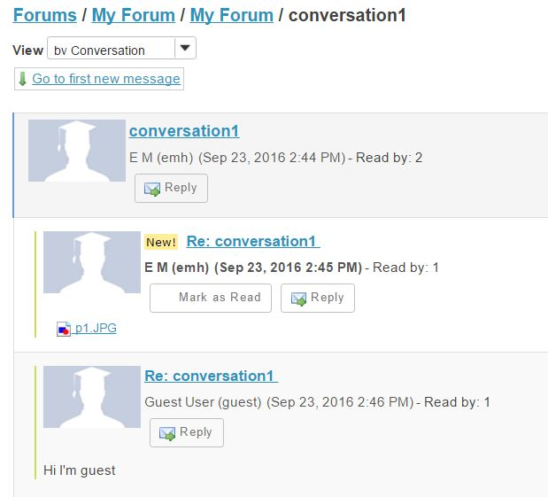
(3) Forums
Forum is where users can exchange ideas and views by creating conversations.

Slide 22
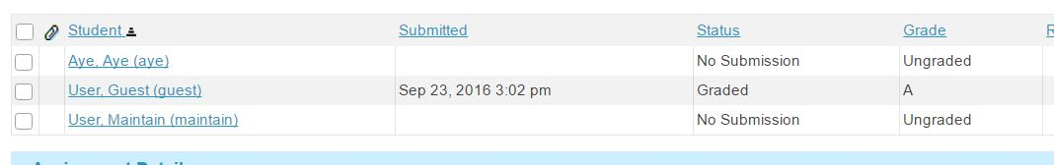
(4) Assignments
Teacher creates the assignment and it will be released on open date.
When creates the assignment, teacher can define the grade scale.
Teacher can monitor the progress of student submit the assignment or not, and can give the grade to the submitted assignment.

Slide 23
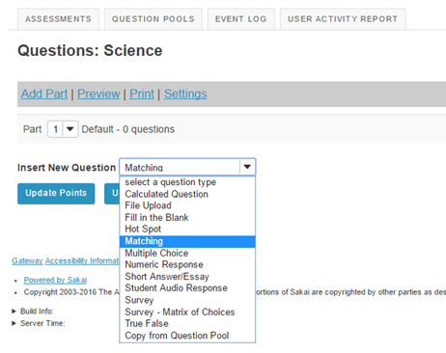
(5) Tests and Quizzes

Slide 24
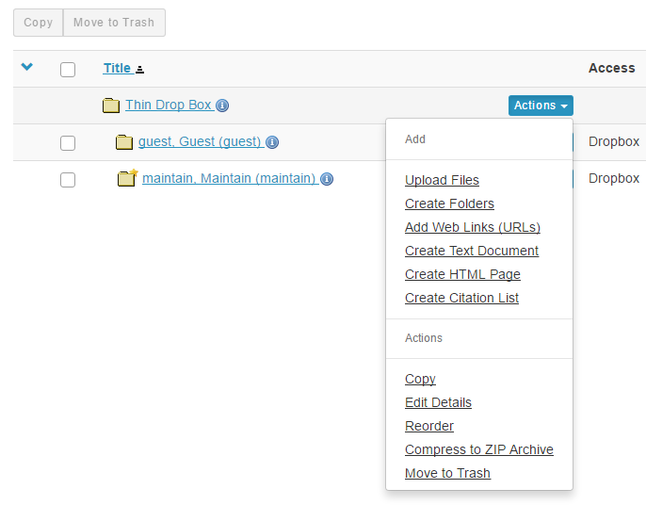
(6) Dropbox
Files in your Drop Box can only be seen by site owner and the site maintainers, other participants cannot access them.
Files which can be uploaded in Drop Box are as follows:

Slide 25
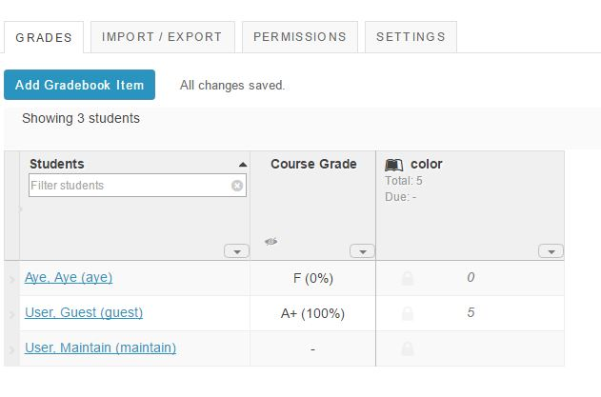
(7) Gradebook
Gradebook is where test’s result is displayed in grade.

Slide 26
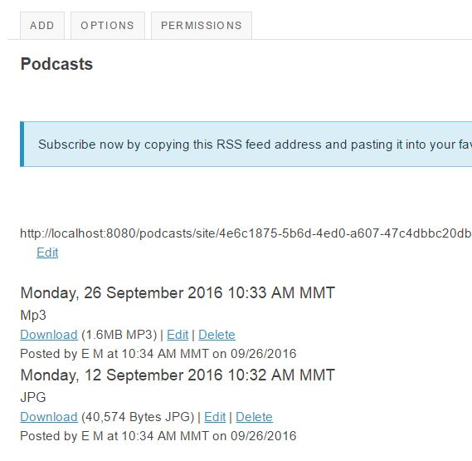
(8) Podcasts
Site owner can upload podcasts(digital media files) and can be downloaded by other users.

Slide 27
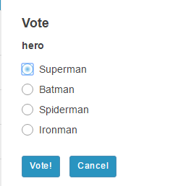
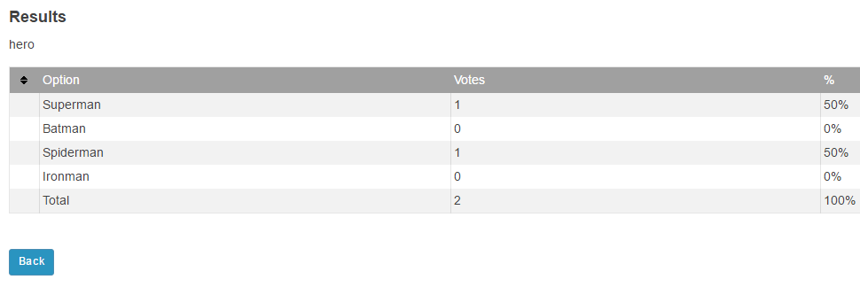
(9) Polls
Site owner can create a poll to be voted by joined users.

Slide 28
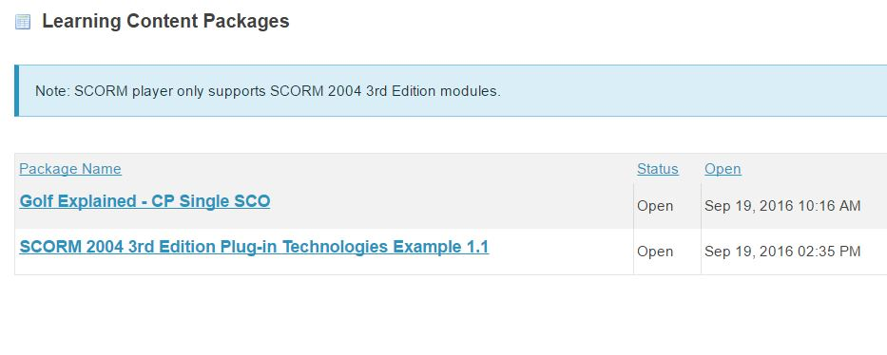
(10) SCORM Player
SCORM, short for "Sharable Content Object Reference Model", is a set of technical standards for e-learning software products.
SCORM player is for uploading SCORM content packages.

Slide 29
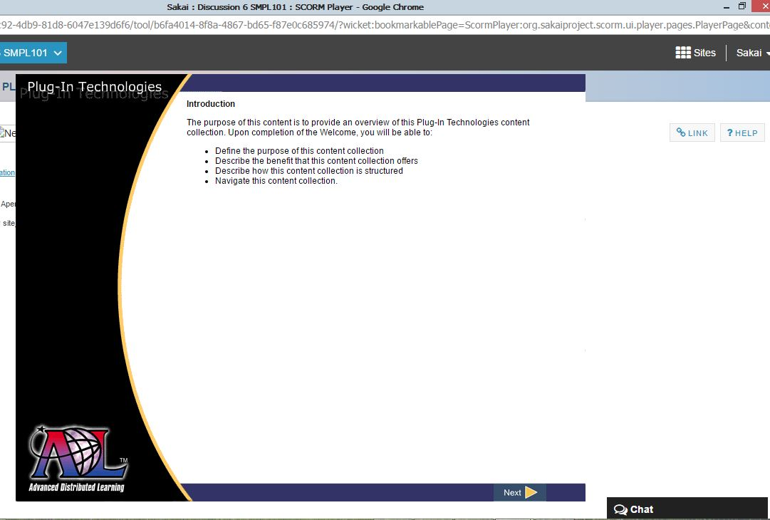
Uploading SCORM package
When uploading scorm package(.zip file) , video within uploaded zip file is displayed.

