Slide 1
Android bug stars and resolution time
MSR 2012 Challenge

Slide 2
Android bug stars and resolution time
Introduction
Android BTS:
"If you find your issue and it's important to you, star it! That's how we know which bugs are most important to fix"
Source:
http://source.android.com/source/report-bugs.html

Slide 3
Android bug stars and resolution time
Introduction
Android OS Project BTS:
Users may subscribe to bugs
The system scores a star to a bug each time a user subscribes to that particular bug

Slide 4
Android bug stars and resolution time
Introduction
Then:
1. Are the most starred bugs solved faster?
2. Do developers assign more priority to the bugs that have more stars?

Slide 5
Android bug stars and resolution time
Methodology
Data gathering
  Raw data from 9th MSR
  Java application to filter the XML with the BTS data
    Got only closed bugs
    Extracts stars, priority and resolution time
    Time resolution in seconds
    Output format: text file, 1 bug per row, info in columns

Slide 6
Android bug stars and resolution time
Methodology
Statistical analysis
  GNU R
  Validate two hypotheses
    (1) Time to solve a bug depends on its number of subscribers
    (2) Priority assigned by the developers to a bug depends on its number of subscribers

Slide 7
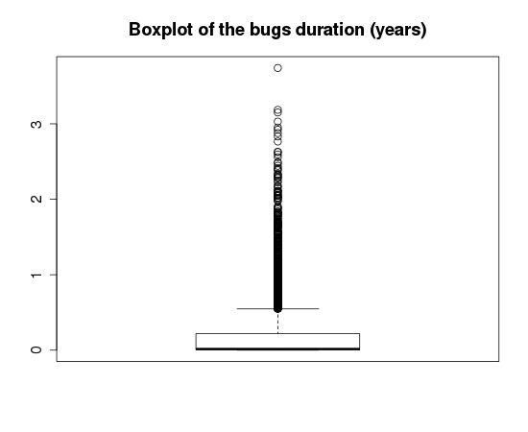
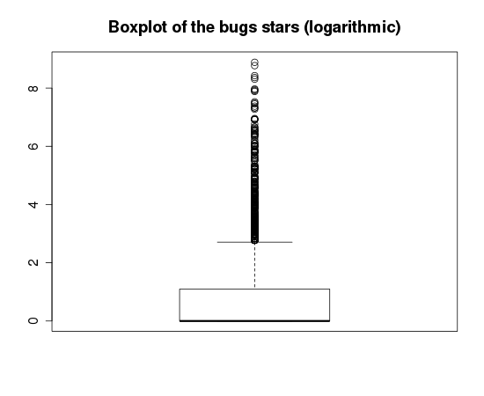
Android bug stars and resolution time
Hypothesis validation (1)
Boxplot of the time to close bugs and the number of bug stars

Slide 8
Android bug stars and resolution time
Hypothesis validation (1)
Variables parameters
Stars
Min. 1st Qu. Median Mean 3rd Qu. Max.
0.00 1.00 1.00 16.39 3.00 7234.00
Standard deviation: 184.491556881241
Duration (years)
Min. 1st Qu. Median Mean 3rd Qu. Max.
0.000001 0.001417 0.016362 0.198503 0.219907 3.741755
Standard deviation: 11811207.4952566
Type
Defect Enhancement
5494 850
Min. 1st Qu. Median Mean 3rd Qu. Max.
1.000 1.000 1.000 1.134 1.000 2.000
Standard deviation: 0.340662906572986
Priority
Blocker Critical High Medium Small
1 10 25 6283 25
Min. 1st Qu. Median Mean 3rd Qu. Max.
1.000 4.000 4.000 3.996 4.000 5.000
Standard deviation: 0.124878382661632
As can be seen, most of the stars are under a value of 3.
Most of the bugs are solved very early.
The bugs priority is a constant with a value of 4.

Slide 9
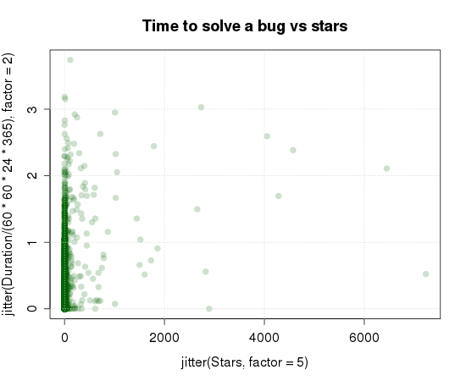
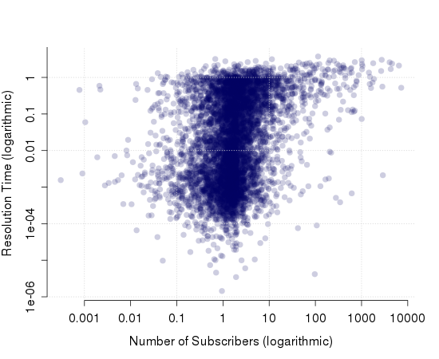
Android bug stars and resolution time
Hypothesis validation (1)
Relation between resolution time and number of subscribers
Don't seem to have any relation
Here we don't have enough resolution, so we decided to use logarithmic axis

Slide 10
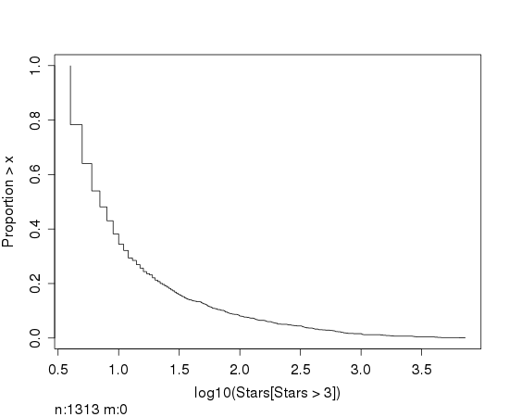
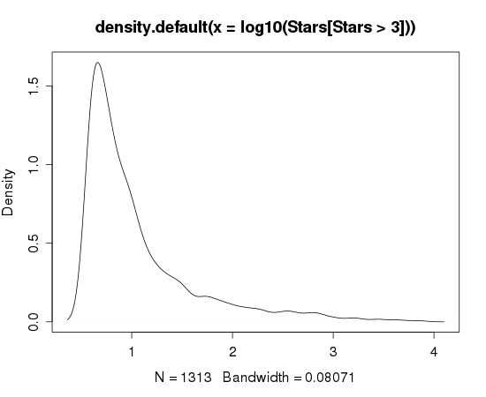
Android bug stars and resolution time
Hypothesis validation (1)
Left figure shows the density function of the logarithm of the number of bug stars, filtering the stars with a value under 3.
Right figures shows the inverse of the cumulative distribution function of the resolution time

Slide 11
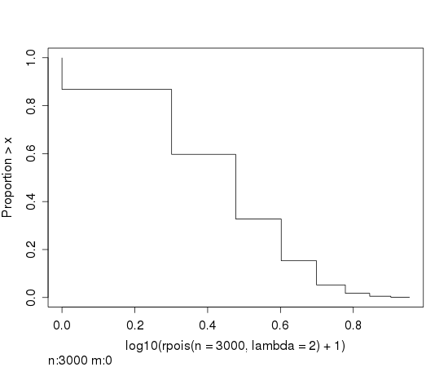
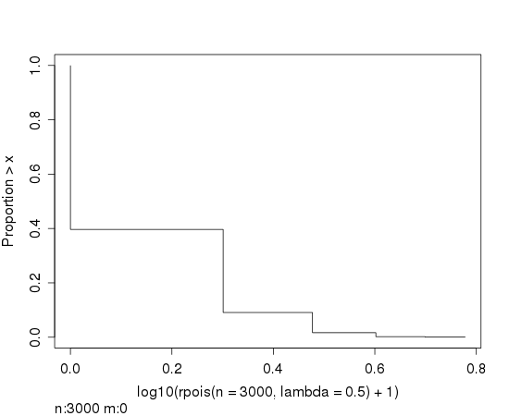
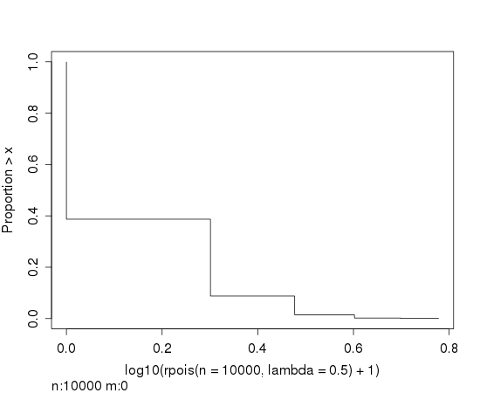
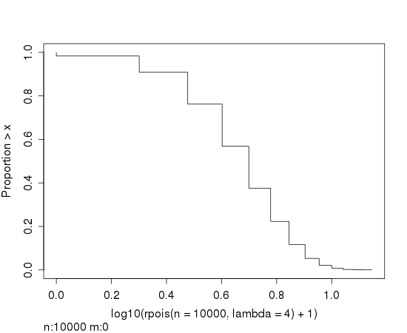
Android bug stars and resolution time
Hypothesis validation (1)
None of the tested distributions fixes with the resolution time variable.

Slide 12
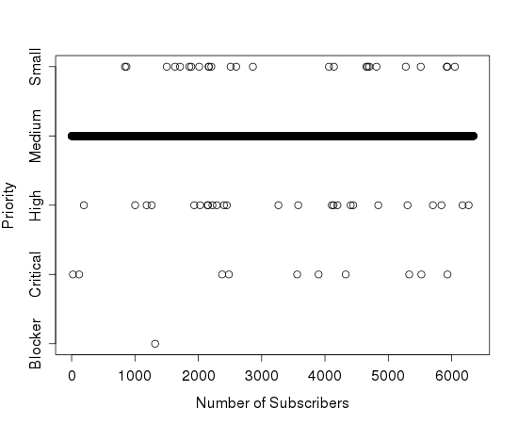
Android bug stars and resolution time
Hypothesis validation (2)
Relation between the bugs priority and its number of subscribers
Can be easily seen that the priority is a constant of value "Medium", so there is no relation between both variables

Slide 13
Android bug stars and resolution time
Threats to validity
Main threat to external validity:
The actual veracity of the values provided by the tracker:
Several systems keeping track of the bugs of the operating system
  Some are kept private by Google.

Slide 14
Android bug stars and resolution time
Conclusions and further work
1. Almost all bugs registered in the public Android tracker have the same priority
2. There is no relation between the resolution time and the number of subscribers of the bugs.

Slide 15
The End
Antonio Arias Losada
Francisco A. Rocha Rivera

