Slide 1
Motion-Based Consequence Analysis
From pre-operation risk assessment to live operational monitoring
Frode Bloch, Brunvoll AS | 2026-10-13

Slide 2
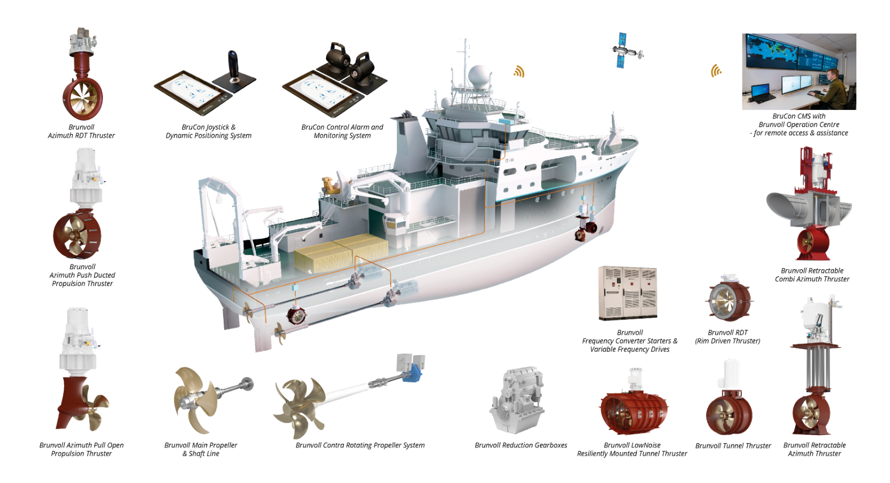

The Brunvoll Company
INNOVATIONS SINCE 1912
Brunvoll is a Norwegian company specializing in designing and manufacturing advanced propulsion, positioning, and manoeuvring systems for seagoing vessels.
More than 11.000 systems delivered
“Made in Norway”
All engineering and manufacturing
in-house
~160 MEUR turnover in 2024
  ~80% export
~600 employees
  >100 engineers

Slide 3
Capability is not the whole answer
Classical CQA asks: can the vessel hold position after the worst-case failure?
  Answers thrust capacity
  Says nothing about how far the vessel moves
Walk-to-work is limited by motion, not by thrust
  Gangway telescope stroke, not a thrust margin
  Green capability, red operation
The operator's question: how far will I move, at worst?

Slide 4
Goal: a motion layer on top of the classical CQA
Before the operation - forecast driven
  Operability polars: where motion limits bite
  WCF decision matrix over the forecast window
During the operation - measurements only
  Live panel, continuously updated
  No forecast at runtime
Classical CQA unchanged; Drift Off / Force Off untouched

Slide 5
Before the operation
Forecast-driven planning

Slide 6
From forecast sea state to motion envelope
Forecast directional spectrum
  Wave drift (QTFs), wind and current forces
Closed-loop vessel model, including the DP controller
Extreme-value step: worst excursion over the operating window
  Typically the next 30 minutes
Compare against vessel and mission-equipment limits
Project to the gangway: telescope stroke, not a circle

Slide 7
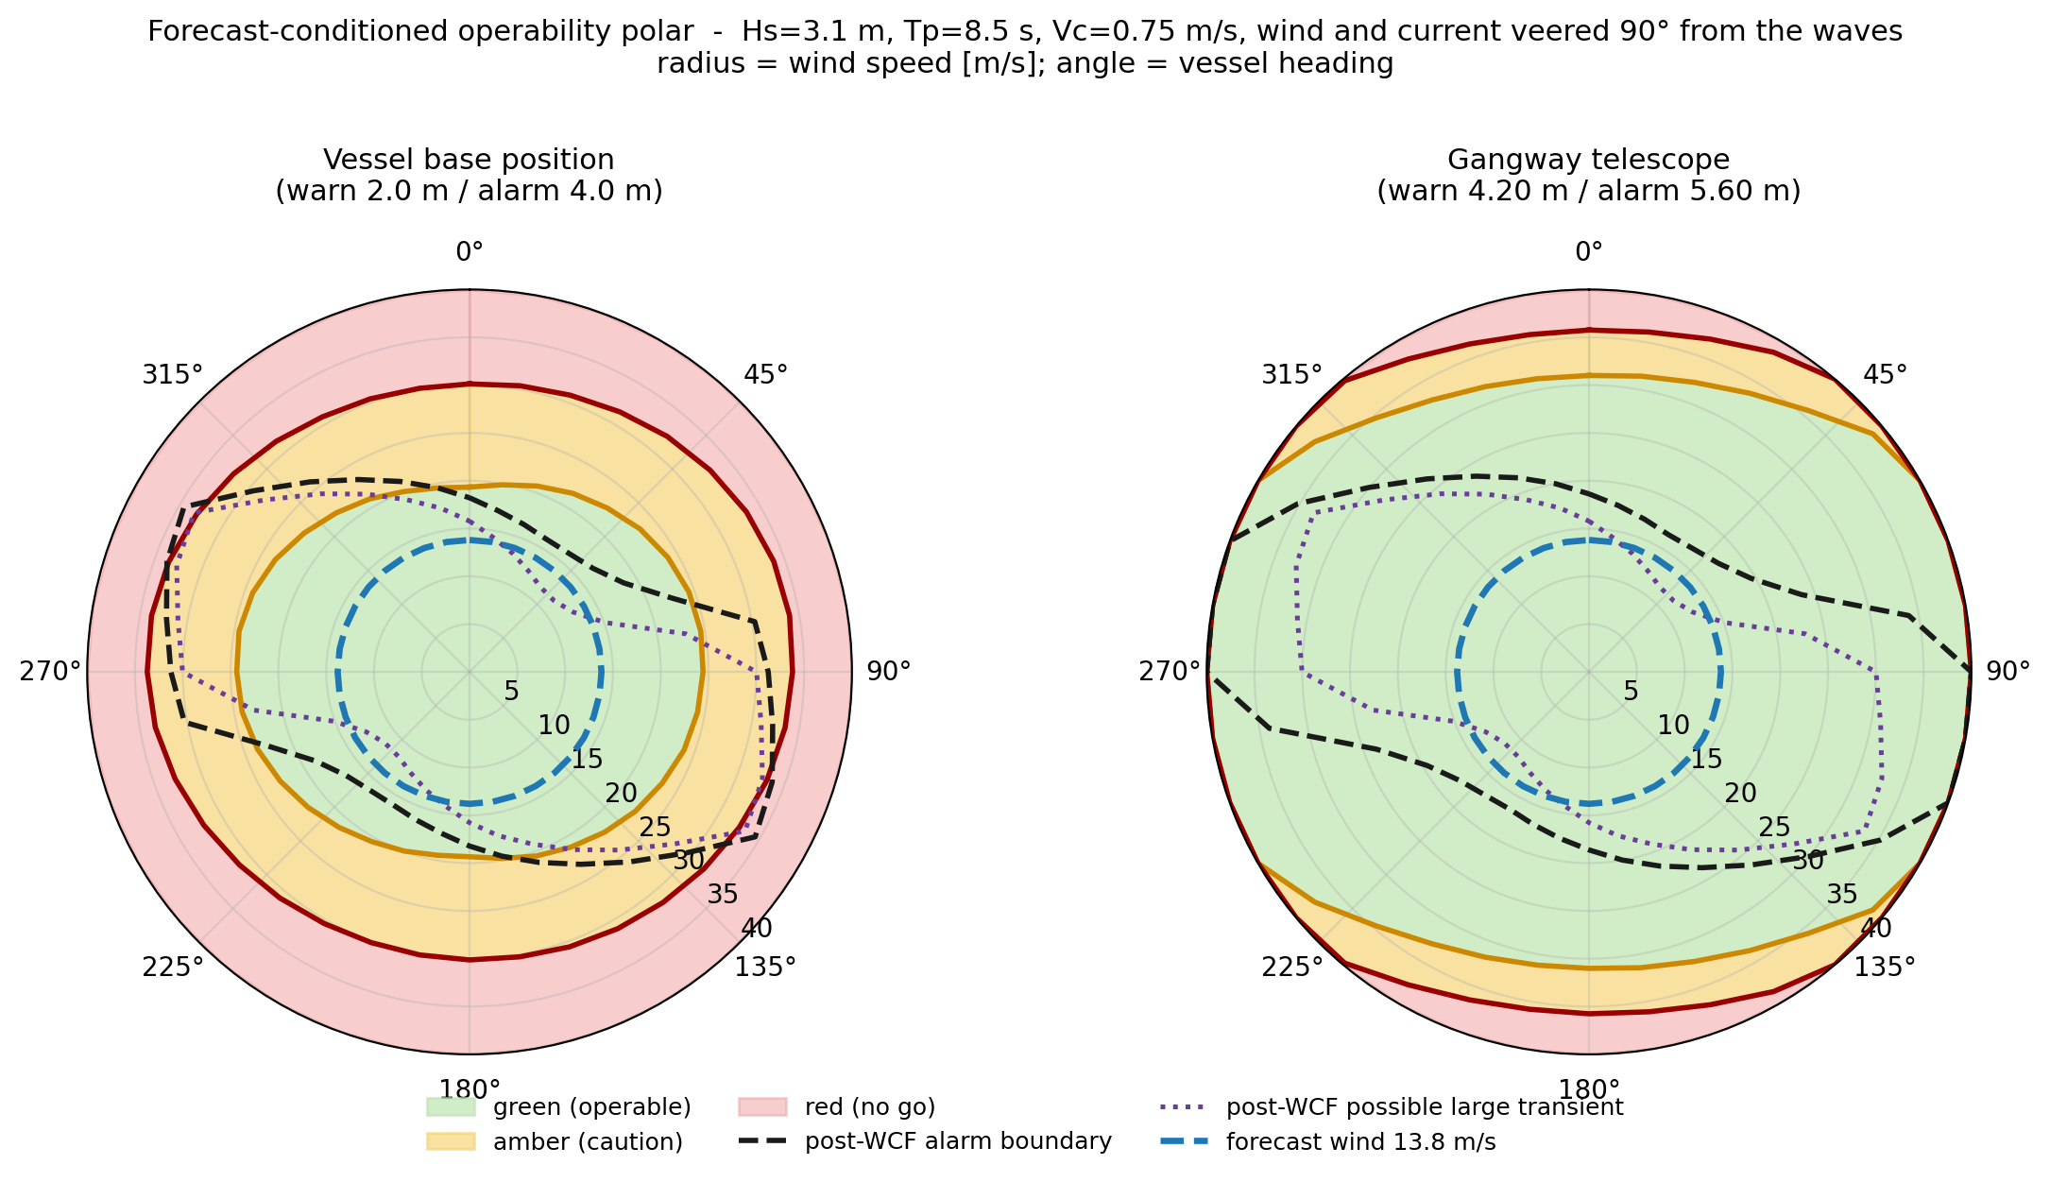
Forecast-conditioned polar
Radius: wind speed. Angle: heading
Waves and current from the forecast
Forecast wind drawn as a ring
Left: vessel. Right: gangway
Makes the heading choice explicit

Slide 8
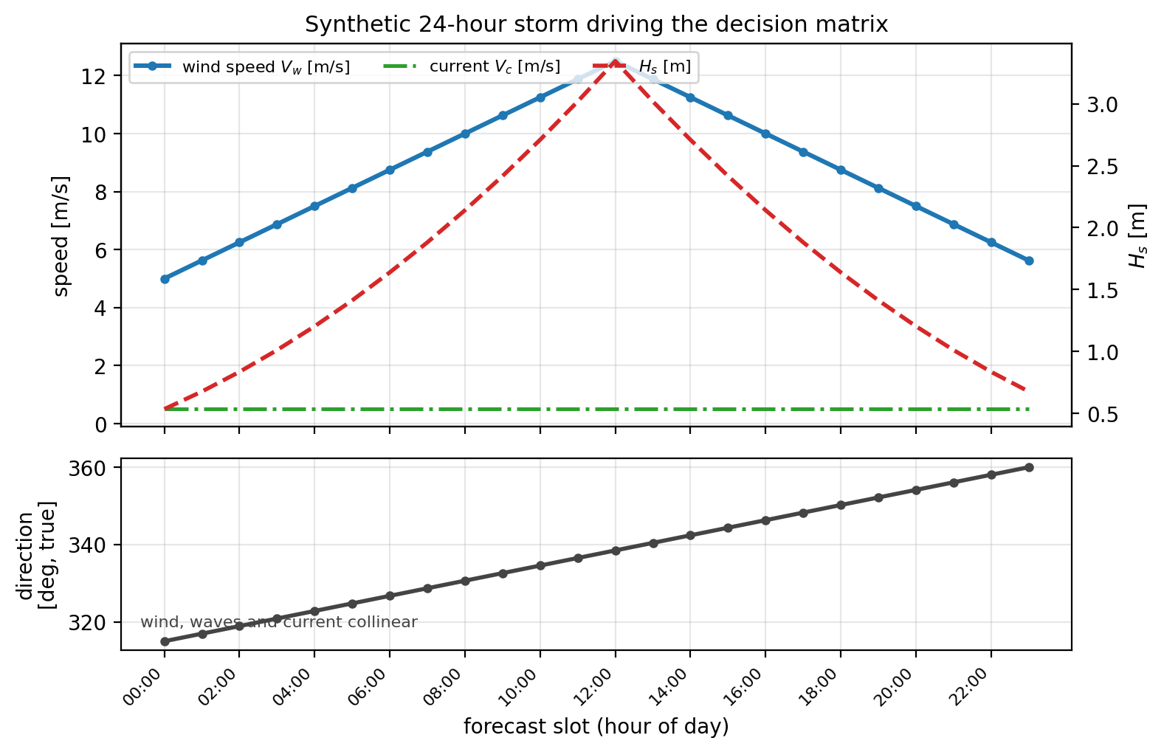
A 24-hour storm to plan against
Synthetic forecast, collinear wind / wave / current
Hs follows the wind per DNV-ST-0111
Drives the decision matrix on the next slide

Slide 9
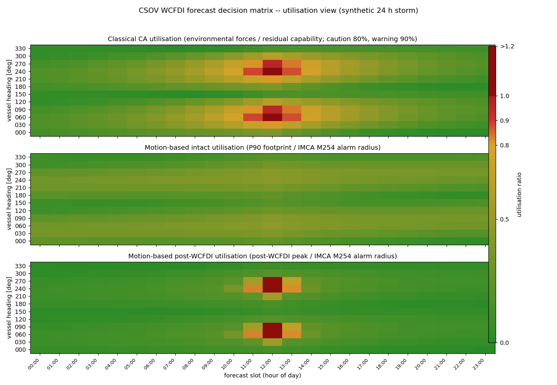
WCF decision matrix
Rows: heading. Columns: forecast hour
Three panels, one utilisation scale
  Classical CQA
  Motion, intact
  Motion, post-WCF
Classical alone: borderline at the peak
Post-WCF: a ~2-hour red window, beam headings
Two heading windows stay green throughout

Slide 10
During the operation
Live, measurement-driven

Slide 11
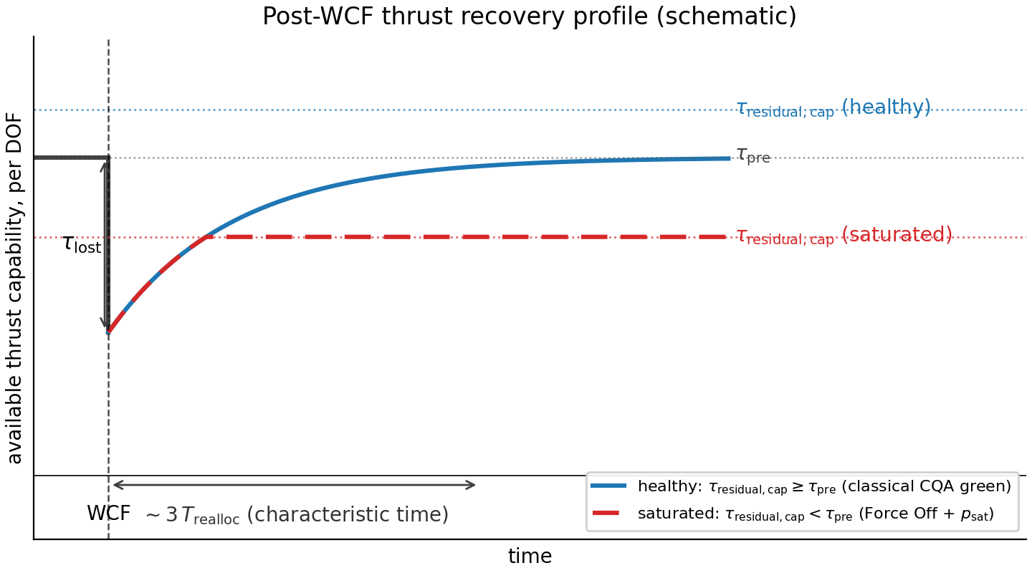
The live panel needs no forecast
Motion statistics estimated online
  Sliding 10-minute window
  Uncertainty visible as a widened band
Thrust recovery taken from the classical CQA
  Lost thrust and residual cap, as-is
One modelling parameter: T_realloc

Slide 12
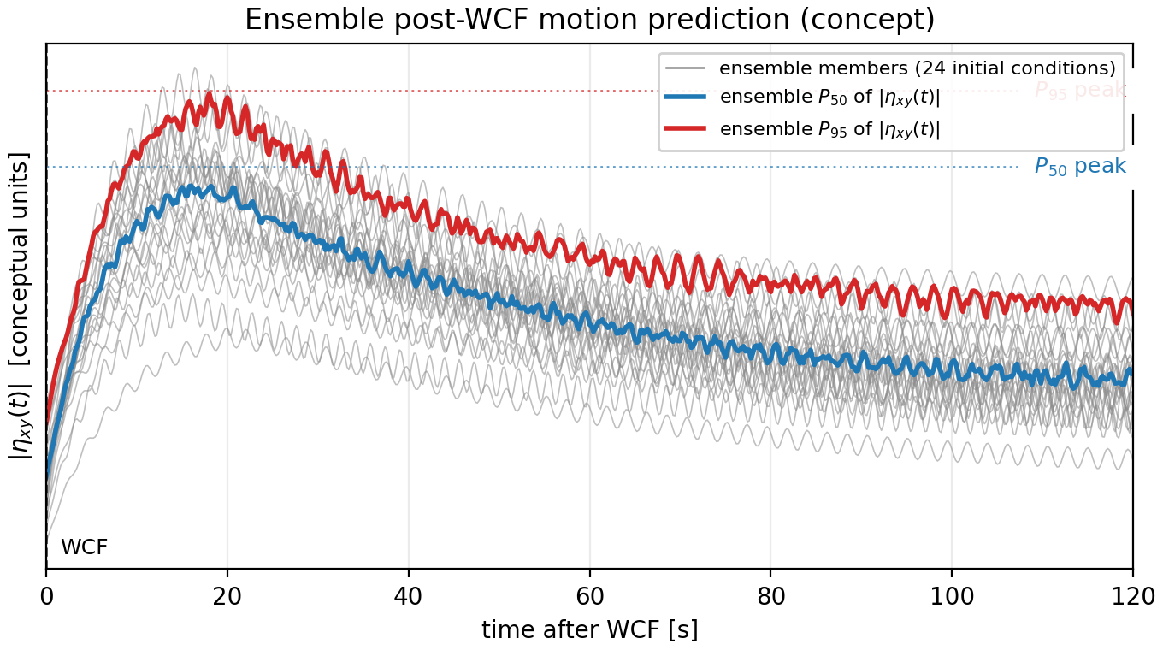
Post-WCF motion: an ensemble, not one run
Many trajectories from recent vessel states
A single deterministic run hides the spread
Reports the P50 and P95 of the per-trajectory peaks

Slide 13
Two independent channels
Motion channel
  Predicted excursion against warn / alarm limits
  Vessel base position and gangway stroke
Saturation channel
  Sustained thrust saturation after the failure
  Independent gate - not derived from the motion
One new operator alert: Large Transient
Drift Off and Force Off remain the primary hard-failure signals

Slide 14
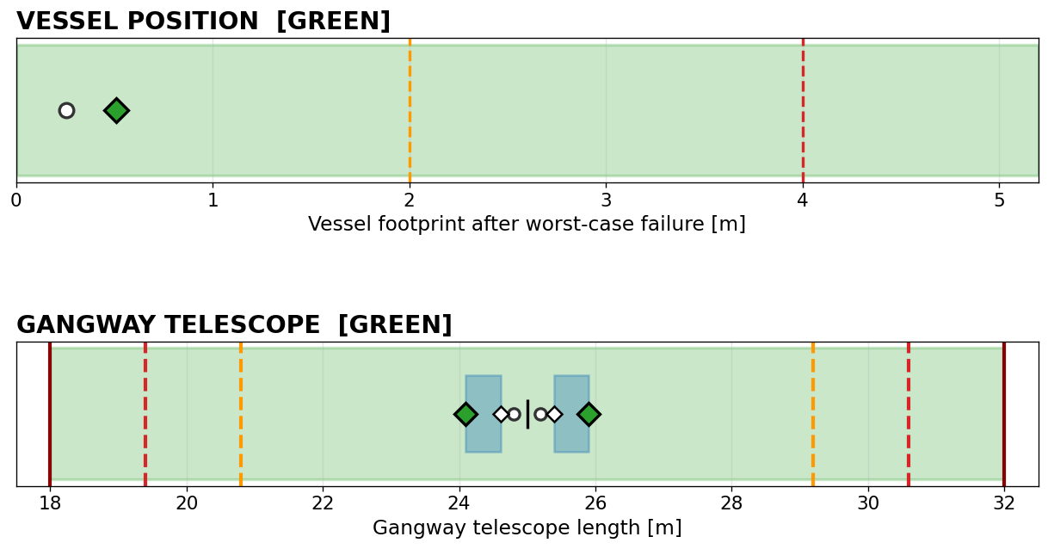
The live operator display
Both bars answer one question - if the worst-case failure happened now.

Slide 15
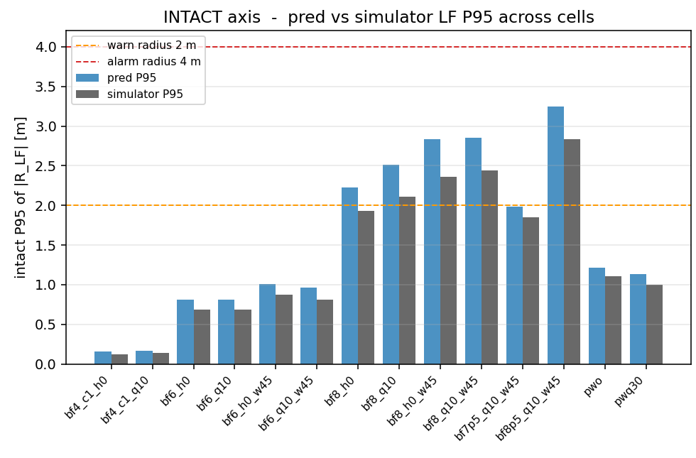
Validation: intact motion
14 cells: BF4 to BF8.5
  Head, quartering and beam
Predicted P95 (blue) vs simulator (grey)
Accurate to within about 1.2x
Bias is positive - and kept
  Conservatism by design, not tuning

Slide 16
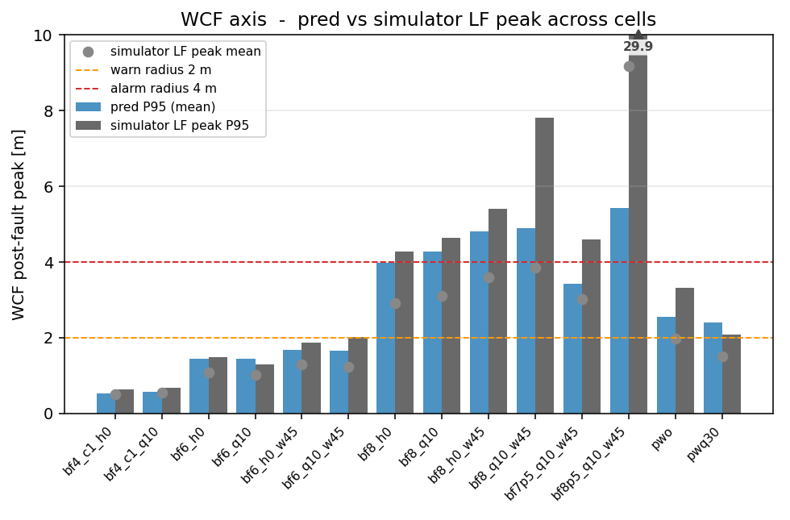
Validation: post-WCF, and a deliberate limit
11 non-saturated cells: within about 1.2x
On saturated cells the linear model breaks
  bf8p5_q10_w45: 5.4 m vs 29.9 m, -82%
We stopped trying to predict the number
  Three refinements tried and rejected
  The information is not in the past record
So the panel flags it instead
  Possible Large Transient - both gates red

Slide 17
Conclusion
Motion-based CQA complements the classical CQA - it does not replace it
Before the operation
  Where motion limits bite, not just where capacity runs out
  A decision matrix across the forecast window
During the operation
  Live, measurement-driven, no forecast at runtime
Next steps
  Real-vessel validation
  Input to the JDP DP Consequence Analysis (CA)

Slide 18
Questions?

