Slide 1
Neighborhood Bus Access
Julian Beckert

Slide 2
Data
American Community Survey + Tract shapefiles
RideOn GTFS
WMATA GTFS
• Census; 2024 5-yr estimates • Household size by vehicles available • Household size by # of workers • Means of transportation to work • Demographics (population) • Location join
• Raw GTFS feed • Use for: • Calendar of trips • Mapping • Location join & analysis • A lot of mutating
• Raw GTFS feed
Property shapes
Cleaning was very involved • Almost no NA • Joins based on GIS • Attention to detail • AI was not helpful
• Montgomery Planning • Use: • Mapping • Quantifying access

Slide 3
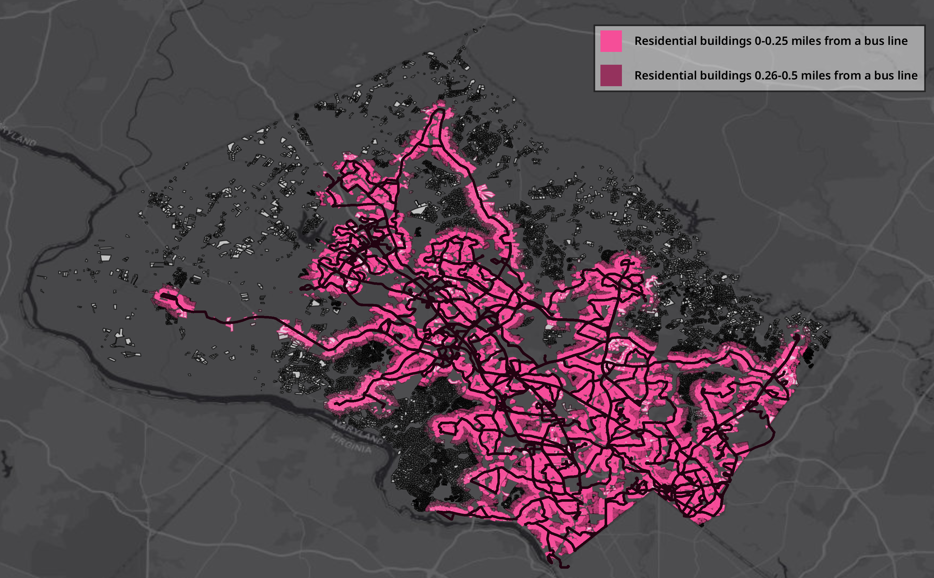

Slide 4
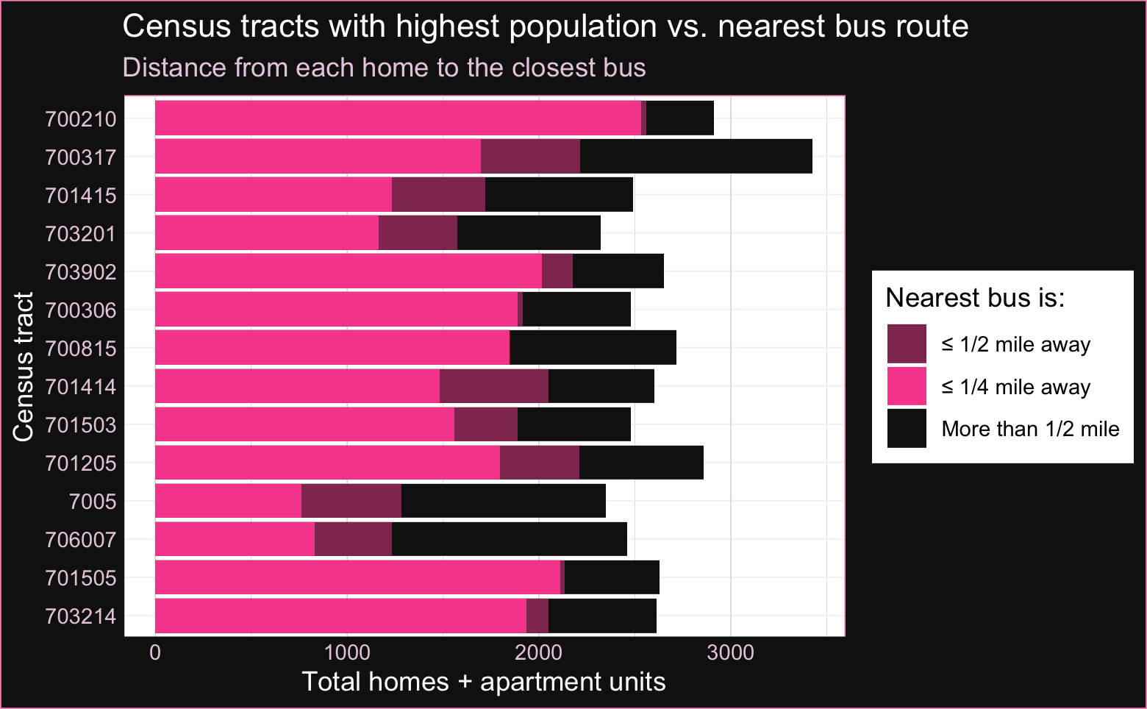

Slide 5
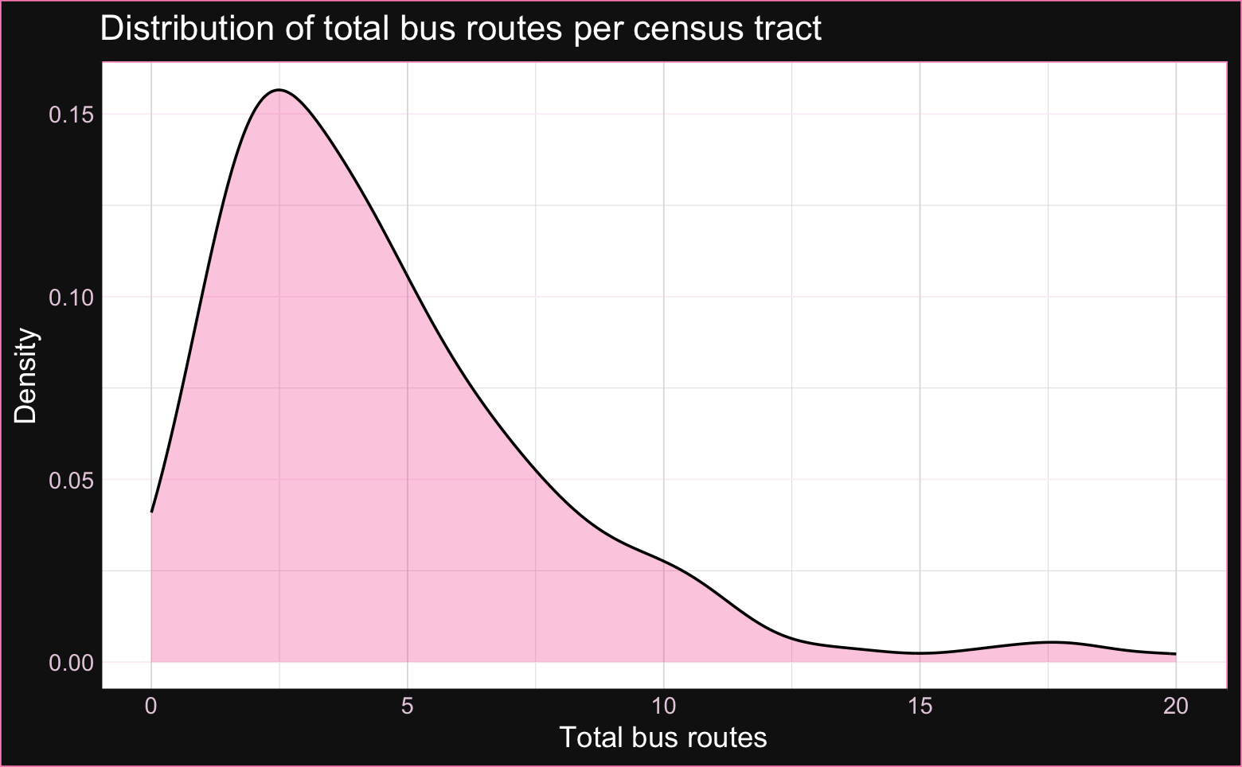

Slide 6
Analysis and findings
67% of homes (incl. apartment units) are in walking distance (0.25 miles) of a RideOn bus route
75% in 0.5 miles
88% of census tracts have ≥1 bus
84% of tracts have weekend service
79% of tracts have frequent service (>100 trips/day)
14% of households have less vehicles than workers
9% of households have 0 vehicles
Correlation between “less vehicles than workers” + total RideOn routes: p-value of almost 0 and adjusted R^2 of 0.19

Slide 7
Next steps…
New data to add:
RideOn ridership
“Need vs response” analysis
Flash BRT stops (ArcGIS)
Map, check correlation between BRT location & need
Select neighborhoods with high need + low coverage:
Close to existing systems or planned BRT lines
In high-ridership areas
Create dashboard of findings & understandable visualizations

