Slide 1
PREDICTING GROUND LEVEL NO₂
WITH METEROLOGY, TRANSPORTATION,
AND TEMPO DATA
By Steven Aarons
link

Slide 2
INTRODUCTION
Problem:
Nitrogen Dioxide (NO₂ ) is a toxic pollutant (gas) produced by industrial processes and the combustion of fossil fuels
Leads to respiratory health affects like asthma
Through photolysis NO₂ is converted to NO + O
Which then leads to the formation of ozone and smog
Research Questions:
What is the relationship between ground-level Nitrogen Dioxide (NO₂) , meterological variables, and transportation traffic volume, and satllite derrived vertical column Nitrogen Dioxide (NO₂) ?
Can we predict ground level NO₂ at station locations across the U.S. using those variables?
PREDICTING GROUND LEVEL NO₂

Slide 3
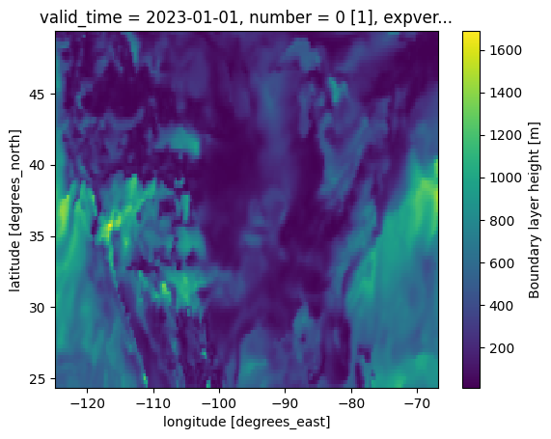
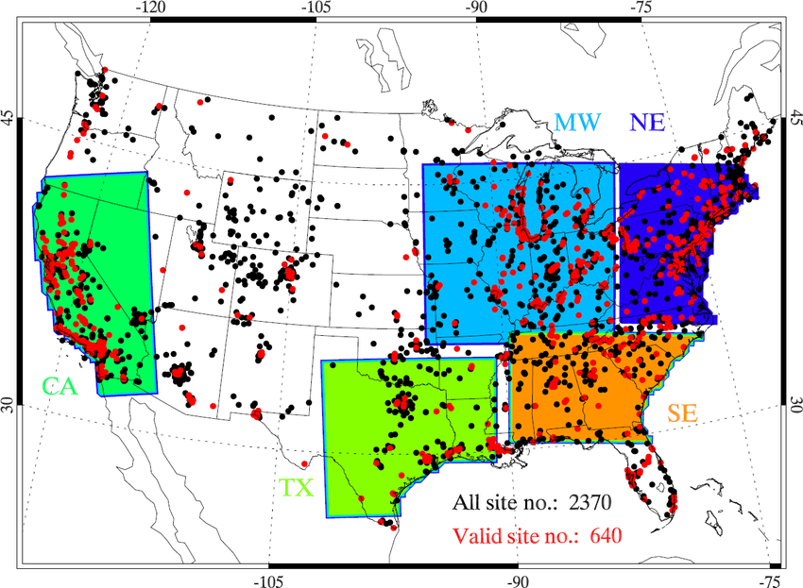
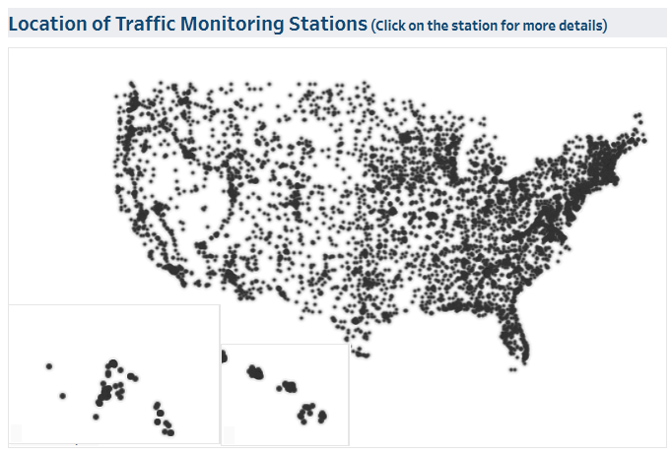
STUDY AREA
ERA5 Reanalysis
EPA AQS Stations

Slide 4



DATA
Meteorology (ERA5)
Boundary Layer Height (BLH) | Surface Pressure
V - N-S 10m Wind – Component | 2m Temperature
U - E-W 10m Wind – Component
Traffic - Travel Monitoring Analysis System Volume (TMAS) Top 3 nearest stations:
Distance to nearest traffic station | Traffic volume averaged
Traffic volume | Traffic volume IDW averaged
Tropospheric Emissions: Monitoring of Pollution (TEMPO)
Vertical column troposphere NO₂)
EPA Air Quality System (AQS)
Ground level NO₂ | Hour, Day of Week, Lat, Long
Notes:
['hour', 'month', 'dayofweek', 'Latitude', 'Longitude',
'blh','v10','u10','sp','t2m',
'traffic_vol_1', 'traffic_vol_2','traffic_vol_3',
'distance_km_1', 'distance_km_2', 'distance_km_3',
'traffic_volume_avg', 'traffic_volume_idw',
'vertical_column_troposphere',
'no2']].dropna()

Slide 5
Research Methods
Meterology
Sample ERA5 data at NO2 station Locations
Transportaiton
Find the 3 nearest traffic stations to NO2 stations
Add data to NO2 dataset
Average all – Mean and IDW
TEMPO
Sample at NO2 stations
Average by hour to analyze dinural patterns and analyze regionally

Slide 6

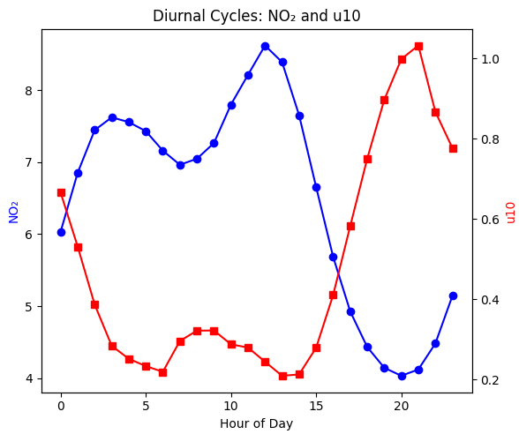
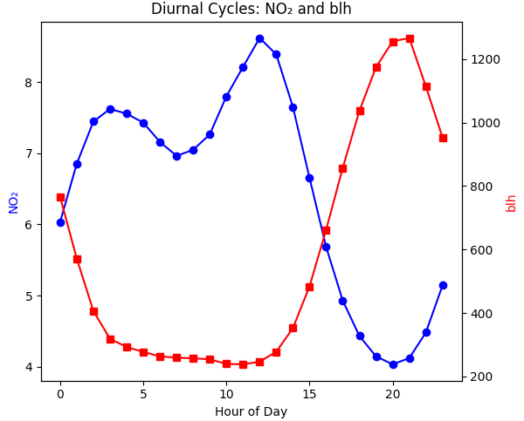
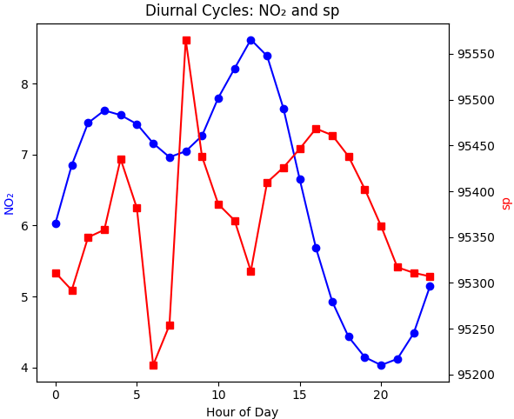
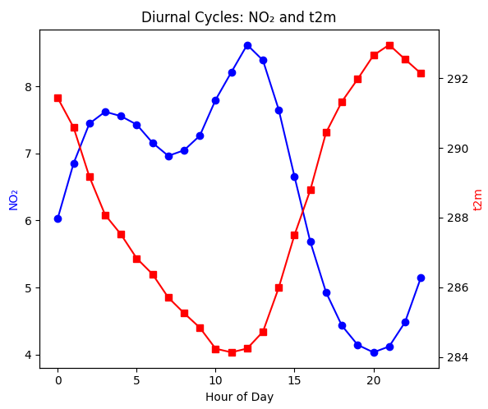
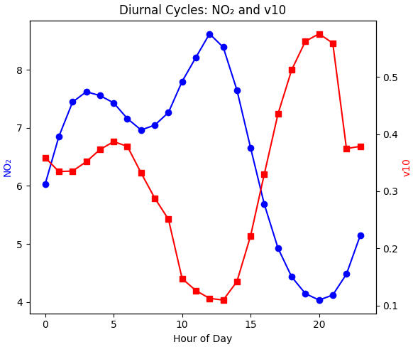
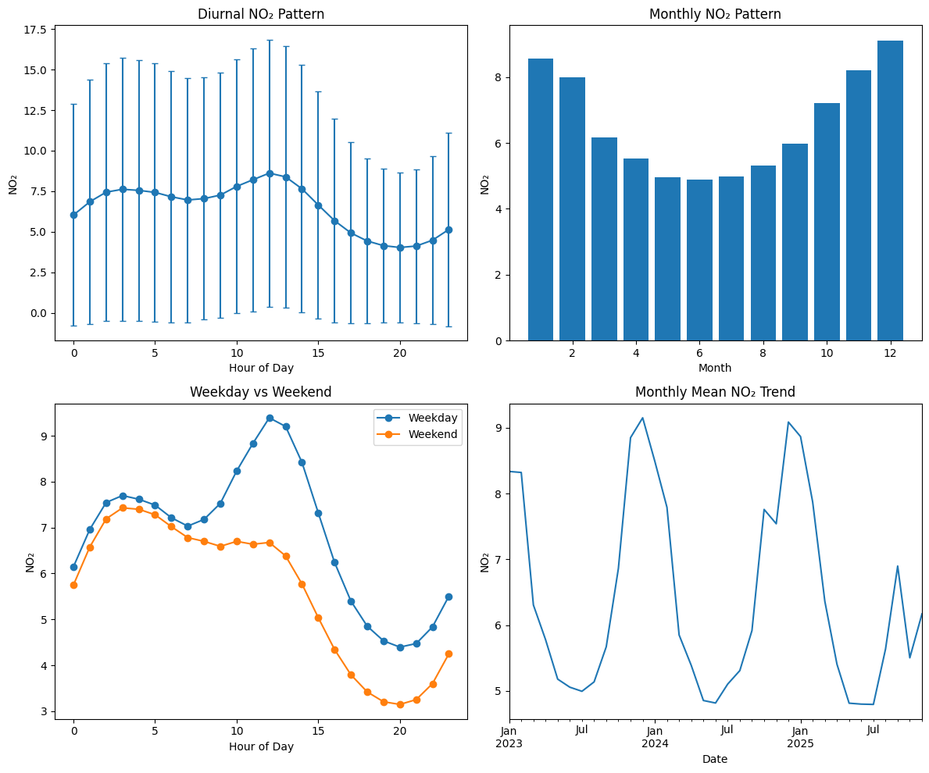
DIURNAL PATTERNS

Slide 7
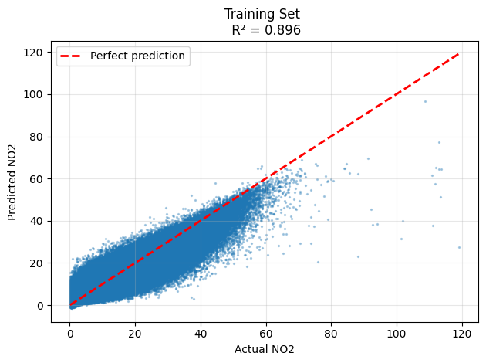
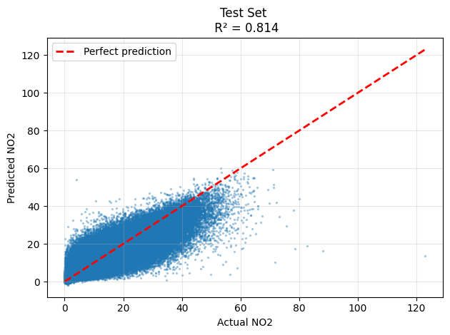
MACHINE LEARNING RESULTS
RANDOM
FOREST
XG
BOOST

Slide 8
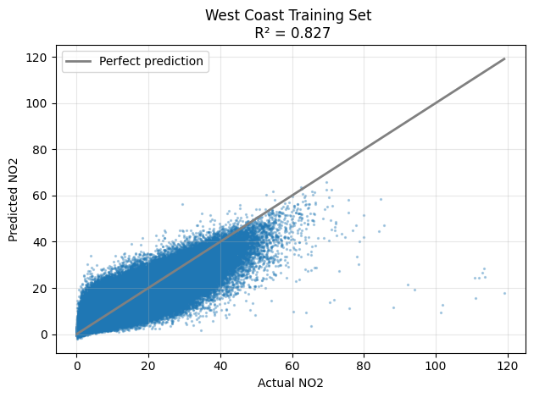
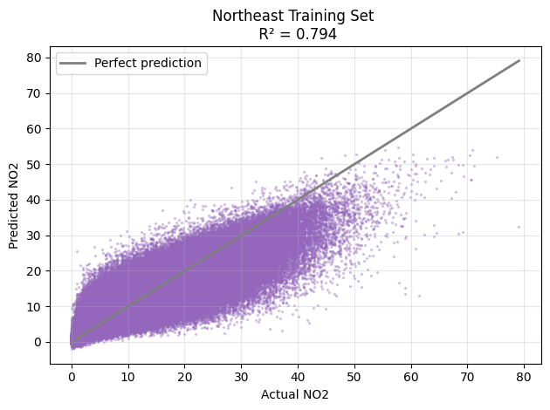
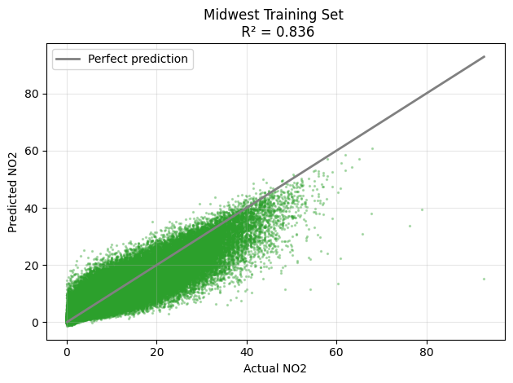
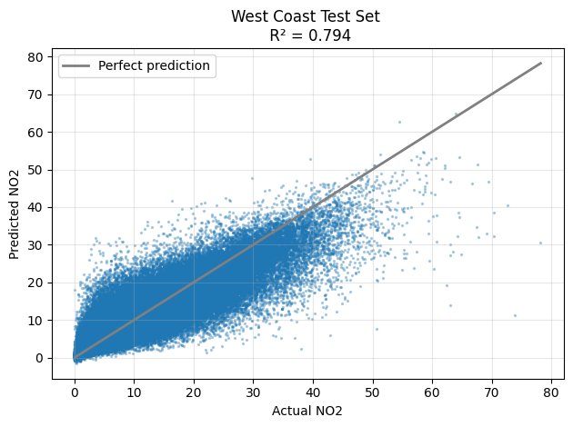
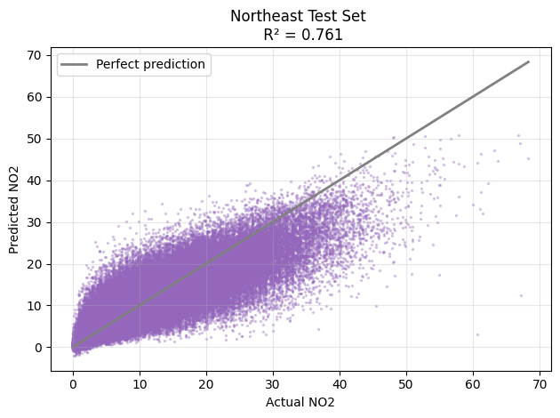
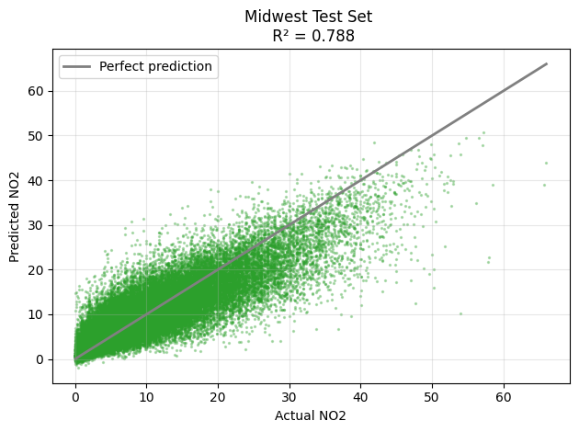
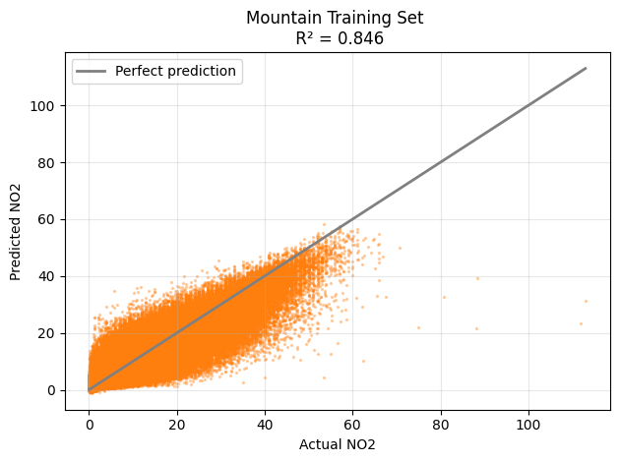
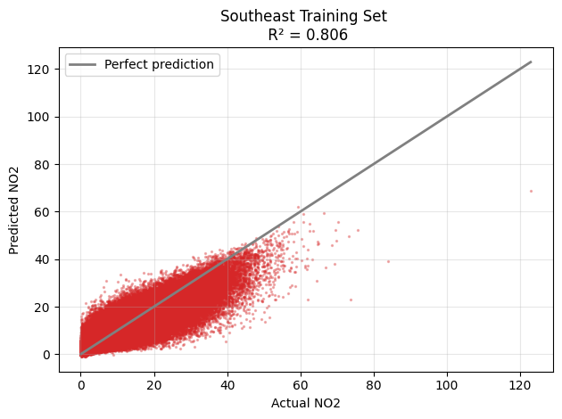
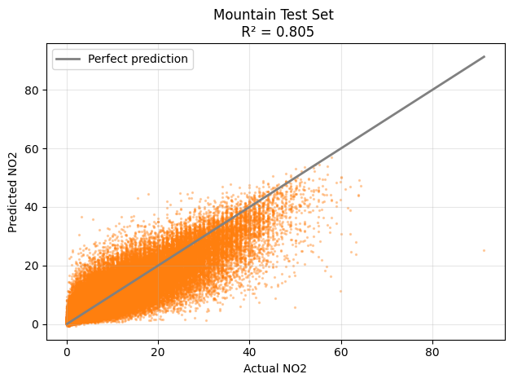
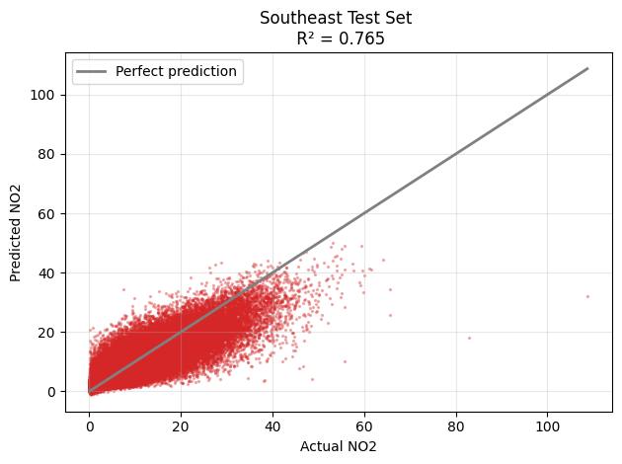
XG BOOST PER REGION

Slide 9
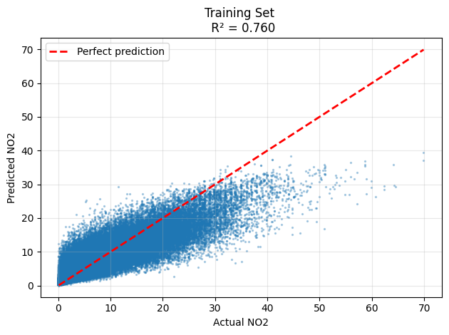
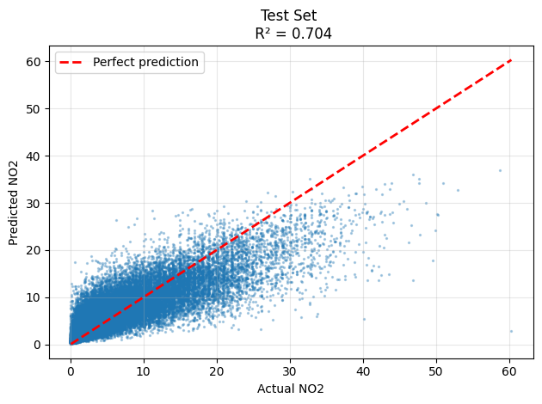
XG BOOST PER REGION cont.

Slide 10
WITH TEMPO
– 1303 hourly samples
Train : 177436 samples
Test : 44359 samples
08/02/2023 – 10/30/2023

Slide 11
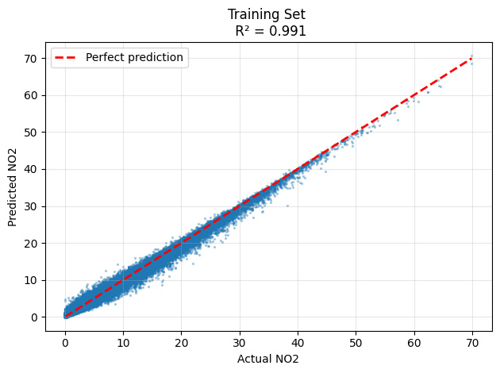
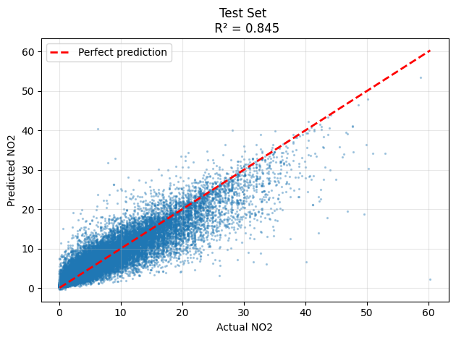
MACHINE LEARNING RESULTS
RANDOM
FOREST
XG
BOOST

Slide 12
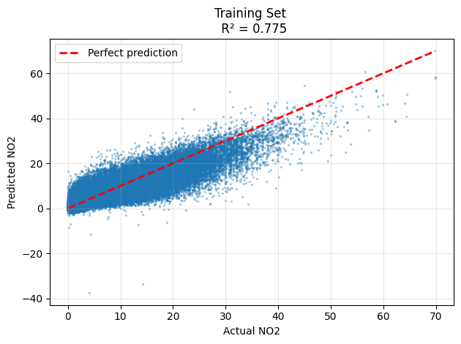
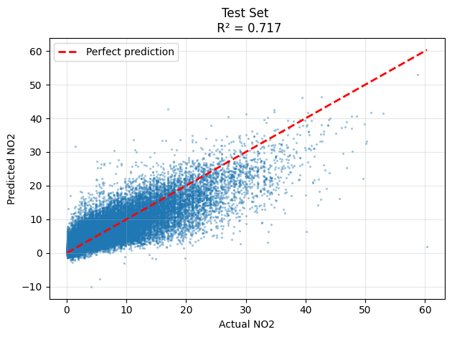
NEURAL NETWORK

Slide 13
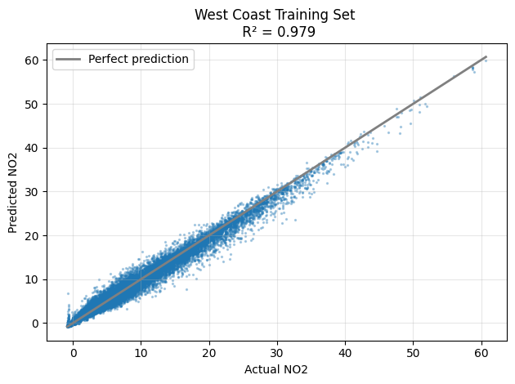
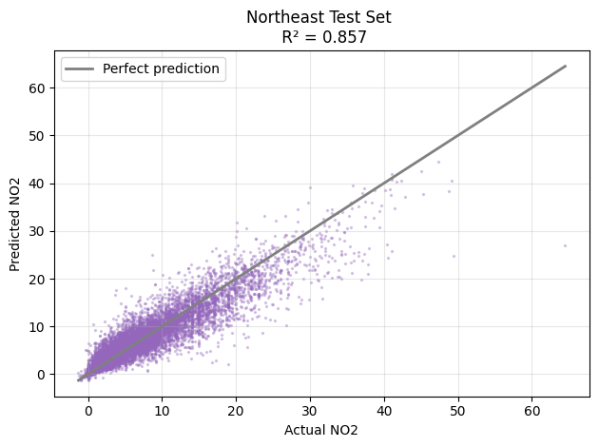
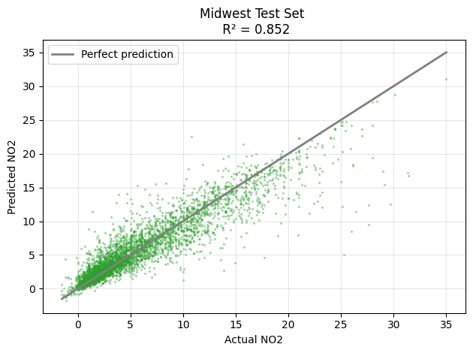
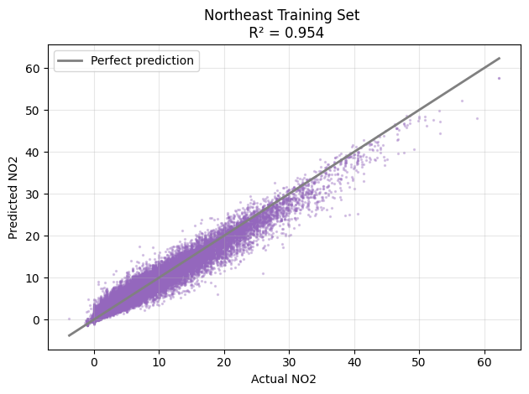
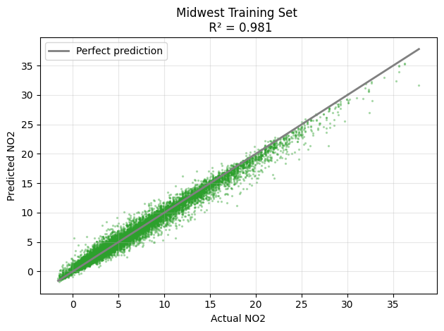
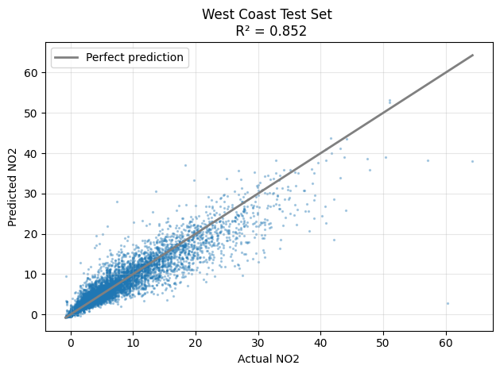
XG BOOST PER REGION

Slide 14
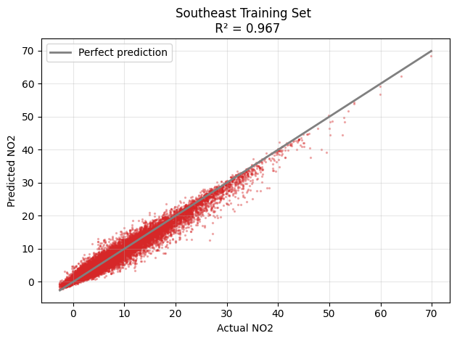
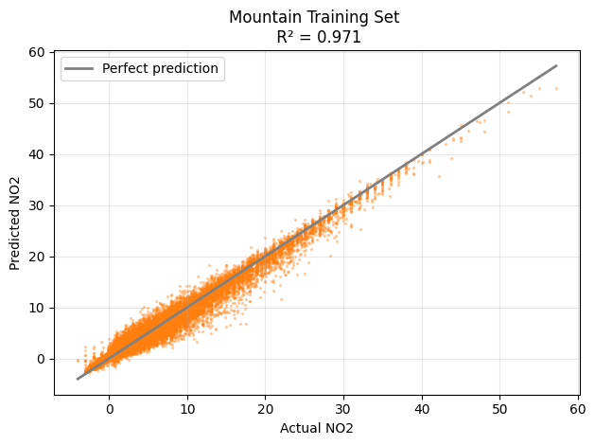
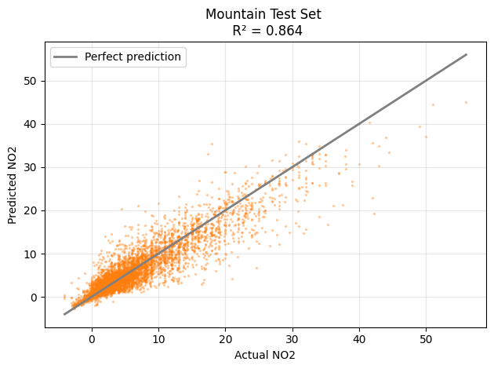
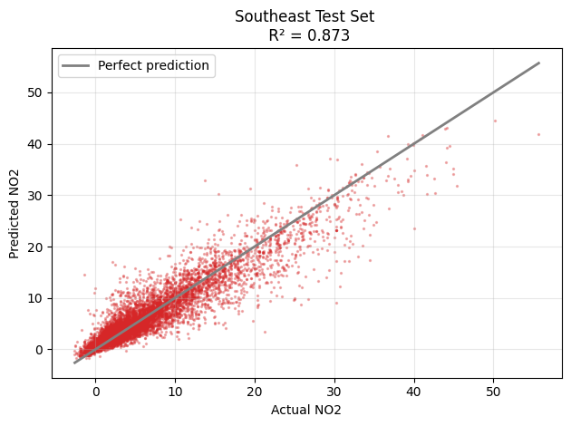
XG BOOST PER REGION cont.

Slide 15
FUTURE WORK
Download more TEMPO data (of course)
Limit comparison w/ & without TEMPO to same date range
Try other machine learning models and architectures
Other suggestions?

Slide 16
Thank you!

