Slide 1
Convolutional Neural Networks

Slide 2
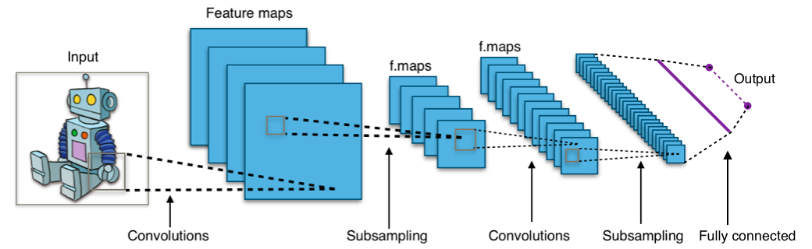
Convolutional Neural Network
What is the Convolutional Neural Network?
Consists of Convolution, Pooling layers

Slide 3
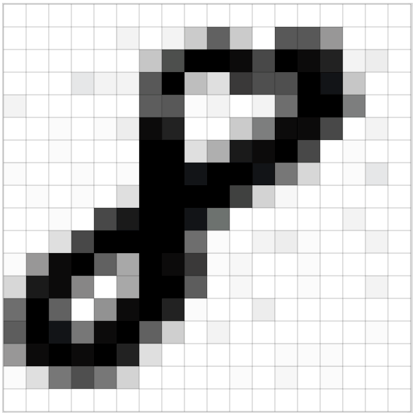
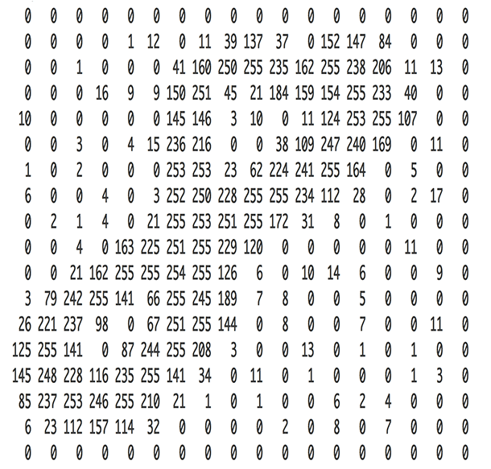
Image data
How to perceive on computer

Slide 4
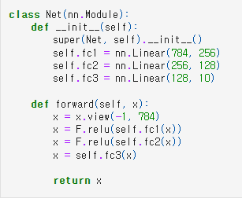
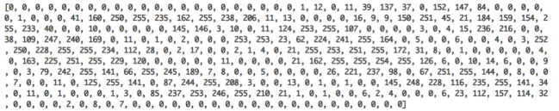
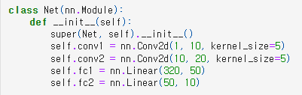
Image data
How to perceive on computer
DNN(Dense Neural network)
CNN(Convolutional Neural network)
784
28
28

Slide 5
Convolution
https://github.com/vdumoulin/conv_arithmetic
Summary (1)
Padding=0, Strides=1
Padding=1 , Strides=1
Padding=0, Strides=2
Padding=1, Strides=2

Slide 6
Convolution
Summary (2)
https://medium.com/@phidaouss/convolutional-neural-networks-cnn-or-convnets-d7c688b0a207

Slide 7
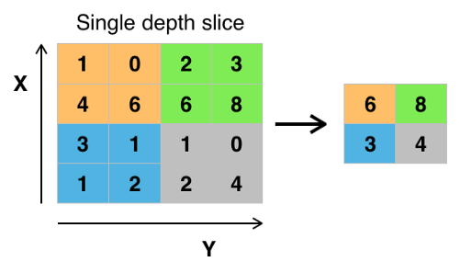
Pooling
Summary (1)
MAX pooling
Sride=2, Kernel_size=2
https://medium.com/@phidaouss/convolutional-neural-networks-cnn-or-convnets-d7c688b0a207

Slide 8
Pooling
Summary (2)
Average pooling
Sride=2, Kernel_size=2
2.75
4.75
1.75
1.75
https://medium.com/@phidaouss/convolutional-neural-networks-cnn-or-convnets-d7c688b0a207

Slide 9
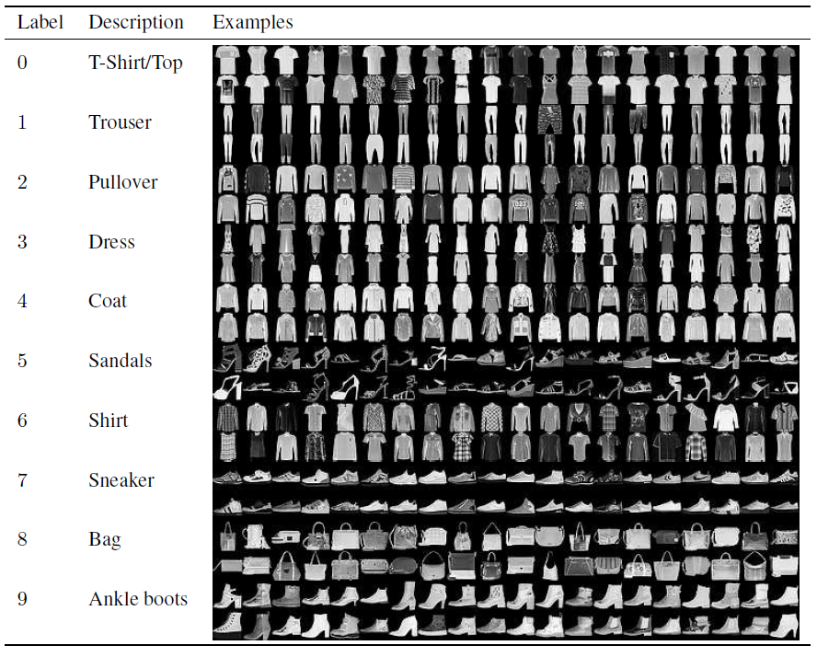

CNN for MNIST
MNIST Dataset
Fashion-MNIST is a dataset of Zalando's article images
It contains training set of 60,000 examples and a test set of 10,000 examples
Each example is a 28x28 grayscale image, associated with a label from 10 classes.

Slide 10
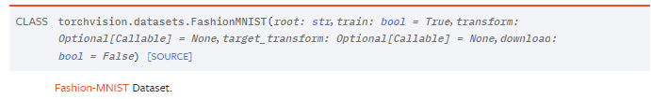
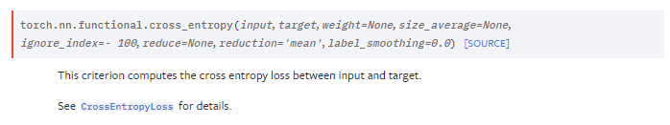

CNN for MNIST
Preparation
Dataset : FMNIST
TASK : Classification
Loss function : cross entropy
Model : CNN
Optimizer : SGD

Slide 11
CNN for MNIST
Preparation
USE_CUDA = torch.cuda.is_available() DEVICE = torch.device("cuda" if USE_CUDA else "cpu")
Select device to use (GPU or CPU)
If GPU can be used, use GPU
else, use CPU
import torch import torch.nn as nn import torch.optim as optim import torch.nn.functional as F from torchvision import transforms, datasets USE_CUDA = torch.cuda.is_available() DEVICE = torch.device("cuda" if USE_CUDA else "cpu")

Slide 12
CNN for MNIST
Setup data
Transforms : Normalize data
transform = transforms.Compose([ transforms.ToTensor(), transforms.Normalize(mean=(0.5,), std=(0.1,)) ])
trainset = datasets.FashionMNIST( root='./.data/', train=True, download=False, transform=transform ) testset = datasets.FashionMNIST( root='./.data/', train=False, download=False, transform=transform )

Slide 13
CNN for MNIST
Setup for mini-batch
Divide by each batch of data
Data Shuffling
BATCH_SIZE = 64 train_loader = torch.utils.data.DataLoader( dataset=trainset, batch_size=BATCH_SIZE, shuffle=True, ) test_loader = torch.utils.data.DataLoader( dataset=testset, batch_size=BATCH_SIZE, shuffle=True, )

Slide 14
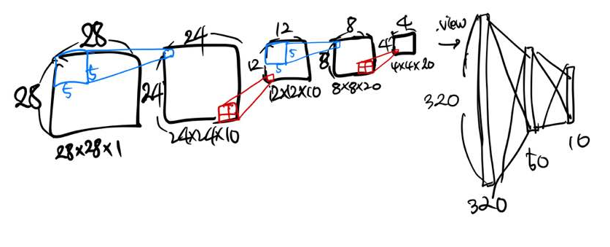
CNN for MNIST
Setup Network
nn.Linear(x, y) = x_dim -> y_dim (node)
nn.Conv2d(x, y) = x_dim -> y_dim (channel)
class Net(nn.Module): def __init__(self): super(Net, self).__init__() self.conv1 = nn.Conv2d(1, 10, kernel_size=5) self.conv2 = nn.Conv2d(10, 20, kernel_size=5) self.fc1 = nn.Linear(320, 50) self.fc2 = nn.Linear(50, 10) def forward(self, x): x = F.relu(F.max_pool2d(self.conv1(x), 2)) x = F.relu(F.max_pool2d(self.conv2(x), 2)) x = x.view(-1, 320) x = F.relu(self.fc1(x)) x = F.dropout(x, training=self.training) x = self.fc2(x) return F.log_softmax(x, dim=1)

Slide 15
CNN for MNIST
Model and Optimizer
Net.to(DEVICE)
.to(): function sends the parameters of the model to the specified location.
DEVICE = GPU or CPU (defined it before)
Stochastic Gradient Descent (SGD)
Parameters to learn
Learning rate – Hyper Parameter
model = Net().to(DEVICE) optimizer = optim.SGD(model.parameters(), lr=0.01)

Slide 16
CNN for MNIST
Setup for training
def train(model, train_loader, optimizer, epoch): model.train() for batch_idx, (data, target) in enumerate(train_loader): data, target = data.to(DEVICE), target.to(DEVICE) optimizer.zero_grad() output = model(data) loss = F.cross_entropy(output, target) loss.backward() optimizer.step() if batch_idx % 200 == 0: print('Train Epoch: {} [{}/{} ({:.0f}%)]\tLoss: {:.6f}'.format( epoch, batch_idx * len(data), len(train_loader.dataset), 100. * batch_idx / len(train_loader), loss.item()))

Slide 17
CNN for MNIST
Setup for evaluation
def evaluate(model, test_loader): model.eval() test_loss = 0 correct = 0 with torch.no_grad(): for data, target in test_loader: data, target = data.to(DEVICE), target.to(DEVICE) output = model(data) test_loss += F.cross_entropy(output, target, reduction='sum').item() pred = output.max(1, keepdim=True)[1] correct += pred.eq(target.view_as(pred)).sum().item() test_loss /= len(test_loader.dataset) test_accuracy = 100. * correct / len(test_loader.dataset) return test_loss, test_accuracy

Slide 18
CNN for MNIST
Run!
EPOCHS= 30 for epoch in range(1, EPOCHS + 1): train(model, train_loader, optimizer, epoch) if epoch % 10 == 0: test_loss, test_accuracy = evaluate(model, test_loader) print('[{}] Test Loss: {:.4f}, Accuracy: {:.2f}%'.format( epoch, test_loss, test_accuracy))
[10] Test Loss: 0.4043, Accuracy: 84.98%
[20] Test Loss: 0.3592, Accuracy: 86.22%
[30] Test Loss: 0.3326, Accuracy: 87.47%

Slide 19
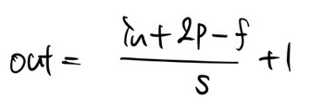
CNN for MNIST
Convolution Layer
Conv2d
Filter: 5x5x10, 5x5x20
Default: Strides: 1, Padding: 0
class Net(nn.Module): def __init__(self): super(Net, self).__init__() self.conv1 = nn.Conv2d(1, 10, kernel_size=5) self.conv2 = nn.Conv2d(10, 20, kernel_size=5) self.fc1 = nn.Linear(320, 50) self.fc2 = nn.Linear(50, 10)

Slide 20
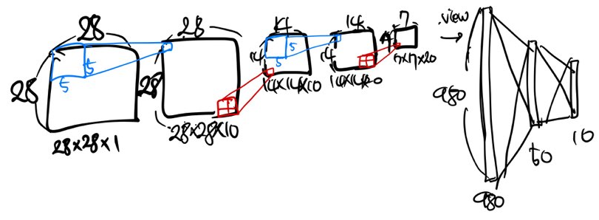
CNN for MNIST
Convolution Layer
Conv2d
Filter: 5x5x10, 5x5x20
Strides: 1, Padding: 2
class Net(nn.Module): def __init__(self): super(Net, self).__init__() self.conv1 = nn.Conv2d(1, 10, kernel_size=5, padding=2) self.conv2 = nn.Conv2d(10, 20, kernel_size=5, padding=2) self.fc1 = nn.Linear(980, 50) self.fc2 = nn.Linear(50, 10)

